Slide 1
Module 5

Slide 2
Module 5
Kernel Machines- Support Vector Machine-
Optimal Separating hyper plane,
Soft-margin hyperplane,
Kernel trick, Kernel functions.
Discrete Markov Processes, Hidden Markov models
Three basic problems of HMMs- Evaluation problem,
finding state sequence, Learning model parameters.
Combining multiple learners, Ways to achieve diversity,
Model combination schemes, Voting, Bagging, Booting

Slide 3
Support Vector Machines
Prevent overfitting
Support larger number of features without much computation

Slide 4
Support Vector Machine
Suppose we want to develop some criteria for determining the weather conditions under which tennis can be played.
To simplify the matters it has been decided to use the measures of temperature and humidity as the critical parameters for the investigation.
Decisions taken as to whether to play tennis or not.
We are required to develop a criteria to know whether one would be playing tennis on a future date if we know the values of the temperature and humidity of that date in advance.

Slide 5
temperature | play
85 | No
60 | Yes
80 | No
68 | Yes
70 | Yes
69 | yes
75 | No
83 | No

Slide 6
temperature | play
85 | No
60 | Yes
80 | No
75 | No
68 | Yes
74 | Yes
69 | yes
78 | No
83 | No

Slide 7
temperature | humidity | play
85 | 85 | No
60 | 70 | Yes
80 | 90 | No
72 | 95 | No
68 | 80 | Yes
74 | 73 | Yes
69 | 70 | yes
75 | 85 | No
83 | 78 | No

Slide 8
Two-class data set
The data are classiﬁed based on the values of the variable “play”.
This variable has only two values or labels, namely “yes” and ”no”.
When there are only two class labels the data is said to be a “two-class data set

Slide 9
Scatter plot of the data
Since there are only two features or parameters, we may plot the values of one of the parameters, say “temperature”, along the horizontal axis (that is, the x-axis) and the values of the other parameter “humidity”, along the vertical axis (that is, the y-axis).
The data can be plotted in a coordinate plane to get a scatter plot of the data
The points which correspond to the decision “yes” on playing tennis has been plotted as ﬁlled squares (◾) and which correspond to the decision “no” has been marked as hollow circles (○).

Slide 10
A separating line
We can draw a straight line in the plane separating the two types of points in the sense that all points plotted as ﬁlled squares are on one side of the line and all points marked as hollow circles are on the other side of the line.
Such a line is called a “separating line” for the data. (ax+by+c=0)
If the data point with values (x′;y′) has the value “yes” for “play”, then ax’+by’+c=0 < 0:
If the data point with values (x;y) has the value “no” for “play” (hollow circle), then ax’+by’+c > 0:
If such a separating line exists for a given data then the data is said to be “linearly separable”. Not all data are linearly separable.

Slide 11
Several separating lines
Apparently, the conditions may be used as the criteria to know whether one would be playing tennis on a future date if we know the values of the temperature and humidity of that date in advance.
But there are several separating lines and the problem of determining which one to choose arises.

Slide 12
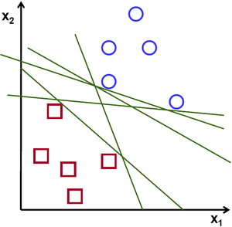

Slide 13
Margin of a separating line
To choose the “best” separating line, we introduce the concept of the margin of a separating line.
Given a separating line for the data, we consider the perpendicular distances of the data points from the separating line.
The double of the shortest perpendicular distance is called the “margin of the separating line”.

Slide 14
Maximal margin separating line
The “best” separating line is the one with the maximum margin.
The separating line with the maximum margin is called the “maximum margin line” or the “optimal separating line”.
This line is also called the “support vector machine”
Unfortunately, ﬁnding the equation of the maximum margin line is not a trivial problem

Slide 15
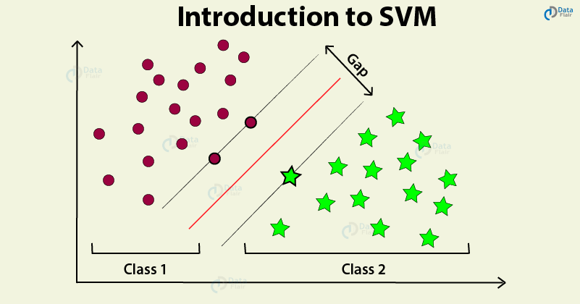

Slide 16
Margin
Minimum distance of a training instance from the decision surface
Choose decision surface for which margin width is higher
The data points which are closest to the maximum margin line are called the “support vectors
Minimum two support vectors
When you are maximising margin width the distance of the closest negative point to the line and closest positive point to the line will be same
Support vectors determine the equation of line

Slide 17
Margin
Maximum margin classifier
Sensitive to outliers
Bias variance threshold

Slide 18
The required criterion
As per theory of support vector machines, the equation of the maximum margin line is used to devise a criterion for taking a decision on whether to play tennis or not.
Let x′ and y′ be the values of temperature and humidity on a given day.
Then the decision as to whether play tennis on that day is “yes” if 7x+6y−995:5 < 0 and
“no” if 7x+6y−995:5 > 0:

Slide 19
Street” of maximum width separating “yes” points and “no” points
We may draw a line through the support vectors 1 and 2 parallel to the maximum margin line, and a line through support vector 3 parallel to the maximum margin line.
The region between these two dashed lines can be thought of as a “road” or a “street” of maximum width that separates the “yes” data points and the “no” data points.

Slide 20
Finite dimensional vector spaces
We have geometrically examined in detail the concepts of the theory of support vector machines with an example having only two features.
Such a geometrical approach is infeasible if there are more than two features.
In such cases we have to resort to formal algebraic/mathematical formalism to investigate the problem.
The theory of what are known as “ﬁnite dimensional vector spaces” provides such a formalism

Slide 21
Two-class data sets
The variable being predicted is called the output variable, the target variable, the dependent variable or the response.
A two-class data set is a data set in which the target variable takes only one of two possible values only.
If the target variable takes more than two possible values, the data set is called a multi-class dataset.
In a two-class dataset, the set of values of the target variable may be{“yes”, “no”}, or{“TRUE”, ”FALSE”}, or {0;1}, or {−1;+1} or any such similar set.
The methods of support vector machines were originally developed for classiﬁcation problems involving two-class data sets.

Slide 22
Linearly separable data
Consider a two-class data set having n numeric features and two possible class labels −1 and +1.
Let the vector ⃗ x = (x₁;:::; x_{n}) represent the values of the features in one instance of the data set.
We say that the data set is linearly separable if we can ﬁnd a hyperplane in the n-dimensional vector space Rn, say 0 + 1 x₁ + 2 x₂ +⋯+ n x_{n} = 0 having the following two properties:
1. For each instance ⃗ x with class label −1 we have 0 + 1 x₁ + 2 x₂ +⋯+ n x_{n} < 0:
2. For each instance ⃗ x with class label +1 we have 0 + 1 x₁ + 2 x₂ +⋯+ n x_{n} > 0:
A hyperplane having the two properties given above is called a separating hyperplane for the data set.

Slide 23
If a data set with two class labels is linearly separable, then, in general, there will be several separating hyperplanes for the data set.
Given a two-class data set, there is no simple method for determining whether the data set is linearly separable.
One of the efﬁcient ways for doing this is to apply the methods of linear programming

Slide 24
Maximal margin hyperplanes
Consider a linearly separable data set having two class labels “−1” and “+1”.
Consider a separating hyperplane H for the data set.
Consider the perpendicular distances from the training instances to the separating hyperplane H and consider the smallest such perpendicular distance. The double of this smallest distance is called the margin of the separating hyperplane H.

Slide 25
The hyperplane for which the margin is the largest is called the maximal margin hyperplane (also called maximum margin hyperplane) or the optimal separating hyperplane.
The maximal margin hyperplane is also called the support vector machine for the data set.
The data points that lie closest to the maximal margin hyperplane are called the support vectors.

Slide 26
Mathematical formulation of the SVM problem
The SVM problem is the problem of ﬁnding the equation of the SVM, that is, the maximal margin hyperplane, given a linearly separable two-class data set.
By the very deﬁnition of SVM, this is an optimisation problem.

Slide 27
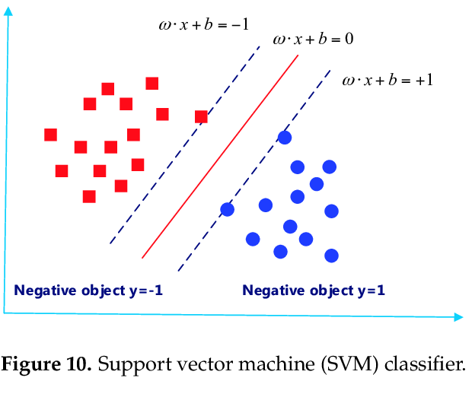

Slide 28
Linear Classifier
Feature vector x
Linear Discriminant Function g(x) = w^{T} x + b
In 2D g(x) reprsents a line w^{T} x + b=0
In 3D g(x) represents a plane
More than 3 dimension hyperplane
w is the vector perpendicular to the hyperplane
W represents orintation of hyperplane in D dimensional space (D- dimensionality of feature vector)
b( a constant) represents position of hyperplane in the D dimensional space→ bias

Slide 29
Two class Problem ( class C₁ and C₂ )
Consider a point X₁ =(x₁₁,x₁₂,..x_{1n})in training set
If X₁ lies on +ve side of hyperplane
g(X₁ )=w^{T} X₁ + b>0
If X₁ lies on -ve side of hyperplane
g(X₁ )=w^{T} X₁ + b<0
If X₁ lies on hyperplane
g(X₁ )=w^{T} x + b=0

Slide 30
Two class Problem ( class C₁ and C₂ )
g(X₁ )=w^{T} X₁ + b>0 X₁ belongs to class C₁
g(X₁ )=w^{T} X₁ + b<0 X₁ belongs to class C₂
Train classifier to find w and b so that correct class can be found
If X₁ belongs to class C₁ then values of w and b such that w^{T} X₁ + b>0 ; otherwise change values

Slide 31
Two class Problem ( class C₁ and C₂ )
If x belongs to class C₁ then w^{T} x + b>0
⃗ w⋅ ⃗ x + b > 0
y values are c1 or c2

Slide 32
Notations --SVM
Assume that we are given a two-class training dataset of N points of the form (⃗ x1;y1); (⃗ x2;y2);:::;(⃗ xN;yN): where the yi’s are either +1 or 1 (the class labels).
Each ⃗ xi is a n-dimensional real vector.
We assume that the dataset is linearly separable.
Any hyperplane can be written as the set of points
⃗ x =(x1;:::;xn) satisfying an equation of the form
⃗ w⋅⃗ x + b = 0:

Slide 33
Notations --SVM
Since the training data is linearly separable, we can select two parallel hyperplanes that separate the two classes of data, so that the distance between them is as large as possible.
The maximum margin hyperplane is the hyperplane that lies halfway between them.

Slide 34
Notations --SVM
For any point on or “above” the hyperplane
, the class label is +1.
⃗ w⋅⃗ x_{i} +b >0; if y_{i} =+1
Similarly, for any point on or “below” the hyperplane
, the class label is −1.
⃗ w⋅⃗ x_{i} +b <0; if y_{i} =−1:
The two conditions can be written as a single condition
y_{i} (⃗ w⋅⃗ xi +b)>0; for all 1 ≤ i ≤ N:

Slide 35
Consider margin as γ
To make the feature vectors secure, they should be at a maximum distance from the hyperplane
To include the concept of margin w^{T} x + b=0 can be modified as w^{T} x + b= γ where γ is the measure of distance of x from the separating plane

Slide 36
Consider a hyperplane w.x+b=0
Distance of a point x from the hyperplane is given by (w.x+b)/ ∥ w∥
(w.x+b)/ ∥ w∥ ≥ γ
w.x+b ≥ γ. ∥ w∥ where γ. ∥ w∥ ≈ 1
w.x+b ≥ 1 if x∈ C₁
w.x+b ≤ -1 if x∈ C₂
y_{i} (⃗ w⋅⃗ x_{i} +b)≥ 1; for all 1 ≤ i ≤ N: during training

Slide 37
Notations --SVM
SVM is a linear machine whose design is affected by the position of the support vectors
y_{i} (⃗ w⋅⃗ x_{i} +b)= 1 when x_{i} is the support vector
It can be shown that these hyperplanes can be described by equations of the following forms:
⃗ w⋅⃗ x+b =+1
⃗ w⋅⃗ x+b =−1

Slide 39
Notations --SVM
For any point on or “above” the hyperplane
⃗w⋅⃗x+b =+1 , the class label is +1.
⃗ w⋅⃗ x_{i} +b ≥+1; if y_{i} =+1
Similarly, for any point on or “below” the hyperplane
⃗ w⋅⃗ x+b =−1 , the class label is −1.
⃗ w⋅⃗ x_{i} +b ≤−1; if y_{i} =−1:
The two conditions can be written as a single condition as
y_{i} (⃗ w⋅⃗ xi +b)≥ 1; for all 1 ≤ i ≤ N:

Slide 40
(w.x+b)/ ∥ w∥ ≥ γ
(w.x+b)/ ∥ w∥ has to be maximum
It can be achieved by minimization of ∥ w∥ and maximization of b
To minimize w apply a minimization function
φ(w)= w^{t} w =w.w
Mathematical convience φ(w)=1/2 w.w
Minimize φ(w) subject to constraint y_{i} (⃗ w⋅⃗ xi +b)= 1

Slide 41
Notations --SVM
Now, the distance between the two hyperplanes is
2/∥ ⃗ w∥:
So, to maximize the distance between the planes we have to minimize ∥⃗ w∥.
Further we also note that∥⃗ w∥is minimum when 1/ 2∥⃗ w∥² is minimum.
(The square of the norm is used to avoid square-roots and the factor “1/2” is introduced to simplify certain expressions.)

Slide 42
Formulation of the problem
Formulate the SVM problem as optimization problem.
Problem
Given a two-class linearly separable dataset of N points of the form
(⃗x1;y1);(⃗x2;y2);:::;(⃗xN;yN):
where the yi’s are either +1 or 1,
ﬁnd a vector ⃗w and a number b which minimize ½ ∥⃗w∥²
subject to yi(⃗w⋅⃗xi +b)≥ 1; for i = 1;:::N

Slide 43
The SVM classiﬁer
The solution of the SYM problem gives us a claasiﬁer for classifying unclassiﬁed data instances.
This is known as the SVM classiﬁer for a given dataset.
The classiﬁer Let ⃗w = ⃗w∗ and b = b∗ be a solution of the SVM problem.
Let ⃗x be an unclassiﬁed data instance.
Assign the class label +1 to ⃗x if ⃗w∗ ⋅ ⃗x + b∗ > 0.
Assign the class label −1 to ⃗x if ⃗ w∗ ⋅ ⃗ x+ b∗ < 0.

Slide 44
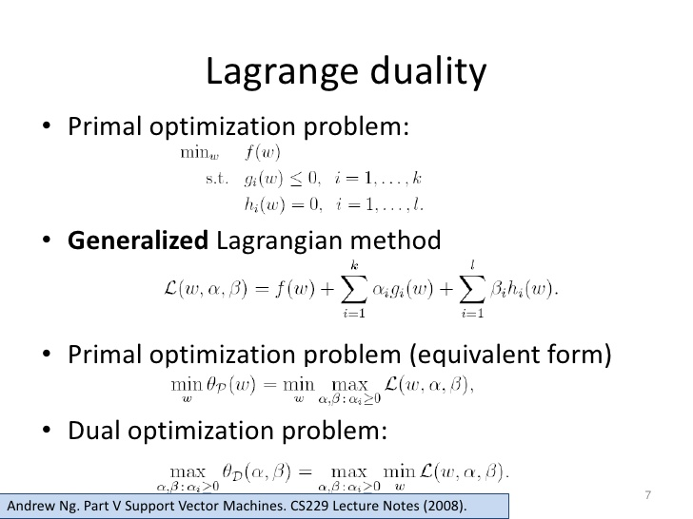

Slide 45
Lagrangian Multiplier
Optimize L(w,b)= ½(w.w) - ∑ α_{i} [y_{i} [w. x_{i} +b]-1]
α is the Lagrangian Multiplier
L(w,b)= ½(w.w) - ∑ α_{i} y_{i} (w. x_{i} )- ∑ α_{i} y_{i} b +∑ α_{i}
Optimization can be done by taking ∂L/ ∂b and ∂L/ ∂w
∂L/ ∂b = - ∑ α_{i} y_{i} =0
₁₌₁ ∑ ^{m} α_{i} y_{i} = 0 (where m is the number of feature vectors) is one constraint

Slide 46
Lagrangian Multiplier
∂L/ ∂w = w- ∑ α_{i} y_{i} x_{i} =0
W= ₁₌₁ ∑ ^{m} α_{i} y_{i} x_{i}
Substitute in L(w,b)
L= ½(w.w) - ∑ α_{i} y_{i} (w. x_{i} )- ∑ α_{i} y_{i} b +∑ α_{i}
Since ∑ α_{i} y_{i} =0
L= ½(w.w) - ∑ α_{i} y_{i} (w. x_{i} ) +∑ α_{i}

Slide 47
Lagrangian Multiplier
Since w= ∑ α_{i} y_{i} x_{i}
In w.w two different subscripts α_{i} so take one as α_{j}
L= ½(w.w) - ∑ α_{i} y_{i} (w. x_{i} ) +∑ α_{i}
L= ½ ∑ α_{i} α_{j} y_{i} y_{j} (x_{i} . x_{j} ) - ∑ α_{i} α_{j} y_{i} y_{j} (x_{i} . x_{j} ) + ∑ α_{i}
L= ∑ α_{i} - ½ ∑ α_{i} α_{j} y_{i} y_{j} (x_{i} . x_{j} ) where α_{i} ≥ 0
Find Lagrangian multipliers that maximizes the expression

Slide 48
Lagrangian Multiplier
If α_{i} =0 the corresponding feature vector xi value is not a support vector
If α_{i} =is high the corresponding feature vector xi value has high influence over the position of decision surface or hyper plane
If α_{i} =extra ordinary high the corresponding feature vector xi value is an outlier

Slide 49
In testing process for a feature vector Z whose class is unknown classification decision D(Z) = w . Z +b
Since w= ∑ α_{i} y_{i} x_{i}
D(Z) = (∑ α_{i} y_{i} x_{i} . Z + b )
Not value but sign of D(Z) is important
If sign is positive the Z classified to c1
If sign negative Z classified to c2

Slide 50
Support vector machines can be used for linear separable data only
To compute value of b
b= ½ [min ∑ α_{i} y_{i} (x_{i} . x_{j} ) _{(i/yi=+1)}
+ max ∑ α_{i} y_{i} (x_{i} . x_{j} ) _{(i/yi=-1)} ]

Slide 51
Solution of the SVM problem
The SVM optimization problem is an example of a constrained optimization problem.
The general method for solving it is to convert it into a quadratic programming problem and then apply the algorithms for solving quadratic programming problems.
These methods yield the following solution to the SVM problem.

Slide 52
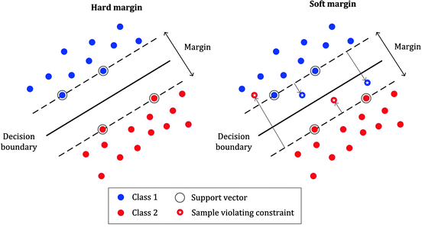

Slide 53
Soft margin hyperlanes
The algorithm for finding the SVM classifier will give give a solution only if the the given two-class dataset is linearly separable.
But, in real life problems, two-class datasets are only rarely linearly separable.
In such a case we introduce additional variables, ξi , called slack variables which store deviations from the margin.
There are two types of deviation:
An instance may lie on the wrong side of the hyperplane and be misclassified.
It may be on the right side but may lie in the margin, namely, not sufficiently away from the hyperplane

Slide 54
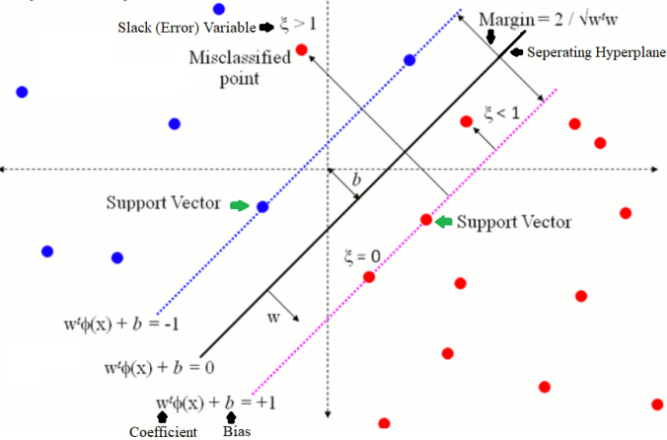

Slide 55
Soft margin hyperlanes
f ξi = 0, then x⃗i is correctly classified and there is no problem with x⃗i .
If 0 < ξi < 1 then x⃗i is correctly classified but it is in the margin.
If ξi > 1, x⃗i is misclassified.
Th sum _{i=1} ∑ ^{N} ξi is defined as the soft error and this is added as a penalty to the function to be minimized.
We also introduce a factor C to the soft error.
With these modifications, we now reformulate the SVM problem

Slide 56
Soft margin hyperlanes
Given a two-class linearly separable dataset of N points of the form (x⃗1, y1), (x⃗2, y2), . . . , (x⃗N , yN ).
where the yi’s are either +1 or 1,
find vectors w⃗ and ⃗ξ and a number b which
minimize 1/ 2 ∥w⃗∥ ² + C _{i=1} ∑ ^{N} ξi
subject to yi(w⃗ ⋅ x⃗i − b) ≥ 1 − ξi , for i = 1, . . . N
ξi ≥ 0, for i = 1, . . . , N

Slide 57
Kernel functions
These functions are used to obtain SVM-like classifiers for two-class datasets which are not linearly separable.
Map nonlinear data to higher dimensional feature space where it is linear x→ φ(x)
Increase the computation cost as dimensionality of data increases
Kernel function helps in dimensionality transfer without computational cost

Slide 58
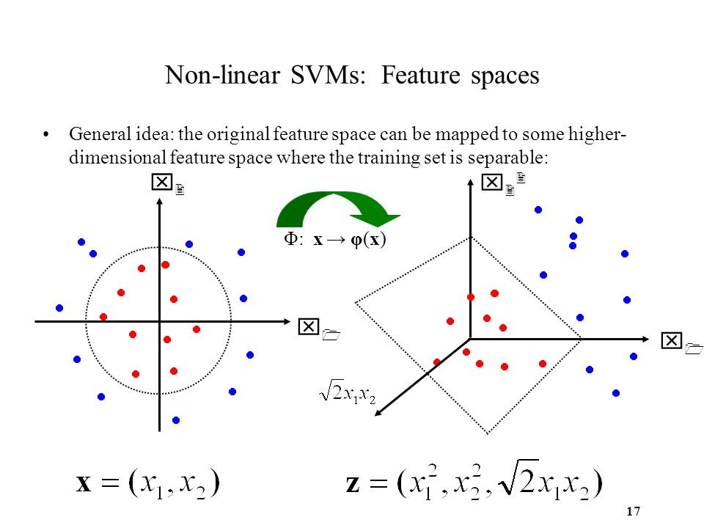

Slide 59
Kernel functions
A kernel function is a function of the form K(x, ⃗ y⃗), where x⃗ and y⃗ are n-dimensional vectors, having a special property.
X1.x2 becomes φ(x1). φ(x2)
K(x1, ⃗ x2⃗) = φ(x1⃗) ⋅ φ(x2⃗).
K is a function of (x1,x2) which can be computed without expanding the terms φ(x⃗) and φ(y⃗)

Slide 60
Definition
Let x⃗ and y⃗ be arbitrary vectors in the n-dimensional vector space R^{n} .
Let φ be a mapping from R^{n} to some vector space.
A function K(x, ⃗ y⃗) is called a kernel function if there is a function φ such that K(x, ⃗ y⃗) = φ(x⃗) ⋅ φ(y⃗).
K is inexpensive to compute

Slide 61
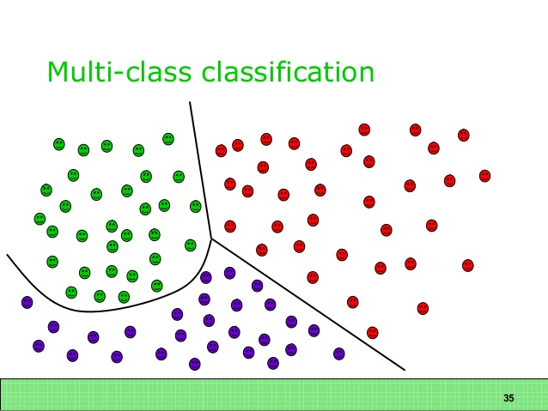

Slide 62
Multiclass SVM’s In machine learning
The multiclass classification is the problem of classifying instances into one of three or more classes.
Classifying instances into one of the two classes is called binary classification.
Support vector machines can be constructed only when the dataset has only two class-labels and is linearly separable.
Two methods are generally used to handle such cases known by the names ”One-against-all" and “one-against-one”

Slide 63
One-against-all” method
The One-Against-All (OAA) SVMs were first introduced by Vladimir Vapnik in 1995.
Let there be p class labels, say, c1, c2, . . . , cp.
We construct the following p two-class datasets and obtain the corresponding SVM classifiers.
First, we assign the class labels +1 to all instances having class label c1 and the class label −1 to all the remaining instances in the data set.
Let f1(x⃗) be the SVM classifier function for the resulting two-class dataset.

Slide 64
One-against-all” method
Next, we assign the class labels +1 to all instances having class label c2 and the class label −1 to all the remaining instances in the data set.
Let f2(x⃗) be the SVM classifier function for the resulting two-class dataset.
We continue like this and generate SVM classifier functions f3(x⃗), . . ., fp(x⃗)

Slide 65
One-against-all” method
Two criteria have been developed to assign a class label to a test instance z⃗.
A data point z⃗ would be classified under a certain class if and only if that class’s SVM accepted it and all other classes’ SVMs rejected it. Thus z⃗ will be assigned c_{i} if f_{i}(z⃗) > 0 and f_{j} (z⃗) < 0 for all j ≠ i.
z⃗ is the assigned the class label c_{i} if f_{j} (z⃗) has the highest value among f₁(z⃗), . . . , f_{p}(z⃗), regardless of sign

Slide 66
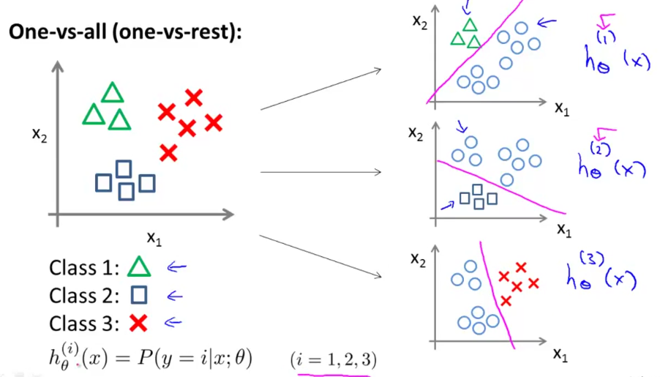

Slide 67
One-against-one” method
In the one-against-one (OAO) (also called one-vs-one (OVO)) strategy, a SVM classifier is constructed for each pair of classes.
If there are p different class labels, a total of
p(p − 1) /2 classifiers are constructed.
An unknown instance is classified with the class getting the most votes.
Ties are broken arbitrarily.

Slide 68
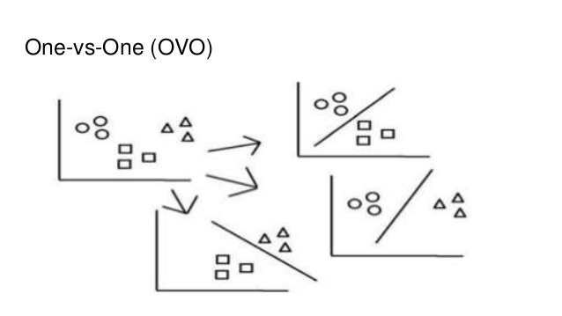

Slide 69
One-against-one” method
For example, let there be three classes, A, B and C.
In the OVO method we construct 3(3 − 1)/2 = 3 SVM binary classifiers.
Now, if z⃗ is to be classified, we apply each of the three classifiers to z⃗.
Let the three classifiers assign the classes A, B, B respectively to z⃗.

Slide 70
One-against-one” method
Since a label to z⃗ is assigned by the majority voting, in this example, we assign the class label of B to z⃗.
One-vs-one (OVO) strategy is not a particular feature of SVM.
Indeed, OVO can be applied to any binary classifier to solve multi-class classification problem.

Slide 71
Hidden Markov models
The HMM is one of the most important machine learning models in speech and language processing.
To deﬁne it properly, we need to ﬁrst understand the concept of discrete Markov processes.

Slide 72
Discrete Markov processes: Examples
1. System and states
Let us consider a highly simpliﬁed model of the different states a stock-market is in, in a given week.
We assume that there are only three possible states:
S1 : Bull market trend
S2 : Bear market trend
S3 : Stagnant market trend

Slide 73
Transition probabilities
Week after week, the stock-market moves from one state to another state.
From previous data, it has been estimated that there are certain probabilities associated with these movements.
These probabilities are called transition probabilities.

Slide 74
Markov assumption
We assume that the following statement (called Markov assumption or Markov property) regarding transition probabilities is true:
Let the weeks be counted as 1;2;::: and let an arbitrary week be the t-th week.
Then, the state in week t + 1 depends only on the state in week t, regardless of the states in the previous weeks.
This corresponds to saying that, given the present state, the future is independent of the past.

Slide 75
Homogeneity assumption
To simplify the computations, we assume that the following property, called the homogeneity assumption, is also true.
The probability that the stock market is in a particular state in a particular week t + 1 given that it is in a particular state in week t, is independent of t.

Slide 76
Representation of transition probabilities Let the probability that a bull week is followed by another bull week be 90%, a bear week be 7.5%, and a stagnant week be 2.5%.
Similarly, let the probability that a bear week is followed by another bull week be 15%, bear week be 80% and a stagnant week be 5%.
Finally, let the probability that a stagnant week be followed by a bull week is 25%, a bear week be 25% and a stagnant week be 50%.

Slide 77
The transition probabilities can be represented in two ways:
The states and the state transition probabilities can be represented diagrammatically
The state transition probabilities can also be represented by a matrix called the state transition matrix. Let us label the states as “1 = bull”, “2 = bear” and “3 = stagnant” and consider the matrix

Slide 78
P = 0.90 0.075 0.025
0.15 0.80 0.05
0.25 0.50 0.25
In this matrix, the element in the i-th row, j-th column represents the probability that the market in state i is followed by market in state j.
Note that in the state transition matrix P, the sum of the elements in every row is 1.

Slide 79
Initial probabilities
The initial probabilities are the probabilities that the stock-market is in a particular state initially.
These are denoted by 1; 2; 3: 1 is the probability that the stock-market is in bull state initially; similarly, 2 and 3.
The values of these probabilities can be presented as a vector

Slide 80
The discrete Markov process
The functioning of the stock-markets with the three states S1;S2;S3 with the assumption that the Markov property is true, the transition probabilities given by the matrix P and the initial probabilities given by the vector constitute a discrete Markov process.
Since we also assume the homogeneity property for the transition probabilities is true, it is a homogeneous discrete Markov process.

Slide 81
The elements in this row vector represent the probabilities that the stock-market is in the bull state, the bear state and the stagnant state respectively in the second week.
In general, the elements of the row vector T Pn represent the probabilities that the stock-market is in the bull state, the bear state and the stagnant state respectively in the (n+1)-th week.

Slide 82
Example 2
Consider a simpliﬁed model of weather. We assume that the weather conditions are observed once a day at noon and it is recorded as in one of the following states:
S1 : Rainy S2 : Cloudy S3 : Sunny
Assuming that the Markov property and the homogeneity property are true, we can write the state transition probability matrix P. Let the matrix be

Slide 83
Assuming that the Markov property and the homogeneity property are true, we can write the state transition probability matrix P.
Let the matrix be
P = 0:4 0:3 0:3
0:2 0:6 0:2
0:1 0:1 0:8
Let the initial probabilities be=[0:25 0:25 0:50]
The changes in weather with the three sates S1;S2;S3 satisfying the Markov property and the homogeneity property, the transition probability matrix P and the initial probabilities given by constitute a discrete homogeneous Markov process.

Slide 84
Discrete Markov processes: General case
A Markov process is a random process indexed by time, and with the property that the future is independent of the past, given the present.
The time space may be discrete taking the values 1;2;::: or continuous taking any nonnegative real number as a value. In these notes, we consider only discrete time Markov processes.

Slide 85
System and states
Consider a system that at any time is in one of N distinct states:
S1;S2;:::;SN
We denote the state at time t by qt for t = 1;2;:::.
So, qt = Si means that the system is in state Si at time t.

Slide 86
Transition probabilities
At regularly spaced discrete times, the system moves to a new state with a given probability, depending on the values of the previous states.
These probabilities are called the transition probabilities.

Slide 87
Markov assumptions (Markov property)
We assume the following called the Markov assumption or the Markov property:
The state at time t + 1 depends only on state at time t, regardless of the states in the previous times.
This corresponds to saying that, given the present state, the future is independent of the past.

Slide 88
Homogeneity property
We assume that the following property, called the homogeneity property, is true.
We also assume that these transition probabilities are independent of time, that is, the probabilities P(qt+1 = Sj ∣qt = Si)are constants and do not depend on t.
We denote this probablity by aij:
aij = P(qt+1 = Sj ∣qt = Si):
We immediately note that aij ≥ 0 and
N ∑ j=1 aij = 1 for all i:

Slide 89
Representation of transition probabilities
The transition probabilities can be represented in two ways:
(a) If the number of states is small, the state transition probabilities can be represented diagrammatically as in Figure 11.1.
(b) The state transition probabilities can also be represented by a matrix called the state transition matrix.
In this matrix, the element in the i-th row, j-th column represents the probability that the system in state Si moves to state Sj.
Note that in the state transition matrix A, the sum of the elements in every row is 1.

Slide 90
Initial probabilities

Slide 91
Discrete Markov process
A system with the states S1;S2;:::;SN satisfying the Markov property is called a discrete Markov process.
If it satisﬁes the homogeneity property, then it is called a homogeneous discrete Markov process

