Slide 1
Operating System Overview

Slide 2
OPERATING SYSTEM OVERVIEW
WHAT IS AN OPERATING SYSTEM?
An interface between users and hardware - an environment "architecture”
Allows convenient usage; hides the tedious stuff
Allows efficient usage; parallel activity, avoids wasted cycles
Provides information protection
Gives each user a slice of the resources
Acts as a control program.

Slide 3
Operating System
Its easier to define by what they can do than what they are
A program that controls the execution of application programs
An interface between applications and hardware
Like a government: provides environment
Resource allocator

Slide 4
Operating System Objectives
Convenience
  Makes the computer more convenient to use
Efficiency
  Allows computer system resources to be used in an efficient manner

Slide 5
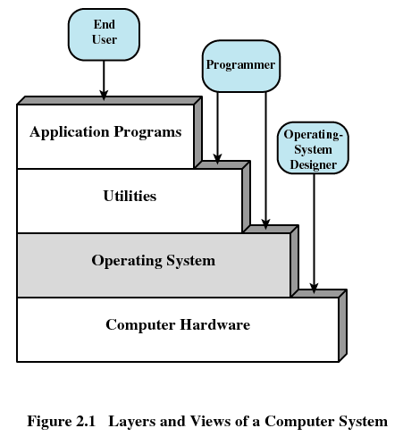
Layers of Computer System

Slide 6
Services Provided by the Operating System
Program development
  Editors and debuggers
Program execution
Access to I/O devices
Controlled access to files
System access

Slide 7
Services Provided by the Operating System
Error detection and response
  Internal and external hardware errors
    Memory error
    Device failure
  Software errors
    Arithmetic overflow
    Access forbidden memory locations

Slide 8
Kernel
Portion of operating system that is in main memory
Contains most frequently used functions
Also called the nucleus

Slide 9
Evolution of Operating Systems
Serial Processing
  No operating system
  Machines run from a console with display lights, toggle switches, input device, and printer
  Schedule time
  Setup included loading the compiler, source program, saving compiled program, and loading and linking

Slide 10
Evolution of Operating Systems
Simple Batch Systems
    Common I/p devices were card readers & Tape drives etc and O/p devices were Line printers, tape drives, card drives etc
    User prepares a Job-consists of the Program, data and control information. After some time later, the output appeared.
    OS is Simple: Software that controls the sequence of events (Job Control Language-JCL)
    Batch jobs together
    Turn around time- delay between job submission and completion
    Lack of interaction

Slide 11
Spooling
Hardware
  Introduction of Disk technology
  Mechanical I/O devices much slower than CPU
  Read 17 cards/sec vs. execute 1000s instructions/sec
Goal of OS
  Improve performance by overlapping I/O with CPU execution
Spooling: Simultaneous Peripheral Operations On-Line
  Read card punches to disk
  Compute (while reading and writing to disk)
  Write output from disk to printer
OS Functionality
  Buffering and interrupt handling
Advantage : overlaps I/O of one job with computation of another

Slide 12
Multiprogrammed Batch Systems
Spooling provides a data structure : Job pool
Pool of jobs on disk allows the OS to select jobs, not in sequential order- job scheduling
Job scheduling enables multiprogramming
The OS keeps several jobs in memory at a time.
CPU utilization increased
Job scheduling: scheduling of jobs from Disk to main memory
CPU scheduling: scheduling of jobs from main memory to CPU
OS is more complex than Simple Batch OS, as decision has to taken for scheduling and Memory management is to be performed

Slide 13
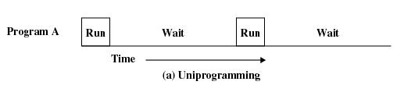
Uniprogramming
Processor must wait for I/O instruction to complete before preceding

Slide 14
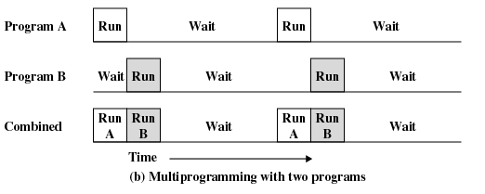
Multiprogramming
When one job needs to wait for I/O, the processor can switch to the other job

Slide 15
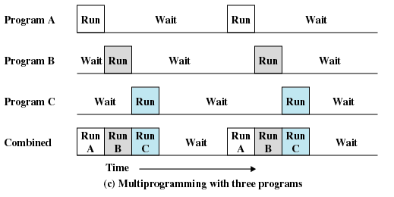
Multiprogramming

Slide 16
Time Sharing
Using multiprogramming to handle multiple interactive jobs
Its also known as multitasking; can be considered as a logical extension of multiprogramming
Processor’s time is shared among multiple users, the CPU switches occur so frequently.
Here I/O may be interactive, so, in the delay of an I/O of one user, the CPU may switch to another user. (eg: typing speed)
Multiple users simultaneously access the system through terminals. Each user may feel that they are using their own computers, whereas actually one computer is shared among them.
An interactive system (time sharing) is used when a short response time is required.
Time-sharing OS is more complex, as memory management and protection may be required.

Slide 17
Personal-Computer Systems
As hardware costs have decreased, PCs started to become popular.
During the earlier times, the OS in PCs lacked the features to support multitasking and multiuser etc.
The goals of the OS were also different. Instead of maximizing CPU and peripheral utilization, the systems opt for maximizing User Convenience and Responsiveness.
DOS, MS-DOS, OS/2, Apple Macintosh, Microsoft Windows were some of the PC OS available.
Later, microcomputers were able to adopt the technology developed for larger systems
Nowadays, the OS using in PCs will be able to support multitasking, multiuser, network monitoring, efficient memory management etc..

Slide 18
Multi-processor Systems
Parallel Systems
  Its having more than one processor in close communication, sharing the computer bus, the clock, and sometimes memory and peripheral devices
  Also referred as tightly coupled systems
Distributed Systems
  Computation distributed in several processors
  More than one processors
  But, processors do not share memory or clock. Each processor has its own local memory.
  The processors communicate through various communication lines, such as high-speed buses or telephone lines.
  Also referred as loosely coupled systems.

Slide 19
Parallel systems (Tightly coupled)
Reasons for building such systems ( features)
  Increased Throughput: speed ratio increased, but..
  Save Money : economical than multiple single processor systems, because the processors can share peripherals, cabinet, power supplies, storage devices etc
  Increased Reliability: if one processor fails, others will take care of that !
  Graceful degradation : ability to continue providing service proportional to the level of surviving hardware. System that are designed for graceful degradation is called fault-tolerant.
Two types of parallel systems are there : Symmetric and Asymmetric
  In the case of Symmetric (it’s the most common), each processor runs an identical copy of the operating system ( backup : if the primary processor fails, the backup is loaded and restart from the last checkpoint).
  In the case of Asymmetric (more common in extremely large systems), each processor is assigned a specific task. This scheme defines a master-slave relationship. Master processor controls the system.

Slide 20
Distributed systems (Loosely coupled)
Reasons for building such systems ( features)
  Resource sharing : eg: printer, files etc sharing
  Computation speed: the computation is distributed among various sites- to run that computation concurrently. If a particular site is overloaded with jobs, some of them may be moved to other lightly loaded sites – load sharing
  Reliability: if the system is composed of a number of small machines, each of which is responsible for some crucial function then a single failure may effectively halt the whole system
  Communication: easy for exchanging data of the same program among various systems

Slide 21
Real-time systems (RT systems)
Rapid response time is the main characteristic feature - fixed time constraints. must be done within time constraints or the system will fail
Used in control of applications where rapid response to a stimulus is essential
Used mainly in scientific experiments, medical imaging, industrial control systems etc.
There are two flavors of RT – Hard RT and Soft RT.
  Hard RT systems guarantees that critical tasks complete on time
  Complex memory management is required
  It can’t be mixed time-sharing system, so none of the general-purpose OSs support hard RT systems
  Soft RT is a less restrictive type of RT system
  Here, a critical real-time task gets priority over other tasks, and retains that priority until it completes.
  It may be mixed with other types of OS
  It is not suitable for industrial controls and Robotics
  Used in areas like multimedia, virtual reality, scientific projects etc

Slide 22
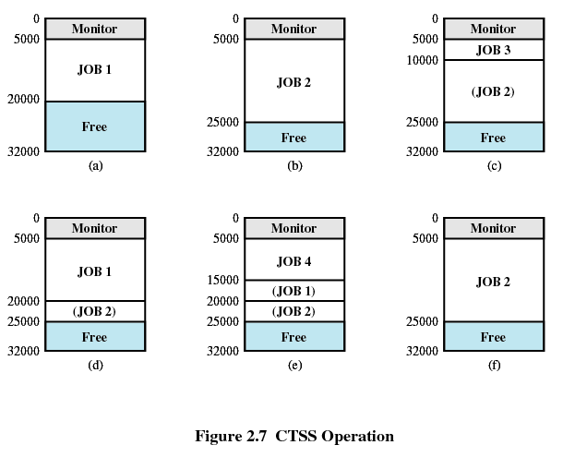
Compatible Time-Sharing System (CTSS)
First time-sharing system developed at MIT

Slide 23
Major Achievements
Processes
Memory Management
Information protection and security
Scheduling and resource management
System structure

Slide 24
Processes
A program in execution
An instance of a program running on a computer
The entity that can be assigned to and executed on a processor
A unit of activity characterized by a single sequential thread of execution, a current state, and an associated set of system resources

Slide 25
Difficulties with Designing
System Software
Improper synchronization
  Ensure a process waiting for an I/O device receives the signal
Failed mutual exclusion
Nondeterminate program operation
  Program should only depend on input to it, not on the activities of other programs
Deadlocks

Slide 26
Process
Consists of three components
  An executable program
  Associated data needed by the program
  Execution context of the program
    All information the operating system needs to manage the process

Slide 27
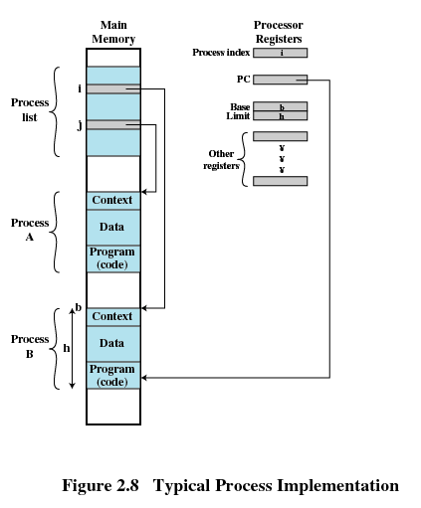
Process

Slide 28
Memory Management
Process isolation
Automatic allocation and management
Support of modular programming
Protection and access control
Long-term storage

Slide 29
Virtual Memory
Allows programmers to address memory from a logical point of view
No hiatus between the execution of successive processes while one process was written out to secondary store and the successor proceess was read in

Slide 30
Virtual Memory and File System
Implements long-term store
Information stored in named objects called files

Slide 31
Paging
Allows process to be comprised of a number of fixed-size blocks, called pages
Virtual address is a page number and an offset within the page
Each page may be located any where in main memory
Real address or physical address in main memory

Slide 32
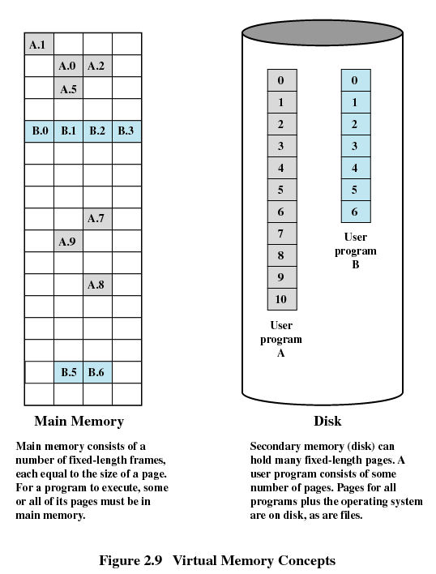
Virtual Memory

Slide 33
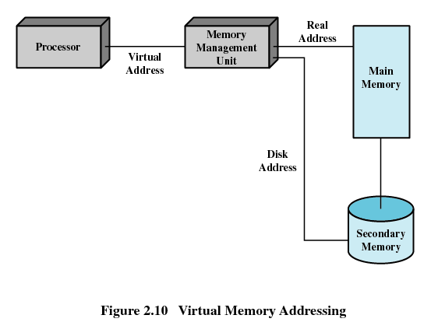
Virtual Memory Addressing

Slide 34
Information Protection and Security
Availability
  Concerned with protecting the system against interruption
Confidentiality
  Assuring that users cannot read data for which access is unauthorized

Slide 35
Information Protection and Security
Data integrity
  Protection of data from unauthorized modification
Authenticity
  Concerned with the proper verification of the identity of users and the validity of messages or data

Slide 36
Scheduling and Resource Management
Fairness
  Give equal and fair access to resources
Differential responsiveness
  Discriminate among different classes of jobs
Efficiency
  Maximize throughput, minimize response time, and accommodate as many uses as possible

Slide 37
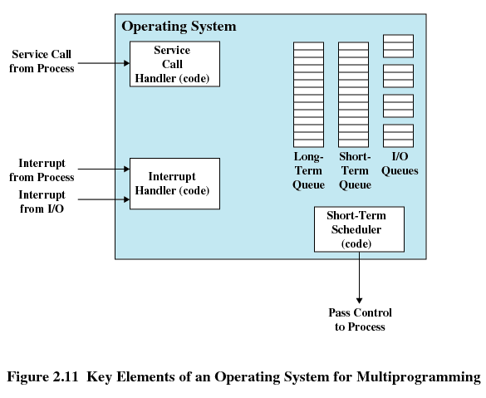
Key Elements of
Operating System

Slide 38
System Structure
View the system as a series of levels
Each level performs a related subset of functions
Each level relies on the next lower level to perform more primitive functions
This decomposes a problem into a number of more manageable subproblems

Slide 39
Process Hardware Levels
Level 1
  Electronic circuits
  Objects are registers, memory cells, and logic gates
  Operations are clearing a register or reading a memory location
Level 2
  Processor’s instruction set
  Operations such as add, subtract, load, and store

Slide 40
Process Hardware Levels
Level 3
  Adds the concept of a procedure or subroutine, plus call/return operations
Level 4
  Interrupts

Slide 41
Concepts with Multiprogramming
Level 5
  Process as a program in execution
  Suspend and resume processes
Level 6
  Secondary storage devices
  Transfer of blocks of data
Level 7
  Creates logical address space for processes
  Organizes virtual address space into blocks

Slide 42
Deal with External Objects
Level 8
  Communication of information and messages between processes
Level 9
  Supports long-term storage of named files
Level 10
  Provides access to external devices using standardized interfaces

Slide 43
Deal with External Objects
Level 11
  Responsible for maintaining the association between the external and internal identifiers
Level 12
  Provides full-featured facility for the support of processes
Level 13
  Provides an interface to the operating system for the user

Slide 44
Modern Operating Systems
Microkernel architecture
  Assigns only a few essential functions to the kernel
    Address spaces
    Interprocess communication (IPC)
    Basic scheduling

Slide 45
Modern Operating Systems
Multithreading
  Process is divided into threads that can run concurrently
    Thread
      Dispatchable unit of work
      executes sequentially and is interruptable
    Process is a collection of one or more threads

Slide 46
Modern Operating Systems
Symmetric multiprocessing (SMP)
  There are multiple processors
  These processors share same main memory and I/O facilities
  All processors can perform the same functions

Slide 47
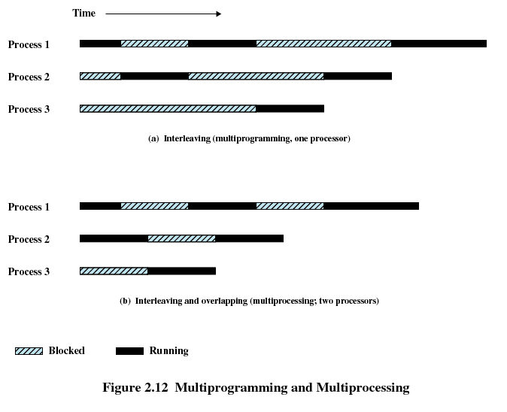
Multiprogramming and Multiprocessing

Slide 48
Modern Operating Systems
Distributed operating systems
  Provides the illusion of a single main memory space and single secondary memory space

Slide 49
Modern Operating Systems
Object-oriented design
  Used for adding modular extensions to a small kernel
  Enables programmers to customize an operating system without disrupting system integrity

Slide 50
Windows Architecture
Modular structure for flexibility
Executes on a variety of hardware platforms
Supports application written for other operating system

Slide 51
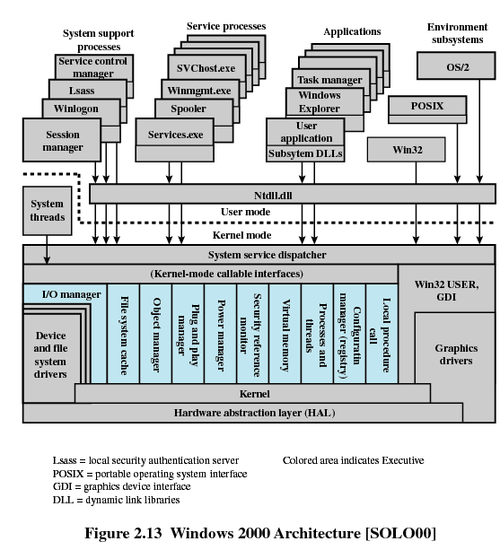

Slide 52
Operating System Organization
Modified microkernel architecture
  Not a pure microkernel
  Many system functions outside of the microkernel run in kernel mode
Any module can be removed, upgraded, or replaced without rewriting the entire system

Slide 53
Kernel-Mode Components
Executive
  Contains base operating system services
    Memory management
    Process and thread management
    Security
    I/O
    Interprocess communication
Kernel
  Consists of the most used components

Slide 54
Kernel-Mode Components
Hardware abstraction layer (HAL)
  Isolates the operating system from platform-specific hardware differences
Device drivers
  Translate user I/O function calls into specific hardware device I/O requests
Windowing and graphics systems
  Implements the graphical user interface (GUI)

Slide 55
Windows Executive
I/O manager
Cache manager
Object manager
Plug and play manager
Power manager
Security reference monitor
Virtual memory manager
Process/thread manager
Configuration manager
Local procedure call (LPC) facility

Slide 56
User-Mode Processes
Special system support processes
  Ex: logon process and the session manager
Service processes
Environment subsystems
User applications

Slide 57
Client/Server Model
Simplifies the Executive
  Possible to construct a variety of APIs
Improves reliability
  Each service runs on a separate process with its own partition of memory
  Clients cannot not directly access hardware
Provides a uniform means for applications to communicate via LPC
Provides base for distributed computing

Slide 58
Threads and SMP
Operating system routines can run on any available processor
Different routines can execute simultaneously on different processors
Multiple threads of execution within a single process may execute on different processors simultaneously
Server processes may use multiple threads
Share data and resources between process

Slide 59
Windows Objects
Encapsulation
  Object consists of one or more data items and one or more procedures
Object class or instance
  Create specified instances of an object
Inheritance
  Support to some extent in the Executive
Polymorphism

Slide 60
UNIX
Hardware is surrounded by the operating system software
Operating system is called the system kernel
Comes with a number of user services and interfaces
  Shell
  Components of the C compiler

Slide 61
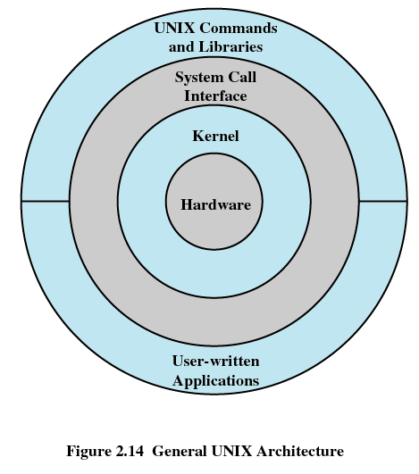
UNIX

Slide 62
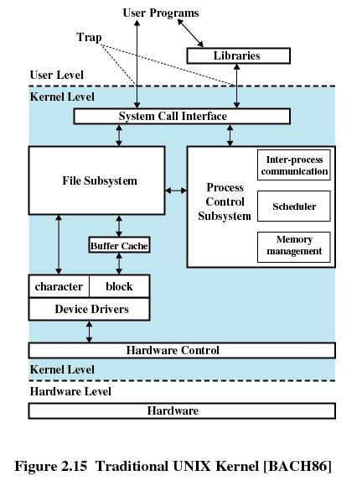
UNIX Kernel

Slide 63
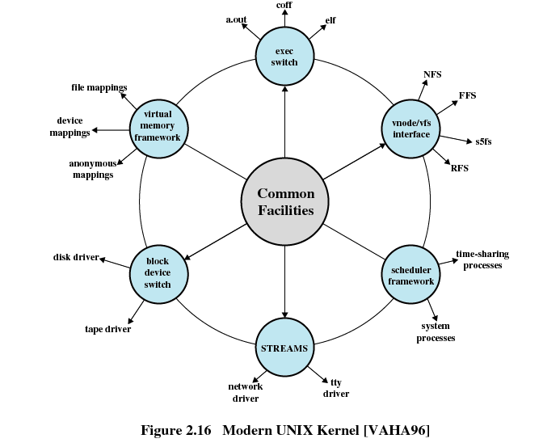
Modern UNIX Kernel

Slide 64
Modern UNIX Systems
System V Release 4 (SVR4)
Solaris 9
4.4BSD
Linux

