Slide 1

IT409 Web Application Development

Slide 2
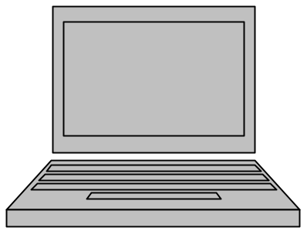
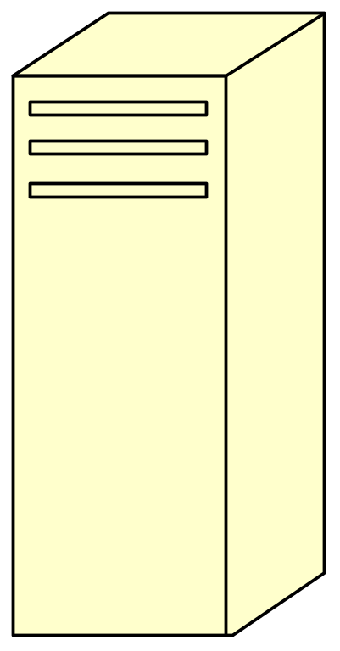
Client Server Model

Slide 3
Server Applications (Software)
Management and maintenance of Data including
  User login data
  Application data
Data processing
Centralized
Access via Login

Slide 4
Client Applications (Software)
Provides user interface
Stores some settings
Can do some data processing
Little to no application data storage
  Same view of data no matter where you login

Slide 5
Client-Server Advantages
Centralized Data Storage
No data redundancy (no duplication of data)
Reduces data dependencies

Slide 6
WWW – Ultimate Client-Server System
Already Standardized
Built on the Widest Area Network you could imagine, i.e., The Internet
Standardized Clients that are free to use
  IE, Firefox, Safari, etc.
Lots of Servers already in place
  Apache, Windows Server (IIS), etc.
Database Servers

Slide 7
3-Tiered Systems

Slide 8
3-Tiered System
Database Tier (Database Server)
  Data storage and low level data manipulation
Server Tier (Application Server)
  Manage client connections and data processing
Client Tier (Client Software installed locally)
  User interface and some data processing

Slide 9
Advantage of 3-Tier Systems
Central Database Server accessed by multiple Application Servers
In turn, each Application Server could independently manage thousands of users
Database Server is specially designed to do its job
  Database Operations: Update, Insert, Remove, etc.
  Lots of disk storage and memory needed
Application Servers can be added to support more users or DIFFERENT APPLICATIONS
  Server Operations: Complex application-dependent computations
  Lots of processor power needed

Slide 10
Internet vs. WWW
Internet is the infrastructure that makes the WWW work.
Packet Switching
TCP/IP Protocol
Physical Infrastructure
  Fiber-optics lines, wires
  Satellites, Cable Modems
  Routers, Hubs, Network Cards, WiFi systems, etc.
WWW is just one of many “virtual networks” built on the Internet.
Websites: http, https, etc.
Email: pop, imap, etc.
Other systems: ftp, instant messaging, etc.

Slide 11
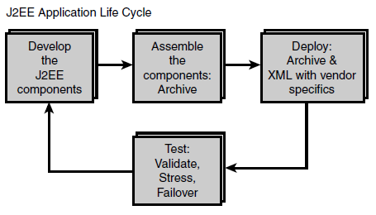
Web Application Life Cycle
implementation process is divided into roles
which can be performed by different individuals with different skills

Slide 12
XML
Extensible Markup Language (XML) is a markup language that defines a set of rules for encoding documents in a format that is both human-readable and machine-readable.
Defined by W3C

Slide 13
XML
XML stands for eXtensible Markup Language.
XML was designed to store and transport data.
XML was designed to be both human- and machine-readable.

Slide 14
XML Sample
<food>
  <price> 200 </price>
  <description> contains onion </description>
  <color> brown <./color>
</food>
<food>
  <price> 200 </price>
  <description> contains onion </description>
  <color> brown <./color>
</food>
XML Name space

Slide 15
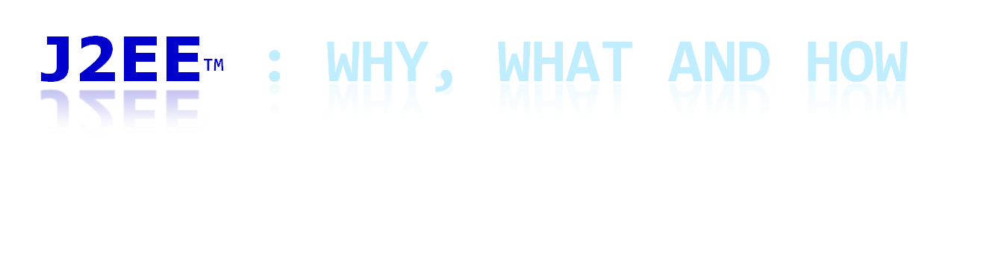

Slide 16
Motivation for J2EE
Why J2EE?
Need for
  New multi-tier enterprise computing model in web environment
  A way to bring in different elements of enterprise application
    Web interface design
    Transaction processing
    Meeting non-functional system requirements:
      Availability, reliability, enhanceability, performance, scalability, reusability, interoperability
    Timely development and deployment
Notes:
Enterprise means “server-side” computation

Slide 17
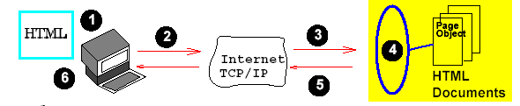
Simple Web Client/Server
Why J2EE?
Client: simply accesses web pages through web browser
Server: retrieves html documents
Notes:
It’s not very useful; not very intelligent
Give url, and web browser brings in web pages

Slide 18
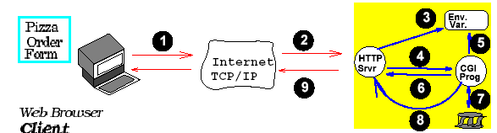
CGI-based Web Client/Server
Why J2EE?
Interaction of two-tier architecture
Client: uses service requiring secondary storage
Server: manipulates forms, Database updates, (primitive) electronic commerce
Fat Server/ Thin Client
Notes:
i.e. order pizza, free after 30 min; should be a way to determine the time
Somebody has to remember the time that I ordered (server)

Slide 19
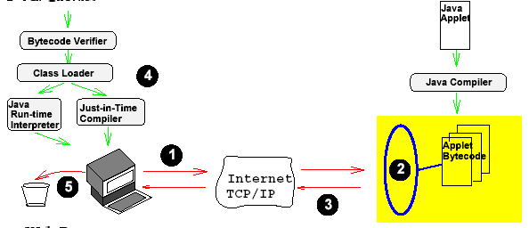
Java Applet-based Web Client/Server
Why J2EE?
Interaction of two-tier architecture
Client: uses Java Applet for client-side computation
Server: provides Applet bytecode
Fat Client/Thin Server
Notes:
Client to do stand-alone processing
But we cannot do important processing, such as done by CGI programming? Java’s utility is fairly limited

Slide 20
Drawbacks of two tier application architecture
Why J2EE?
Easy to deploy, but difficult to enhance or upgrade
Reusability of business and presentation logic difficult
Not scalable

Slide 21
Vision of J2EE
Why J2EE?
An open standard
Umbrella for anything Java-related
For designing, developing, assembling, and deploying component-based enterprise applications
Separation of business logic from presentation
Reusability, enhanceability, scalability, interoperability
Notes:
Enterprise means “server-side” computation

Slide 22
Separation of Business logic from Presentation logic
Why J2EE?
Presentation logic : display
Business logic : what the company wants to do
Example: the distribution of different sales figures by diff dept (business logic) can be represented in many different ways (pie chart, bar graph, etc)

Slide 23
Why J2EE?
Simplifies the complexity of a building n-tier application
Standardizes an API between components and application server container
J2EE Application Server and Containers provide the framework services

Slide 24
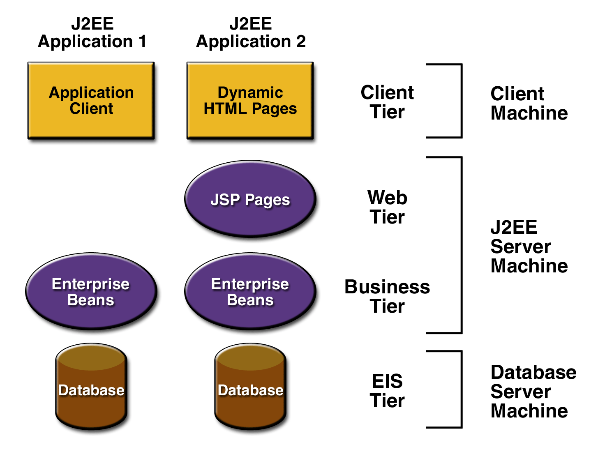
Thin-client Multi-tiered Architecture
What is J2EE?
Notes:
So J2EE comes up w/ solution; what is the solution?

Slide 25
J2EE Tiers
Client Presentation
  HTML or Java applets deployed in Browser
  XML documentations transmitted through HTTP
  Java clients running in Client Java Virtual Machine (JVM)
Presentation Logic
  Servlets or JavaServer Pages running in web server
Application Logic
  Enterprise JavaBeans running in Server

Slide 26
J2EE Components & Services
Components
  Java Servlets
  JavaServer Pages (JSP)
  Enterprise JavaBeans (EJB)
Standard services & supporting technologies
  Java database connectivity(JDBC) data access API
  Java Messaging Service (JMS)
  (Remote Method Invocations (RMI))
  Extensible Markup Languages(XML)
  JavaIDL (Interface Description Language)
  JavaMail
  Java Security
  CORBA technology
  Design Patterns
Notes:
Components based model
Container-provided services
Design Patterns are oo reusable components (solutions to recurring problem)
MVC: architectural concept; in Smalltalk environments;
Java Beans:reusable unit of component; a java class w/ four kinds of special features 1: properties(get/set); 2:methods(internal,get/set);3.persistence;4.events

Slide 27
Servlets
Technology for generating dynamic Web pages
Protocol and platform-independent server side components, written in Java, which extend the standard Web servers
Java programs that serve HTTP requests
extends HttpServlet class
Provide a general framework for services built on the request-response paradigm

Slide 28
Servlets
Portable to any Java application server
Can serve as “Controller” of JSP/Servlet application

Slide 29
Benefits of Servlets
Portability - Write once, serve everywhere
Power - Can take advantage of all Java APIs
Elegance - Simplicity due to abstraction
Efficiency & Endurance - Highly scalable
Safety
Integration - Servlets tightly coupled with server
Extensibility & Flexibility

Slide 30
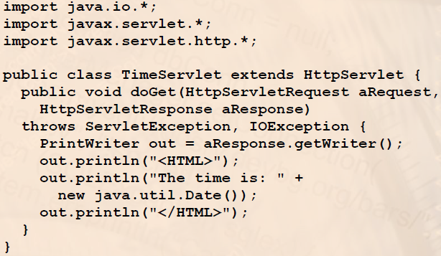
Time Servlet - Example

Slide 31
Servlets Architecture
The HttpServlet class
  Serves client's HTTP requests
For each of the HTTP methods, GET, POST, and others, there is corresponding method:
  doGet(…) – serves HTTP GET requests
  doPost(…) – serves HTTP POST requests
  doPut(…), doHead(…), doDelete(…), doTrace(…), doOptions(…)
• The Servlet usually must implement one of the first two methods or the service(…) method

Slide 32
Servlets Architecture
The HttpServletRequest object
  Contains the request data from the client
  HTTP request headers
  Form data and query parameters
  Other client data (cookies, path, etc.)
The HttpServletResponse object
  Encapsulates data sent back to client
  HTTP response headers (content type, cookies, etc.)
  Response body (as OutputStream)

Slide 33
GET and POST
The HTTP GET method is used when:
  The processing of the request does not change the state of the server
  The amount of form data is small
  You want to allow the request to be bookmarked

Slide 34
GET and POST ...
The HTTP POST method is used when:
  The processing of the request changes the state of the server, e.g. storing data in a DB
  The amount of form data is large
  The contents of the data should not be visible in the URL (for example, passwords)

Slide 35
MVC Architecture
Model View Controller (MVC) is a software architecture pattern, commonly used to implement user interfaces.
it is therefore a popular choice for architecting web apps.
In general, it separates out the application logic into three separate parts, promoting modularity and ease of collaboration and reuse.
It also makes applications more flexible and welcoming to iterations.

Slide 36
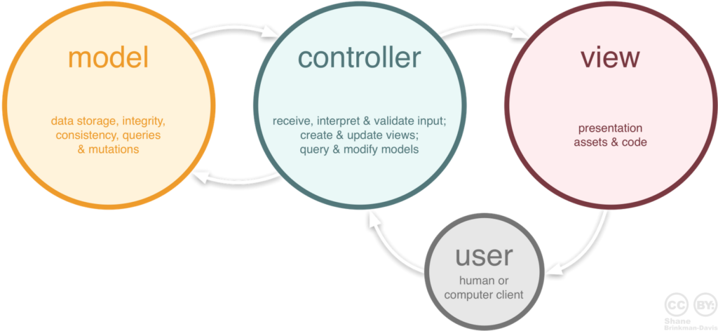
MVC Architecture ...

Slide 37
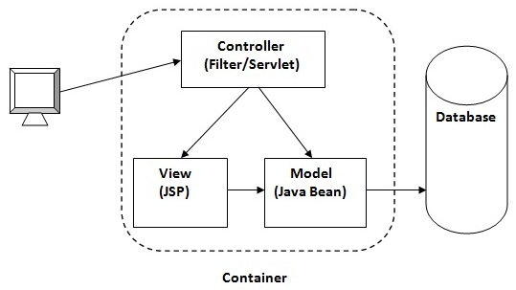
Servlet as the controller

Slide 38
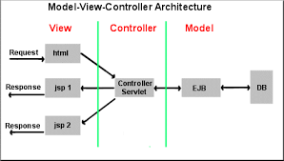
Servlet as the controller

Slide 39
Servlet Container
Component of a web server that interacts with Java servlets.
Responsible for managing the lifecycle of servlets
Maps a URL to a particular servlet and ensuring that the URL requester has the correct access-rights.

Slide 40
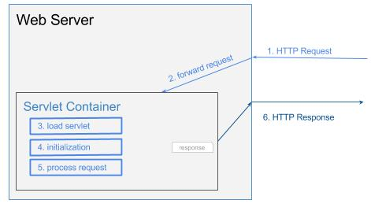
Servlet Container ...

Slide 41
Service methods
doGet
doPost
doHead
doPut
doDelete
doOptions
doTrace
Assignment I

Slide 42
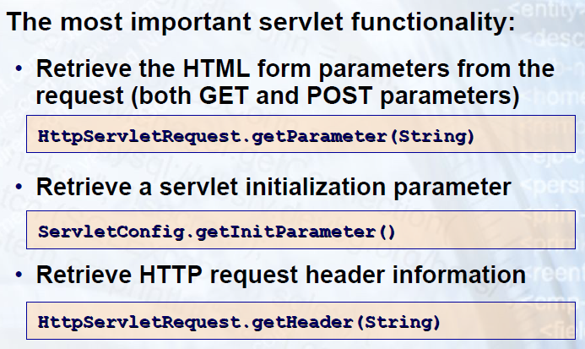
Servlets API

Slide 43
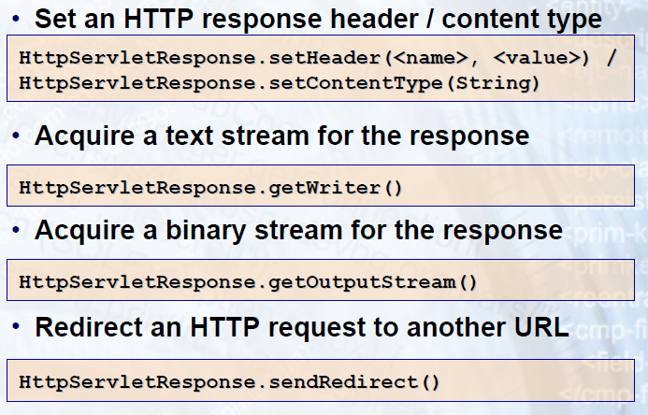
Servlets API ...

Slide 44
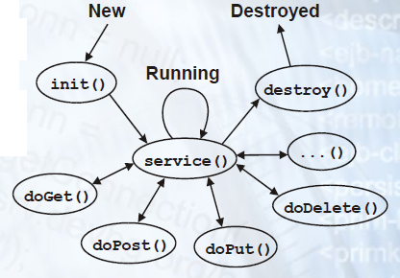
Servlet Life cycle

Slide 45
Servlet Life cycle ...
The servlet is initialized by calling the init() method.
The servlet calls service() method to process a client's request.
The servlet is terminated by calling the destroy() method.
Finally, servlet is garbage collected by the garbage collector of the JVM

Slide 46
Servlet API
javax.servlet and javax.servlet.http packages represent interfaces and classes for servlet api.

Slide 47
Servlet API
javax.servlet package contains many interfaces and classes that are used by the servlet or web container.
javax.servlet.http package contains interfaces and classes that are responsible for http requests only.

Slide 48
Interfaces in javax.servlet package
Servlet
ServletRequest
ServletResponse
RequestDispatcher
ServletConfig
ServletContext
SingleThreadModel
Filter
FilterConfig
FilterChain
ServletRequestListener
ServletRequestAttributeListener
ServletContextListener
ServletContextAttributeListener

Slide 49
Classes in javax.servlet package
GenericServlet
ServletInputStream
ServletOutputStream
ServletRequestWrapper
ServletResponseWrapper
ServletRequestEvent
ServletContextEvent
ServletRequestAttributeEvent
ServletContextAttributeEvent
ServletException
UnavailableException

Slide 50
Interfaces in javax.servlet.http package
HttpServletRequest
HttpServletResponse
HttpSession
HttpSessionListener
HttpSessionAttributeListener
HttpSessionBindingListener
HttpSessionActivationListener
HttpSessionContext (deprecated now)

Slide 51
Classes in javax.servlet.http package
HttpServlet
Cookie
HttpServletRequestWrapper
HttpServletResponseWrapper
HttpSessionEvent
HttpSessionBindingEvent
HttpUtils (deprecated now)

Slide 52
protected void doPost(HttpServletRequest request, HttpServletResponse response)
throws ServletException, IOException {
Connection connection;
String url = "jdbc:postgresql://localhost:5432/TestDB";
String user = "postgres";
String password = "root123";
String _firstname = request.getParameter("firstname");

Slide 53
String _lastname = request.getParameter("lastname");
String _username = request.getParameter("username");
String _password = request.getParameter("password");
PrintWriter out = response.getWriter();

Slide 54
try {
Class.forName("org.postgresql.Driver");
} catch(ClassNotFoundException e ){
//e.getMessage();
out.println(e.getMessage());
}

Slide 55
try {
connection = DriverManager.getConnection(url, user, password);
out.println("Connected");
Statement stmt = connection.createStatement();
int i = stmt.executeUpdate("INSERT INTO public.\"Registration\"(firstname, lastname, username, password) VALUES ('"+_firstname+"','"+ _lastname+"','"+ _username+"','" + _password +"');");

Slide 56
out.println(i);
connection.close();
} catch (SQLException ex) {
out.println(ex.getMessage());
}

