Slide 1
Module II

Slide 2
Session Management
HTTP is a stateless protocol—it provides no intrinsic way to associate one request/response transaction with any subsequent transactions.
But very often a Web application requires that the server engage in a non-trivial dialog with a single user, involving multiple client requests and server responses.
So the problem is to find ways to define and keep track of a particular “session” between browser and Web server.
This is called session tracking.

Slide 3
Session simply means a particular interval of time.
Each time user requests to the server, server treats the request as the new request. So we need to maintain the state of an user to recognize a particular user.

Slide 4
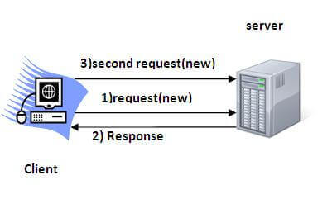

Slide 5
Session Tracking Techniques
Cookies
Hidden Form Field
URL Rewriting
HttpSession

Slide 6
Cookies
A cookie is a small piece of information that is persisted between the multiple client requests
A cookie has a name, a single value, and optional attributes such as a comment, path and domain qualifiers, a maximum age, and a version number

Slide 7
How Cookie works
By default, each request is considered as a new request.
In cookies technique, we add cookie with response from the servlet.
So cookie is stored in the cache of the browser.
After that if request is sent by the user, cookie is added with request by default.
Thus, we recognize the user as the old user.

Slide 8
Types of Cookie
There are 2 types of cookies in servlets.
  Non-persistent cookie : It is valid for single session only. It is removed each time when user closes the browser.
  Persistent cookie : It is valid for multiple session . It is not removed each time when user closes the browser

Slide 9
Advantage of Cookies
Simplest technique of maintaining the state.
Cookies are maintained at client side.

Slide 10
Disadvantage of Cookies
It will not work if cookie is disabled from the browser.
Only textual information can be set in Cookie object.

Slide 11
Cookie class
javax.servlet.http.Cookie class provides the functionality of using cookies. It provides a lot of useful methods for cookies
Constructor | Description
Cookie() | constructs a cookie.
Cookie(String name, String value) | constructs a cookie with a specified name and value.

Slide 12
Useful Methods of Cookie class
Method | Description
public void setMaxAge(int expiry) | Sets the maximum age of the cookie in seconds.
public String getName() | Returns the name of the cookie. The name cannot be changed after creation.
public String getValue() | Returns the value of the cookie.
public void setName(String name) | changes the name of the cookie.
public void setValue(String value) | changes the value of the cookie.

Slide 13
Other methods required for using Cookies
For adding cookie or getting the value from the cookie, we need some methods provided by other interfaces. They are:
public void addCookie(Cookie ck):method of HttpServletResponse interface is used to add cookie in response object.
public Cookie[] getCookies():method of HttpServletRequest interface is used to return all the cookies from the browser

Slide 14
How to create Cookie?
Cookie ck=new Cookie("user",”shijin knox");//creating cookie object
response.addCookie(ck);//adding cookie in the response

Slide 15
How to delete Cookie?
//deleting value of cookie
Cookie ck=new Cookie("user","");
//changing the maximum age to 0 seconds
ck.setMaxAge(0);
//adding cookie in the response
response.addCookie(ck);

Slide 16
How to get Cookies?
Cookie ck[]=request.getCookies();
for(int i=0;i<ck.length;i++){
out.print("<br>"+ck[i].getName()+" "+ck[i].getValue());//printing name and value of cookie
}

Slide 17
index.html
<form action="servlet1" method="post">
Name:<input type="text" name="userName"/><br/>
<input type="submit" value="go"/>
</form>

Slide 18
FirstServlet.java
import java.io.*;
import javax.servlet.*;
import javax.servlet.http.*;
public class FirstServlet extends HttpServlet {
public void doPost(HttpServletRequest request, HttpServletResponse response){
try{
response.setContentType("text/html");
PrintWriter out = response.getWriter();
String n=request.getParameter("userName");
out.print("Welcome "+n);

Slide 19
Cookie ck=new Cookie("uname",n);//creating cookie object
response.addCookie(ck);//adding cookie in the response
//creating submit button
out.print("<form action='servlet2'>");
out.print("<input type='submit' value='go'>");
out.print("</form>");
out.close();
}catch(Exception e){System.out.println(e);}
}
}

Slide 20
SecondServlet.java
import java.io.*;
import javax.servlet.*;
import javax.servlet.http.*;
public class SecondServlet extends HttpServlet {
public void doPost(HttpServletRequest request, HttpServletResponse response){
try{
response.setContentType("text/html");
PrintWriter out = response.getWriter();

Slide 21
Cookie ck[]=request.getCookies();
out.print("Hello "+ck[0].getValue());
out.close();
}catch(Exception e){System.out.println(e);}
}
}

Slide 22
Hidden Form Field
A hidden (invisible) textfield is used for maintaining the state of an user.
<input type="hidden" name="uname" value=“shijin knox">

Slide 23
Advantage
It will always work whether cookie is disabled or not.

Slide 24
Disadvantages
It is maintained at server side.
Extra form submission is required on each pages.
Only textual information can be used.

Slide 25
index.html
<form action="servlet1">
Name:<input type="text" name="userName"/><br/>
<input type="submit" value="go"/>
</form>

Slide 26
FirstServlet.java
import java.io.*;
import javax.servlet.*;
import javax.servlet.http.*;
public class FirstServlet extends HttpServlet {
public void doGet(HttpServletRequest request, HttpServletResponse response){
try{
response.setContentType("text/html");
PrintWriter out = response.getWriter();

Slide 27
String n=request.getParameter("userName");
out.print("Welcome "+n);
//creating form that have invisible textfield
out.print("<form action='servlet2'>");
out.print("<input type='hidden' name='uname' value='"+n+"'>");
out.print("<input type='submit' value='go'>");
out.print("</form>");
out.close();
}catch(Exception e){System.out.println(e);}
}
}

Slide 28
SecondServlet.java
import java.io.*;
import javax.servlet.*;
import javax.servlet.http.*;
public class SecondServlet extends HttpServlet {
public void doGet(HttpServletRequest request, HttpServletResponse response)
try{
response.setContentType("text/html");
PrintWriter out = response.getWriter();

Slide 29
//Getting the value from the hidden field
String n=request.getParameter("uname");
out.print("Hello "+n);
out.close();
}catch(Exception e){System.out.println(e);}
}
}

Slide 30
URL-Rewriting
Assuming a form with a hidden field is submitted using the GET method, what the server really sees is just a request whose URI has been extended with an encoding of the value in the hidden field.
In URL-rewriting we cut out role of the browser (encoding session data from hidden fields) and directly extend the URL in the action attribute of the form with an encoding of the session data.

Slide 31
URL-Rewriting …
We can send parameter name/value pairs using the following format:
url?name1=value1&name2=value2&??
A name and a value is separated using an equal = sign, a parameter name/value pair is separated from another parameter using the ampersand(&).

Slide 32
URL-Rewriting …
When the user clicks the hyperlink, the parameter name/value pairs will be passed to the server.

Slide 33
URL-Rewriting …
Advantage of URL Rewriting
  It will always work whether cookie is disabled or not (browser independent).
  Extra form submission is not required on each pages.
Disadvantage of URL Rewriting
  It will work only with links.
  It can send Only textual information.

Slide 34
index.html
<form action="servlet1">
Name:<input type="text" name="userName"/><br/>
<input type="submit" value="go"/>
</form>

Slide 35
firstservlet.java
import java.io.*;
import javax.servlet.*;
import javax.servlet.http.*;
public class FirstServlet extends HttpServlet {
public void doGet(HttpServletRequest request, HttpServletResponse response){
try{
response.setContentType("text/html");
PrintWriter out = response.getWriter();

Slide 36
String n=request.getParameter("userName");
out.print("Welcome "+n);
//appending the username in the query string
out.print("<a href='servlet2?uname="+n+"'>visit</a>");
out.close();
}catch(Exception e){System.out.println(e);}
}
}

Slide 37
secondservlet.java
import java.io.*;
import javax.servlet.*;
import javax.servlet.http.*;
public class SecondServlet extends HttpServlet {
public void doGet(HttpServletRequest request, HttpServletResponse response)
try{
response.setContentType("text/html");
PrintWriter out = response.getWriter();
//getting value from the query string
String n=request.getParameter("uname");
out.print("Hello "+n);

Slide 38
secondservlet.java
out.close();
}catch(Exception e){System.out.println(e);}
}
}

Slide 39
HttpSession interface
container creates a session id for each user.
The container uses this id to identify the particular user.
An object of HttpSession can be used to perform two tasks:
  bind objects
  view and manipulate information about a session, such as the session identifier, creation time, and last accessed time.

Slide 40

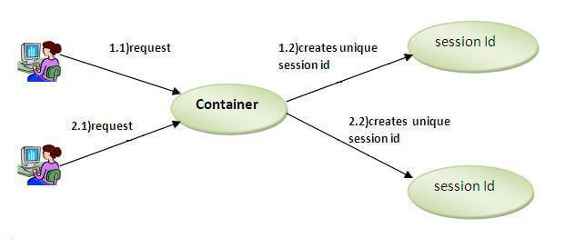
HttpSession interface ...

Slide 41
HttpSession object
public HttpSession getSession(): Returns the current session associated with a request, or if the request does not have a session, creates one.
public HttpSession getSession(boolean create): Returns the current HttpSession associated with a request or, if there is no current session and create is true, returns a new session.

Slide 42
HttpSession ...
public String getId
public long getCreationTime()
public long getLastAccessedTime()
public void invalidate()

Slide 43
index.html
<form action="servlet1">
Name:<input type="text" name="userName"/><br/>
<input type="submit" value="go"/>
</form>

Slide 44
Servlet1.java
import java.io.*;
import javax.servlet.*;
import javax.servlet.http.*;
public class FirstServlet extends HttpServlet {
public void doGet(HttpServletRequest request, HttpServletResponse response){
try{
response.setContentType("text/html");
PrintWriter out = response.getWriter();
String n=request.getParameter("userName");
out.print("Welcome "+n);

Slide 45
HttpSession session=request.getSession();
session.setAttribute("uname",n);
out.print("<a href='servlet2'>visit</a>");
out.close();
}catch(Exception e){System.out.println(e);}
}
}

Slide 46
servlet2
import java.io.*;
import javax.servlet.*;
import javax.servlet.http.*;
public class SecondServlet extends HttpServlet {
public void doGet(HttpServletRequest request, HttpServletResponse response)
try{
response.setContentType("text/html");
PrintWriter out = response.getWriter();

Slide 47
HttpSession session=request.getSession(false);
String n=(String)session.getAttribute("uname");
out.print("Hello "+n);
out.close();
}catch(Exception e){System.out.println(e);}
}
}

Slide 48
dispatching requests
For more dynamic collaboration, servlets can share control of the request.
First, a servlet can forward an entire request, doing some preliminary processing and then passing off the request to another component.
Second, a servlet can include in its response a bit of content generated by another component.

Slide 49
RequestDispatcher in Servlet
The RequestDispatcher interface provides the facility of dispatching the request to another resource it may be html, servlet or jsp.
This interface can also be used to include the content of another resource also. It is one of the way of servlet collaboration.

Slide 50
Methods of RequestDispatcher interface
forward - Forwards a request from a servlet to another resource (servlet, JSP file, or HTML file) on the server.
include - Includes the content of a resource (servlet, JSP page, or HTML file) in the response.

Slide 51
forward & include
public void forward(ServletRequest request,ServletResponse response)throws ServletException, java.io.IOException
public void include(ServletRequest request,ServletResponse response)throws ServletException, java.io.IOException

Slide 52
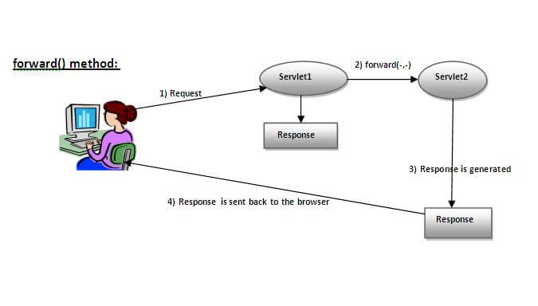
forward()

Slide 53
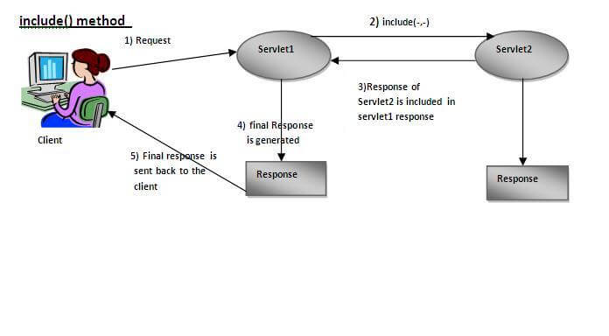
include()

Slide 54
Assignment
Write sample programs for forward() and include() request dispatchers
Write a sample program for sendRedirect() method

Slide 55
Servlets with JDBC
LoginServlet.java
RegistrationServlet.java

Slide 56
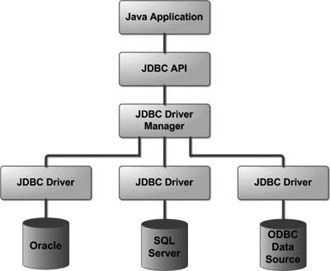
JDBC Architecture

Slide 57
Common JDBC Components
DriverManager: This class manages a list of database drivers
Driver: This interface handles the communications with the database server
Connection: This interface with all methods for contacting a database.
Statement: You use objects created from this interface to submit the SQL statements to the database.
ResultSet: These objects hold data retrieved from a database
SQLException: This class handles any errors that occur in a database application.

Slide 58
Assignment
JDBC API - java.sql, javax.sql

