Slide 1

MICROCONTROLLERS
8051

Slide 2
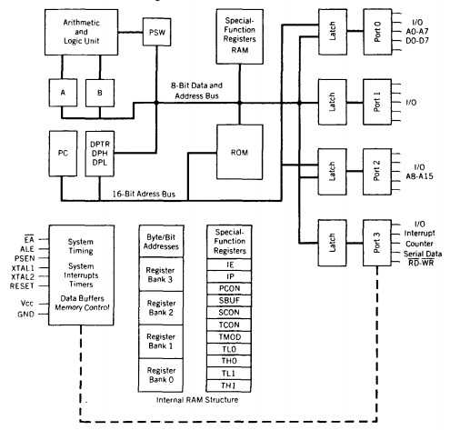
Architecture of 8051

Slide 3
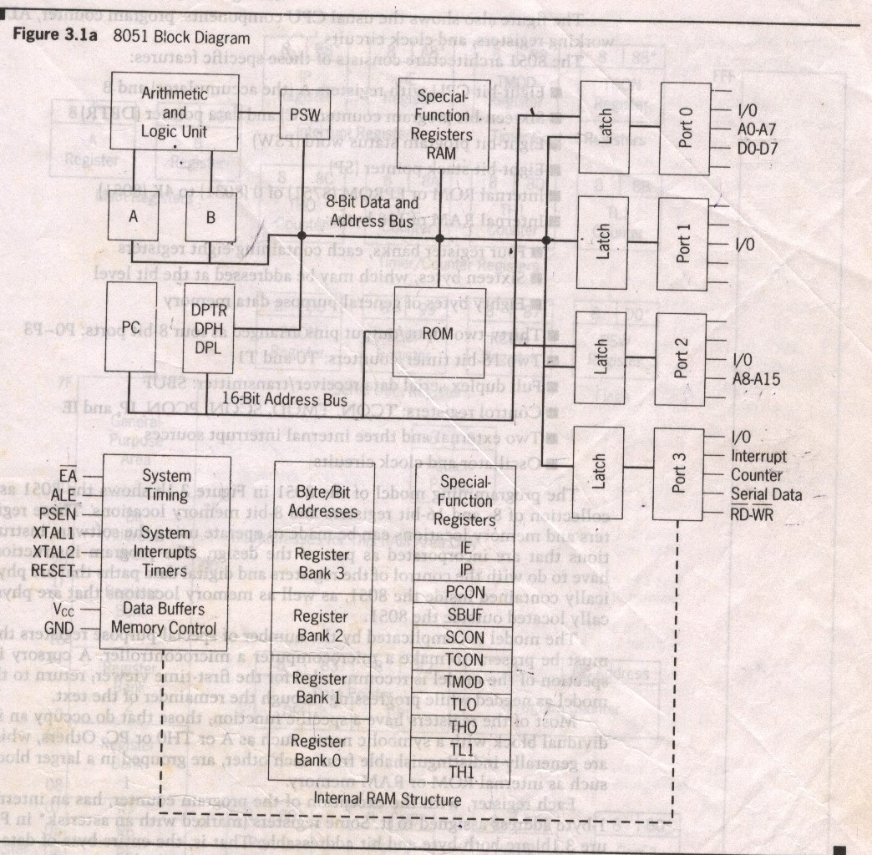
Sachin Bhalavat (9409049436)

Slide 4
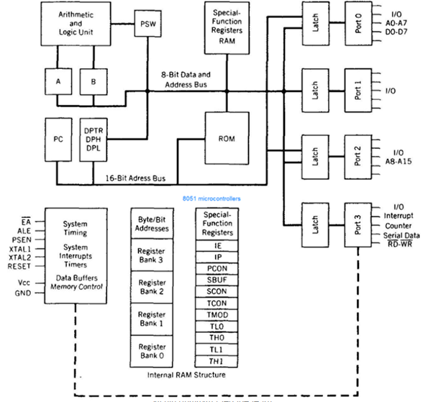

Slide 5
The 8051 Architecture consist of these specific features
The 8 bit CPU with Registers A and B
Internal ROM
16-bit program counter(PC) and data pointer(DPTR)
Internal RAM of 128 bytes
8-bit Program Status word(PSW)
Two 16 bit Counter / timers
4 eight-bit ports
3 internal interrupts and 2 external interrupts.
Control register
Oscillator and clock circuits.

Slide 6
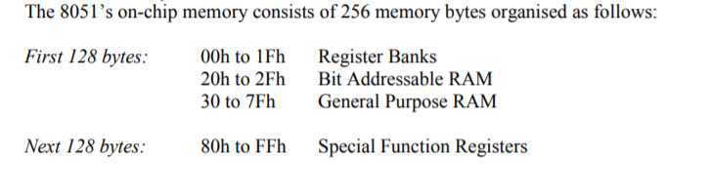
INTERNAL MEMORY

Slide 7
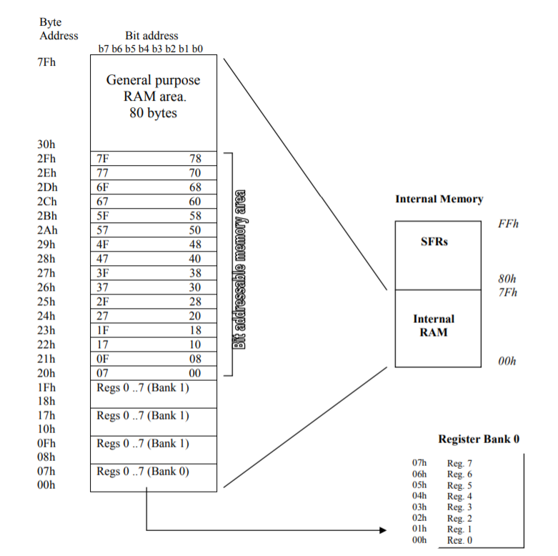

Slide 8
Internal RAM
The 128 byte internal RAM shown in figure
It is organized into three areas.
1.Working register:
Thirty-two bytes from address 00h to 1Fh that make up 32 working register
organized as Four bank of eight bit each.
Bits RS0 and RS1 in the PSW determine which bank of register is currently
Is use.
Bank 0 is selected upon reset
2.Bit addressable:
A bit addressable area of 16 bytes occupies RAM bytes addresses 20h to
2Fh,forming A total of 128 addressable bits.
An addressable bit may be specified by its bit address of 00h to 7Fh.
3.General purpose:
A general-purpose RAM area above the bit area,form 30h to 7Fh,addresable
as bytes.
A total of 80 bytes from locations 30H to 7FH are used for read and write storage, called scratch pad.

Slide 9
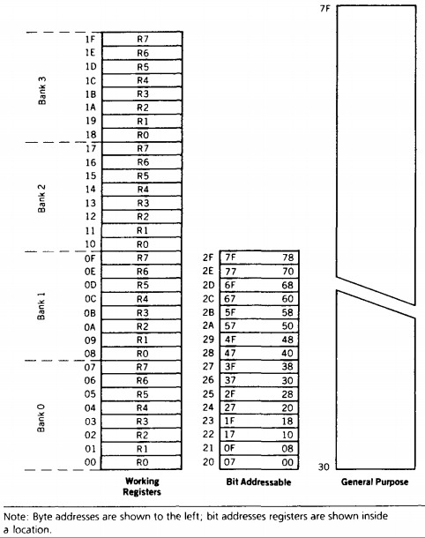
Internal RAM Organization
Sachin Bhalavat (9409049436)

Slide 10
External memory
External memory is used in cases when the internal ROM and RAM memory Available On chip is not sufficient. Two separate are made available by the 16-bit PC and the DPTR and by different control pins for enabling external ROM and RAM chips.
If the 128 bytes of internal RAM is insufficient, the external RAM is accessed by the DPTR. In the 8051 family, external RAM of upto 64 KB can be added to any chip.

Slide 11
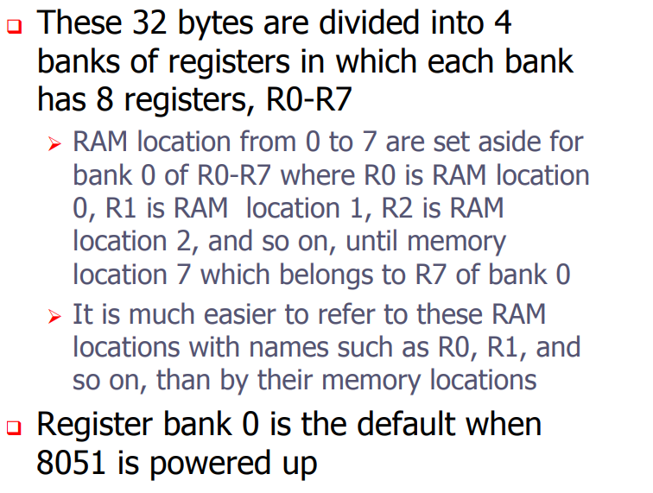
Register bank

Slide 12
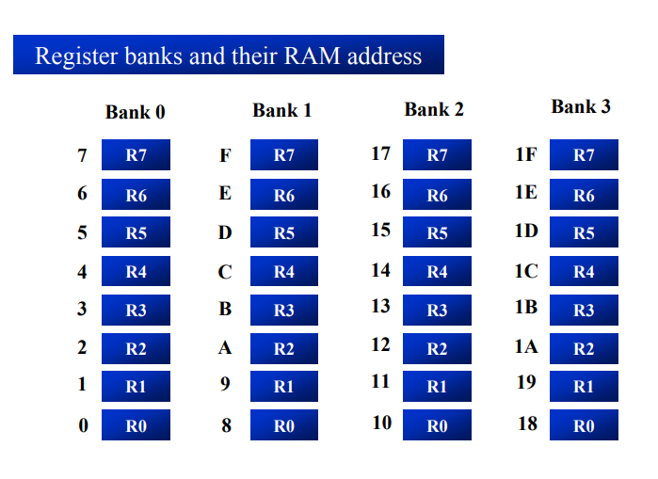

Slide 13
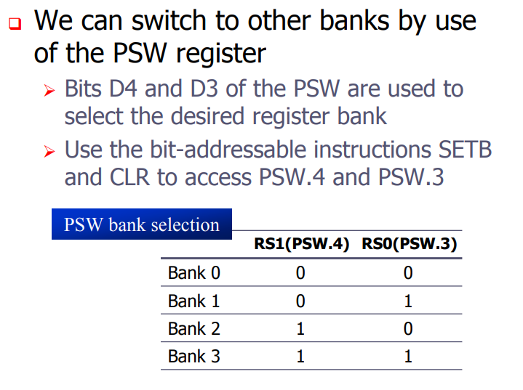

Slide 14
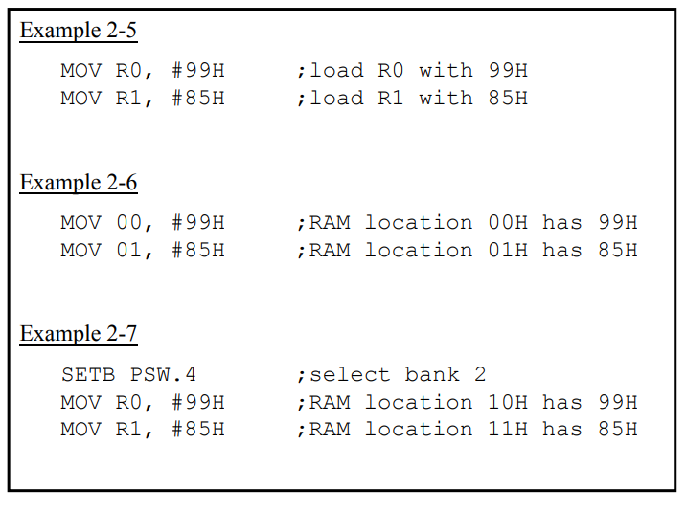

Slide 15
Special function register
8051 provides 21 SFR and they are for selecting various programmable features of the microcontroller.
Each SFR has an internal one byte address assigned to it.
Some of the registers are both byte and bit addressable.

Slide 16
Special Function Register (SFR)
The SFR (Special Function Register) can be accessed by their names or by their addresses.
‰ The SFR registers have addresses between 80H and FFH.
Not all the address space of 80 to FF is used by SFR.
The unused locations 80H to FFH are reserved and must not be used by the 8051 programmer.

Slide 17
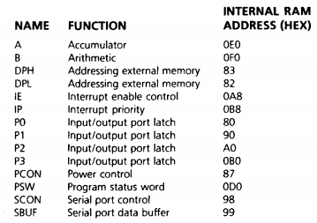
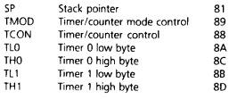
Special Function Register (SFR)

Slide 18
Special Function Register (SFR)cont..
CPU registers:
- ACC : Accumulator.
- B : B register.
- PSW : Program Status Word.
- SP : Stack Pointer.
- DPTR : Data Pointer (DPH, DPL).
Interrupt control:
-IE : Interrupt Enable.
-IP : Interrupt Priority.
I/O Ports:
- P0 : Port 0.
- P1 : Port 1.
- P2 : Port 2.
- P3 : Port 3.

Slide 19
Special Function Register (SFR)cont..
Timers:
- TMOD : Timer mode.
- TCON : Timer control.
- TH0 : Timer 0 high byte.
- TL0 : Timer 0 low byte.
- TH1 : Timer 1 high byte.
- TL1 : Timer 1 low byte.
Serial I/O:
- SCON : Serial port control.
- SBUF : Serial data registers.
Other:
- PCON : Power control

Slide 20
A and B CPU Register
The 8051 contains 34 general purpose or working registers.
Two of these Register A and B.
The immediate result is stored in the accumulator register (Acc) for next operation.
The B register is a register just for multiplication and division operation which requires more register spaces for the product of multiplication and the quotient and the remainder for the division.

Slide 21
Program status word(PSW)
The program status store the status of the result of ALU operations.
The PSW contain the math flags, user definable flag and the register select bits that identify which of the four General-purpose register banks is currently in use by the program.
The math flags include carry(c),auxiliary carry(AC), overflow(OV) and parity(p)

Slide 22
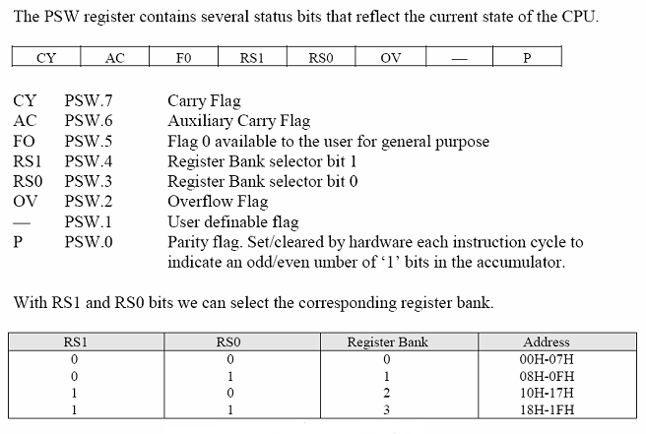
Program Status Word (PSW)

Slide 23

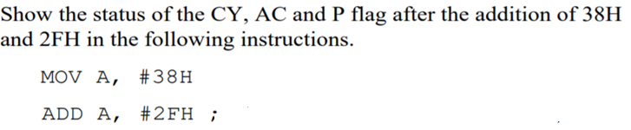
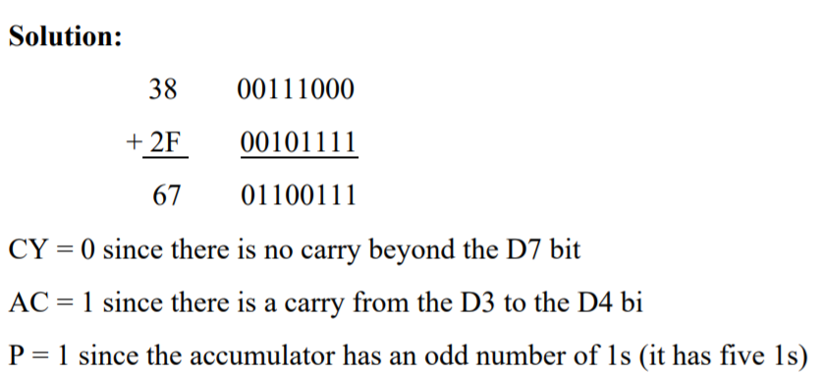
Eg :

Slide 24
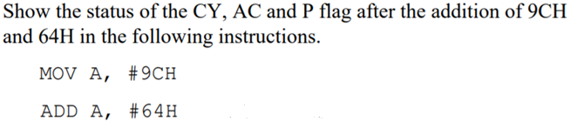
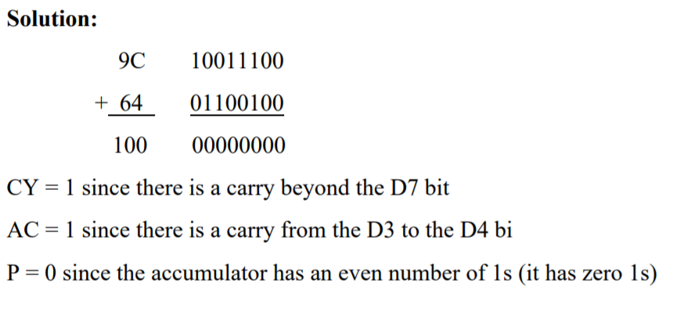
Eg:2

Slide 25
Program counter (PC)
The program counter points to the address of the next instruction to be Executed
As the CPU fetches the opcode from the program ROM, the program counter is increasing to point to the next instruction.
The program counter is 16 bits wide
This means that it can access program addresses 0000 to FFFFH, a total of 64K bytes of code

Slide 26
Data pointer (DPTR)
The data pointer is 16 bit register.
It is used to hold the 16 bit address of the data in the memory.
The DPTR register can be accessed separately as lower eight bit(DPL) and higher eight bit (DPH).
It can be used as a 16 bit data register or two independent data register.

Slide 27
The stack and
The stack pointer (SP)
The stack is a section of RAM used by the CPU to store information temporarily
This information could be data or an address
‰ The register used to access the stack is called the SP (stack pointer) register
The stack pointer in the 8051 is only 8 bit wide.

Slide 28
Operation of stack
pop
push
stack pointer
stack

Slide 29
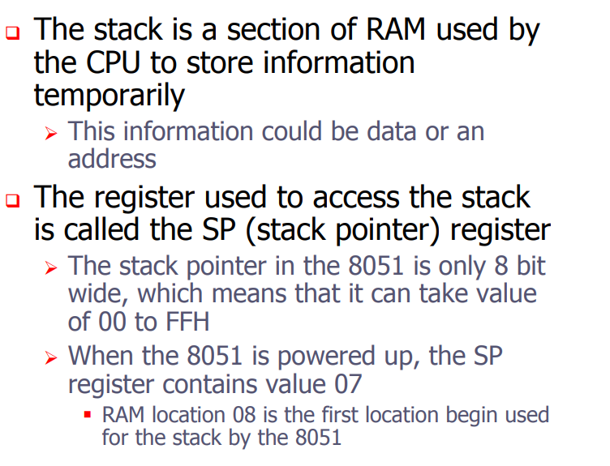
Stack

Slide 30
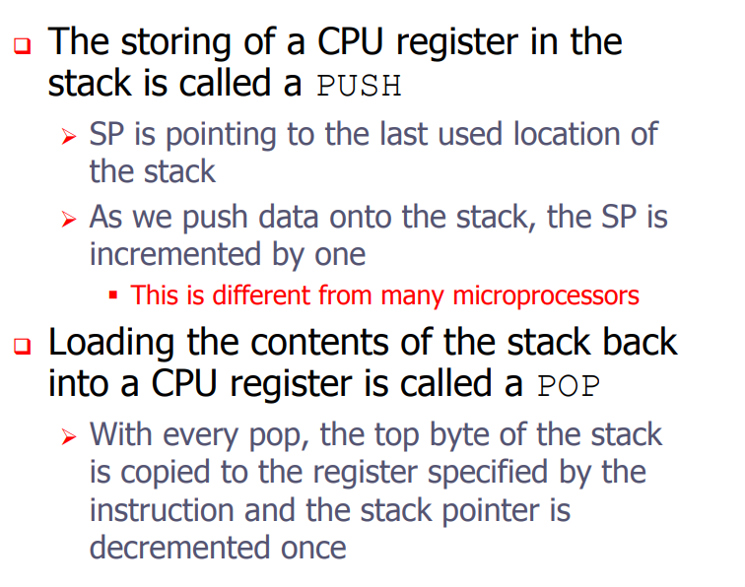

Slide 31
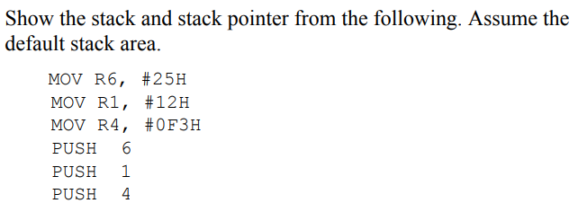
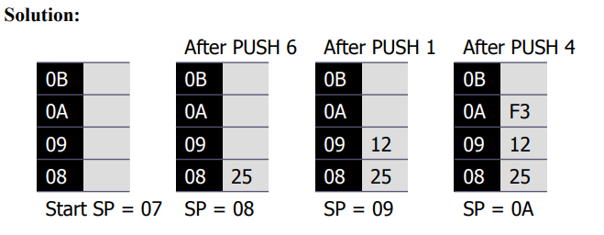

Slide 32
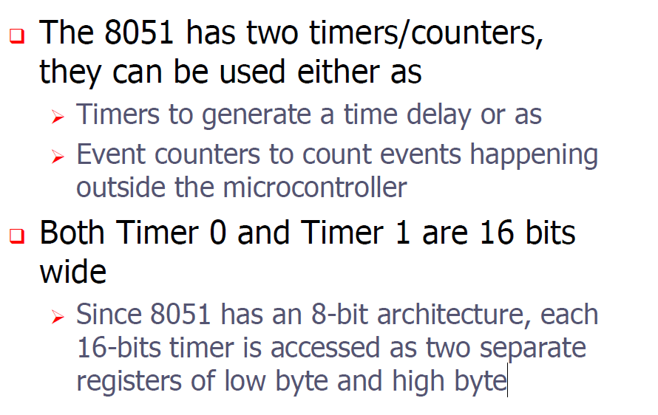
Timer/Counters

Slide 33
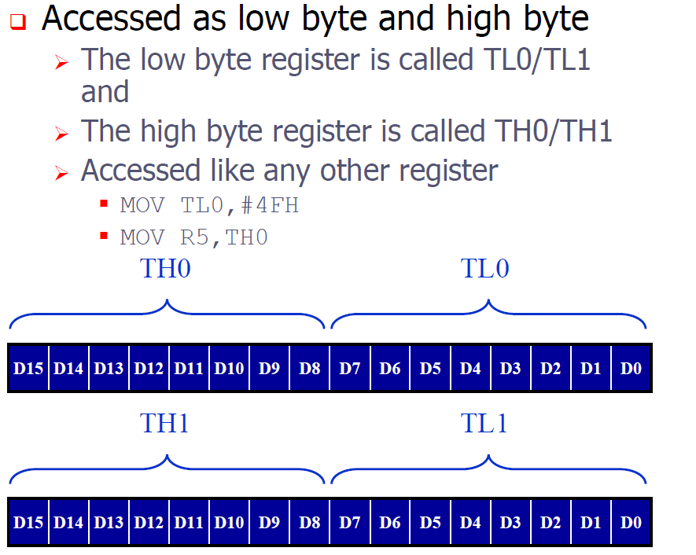

Slide 34
Timer/Counters
Two 16-bit up counters, named T0 and T1, are provided for the general use of the programmer.
Each counter may be programmed to count internal clock pulses, acting as a timer, or programmed to count external pulses as a counter.
The counters are divided into two 8-bit registers called the timer low (TL0,TL1) and high (TH0, TH1) bytes.
All counter action is controlled by bit states in the timer mode control register (TMOD), the timer/counter control register (TCON) and certain program instructions.
TMOD is dedicated to the two timers and can be consider two duplicate 4-bit registers, each of which controls the action of the timers.
TCON has control bits and flags for the timers in the upper control bits and flags for the external interrupts in the lower nibble.

Slide 35
TMOD
Both timers 0 and 1 use the same register, called TMOD (timer mode), to set the various timer operation modes
TMOD is a 8-bit register
    The lower 4 bits are for Timer 0
    The upper 4 bits are for Timer 1
In each case,
    The lower 2 bits are used to set the timer mode
    The upper 2 bits to specify the operation

Slide 36
MSB
LSB
GATE
C / T
M1
M0
GATE
C / T
M1
M0
Timer 1
Timer 0
TMOD Register

Slide 37
Timers of 8051 do starting and stopping by either software or hardware control
In using software to start and stop the timer where GATE=0
  The start and stop of the timer are controlled by way of software by the TR (timer start) bits TR0 and TR1
  – The SETB instruction starts it, and it is stopped by the CLR instruction
  – These instructions start and stop the timers as long as GATE=0 in the TMOD register
The hardware way of starting and stopping the timer by an external source is achieved by making GATE=1 in the TMOD register
C/T : Set for counter operation, reset for timer operation

Slide 38
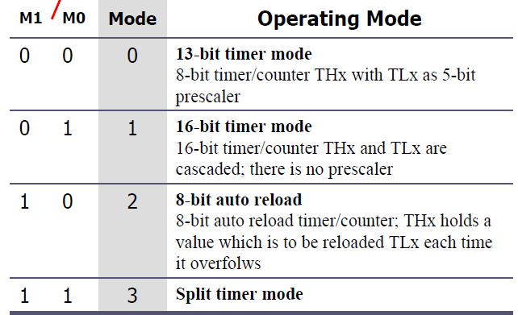
TMOD

Slide 39
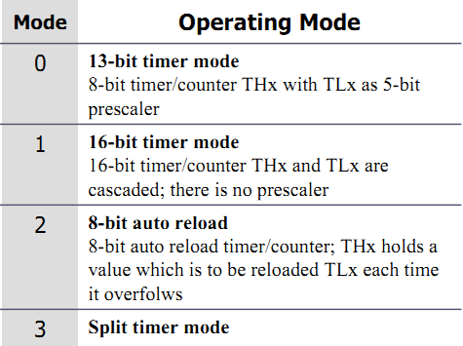
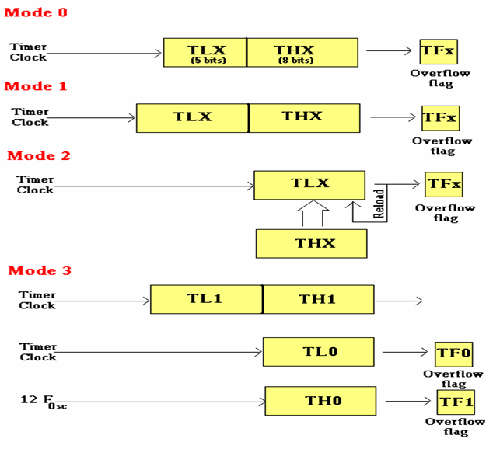


Slide 40
Timers of 8051 do starting and stopping by either software or hardware control
In using software to start and stop the timer where GATE=0
  The start and stop of the timer are controlled by way of software by the TR (timer start) bits TR0 and TR1
– The SETB instruction starts it, and it is stopped by the CLR instruction
– These instructions start and stop the timers as long as GATE=0 in the TMOD register
The hardware way of starting and stopping the timer by an external source is achieved by making GATE=1 in the TMOD register
Find the value for TMOD if we want to program timer 0 in mode 2, use 8051 XTAL for the clock source, and use instructions to start and stop the timer.
TMOD = 0000 0010

Slide 41
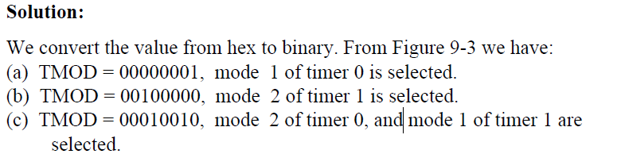

Slide 42
Timer/Counters(cont..)
These timers exist in the SFR area as pairs of 8- bit registers.
– TL0 (8AH) and TH0 (8CH) for Timer0.
– TL1 (8BH) and TH1 (8DH) for Timer1. (LSB is bit 0 ; MSB is bit 7)
When used as timers, the registers are incremented once per machine cycle. – Each machine cycle is 12 clock cycles.
Count frequency = (system clock frequency) / 12
When used as counters, the registers will be incremented once on every 1-0 (negative edge) on the appropriate input pin.
• T0 – P3.4
• T1 – P3.5
The pins must be held high for one complete machine cycle and then low for one complete machine cycle.

Slide 43
Structure of TCON register
TF1
TR1
TF0
TR0
IE1
IT1
IE0
IT0
- TF1, TF0 : Overflow flags for Timer 1 and Timer 0.
TR1, TR0 : Run control bits for Timer 1 and Timer 0.
Set to run, reset to hold.
- IE1, IE0 : Edge flag for external interrupts 1 and 0. *
Set by interrupt edge, cleared when interrupt is processed.
- IT1, IT0 : Type bit for external interrupts. *
Set for falling edge interrupts, reset for 0 level interrupts.
* = not related to counter/timer operation.

Slide 44
TCON (Counter/Timer Control Register)
TF1 TR1 TF0 TR0 IE1 IT1 IE0 IT0
- TF1, TF0 : Overflow flags for Timer 1 and Timer 0.
TR1, TR0 : Run control bits for Timer 1 and Timer 0.
Set to run, reset to hold.
- IE1, IE0 : Edge flag for external interrupts 1 and 0. *
Set by interrupt edge, cleared when interrupt is processed.
- IT1, IT0 : Type bit for external interrupts. *
Set for falling edge interrupts, reset for 0 level interrupts.
* = not related to counter/timer operation.

Slide 45
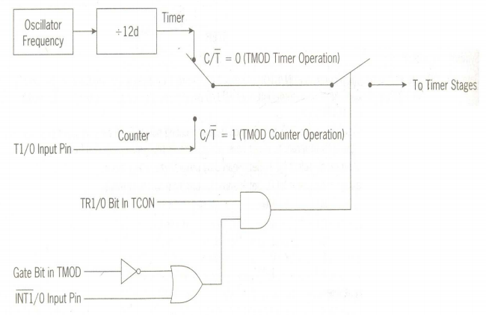
Timer/Counters: Block Schematic

Slide 46
Timer/Counters: Application
The timers can be used for:
1. Interval timing
The timer is programmed to overflow at a regular interval and set the timer overflow flag. Overflow means reaching maximum count of FFFFH.
2. Event counting
Determine the number of occurrences of an event. An event is any external stimulus that provides a 1-to-0 transition on a pin of the µC.

Slide 47
Pin Description of the 8051
P1.0
1
40
Vcc
P1.1
2
39
P0.0(AD0)
P1.2
3
38
P0.1(AD1)
P1.3
4
8051
37
P0.2(AD2)
P1.4
5
36
P0.3(AD3)
P1.5
6
35
P0.4(AD4)
P1.6
7
34
P0.5(AD5)
P1.7
8
33
P0.6(AD6)
RST
9
32
P0.7(AD7)
(RXD)P3.0
10
31
EA/VPP
(TXD)P3.1
11
30
ALE/PROG
(INT0)P3.2
12
29
PSEN
(INT1)P3.3
13
28
P2.7(A15)
(T0)P3.4
14
27
P2.6(A14)
(T1)P3.5
15
26
P2.5(A13)
(WR)P3.6
16
25
P2.4(A12)
(RD)P3.7
17
24
P2.3(A11)
XTAL2
18
23
P2.2(A10)
XTAL1
19
22
P2.1(A9)
GND
20
21
P2.0(A8)

Slide 48
I/O Ports
Four 8-bit I/O ports.
Port 0
Port 1
Port 2
Port 3

Slide 49
The 8051 microcontroller has four parallel I/O ports , each of 8-bits .
So, it provides the user 32 I/O lines for connecting the microcontroller to the peripherals.
The four ports are P0 (Port 0), P1(Port1) ,P2(Port 2) and P3 (Port3).
Upon reset all the ports are output ports.
In order to make them input, all the ports must be set
i.e a high bit must be sent to all the port pins.

Slide 50
Port 0
Port 0 is an 8-bit I/O port with dual purpose.
If external memory is used, these port pins are used for the lower address byte address/data (AD0-AD7), otherwise all bits of the port are either input or output.
Port 0 can also be used as address/data bus(AD0-AD7), allowing it to be used for both address and data.
When connecting the 8051 to an external memory, port 0 provides both address and data.
The 8051 multiplexes address and data through port 0 to save the pins. ALE indicates whether P0 has address or data.
When ALE = 0, it provides data D0-D7, and when ALE =1 it provides address

Slide 51
Port 1
Port 1 occupies a total of 8 pins (pins 1 through 8).
It has no dual application and acts only as input or output port.
In contrast to port 0, this port does not need any pull-up resistors since pull-up resistors connected internally.
Upon reset, Port 1 is configured as an output port.
To configure it as an input port , port bits must be set i.e a high bit must be sent to all the port pins.
This is normally done by the instruction ―SETB.
For Ex :
    MOV A, #0FFH ; A=FF HEX
    MOV P1,A

Slide 52
Port 2
Port 2 is also an eight bit parallel port. (pins 21- 28).
It can be used as input or output port.
As this port is provided with internal pull-up resistors it does not need any external pull-up resistors.
Upon reset, Port 2 is configured as an output port.
If the port is to be used as input port, all the port bits must be made high by sending FF to the port.
Port2 lines are also associated with the higher order address lines A8-A15.
For ex,
    MOV A, #0FFH ; A=FF hex
    MOV P2, A ; make P2 an input port by writing all 1’s to it

Slide 53
Port 3
Port3 is also an 8-bit parallel port with dual function.( pins 10 to 17).
The port pins can be used for I/O operations as well as for control operations.
Upon reset port 3 is configured as an output port .
If the port is to be used as input port, all the port bits must be made high by sending FF to the port.

Slide 54
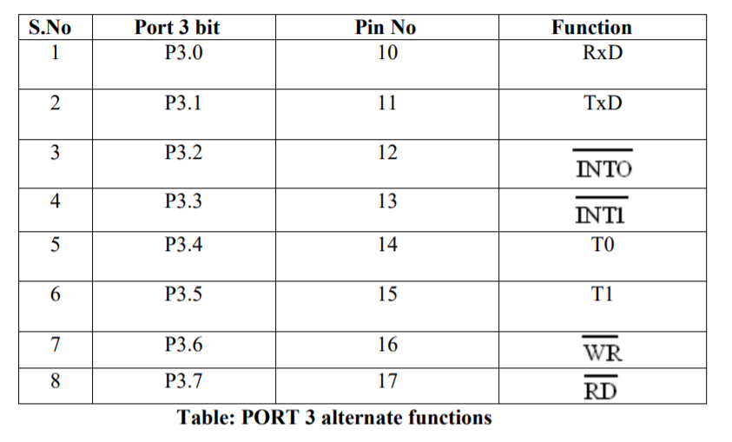

Slide 55
Interrupt System
5 Interrupt Sources (in order of priority):
1 External Interrupt 0 (IE0)
2 Timer 0 (TF0)
3 External Interrupt 1 (IE1)
4 Timer 1 (TF1)
5 Serial Port (RI/TI)
Each interrupt type has a separate vector
address.
Each interrupt type can be programmed
to one of two priority levels.
External interrupts can be programmed
for edge or level sensitivity.

Slide 56
Upon reset all Interrupts are disabled & do not respond to the Microcontroller.
These interrupts must be enabled by software in order for the Microcontroller to respond to them.
This is done by an 8-bit register called Interrupt Enable Register (IE).
Sachin Bhalavat (9409049436)

Slide 57
Sachin Bhalavat (9409049436)

Slide 58
Interrupt vector Addresses
Source Address
IE0 03H
TF0 0BH
IE1 13H
TF1 1BH
RI&TI 23H
The 8051 starts execution at 0000H after Reset.

Slide 59
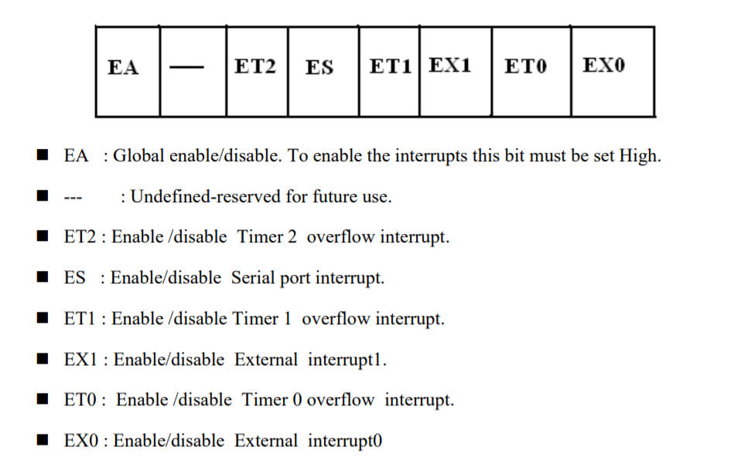
Interrupt Enable Register

Slide 60
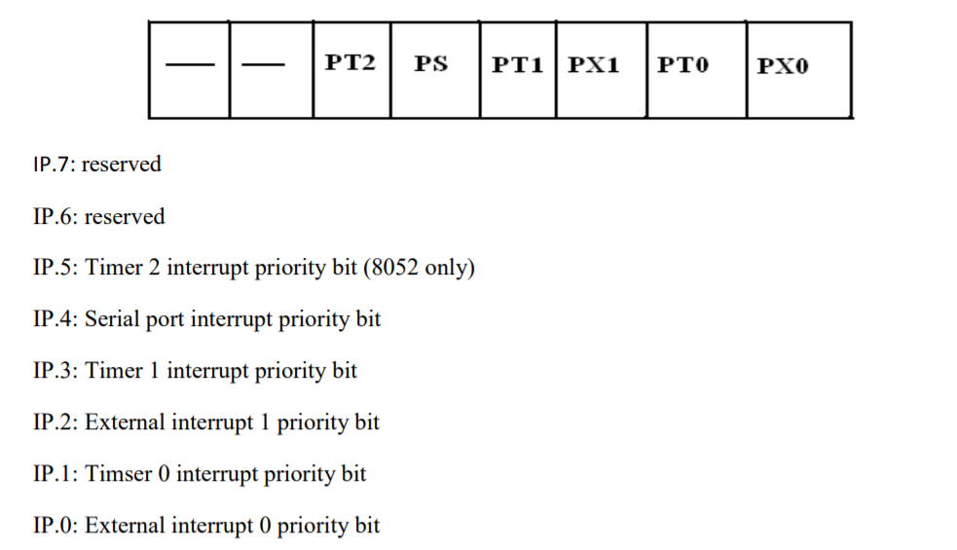
IP: Interrupt Priority Register
Priority can also be set to high or low by 8-bit IP register- Interrupt priority register

Slide 61
IP: Interrupt Priority Register

Slide 62
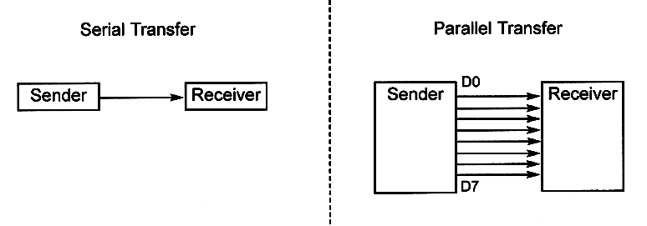
Basics of serial communication

Slide 63
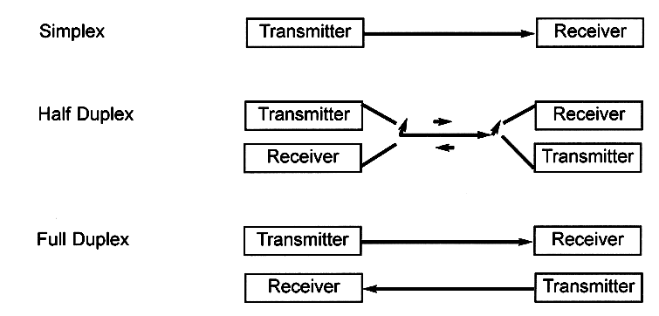
Types of Serial communications

Slide 64
RxD and TxD pins in the 8051
The 8051 has two pins for transferring and receiving data by serial communication. These two pins are part of the Port3(P3.0 &P3.1)
These pins are TTL compatible and hence they require a line driver to make them RS232 compatible
Serial communication is controlled by an 8-bit register called SCON register, it is a bit addressable register.

Slide 65
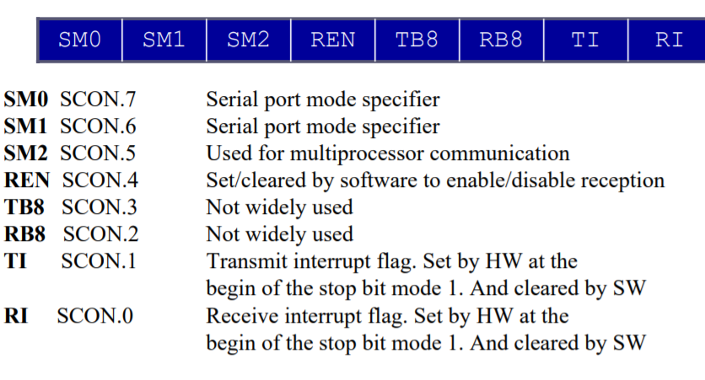
SCON : Serial Control Register

Slide 66
SM0 , SM1
These two bits of SCON register determine the framing of data by specifying the number of bits per character and start bit and stop bits. There are 4 serial modes.
SM0 SM1
0 0 Serial Mode 0
0 1 Serial Mode 1, 8 bit data,
1 stop bit, 1 start bit
1 0 Serial Mode 2
1 1 Serial Mode 3

Slide 67
REN
REN (Receive Enable) also referred as SCON.4. When it is high,it allows the 8051 to receive data on the RxD pin. So to receive and transfer data REN must be set to 1.When REN=0,the receiver is disabled. This is achieved as below
SETB SCON.4
& CLR SCON.4

Slide 68
TI , RI
TI (Transmit interrupt) is the D1 bit of SCON register. When 8051 finishes the transfer of 8-bit character, it raises the TI flag to indicate that it is ready to transfer another byte. The TI bit is raised at the beginning of the stop bit.
RI (Receive interrupt) is the D0 bit of the SCON register. When the 8051 receives data serially ,via RxD, it gets rid of the start and stop bits and places the byte in the SBUF register. Then it raises the RI flag bit to indicate that a byte has been received and should be picked up before it is lost. RI is raised halfway through the stop bit.

Slide 69
The 8051 oscillator and clock
The 8051 requires an external oscillator circuit. The oscillator circuit usually runs around 12MHz. The crystal generates 12M pulses in one second.
A machine cycle is minimum amount time must take by simplest
machine instruction
An 8051 machine cycle consists of 12 crystal pulses (clock cycle).
The first 6 crystal pulses (clock cycle) is used to fetch the Opcode and the second 6 pulses are used to perform the operation on the operands in the ALU.
This gives an effective machine cycle rate at 1MIPS (Million Instructions Per Second).

Slide 70
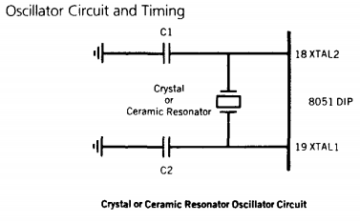
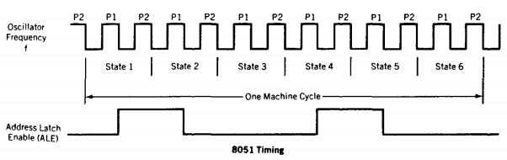
Oscillator circuit and timing

