Slide 1
Introduction
An interrupt is an event which informs the CPU that its service (action) is needed.
Sources of interrupts:
  internal fault (e.g.. divide by zero, overflow)
  software
  external hardware :
    maskable
    nonmaskable
  reset

Slide 2
Basic Procedure for Processing Interrupts
When an interrupt is executed, the μp:
  finishes executing its current instruction (if any).
  saves (PUSH) the flag register, IP and CS register in the stack.
  goes to a fixed memory location.
  reads the address of the associated ISR.
  Jumps to that address and executes the ISR.
  gets (PULL) the flag register, CS:IP register from the stack.
  continues executing the previous job (if any).

Slide 3
8088/86 Hardware Interrupts pins
INTR: Interrupt Request.
  Input signal into the CPU
  If it is activated, the CPU will finish the current instruction and respond with the interrupt acknowledge operation
  Can be masked (ignored) through instructions CLI and STI
NMI: NonMaskable interrupt.
  Input signal
  Cannot be masked or unmasked through CLI and STI
  Examples of use: power failure. Memory error
INTA: Interrupt Acknowledge.
  Output signal

Slide 4
The Interrupt flag
IF (Interrupt Enable Flag) D9: used to mask any hardware interrupt that may come in from the INTR pin.
When IF=0, all hardware interrupt requests through INTR are masked.
This has no effect on interrupts coming from the NMI pin or “INT nn” instructions.
CLI sets IF to 0, STI sets IF to 1.

Slide 5
INT n and ISR
n is multiplied by 4
In the address “4n” the offset address the ISR is found.
Example:Intel has set aside INT 2 for the NMI interrupt.
Whenever the NMI pin is activated, the CPU jumps to physical memory location 00008 to fetch the CS:IP of the interrupt service routine associated with the NMI.

Slide 7
Programmable Interrupt Controller: 8259A

Slide 8
In a system, microprocessor may need to perform the following tasks in an efficient way using interrupt:
    ReadASCII characters from a keyboard on an interrupt basis.
    Count interrupts from a timer to produce a real time clock of seconds, minutes and hours.
    Communicate with anA/D converter.
    Communicate with a display or printer.
    Detect several emergency signal like power failure etc on an interrupt basis.
Each of these interrupt applications requires a separate interrupt pin. But, the 8086 has only two interrupt inputs: NMI and INTR. If we use NMI for a power failure interrupt, this leaves only one interrupt input for all other applications.
The solution is to use an external device called a priority interrupt controller (PIC) such as Intel 8259A

Slide 9
Features of 8259A
Handle eight interrupt inputs. This is equivalent to providing eight interrupt pins on the processor in place of one INTR/INT pin.
Resolve eight levels of interrupt priorities in a variety of modes.
Mask each interrupt request individually.
Read the status of pending interrupts, in service interrupts, and masked interrupts.
Programmed to accept either the level triggered or edge triggered interrupt request.
It can be cascade to accept a maximum of 64 interrupts.

Slide 10
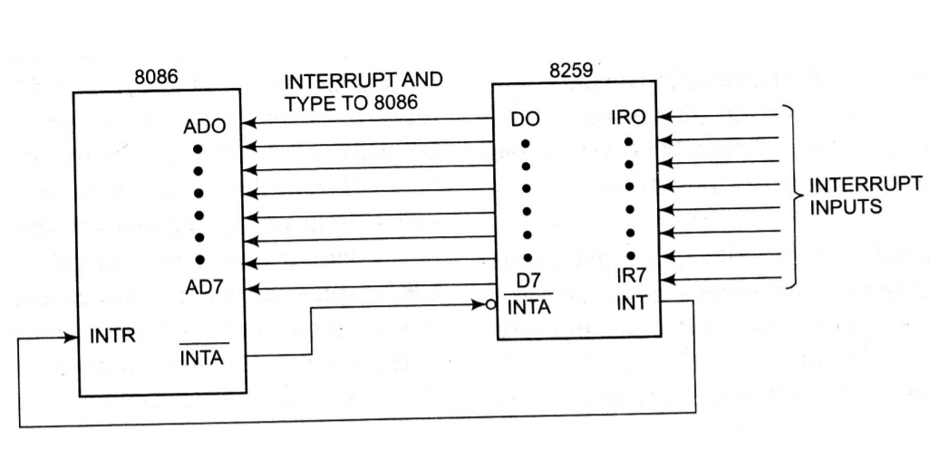
Connection of 8259A with 8086 microprocessor (Single Mode)

Slide 11
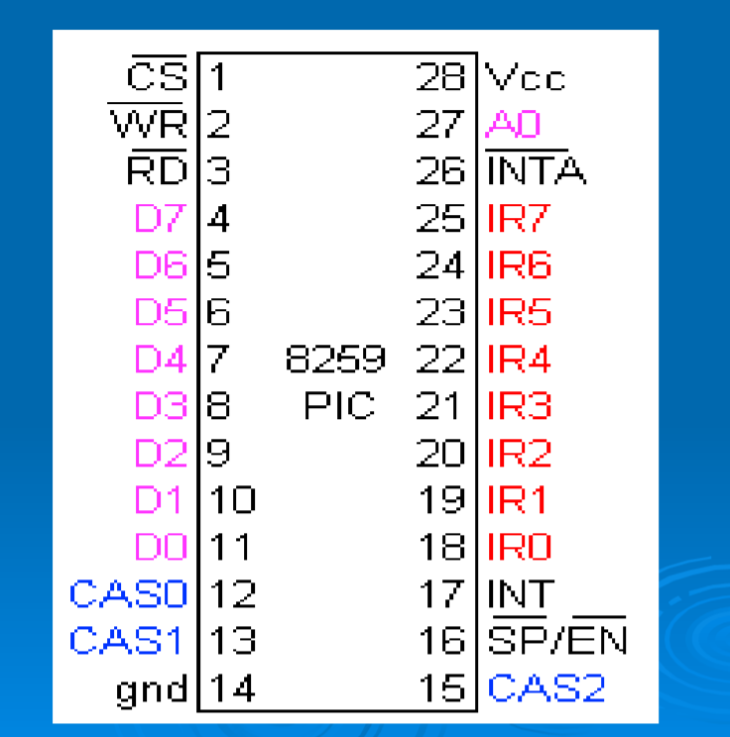
Pin description

Slide 12
The direction of data flow is controlled by RD and WR.
CS is as usual connected to the output of the address decoder.
Interrupt requests are output on INT which is connected to the INTR of the processor.
Int. acknowledgment is received by INTA.
IR0-IR7 allow 8 separate interrupt requests to be inputted to the PIC.
sp/en=1 for master , sp/en=0 for slave.
CAS0-3 inputs/outputs are used when more than one PIC to cascaded.

Slide 13
A0 address line:
  It is used by the 8259A to send various command words from the CPU and to read the status.
  If is connected to the CPU A0 address line.
  Two addresses must be reserved in the I/O address space for each 8259 in the system
IR0-IR7:
  Interrupt Requests:
  An interrupt request is executed by raising an IR input (low to high), and holding it high until it is acknowledged (Edge triggered mode).or just by a high level on an IR input (levels triggered mode)

Slide 14
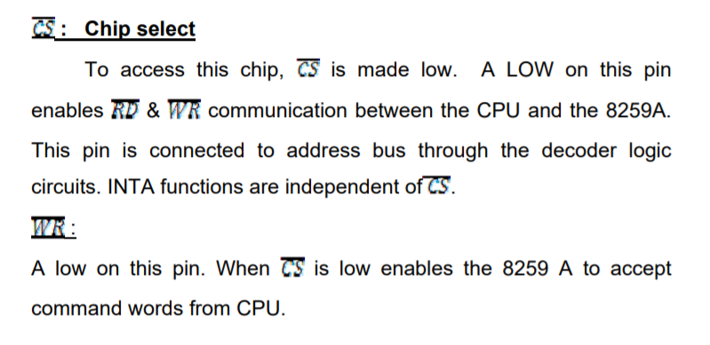

Slide 15
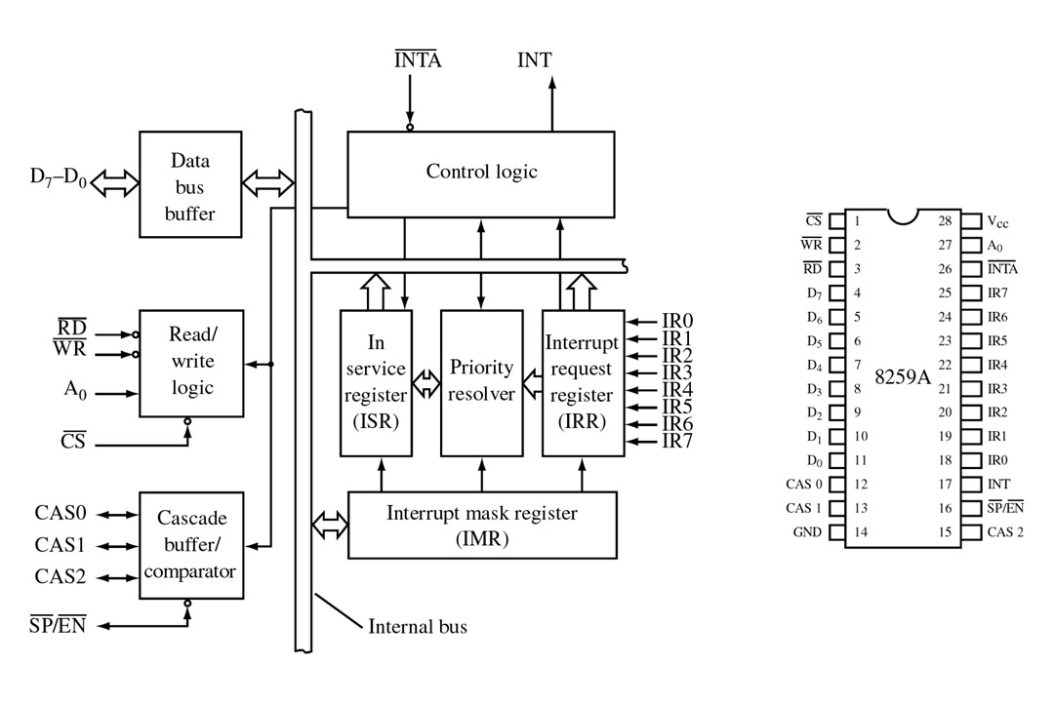
Block diagram of 8259A PIC

Slide 16
Interrupt request register (IRR):
  IRR stores all the interrupt inputs that are requesting service.
  Basically, it keeps track of which interrupt inputs are asking for service.
  If an interrupt input is unmasked, and has an interrupt signal on it, then the corresponding bit in the IRR will be set

Slide 17
In service register (ISR):
  The in service registers keeps tracks of which interrupt inputs are currently being serviced.
  For each input that is currently being serviced the corresponding bit will be set in the in service register.
  Each of these 3-reg can be read as status reg

Slide 18
Interrupt mask register (IMR):
  This register is used to disable (mask) or enable (unmask) individual interrupt inputs.
  Each bit in this register corresponds to the interrupt input with the same number.
  We can unmask an interrupt input by sending a command word with a 0 in the bit position that corresponds to that input.

Slide 19
Priority Resolver:
  This logic block determines the priorities of the bits set in the IRR.
  The highest priority is selected and strobed into the corresponding bit of the ISR during INTA pulse.

Slide 20
8-bit data bus:
    The 8-bit data bus (𝐷7 − 𝐷0) allows the 8086-
      to send control words to the 8259A and read a status word from the 8259A.
      to send interrupt types to the 8086.
    The eight data lines are always connected to the lower half of the 8086 data bus because the 8086 expects to receive interrupt types on lower 8-bit data lines.

Slide 21
Read/Write & control logic:
    The function of this block is to accept OUTPUT commands from the CPU.
    It contains the initialization command word (ICW) register and operation command word (OCW) register which store the various control formats for device operation.
    This function block also allows the status of 8259A to be transferred to the data bus.

Slide 22
Processing of interrupt by 8259
To implement interrupts, the processor interrupts should be enabled and 8259 is initialized.
The 8259 is initialized by sending ICWs(initilzation command word) and OCW(operation command word).
The ICWs are used to set up the proper conditions and to specify interrupt type number.
The OCWs are used to perform functions such as masking interrupts, setting up status, read operations etc.

Slide 23
After 8259 is intilalized, the following sequence of events occur when one or more interrupt request lines go high.
IRR stores the request
Priority resolver checks three register. It resolves the priority and sets the INT high when appropriate.
Processor acknowledges the interrupt by sending two INTA signals one by one.
When the first INTA is received, the appropriate priority bit in the ISR is set to indicate which interrupt level is being served, and the corresponding bit in IRR is reset to indicate that the request is accepted.
(The first INTA is send to 8259, to inform the acceptance of interrupt and to prepare 8259 for supplying type number).
The second INTA is send to 8259 to read the type number from the 8259.

Slide 24
When the 8259 receives the second INTA, it places the type number on the data bus.
Once the processor reads the type number from 8259, the bits corresponds to the current interrupt being serviced in the ISR should be resetted to allow next interrupt. This is done automatically if 8259 is programmed for AEOI(automatic end of interrupt).
The 8086 processor multipy the type number by four to generate a vector table address and from the vector table the processor read the vector address of the interrupt type and load IP and CS register.
Then processor starts executing ISR.

