Slide 1
ADDRESSING MODES &
INSTRUCTIONS SET OF
8051 MICRO CONTROLLER

Slide 2
Addressing modes
Definition:-
The different ways in which a source operand in an instruction are known as the addressing modes.
The 8051 provides a total of 5 distinct addressing modes.

Slide 3
Types of Addressing modes
Addressing modes
Immediate
Addressing mode
Register
Addressing mode
Direct
Addressing mode
Register indirect
Addressing mode
Indexed
Addressing mode

Slide 4
Immediate addressing mode
In this addressing mode the source operand is constant. In immediate addressing mode, when the instruction is assembled, the operand comes immediately after the op-code.

Slide 5
Continue…
The immediate data must be preceded by ‘#’ sign.
This addressing mode can be used to load information into any of the register, including the DPTR.

Slide 6
Continue…
Ex :-
MOV A,#25H // load 25H in to A
MOV R4,#62 // load the decimal value 62 into R4.
MOV DPTR,#4532H // DPTR=4532H.

Slide 7
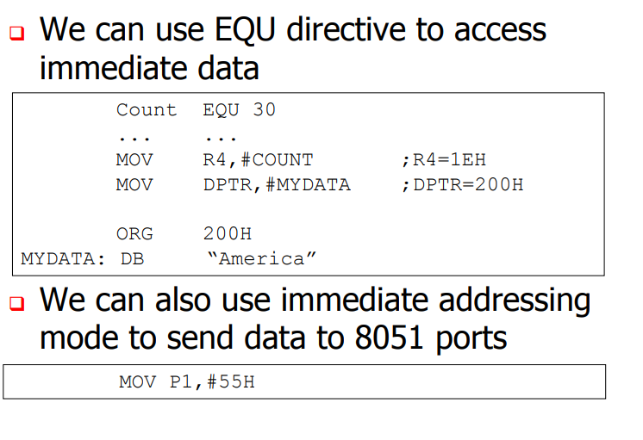


Slide 8
Register addressing mode
Register addressing mode involves the use of registers to hold the data to be manipulated.

Slide 9
Continue…
Ex :-
MOV A,R0 // copy the contents of R0 in to A.
MOV R2,A // copy the contents of A in to
R2.
ADD A,R5 // add the content of R5 to content of A.

Slide 10
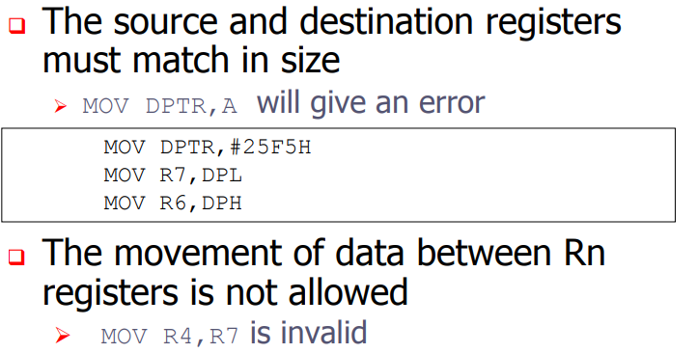

Slide 11
Direct addressing mode
In direct addressing mode, the data is in a RAM memory location whose address is known, and this address is given as a part of the instruction. Contrast this with the immediate addressing mode in which the operand itself is provided with the instruction.

Slide 12
Direct addressing mode
In this mode the operand is specified by an 8-bit address field In the instruction.
One can access all the 128 bytes of internal RAM locations and each SFR.
If the MSB bit = 0 then the location is within on chip internal RAM. If MSB bit = 1 then the location is SFR.

Slide 13
Direct addressing mode
The location 00h to 7Fh to address the internal RAM .
SFR addresses from 80h to FF h
e.g. MOV A,40h
MOV R0,14h

Slide 14
Continue…
Ex:-
MOV R0,40H // save content of RAM
location 40h into R0.
MOV 56H,A // save content of A in
RAM location 56H.

Slide 15
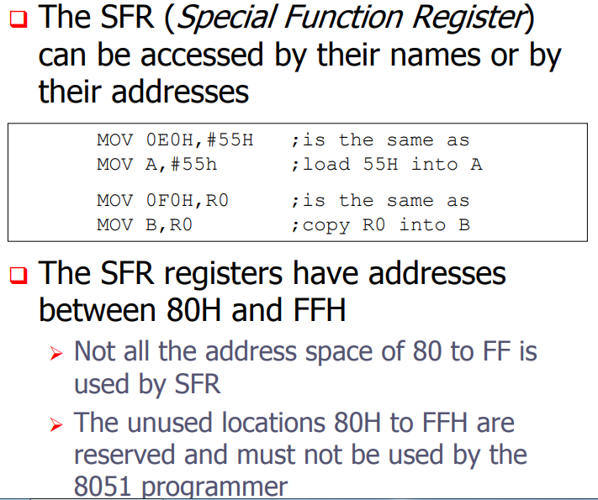

Slide 16
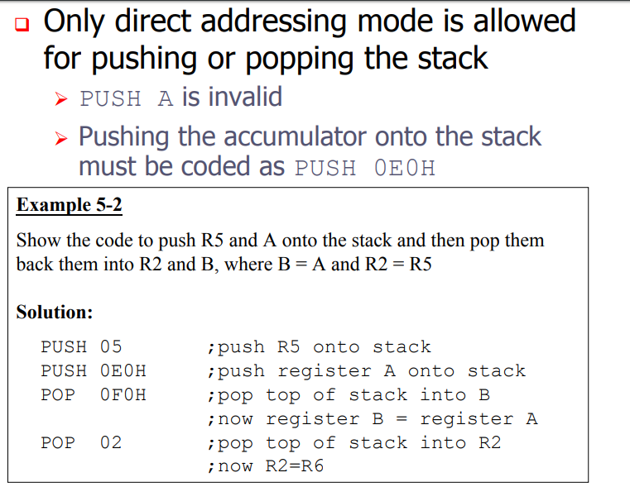

Slide 17
Register indirect addressing mode
In the register indirect addressing mode, a register is used as a pointer to the data.
If the data is inside the CPU, only register R0 and R1 are used for this purpose.
In other words,R2-R7 cannot be used to hold the address of an operand located in RAM when using this addressing mode.

Slide 18
Continue…
When R0 and R1 are used as pointers , that is, when they hold the address of RAM locations , they must be preceded by the “@” sign.
Note : only register R0 and R1 can be used for indirect addressing mode .
MOV A,@R2 invalid instruction.

Slide 19
Continue…
Ex :-
MOV A,@R0 // move contents of RAM
location whose address
is held by R0 into A.
MOV @R1,B // move contents of B to
RAM location whose
address is held by R1

Slide 20
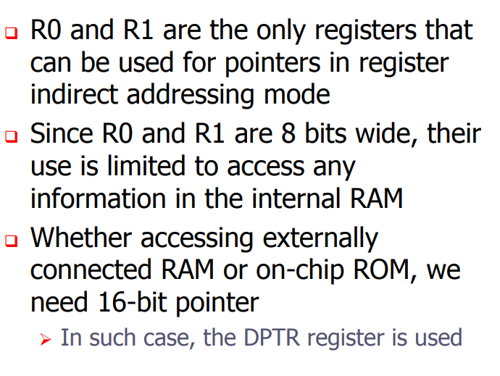

Slide 21
External addressing mode or Indexed addressing mode
Code access (ROM access)
Using these instructions only program memory can be accessed.
This addressing mode is preferred for reading look up tables in the program memory.
Either DPTR or PC can be used as pointer.

Slide 22
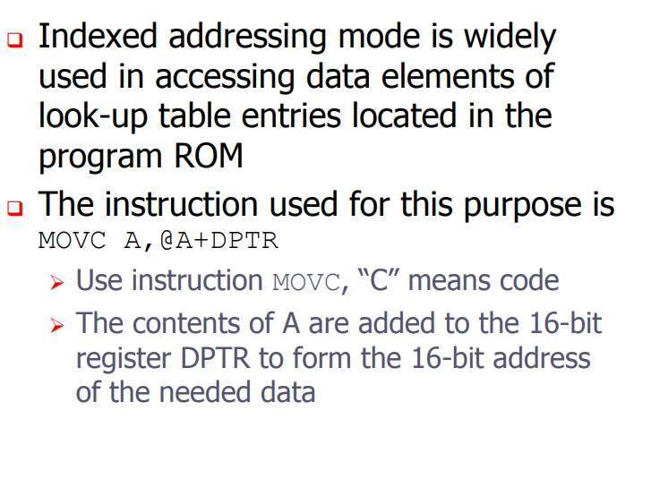

Slide 23
External addressing mode or Indexed addressing mode
E.g.
MOVC A,@A+DPTR
MOVC A,@A+PC

Slide 24
External addressing mode or Indexed addressing mode
(b) Data access (RAM access)
Using this addressing mode the programmer can access the external Data memory
E.g. MOVX A,@DPTR
MOVX @R0,A
Prof. Nitin Ahire

Slide 25
Continue…
In this instruction the content of A are added to the 16-bit register DPTR to form the 16-bit address of the needed data.

Slide 26
Instruction set of 8051
8051 has simple instruction set in different groups. There are:
Arithmetic instructions
Logical instructions
Data transfer instructions
Branching and looping instructions
Bit control instructions

Slide 27
Arithmetic instructions
These instructions are used to perform various mathematical operations like addition, subtraction, multiplication, and division etc.

Slide 28
Continue…
ADD A, R1 // Add the content of register1 to Accumulator
ADDC A,#2 // Add 2 to accumulator with carry
SUBB A,R2 // Subtract content of register2 from Accumulator

Slide 29
Continue…
INC A // Increment accumulator
DEC A // Decrement accumulator
MUL AB // Multiply A and B
DIV AB // Divide A by B

Slide 30
Logical instructions
The logical instructions are the instructions which are used for performing some operations like AND, OR, NOT, X-OR and etc., on the operands.

Slide 31
Continue…
ANL A, Rn // AND register to accumulator
ORL A, Rn // OR register to accumulator
XRL A, Rn // Exclusive OR Reg to Acc
CLR A // Clear Accumulator
CPL A // Complement Accumulator

Slide 32
Data Transfer Instructions
These instruction are used to transfer the data from source operand to destination operand. All the store, move, load, exchange input and output instructions belong to this to this group.

Slide 33
Continue…
MOV A, Rn // Move Reg to Acc
MOVX A,@DPTR // Move external RAM to Accumulator
PUSH direct // PUSH direct byte on to stack
POP direct // POP direct byte from stack

Slide 34
Branch and Looping Instructions
These instructions are used for both branching as well as looping.
These instructions include conditional & unconditional jump or loop instructions.

Slide 35
Conditional Jump Instructions
JC // Jump if carry equal to one
JNC // Jump if carry equal to zero
JB // Jump if bit equal to one
JNB // Jump if bit equal to zero
JBC // Jump if bit equal to one and clear bit

Slide 36
Continue…
JZ // Jump if A=Zero
JNZ // Jump if A not equal to zero
DJNZ // Decrement and Jump if not equal to zero.

Slide 37
Unconditional Jump Instructions
In 8051 there two unconditional jumps. They are:
SJMP // Short jump
LJMP // Long jump

