Slide 1
MEMORY MANAGEMENT
Definitions
Relocatable Means that the program image can reside anywhere in physical memory.
Binding Programs need real memory in which to reside. When is the location of that real memory determined?
  This is called mapping logical to physical addresses.
  This binding can be done at compile/link time. Converts symbolic to relocatable. Data used within compiled source is offset within object module.
Compiler: If it’s known where the program will reside, then absolute code is generated. Otherwise compiler produces relocatable code.
Load: Binds relocatable to physical. Can find best physical location.
Execution: The code can be moved around during execution. Means flexible virtual mapping.

Slide 2
MEMORY MANAGEMENT
Binding Logical To Physical
Source
This binding can be done at compile/link time. Converts symbolic to relocatable. Data used within compiled source is offset within object module.
  Can be done at load time. Binds relocatable to physical.
  Can be done at run time. Implies that the code can be moved around during execution.
The next example shows how a compiler and linker actually determine the locations of these effective addresses.
Compiler
Object
Other Objects
Linker
Executable
Libraries
Loader
In-memory Image

Slide 3
MEMORY MANAGEMENT
Binding Logical To Physical
4 void main()
5 {
6 printf( "Hello, from main\n" );
7 b();
8 }
9
10
11 void b()
12 {
13 printf( "Hello, from 'b'\n" );
14 }

Slide 4
MEMORY MANAGEMENT
Binding Logical To Physical
ASSEMBLY LANGUAGE LISTING
000000B0: 6BC23FD9 stw %r2,-20(%sp ; main()
000000B4 37DE0080 ldo 64(%sp),%sp
000000B8 E8200000 bl 0x000000C0,%r1 ; get current addr=BC
000000BC D4201C1E depi 0,31,2,%r1
000000C0 34213E81 ldo -192(%r1),%r1 ; get code start area
000000C4 E8400028 bl 0x000000E0,%r2 ; call printf
000000C8 B43A0040 addi 32,%r1,%r26 ; calc. String loc.
000000CC E8400040 bl 0x000000F4,%r2 ; call b
000000D0 6BC23FD9 stw %r2,-20(%sp) ; store return addr
000000D4 4BC23F59 ldw -84(%sp),%r2
000000D8 E840C000 bv %r0(%r2) ; return from main
000000DC 37DE3F81 ldo -64(%sp),%sp
STUB(S) FROM LINE 6
000000E0: E8200000 bl 0x000000E8,%r1
000000E4 28200000 addil L%0,%r1
000000E8: E020E002 be,n 0x00000000(%sr7,%r1)
000000EC 08000240 nop void b()
000000F0: 6BC23FD9 stw %r2,-20(%sp)
000000F4: 37DE0080 ldo 64(%sp),%sp
000000F8 E8200000 bl 0x00000100,%r1 ; get current addr=F8
000000FC D4201C1E depi 0,31,2,%r1
00000100 34213E01 ldo -256(%r1),%r1 ; get code start area
00000104 E85F1FAD bl 0x000000E0,%r2 ; call printf
00000108 B43A0010 addi 8,%r1,%r26
0000010C 4BC23F59 ldw -84(%sp),%r2
00000110 E840C000 bv %r0(%r2) ; return from b
00000114 37DE3F81 ldo -64(%sp),%sp

Slide 5
MEMORY MANAGEMENT
Binding Logical To Physical
EXECUTABLE IS DISASSEMBLED HERE
00002000 0009000F ; . . . .
00002004 08000240 ; . . . @
00002008 48656C6C ; H e l l
0000200C 6F2C2066 ; o , f
00002010 726F6D20 ; r o m
00002014 620A0001 ; b . . .
00002018 48656C6C ; H e l l
0000201C 6F2C2066 ; o , f
00002020 726F6D20 ; r o m
00002024 6D61696E ; m a i n
000020B0 6BC23FD9 stw %r2,-20(%sp) ; main
000020B4 37DE0080 ldo 64(%sp),%sp
000020B8 E8200000 bl 0x000020C0,%r1
000020BC D4201C1E depi 0,31,2,%r1
000020C0 34213E81 ldo -192(%r1),%r1
000020C4 E84017AC bl 0x00003CA0,%r2
000020C8 B43A0040 addi 32,%r1,%r26
000020CC E8400040 bl 0x000020F4,%r2
000020D0 6BC23FD9 stw %r2,-20(%sp)
000020D4 4BC23F59 ldw -84(%sp),%r2
000020D8 E840C000 bv %r0(%r2)
000020DC 37DE3F81 ldo -64(%sp),%sp
000020E0 E8200000 bl 0x000020E8,%r1 ; stub
000020E4 28203000 addil L%6144,%r1
000020E8 E020E772 be,n 0x000003B8(%sr7,%r1)
000020EC 08000240 nop

Slide 6
MEMORY MANAGEMENT
Binding Logical To Physical
EXECUTABLE IS DISASSEMBLED HERE
000020F0 6BC23FD9 stw %r2,-20(%sp) ; b
000020F4 37DE0080 ldo 64(%sp),%sp
000020F8 E8200000 bl 0x00002100,%r1
000020FC D4201C1E depi 0,31,2,%r1
00002100 34213E01 ldo -256(%r1),%r1
00002104 E840172C bl 0x00003CA0,%r2
00002108 B43A0010 addi 8,%r1,%r26
0000210C 4BC23F59 ldw -84(%sp),%r2
00002110 E840C000 bv %r0(%r2)
00002114 37DE3F81 ldo -64(%sp),%sp
00003CA0 6BC23FD9 stw %r2,-20(%sp) ; printf
00003CA4 37DE0080 ldo 64(%sp),%sp
00003CA8 6BDA3F39 stw %r26,-100(%sp)
00003CAC 2B7CFFFF addil L%-26624,%dp
00003CB0 6BD93F31 stw %r25,-104(%sp)
00003CB4 343301A8 ldo 212(%r1),%r19
00003CB8 6BD83F29 stw %r24,-108(%sp)
00003CBC 37D93F39 ldo -100(%sp),%r25
00003CC0 6BD73F21 stw %r23,-112(%sp)
00003CC4 4A730009 ldw -8188(%r19),%r19
00003CC8 B67700D0 addi 104,%r19,%r23
00003CCC E8400878 bl 0x00004110,%r2
00003CD0 08000258 copy %r0,%r24
00003CD4 4BC23F59 ldw -84(%sp),%r2
00003CD8 E840C000 bv %r0(%r2)
00003CDC 37DE3F81 ldo -64(%sp),%sp
00003CE0 E8200000 bl 0x00003CE8,%r1
00003CE8 E020E852 be,n 0x00000428(%sr7,%r1)

Slide 7
MEMORY MANAGEMENT
More Definitions
Dynamic loading Routine isn't called into memory until needed. May or may not require binding at run time. Eg: error routines
Dynamic Linking Code is mapped or linked at execution time. Example is system libraries.
Overlays : To enable a process to be larger than the amount of memory allocated to it, Overlays can be used. In this case, only those instructions and data that are needed at any given time are allowed to be in memory
Memory Management Performs the above operations. Usually requires hardware support.

Slide 8
Overlays
Consider a two-pass assembler.
During pass I, it constructs a symbol table;
During pass 2, it generates machine-language code.
We may be able to partition such an assembler into pass 1 code, pass 2 code, the symbol table, and common support routines used by both pass 1 and pass 2
Assume that the sizes of these components are as follows:
Pass 1 70KB
Pass 2 80 KB
Symbol table 20KB
Common routines 30 KB
To load everything at once, we would require 200 KB of memory. If only 150
KB is available, we cannot run our process.

Slide 9
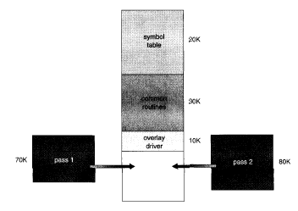

Slide 10
MEMORY MANAGEMENT
More Definitions
LOGICAL VERSUS PHYSICAL ADDRESS SPACE:
The concept of a logical address space that is bound to a separate physical address space is central to proper memory management.
Logical address generated by the CPU; also referred to as a virtual address.
Physical address address seen by the memory unit (hardware).
Logical and physical addresses are the same in compile-time and load-time address binding schemes; logical (virtual) and physical addresses differ in execution-time address-binding schemes.
Memory-management Unit (MMU) is a hardware device that maps virtual to physical addresses.
The user program deals with logical addresses; it never sees the real physical addresses.

Slide 11
MEMORY
Relocation
Register
1400
Physical address
CPU
Logical address
+
346
14346
MMU

Slide 12
MEMORY MANAGEMENT
More Definitions
SWAPPING
Several processes share the same physical memory and are swapped to/from disk in turn. What are pros and cons of this?
Medium term scheduler tries to make sure ALL processes get share of the action.
If a higher priority job wants action, then can swap IN that process by swapping OUT some other process.- Roll out and Roll in
Normally a process that is swapped out will be swapped back into the same memory space that is occupied previously. This restriction depends on the methods of address binding used.
Swapping requires backing store. The system maintains a ready queue consisting of all processes whose memory images are on backing store or in memory and are ready to run.
The context-switch time in a swapping system is fairly high. The total transfer time is directly proportional to the amount of memory swapped.
If we want to swap a process, we must ensure that it is completely idle.

Slide 13
MEMORY MANAGEMENT
SINGLE PARTITION
ALLOCATION
BARE MACHINE:
  No protection, no utilities, no overhead.
  This is the simplest form of memory management.
  Used by hardware diagnostics, by system boot code, real time/dedicated systems.
  logical == physical
  User can have complete control, the operating system has none.
DEFINITION OF PARTITIONS:
  Division of physical memory into fixed sized regions. (Allows addresses spaces to be distinct = one user can't mess with another user, or the system.)
  The number of partitions determines the level of multiprogramming. Partition is given to a process when it's scheduled.
  Protection around each partition determined by
    bounds ( upper, lower )
    base / limit.
  These limits are done in hardware.

Slide 14
MEMORY MANAGEMENT
SINGLE PARTITION
ALLOCATION
RESIDENT MONITOR:
  Primitive Operating System.
  Usually in low memory where interrupt vectors are placed.
  Must check each memory reference against fence (fixed or variable ) in hardware or register. If user generated address < fence, then illegal.
  Isolate user from physical address space using logical address space.
  Concept of "mapping addresses” shown on next slide.

Slide 15
MEMORY MANAGEMENT
SINGLE PARTITION
ALLOCATION
Limit
Register
Relocation
Register
MEMORY
CPU
Yes
<
+
Logical
Address
Physical
Address
No
Trap; addressing error
Limit register contains the limit of logical addresses, Relocation register contains the value of the smallest physical address.

Slide 16
MEMORY MANAGEMENT
MULTIPLE
PARTITION
ALLOCATION
  one of the simplest methods for memory allocation is to divide memory into several f
fixed-sized partitions
  Each partition may contain exactly one process
  Must take into account who wants to run, the memory needs, and partition availability. (This is a combination of short/medium term scheduling.)
  Sequence of events:
    In an empty memory slot, load a program
    THEN it can compete for CPU time.
    Upon job completion, the partition becomes available.
  Can determine memory size required ( either user specified or "automatically" ).

Slide 17
MEMORY MANAGEMENT
MULTIPLE
PARTITION
ALLOCATION
DYNAMIC STORAGE
  (Variable sized holes in memory allocated on need.)
  Operating System keeps table of this memory - space allocated based on table.
  Adjacent freed space merged to get largest holes - buddy system.
ALLOCATION PRODUCES HOLES
P1 – 600k
P2 – 1000k
P3 – 300k
P4 – 700k
P5 – 500k
0
0
OS
OS
0
0
0
400
OS
OS
OS
400
400
400
400
process 5
process 1
process 1
1000
process 1
900
1000
Process 4
Starts
1000
1000
1000
Process 2
Terminates
process 4
Process 1
Terminates
process 4
Process 5
Starts
process 4
process 2
1700
1700
1700
2000
2000
process 3
2000
2000
2000
process 3
process 3
process 3
process 3
2300
2300
2300
2300
2300
2560
2560
2560
2560
2560

Slide 18
MEMORY MANAGEMENT
MULTIPLE
PARTITION
ALLOCATION
HOW DO YOU ALLOCATE MEMORY TO NEW PROCESSES?
First fit - allocate the first hole that's big enough.
Best fit - allocate smallest hole that's big enough.
Worst fit - allocate largest hole.
(First fit is fastest, worst fit has lowest memory utilization.)
  Avoid small holes (external fragmentation). This occurs when there are many small pieces of free memory.
  Want to also avoid internal fragmentation. This is when memory is handed out in some fixed way (power of 2 for instance) and requesting program doesn't use it all.

Slide 19
MEMORY MANAGEMENT
COMPACTION
Trying to move free memory to one large block.
Only possible if programs linked with dynamic relocation (base and limit.)
OS
OS
OS
P1
P1
P1
P2
P3
P3
P2
P2
P3

Slide 20
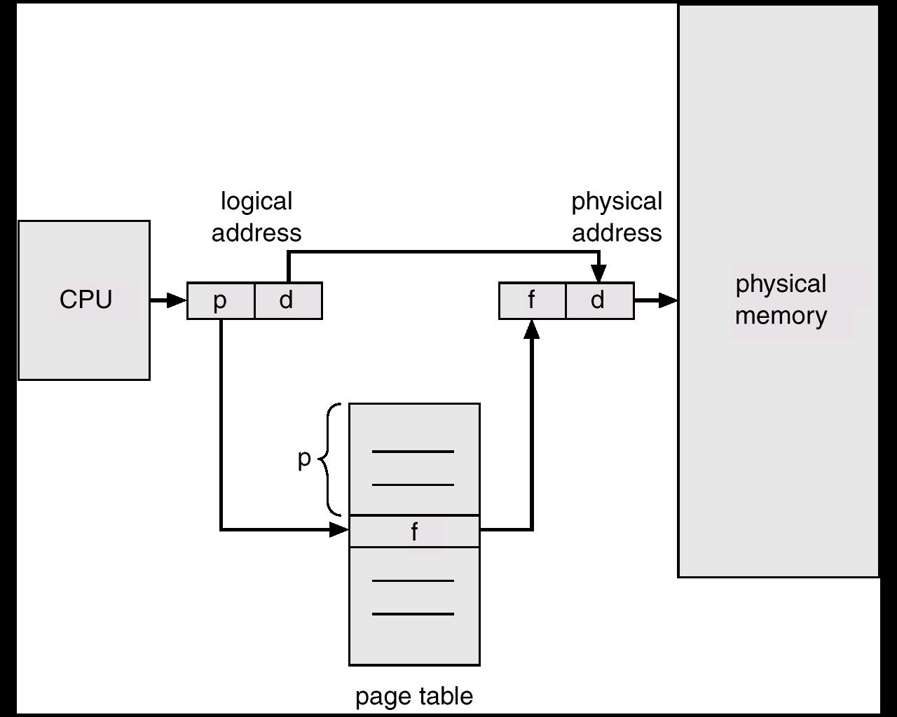
MEMORY MANAGEMENT
PAGING
Permits a program's memory to be physically noncontiguous so it can be allocated from wherever available. This avoids fragmentation and compaction.
Frames = physical blocks
Pages = logical blocks
Size of frames/pages is defined by hardware (power of 2 to ease calculations)
HARDWARE
An address is determined by:
page number ( index into table ) + offset
---> mapping into --->
base address ( from table ) + offset.

Slide 21
MEMORY MANAGEMENT
PAGING
Page Number Offset
p
d
If Logical address space 2^{m} and Page size 2^{n}
then m-n higher order bits designate page number, and n lower order bits designate page offset.

Slide 22
PAGING
MEMORY MANAGEMENT
0
Paging Example - 32-byte memory with 4-byte pages
4 I
j
k
l
0 a
1 b
2 c
3 d
Page 0
8 m
n
o
p
0 5
1 6
2 1
3 2
4 e
5 f
6 g
7 h
12
Page 1
16
8 I
9 j
10 k
11 l
Page Table
20 a
b
c
d
Page 2
12 m
13 n
14 o
15 p
24 e
f
g
h
Page 3
Physical Memory
28
Logical Memory

Slide 23
MEMORY MANAGEMENT
PAGING
IMPLEMENTATION OF THE PAGE TABLE
  Could use dedicated registers (only with small tables.)
  Could use a register –Page Table Base Register (PTBR) pointing to table in memory (slow access.)
  Cache or associative memory (TLB = Translation Look-aside Buffer ):TLB is a special, small, fast-lookup hardware cache.
  simultaneous search, so fast but hardware is expensive

Slide 24
TLB
TLB Hit
TLB Miss
Paging Hardware with TLB

Slide 25
MEMORY MANAGEMENT
PAGING
IMPLEMENTATION OF THE PAGE TABLE
Issues include:
key and value
hit rate 90 - 98% with 100 registers
add entry if not found
Effective access time = %TLB Hit * time to access + %TLB Miss * time to
access
Relevant times:
20 nanoseconds to search associative memory – the TLB.
200 nanoseconds to access memory and bring it into TLB for next time.
Calculate time of access:
hit = 1 search + 1 memory reference
miss = 1 search + 1 mem reference (of page table) + 1 mem reference.

Slide 26

MEMORY MANAGEMENT
PAGING
SHARED PAGES
Data occupying one physical page, but pointed to by multiple logical pages.
Useful for common code - must be write protected. (NO write-able data mixed with code.)
Extremely useful for read/write communication between processes.

Slide 27
MEMORY MANAGEMENT
PAGING
PROTECTION:
Bits associated with page tables.
Can have read, write, execute, valid bits.
Valid bit says page isn’t in address space.
Write to a write-protected page causes a fault. Touching an invalid page causes a fault.

Slide 28
Eg: system with 14-bit address space(0-16383), and a program that use only addresses 0 to 10469. Page size 2K
Frame number
Valid-invalid bit
0
00000
1
Page 0
2
Page 0
0
2
v
3
Page 1
Page 1
1
3
v
2
4
v
4
Page 2
Page 2
3
7
v
5
4
8
v
6
Page 3
5
9
v
7
Page 3
6
0
i
8
Page 4
Page 4
7
0
i
10468
9
Page 5
Page table
Page 5
:
12287
Page n

Slide 29


MEMORY MANAGEMENT
PAGING
MULTILEVEL PAGE TABLE
A means of using page tables for large address spaces.

Slide 30
MEMORY MANAGEMENT
SEGMENTATION
SEGMENTATION:
USER'S VIEW OF MEMORY
A programmer views a process consisting of unordered segments with various purposes. This view is more useful than thinking of a linear array of words. We really don't care at what address a segment is located.
Typical segments include
global variables
procedure call stack
code for each function
local variables for each
large data structures
Logical address = segment name ( number ) + offset
Memory is addressed by both segment and offset.

Slide 31
MEMORY MANAGEMENT
HARDWARE -- Must map a dyad (segment / offset) into one-dimensional address.
Segment Table
Limit Base
CPU
S D
MEMORY
Logical
Address
Yes
<
+
Physical
Address
No

Slide 32
MEMORY MANAGEMENT
PAGING
HARDWARE
base / limit pairs in a segment table.
1400
Seg 0
0
1
2
3
4
Limit
1000
400
400
1100
1000
Base
1400
6300
4300
3200
4700
2400
3200
Seg 3
1
4300
4700
Seg 2
2
Seg 4
0
3
5700
6300
4
Seg 1
Logical Address Space
Physical Memory

Slide 33
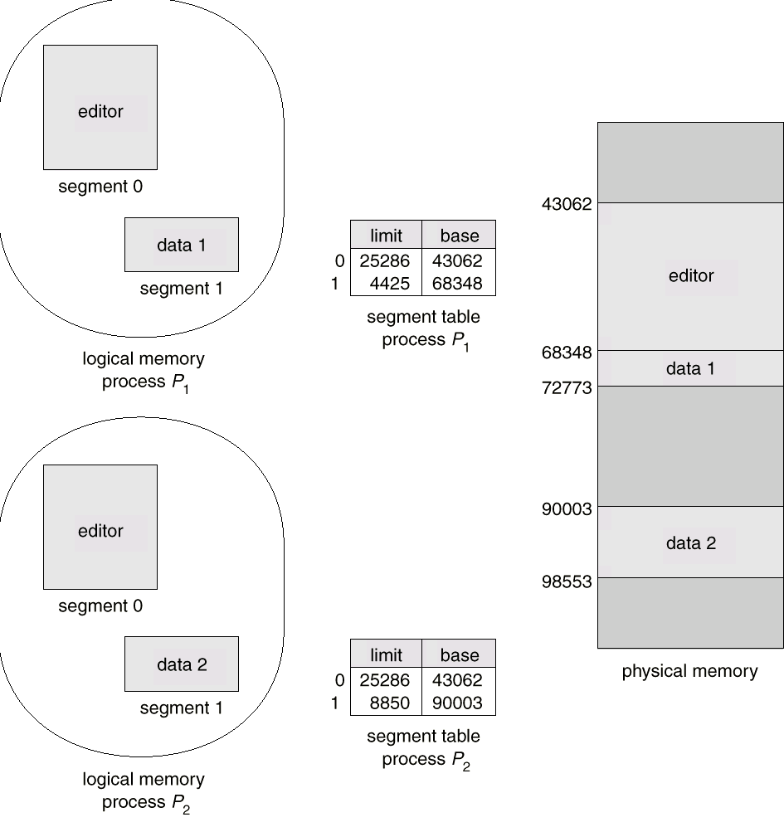
MEMORY MANAGEMENT
PROTECTION AND SHARING
Addresses are associated with a logical unit (like data, code, etc.) so protection is easy.
Can do bounds checking on arrays
Sharing specified at a logical level, a segment has an attribute called "shareable".
Can share some code but not all - for instance a common library of subroutines.
FRAGMENTATION
Use variable allocation since segment lengths vary.
Again have issue of fragmentation; Smaller segments means less fragmentation. Can use compaction since segments are relocatable.

Slide 34
Segmented paging
Segments are divided into pages
Implementation requires STR(segment table register) and PMT(page map table)
In this scheme, each virtual address consists of a segment number, page number within that segment and an offset within that page.
The segment number indexes into segment table which yields the base address of the page table for that segment.
The page number indexes into the page table,each of which entry is a page frame.
Adding the PFN(page frame number) and the offset results in the physical address.

Slide 35
MEMORY MANAGEMENT
WRAPUP
We’ve looked at how to do paging - associating logical with physical memory.
This subject is at the very heart of what every operating system must do today.

