Slide 1
FILE SYSTEMS
The File System consists of Two distinct parts :
A collection files-storing data
A Directory Structure- organizes and provides information about all the files in a system
File Concept
File is a named collection of related information that is recorded on a secondary storage
A file is the smallest allotment of logical secondary storage
A file is sequence of bits, bytes, lines, or records whose meaning is defined by the file’s creator and user.
A file has a certain defined structure according to its type. (Eg.text,source,object, executable file)
The file is an entry in a directory.
The file may have attributes (name, creator, date, type, permissions)
10: File Systems

Slide 2
FILE SYSTEMS INTERFACE
File Concept
A file can have various kinds of structure
None - sequence of words, bytes
Simple record structure
    Lines
    Fixed length
    Variable length
Complex Structures
    Formatted document
    Relocatable load file
Who interprets this structure?
    Operating system
    Program
10: File Systems

Slide 3
FILE SYSTEMS INTERFACE
File Concept
Attributes of a File
Name – only information kept in human-readable form
Identifier – unique tag (number) identifies file within file system
Type – needed for systems that support different types
Location – pointer to file location on device
Size – current file size
Protection – controls who can do reading, writing, executing
Time, date, and user identification – data for protection, security, and usage monitoring
Information about files is kept in the directory structure, which is maintained on the disk.
10: File Systems

Slide 4
FILE SYSTEMS INTERFACE
File Concept
File Operations
Creating a File- Two steps needed. First, find out space in the file system. Second, Make an entry in the Directory with the name and the location in the file system
Writing a File- system call specifies name of the file and the information. Search the directory to locate-keep write pointer.
Reading a File-read pointer, current-file position pointer
Deleting a file – locate the entry in directory-release all file space-erase directory entry
Truncating a file – when user wants to keep the attributes of a file but to erase the contents. File length to be reset to zero
10: File Systems

Slide 5

FILE SYSTEMS INTERFACE
Access
Methods
If files had only one "chunk" of data, life would be simple. But for large files, the files themselves may contain structure, making access faster.
SEQUENTIAL ACCESS
  Implemented by the filesystem.
  Data is accessed one record right after the last.
  Reads cause a pointer to be moved ahead by one.
  Writes allocate space for the record and move the pointer to the new End Of File.
  Such a method is reasonable for tape
10: File Systems

Slide 6
FILE SYSTEMS INTERFACE
Access
Methods
DIRECT ACCESS
  Method useful for disks.
  The file is viewed as a numbered sequence of blocks or records.
  There are no restrictions on which blocks are read/written in any order.
  User now says "read n" rather than "read next".
  "n" is a number relative to the beginning of file, not relative to an absolute physical disk location.
10: File Systems

Slide 7
FILE SYSTEMS INTERFACE
Access
Methods
OTHER ACCESS METHODS
Built on top of direct access and often implemented by a user utility.
Indexed ID plus pointer.
  An index block says what's in each remaining block or contains pointers to blocks containing particular items. Suppose a file contains many blocks of data arranged by name alphabetically.
Example 1: Index contains the name appearing as the first record in each block. There are as many index entries as there are blocks.
Example 2: Index contains the block number where "A" begins, where "B" begins, etc. Here there are only 26 index entries.
10: File Systems

Slide 8
FILE SYSTEMS INTERFACE
Access
Methods
Adams
Example 1: Index contains the name appearing as the first record in each block. There are as many index entries as there are blocks.
Example 2: Index contains the block number where "A" begins, where "B" begins, etc. Here there are only 26 index entries.
Arthur
Asher
Smith, John | data
Smith
Adams
Adams | Data
Baker
Arthur | Data
Charles
Asher | Data
Baker | Data
Saarnin
Saarnin | data
Smith, John | data
10: File Systems

Slide 9
FILE SYSTEMS INTERFACE
Directory
Structure
Directories maintain information about files:
For a large number of files, may want a directory structure - directories under directories.
Information maintained in a directory:
  Name The user visible name.
  Type The file is a directory, a program image, a user file, a link, etc.
  Location Device and location on the device where the file header is located.
  Size Number of bytes/words/blocks in the file.
  Position Current next-read/next-write pointers.
  Protection Access control on read/write/ execute/delete.
  Usage Open count
  Usage time of creation/access, etc.
  Mounting a filesystem occurs when the root of one filesystem is "grafted" into the existing tree of another filesystem.
There is a need to PROTECT files and directories.
Actions that might be protected include: read, write, execute, append, delete, list
In Memory only!
10: File Systems

Slide 10
FILE SYSTEMS INTERFACE
Directory
Structure
jbreecher@younger:~/public/os$ stat Code
File: `Code'
Size: 4096 Blocks: 8 IO Block: 4096 directory
Device: 14h/20d Inode: 28606492 Links: 2
Access: (0755/drwxr-xr-x) Uid: ( 1170/jbreecher) Gid: ( 100/ users)
Access: 2006-11-16 14:52:11.000000000 -0500
Modify: 2006-11-16 14:52:01.000000000 -0500
Change: 2006-11-16 14:52:01.000000000 -0500
10: File Systems

Slide 11
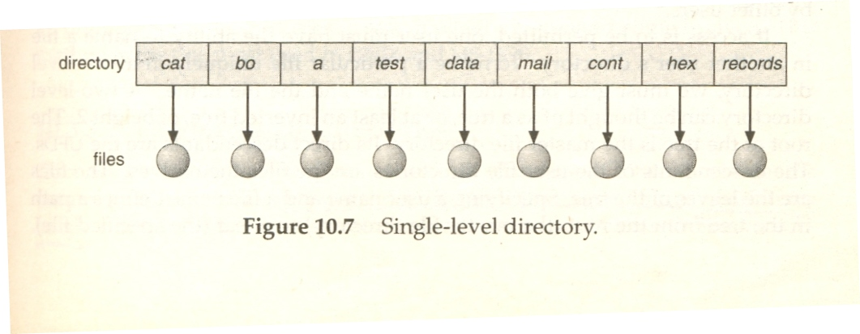
Single-Level Directory
FILE SYSTEMS INTERFACE
Directory
Structure
10: File Systems

Slide 12
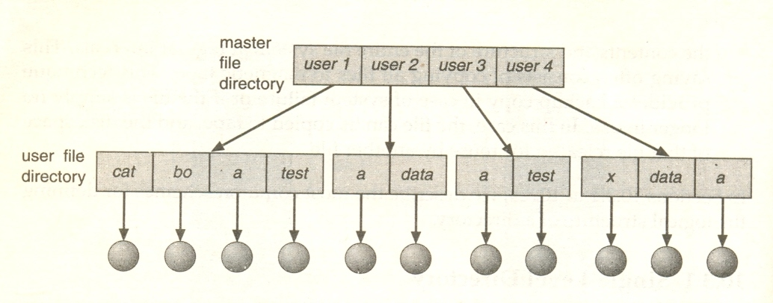
Two-Level Directory
FILE SYSTEMS INTERFACE
Directory
Structure
10: File Systems

Slide 13

FILE SYSTEMS INTERFACE
Directory
Structure
Tree-Structured Directory
10: File Systems

Slide 14
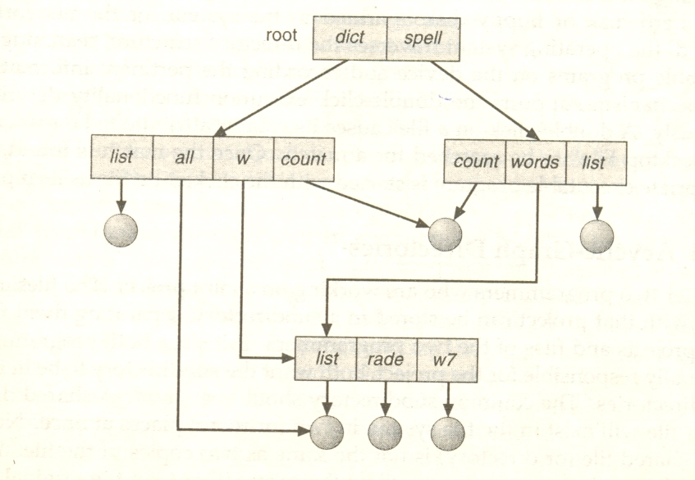
FILE SYSTEMS INTERFACE
Directory
Structure
Acyclic-Graph Directory
10: File Systems

Slide 15
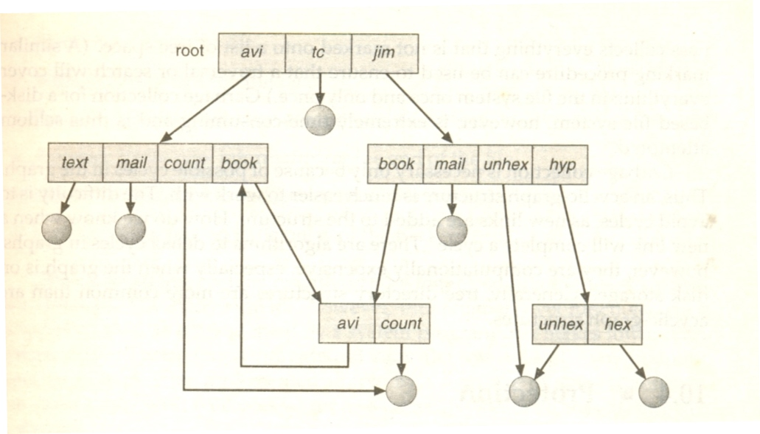
FILE SYSTEMS INTERFACE
Directory
Structure
General Graph Directory
10: File Systems

Slide 16
FILE SYSTEMS INTERFACE
Other Issues
Mounting:
Attaching portions of the file system into a directory structure.
Sharing:
Sharing must be done through a protection scheme
May use networking to allow file system access between systems
  Manually via programs like FTP or SSH
  Automatically, seamlessly using distributed file systems
  Semi automatically via the world wide web
Client-server model allows clients to mount remote file systems from servers
  Server can serve multiple clients
  Client and user-on-client identification is insecure or complicated
  NFS is standard UNIX client-server file sharing protocol
  CIFS is standard Windows protocol
  Standard operating system file calls are translated into remote calls
10: File Systems

Slide 17
FILE SYSTEMS INTERFACE
Protection
File owner/creator should be able to control:
  what can be done
  by whom
Types of access
  Read
  Write
  Execute
  Append
  Delete
  List
Mode of access: read, write, execute
Three classes of users
RWX
a) owner access 7 ⇒ 1 1 1
RWX
b) group access 6 ⇒ 1 1 0
RWX
c) public access 1 ⇒ 0 0 1
Ask manager to create a group (unique name), say G, and add some users to the group.
For a particular file (say game) or subdirectory, define an appropriate access.
owner
group
public
chmod
761
game
Attach a group to a file
“chgrp G game”
10: File Systems

Slide 18

FILE SYSTEMS INTERFACE
Protection
Example on Windows XP
10: File Systems

Slide 19
FILE SYSTEM IMPLEMENTATION
FILE SYSTEM STRUCTURE:
When talking about “the file system”, you are making a statement about both the rules used for file access, and about the algorithms used to implement those rules. Here’s a breakdown of those algorithmic pieces.
Application Programs The code that's making a file request.
Logical File System This is the highest level in the OS; it does protection, and security. Uses the directory structure to do name resolution.
File-organization Module Here we read the file control block maintained in the directory so we know about files and the logical blocks where information about that file is located.
Basic File System Knowing specific blocks to access, we can now make generic requests to the appropriate device driver.
IO Control These are device drivers and interrupt handlers. They cause the device to transfer information between that device and CPU memory.
Devices The disks / tapes / etc.
10: File Systems

Slide 20
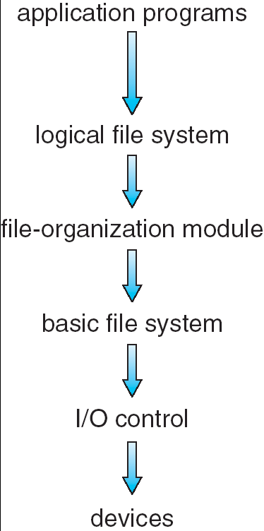
FILE SYSTEM IMPLEMENTATION
Layered File System
Handles the CONTENT of the file. Knows the file’s internal structure.
Handles the OPEN, etc. system calls. Understands paths, directory structure, etc.
Uses directory information to figure out blocks, etc. Implements the READ. POSITION calls.
Determines where on the disk blocks are located.
Interfaces with the devices – handles interrupts.
10: File Systems

Slide 21
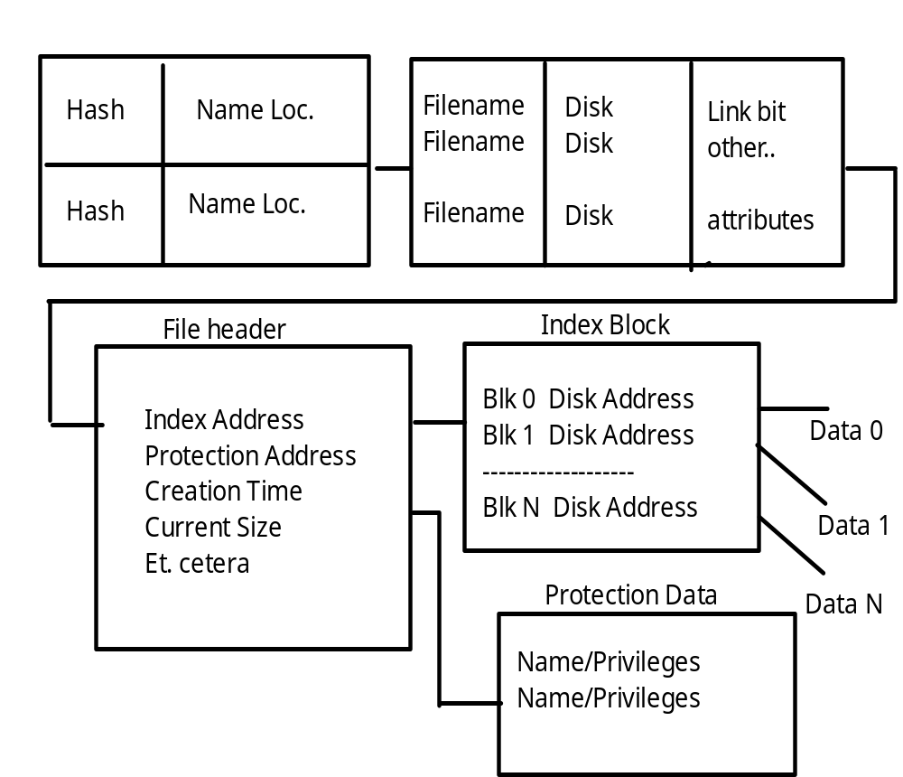
FILE SYSTEM IMPLEMENTATION
Example of
Directory and
File
Structure
Directory Hash Table
Directory Brief Info.
10: File Systems

Slide 22

FILE SYSTEM IMPLEMENTATION
Virtual File Systems
Virtual File Systems (VFS) provide an object-oriented way of implementing file systems.
VFS allows the same system call interface (the API) to be used for different types of file systems.
The API is to the VFS interface, rather than any specific type of file system.
10: File Systems

Slide 23

FILE SYSTEM IMPLEMENTATION
Allocation Methods
CONTIGUOUS ALLOCATION
Method: Lay down the entire file on contiguous sectors of the disk. Define by a dyad <first block location, length >.
  Accessing the file requires a minimum of head movement.
  Easy to calculate block location: block i of a file, starting at disk address b, is b + i.
  Difficulty is in finding the contiguous space, especially for a large file. Problem is one of dynamic allocation (first fit, best fit, etc.) which has external fragmentation. If many files are created/deleted, compaction will be necessary.
It's hard to estimate at create time what the size of the file will ultimately be. What happens when we want to extend the file --- we must either terminate the owner of the file, or try to find a bigger hole.
10: File Systems

Slide 24

FILE SYSTEM IMPLEMENTATION
Allocation Methods
LINKED ALLOCATION
Each file is a linked list of disk blocks, scattered anywhere on the disk.
At file creation time, simply tell the directory about the file. When writing, get a free block and write to it, enqueueing it to the file header.
There's no external fragmentation since each request is for one block.
Method can only be effectively used for sequential files.
Pointers use up space in each block. Reliability is not high because any loss of a pointer loses the rest of the file.
A File Allocation Table is a variation of this.
10: File Systems

Slide 25

FILE SYSTEM IMPLEMENTATION
Allocation Methods
LINKED ALLOCATION
Pointers use up space in each block. Reliability is not high because any loss of a pointer loses the rest of the file.
A File Allocation Table is a variation of this.
It uses a separate disk area to hold the links.
This method doesn't use space in data blocks. Many pointers may remain in memory.
A FAT file system is used by MS-DOS.
10: File Systems

Slide 26

FILE SYSTEM IMPLEMENTATION
Allocation Methods
INDEXED ALLOCATION
Each file uses an index block on disk to contain addresses of other disk blocks used by the file.
When the i th block is written, the address of a free block is placed at the i th position in the index block.
Method suffers from wasted space since, for small files, most of the index block is wasted. What is the optimum size of an index block?
If the index block is too small, it will not be enough to hold pointers for large files. Mechanisms to deal such situations:
  Link several together
  Use a multilevel index
10: File Systems

Slide 27

FILE SYSTEM IMPLEMENTATION
Allocation Methods
UNIX METHOD:
Note that various mechanisms are used here so as to optimize the technique based on the size of the file.
10: File Systems

Slide 28
FILE SYSTEM IMPLEMENTATION
Allocation Methods
PERFORMANCE ISSUES FOR THESE METHODS
It's difficult to compare mechanisms because usage is different. Let's calculate, for each method, the number of disk accesses to read block i from a file:
contiguous: 1 access from location start + i.
linked: i + 1 accesses, reading each block in turn. (is this a fair example?)
index: 2 accesses, 1 for index, 1 for data.
10: File Systems

Slide 29
FILE SYSTEM IMPLEMENTATION
Free Space
Management
We need a way to keep track of space currently free. This information is needed when we want to create or add (allocate) to a file. When a file is deleted, we need to show what space is freed up.
BIT VECTOR METHOD
Each block is represented by a bit
1 1 0 0 1 1 0 means blocks 2, 3, 6 are free.
This method allows an easy way of finding contiguous free blocks. Requires the overhead of disk space to hold the bitmap.
A block is not REALLY allocated on the disk unless the bitmap is updated.
What operations (disk requests) are required to create and allocate a file using this implementation?
10: File Systems

Slide 30
FILE SYSTEM IMPLEMENTATION
Free Space
Management
FREE LIST METHOD
Free blocks are chained together, each holding a pointer to the next one free.
This is very inefficient since a disk access is required to look at each sector.
GROUPING METHOD
In one free block, put lots of pointers to other free blocks. Include a pointer to the next block of pointers.
COUNTING METHOD
Since many free blocks are contiguous, keep a list of dyads holding the starting address of a "chunk", and the number of blocks in that chunk.
Format < disk address, number of free blocks >
10: File Systems

Slide 31
FILE SYSTEM IMPLEMENTATION
Directory
Management
The issue here is how to be able to search for information about a file in a directory given its name.
Could have linear list of file names with pointers to the data blocks. This is:
simple to program BUT time consuming to search.
Could use hash table - a linear list with hash data structure.
  Use the filename to produce a value that's used as entry to hash table.
  Hash table contains where in the list the file data is located.
  This decreases the directory search time (file creation and deletion are faster.)
  Must contend with collisions - where two names hash to the same location.
  The number of hashes generally can't be expanded on the fly.
10: File Systems

Slide 32
FILE SYSTEM IMPLEMENTATION
Directory/File
Management
GAINING CONSISTENCY
Required when system crashes or data on the disk may be inconsistent:
Consistency checker - compares data in the directory structure with data blocks on disk and tries to fix inconsistencies. For example, What if a file has a pointer to a block, but the bit map for the free-space-management says that block isn't allocated.
Back-up- provides consistency by copying data to a "safe" place.
Recovery - occurs when lost data is retrieved from backup.
10: File Systems

Slide 33

FILE SYSTEM IMPLEMENTATION
Efficiency and
Performance
THE DISK CACHE MECHANISM
There are many places to store disk data so the system doesn’t need to get it from the disk again and again.
10: File Systems

Slide 34
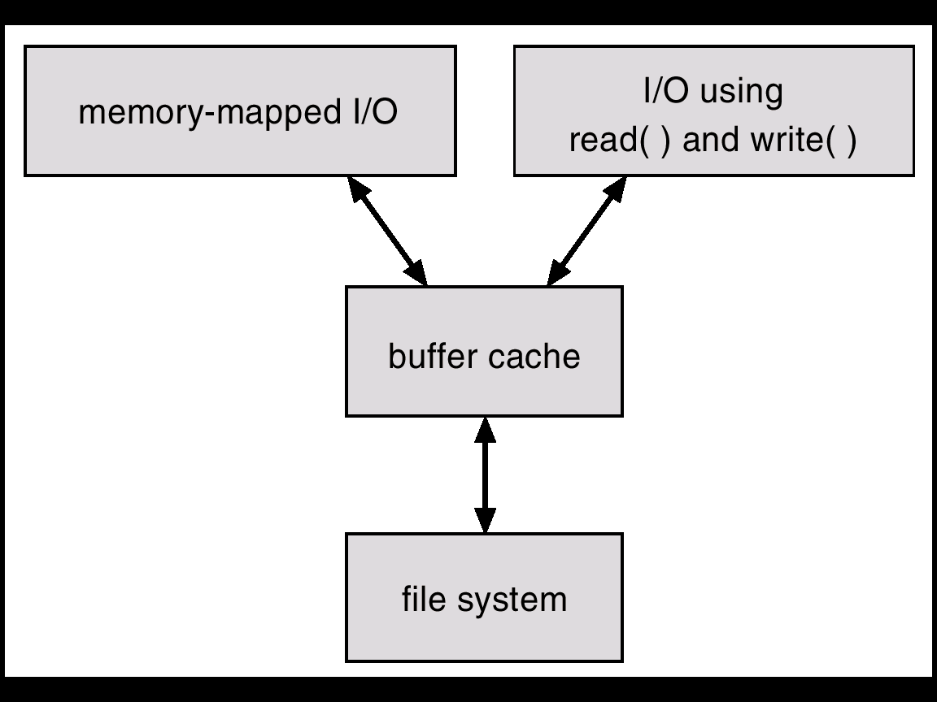
FILE SYSTEM IMPLEMENTATION
Efficiency and
Performance
THE DISK CACHE MECHANISM
This is an essential part of any well-performing Operating System.
The goal is to ensure that the disk is accessed as seldom as possible.
Keep previously read data in memory so that it might be read again.
They also hold on to written data, hoping to aggregate several writes from a process.
Can also be “smart” and do things like read-ahead. Anticipate what will be needed.
10: File Systems

Slide 35
DISTRIBUTED FILE SYSTEMS
SUN Network File System
OVERVIEW:
Runs on SUNOS - NFS is both an implementation and a specification of how to access remote files. It's both a definition and a specific instance.
The goal: to share a file system in a transparent way.
Uses client-server model ( for NFS, a node can be both simultaneously.) Can act between any two nodes ( no dedicated server. ) Mount makes a server file-system visible from a client.
mount server:/usr/shared client:/usr/local
Then, transparently, a request for /usr/local/dir-server accesses a file that is on the server.
Can use heterogeneous machines - different hardware, operating systems, network protocols.
Uses RPC for isolation - thus all implementations must have the same RPC calls. These RPC's implement the mount protocol and the NFS protocol.
10: File Systems

Slide 36
DISTRIBUTED FILE SYSTEMS
SUN Network File System
THE MOUNT PROTOCOL:
The following operations occur:
  1. The client's request is sent via RPC to the mount server ( on server machine.)
  2. Mount server checks export list containing
    file systems that can be exported,
    legal requesting clients.
    It's legitimate to mount any directory within the legal filesystem.
  3. Server returns "file handle" to client.
  4. Server maintains list of clients and mounted directories -- this is state information! But this data is only a "hint" and isn't treated as essential.
  5. Mounting often occurs automatically when client or server boots.
10: File Systems

Slide 37
DISTRIBUTED FILE SYSTEMS
SUN Network File System
THE NFS PROTOCOL:
RPC’s support these remote file operations:
  Search for file within directory.
  Read a set of directory entries.
  Manipulate links and directories.
  Read/write file attributes.
  Read/write file data.
Note:
  Open and close are absent from this list. NFS servers are stateless. Each request must provide all information. With a server crash, no information is lost.
  Modified data must actually get to server disk before client is informed the action is complete. Using a cache would imply state information.
  A single NFS write is atomic. A client write request may be broken into several atomic RPC calls, so the whole thing is NOT atomic. Since lock management is stateful, NFS doesn't do it. A higher level must provide this service.
10: File Systems

Slide 38
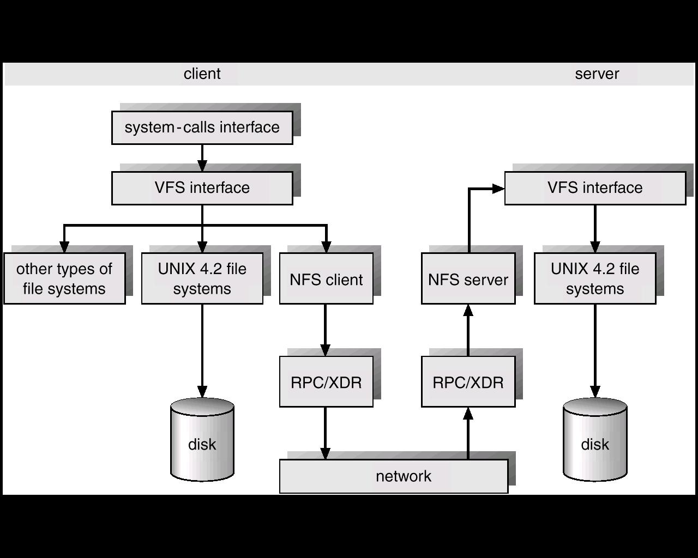
DISTRIBUTED FILE SYSTEMS
SUN Network File System
NFS ARCHITECTURE:
Follow local and remote access through this figure:
10: File Systems

Slide 39
DISTRIBUTED FILE SYSTEMS
SUN Network File System
NFS ARCHITECTURE:
1. UNIX filesystem layer - does normal open / read / etc. commands.
2. Virtual file system ( VFS ) layer -
  Gives clean layer between user and filesystem.
  Acts as deflection point by using global vnodes.
  Understands the difference between local and remote names.
  Keeps in memory information about what should be deflected (mounted directories) and how to get to these remote directories.
3. System call interface layer -
  Presents sanitized validated requests in a uniform way to the VFS.
10: File Systems

Slide 40
DISTRIBUTED FILE SYSTEMS
SUN Network File System
PATH-NAME TRANSLATION:
Break the complete pathname into components.
For each component, do an NFS lookup using the
component name + directory vnode.
After a mount point is reached, each component piece will cause a server access.
Can't hand the whole operation to server since the client may have a second mount on a subsidiary directory (a mount on a mount ).
A directory name cache on the client speeds up lookups.
10: File Systems

Slide 41
DISTRIBUTED FILE SYSTEMS
SUN Network File System
CACHES OF REMOTE DATA:
The client keeps:
  File block cache - ( the contents of a file )
  File attribute cache - ( file header info (inode in UNIX) ).
The local kernel hangs on to the data after getting it the first time.
On an open, local kernel, it checks with server that cached data is still OK.
Cached attributes are thrown away after a few seconds.
Data blocks use read ahead and delayed write.
Mechanism has:
  Server consistency problems.
  Good performance.
10: File Systems

Slide 42
FILE SYSTEMS
Wrap Up
In this section we have looked at how the file is put together. What are the components that must be present in the file and implicitly, what procedures must be in the Operating System in order to act on these files.
We’ve also examined the internal structure of files.
This gives a file system knowledge about how to get around in the file – especially how to find the required data block.
10: File Systems

