Slide 1
Model-View-Controller Architecture

Slide 2
Give someone a program, you frustrate them for a day; teach them how to program, you frustrate them for a lifetime.
— David Leinweber

Slide 3
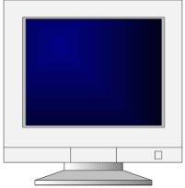
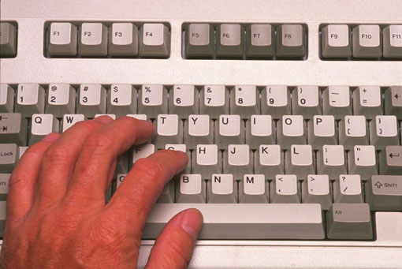

Model-View-Controller
Architecture for interactive apps
  introduced by Smalltalk developers at PARC
Partitions application so that it is
  scalable
  maintainable
View
Model
Controller

Slide 4
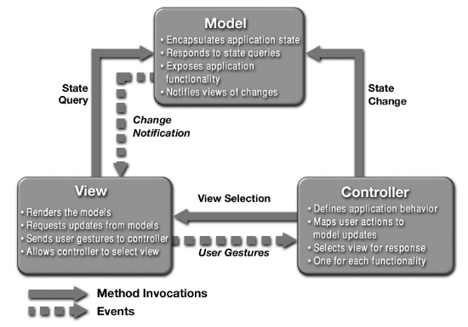
What is MVC?

Slide 5
The Model
Model
View
Controller
Most programs are supposed to do work, not just be “another pretty face”
  but there are some exceptions
  useful programs existed long before GUIs
The Model is the part that does the work--it models the actual problem being solved
The Model should be independent of both the Controller and the View
  But it provides services (methods) for them to use
Independence gives flexibility, robustness

Slide 6
The View
View
Model
Controller
Typically, the user has to be able to see, or view, what the program is doing
The View shows what the Model is doing
  The View is a passive observer; it should not affect the model
The Model should be independent of the View, but (but it can provide access methods)
The View should not display what the Controller thinks is happening

Slide 7
The Controller
View
Model
Controller
The Controller decides what the model is to do
Often, the user is put in control by means of a GUI
  in this case, the GUI and the Controller are often the same
The Controller and the Model can almost always be separated (what to do versus how to do it)
The design of the Controller depends on the Model
The Model should not depend on the Controller

Slide 8
Controller Communication
View
Model
Controller
Communicates with view
  determines which objects are being manipulated
    e.g., which object was selected with mouse click
Calls model methods to make changes
  model makes change and notifies views to update

Slide 9
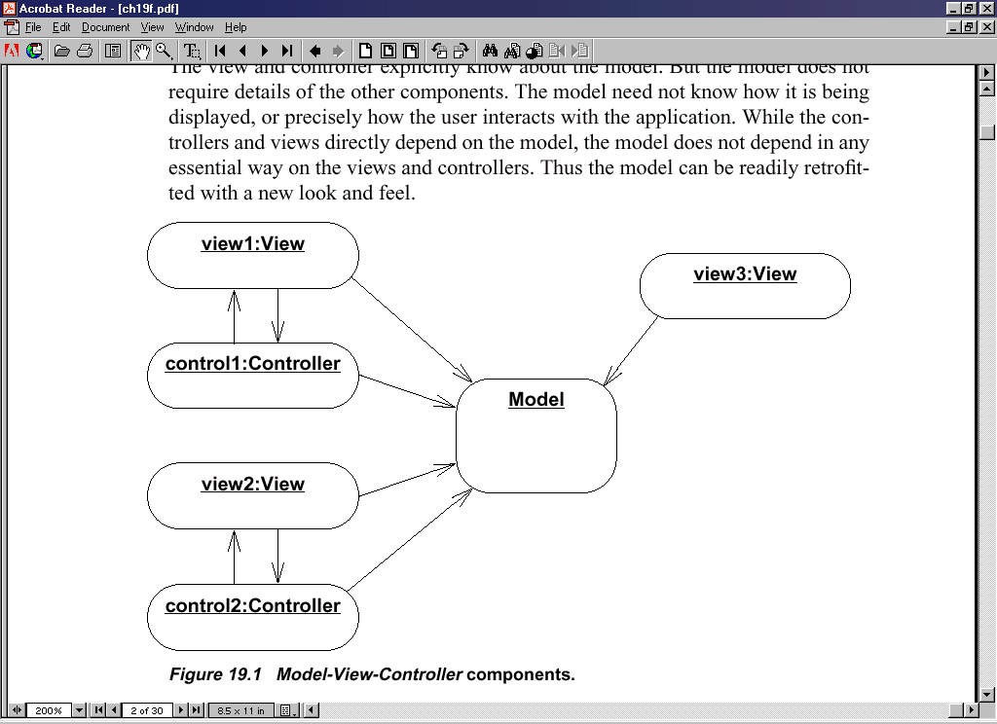
Advantages
Input processing is separated from output processing.
Controllers can be interchanged, allowing different user interaction modes.
Multiple views of the model can be supported easily.

Slide 10
Other ways
Combining Controller and View
  Small programs
  May be highly interdependent
  Never mix model
Model
View
Controller

Slide 11
Other Ways
No Model-View interaction
All interaction happens through controller
Controller talks to Model and View
Your project
View
Model
Controller

Slide 12
Why MVC?
Provides a logical structure for heavily interactive system
Adheres to good engineering design principles and practices
  Information hiding, less coupling, simplicity, etc.
  Delegated control style

Slide 13
Why MVC?
Combining MVC into one class or using global variables will not scale. Why?
  model may have more than one view
    each different & needing update on model changes
Separation eases maintenance. Why?
  easy to add a new view later
    may need new model info, but old views still work
  can change a view later
    e.g., draw shapes in 3-d
      recall that the view handles selection

