Slide 1
Data Warehouse and OLAP Technology: An Overview
What is a data warehouse?
A multi-dimensional data model
Data warehouse architecture
Data warehouse implementation
From data warehousing to data mining
Data Mining: Concepts and Techniques

Slide 2
What is Data Warehouse?
Data warehousing provides architectures and tools for business executives to systematically organize, understand, and use their data to make strategic decisions
Data warehousing is the latest must-have marketing weapon—a way to retain customers by learning more about their needs
Defined in many different ways, but not rigorously
  A decision support database that is maintained separately from the organization’s operational database
  Support information processing by providing a solid platform of consolidated, historical data for analysis
Data Mining: Concepts and Techniques

Slide 3
What is Data Warehouse?
“A data warehouse is a subject-oriented, integrated, time-variant, and nonvolatile collection of data in support of management’s decision-making process”—W. H. Inmon
Data warehousing:
  The process of constructing and using data warehouses
Data Mining: Concepts and Techniques

Slide 4
Data Warehouse—Subject-Oriented
Organized around major subjects, such as customer, product, sales
Focus on the modeling and analysis of data for decision makers, not on daily operations or transaction processing
Provide a simple and concise view around particular subject issues by excluding data that are not useful in the decision support process
Data Mining: Concepts and Techniques

Slide 5
Data Warehouse—Integrated
Constructed by integrating multiple, heterogeneous data sources
  relational databases, flat files, on-line transaction records
Data cleaning and data integration techniques are applied
  Ensure consistency in naming conventions, encoding structures, attribute measures, etc. among different data sources
  When data is moved to the warehouse, it is converted
Data Mining: Concepts and Techniques

Slide 6
Data Warehouse—Time Variant
The time horizon for the data warehouse is significantly longer than that of operational systems
  Operational database: current value data
  Data warehouse data: provide information from a historical perspective (e.g., past 5-10 years)
Every key structure in the data warehouse
  Contains an element of time, explicitly or implicitly
  But the key of operational data may or may not contain “time element”
Data Mining: Concepts and Techniques

Slide 7
Data Warehouse—Nonvolatile
A physically separate store of data transformed from the operational environment
Operational update of data does not occur in the data warehouse environment
  Does not require transaction processing, recovery, and concurrency control mechanisms
  Requires only two operations in data accessing:
    initial loading of data and access of data
Data Mining: Concepts and Techniques

Slide 8
What is Data Warehouse?
A semantically consistent data store that serves as a physical implementation of a decision support data model and stores the information on which an enterprise needs to make strategic decisions
Also viewed as an architecture, constructed by integrating data from multiple heterogeneous sources to support structured and/or ad hoc queries, analytical reporting, and decision making
Data Mining: Concepts and Techniques

Slide 9
What is Data Warehouse?
“How are organizations using the information from data warehouses?”
Organizations use this information to support business decision-making activities, including
  increasing customer focus, which includes the analysis of customer buying patterns (such as buying preference, buying time, budget cycles, and appetites for spending);
  repositioning products and managing product portfolios by comparing the performance of sales by quarter, by year, and by geographic regions in order to fine-tune production strategies;
  analyzing operations and looking for sources of profit; and
  managing the customer relationships, making environmental corrections, and managing the cost of corporate assets
Data Mining: Concepts and Techniques

Slide 10
Data Warehouse vs. Heterogeneous DBMS
Traditional heterogeneous DB integration: A query driven approach
  Build wrappers/mediators on top of heterogeneous databases
  When a query is posed to a client site, a meta-dictionary is used to translate the query into queries appropriate for individual heterogeneous sites involved, and the results are integrated into a global answer set
  Complex information filtering and integration, compete for resources
Data warehouse: update-driven, high performance
  Information from heterogeneous sources is integrated in advance and stored in warehouses for direct query and analysis
  Data are copied, preprocessed, integrated, annotated, summarized and restructured into one semantic data store
Data Mining: Concepts and Techniques

Slide 11
Data Warehouse vs. Operational DBMS
OLTP (on-line transaction processing)
  On-line transaction and query processing
  Day-to-day operations: purchasing, inventory, banking, manufacturing, payroll, registration, accounting, etc.
OLAP (on-line analytical processing)
  Data analysis and decision making
  Organize and present data in various formats
Distinct features (OLTP vs. OLAP):
  User and system orientation: customer vs. market
  Data contents: current, detailed vs. historical, consolidated
  Database design: ER + application vs. star + subject
  View: current, local vs. evolutionary, integrated
  Access patterns: atomic transactions, update vs. read-only but complex queries
Data Mining: Concepts and Techniques

Slide 12
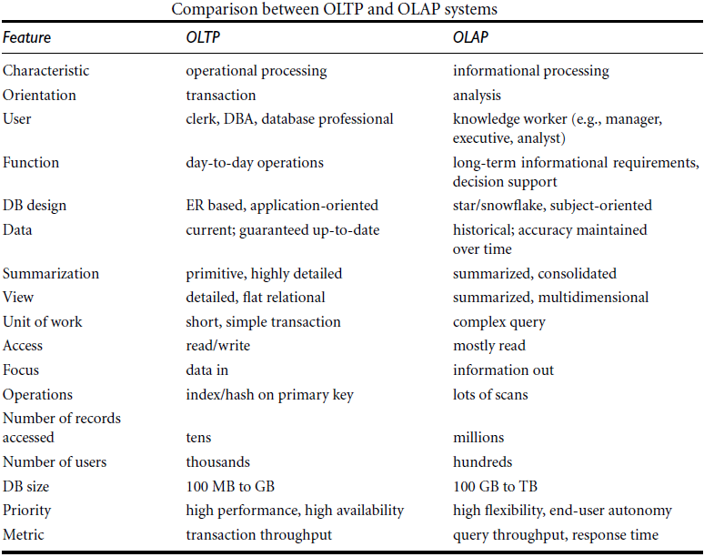
Data Mining: Concepts and Techniques

Slide 13
Why Separate Data Warehouse?
High performance for both systems
  DBMS— tuned for OLTP: access methods, indexing, concurrency control, recovery
  Warehouse—tuned for OLAP: complex OLAP queries, multidimensional view, consolidation
Different functions and different data:
  missing data: Decision support requires historical data which operational DBs do not typically maintain
  data consolidation: DS requires consolidation (aggregation, summarization) of data from heterogeneous sources
  Concurrency control and recovery mechanism: needed in OLTP
  data quality: different sources typically use inconsistent data representations, codes and formats which have to be reconciled
Data Mining: Concepts and Techniques

Slide 14
Data Warehouse and OLAP Technology: An Overview
What is a data warehouse?
A multi-dimensional data model
Data warehouse architecture
Data warehouse implementation
From data warehousing to data mining
Data Mining: Concepts and Techniques

Slide 15
From Tables and Spreadsheets to Data Cubes
A data warehouse is based on a multidimensional data model which views data in the form of a data cube
“What is a data cube?”
  A data cube allows data to be modeled and viewed in multiple dimensions
  It is defined by dimensions and facts
Dimensions - the perspectives or entities with respect to which an organization wants to keep records
Dimension table - a table associated with each dimension which further describes the dimension
Data Mining: Concepts and Techniques

Slide 16
From Tables and Spreadsheets to Data Cubes
Fact table represents the central theme around which a multidimensional data model is typically organized
  Eg: sales
Fact table - contains the names of the facts, or measures, as well as keys to each of the related dimension tables
Facts - numerical measures
  The quantities by which we want to analyze relationships between dimensions
  Eg: dollars_sold (sales amount in dollars), units_sold (number of units sold), and amount_budgeted
Data Mining: Concepts and Techniques

Slide 17
From Tables and Spreadsheets to Data Cubes
A data cube, such as sales, allows data to be modeled and viewed in multiple dimensions
  Dimensions can be time, item, branch, and location
  Dimension tables, such as item may contain the attributes (item_name, brand, type), or time may contain the attributes (day, week, month, quarter, year)
  Fact table contains measures (such as dollars_sold) and keys to each of the related dimension tables
Data Mining: Concepts and Techniques

Slide 18
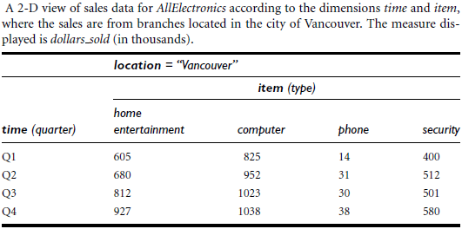
From Tables and Spreadsheets to Data Cubes
Data Mining: Concepts and Techniques

Slide 19
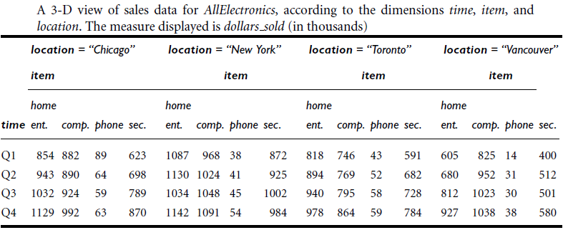
From Tables and Spreadsheets to Data Cubes
Data Mining: Concepts and Techniques

Slide 20
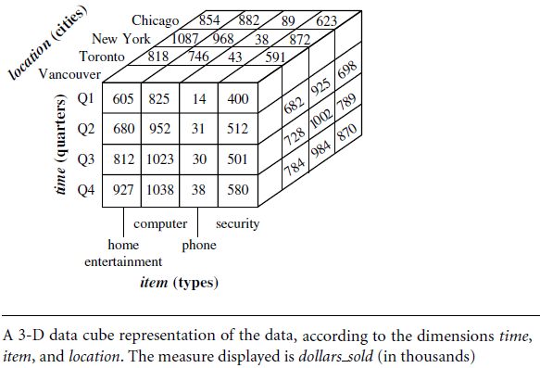
From Tables and Spreadsheets to Data Cubes
Data Mining: Concepts and Techniques

Slide 21
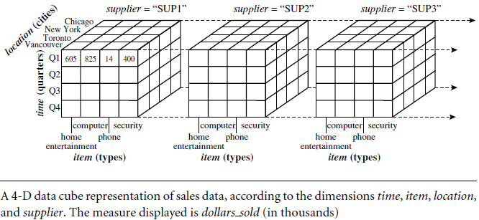
From Tables and Spreadsheets to Data Cubes
Data Mining: Concepts and Techniques

Slide 22
From Tables and Spreadsheets to Data Cubes
In data warehousing literature, an n-D base cube is called a base cuboid
The top most 0-D cuboid, which holds the highest-level of summarization, is called the apex cuboid
The apex cuboid is typically denoted by all
The lattice of cuboids forms a data cube
Data Mining: Concepts and Techniques

Slide 23
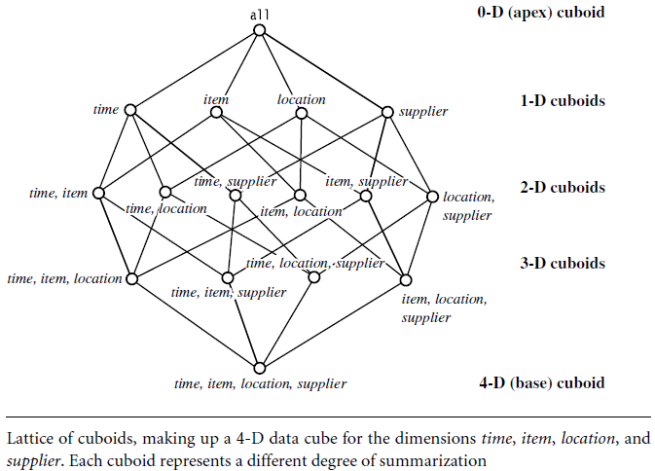
Cube: A Lattice of Cuboids
Data Mining: Concepts and Techniques

Slide 24
Conceptual Modeling of Data Warehouses
Modeling data warehouses: multidimensional model
  Star schema: A fact table in the middle connected to a set of dimension tables
  Snowflake schema: A refinement of star schema where some dimensional hierarchy is normalized into a set of smaller dimension tables, forming a shape similar to snowflake
  Fact constellations: Multiple fact tables share dimension tables, viewed as a collection of stars, therefore called galaxy schema or fact constellation
Data Mining: Concepts and Techniques

Slide 25
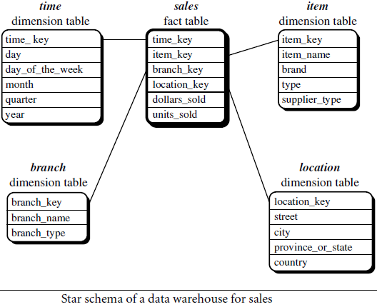
Example of Star Schema
Data Mining: Concepts and Techniques

Slide 26
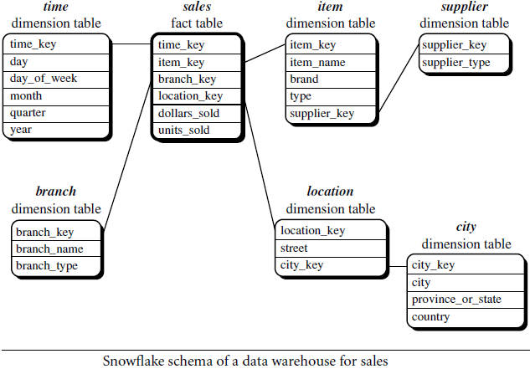
Example of Snowflake Schema
Data Mining: Concepts and Techniques

Slide 27
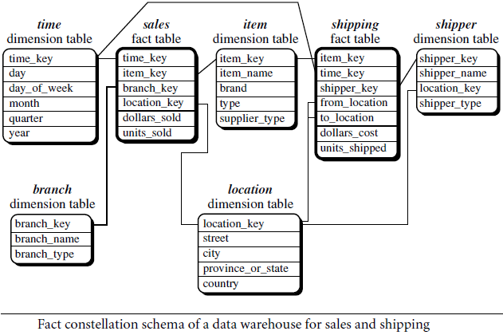
Example of Fact Constellation
Data Mining: Concepts and Techniques

Slide 28
Conceptual Modeling of Data Warehouses
Data warehouse
  collects information about subjects that span the entire organization
  its scope is enterprise-wide
  the fact constellation schema is commonly used, since it can model multiple, interrelated subjects
Data mart
  a department subset of the data warehouse that focuses on selected subjects
  its scope is department-wide
  the star or snowflake schema are commonly used
Data Mining: Concepts and Techniques

Slide 29
Cube Definition Syntax in DMQL
Cube Definition (Fact Table)
  define cube <cube_name> [<dimension_list>]: <measure_list>
Dimension Definition (Dimension Table)
  define dimension <dimension_name> as (<attribute_or_subdimension_list>)
Special Case (Shared Dimension Tables)
  First time as “cube definition”
  define dimension <dimension_name> as <dimension_name_first_time> in cube <cube_name_first_time>
Data Mining: Concepts and Techniques

Slide 30
Defining Star Schema in DMQL
define cube sales_star [time, item, branch, location]:
    dollars_sold = sum(sales_in_dollars), units_sold = count(*)
define dimension time as (time_key, day, day_of_week, month, quarter, year)
define dimension item as (item_key, item_name, brand, type, supplier_type)
define dimension branch as (branch_key, branch_name, branch_type)
define dimension location as (location_key, street, city, province_or_state, country)
Data Mining: Concepts and Techniques

Slide 31
Defining Snowflake Schema in DMQL
define cube sales_snowflake [time, item, branch, location]:
    dollars_sold = sum(sales_in_dollars), units_sold = count(*)
define dimension time as (time_key, day, day_of_week, month, quarter, year)
define dimension item as (item_key, item_name, brand, type, supplier(supplier_key, supplier_type))
define dimension branch as (branch_key, branch_name, branch_type)
define dimension location as (location_key, street, city(city_key, province_or_state, country))
Data Mining: Concepts and Techniques

Slide 32
Defining Fact Constellation in DMQL
define cube sales [time, item, branch, location]:
    dollars_sold = sum(sales_in_dollars), units_sold = count(*)
define dimension time as (time_key, day, day_of_week, month, quarter, year)
define dimension item as (item_key, item_name, brand, type, supplier_type)
define dimension branch as (branch_key, branch_name, branch_type)
define dimension location as (location_key, street, city, province_or_state, country)
define cube shipping [time, item, shipper, from_location, to_location]:
    dollar_cost = sum(cost_in_dollars), unit_shipped = count(*)
define dimension time as time in cube sales
define dimension item as item in cube sales
define dimension shipper as (shipper_key, shipper_name, location as location in cube sales, shipper_type)
define dimension from_location as location in cube sales
define dimension to_location as location in cube sales
Data Mining: Concepts and Techniques

Slide 33
Measures of Data Cube
“How are measures computed?”
A multidimensional point in the data cube space can be defined by a set of dimension-value pairs
  For example, time = “Q1”, location = “Vancouver”, item = “computer”
A data cube measure is a numerical function that can be evaluated at each point in the data cube space
A measure value is computed for a given point by
  aggregating the data corresponding to the respective dimension-value pairs defining the given point
Data Mining: Concepts and Techniques

Slide 34
Measures of Data Cube: Three Categories
Distributive: if the result derived by applying the function to n aggregate values is the same as that derived by applying the function on all the data without partitioning
    E.g., count(), sum(), min(), max()
Algebraic: if it can be computed by an algebraic function with M arguments, each of which is obtained by applying a distributive aggregate function
    E.g., avg(), min_N(), max_N(), standard_deviation()
Holistic: if there does not exist an algebraic function with M arguments (where M is a constant) that characterizes the computation
    E.g., median(), mode(), rank()
Data Mining: Concepts and Techniques

Slide 35
Interpreting Measures for Data Cube
Suppose that the relational database schema of AllElectronics is the following:
  time(time_key, day, day_of_week, month, quarter, year)
  item(item_key, item_name, brand, type, supplier_type)
  branch(branch_key, branch_name, branch_type)
  location(location_key, street, city, province_or_state, country)
  sales(time_key, item_key, branch_key, location_key, number_of_units_sold, price)
Data Mining: Concepts and Techniques

Slide 36
Interpreting Measures for Data Cube
The DMQL specification is translated into the following SQL query, which generates the required sales star cube
Here, the sum aggregate function, is used to compute both dollars_sold and units_sold
  select s.time_key, s.item_key, s.branch_key, s.location_key,
  sum(s.number_of_units_sold * s.price), sum(s.number_of_units_sold)
  from time t, item i, branch b, location l, sales s,
  where s.time_key = t.time_key and s.item_key = i.item_key
  and s.branch_key = b.branch_key and s.location_key = l.location_key
  group by s.time_key, s.item_key, s.branch_key, s.location_key
Data Mining: Concepts and Techniques

Slide 37
Concept Hierarchies
A concept hierarchy defines a sequence of mappings from a set of low-level concepts to higher-level, more general concepts
schema hierarchy - A concept hierarchy that is a total or partial order among attributes in a database schema
set-grouping hierarchy – A concept hierarchy defined by discretizing or grouping values for a given dimension or attribute
Data Mining: Concepts and Techniques

Slide 38
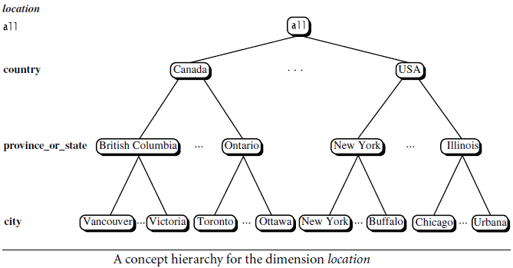
A Concept Hierarchy: Dimension (location)
Data Mining: Concepts and Techniques

Slide 39
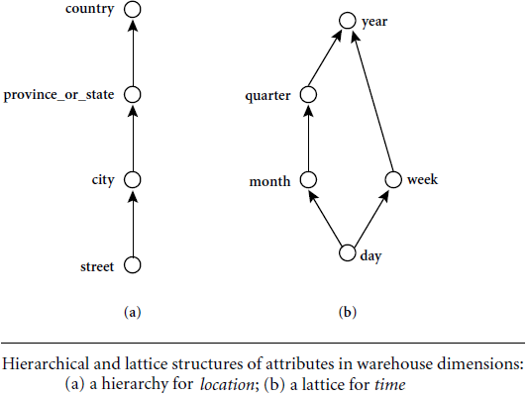
Concept Hierarchies
Specification of hierarchies
Schema hierarchy
day < {month < quarter; week} < year
Data Mining: Concepts and Techniques

Slide 40
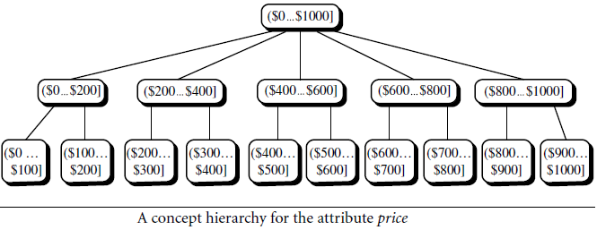
Concept Hierarchies
Specification of hierarchies
Set_grouping hierarchy
Data Mining: Concepts and Techniques

Slide 41
Concept Hierarchies
There may be more than one concept hierarchy for a given attribute or dimension, based on different user viewpoints
  For instance, a user may prefer to organize price by defining ranges for inexpensive, moderately_priced, and expensive
Concept hierarchies may be provided manually by system users, domain experts, or knowledge engineers, or may be automatically generated based on statistical analysis of the data distribution
Concept hierarchies allow data to be handled at varying levels of abstraction
Data Mining: Concepts and Techniques

Slide 42
OLAP Operations in Multidimensional Data Model
“How are concept hierarchies useful in OLAP?”
In the multidimensional model,
  data are organized into multiple dimensions, and each dimension contains multiple levels of abstraction defined by concept hierarchies
  This organization provides users with the flexibility to view data from different perspectives
A number of OLAP data cube operations exist to materialize these different views, allowing interactive querying and analysis of the data at hand
Hence, OLAP provides a user-friendly environment for interactive data analysis
Data Mining: Concepts and Techniques

Slide 43
A Sample Data Cube
Data Mining: Concepts and Techniques

Slide 44
Typical OLAP Operations
Roll up (drill-up): summarize data
  by climbing up hierarchy or by dimension reduction
Drill down (roll down): reverse of roll-up
  from higher level summary to lower level summary or detailed data, or introducing new dimensions
Slice and dice: project and select
Pivot (rotate):
  reorient the cube, visualization, 3D to series of 2D planes
Other operations
  drill across: involving (across) more than one fact table
Data Mining: Concepts and Techniques

Slide 45
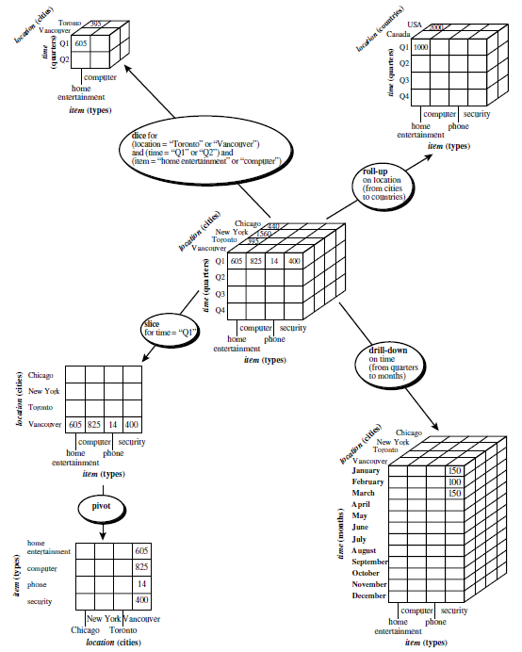
Typical OLAP Operations
Data Mining: Concepts and Techniques

Slide 46
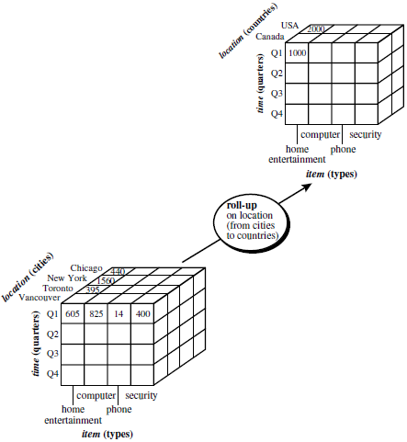
Roll-up OLAP Operation
Data Mining: Concepts and Techniques

Slide 47
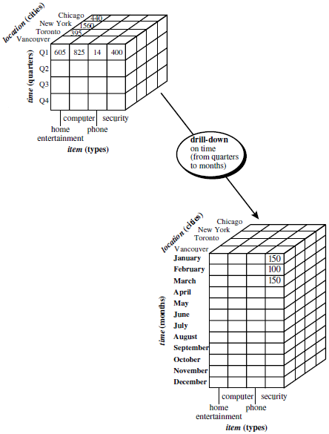
Drill-down OLAP Operation
Data Mining: Concepts and Techniques

Slide 48
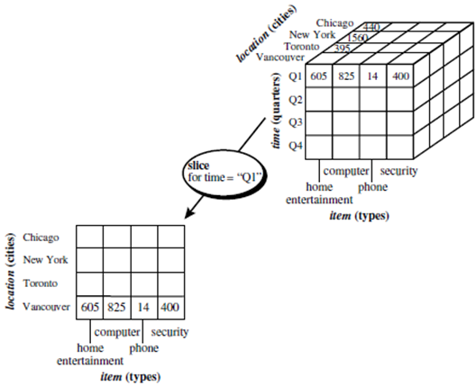
Slice OLAP Operation
Data Mining: Concepts and Techniques

Slide 49
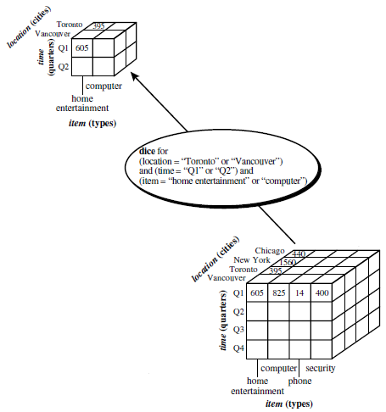
Dice OLAP Operation
Data Mining: Concepts and Techniques

Slide 50
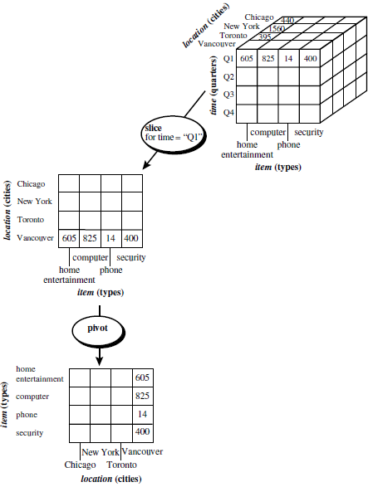
Slice OLAP Operation
Pivot OLAP Operation
Data Mining: Concepts and Techniques

Slide 51
OLAP Systems versus Statistical Databases
OLAP Systems | Statistical Databases
The characteristics in common: the use of a multidimensional data model and concept hierarchies, the association of measures with dimensions, and the notions of roll-up and drill-down
designed to support analytical applications | a database system that is designed to support statistical applications
targeted for business applications | focus on socioeconomic applications
No such problems | Privacy issues regarding concept hierarchies are a major concern
designed for handling huge amounts of data efficiently | designed for handling small amounts of data
Data Mining: Concepts and Techniques

Slide 52
A Starnet Query Model for Querying
Multidimensional Databases
A starnet model consists of radial lines emanating from a central point, where each line represents a concept hierarchy for a dimension
Each abstraction level in the hierarchy is called a footprint
These represent the granularities available for use by OLAP operations such as drill-down and roll-up
Data Mining: Concepts and Techniques

Slide 53
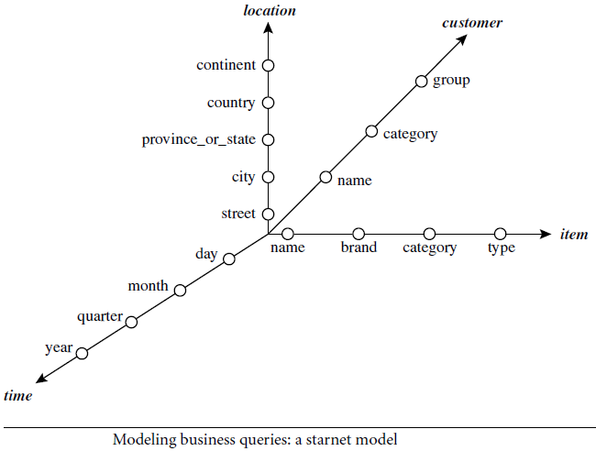
A Starnet Query Model for Querying
Multidimensional Databases
Data Mining: Concepts and Techniques

Slide 54
A Starnet Query Model for Querying
Multidimensional Databases
A concept hierarchy may involve
  a single attribute (like date for the time hierarchy) or
  several attributes (e.g., the concept hierarchy for location involves the attributes street, city, province or state, and country)
Concept hierarchies can be used
  to generalize data by replacing low-level values (such as “day” for the time dimension) by higher-level abstractions (such as “year”), or
  to specialize data by replacing higher-level abstractions with lower-level values
Data Mining: Concepts and Techniques

Slide 55
A Starnet Query Model for Querying
Multidimensional Databases
Customer Orders
Shipping Method
Customer
CONTRACTS
AIR-EXPRESS
ORDER
TRUCK
PRODUCT LINE
Time
Product
ANNUALY
QTRLY
DAILY
PRODUCT ITEM
PRODUCT GROUP
CITY
SALES PERSON
COUNTRY
DISTRICT
REGION
DIVISION
Location
Promotion
Organization
Data Mining: Concepts and Techniques

Slide 56
Data Warehouse and OLAP Technology: An Overview
What is a data warehouse?
A multi-dimensional data model
Data warehouse architecture
Data warehouse implementation
From data warehousing to data mining
Data Mining: Concepts and Techniques

Slide 57
Design of Data Warehouse: A Business Analysis Framework
“What can business analysts gain from having a data warehouse?”
May provide a competitive advantage
  by presenting relevant information from which to measure performance and make critical adjustments in order to help win over competitors
Can enhance business productivity
  because it is able to quickly and efficiently gather information that accurately describes the organization
Facilitates customer relationship management
  because it provides a consistent view of customers and items across all lines of business, all departments, and all markets
May bring about cost reduction
  by tracking trends, patterns, and exceptions over long periods in a consistent and reliable manner
Data Mining: Concepts and Techniques

Slide 58
Design of Data Warehouse: A Business Analysis Framework
Four views regarding the design of a data warehouse
  Top-down view
    allows selection of the relevant information necessary for the data warehouse
  Data source view
    exposes the information being captured, stored, and managed by operational systems
  Data warehouse view
    consists of fact tables and dimension tables
  Business query view
    sees the perspectives of data in the warehouse from the view of end-user
Data Mining: Concepts and Techniques

Slide 59
Design of Data Warehouse: A Business Analysis Framework
Building and using a data warehouse is a complex task because it requires business skills, technology skills, and program management skills
Business skills,
  building a data warehouse involves understanding
    how such systems store and manage their data,
    how to build extractors that transfer data from the operational system to the data warehouse, and
    how to build warehouse refresh software that keeps the data warehouse reasonably up-to-date with the operational system’s data
  Using a data warehouse involves
    understanding the significance of the data it contains, as well as
    understanding and translating the business requirements into queries that can be satisfied by the data warehouse
Data Mining: Concepts and Techniques

Slide 60
Design of Data Warehouse: A Business Analysis Framework
Technology skills
  data analysts are required to understand how to
    make assessments from quantitative information and
    derive facts based on conclusions from historical information in the data warehouse
  skills include the ability
    to discover patterns and trends,
    to extrapolate trends based on history and look for anomalies or paradigm shifts, and
    to present coherent managerial recommendations based on such analysis
Program management skills
  involve the need to interface with many technologies, vendors, and end users in order to deliver results in a timely and cost-effective manner
Data Mining: Concepts and Techniques

Slide 61
Data Warehouse Design Process
Top-down, bottom-up approaches or a combination of both
The top-down approach
  starts with the overall design and planning
  It is useful in cases where the technology is mature and well known, and where the business problems that must be solved are clear and well understood
The bottom-up approach
  starts with experiments and prototypes
  This is useful in the early stage of business modeling and technology development
  It allows an organization to move forward at considerably less expense and to evaluate the benefits of the technology before making significant commitments
In the combined approach,
  an organization can exploit
    the planned and strategic nature of the top-down approach while
    retaining the rapid implementation and application of the bottom-up approach
Data Mining: Concepts and Techniques

Slide 62
Data Warehouse Design Process
From software engineering point of view the design and construction of a data warehouse may consist of the following steps:
  planning, requirements study, problem analysis, warehouse design, data integration and testing, and finally deployment of the data warehouse
  Waterfall: structured and systematic analysis at each step before proceeding to the next
  Spiral: rapid generation of increasingly functional systems with short intervals between successive releases
    The turnaround time is short,
    modifications can be done quickly, and
    new designs and technologies can be adapted in a timely manner
    a good choice for data warehouse development
Data Mining: Concepts and Techniques

Slide 63
Data Warehouse Design Process
Typical data warehouse design process
  Choose a business process to model, e.g., orders, invoices, etc.
    if the business process is organizational and involves multiple complex object collections - a data warehouse model
    if the process is departmental and focuses on the analysis of one kind of business process - a data mart model
  Choose the grain of the business process
    The grain is the fundamental, atomic level of data to be represented in the fact table for this process
    e.g., individual transactions, individual daily snapshots, and so on
  Choose the dimensions that will apply to each fact table record
    Typical dimensions are time, item, customer, supplier, warehouse, transaction type, and status
  Choose the measure that will populate each fact table record
    Typical measures are numeric additive quantities like dollars_sold and units_sold
Data Mining: Concepts and Techniques

Slide 64
Data Warehouse Design Process
The goals of an initial data warehouse implementation should be specific, achievable, and measurable
This involves determining
  the time and budget allocations,
  the subset of the organization that is to be modeled,
  the number of data sources selected, and
  the number and types of departments to be served
Data Mining: Concepts and Techniques

Slide 65
Data Warehouse Design Process
Once a data warehouse is designed and constructed, the initial deployment of the warehouse includes
  initial installation, roll-out planning, training, and orientation
Platform upgrades and maintenance must also be considered
Data warehouse administration includes
  data refreshment, data source synchronization, planning for disaster recovery, managing access control and security, managing data growth, managing database performance, and data warehouse enhancement and extension
Scope management includes
  controlling the number and range of queries, dimensions, and reports;
  limiting the size of the data warehouse; or
  limiting the schedule, budget, or resources
Data Mining: Concepts and Techniques

Slide 66
Data Warehouse Design Process
Various kinds of data warehouse design tools are available
Data warehouse development tools
  provide functions to define and edit metadata repository contents (such as schemas, scripts, or rules), answer queries, output reports, and ship metadata to and from relational database system catalogues
Planning and analysis tools
  study the impact of schema changes and of refresh performance when changing refresh rates or time windows
Data Mining: Concepts and Techniques

Slide 67
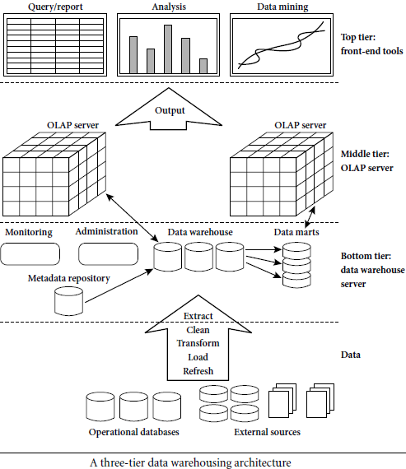
Data Warehouse: A Multi-Tiered Architecture
Front-End Tools
OLAP Engine
Data Storage
Data Sources
Data Mining: Concepts and Techniques

Slide 68
Data Warehouse: A Multi-Tiered Architecture
The bottom tier
  is a warehouse database server that is almost always a relational database system
  Back-end tools and utilities are used to feed data into the bottom tier from operational databases or other external sources
  These tools and utilities perform data extraction, cleaning, and transformation (e.g., to merge similar data from different sources into a unified format), as well as load and refresh functions to update the data warehouse
  The data are extracted using application program interfaces known as gateways
  Examples of gateways include ODBC (Open Database Connection) and OLEDB (Open Linking and Embedding for Databases) by Microsoft and JDBC (Java Database Connection)
  This tier also contains a metadata repository, which stores information about the data warehouse and its contents
Data Mining: Concepts and Techniques

Slide 69
Data Warehouse: A Multi-Tiered Architecture
The bottom tier
  is a warehouse database server that is almost always a relational database system
  Back-end tools and utilities are used to feed data into the bottom tier from operational databases or other external sources
  These tools and utilities perform data extraction, cleaning, and transformation (e.g., to merge similar data from different sources into a unified format), as well as load and refresh functions to update the data warehouse
  The data are extracted using application program interfaces known as gateways
  Examples of gateways include ODBC (Open Database Connection) and OLEDB (Open Linking and Embedding for Databases) by Microsoft and JDBC (Java Database Connection)
  This tier also contains a metadata repository, which stores information about the data warehouse and its contents
Data Mining: Concepts and Techniques

Slide 70
Data Warehouse: A Multi-Tiered Architecture
The middle tier
  is an OLAP server that is typically implemented using either
    a relational OLAP (ROLAP) model, that is, an extended relational DBMS that maps operations on multidimensional data to standard relational operations; or
    a multidimensional OLAP (MOLAP) model, that is, a special-purpose server that directly implements multidimensional data and operations
The top tier
  is a front-end client layer, which contains query and reporting tools, analysis tools, and/or data mining tools (e.g., trend analysis, prediction, and so on)
Data Mining: Concepts and Techniques

Slide 71
Three Data Warehouse Models
From the architecture point of view, there are three data warehouse models:
Enterprise warehouse
  An enterprise warehouse collects all of the information about subjects spanning the entire organization
  It provides corporate-wide data integration, usually from one or more operational systems or external information providers, and is cross-functional in scope
  It typically contains detailed data as well as summarized data
  can range in size from a few gigabytes to hundreds of gigabytes, terabytes, or beyond
  An enterprise data warehouse may be implemented on traditional mainframes, computer superservers, or parallel architecture platforms
  It requires extensive business modeling and may take years to design and build
Data Mining: Concepts and Techniques

Slide 72
Three Data Warehouse Models
Data Mart
  A data mart contains a subset of corporate-wide data that is of value to a specific group of users
  The scope is confined to specific selected subjects
  The data contained in data marts tend to be summarized
  Data marts are usually implemented on low-cost departmental servers that are UNIX/LINUX- or Windows-based
  The implementation cycle of a data mart is more likely to be measured in weeks rather than months or years
  It may involve complex integration in the long run if its design and planning were not enterprise-wide
  Depending on the source of data, data marts can be categorized as independent or dependent
  Independent data marts are sourced from data captured from one or more operational systems or external information providers, or from data generated locally within a particular department or geographic area
  Dependent data marts are sourced directly from enterprise data warehouses
Data Mining: Concepts and Techniques

Slide 73
Three Data Warehouse Models
Virtual warehouse
  A virtual warehouse is a set of views over operational databases
  For efficient query processing, only some of the possible summary views may be materialized
  A virtual warehouse is easy to build but requires excess capacity on operational database servers
Data Mining: Concepts and Techniques

Slide 74
Three Data Warehouse Models
“What are the pros and cons of the top-down and bottom-up approaches to data warehouse development?”
  The top-down development of an enterprise warehouse
    serves as a systematic solution and minimizes integration problems
    it is expensive, takes a long time to develop, and lacks flexibility due to the difficulty in achieving consistency and consensus for a common data model for the entire organization
  The bottom-up approach to the design, development, and deployment of independent data marts
    provides flexibility, low cost, and rapid return of investment
    It can lead to problems when integrating various disparate data marts into a consistent enterprise data warehouse
Data Mining: Concepts and Techniques

Slide 75
Data Warehouse Development: A Recommended Approach
A recommended method for the development of data warehouse systems is to implement the warehouse in an incremental and evolutionary manner
  a high-level corporate data model is defined within a reasonably short period (such as one or two months) that provides a corporate-wide, consistent, integrated view of data among different subjects and potential usages
  This high-level model,
    will need to be refined in the further development of enterprise data warehouses and departmental data marts
    will greatly reduce future integration problems
Data Mining: Concepts and Techniques

Slide 76
Data Warehouse Development: A Recommended Approach
  independent data marts can be implemented in parallel with the enterprise warehouse based on the same corporate data model set
  distributed data marts can be constructed to integrate different data marts
  a multitier data warehouse is constructed where the enterprise warehouse is the sole custodian of all warehouse data, which is then distributed to the various dependent data marts
Data Mining: Concepts and Techniques

Slide 77
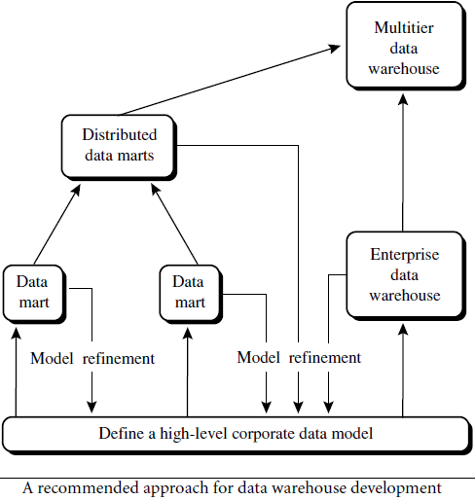
Data Warehouse Development: A Recommended Approach
Data Mining: Concepts and Techniques

Slide 78
Data Warehouse Back-End Tools and Utilities
Data warehouse systems use back-end tools and utilities to populate and refresh their data
Data extraction
  get data from multiple, heterogeneous, and external sources
Data cleaning
  detect errors in the data and rectify them when possible
Data transformation
  convert data from legacy or host format to warehouse format
Load
  sort, summarize, consolidate, compute views, check integrity, and build indices and partitions
Refresh
  propagate the updates from the data sources to the warehouse
Data Mining: Concepts and Techniques

Slide 79
Metadata Repository
Meta data is the data defining warehouse objects
It stores:
Description of the structure of the data warehouse
  schema, view, dimensions, hierarchies, derived data definition, data mart locations and contents
Operational meta-data
  data lineage (history of migrated data and transformation path), currency of data (active, archived, or purged), monitoring information (warehouse usage statistics, error reports, audit trails)
The algorithms used for summarization
  measure and dimension definition algorithms, data on granularity, partitions, subject areas, aggregation, summarization, and predefined queries and reports
Data Mining: Concepts and Techniques

Slide 80
Metadata Repository
The mapping from operational environment to the data warehouse
  source databases and their contents, gateway descriptions, data partitions, data extraction, cleaning, transformation rules and defaults, data refresh and purging rules, and security (user authorization and access control)
Data related to system performance
  indices and profiles that improve data access and retrieval performance, rules for the timing and scheduling of refresh, update, and replication cycles
Business meta data
  business terms and definitions, data ownership information, and charging policies
Data Mining: Concepts and Techniques

Slide 81
Metadata Repository
Metadata play a very different role than other data warehouse data and are important for many reasons
metadata are used
  as a directory to help the decision support system analyst locate the contents of the data warehouse,
  as a guide to the mapping of data when the data are transformed from the operational environment to the data warehouse environment, and
  as a guide to the algorithms used for summarization between the current detailed data and the lightly summarized data, and between the lightly summarized data and the highly summarized data
Metadata should be stored and managed persistently (i.e., on disk)
Data Mining: Concepts and Techniques

Slide 82
OLAP Server Architectures
Relational OLAP (ROLAP)
  Use relational or extended-relational DBMS to store and manage warehouse data and OLAP middle ware to support missing pieces
  Include optimization of DBMS backend, implementation of aggregation navigation logic, and additional tools and services
  Greater scalability
Multidimensional OLAP (MOLAP)
  array-based multidimensional storage engine
  Fast indexing to pre-computed summarized data
  denser subcubes are identified and stored as array structures, whereas sparse subcubes employ compression technology for efficient storage utilization
Data Mining: Concepts and Techniques

Slide 83
OLAP Server Architectures
Hybrid OLAP (HOLAP)
  The hybrid OLAP approach combines ROLAP and MOLAP technology, benefiting from the greater scalability of ROLAP and the faster computation of MOLAP
  a HOLAP server may allow large volumes of detail data to be stored in a relational database, while aggregations are kept in a separate MOLAP store
  The Microsoft SQL Server 2000 supports a hybrid OLAP server
Specialized SQL servers
  To meet the growing demand of OLAP processing in relational databases, some database system vendors implement specialized SQL servers
  provide advanced query language and query processing support for SQL queries over star and snowflake schemas in a read-only environment
Data Mining: Concepts and Techniques

Slide 84
OLAP Server Architectures
“How are data actually stored in ROLAP and MOLAP architectures?”
ROLAP uses relational tables, summary fact tables to store data for on-line analytical processing
  Some summary fact tables store both base fact table data and aggregated data
  Alternatively, separate summary fact tables can be used for each level of abstraction, to store only aggregated data
MOLAP uses multidimensional array structures to store data for on-line analytical processing
Data Mining: Concepts and Techniques

Slide 85
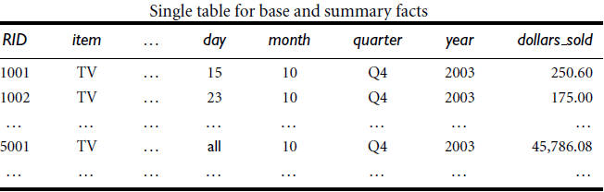
OLAP Server Architectures
Data Mining: Concepts and Techniques

Slide 86
Data Warehouse and OLAP Technology: An Overview
What is a data warehouse?
A multi-dimensional data model
Data warehouse architecture
Data warehouse implementation
From data warehousing to data mining
Data Mining: Concepts and Techniques

Slide 87
Data Warehouse Implementation
Data warehouses contain huge volumes of data
OLAP servers demand that decision support queries be answered in the order of seconds
data warehouse systems support
  highly efficient cube computation techniques,
  access methods, and
  query processing techniques
The core of multidimensional data analysis is the efficient computation of aggregations across many sets of dimensions
In SQL terms, these aggregations are referred to as group-by’s
Each group-by can be represented by a cuboid, where the set of group-by’s forms a lattice of cuboids defining a data cube
Data Mining: Concepts and Techniques

Slide 88
Efficient Data Cube Computation
The compute cube Operator
  One approach to cube computation extends SQL so as to include a compute cube operator
  The compute cube operator computes aggregates over all subsets of the dimensions specified in the operation
  This may require excessive storage space, especially for large numbers of dimensions
For a cube with n dimensions, there are a total of 2^{n} cuboids, including the base cuboid
Data Mining: Concepts and Techniques

Slide 89
Cube Operation
Cube definition and computation in DMQL
    define cube sales[item, city, year]: sum(sales_in_dollars)
    compute cube sales - computes the sales aggregate cuboids
Need compute the following group-bys
    { (item, city, year), (item, city),(item, year), (city, year), (item), (city), (year), () }
Data Mining: Concepts and Techniques

Slide 90
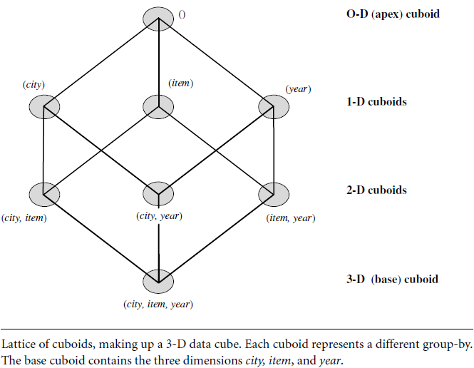
Cube Operation
Data Mining: Concepts and Techniques

Slide 91
Efficient Data Cube Computation
curse of dimensionality
  On-line analytical processing may need to access different cuboids for different queries
  Therefore, it may seem like a good idea to compute all or at least some of the cuboids in a data cube in advance
  Precomputation leads to fast response time and avoids some redundant computation
  Most OLAP products resort to some degree of precomputation of multidimensional aggregates
  A major challenge related to this precomputation is that the required storage space may explode if all of the cuboids in a data cube are precomputed, especially when the cube has many dimensions
  The storage requirements are even more excessive when many of the dimensions have associated concept hierarchies, each with multiple levels
  This problem is referred to as the curse of dimensionality
Data Mining: Concepts and Techniques

Slide 92

Efficient Data Cube Computation
How many cuboids in an n-dimensional cube with L levels?
        where L_{i} is the number of levels associated with dimension I
        One is added to L_{i} to include the virtual top level, all
generalizing to all is equivalent to the removal of the dimension
it is unrealistic to precompute and materialize all of the cuboids that can possibly be generated for a data cube
Data Mining: Concepts and Techniques

Slide 93
Efficient Data Cube Computation
Materialization of data cube - There are three choices for data cube materialization given a base cuboid
  No materialization: Do not precompute any of the “nonbase” cuboids
    This leads to computing expensive multidimensional aggregates on the fly, which can be extremely slow
  Full materialization: Precompute all of the cuboids
    The resulting lattice of computed cuboids is referred to as the full cube
    This choice typically requires huge amounts of memory space in order to store all of the precomputed cuboids
  Partial materialization: Selectively compute a proper subset of the whole set of possible cuboids
    we may compute a subset of the cube, subcube, which contains only those cells that satisfy some user-specified criterion, such as where the tuple count of each cell is above some threshold
    Partial materialization represents an interesting trade-off between storage space and response time
Data Mining: Concepts and Techniques

Slide 94
Efficient Data Cube Computation
The partial materialization of cuboids or subcubes should consider three factors:
  identify the subset of cuboids or subcubes to materialize;
  exploit the materialized cuboids or subcubes during query processing; and
  efficiently update the materialized cuboids or subcubes during load and refresh
The selection of the subset of cuboids or subcubes to materialize should take into account the queries in the workload, their frequencies, and their accessing costs
It should consider workload characteristics, the cost for incremental updates, and the total storage requirements
It must also consider the physical database design, such as the generation and selection of indices
Data Mining: Concepts and Techniques

Slide 95
Efficient Data Cube Computation
Several OLAP products have adopted heuristic approaches for cuboid and subcube selection
A popular approach is to materialize the set of cuboids on which other frequently referenced cuboids are based
compute an iceberg cube,
  data cube that stores only those cube cells whose aggregate value (e.g., count) is above some minimum support threshold
Another common strategy is to materialize a shell cube
  This involves precomputing the cuboids for only a small number of dimensions (such as 3 to 5) of a data cube
  Queries on additional combinations of the dimensions can be computed on-the-fly
Data Mining: Concepts and Techniques

Slide 96

Iceberg Cube
Computing only the cuboid cells whose count or other aggregates satisfying the condition like
      HAVING COUNT(*) >= minsup
Motivation
  Only a small portion of an iceberg may be “above the water’’
  Only calculate “interesting” cells—data above certain threshold
Data Mining: Concepts and Techniques

Slide 97
Efficient Data Cube Computation
Once the selected cuboids have been materialized, it is important to take advantage of them during query processing
This involves several issues, such as
  how to determine the relevant cuboid(s) from among the candidate materialized cuboids,
  how to use available index structures on the materialized cuboids, and
  how to transform the OLAP operations onto the selected cuboid(s)
Finally, during load and refresh, the materialized cuboids should be updated efficiently
  Parallelism and incremental update techniques for this operation should be explored
Data Mining: Concepts and Techniques

Slide 98
Indexing OLAP Data
To facilitate efficient data accessing, most data warehouse systems support index structures and materialized views (using cuboids)
OLAP data are indexed by
  bitmap indexing and
  join indexing
Data Mining: Concepts and Techniques

Slide 99
Indexing OLAP Data: Bitmap Index
The bitmap indexing method is popular in OLAP products because it allows quick searching in data cubes
In the bitmap index for a given attribute, there is a distinct bit vector, Bv, for each value v in the domain of the attribute
If the domain of a given attribute consists of n values, then n bits are needed for each entry in the bitmap index (i.e., there are n bit vectors)
If the attribute has the value v for a given row in the data table, then the bit representing that value is set to 1 in the corresponding row of the bitmap index
All other bits for that row are set to 0
Data Mining: Concepts and Techniques

Slide 100
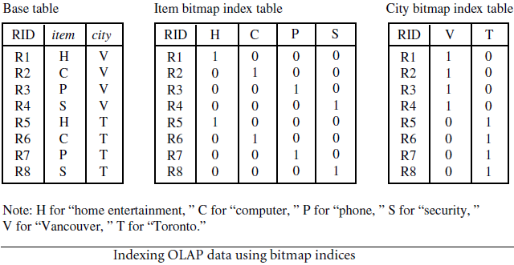
Indexing OLAP Data: Bitmap Index
Index on a particular column
Each value in the column has a bit vector: bit-operation is fast
The length of the bit vector: # of records in the base table
Data Mining: Concepts and Techniques

Slide 101
Indexing OLAP Data: Bitmap Index
Bitmap indexing is advantageous compared to hash and tree indices
It is especially useful for low-cardinality domains because comparison, join, and aggregation operations are then reduced to bit arithmetic, which substantially reduces the processing time
Bitmap indexing leads to significant reductions in space and I/O since a string of characters can be represented by a single bit
For higher-cardinality domains, the method can be adapted using compression techniques
Data Mining: Concepts and Techniques

Slide 102
Indexing OLAP Data: Join Indices
Used in relational database query processing
Traditional indexing maps the value in a given column to a list of rows having that value
join indexing registers the joinable rows of two relations from a relational database
For example, if two relations R(RID, A) and S(B, SID) join on the attributes A and B, then the join index record contains the pair (RID, SID), where RID and SID are record identifiers from the R and S relations, respectively
Hence, the join index records can identify joinable tuples without performing costly join operations
Join indexing is especially useful for maintaining the relationship between a foreign key and its matching primary keys, from the joinable relation
Data Mining: Concepts and Techniques

Slide 103
Indexing OLAP Data: Join Indices
The star schema model of data warehouses makes join indexing attractive for cross table search, because the linkage between a fact table and its corresponding dimension tables comprises the foreign key of the fact table and the primary key of the dimension table
Join indexing maintains relationships between attribute values of a dimension (e.g., within a dimension table) and the corresponding rows in the fact table
Join indices may span multiple dimensions to form composite join indices
We can use join indices to identify subcubes that are of interest
Data Mining: Concepts and Techniques

Slide 104
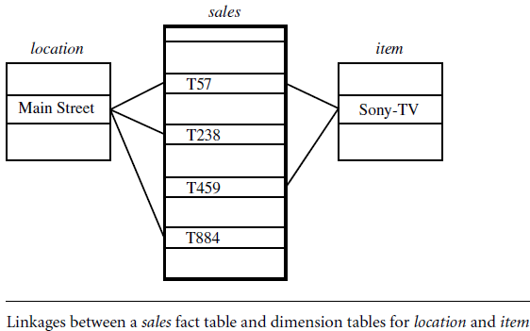
Indexing OLAP Data: Join Indices
Data Mining: Concepts and Techniques

Slide 105
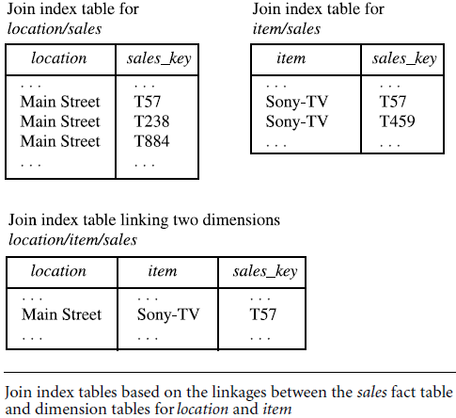
Indexing OLAP Data: Join Indices
Data Mining: Concepts and Techniques

Slide 106
Efficient Processing OLAP Queries
The purpose of materializing cuboids and constructing OLAP index structures is to speed up query processing in data cubes
Given materialized views, query processing should proceed as follows:
  Determine which operations should be performed on the available cuboids
    Transform drill, roll, etc. into corresponding SQL and/or OLAP operations,
    e.g., dice = selection + projection
  Determine to which materialized cuboid(s) the relevant operations should be applied
  Explore indexing structures and compressed vs. dense array structures in MOLAP
Data Mining: Concepts and Techniques

Slide 107
Efficient Processing OLAP Queries
Suppose that we define a data cube for AllElectronics of the form“sales cube [time, item, location]: sum(sales in dollars)”
The dimension hierarchies used are “day < month < quarter < year” for time, “item_name < brand < type” for item, and “street < city < province_or_state < country” for location
Let the query to be processed be on {brand, province_or_state} with the condition “year = 2004”, and there are 4 materialized cuboids available:
    1) {year, item_name, city}
    2) {year, brand, country}
    3) {year, brand, province_or_state}
    4) {item_name, province_or_state} where year = 2004
    Which should be selected to process the query?
Data Mining: Concepts and Techniques

Slide 108
Efficient Processing OLAP Queries
Finer granularity data cannot be generated from coarser-granularity data
  So cuboid 2 cannot be used because country is more general concept than province_state
Cuboids 1,3 and 4 can be used to process the query because
  They have the same set or a superset of the dimensions in the query
  The selection clause in the query can imply the selection of the dimensions in the query
  The abstraction levels for the item and location dimensions in these cuboids are at a finer level than brand and province or state respectively
Some cost based estimation is required in order to decide which set of cuboids should be selected for query processing
Data Mining: Concepts and Techniques

Slide 109
Efficient Processing OLAP Queries
“Are there any other strategies for answering queries quickly?”
on-line aggregation
  a data mining system can display “what it knows so far” instead of waiting until the query is fully processed
top N queries
  Suppose that you are interested in finding only the best-selling items among the millions of items sold
  Using statistics, query processing can be optimized to return the top N items, rather than the whole sorted list
  This results in faster response time while helping to promote user interactivity and reduce wasted resources
Data Mining: Concepts and Techniques

Slide 110
Data Warehouse and OLAP Technology: An Overview
What is a data warehouse?
A multi-dimensional data model
Data warehouse architecture
Data warehouse implementation
From data warehousing to data mining
Data Mining: Concepts and Techniques

Slide 111
Data Warehouse Usage
Data warehouses are used as an integral part of a plan-execute-assess ”closed loop” feedback system for enterprise management
Used in banking and financial services, consumer goods and retail distribution sectors etc.
  Used for generating reports and answering predefined queries
  Used to analyze summarized and detail data( reports and charts)
  Used for strategic purposes, performing multi dimensional analysis and sophisticated slice-and–dice operations
  Employed for knowledge discovery and strategic decision making using data mining tools
Data Mining: Concepts and Techniques

Slide 112
Tools for data warehousing
Access and retrieval tools
Database reporting tools
Data analysis tools
Data mining tools
Data Mining: Concepts and Techniques

Slide 113
Data Warehouse Usage
Three kinds of data warehouse applications
  Information processing
    Information processing supports querying, basic statistical analysis, and reporting using crosstabs, tables, charts, or graphs
    A current trend in data warehouse information processing is to construct low-cost Web-based accessing tools that are then integrated with Web browsers
    Information processing, based on queries, can find useful information
    answers to such queries reflect the information directly stored in databases or computable by aggregate functions
    They do not reflect sophisticated patterns or regularities buried in the database
    Therefore, information processing is not data mining
Data Mining: Concepts and Techniques

Slide 114
Data Warehouse Usage
Three kinds of data warehouse applications
  Analytical processing
    Analytical processing supports basic OLAP operations, including slice-and-dice, drill-down, roll-up, and pivoting
    It generally operates on historical data in both summarized and detailed forms
    The major strength of on-line analytical processing over information processing is the multidimensional data analysis of data warehouse data
    On-line analytical processing comes a step closer to data mining because it can derive information summarized at multiple granularities from user-specified subsets of a data warehouse
Data Mining: Concepts and Techniques

Slide 115
Data Warehouse Usage
Three kinds of data warehouse applications
  Data mining
    Data mining supports knowledge discovery by finding hidden patterns and associations, constructing analytical models, performing classification and prediction, and presenting the mining results using visualization tools
Data Mining: Concepts and Techniques

Slide 116
Data Warehouse Usage
OLAP | DATA MINING
data summarization/aggregation tool that helps simplify data analysis | allows the automated discovery of implicit patterns and interesting knowledge hidden in large amounts of data
targeted toward simplifying and supporting interactive data analysis | to automate as much of the process as possible, while still allowing users to guide the process
for user-directed data summary and comparison | covers both data description and data modeling
 | Also performs association, classification, prediction, clustering, time-series analysis, and other data analysis tasks
 | covers a broader spectrum than OLAP with respect to data mining functionality and the complexity of the data handled
 | have broader applications
Data Mining: Concepts and Techniques

Slide 117
From On-Line Analytical Processing (OLAP) to On Line Analytical Mining (OLAM)
On-line analytical mining (OLAM) (also called OLAP mining) integrates on-line analytical processing (OLAP) with data mining and mining knowledge in multidimensional databases
Why online analytical mining?
  High quality of data in data warehouses
    DW contains integrated, consistent, cleaned data
  Available information processing structure surrounding data warehouses
    ODBC, OLEDB, Web accessing, service facilities, reporting and OLAP tools
  OLAP-based exploratory data analysis
    Mining with drilling, dicing, pivoting, etc.
  On-line selection of data mining functions
    Integration and swapping of multiple mining functions, algorithms, and tasks
Data Mining: Concepts and Techniques

Slide 118
An OLAM System Architecture
Mining query
Mining result
Layer4
User Interface
User GUI API
OLAM
Engine
OLAP
Engine
Layer3
OLAP/OLAM
Data Cube API
Layer2
MDDB
MDDB
Meta Data
Filtering&Integration
Database API
Filtering
Layer1
Data Repository
Data cleaning
Data
Warehouse
Databases
Data integration
Data Mining: Concepts and Techniques

Slide 119
An OLAM System Architecture
The OLAM and OLAP servers
  both accept user on-line queries (or commands) via a graphical user interface API and
  work with the data cube in the data analysis via a cube API
A metadata directory is used to guide the access of the data cube
The data cube can be constructed
  by accessing and/or integrating multiple databases via an MDDB API and/or
  by filtering a data warehouse via a database API that may support OLE DB or ODBC connections
Data Mining: Concepts and Techniques

Slide 120
An OLAM System Architecture
an OLAM server may perform multiple data mining tasks
  such as concept description, association, classification, prediction, clustering, time-series analysis, and so on
It usually consists of multiple integrated data mining modules and is more sophisticated than an OLAP server
Users may also navigate from the transaction level to the customer level or customer-type level in the search for interesting associations
Such an OLAP style of data mining is characteristic of OLAP mining
Data Mining: Concepts and Techniques

