Slide 1

I/O SYSTEMS
Overview
This Chapter is About Processor I/O Interfaces:
Connections exist between processors, memory, and IO devices. The OS must manage these connections.
This figure shows a good overview of possible mechanisms.

Slide 2
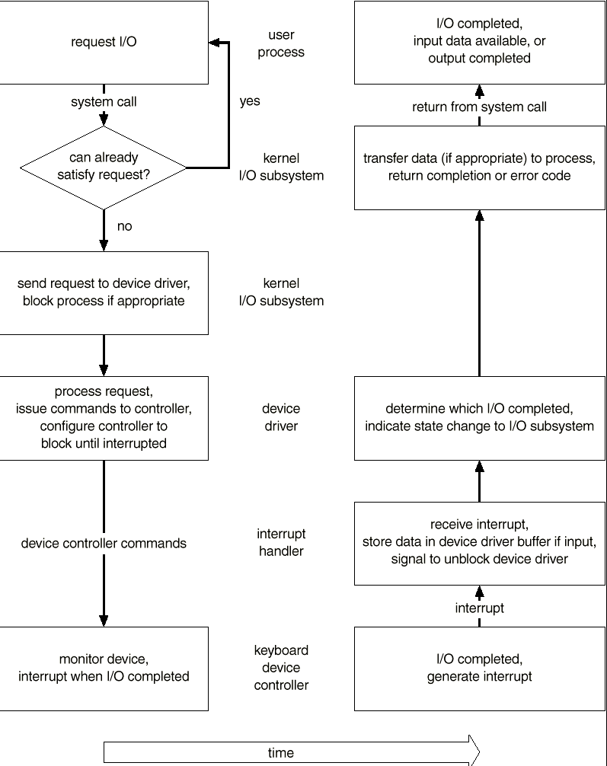
I/O SYSTEMS
Overview
PROCESSOR – I/O INTERFACES
An I/O request has a number of steps that can be seen in this figure.

Slide 3
I/O SYSTEMS
Disk
Characteristics
A disk can be viewed as an array of blocks. In fact, a file system will want to view it at that logical level.
However, there's a mapping scheme from logical block address B, to physical address (represented by a track / sector pair.)‏
The smallest storage allocation is a block - nothing smaller can be placed on the disk. This results in unused space (internal fragmentation) on the disk, since quite often the data being placed on the disk doesn't need a whole block.

Slide 4

I/O SYSTEMS
Disk Scheduling
The components making up disk service time include:
  time = setup + seek + rotation time + transfer + wrap-up
The methods discussed below try to optimize seek time but make no attempt to account for the total time. The ideal method would optimize the total time and many controllers are now able to accomplish this.
FCFS: Do requests in the order they come in: makes no attempt to minimize head motion. This may not give the best ( average ) service.
In this eg, it requires a total head movement of 640 cylinders.

Slide 5

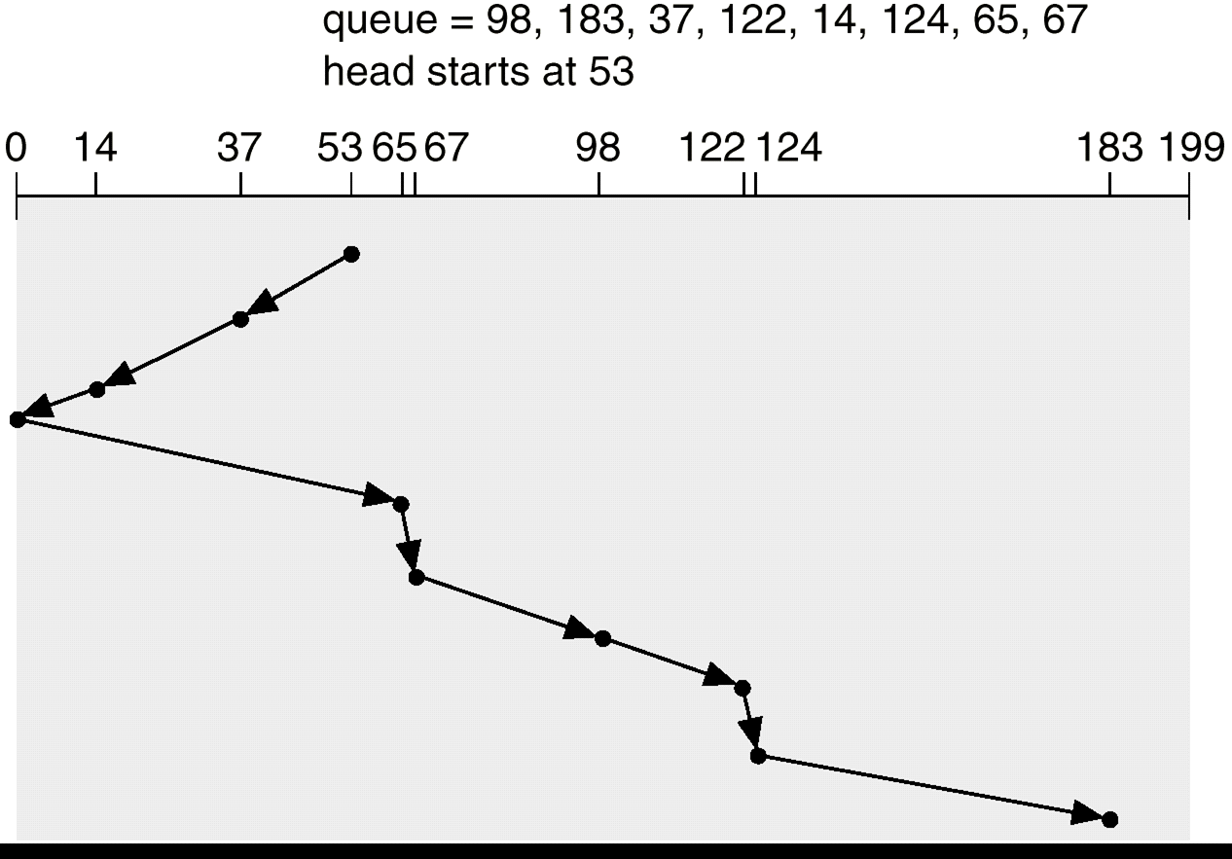
Disk Scheduling
SHORTEST SEEK TIME FIRST:
Select the request with cylinder closest to the current position. This is not the optimal or shortest path. Can cause starvation of some requests Substantial improvement over FCFS.
Here, the head movements- 236 cylinders
SCAN:
Move from one end of the disk to the other, servicing requests as encountered; then reverse at end.
It is sometimes called Elevator algorithm.

Slide 6

I/O SYSTEMS
Disk
Scheduling
Upon reversing, it's those requests at the far end which have waited the longest, but will still need to wait until the arm gets to that end.
C-SCAN: Returns to lowest cylinder at end of each scan. This results in a more uniform wait time.
LOOK: (In practice, both SCAN and C-SCAN stop at the last request, rather than actually traveling to the end of the disk. ) This is called LOOK and C-LOOK.

Slide 7
Disk
Scheduling
N-step-SCAN and FSCAN:
To avoid the “arm stickiness”, the disk request queue can be segmented, with one segment at a time being processed completely. Two examples for this approach are N-step-SCAN and FSCAN.
The N-step-SCAN policy segments the disk queue into sub queues of length N. Sub queues are processed one at a time, using SCAN. While a queue is being processed, new requests must be added to some other queues.
With large values of N, the performance of N-step-SCAN approaches that of SCAN; with a value of N=1, the FIFO policy is adopted.
FSCAN policy uses two sub queues. When a scan begins, all of the requests are in one of the queues, with other empty. During scan, all new requests are put into the other queue. Service of new requests is delayed until all of the old requests have been processed.

Slide 8
I/O SYSTEMS
Disk
Scheduling
SELECTING A SCHEDULING ALGORITHM
Evaluate the performance based on usage. Performance heavily depends on the number and types of the requests.
How the files were allocated becomes important (sequential, indexed, etc.)‏
Locality of reference also matters (Directory structure).
If the request queue is short, algorithm doesn't matter.
Today’s disks do all this scheduling in their own firmware.

Slide 9

Disk Scheduling
Mass-Storage Structure
The components making up disk service time include:
  time = setup + seek + rotation time + transfer + wrap-up
The methods discussed below try to optimize seek time but make no attempt to account for the total time. The ideal method would optimize the total time and many controllers are now able to accomplish this.

Slide 10
I/O SYSTEMS
Disk Management
Disk formatting Creates a logical disk from the raw disk. Includes setting aside chunks of the disk for booting, bad blocks, etc. Also provides information needed by the driver to understand its positioning.(Low level format, Error Correcting Code, Partitions, Making File System)‏
Boot block That location on the disk that is accessed when trying to boot the operating system. It's a well-known location that contains the code that understands how to get at the operating system - generally this code has a rudimentary knowledge of the file system. (Bootstrap, ROM, Bootstrap Loader,Boot Block, Boot Disk)‏
Bad blocks The driver knows how to compensate for a bad block on the disk. It does this by putting a pointer, at the location of the bad block, indicating where a good copy of the data can be found.(Format,CHKDSK,Sector Sparing or forwarding in SCSI)‏
Swap Space Management The Operating System requires a contiguous space where it knows that disk blocks have been reserved for paging. This space is needed because a program can't be given unshared memory unless there's a backing store location for that memory.

Slide 11
I/O SYSTEMS
Performance and Reliability
MIRRORING One way to increase reliability is to "mirror" data on a disk. Every piece of data is maintained on two disks - disk drivers must be capable of getting data from either disk. Performance issues: a read is faster since data can be obtained from either disk - writes are slower since the data must be put on both disks.
RAID Redundant Array of Inexpensive Disks: Rather than maintain two copies of the data, maintain one copy plus parity. For example, four disks contain data, and a fifth disk holds the parity of the XOR of the four data disks. Reads slower than mirroring, writes much slower. But RAID is considerably CHEAPER than mirroring.
DISK STRIPING Disks tend to be accessed unevenly - programs ask for a number of blocks from the same file, for instance. Accesses can be distributed more evenly by spreading a file out over several disks. This works well with RAID. Thus block 0 is on disk 0, block 1 is on disk 1, block 4 is on disk 0.
Consider how to recover from a failure on these architectures.

Slide 12
I/O SYSTEMS
Wrap Up
This chapter is mostly about managing disks. In particular, how to get good performance out of that disk.
We also discussed reliability, and various disk management details.

