Slide 1
Data Preprocessing

Slide 2
Data Preprocessing
Why preprocess the data?
Data cleaning
Data integration and transformation
Data reduction
Discretization and concept hierarchy generation
Summary

Slide 3
Why Data Preprocessing?
Data in the real world is dirty
  incomplete: lacking attribute values, lacking certain attributes of interest, or containing only aggregate data
  noisy: containing errors or outliers
  inconsistent: containing discrepancies in codes or names
No quality data, no quality mining results!
  Quality decisions must be based on quality data
  Data warehouse needs consistent integration of quality data
  Required for both OLAP and Data Mining!

Slide 4
Why can Data be Incomplete?
Attributes of interest are not available (e.g., customer information for sales transaction data)
Data were not considered important at the time of transactions, so they were not recorded!
Data not recorder because of misunderstanding or malfunctions
Data may have been recorded and later deleted!
Missing/unknown values for some data

Slide 5
Why can Data be Noisy/Inconsistent?
Faulty instruments for data collection
Human or computer errors
Errors in data transmission
Technology limitations (e.g., sensor data come at a faster rate than they can be processed)
Inconsistencies in naming conventions or data codes (e.g., 2/5/2002 could be 2 May 2002 or 5 Feb 2002)
Duplicate tuples, which were received twice should also be removed

Slide 6
Multi-Dimensional Measure of Data Quality
A well-accepted multidimensional view:
  Accuracy
  Completeness
  Consistency
  Timeliness
  Believability
  Value added
  Interpretability
  Accessibility
Broad categories:
  intrinsic, contextual, representational, and accessibility.

Slide 7
Major Tasks in Data Preprocessing
outliers=exceptions!
Data cleaning
  Fill in missing values, smooth noisy data, identify or remove outliers, and resolve inconsistencies
Data integration
  Integration of multiple databases, data cubes, or files
Data transformation
  Normalization and aggregation
Data reduction
  Obtains reduced representation in volume but produces the same or similar analytical results
Data discretization
  Part of data reduction but with particular importance, especially for numerical data

Slide 8
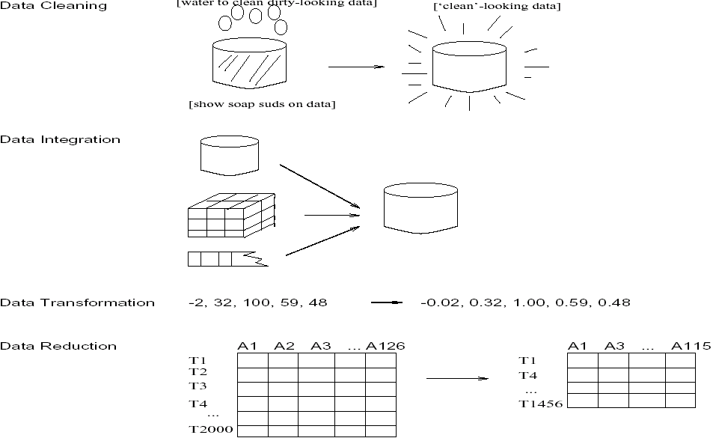
Forms of data preprocessing

Slide 9
Data Preprocessing
Why preprocess the data?
Data cleaning
Data integration and transformation
Data reduction
Discretization and concept hierarchy generation
Summary

Slide 10
Data Cleaning
Data cleaning tasks
  Fill in missing values
  Identify outliers and smooth out noisy data
  Correct inconsistent data

Slide 11
How to Handle Missing Data?
Ignore the tuple: usually done when class label is missing (assuming the tasks in classification)—not effective when the percentage of missing values per attribute varies considerably.
Fill in the missing value manually: tedious + infeasible?
Use a global constant to fill in the missing value: e.g., “unknown”, a new class?!
Use the attribute mean to fill in the missing value
Use the attribute mean for all samples belonging to the same class to fill in the missing value: smarter
Use the most probable value to fill in the missing value: inference-based such as Bayesian formula or decision tree

Slide 12
How to Handle Missing Data?
Age | Income | Religion | Gender
23 | 24,200 | Muslim | M
39 | ? | Christian | F
45 | 45,390 | ? | F
Fill missing values using aggregate functions (e.g., average) or probabilistic estimates on global value distribution
E.g., put the average income here, or put the most probable income based on the fact that the person is 39 years old
E.g., put the most frequent religion here

Slide 13
Noisy Data
Noise: random error or variance in a measured variable
Incorrect attribute values may exist due to
  faulty data collection instruments
  data entry problems
  data transmission problems
  technology limitation
  inconsistency in naming convention
Other data problems which requires data cleaning
  duplicate records
  incomplete data
  inconsistent data

Slide 14
How to Handle Noisy Data?
Smoothing techniques
Binning method:
  first sort data and partition into (equi-depth) bins
  then one can smooth by bin means, smooth by bin median, smooth by bin boundaries, etc.
Clustering
  detect and remove outliers
Combined computer and human inspection
  computer detects suspicious values, which are then checked by humans
Regression
  smooth by fitting the data into regression functions
Use Concept hierarchies
  use concept hierarchies, e.g., price value -> “expensive”

Slide 15
Simple Discretization Methods: Binning
Equal-width (distance) partitioning:
  It divides the range into N intervals of equal size: uniform grid
  if A and B are the lowest and highest values of the attribute, the width of intervals will be: W = (B-A)/N.
  The most straightforward
  But outliers may dominate presentation
  Skewed data is not handled well.
Equal-depth (frequency) partitioning:
  It divides the range into N intervals, each containing approximately same number of samples
  Good data scaling – good handing of skewed data

Slide 16
Simple Discretization Methods: Binning
Example: customer ages
number
of values
Equi-width binning:
0-10
10-20
20-30
30-40
40-50
50-60
60-70
70-80
Equi-width binning:
0-22
22-31
48-55
62-80
38-44
32-38
44-48
55-62

Slide 17
Smoothing using Binning Methods
* Sorted data for price (in dollars): 4, 8, 9, 15, 21, 21, 24, 25, 26, 28, 29, 34
* Partition into (equi-depth) bins:
- Bin 1: 4, 8, 9, 15
- Bin 2: 21, 21, 24, 25
- Bin 3: 26, 28, 29, 34
* Smoothing by bin means:
- Bin 1: 9, 9, 9, 9
- Bin 2: 23, 23, 23, 23
- Bin 3: 29, 29, 29, 29
* Smoothing by bin boundaries: [4,15],[21,25],[26,34]
- Bin 1: 4, 4, 4, 15
- Bin 2: 21, 21, 25, 25
- Bin 3: 26, 26, 26, 34

Slide 18
Cluster Analysis
salary
cluster
outlier
age

Slide 19
Regression
y
(salary)
Example of linear regression
Y1
y = x + 1
X1
x
(age)

Slide 20
Inconsistent Data
Inconsistent data are handled by:
  Manual correction (expensive and tedious)
  Use routines designed to detect inconsistencies and manually correct them. E.g., the routine may use the check global constraints (age>10) or functional dependencies
  Other inconsistencies (e.g., between names of the same attribute) can be corrected during the data integration process

Slide 21
Data Preprocessing
Why preprocess the data?
Data cleaning
Data integration and transformation
Data reduction
Discretization and concept hierarchy generation
Summary

Slide 22
Data Integration
Data integration:
  combines data from multiple sources into a coherent store
Schema integration
  integrate metadata from different sources
    metadata: data about the data (i.e., data descriptors)
  Entity identification problem: identify real world entities from multiple data sources, e.g., A.cust-id ≡ B.cust-#
Detecting and resolving data value conflicts
  for the same real world entity, attribute values from different sources are different (e.g., J.D.Smith and Jonh Smith may refer to the same person)
  possible reasons: different representations, different scales, e.g., metric vs. British units (inches vs. cm)

Slide 23
Handling Redundant Data in Data Integration
Redundant data occur often when integration of multiple databases
  The same attribute may have different names in different databases
  One attribute may be a “derived” attribute in another table, e.g., annual revenue
Redundant data may be able to be detected by correlation analysis
Careful integration of the data from multiple sources may help reduce/avoid redundancies and inconsistencies and improve mining speed and quality

Slide 24
Data Transformation
Smoothing: remove noise from data
Aggregation: summarization, data cube construction
Generalization: concept hierarchy climbing
Normalization: scaled to fall within a small, specified range
  min-max normalization
  z-score normalization
  normalization by decimal scaling
Attribute/feature construction
  New attributes constructed from the given ones

Slide 25
Normalization: Why normalization?
Speeds-up some learning techniques (ex. neural networks)
Helps prevent attributes with large ranges outweigh ones with small ranges
  Example:
    income has range 3000-200000
    age has range 10-80
    gender has domain M/F

Slide 26

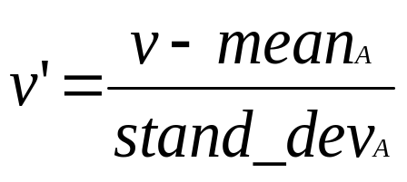


Data Transformation: Normalization
min-max normalization
  e.g. convert age=30 to range 0-1, when min=10,max=80. new_age=(30-10)/(80-10)=2/7
z-score normalization
normalization by decimal scaling
Where j is the smallest integer such that Max(| |)<1

Slide 27
Data Preprocessing
Why preprocess the data?
Data cleaning
Data integration and transformation
Data reduction
Discretization and concept hierarchy generation
Summary

Slide 28
Data Reduction Strategies
Warehouse may store terabytes of data: Complex data analysis/mining may take a very long time to run on the complete data set
Data reduction
  Obtains a reduced representation of the data set that is much smaller in volume but yet produces the same (or almost the same) analytical results
Data reduction strategies
  Data cube aggregation
  Dimensionality reduction
  Data compression
  Numerosity reduction
  Discretization and concept hierarchy generation

Slide 29
Data Cube Aggregation
The lowest level of a data cube
  the aggregated data for an individual entity of interest
  e.g., a customer in a phone calling data warehouse.
Multiple levels of aggregation in data cubes
  Further reduce the size of data to deal with
Reference appropriate levels
  Use the smallest representation which is enough to solve the task
Queries regarding aggregated information should be answered using data cube, when possible

Slide 30
Dimensionality Reduction
Feature selection (i.e., attribute subset selection):
  Select a minimum set of features such that the probability distribution of different classes given the values for those features is as close as possible to the original distribution given the values of all features
  reduce # of patterns in the patterns, easier to understand
Heuristic methods (due to exponential # of choices):
  step-wise forward selection
  step-wise backward elimination
  combining forward selection and backward elimination
  decision-tree induction

Slide 31
Heuristic Feature Selection Methods
There are 2^{d} possible sub-features of d features
Several heuristic feature selection methods:
  Best single features under the feature independence assumption: choose by significance tests.
  Best step-wise feature selection:
    The best single-feature is picked first
    Then next best feature condition to the first, ...
  Step-wise feature elimination:
    Repeatedly eliminate the worst feature
  Best combined feature selection and elimination:
  Optimal branch and bound:
    Use feature elimination and backtracking

Slide 32
Example of Decision Tree Induction
Initial attribute set:
{A1, A2, A3, A4, A5, A6}
A4 ?
A1?
A6?
Class 1
Class 2
Class 1
Class 2
>
Reduced attribute set: {A1, A4, A6}

Slide 33
Data Compression
Original Data
Compressed
Data
lossless
Original Data
Approximated
lossy

Slide 34
Principal Component Analysis or Karhuren-Loeve (K-L) method
Given N data vectors from k-dimensions, find c <= k orthogonal vectors that can be best used to represent data
  The original data set is reduced to one consisting of N data vectors on c principal components (reduced dimensions)
Each data vector is a linear combination of the c principal component vectors
Works for numeric data only
Used when the number of dimensions is large

Slide 35
Principal Component Analysis
X1, X2: original axes (attributes)
Y1,Y2: principal components
X2
Y1
Y2
significant component (high variance)
X1
Order principal components by significance and eliminate weaker ones

Slide 36
Numerosity Reduction:
Reduce the volume of data
Parametric methods
  Assume the data fits some model, estimate model parameters, store only the parameters, and discard the data (except possible outliers)
  Log-linear models: obtain value at a point in m-D space as the product on appropriate marginal subspaces
Non-parametric methods
  Do not assume models
  Major families: histograms, clustering, sampling

Slide 37
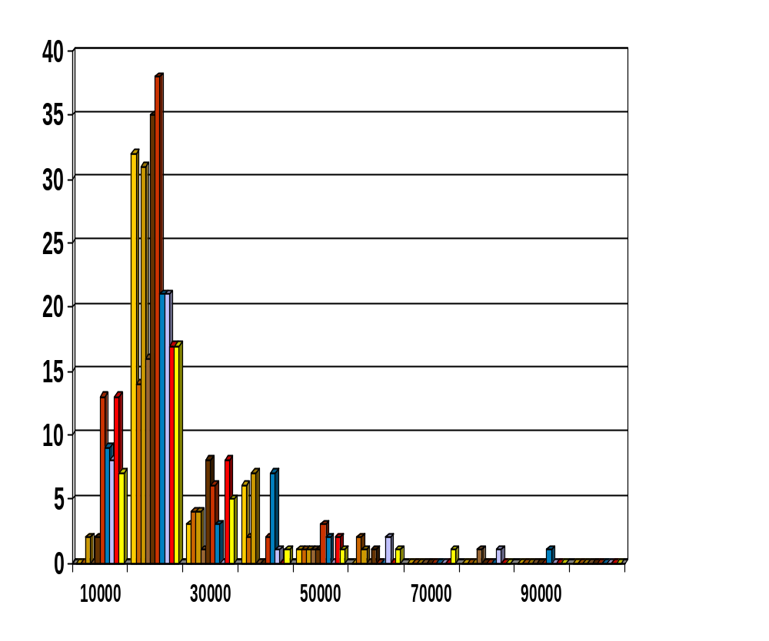
Histograms
A popular data reduction technique
Divide data into buckets and store average (or sum) for each bucket
Can be constructed optimally in one dimension using dynamic programming
Related to quantization problems.

Slide 38
Histogram types
Equal-width histograms:
  It divides the range into N intervals of equal size
Equal-depth (frequency) partitioning:
  It divides the range into N intervals, each containing approximately same number of samples
V-optimal:
  It considers all histogram types for a given number of buckets and chooses the one with the least variance.
MaxDiff:
  After sorting the data to be approximated, it defines the borders of the buckets at points where the adjacent values have the maximum difference
    Example: split 1,1,4,5,5,7,9,14,16,18,27,30,30,32 to three buckets
    MaxDiff 27-18 and 14-9
Histograms

Slide 39
Clustering
Partitions data set into clusters, and models it by one representative from each cluster
Can be very effective if data is clustered but not if data is “smeared”
There are many choices of clustering definitions and clustering algorithms, further detailed in Chapter 7

Slide 40
Cluster Analysis
the distance between points in the same cluster should be small
salary
the distance between points in different clusters should be large
cluster
outlier
age

Slide 41
Hierarchical Reduction
Use multi-resolution structure with different degrees of reduction
Hierarchical clustering is often performed but tends to define partitions of data sets rather than “clusters”
Parametric methods are usually not amenable to hierarchical representation
Hierarchical aggregation
  An index tree hierarchically divides a data set into partitions by value range of some attributes
  Each partition can be considered as a bucket
  Thus an index tree with aggregates stored at each node is a hierarchical histogram

Slide 42
Data Preprocessing
Why preprocess the data?
Data cleaning
Data integration and transformation
Data reduction
Discretization and concept hierarchy generation
Summary

Slide 43
Discretization
Three types of attributes:
  Nominal — values from an unordered set
  Ordinal — values from an ordered set
  Continuous — real numbers
Discretization:
  divide the range of a continuous attribute into intervals
  why?
    Some classification algorithms only accept categorical attributes.
    Reduce data size by discretization
    Prepare for further analysis

Slide 44
Discretization and Concept hierachy
Discretization
  reduce the number of values for a given continuous attribute by dividing the range of the attribute into intervals. Interval labels can then be used to replace actual data values.
Concept hierarchies
  reduce the data by collecting and replacing low level concepts (such as numeric values for the attribute age) by higher level concepts (such as young, middle-aged, or senior).

Slide 45
Discretization and concept hierarchy generation for numeric data
Binning/Smoothing (see sections before)
Histogram analysis (see sections before)
Clustering analysis (see sections before)
Entropy-based discretization
Segmentation by natural partitioning

Slide 46
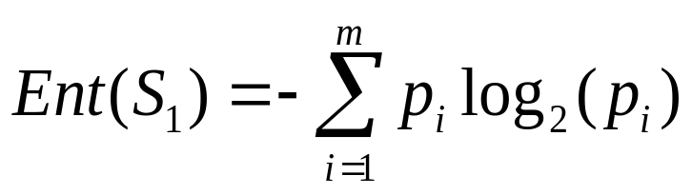
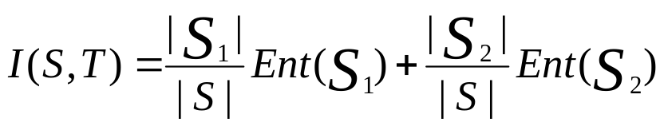

Entropy-Based Discretization
Entropy:
Given a set of samples S, if S is partitioned into two intervals S1 and S2 using boundary T, the information gain I(S,T) after partitioning is
The boundary that maximizes the information gain over all possible boundaries is selected as a binary discretization.
The process is recursively applied to partitions obtained until some stopping criterion is met, e.g.,
Experiments show that it may reduce data size and improve classification accuracy

Slide 47
Segmentation by natural partitioning
Users often like to see numerical ranges partitioned into relatively uniform, easy-to-read intervals that appear intuitive or “natural”. E.g., [50-60] better than [51.223-60.812]
The 3-4-5 rule can be used to segment numerical data into
relatively uniform, “natural” intervals.
* If an interval covers 3, 6, 7 or 9 distinct values at the most significant digit, partition the range into 3 equiwidth intervals for 3,6,9 or 2-3-2 for 7
* If it covers 2, 4, or 8 distinct values at the most significant digit, partition the range into 4 equiwidth intervals
* If it covers 1, 5, or 10 distinct values at the most significant digit, partition the range into 5 equiwidth intervals
The rule can be recursively applied for the resulting intervals

Slide 48
Concept hierarchy generation for categorical data
Categorical attributes: finite, possibly large domain, with no ordering among the values
  Example: item type
Specification of a partial ordering of attributes explicitly at the schema level by users or experts
  Example: location is split by domain experts to street<city<state<country
Specification of a portion of a hierarchy by explicit data grouping
Specification of a set of attributes, but not of their partial ordering
Specification of only a partial set of attributes

Slide 49
Specification of a set of attributes
Concept hierarchy can be automatically generated based on the number of distinct values per attribute in the given attribute set. The attribute with the most distinct values is placed at the lowest level of the hierarchy.
country
15 distinct values
province_or_ state
65 distinct values
city
3567 distinct values
street
674,339 distinct values

