Slide 1
Chapter 11
Object and Object-Relational Databases

Slide 2
Chapter 11 Outline
Overview of Object Database Concepts
Object-Relational Features:
Object Database Extensions to SQL
The ODMG Object Model and the Object Definition Language ODL
Object Database Conceptual Design
The Object Query Language OQL
Overview of the C++ Language Binding in the ODMG Standard

Slide 3
Object and Object-Relational
Databases
Object databases (ODB)
  Object data management systems (ODMS)
  Meet some of the needs of more complex applications
  Specify:
    Structure of complex objects
    Operations that can be applied to these objects

Slide 4
Overview of Object Database Concepts
Introduction to object-oriented concepts and features
  Origins in OO programming languages
  Object has two components:
    State (value) and behavior (operations)
  Instance variables
    Hold values that define internal state of object
  Operation is defined in two parts:
    Signature or interface and implementation

Slide 5
Overview of Object Database Concepts (cont’d.)
  Inheritance
    Permits specification of new types or classes that inherit much of their structure and/or operations from previously defined types or classes
  Operator overloading
    Operation’s ability to be applied to different types of objects
    Operation name may refer to several distinct implementations

Slide 6
Object Identity, and Objects versus Literals
Unique identity
  Implemented via a unique, system-generated object identifier (OID)
  Immutable
Most OO database systems allow for the representation of both objects and literals (or values)

Slide 7
Complex Type Structures for Objects and Literals
Structure of arbitrary complexity
  Contain all necessary information that describes object or literal
Nesting type constructors
  Construct complex type from other types
Most basic constructors:
  Atom
  Struct (or tuple)
  Collection

Slide 8
Complex Type Structures for Objects and Literals (cont’d.)
Collection types:
  Set
  Bag
  List
  Array
  Dictionary
Object definition language (ODL)
  Used to define object types for a particular database application

Slide 9
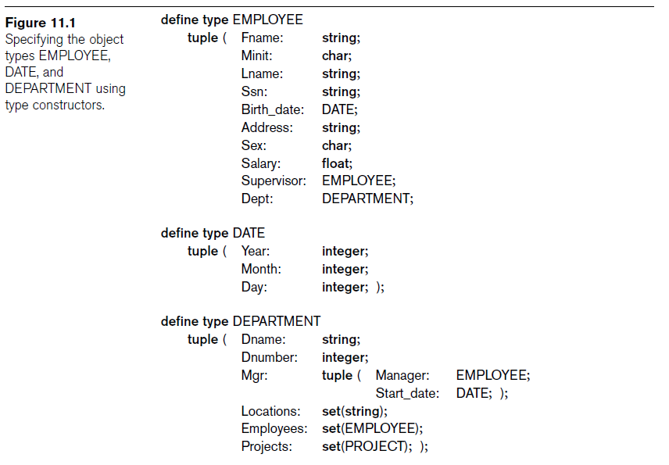

Slide 10
Encapsulation of Operations and Persistence of Objects
Encapsulation
  Related to abstract data types and information hiding in programming languages
  Define behavior of a type of object based on operations that can be externally applied
  External users only aware of interface of the operations
  Divide structure of object into visible and hidden attributes

Slide 11
Object Behavior/Operations
See figure 11.2

Slide 12
Encapsulation of Operations
Object constructor
  Used to create a new object
Destructor operation
  Used to destroy (delete) an object
Modifier operations
  Modify the states (values) of various attributes of an object
Retrieve information about the object
Dot notation used to apply operations to object

Slide 13
Persistence of Objects
Transient objects
  Exist in executing program
  Disappear once program terminates
Persistent objects
  Stored in database and persist after program termination
  Naming mechanism
  Reachability

Slide 14
Type Hierarchies and Inheritance
Inheritance
  Definition of new types based on other predefined types
  Leads to type (or class) hierarchy
Type: type name and list of visible (public) functions
  Format:
    TYPE_NAME: function, function, ..., function

Slide 15
Type Hierarchies and Inheritance (cont’d.)
Subtype
  Useful when creating a new type that is similar but not identical to an already defined type
  Example:
    EMPLOYEE subtype-of PERSON: Salary, Hire_date, Seniority
    STUDENT subtype-of PERSON: Major, Gpa

Slide 16
Type Hierarchies and Inheritance (cont’d.)
Extent
  Store collection of persistent objects for each type or subtype
  Extents are subsets of the extent of class OBJECT
Persistent collection
  Stored permanently in the database
Transient collection
  Exists temporarily during the execution of a program

Slide 17
Other Object-Oriented Concepts
Polymorphism of operations
  Also known as operator overloading
  Allows same operator name or symbol to be bound to two or more different implementations
  Depending on type of objects to which operator is applied
Multiple inheritance
  Subtype inherits functions (attributes and methods) of more than one supertype

Slide 18
Other Object-Oriented Concepts (cont’d.)
Selective inheritance
  Subtype inherits only some of the functions of a supertype

Slide 19
Summary of Object Database Concepts
Object identity
Type constructor
Encapsulation of operations
Programming language compatibility
Type hierarchies and inheritance
Extents
Polymorphism and operator overloading

Slide 20
Object-Relational Features:
Object Database Extensions to SQL
Type constructors
  Specify complex objects
Mechanism for specifying object identity
Encapsulation of operations
  Provided through user-defined types (UDTs)
Inheritance mechanisms
  Provided using keyword UNDER

Slide 21
User-Defined Types and Complex Structures for Objects
UDT syntax:
  CREATE TYPE TYPE_NAME AS (<component declarations>);
ROW TYPE
  Directly create a structured attribute using the keyword ROW
  phone_no ROW (
  area_code char (3),
  prefix_no char (3),
  number char (4),
  ),

Slide 22
User-Defined Types and Complex Structures for Objects (cont’d.)
Array type
  Reference elements using [ ]
CARDINALITY function
  Return the current number of elements in an array

Slide 23
Object Identifiers Using Reference Types
Reference type
  Create unique system-generated object identifiers
  Examples:
    REF IS SYSTEM GENERATED
    REF IS <OID_ATTRIBUTE> <VALUE_GENERATION_METHOD> ;
    Generation methods: SYSTEM GENERATED or DERIVED

Slide 24
Creating Tables Based on the UDTs
INSTANTIABLE
  Specify that UDT is instantiable
  Causes one or more tables to be created

Slide 25
Encapsulation of Operations
User-defined type
  Specify methods (or operations) in addition to the attributes
  Format:
  CREATE TYPE <TYPE-NAME> (
  <LIST OF COMPONENT ATTRIBUTES AND THEIR TYPES>
  <DECLARATION OF FUNCTIONS (METHODS)>
  );

Slide 26
Encapsulation of Operations (cont’d.)
Constructor function TYPE_T( )
  Returns a new object of that type
Observer function A implicitly created for each attribute A
  A(X) or X.A return the of attribute A
User defined functions can internal (SQL) or external
  External functions written in a host language

Slide 27
Specifying Inheritance and Overloading of Functions
Inheritance rules:
  All attributes inherited
  Order of supertypes in UNDER clause determines inheritance hierarchy
  Instance of a subtype can be used in every context in which a supertype instance used
  Subtype can redefine any function defined in supertype
  NOT FINAL: subtypes are allowed to be defined

Slide 28
Specifying Inheritance and Overloading of Functions (cont’d.)
  When a function is called, best match selected based on types of all arguments
  For dynamic linking, runtime types of parameters is considered

Slide 29
Specifying Relationships via Reference
Component attribute of one tuple may be a reference to a tuple of another table
  Specified using keyword REF
Keyword SCOPE: Specify name of table whose tuples referenced (e.g, FK)
Dot notation: Build path expressions
–> Used for dereferencing
SELECT E.Employee -> Name
FROM EMPLOYMENT AS E
WHERE E.Company -> Name = ‘Microsoft’;

Slide 30
The ODMG Object Model and the Object Definition Language ODL
ODMG object model
  Data model for object definition language (ODL) and object query language (OQL)
Objects and Literals
  Basic building blocks of the object model
Object has five aspects:
  Identifier, name, lifetime, structure, and creation
Literal
  Value that does not have an object identifier

Slide 31
The ODMG Object Model and the ODL (cont’d.)
Behavior refers to operations
State refers to properties
Interface
  Specifies only behavior of an object type
  Typically noninstantiable
Class
  Specifies both state (attributes) and behavior (operations) of an object type
  Instantiable

Slide 32
Inheritance in the Object Model of ODMG
Behavior inheritance
  Also known as IS-A or interface inheritance
  Specified by the colon (:) notation
EXTENDS inheritance
  Specified by keyword extends
  Inherit both state and behavior strictly among classes
  Multiple inheritance via extends not permitted

Slide 33
Built-in Interfaces and Classes in the Object Model
Collection objects
  Inherit the basic Collection interface
I = O.create_iterator()
  Creates an iterator object for the collection
Collection objects further specialized into:
  set, list, bag, array, and dictionary

Slide 34
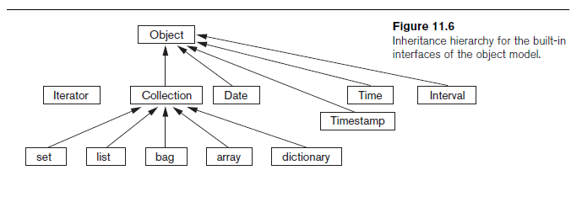
Built-in Interfaces and Classes in the Object Model (cont’d.)

Slide 35
Atomic (User-Defined) Objects
Specified using keyword class in ODL
Attribute
  Property; describes some aspect of an object
Relationship
  Two objects in the database are related
  Keyword inverse
    Single conceptual relationship in inverse directions
Operation signature:
  Operation name, argument types, return value

Slide 36
Extents, Keys, and Factory Objects
Extent
  Contains all persistent objects of class
Key
  One or more properties whose values are unique for each object in extent
Factory object
  Used to generate or create individual objects via its operations

Slide 37
The Object Definition Language ODL
Support semantic constructs of ODMG object model
Independent of any particular programming language

Slide 38
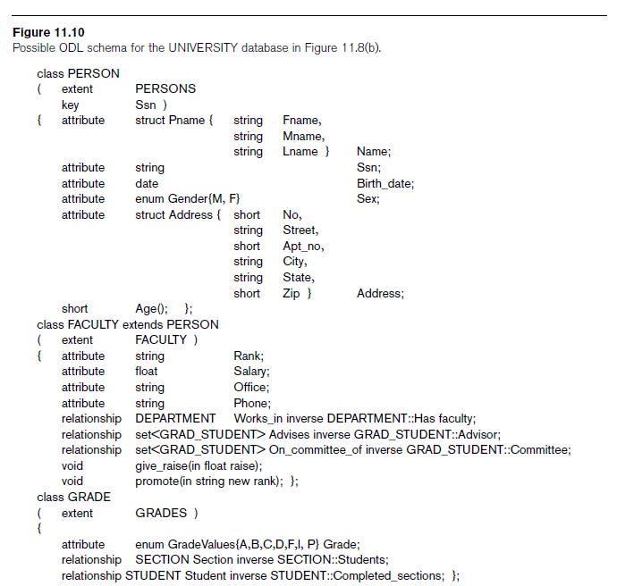

Slide 39
Object Database Conceptual Design
Differences between conceptual design of ODB and RDB, handling of:
  Relationships
  Inheritance
Philosophical difference between relational model and object model of data
  In terms of behavioral specification

Slide 40
Mapping an EER Schema to an ODB Schema
Create ODL class for each EER entity type
Add relationship properties for each binary relationship
Include appropriate operations for each class
ODL class that corresponds to a subclass in the EER schema
  Inherits type and methods of its superclass in ODL schema

Slide 41
Mapping an EER Schema to an ODB Schema (cont’d.)
Weak entity types
  Mapped same as regular entity types
Categories (union types)
  Difficult to map to ODL
An n-ary relationship with degree n > 2
  Map into a separate class, with appropriate references to each participating class

Slide 42
The Object Query Language OQL
Query language proposed for ODMG object model
Simple OQL queries, database entry points, and iterator variables
  Syntax: select ... from ... where ... structure
  Entry point: named persistent object
  Iterator variable: define whenever a collection is referenced in an OQL query

Slide 43
Query Results and Path Expressions
Result of a query
  Any type that can be expressed in ODMG object model
OQL orthogonal with respect to specifying path expressions
  Attributes, relationships, and operation names (methods) can be used interchangeably within the path expressions

Slide 44
Other Features of OQL
Named query
  Specify identifier of named query
OQL query will return collection as its result
  If user requires that a query only return a single element use element operator
Aggregate operators
Membership and quantification over a collection

Slide 45
Other Features of OQL (cont’d.)
Special operations for ordered collections
Group by clause in OQL
  Similar to the corresponding clause in SQL
  Provides explicit reference to the collection of objects within each group or partition
Having clause
  Used to filter partitioned sets

Slide 46
Overview of the C++ Language Binding in the ODMG Standard
Specifies how ODL constructs are mapped to C++ constructs
Uses prefix d_ for class declarations that deal with database concepts
Template classes
  Specified in library binding
  Overloads operation new so that it can be used to create either persistent or transient objects

Slide 47
Summary
Overview of concepts utilized in object databases
  Object identity and identifiers; encapsulation of operations; inheritance; complex structure of objects through nesting of type constructors; and how objects are made persistent
Description of the ODMG object model and object query language (OQL)
Overview of the C++ language binding

