Slide 1


Slide 2
Chapter 12 Outline
Overview of Object Database Concepts
Object-Relational Features
Object Database Extensions to SQL
ODMG Object Model and the Object Definition Language ODL
Object Database Conceptual Design
The Object Query Language OQL
Overview of the C++ Language Binding
Slide 12- 2

Slide 3
Object and Object-Relational
Databases
Object databases (ODB)
  Object data management systems (ODMS)
  Meet some of the needs of more complex applications
  Specify:
    Structure of complex objects
    Operations that can be applied to these objects
Slide 12- 3

Slide 4
Overview of Object Database Concepts
Introduction to object-oriented concepts and features
  Origins in OO programming languages
  Object has two components:
    State (value) and behavior (operations)
  Instance variables (attributes)
    Hold values that define internal state of object
  Operation is defined in two parts:
    Signature (interface) and implementation (method)
Slide 12- 4

Slide 5
Overview of Object Database Concepts (cont’d.)
  Inheritance
    Permits specification of new types or classes that inherit much of their structure and/or operations from previously defined types or classes
  Operator overloading
    Operation’s ability to be applied to different types of objects
    Operation name may refer to several distinct implementations
Slide 12- 5

Slide 6
Object Identity, and Objects versus Literals
Object has Unique identity
  Implemented via a unique, system-generated object identifier (OID)
  Immutable
Most OO database systems allow for the representation of both objects and literals (simple or complex values)
Slide 12- 6

Slide 7
Complex Type Structures for Objects and Literals
Structure of arbitrary complexity
  Contain all necessary information that describes object or literal
Nesting type constructors
  Generate complex type from other types
Type constructors (type generators):
  Atom (basic data type – int, string, etc.)
  Struct (or tuple)
  Collection
Slide 12- 7

Slide 8
Complex Type Structures for Objects and Literals (cont’d.)
Collection types:
  Set
  Bag
  List
  Array
  Dictionary
Object definition language (ODL)
  Used to define object types for a particular database application
Slide 12- 8

Slide 9
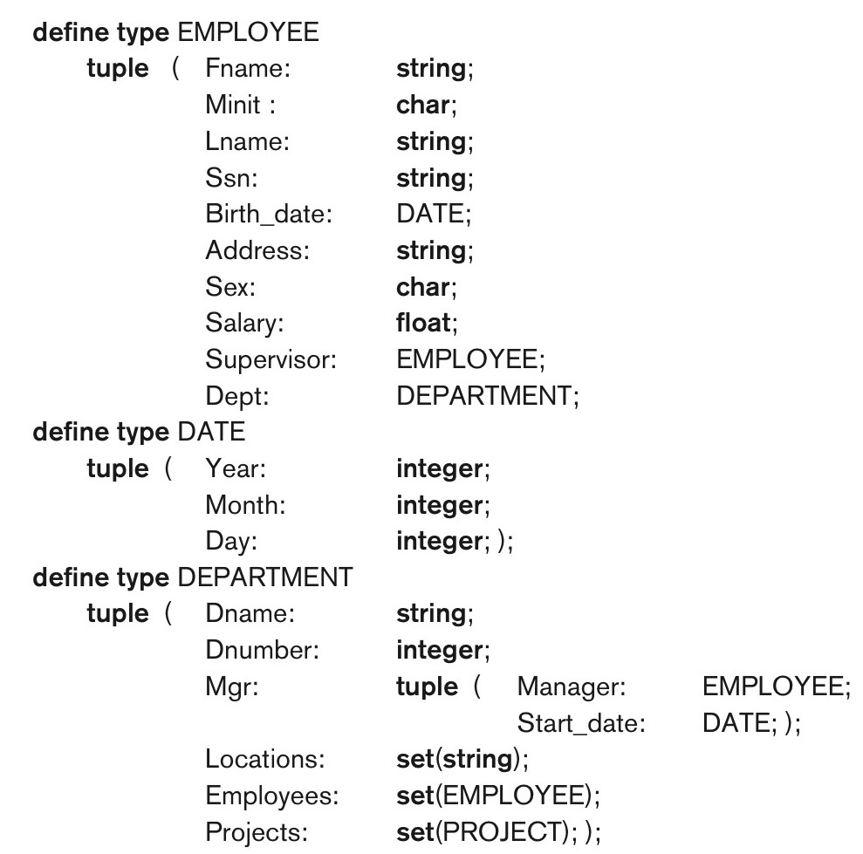
Figure 12.1 Specifying the object types EMPLOYEE, DATE, and DEPARTMENT using type constructors.
Slide 12- 9

Slide 10
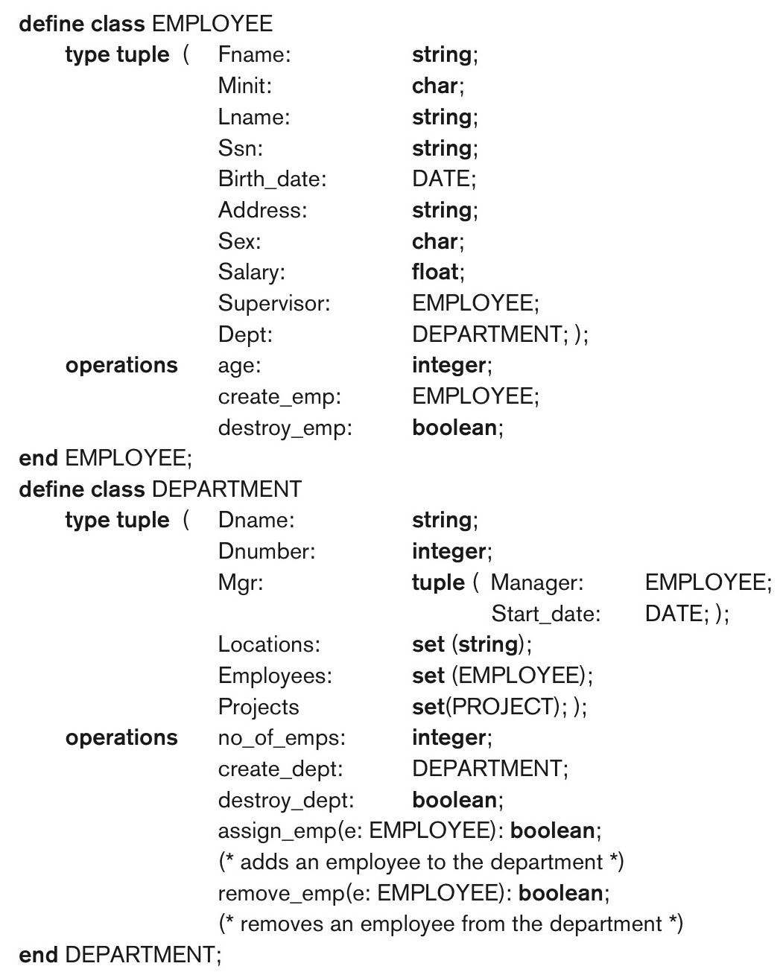
Figure 12.2 Adding operations to the definitions of EMPLOYEE and DEPARTMENT.
Slide 12- 10

Slide 11
Encapsulation of Operations
Encapsulation
  Related to abstract data types
  Define behavior of a class of object based on operations that can be externally applied
  External users only aware of interface of the operations
  Can divide structure of object into visible and hidden attributes
Slide 12- 11

Slide 12
Encapsulation of Operations
Constructor operation
  Used to create a new object
Destructor operation
  Used to destroy (delete) an object
Modifier operations
  Modify the state of an object
Retrieve operation
Dot notation to apply operations to object
Slide 12- 12

Slide 13
Persistence of Objects
Transient objects
  Exist in executing program
  Disappear once program terminates
Persistent objects
  Stored in database, persist after program termination
  Naming mechanism: object assigned a unique name in object base, user finds object by its name
  Reachability: object referenced from other persistent objects, object located through references
Slide 12- 13

Slide 14
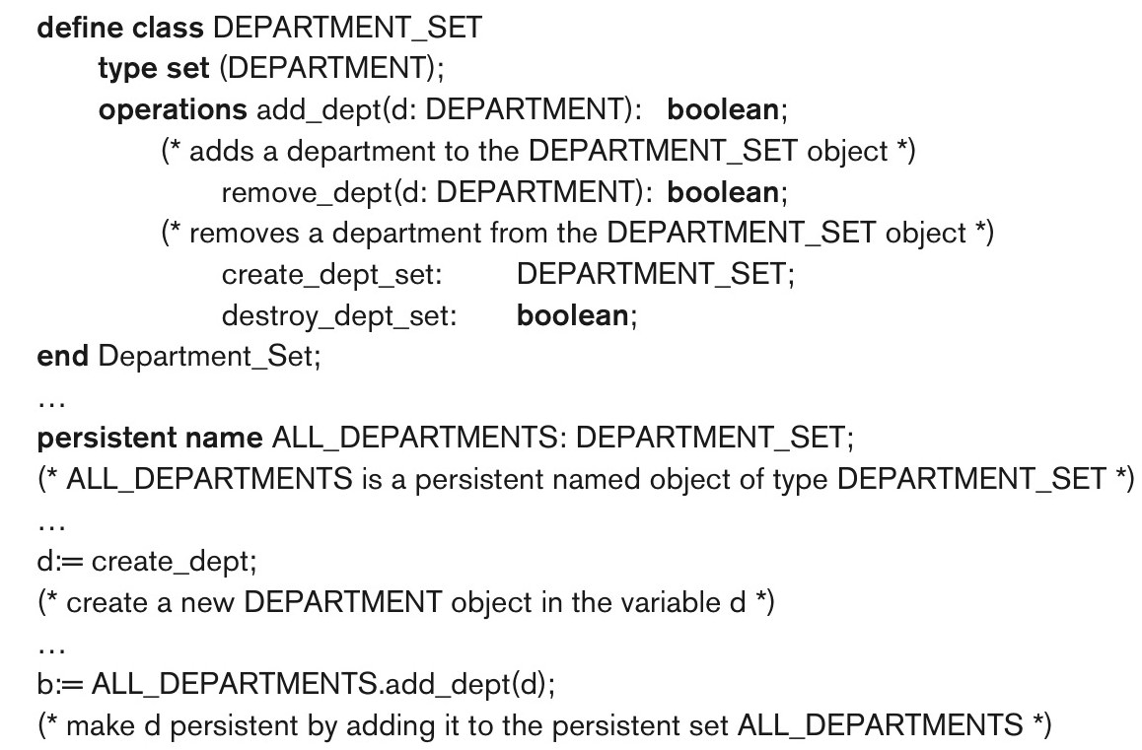
Figure 12.3 Creating persistent objects by naming and reachability.
Slide 12- 14

Slide 15
Type (Class) Hierarchies and Inheritance
Inheritance
  Definition of new types based on other predefined types
  Leads to type (or class) hierarchy
Type: type name and list of visible (public) functions (attributes or operations)
  Format:
    TYPE_NAME: function, function, ..., function
Slide 12- 15

Slide 16
Type (Class) Hierarchies and Inheritance (cont’d.)
Subtype
  Useful when creating a new type that is similar but not identical to an already defined type
  Subtype inherits functions
  Additional (local or specific) functions in subtype
  Example:
    EMPLOYEE subtype-of PERSON: Salary, Hire_date, Seniority
    STUDENT subtype-of PERSON: Major, Gpa
Slide 12- 16

Slide 17
Type (Class) Hierarchies and Inheritance (cont’d.)
Extent
  A named persistent object to hold collection of all persistent objects for a class
Persistent collection
  Stored permanently in the database
Transient collection
  Exists temporarily during the execution of a program (e.g. query result)
Slide 12- 17

Slide 18
Other Object-Oriented Concepts
Polymorphism of operations
  Also known as operator overloading
  Allows same operator name or symbol to be bound to two or more different implementations
  Type of objects determines which operator is applied
Multiple inheritance
  Subtype inherits functions (attributes and operations) of more than one supertype
Slide 12- 18

Slide 19
Summary of Object Database Concepts
Object identity
Type constructors (type generators)
Encapsulation of operations
Programming language compatibility
Type (class) hierarchies and inheritance
Extents
Polymorphism and operator overloading
Slide 12- 19

Slide 20
Object-Relational Features:
Object DB Extensions to SQL
Type constructors (generators)
  Specify complex types using UDT
Mechanism for specifying object identity
Encapsulation of operations
  Provided through user-defined types (UDTs)
Inheritance mechanisms
  Provided using keyword UNDER
Slide 12- 20

Slide 21
User-Defined Types (UDTs) and Complex Structures for Objects
UDT syntax:
  CREATE TYPE <type name> AS (<component declarations>);
  Can be used to create a complex type for an attribute (similar to struct – no operations)
  Or: can be used to create a type as a basis for a table of objects (similar to class – can have operations)
Slide 12- 21

Slide 22
User-Defined Types and Complex Structures for Objects (cont’d.)
Array type – to specify collections
  Reference array elements using []
CARDINALITY function
  Return the current number of elements in an array
Early SQL had only array for collections
  Later versions of SQL added other collection types (set, list, bag, array, etc.)
Slide 12- 22

Slide 23
Object Identifiers Using Reference Types
Reference type
  Create unique object identifiers (OIDs)
  Can specify system-generated object identifiers
  Alternatively can use primary key as OID as in traditional relational model
  Examples:
    REF IS SYSTEM GENERATED
    REF IS <OID_ATTRIBUTE> <VALUE_GENERATION_METHOD> ;
Slide 12- 23

Slide 24
Creating Tables Based on the UDTs
INSTANTIABLE
  Specify that UDT is instantiable
  The user can then create one or more tables based on the UDT
  If keyword INSTANTIABLE is left out, can use UDT only as attribute data type – not as a basis for a table of objects
Slide 12- 24

Slide 25
Encapsulation of Operations
User-defined type
  Specify methods (or operations) in addition to the attributes
  Format:
  CREATE TYPE <TYPE-NAME> (
  <LIST OF COMPONENT ATTRIBUTES AND THEIR TYPES>
  <DECLARATION OF FUNCTIONS (METHODS)>
  );
Slide 12- 25

Slide 26
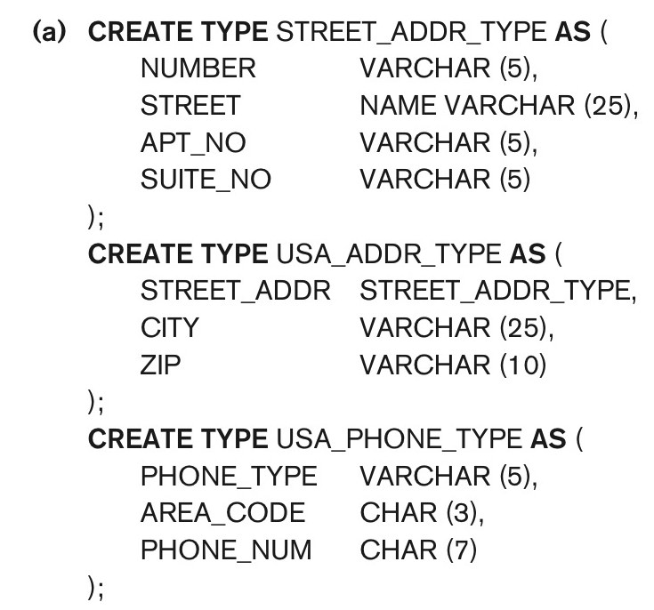
Figure 12.4a Illustrating some of the object features of SQL. Using UDTs as types for attributes such as Address and Phone.
continued on next slide
Slide 12- 26

Slide 27
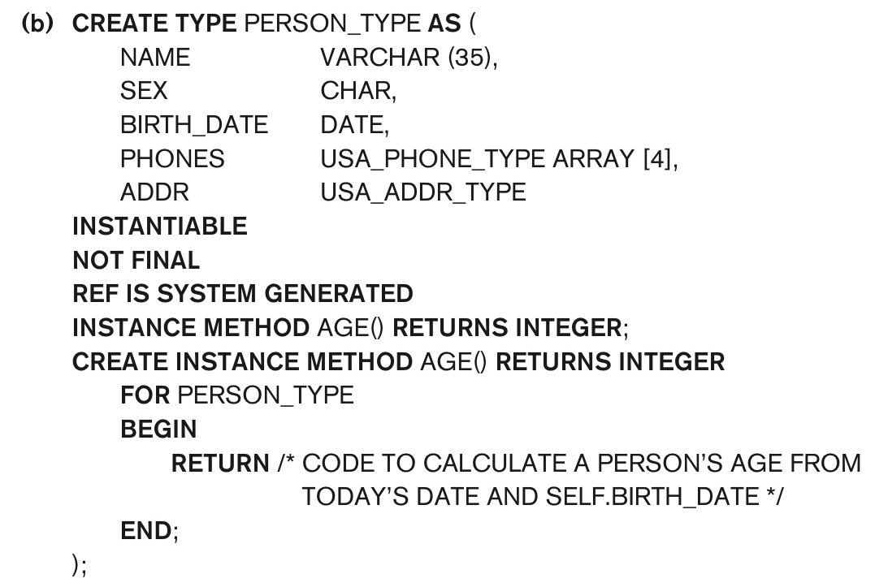
Figure 12.4b Illustrating some of the object features of SQL. Specifying UDT for PERSON_TYPE.
continued on next slide
Slide 12- 27

Slide 28
Specifying Type Inheritance
NOT FINAL:
  The keyword NOT FINAL indicates that subtypes can be created for that type
UNDER
  The keyword UNDER is used to create a subtype
Slide 12- 28

Slide 29
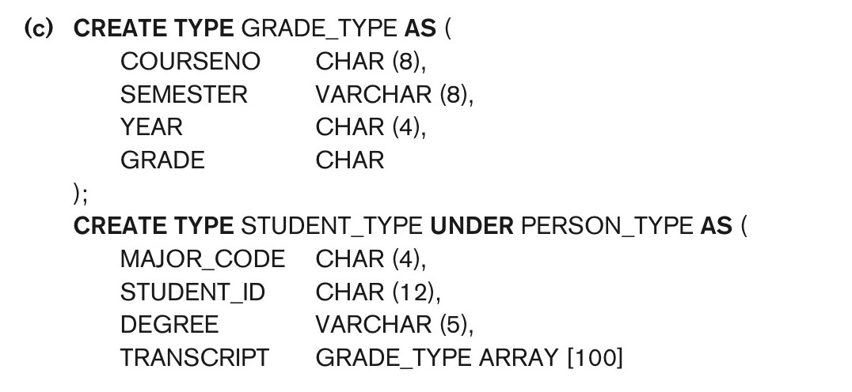
Figure 12.4c Illustrating some of the object features of SQL. Specifying UDTs for STUDENT_TYPE and EMPLOYEE_TYPE as two subtypes of PERSON_TYPE.
continued on next slide
Slide 12- 29

Slide 30
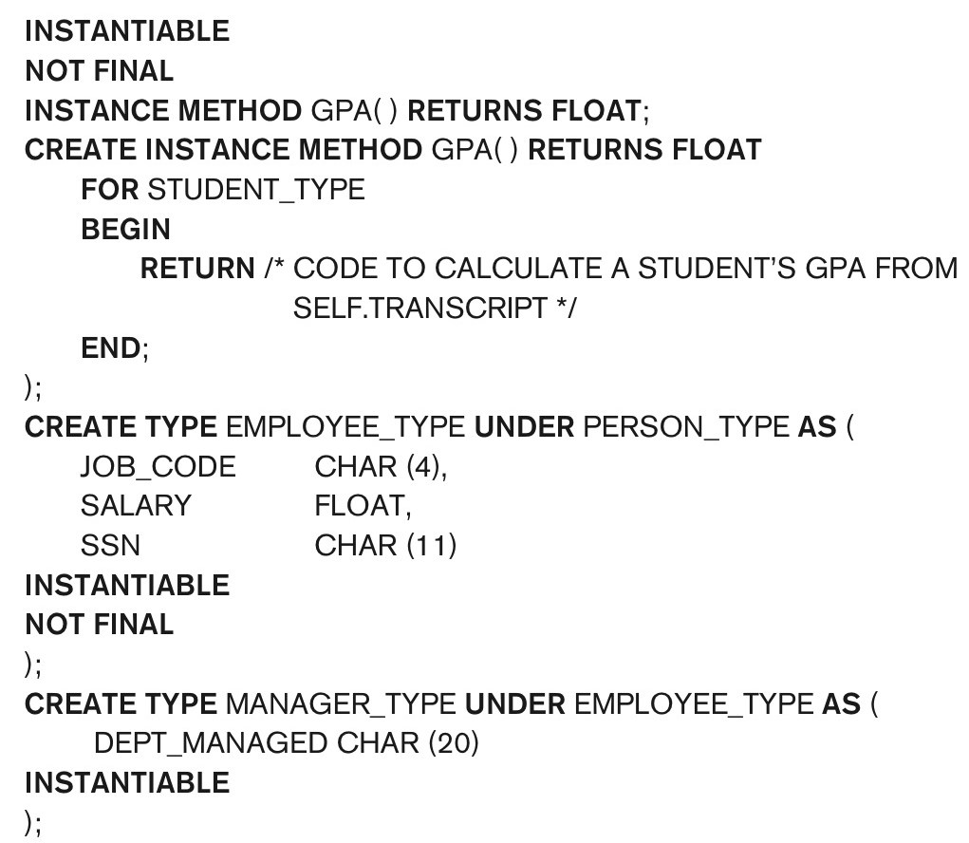
Figure 12.4c (continued) Illustrating some of the object features of SQL. Specifying UDTs for STUDENT_TYPE and EMPLOYEE_TYPE as two subtypes of PERSON_TYPE.
continued on next slide
Slide 12- 30

Slide 31
Specifying Type Inheritance
Type inheritance rules:
  All attributes/operations are inherited
  Order of supertypes in UNDER clause determines inheritance hierarchy
  Instance (object) of a subtype can be used in every context in which a supertype instance used
  Subtype can redefine any function defined in supertype
Slide 12- 31

Slide 32
Creating Tables based on UDT
  UDT must be INSTANTIABLE
  One or more tables can be created
  Table inheritance:
    UNDER keyword can also be used to specify supertable/subtable inheritance
    Objects in subtable must be a subset of the objects in the supertable
Slide 12- 32

Slide 33
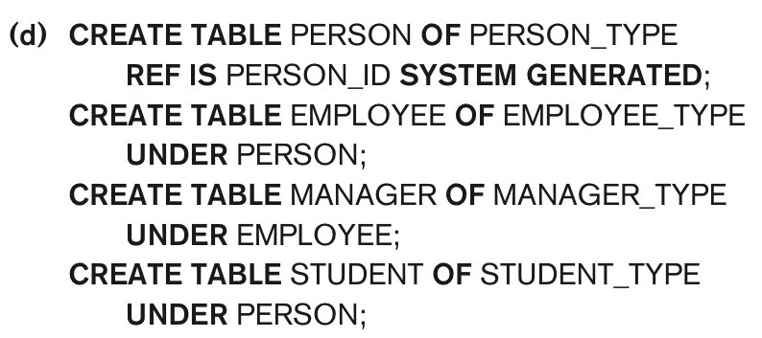
Figure 12.4d Illustrating some of the object features of SQL. Creating tables based on some of the UDTs, and illustrating table inheritance.
continued on next slide
Slide 12- 33

Slide 34
Specifying Relationships via Reference
Component attribute of one tuple may be a reference to a tuple of another table
  Specified using keyword REF
Keyword SCOPE
  Specify name of table whose tuples referenced
Dot notation
  Build path expressions
–>
  Used for dereferencing
Slide 12- 34

Slide 35
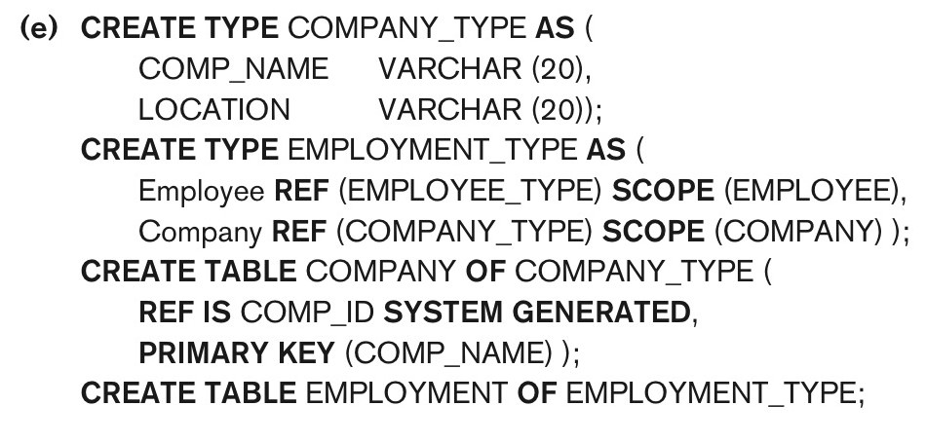
Figure 12.4e Illustrating some of the object features of SQL. Specifying relationships using REF and SCOPE.
Slide 12- 35

Slide 36
Summary of SQL Object Extensions
UDT to specify complex types
  INSTANTIABLE specifies if UDT can be used to create tables; NOT FINAL specifies if UDT can be inherited by a subtype
REF for specifying object identity and inter-object references
Encapsulation of operations in UDT
Keyword UNDER to specify type inheritance and table inheritance
Slide 12- 36

Slide 37
ODMG Object Model and Object Definition Language ODL
ODMG object model
  Data model for object definition language (ODL) and object query language (OQL)
Objects and Literals
  Basic building blocks of the object model
Object has five aspects:
  Identifier, name, lifetime, structure, and creation
Literal
  Value that does not have an object identifier
Slide 12- 37

Slide 38
The ODMG Object Model and the ODL (cont’d.)
Behavior refers to operations
State refers to properties (attributes)
Interface
  Specifies only behavior of an object type
  Typically noninstantiable
Class
  Specifies both state (attributes) and behavior (operations) of an object type
  Instantiable
Slide 12- 38

Slide 39
Inheritance in the Object Model of ODMG
Behavior inheritance
  Also known as IS-A or interface inheritance
  Specified by the colon (:) notation
EXTENDS inheritance
  Specified by keyword extends
  Inherit both state and behavior strictly among classes
  Multiple inheritance via extends not permitted
Slide 12- 39

Slide 40
Built-in Interfaces and Classes in the Object Model
Collection objects
  Inherit the basic Collection interface
i = o.create_iterator()
  Creates an iterator object for the collection
  To loop over each object in a collection
Collection objects further specialized into:
  set, list, bag, array, and dictionary
Slide 12- 40

Slide 41
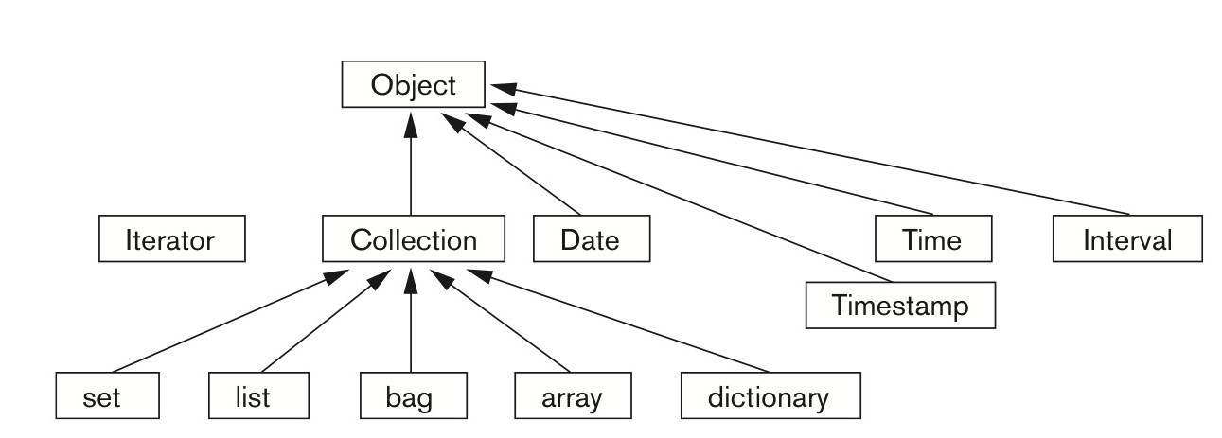
Figure 12.6 Inheritance hierarchy for the built-in interfaces of the object model.
Slide 12- 41

Slide 42
Atomic (User-Defined) Objects
Specified using keyword class in ODL
Attribute
  Property; describes data in an object
Relationship
  Specifies inter-object references
  Keyword inverse
    Single conceptual relationship in inverse directions
Operation signature:
  Operation name, argument types, return value
Slide 12- 42

Slide 43
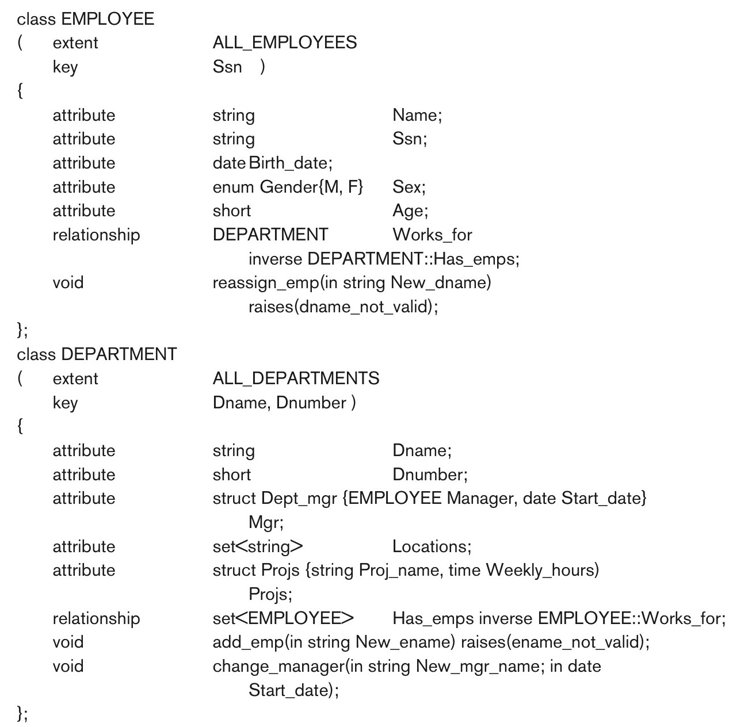
Figure 12.7 The attributes, relationships, and operations in a class definition.
Slide 12- 43

Slide 44
Extents, Keys, and Factory Objects
Extent
  A persistent named collection object that contains all persistent objects of class
Key
  One or more properties whose values are unique for each object in extent of a class
Factory object
  Used to generate or create individual objects via its operations
Slide 12- 44

Slide 45
Object Definition Language ODL
Support semantic constructs of ODMG object model
Independent of any particular programming language
Example on next slides of a UNIVERSITY database
Graphical diagrammatic notation is a variation of EER diagrams
Slide 12- 45

Slide 46
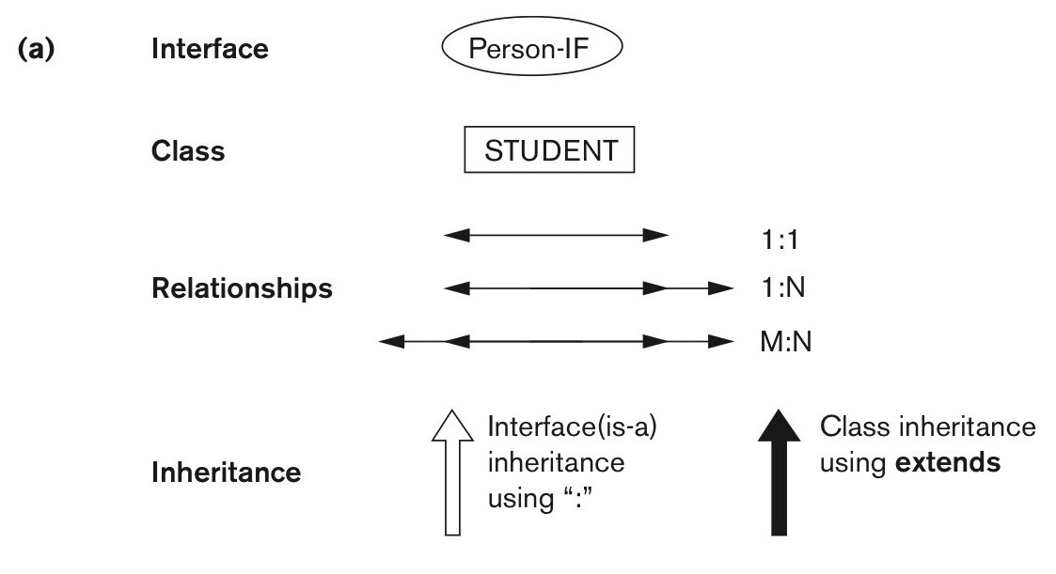
Figure 12.9a An example of a database schema. Graphical notation for representing ODL schemas.
continued on next slide
Slide 12- 46

Slide 47
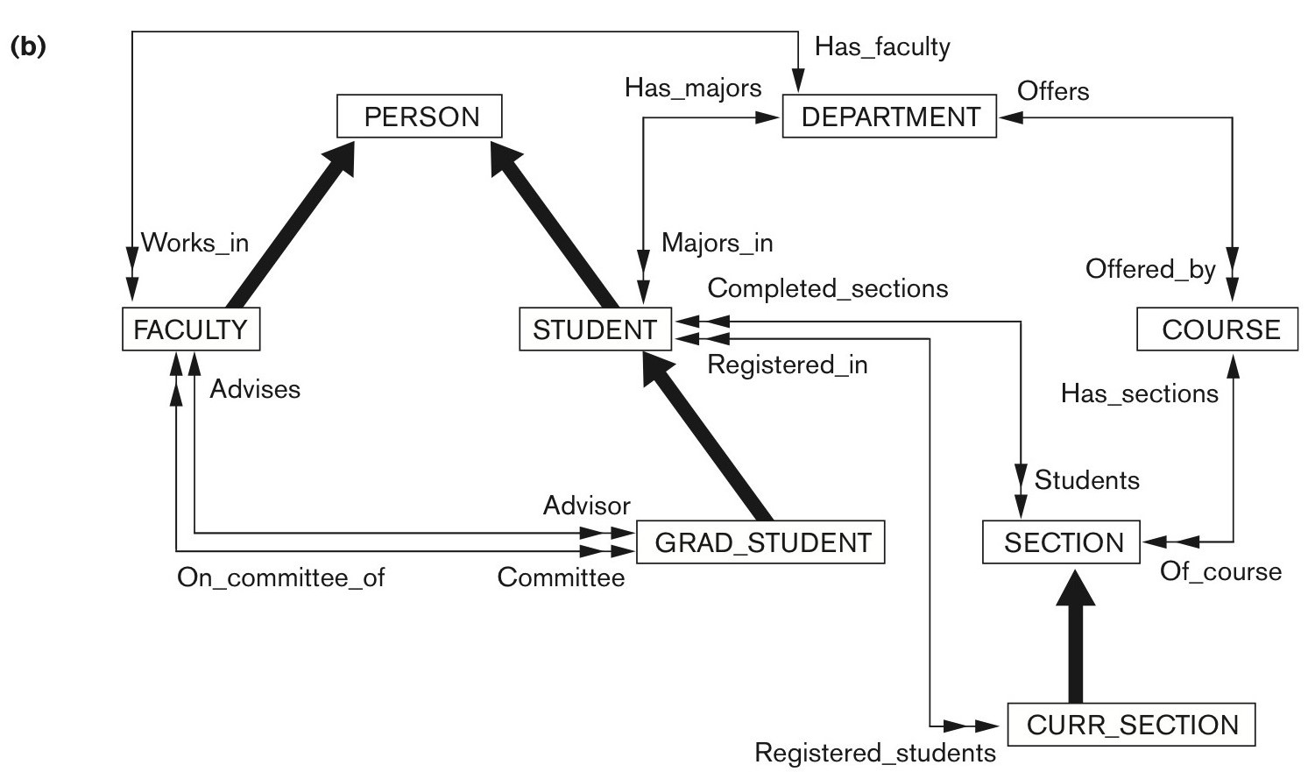
Figure 12.9b An example of a database schema. A graphical object database schema for part of the UNIVERSITY database (GRADE and DEGREE classes are not shown).
Slide 12- 47

Slide 48
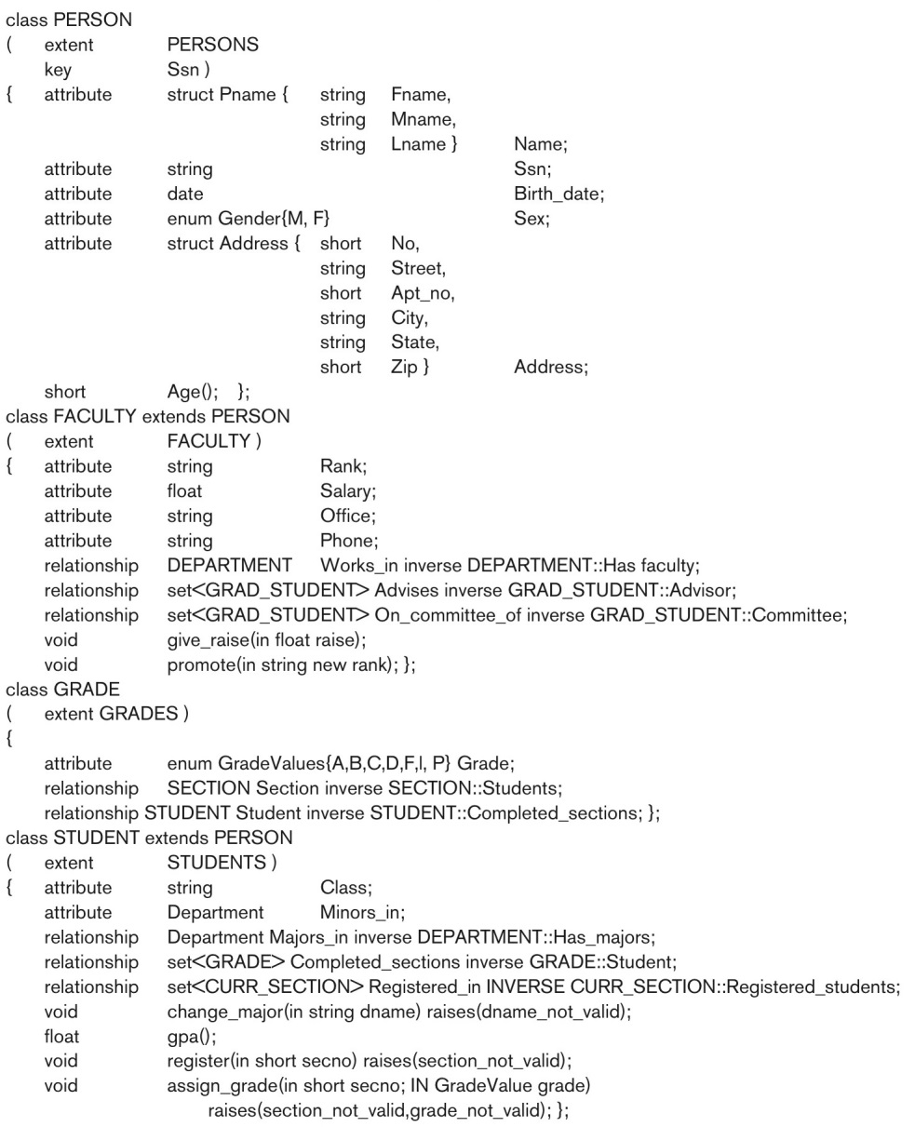
Figure 12.10 Possible ODL schema for the UNIVERSITY database in Figure 12.9(b).
continued on next slide
Slide 12- 48

Slide 49
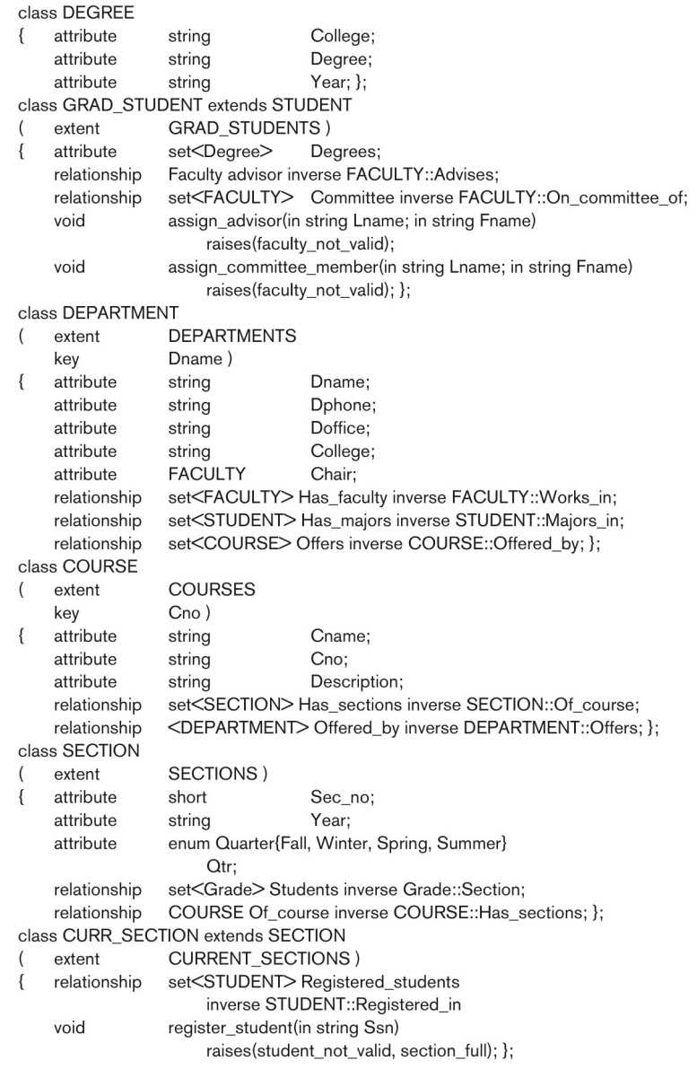
Figure 12.10 (continued) Possible ODL schema for the UNIVERSITY database in Figure 12.9(b).
Slide 12- 49

Slide 50
Interface Inheritance in ODL
Next example illustrates interface inheritance in ODL
Slide 12- 50

Slide 51
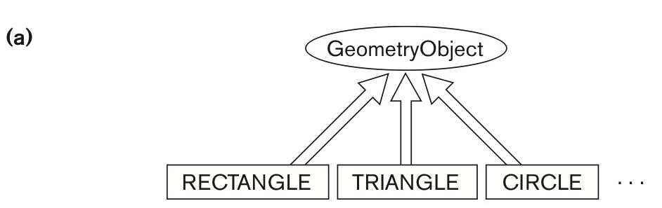
Figure 12.11a An illustration of interface inheritance via “:”. Graphical schema representation.
continued on next slide
Slide 12- 51

Slide 52
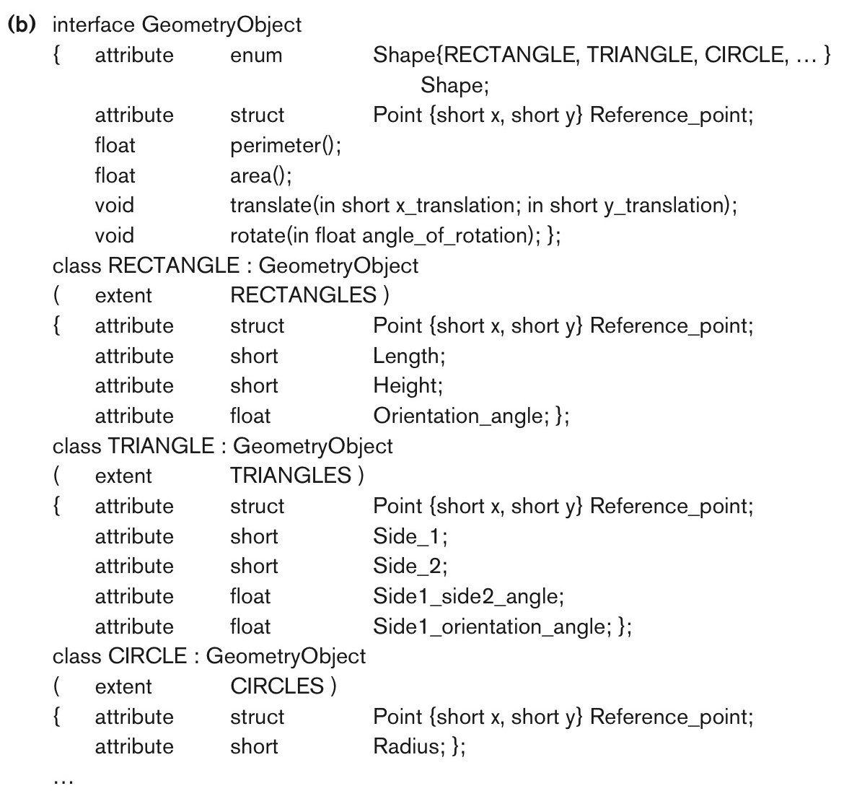
Figure 12.11b An illustration of interface inheritance via “:”. Corresponding interface and class definitions in ODL.
Slide 12- 52

Slide 53
Object Database Conceptual Design
Differences between conceptual design of ODB and RDB, handling of:
  Relationships
  Inheritance
Philosophical difference between relational model and object model of data
  In terms of behavioral specification
Slide 12- 53

Slide 54
Mapping an EER Schema to an ODB Schema
Create ODL class for each EER entity type
Add relationship properties for each binary relationship
Include appropriate operations for each class
ODL class that corresponds to a subclass in the EER schema
  Inherits type and methods of its superclass in ODL schema
Slide 12- 54

Slide 55
Mapping an EER Schema to an ODB Schema (cont’d.)
Weak entity types
  Mapped same as regular entity types
Categories (union types)
  Difficult to map to ODL
An n-ary relationship with degree n > 2
  Map into a separate class, with appropriate references to each participating class
Slide 12- 55

Slide 56
The Object Query Language OQL
Query language proposed for ODMG object model
Simple OQL queries, database entry points, and iterator variables
  Syntax: select ... from ... where ... structure
  Entry point: named persistent object
  Iterator variable: define whenever a collection is referenced in an OQL query
Slide 12- 56

Slide 57
Query Results and Path Expressions
Result of a query
  Any type that can be expressed in ODMG object model
OQL orthogonal with respect to specifying path expressions
  Attributes, relationships, and operation names (methods) can be used interchangeably within the path expressions
Slide 12- 57

Slide 58
Other Features of OQL
Named query
  Specify identifier of named query
OQL query will return collection as its result
  If user requires that a query only return a single element use element operator
Aggregate operators
Membership and quantification over a collection
Slide 12- 58

Slide 59
Other Features of OQL (cont’d.)
Special operations for ordered collections
Group by clause in OQL
  Similar to the corresponding clause in SQL
  Provides explicit reference to the collection of objects within each group or partition
Having clause
  Used to filter partitioned sets
Slide 12- 59

Slide 60
Overview of the C++ Language Binding in the ODMG Standard
Specifies how ODL constructs are mapped to C++ constructs
Uses prefix d_ for class declarations that deal with database concepts
Template classes
  Specified in library binding
  Overloads operation new so that it can be used to create either persistent or transient objects
Slide 12- 60

Slide 61
Summary
Overview of concepts utilized in object databases
  Object identity and identifiers; encapsulation of operations; inheritance; complex structure of objects through nesting of type constructors; and how objects are made persistent
Description of the ODMG object model and object query language (OQL)
Overview of the C++ language binding
Slide 12- 61

