Slide 1
Java servlet
Java servlet is a server side program.
Java Servlets are programs that run on a Web or Application server and act as a middle layer between a request coming from a Web browser or other HTTP client and databases or applications on the HTTP server.
Using Servlets, you can collect input from users through web page forms, present records from a database or another source, and create web pages dynamically.
Java Servlets often serve the same purpose as programs implemented using the Common Gateway Interface (CGI). But Servlets offer several advantages in comparison with the CGI.

Slide 2
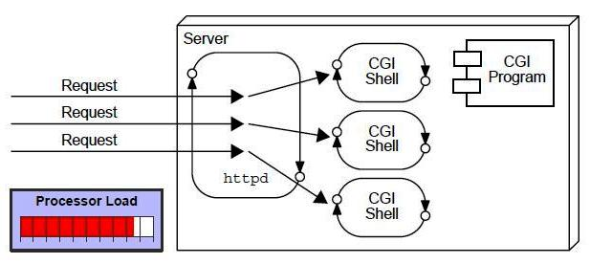
A web application is an application accessible from the web. A web application is composed of web components like Servlet, JSP, Filter etc. and other components such as HTML. The web components typically execute in Web Server and respond to HTTP request.
CGI(Commmon Gateway Interface)
CGI technology enables the web server to call an external program and pass HTTP request information to the external program to process the request. For each request, it starts a new process.

Slide 3
Disadvantages of CGI
There are many problems in CGI technology:
If number of clients increases, it takes more time for sending response.
For each request, it starts a process and Web server is limited to start processes.
It uses platform dependent language e.g. C, C++, perl.

Slide 4
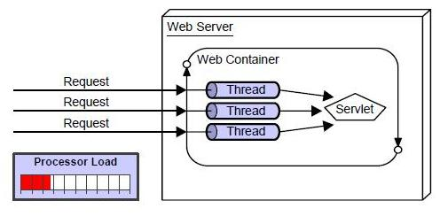

Slide 5
Advantage of Servlet
There are many advantages of servlet over CGI. The web container creates threads for handling the multiple requests to the servlet. Threads have a lot of benefits over the Processes such as they share a common memory area, lightweight, cost of communication between the threads are low. The basic benefits of servlet are as follows:
better performance: because it creates a thread for each request not process.
Portability: because it uses java language.
Robust: Servlets are managed by JVM so we don't need to worry about memory leak, garbage collection etc.
Secure: because it uses java language..

Slide 6
Performance is significantly better.
Servlets execute within the address space of a Web server. It is not necessary to create a separate process to handle each client request.
Servlets are platform-independent because they are written in Java.
Java security manager on the server enforces a set of restrictions to protect the resources on a server machine. So servlets are trusted.
The full functionality of the Java class libraries is available to a servlet. It can communicate with applets, databases, or other software via the sockets and RMI(remote method invocation) mechanisms.

Slide 7
Servlet can be described in many ways, depending on the context.
Servlet is a technology i.e. used to create web application.
Servlet is an API that provides many interfaces and classes including documentations.
Servlet is an interface that must be implemented for creating any servlet.
Servlet is a class that extend the capabilities of the servers and respond to the incoming request. It can respond to any type of requests.
Servlet is a web component that is deployed on the server to create dynamic web page.

Slide 8
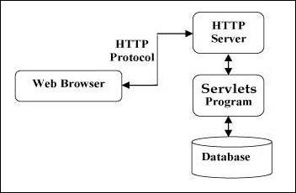
Servlet architecture

Slide 9
Servlet tasks
Servlets perform the following major tasks −
Read the explicit data sent by the clients (browsers). This includes an HTML form on a Web page or it could also come from an applet or a custom HTTP client program.
Read the implicit HTTP request data sent by the clients (browsers). This includes cookies, media types and compression schemes the browser understands, and so forth.
Process the data and generate the results. This process may require talking to a database, executing an RMI or CORBA call, invoking a Web service, or computing the response directly.
Send the explicit data (i.e., the document) to the clients (browsers). This document can be sent in a variety of formats, including text (HTML or XML), binary (GIF images), Excel, etc.
Send the implicit HTTP response to the clients (browsers). This includes telling the browsers or other clients what type of document is being returned (e.g., HTML), setting cookies and caching parameters, and other such tasks.

Slide 10
Servlet Packages
Java Servlets are Java classes run by a web server that has an interpreter that supports the Java Servlet specification.
Servlets can be created using the javax.servlet and javax.servlet.httppackages, which are a standard part of the Java's enterprise edition, an expanded version of the Java class library that supports large-scale development projects.
These classes implement the Java Servlet and JSP specifications. At the time of writing this tutorial, the versions are Java Servlet 2.5 and JSP 2.1.
Java servlets have been created and compiled just like any other Java class. After you install the servlet packages and add them to your computer's Classpath, you can compile servlets with the JDK's Java compiler or any other current compiler.

Slide 11
Website
Website is a collection of related web pages that may contain text, images, audio and video. The first page of a website is called home page. Each website has specific internet address (URL) that you need to enter in your browser to access a website.
Website is hosted on one or more servers and can be accessed by visiting its homepage using a computer network. A website is managed by its owner that can be an individual, company or an organization.

Slide 12
Static website
Static website is the basic type of website that is easy to create. You don't need web programming and database design to create a static website. Its web pages are coded in HTML.
The codes are fixed for each page so the information contained in the page does not change and it looks like a printed page.

Slide 13
Dynamic website
Dynamic website is a collection of dynamic web pages whose content changes dynamically. It accesses content from a database or Content Management System (CMS). Therefore, when you alter or update the content of the database, the content of the website is also altered or updated.
Dynamic website uses client-side scripting or server-side scripting, or both to generate dynamic content.
Client side scripting generates content at the client computer on the basis of user input. The web browser downloads the web page from the server and processes the code within the page to render information to the user.
In server side scripting, the software runs on the server and processing is completed in the server then plain pages are sent to the user.

Slide 14
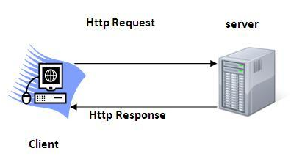
HTTP (Hyper Text Transfer Protocol)
The Hypertext Transfer Protocol (HTTP) is application-level protocol for collaborative, distributed, hypermedia information systems. It is the data communication protocol used to establish communication between client and server.
HTTP is TCP/IP based communication protocol, which is used to deliver the data like image files, query results, HTML files etc on the World Wide Web (WWW) with the default port is TCP 80. It provides the standardized way for computers to communicate with each other.

Slide 15
The Basic Characteristics of HTTP (Hyper Text Transfer Protocol):
It is the protocol that allows web servers and browsers to exchange data over the web.It is a request response protocol.
It uses the reliable TCP connections by default on TCP port 80.
It is stateless means each request is considered as the new request. In other words, server doesn't recognize the user by default.
The Basic Features of HTTP (Hyper Text Transfer Protocol):
There are three fundamental features that make the HTTP a simple and powerful protocol used for communication:
HTTP is media independent: It refers to any type of media content can be sent by HTTP as long as both the server and the client can handle the data content.
HTTP is connectionless: It is a connectionless approach in which HTTP client i.e., a browser initiates the HTTP request and after the request is sends the client disconnects from server and waits for the response.
HTTP is stateless: The client and server are aware of each other during a current request only. Afterwards, both of them forget each other. Due to the stateless nature of protocol, neither the client nor the server can retain the information about different request across the web pages.

Slide 16
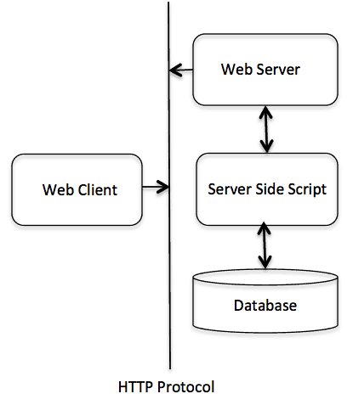
The Basic Architecture of HTTP (Hyper Text Transfer Protocol
The below diagram represents the basic architecture of web application and depicts where HTTP stands:
.

Slide 17
http request
HTTP is request/response protocol which is based on client/server based architecture. In this web browser, search engines, etc behaves as a HTTP clients, and the Web server like Servlet behaves as a server HTTP Requests
The request sends by the computer to a web server that contains all sorts of potentially interesting information is known as HTTP requests.
The HTTP client sends the request to the server in the form of request message which includes following information:
The Request-line
The analysis of source IP address, proxy and port
The analysis of destination IP address, protocol, port and host
The Requested URI (Uniform Resource Identifier)
The Request method and Content
The User-Agent header
The Connection control header
The Cache control header

Slide 18
http Request methods
The HTTP request method indicates the method to be performed on the resource identified by the Requested URI (Uniform Resource Identifier). This method is case-sensitive and should be used in uppercase.
The HTTP request methods are:

Slide 19
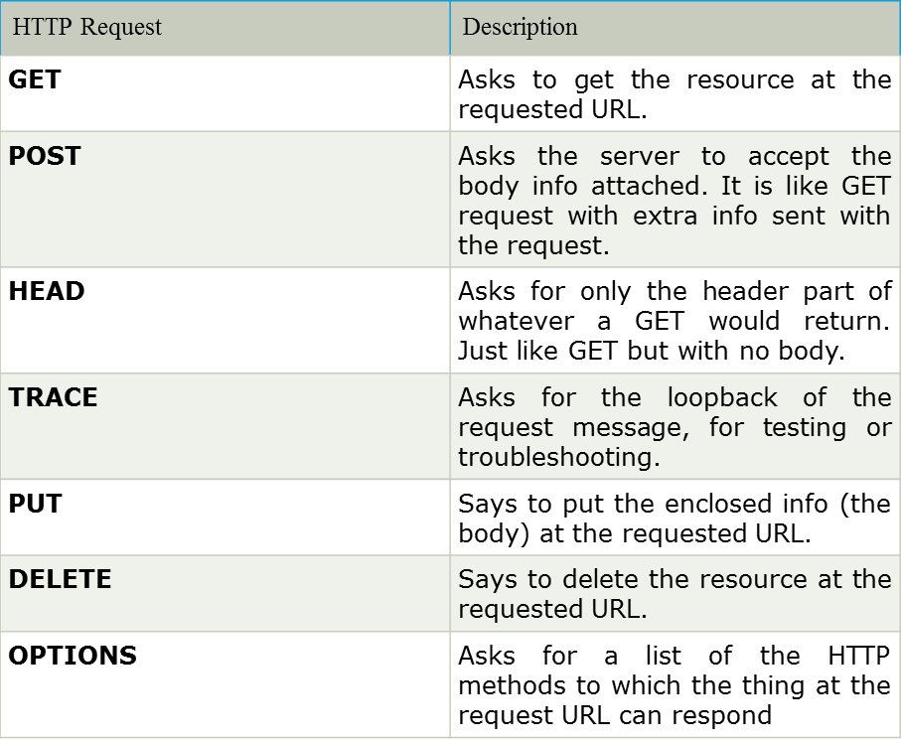

Slide 20
Servlet container
It provides the runtime environment for JavaEE (j2ee) applications. The client/user can request only a static Web Pages from the server. If the user wants to read the web pages as per input then the servlet container is used in java.
The servlet container is used in java for dynamically generate the web pages on the server side. Therefore the servlet container is the part of a web server that interacts with the servlet for handling the dynamic web pages from the client.

Slide 21
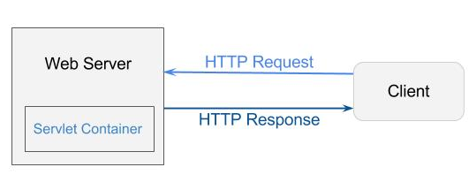

Slide 22
Servlet Container States
The servlet container is the part of web server which can be run in a separate process. We can classify the servlet container states in three types:
Standalone: It is typical Java-based servers in which the servlet container and the web servers are the integral part of a single program. For example:- Tomcat running by itself
In-process: It is separated from the web server, because a different program is runs within the address space of the main server as a plug-in. For example:- Tomcat running inside the JBoss.
Out-of-process: The web server and servlet container are different programs which are run in a different process. For performing the communications between them, web server uses the plug-in provided by the servlet container.
The Servlet Container performs many operations that are given below:
Life Cycle Management
Multithreaded support
Object Pooling
Security etc.

Slide 23
Servlet API
The javax.servlet and javax.servlet.http packages represent interfaces and classes for servlet api.
The javax.servlet package contains many interfaces and classes that are used by the servlet or web container. These are not specific to any protocol.
The javax.servlet.http package contains interfaces and classes that are responsible for http requests only.
Let's see what are the interfaces of javax.servlet package.

Slide 24
Interfaces in javax.servlet package
There are many interfaces in javax.servlet package. They are as follows:
Servlet
ServletRequest
ServletResponse
RequestDispatcher
ServletConfig
ServletContext
SingleThreadModel
Filter
FilterConfig
FilterChain
ServletRequestListener
ServletRequestAttributeListener
ServletContextListener
ServletContextAttributeListener

Slide 25
Classes in javax.servlet package
There are many classes in javax.servlet package. They are as follows:
GenericServlet
ServletInputStream
ServletOutputStream
ServletRequestWrapper
ServletResponseWrapper
ServletRequestEvent
ServletContextEvent
ServletRequestAttributeEvent
ServletContextAttributeEvent
ServletException
UnavailableException

Slide 26
Servlet interfaces
Methods of Servlet interface
Servlet interface provides common behaviour to all the servlets.
Servlet interface needs to be implemented for creating any servlet (either directly or indirectly). It provides 3 life cycle methods that are used to initialize the servlet, to service the requests, and to destroy the servlet and 2 non-life cycle methods.
Methods of Servlet interface
There are 5 methods in Servlet interface. The init, service and destroy are the life cycle methods of servlet. These are invoked by the web container.

Slide 27
Method | Description
public void init(ServletConfig config) | initializes the servlet. It is the life cycle method of servlet and invoked by the web container only once.
public void service(ServletRequest request,ServletResponse response) | provides response for the incoming request. It is invoked at each request by the web container.
public void destroy() | is invoked only once and indicates that servlet is being destroyed.
public ServletConfig getServletConfig() | returns the object of ServletConfig.
public String getServletInfo() | returns information about servlet such as writer, copyright, version etc

