Slide 1
DISTRIBUTED SYSTEMS
Principles and Paradigms
Second Edition
ANDREW S. TANENBAUM
MAARTEN VAN STEEN
Chapter 4
Communication
Tanenbaum & Van Steen, Distributed Systems: Principles and Paradigms, 2e, (c) 2007 Prentice-Hall, Inc. All rights reserved. 0-13-239227-5

Slide 2
Introduction
IPC in distributed systems is always based on low-level message passing
Remote procedure Call (RPC)
Hiding most of the intricacies of message passing
client-server applications
Message-Oriented Middleware (MOM)
Not strict pattern of client-server interaction
High-level message queuing
Data Steaming for Multimedia
Continuous flow subject timing constraints
Multicasting
Tanenbaum & Van Steen, Distributed Systems: Principles and Paradigms, 2e, (c) 2007 Prentice-Hall, Inc. All rights reserved. 0-13-239227-5

Slide 3
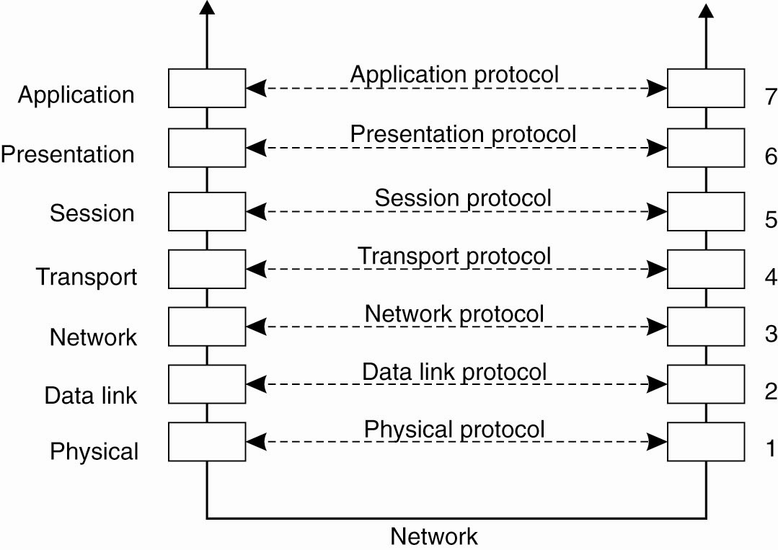
Layered Protocols (1)
Figure 4-1. Layers, interfaces, and protocols
in the OSI model.
Tanenbaum & Van Steen, Distributed Systems: Principles and Paradigms, 2e, (c) 2007 Prentice-Hall, Inc. All rights reserved. 0-13-239227-5

Slide 4
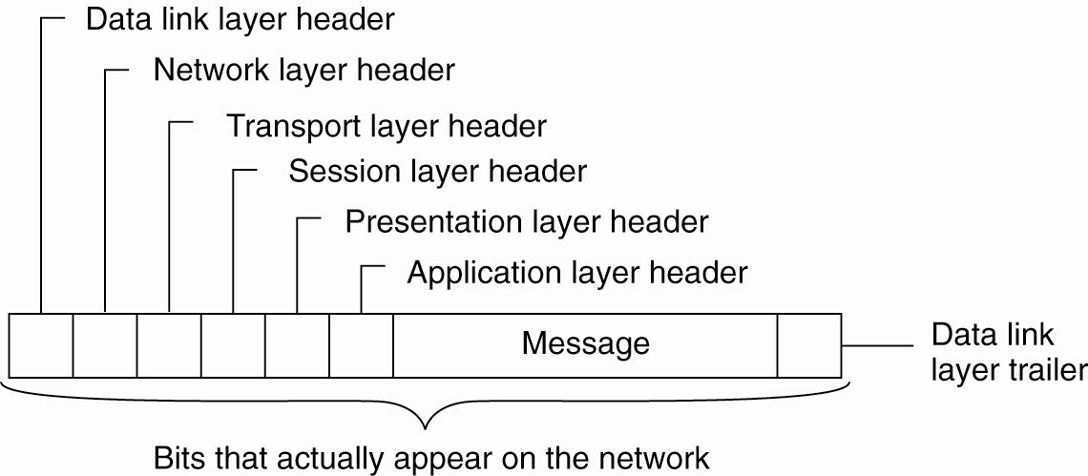
Layered Protocols (2)
Figure 4-2. A typical message as it appears on the network.
Tanenbaum & Van Steen, Distributed Systems: Principles and Paradigms, 2e, (c) 2007 Prentice-Hall, Inc. All rights reserved. 0-13-239227-5

Slide 5
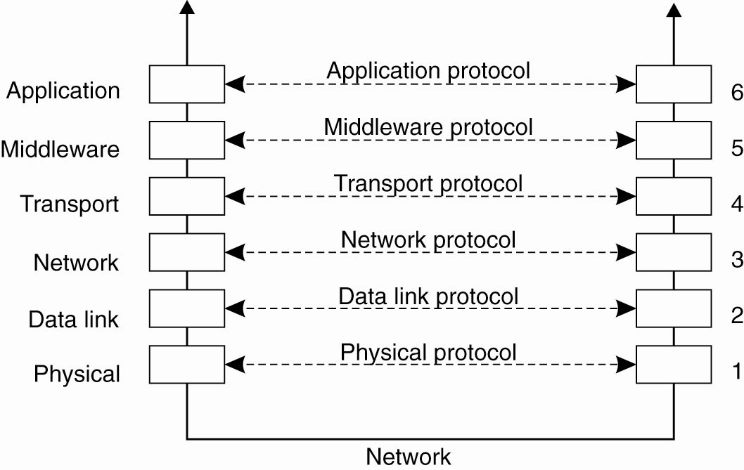
Middleware Protocols
Figure 4-3. An adapted reference model
for networked communication.
Tanenbaum & Van Steen, Distributed Systems: Principles and Paradigms, 2e, (c) 2007 Prentice-Hall, Inc. All rights reserved. 0-13-239227-5

Slide 6
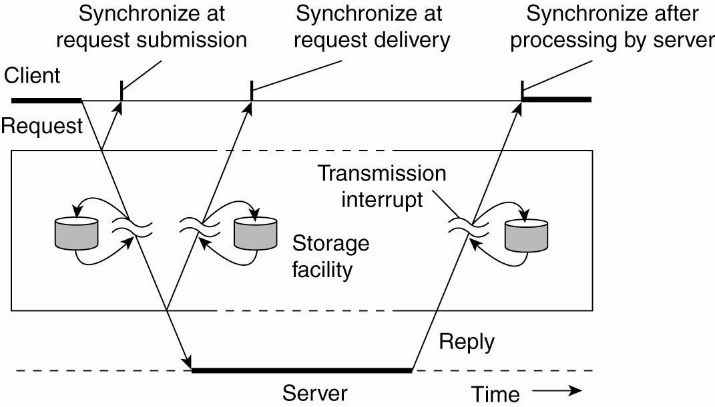
Types of Communication
Figure 4-4. Viewing middleware as an intermediate (distributed) service in application-level communication.
Tanenbaum & Van Steen, Distributed Systems: Principles and Paradigms, 2e, (c) 2007 Prentice-Hall, Inc. All rights reserved. 0-13-239227-5

Slide 7
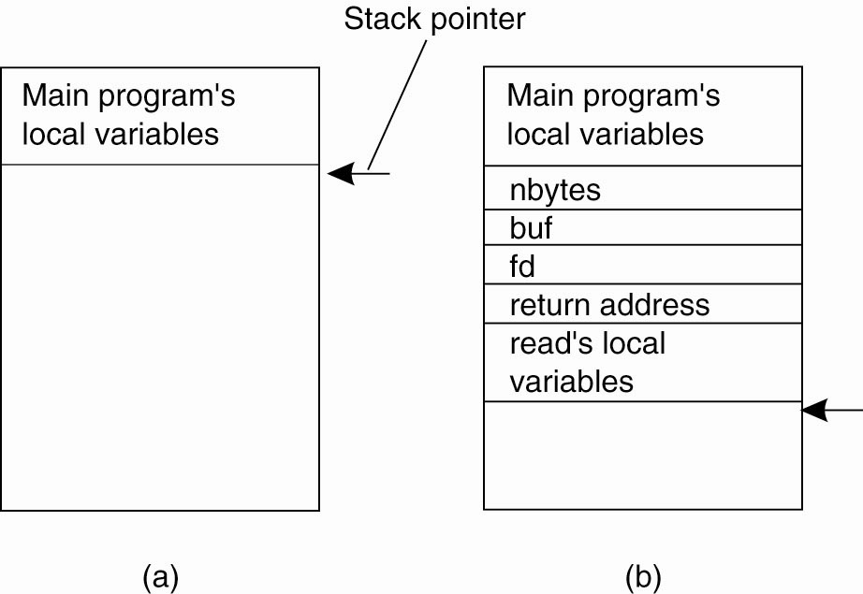
Conventional Procedure Call
Figure 4-5. (a) Parameter passing in a local procedure call: the stack before the call to read. (b) The stack while the called procedure is active.
Tanenbaum & Van Steen, Distributed Systems: Principles and Paradigms, 2e, (c) 2007 Prentice-Hall, Inc. All rights reserved. 0-13-239227-5

Slide 8
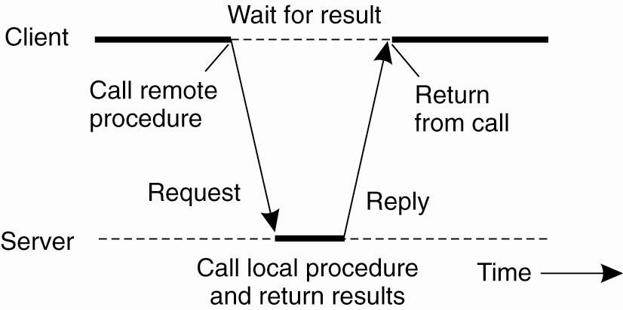
Client and Server Stubs
Figure 4-6. Principle of RPC between a client and server program.
Tanenbaum & Van Steen, Distributed Systems: Principles and Paradigms, 2e, (c) 2007 Prentice-Hall, Inc. All rights reserved. 0-13-239227-5

Slide 9
Remote Procedure Calls (1)
A remote procedure call occurs in the following
steps:
The client procedure calls the client stub in the normal way.
The client stub builds a message and calls the local operating system.
The client’s OS sends the message to the remote OS.
The remote OS gives the message to the server stub.
The server stub unpacks the parameters and calls the server.
Continued …
Tanenbaum & Van Steen, Distributed Systems: Principles and Paradigms, 2e, (c) 2007 Prentice-Hall, Inc. All rights reserved. 0-13-239227-5

Slide 10
Remote Procedure Calls (2)
A remote procedure call occurs in the following
steps (continued):
The server does the work and returns the result to the stub.
The server stub packs it in a message and calls its local OS.
The server’s OS sends the message to the client’s OS.
The client’s OS gives the message to the client stub.
The stub unpacks the result and returns to the client.
Tanenbaum & Van Steen, Distributed Systems: Principles and Paradigms, 2e, (c) 2007 Prentice-Hall, Inc. All rights reserved. 0-13-239227-5

Slide 11
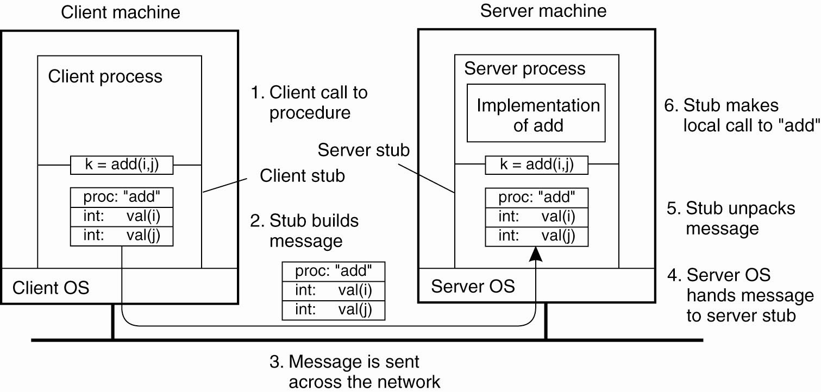
Passing Value Parameters (1)
Figure 4-7. The steps involved in a doing a
remote computation through RPC.
Tanenbaum & Van Steen, Distributed Systems: Principles and Paradigms, 2e, (c) 2007 Prentice-Hall, Inc. All rights reserved. 0-13-239227-5

Slide 12
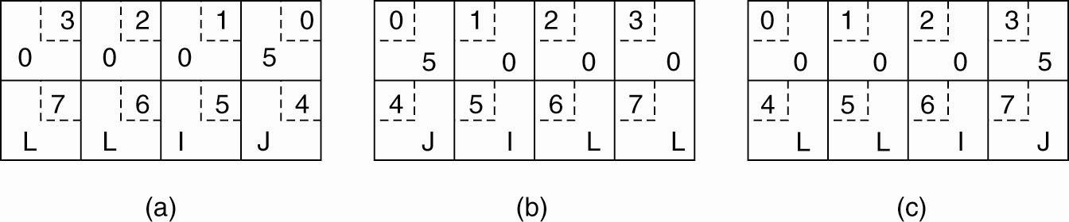
Passing Value Parameters (2)
Figure 4-8. (a) The original message on the Pentium.
Tanenbaum & Van Steen, Distributed Systems: Principles and Paradigms, 2e, (c) 2007 Prentice-Hall, Inc. All rights reserved. 0-13-239227-5

Slide 13
Passing Value Parameters (3)
Figure 4-8. (b) The message after receipt on the SPARC
Tanenbaum & Van Steen, Distributed Systems: Principles and Paradigms, 2e, (c) 2007 Prentice-Hall, Inc. All rights reserved. 0-13-239227-5

Slide 14
Passing Value Parameters (4)
Figure 4-8. (c) The message after being inverted. The little numbers in boxes indicate the address of each byte.
Tanenbaum & Van Steen, Distributed Systems: Principles and Paradigms, 2e, (c) 2007 Prentice-Hall, Inc. All rights reserved. 0-13-239227-5

Slide 15
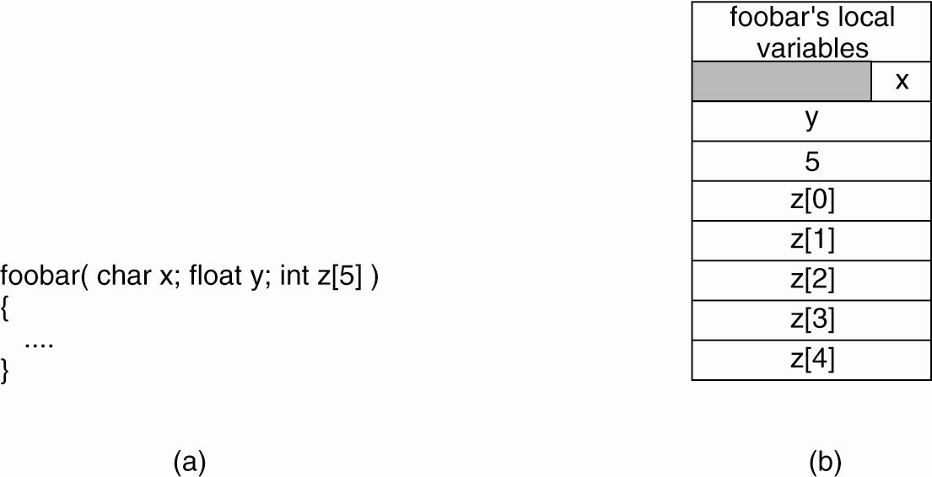
Parameter Specification and Stub Generation
Figure 4-9. (a) A procedure. (b) The corresponding message.
Tanenbaum & Van Steen, Distributed Systems: Principles and Paradigms, 2e, (c) 2007 Prentice-Hall, Inc. All rights reserved. 0-13-239227-5

Slide 16
SUN Open Networking RPC
Server register it service (program/version) at portmapper
(rpcbind) – residing on the same machine
Client that needs the service will contact portmapper
to retrieve the service port by giving the (program/version)
Client requests the service from the server
client and server then communicate
Tanenbaum & Van Steen, Distributed Systems: Principles and Paradigms, 2e, (c) 2007 Prentice-Hall, Inc. All rights reserved. 0-13-239227-5

Slide 17
Sun ONC RPC Program Example
The specification file date.x
%rpcgen date.x
date.h date_svc.c (server stub) date_client.c (client stub)
% cc –o client client.c date_client.c –lnsl
% cc –o server server.c date_svc.c –lnsl
%run server
%run client serverhost
Tanenbaum & Van Steen, Distributed Systems: Principles and Paradigms, 2e, (c) 2007 Prentice-Hall, Inc. All rights reserved. 0-13-239227-5

Slide 18
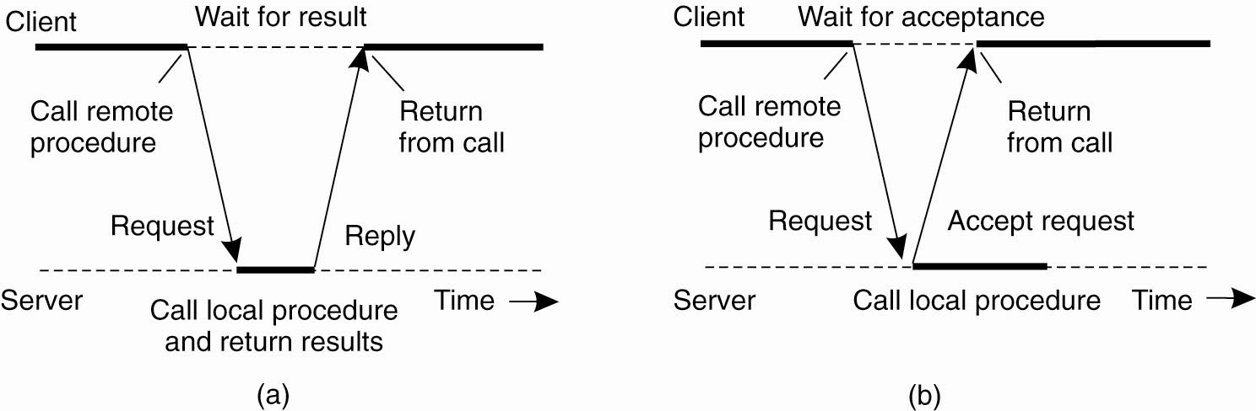
Traditional RPC (1)
Figure 4-10. (a) The interaction between client and
server in a traditional RPC.
Tanenbaum & Van Steen, Distributed Systems: Principles and Paradigms, 2e, (c) 2007 Prentice-Hall, Inc. All rights reserved. 0-13-239227-5

Slide 19
Asynchronous RPC (2)
Figure 4-10. (b) The interaction using asynchronous RPC.
Tanenbaum & Van Steen, Distributed Systems: Principles and Paradigms, 2e, (c) 2007 Prentice-Hall, Inc. All rights reserved. 0-13-239227-5

Slide 20
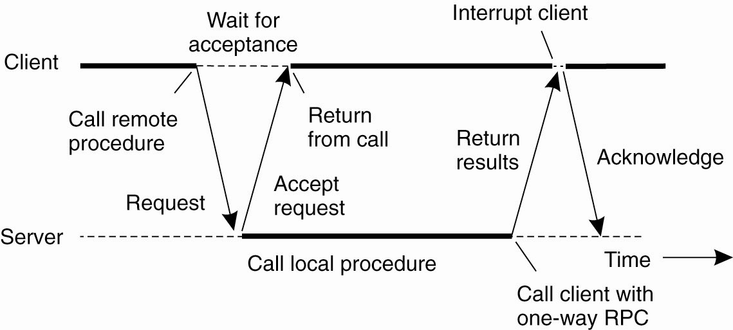
Asynchronous RPC (3)
Figure 4-11. A client and server interacting through
two asynchronous RPCs.
Tanenbaum & Van Steen, Distributed Systems: Principles and Paradigms, 2e, (c) 2007 Prentice-Hall, Inc. All rights reserved. 0-13-239227-5

Slide 21
DCE RPC
Distributed Computing Environment (DCE) developed by Open Software Foundation (OSF)
Uuidgen generate a prototype IDL file
Editing the IDL file filling remote procedures and parameters
IDL compiler then generate
Header file
Client stub
Server stub
Tanenbaum & Van Steen, Distributed Systems: Principles and Paradigms, 2e, (c) 2007 Prentice-Hall, Inc. All rights reserved. 0-13-239227-5

Slide 22
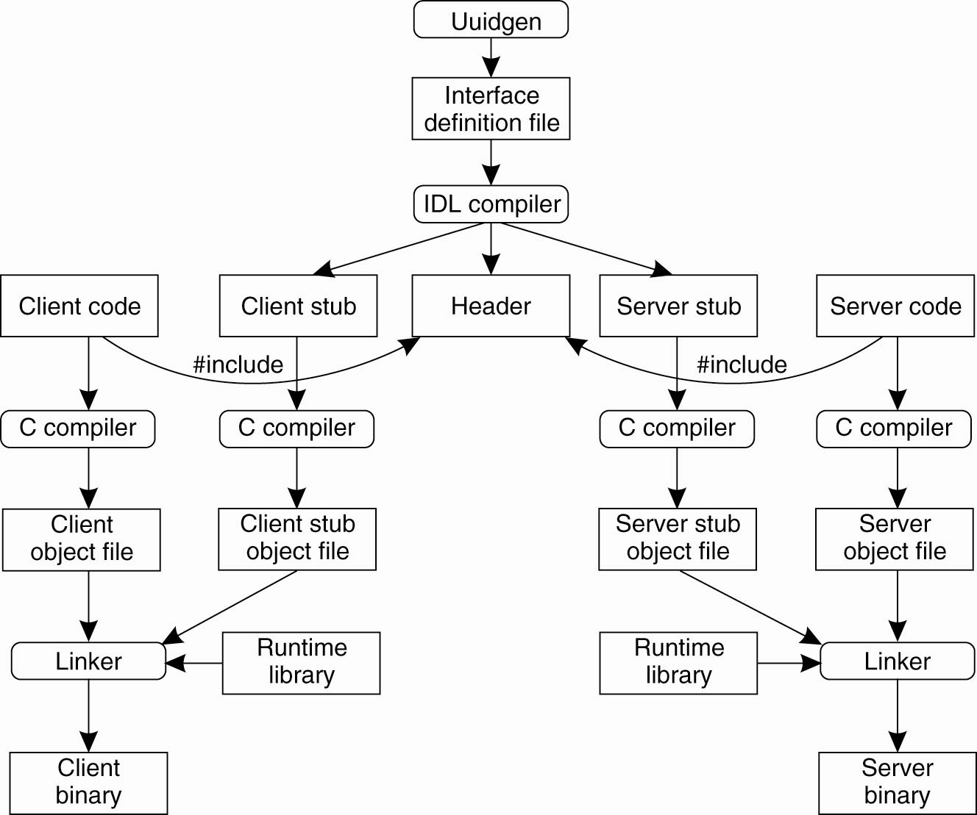
Writing a Client and a Server (1)
Figure 4-12. The steps in writing a client and
a server in DCE RPC.
Tanenbaum & Van Steen, Distributed Systems: Principles and Paradigms, 2e, (c) 2007 Prentice-Hall, Inc. All rights reserved. 0-13-239227-5

Slide 23
Writing a Client and a Server (2)
Three files output by the IDL compiler:
A header file (e.g., interface.h, in C terms).
The client stub.
The server stub.
Tanenbaum & Van Steen, Distributed Systems: Principles and Paradigms, 2e, (c) 2007 Prentice-Hall, Inc. All rights reserved. 0-13-239227-5

Slide 24
Binding a Client to a Server (1)
Registration of a server makes it possible for a client to locate the server and bind to it.
Server location is done in two steps:
  Locate the server’s machine.
  Locate the server on that machine.
Tanenbaum & Van Steen, Distributed Systems: Principles and Paradigms, 2e, (c) 2007 Prentice-Hall, Inc. All rights reserved. 0-13-239227-5

Slide 25
Binding Client to Server (DCE RPC)
Server asks operating system for an end point (port)
Register the endpoint with DCE daemon that records in the end table
Server register with directory server with its network address and its name (program name)
Now Client pass the name to directory server and find the server network address
Client goes to DCE daemon (well know port) on that machine
and ask for look up the end point (port) of the server in its end point table
RPC then takes place
Tanenbaum & Van Steen, Distributed Systems: Principles and Paradigms, 2e, (c) 2007 Prentice-Hall, Inc. All rights reserved. 0-13-239227-5

Slide 26
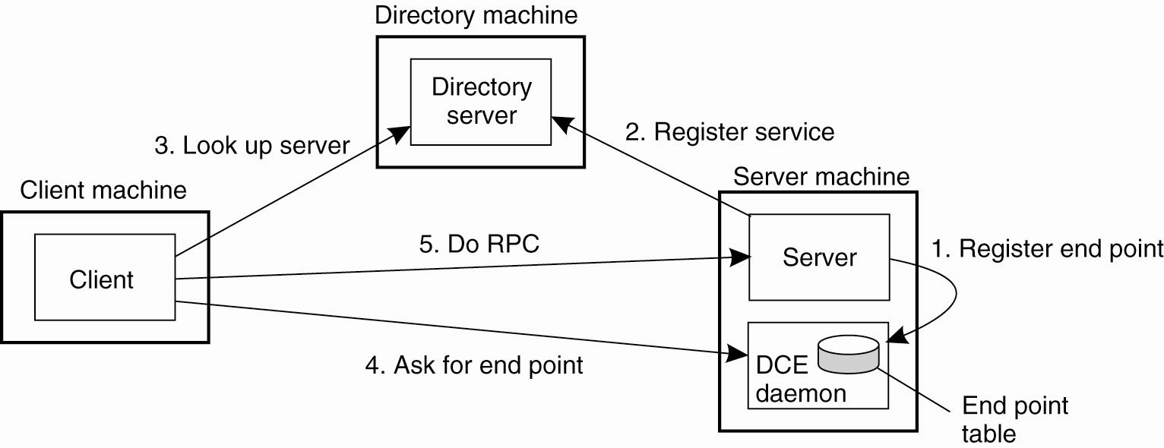
Binding a Client to a Server (2)
Figure 4-13. Client-to-server binding in DCE.
Tanenbaum & Van Steen, Distributed Systems: Principles and Paradigms, 2e, (c) 2007 Prentice-Hall, Inc. All rights reserved. 0-13-239227-5

Slide 27
Message-Oriented Communication
Non Procedure-Oriented Communication
RPC assume that receiver side is executing at the time when request is issued (TRANSIENT)
RPC is also synchronous in general (unless Async RPC)
Message-Oriented Transient Communication – sockets
Message-Oriented Persistent Communication – IBM Websphere
Tanenbaum & Van Steen, Distributed Systems: Principles and Paradigms, 2e, (c) 2007 Prentice-Hall, Inc. All rights reserved. 0-13-239227-5

Slide 28
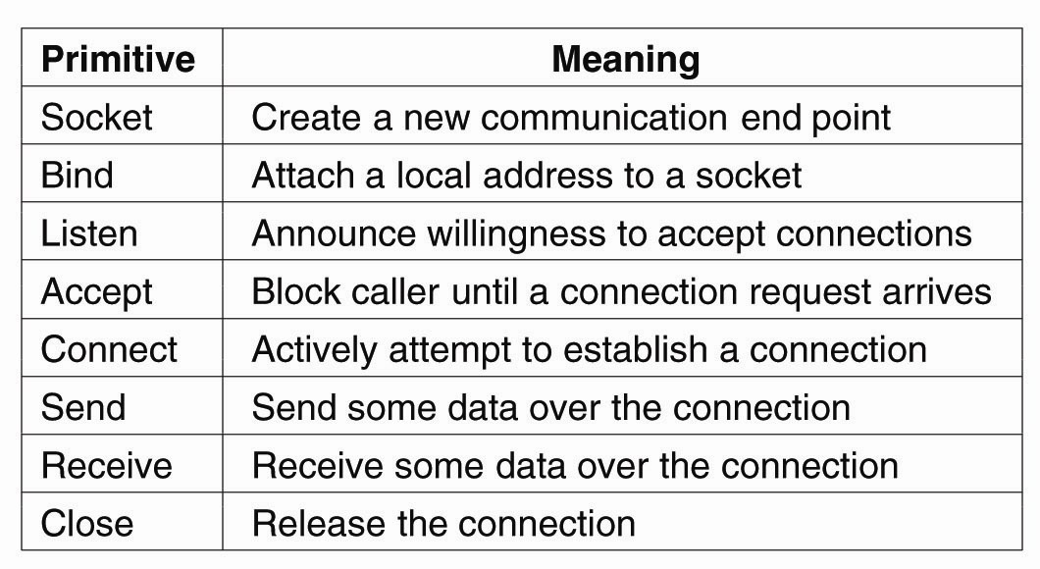
Berkeley Sockets
Figure 4-14. The socket primitives for TCP/IP.
Tanenbaum & Van Steen, Distributed Systems: Principles and Paradigms, 2e, (c) 2007 Prentice-Hall, Inc. All rights reserved. 0-13-239227-5

Slide 29
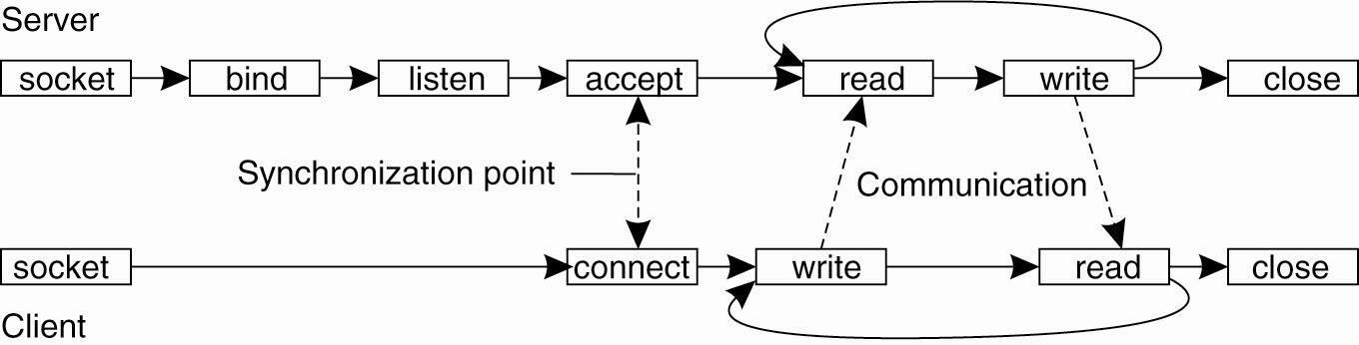
The Message-Passing Interface (1)
Figure 4-15. Connection-oriented communication
pattern using sockets.
Tanenbaum & Van Steen, Distributed Systems: Principles and Paradigms, 2e, (c) 2007 Prentice-Hall, Inc. All rights reserved. 0-13-239227-5

Slide 30
Message-Oriented Persistent Communication
Message-Queuing Systems or Message-Oriented Middleware (MOM)
Persistent asynchronous communication
Difference from Berkeley sockets
Targeted to support message transfer for longer time
Insert messages in the specific queues
Tanenbaum & Van Steen, Distributed Systems: Principles and Paradigms, 2e, (c) 2007 Prentice-Hall, Inc. All rights reserved. 0-13-239227-5

Slide 31
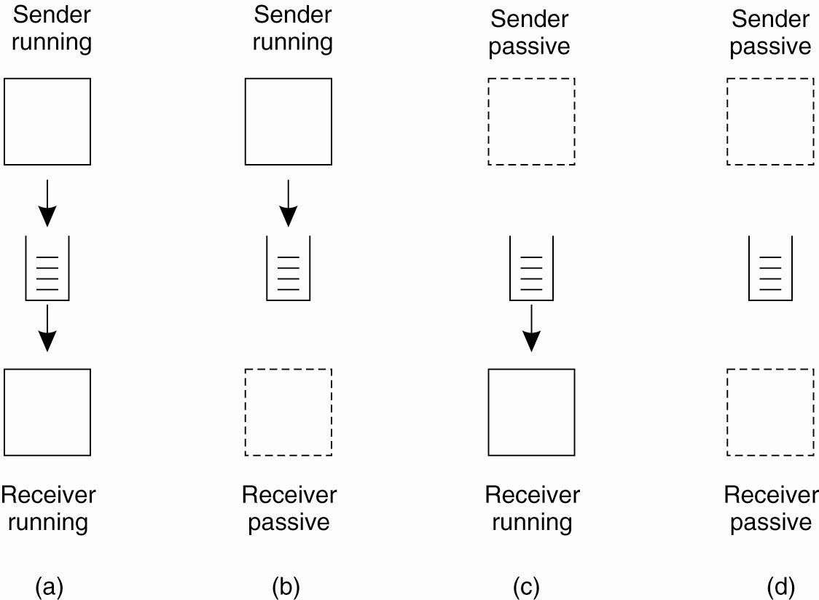
Message-Queuing Model (1)
Figure 4-17. Four combinations for loosely-coupled communications using queues.
Tanenbaum & Van Steen, Distributed Systems: Principles and Paradigms, 2e, (c) 2007 Prentice-Hall, Inc. All rights reserved. 0-13-239227-5

Slide 32
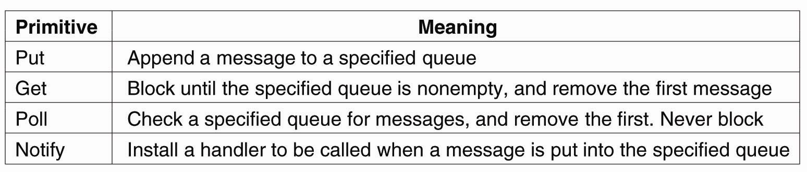
Message-Queuing Model (2)
Figure 4-18. Basic interface to a queue in a
message-queuing system.
Tanenbaum & Van Steen, Distributed Systems: Principles and Paradigms, 2e, (c) 2007 Prentice-Hall, Inc. All rights reserved. 0-13-239227-5

Slide 33
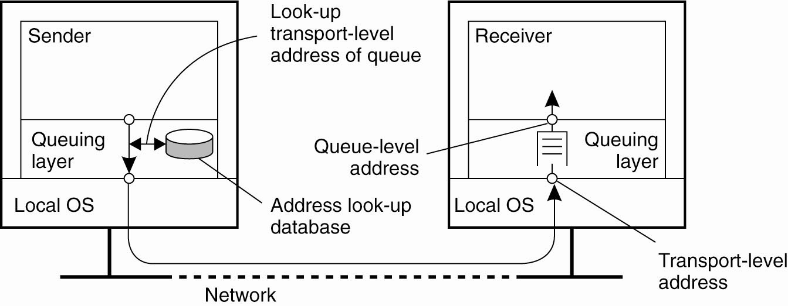
General Architecture of a Message-Queuing System (1)
Figure 4-19. The relationship between queue-level addressing and network-level addressing.
Tanenbaum & Van Steen, Distributed Systems: Principles and Paradigms, 2e, (c) 2007 Prentice-Hall, Inc. All rights reserved. 0-13-239227-5

Slide 34
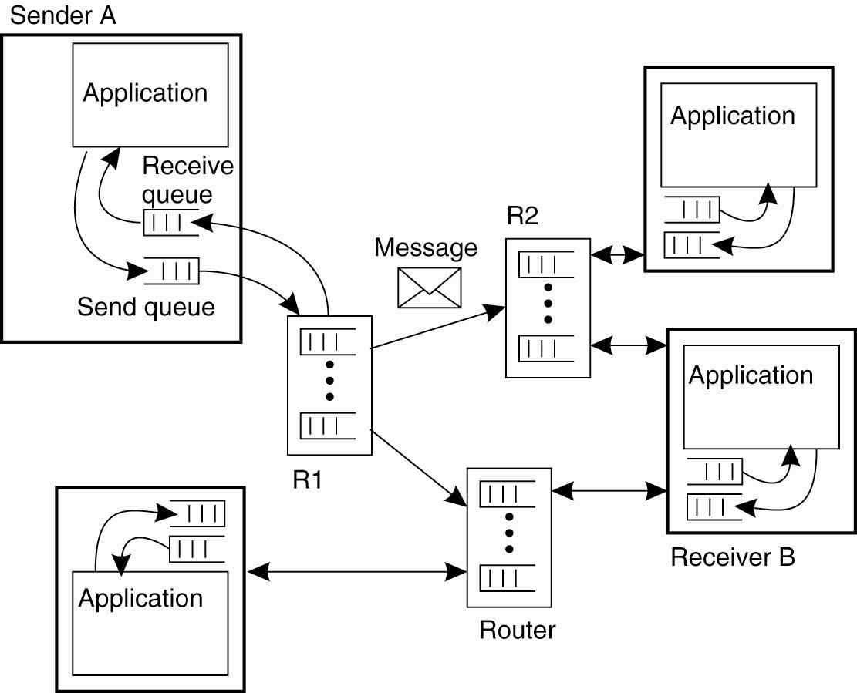
General Architecture of a Message-Queuing System (2)
Figure 4-20. The
general organization of
a message-queuing
system with routers.
Tanenbaum & Van Steen, Distributed Systems: Principles and Paradigms, 2e, (c) 2007 Prentice-Hall, Inc. All rights reserved. 0-13-239227-5

Slide 35
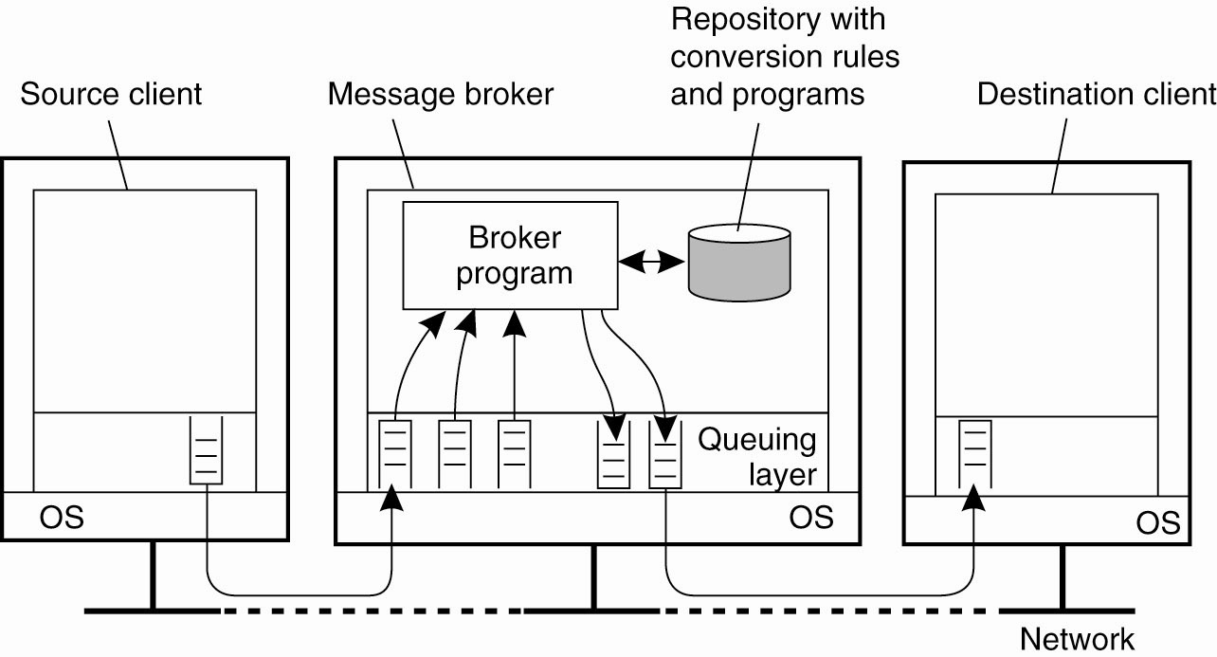
Message Brokers
(Application Gateway for different message format translation)
Figure 4-21. The general organization of a message broker
in a message-queuing system.
Tanenbaum & Van Steen, Distributed Systems: Principles and Paradigms, 2e, (c) 2007 Prentice-Hall, Inc. All rights reserved. 0-13-239227-5

Slide 36
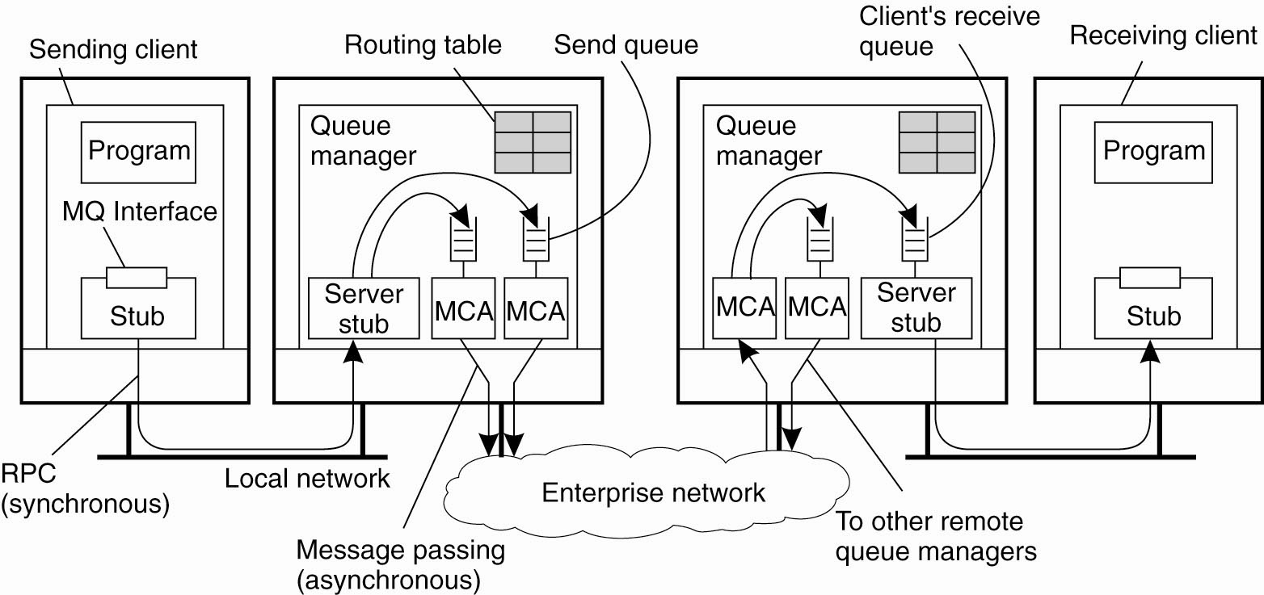
IBM’s WebSphere Message-Queuing System
Figure 4-22. General organization of IBM’s message-queuing system.
Tanenbaum & Van Steen, Distributed Systems: Principles and Paradigms, 2e, (c) 2007 Prentice-Hall, Inc. All rights reserved. 0-13-239227-5

Slide 37
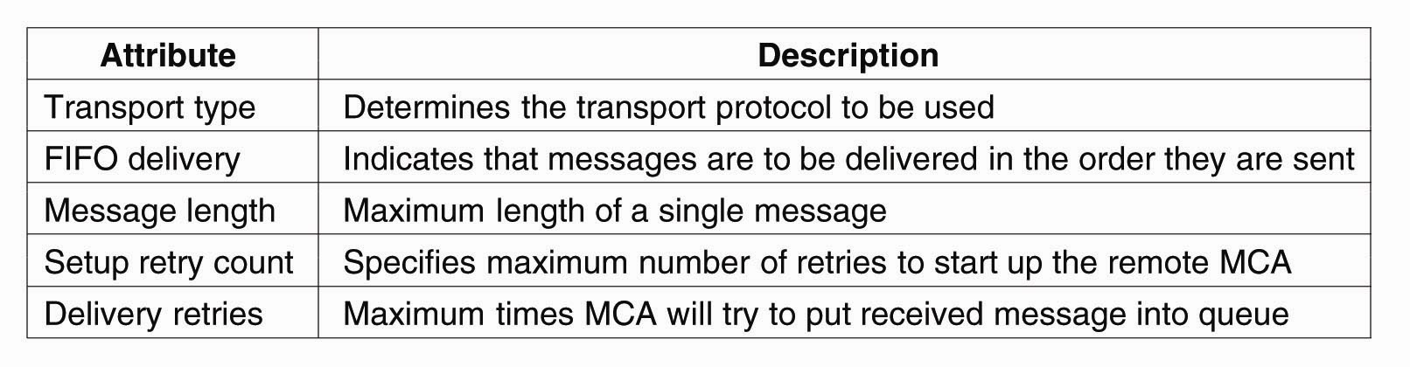
Channels
Figure 4-23. Some attributes associated with
message channel agents.
Tanenbaum & Van Steen, Distributed Systems: Principles and Paradigms, 2e, (c) 2007 Prentice-Hall, Inc. All rights reserved. 0-13-239227-5

Slide 38
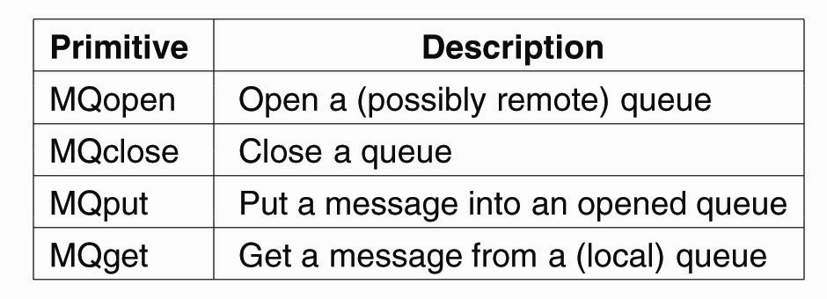
Message Transfer (2)
Figure 4-25. Primitives available in the
message-queuing interface.
Tanenbaum & Van Steen, Distributed Systems: Principles and Paradigms, 2e, (c) 2007 Prentice-Hall, Inc. All rights reserved. 0-13-239227-5

Slide 39
Stream-Oriented Communication
Time plays a crucial role, audio/video
Temporal relationships between different data items
Data Stream = A sequence of data units
Playing audio/video files – continuous sdata stream
Tanenbaum & Van Steen, Distributed Systems: Principles and Paradigms, 2e, (c) 2007 Prentice-Hall, Inc. All rights reserved. 0-13-239227-5

Slide 40
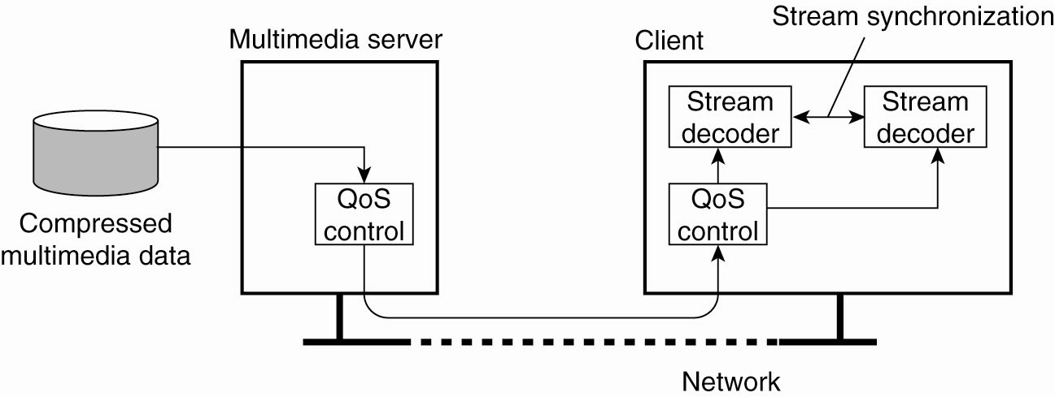
Data Stream
Figure 4-26. A general architecture for streaming stored multimedia data over a network.
Tanenbaum & Van Steen, Distributed Systems: Principles and Paradigms, 2e, (c) 2007 Prentice-Hall, Inc. All rights reserved. 0-13-239227-5

Slide 41
Streams and Quality of Service
Properties for Quality of Service:
The required bit rate at which data should be transported.
The maximum delay until a session has been set up
The maximum end-to-end delay .
The maximum delay variance, or jitter.
The maximum round-trip delay.
Tanenbaum & Van Steen, Distributed Systems: Principles and Paradigms, 2e, (c) 2007 Prentice-Hall, Inc. All rights reserved. 0-13-239227-5

Slide 42
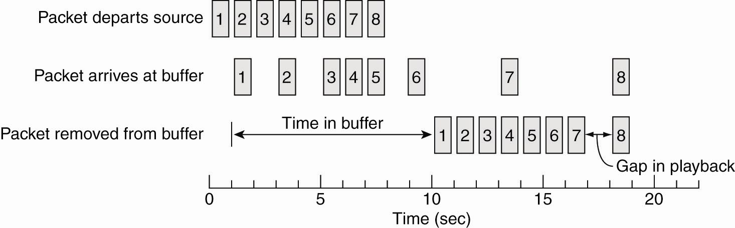
Enforcing QoS (1)
Figure 4-27. Using a buffer to reduce jitter.
Tanenbaum & Van Steen, Distributed Systems: Principles and Paradigms, 2e, (c) 2007 Prentice-Hall, Inc. All rights reserved. 0-13-239227-5

Slide 43
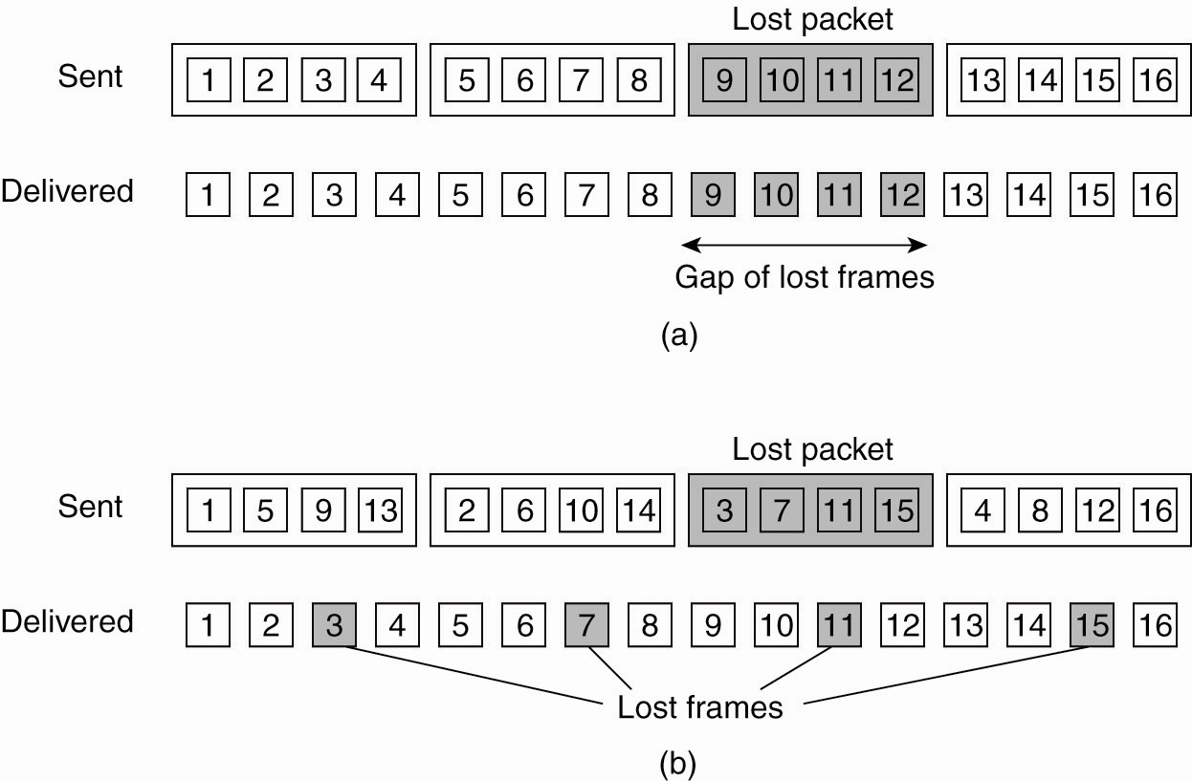
Enforcing QoS (2)
Figure 4-28. The effect of packet loss in (a) non interleaved transmission and (b) interleaved transmission.
Tanenbaum & Van Steen, Distributed Systems: Principles and Paradigms, 2e, (c) 2007 Prentice-Hall, Inc. All rights reserved. 0-13-239227-5

