Slide 1
Distributed Systems
Architectures
Chapter 2

Slide 2
Course/Slides Credits
Note: all course presentations are based on those developed by Andrew S. Tanenbaum and Maarten van Steen. They accompany their "Distributed Systems: Principles and Paradigms" textbook (1st & 2nd editions).
http://www.prenhall.com/divisions/esm/app/author_tanenbaum/custom/dist_sys_1e/index.html
And additions made by Paul Barry in course CW046-4: Distributed Systems
http://glasnost.itcarlow.ie/~barryp/net4.html

Slide 3
Modeling Distributed Systems
When building distributed applications, system builders have often looked to the
non-distributed systems world for models to follow (… inspiration?).
Consequently, distributed systems tend to exhibit certain characteristics that are
already familiar to us.
This applies equally to hardware concepts
as it does to software concepts.

Slide 4
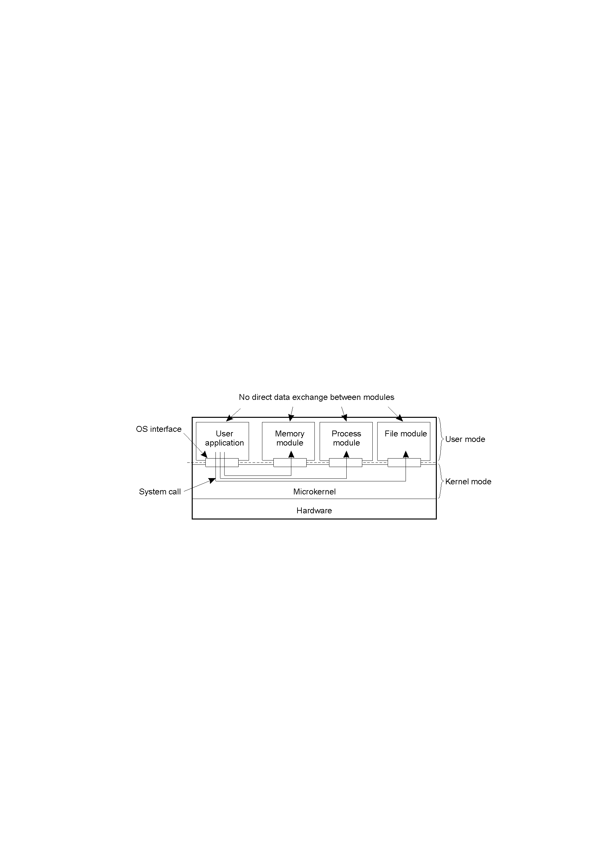
Uniprocessor Operating Systems
1.11
Separating applications from operating system code through a “microkernel” – can provide a good base upon which to build a distributed OS (DOS)

Slide 5
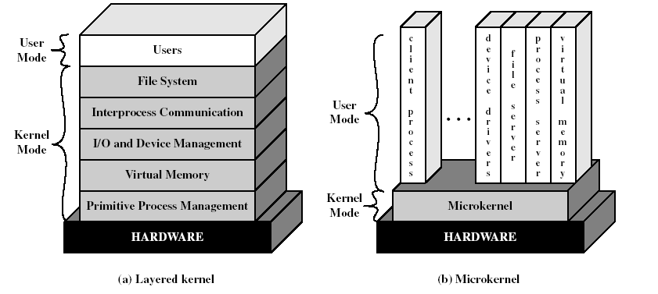
Layered vs. Microkernel Architecture

Slide 6
Types of Operating Systems
System | Description | Main Goal
DOS | Tightly-coupled operating system for multi-processors and homogeneous multicomputers | Hide and manage hardware resources
NOS | Loosely-coupled operating system for heterogeneous multicomputers (LAN and WAN) | Offer local services to remote clients
Middleware | Additional layer atop of NOS implementing general-purpose services | Provide distribution transparency

Slide 7
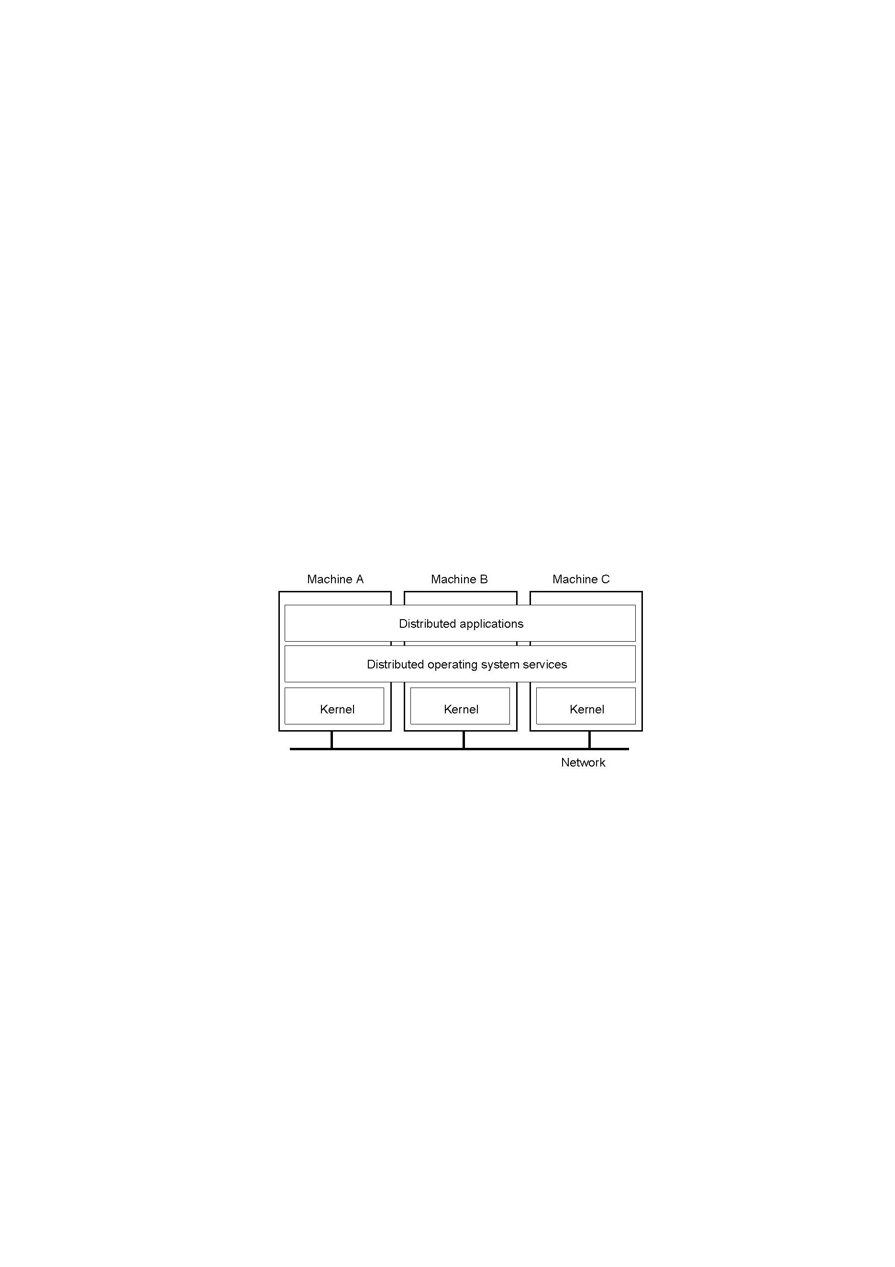
Multicomputer Operating Systems
1.14
General structure of a multicomputer operating system –
all the systems are of the same type: homogeneous

Slide 8
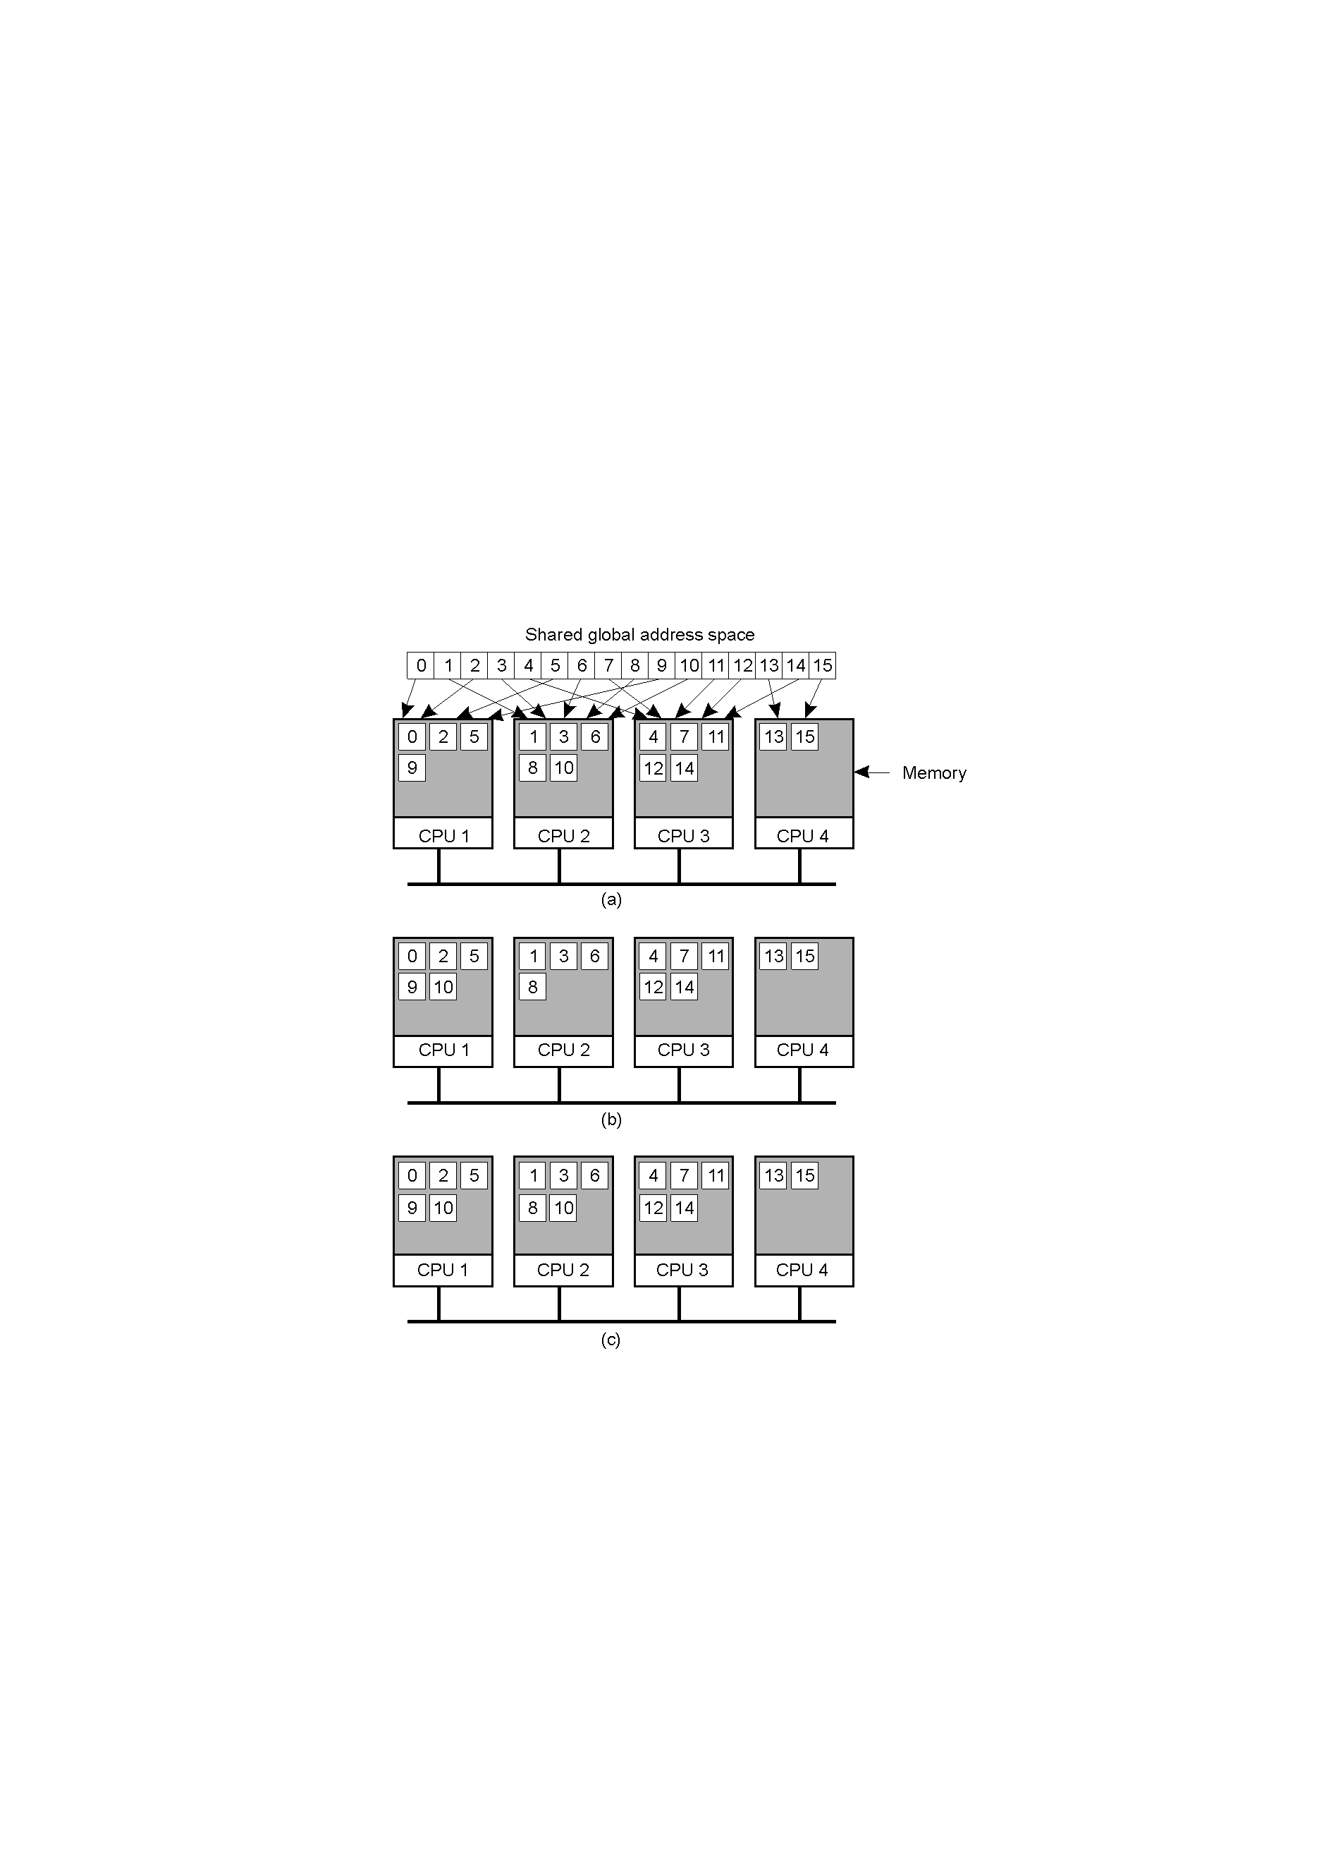
Distributed Shared Memory Systems (1)
a) Pages of address space distributed among four machines
b) Situation after CPU 1 references page 10
c) Situation if page 10 is read only and replication is used

Slide 9
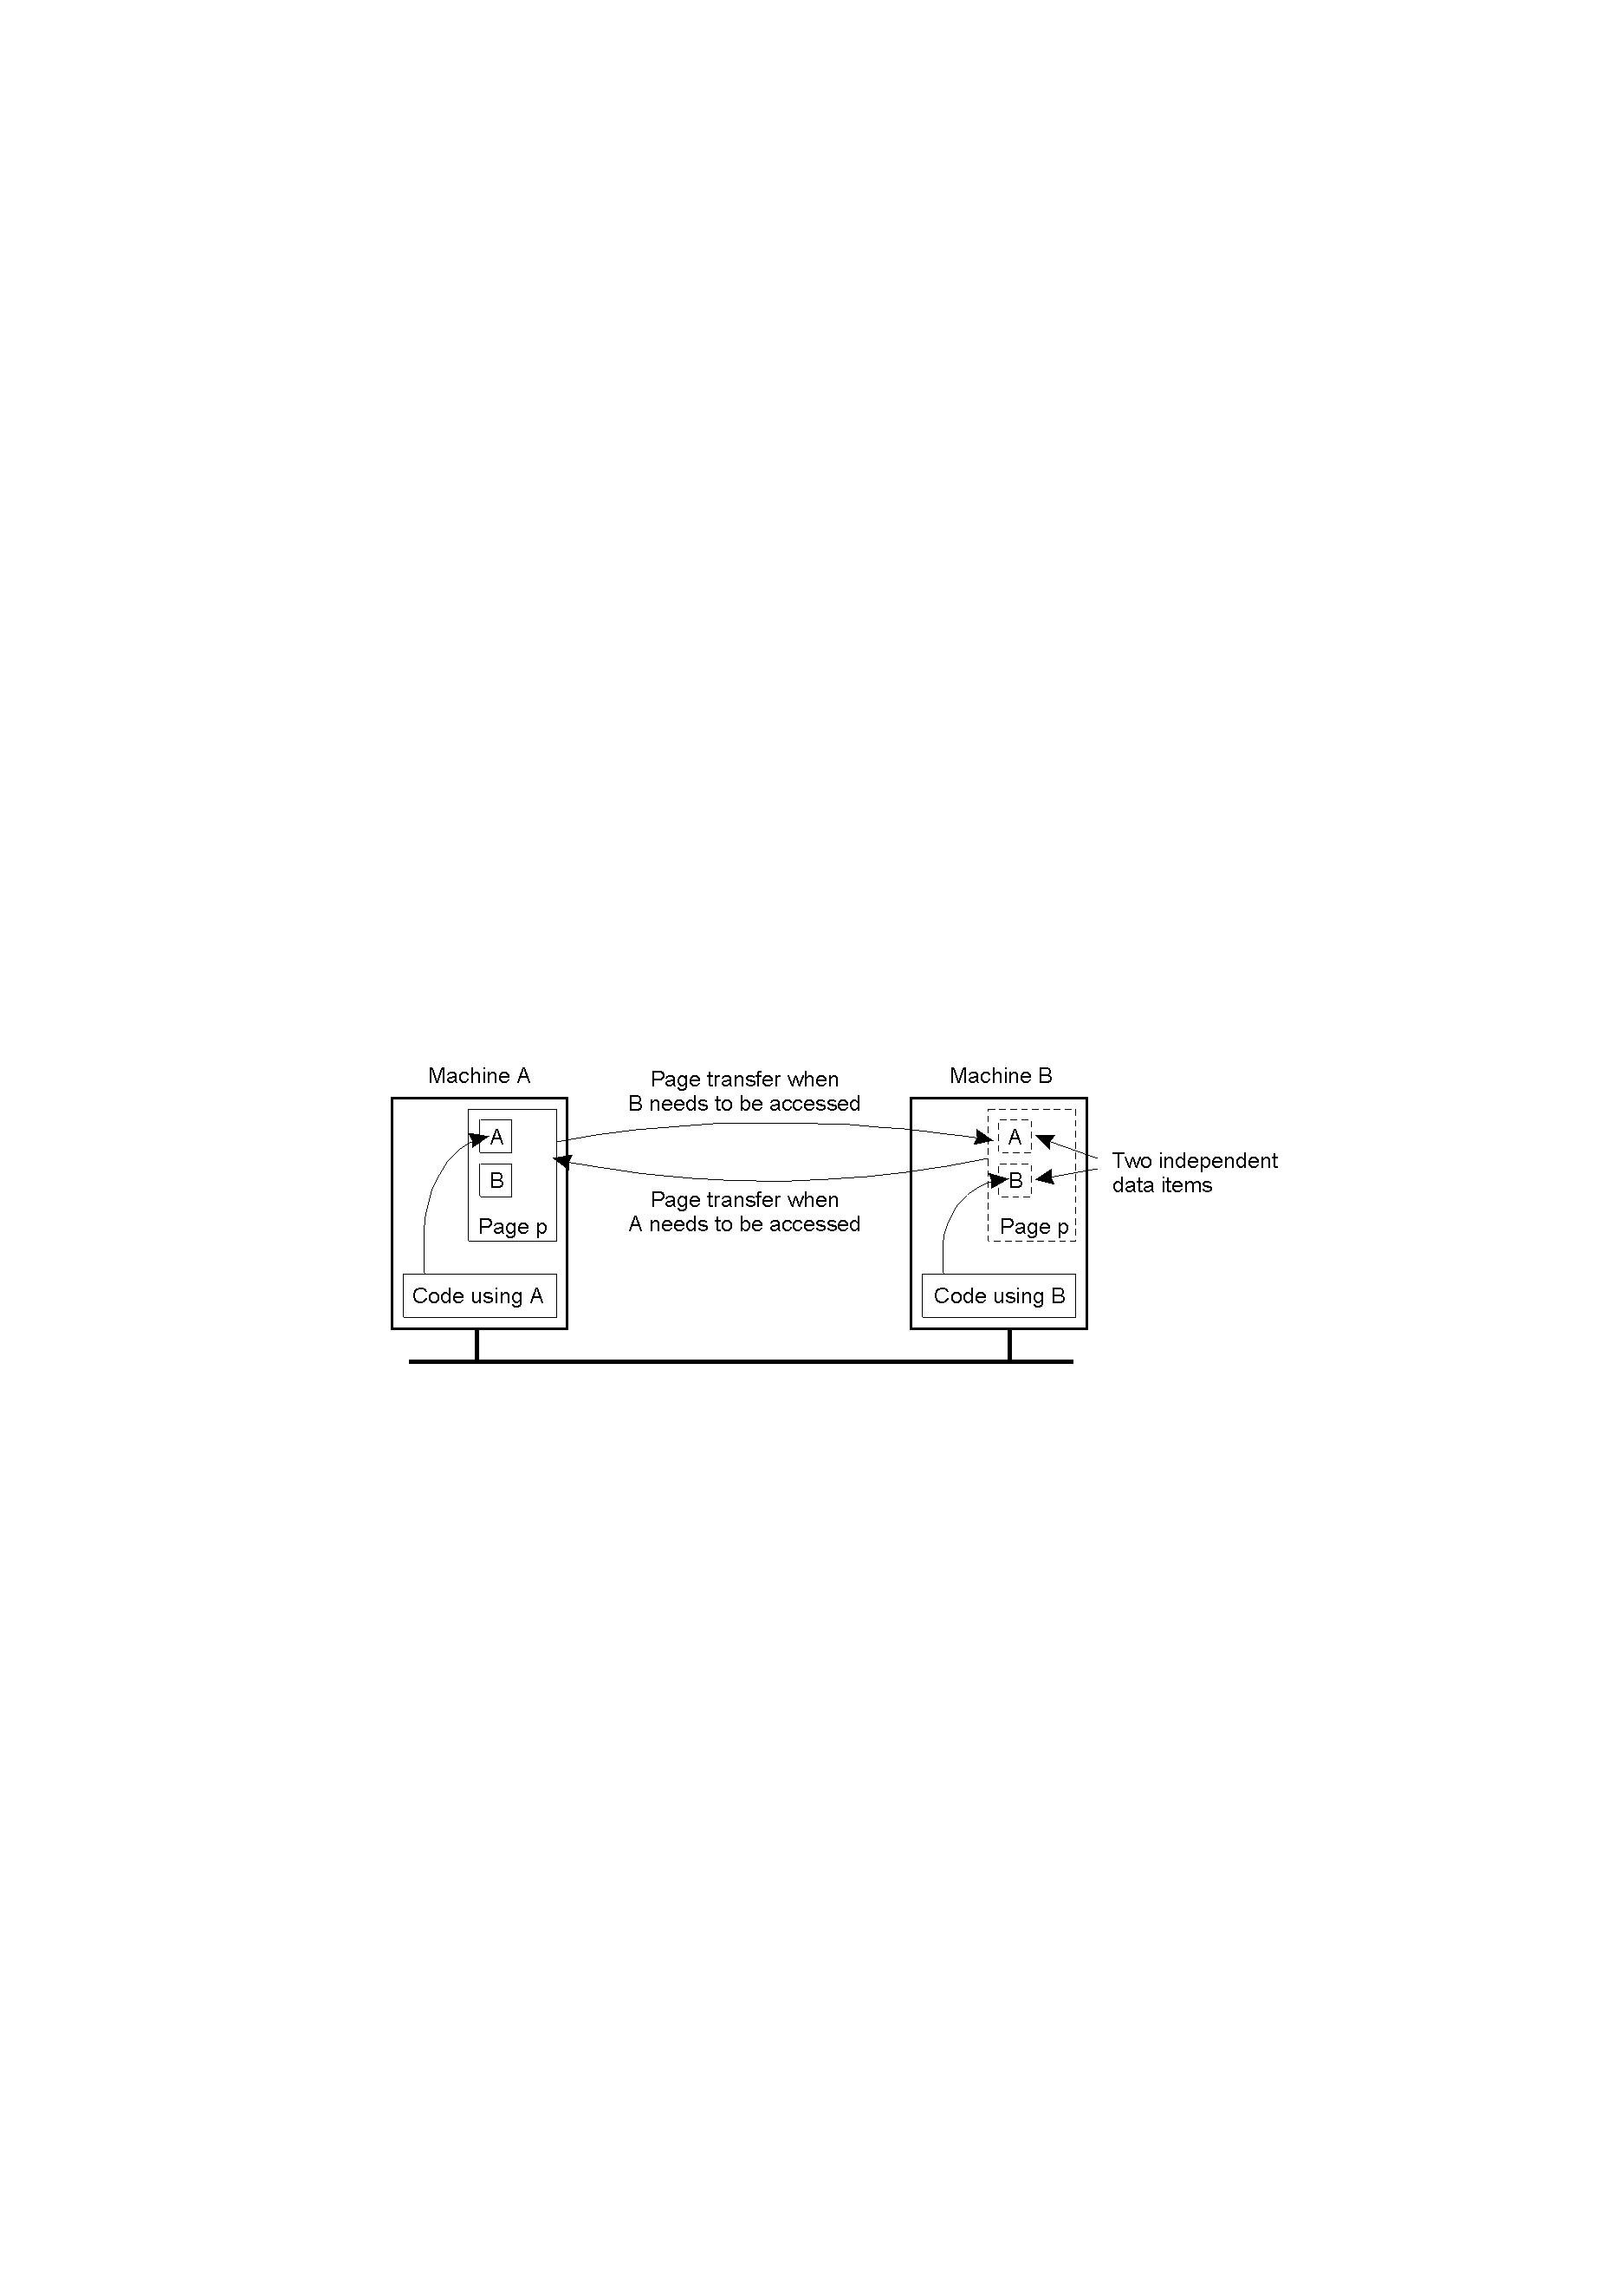
Distributed Shared Memory Systems (2)
False sharing of a page between 2 independent processes

Slide 10
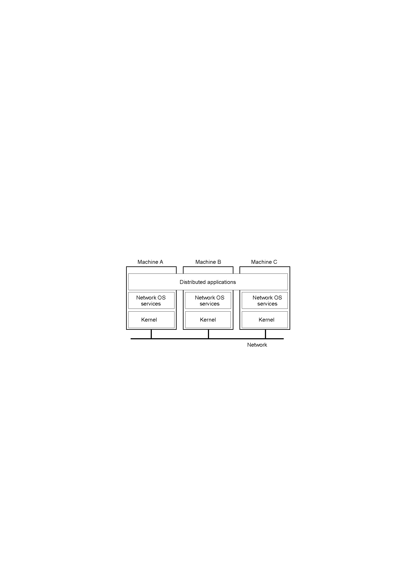
Network Operating System (1)
1-19
General structure of a network operating system –
all the systems are of different types: heterogeneous

Slide 11
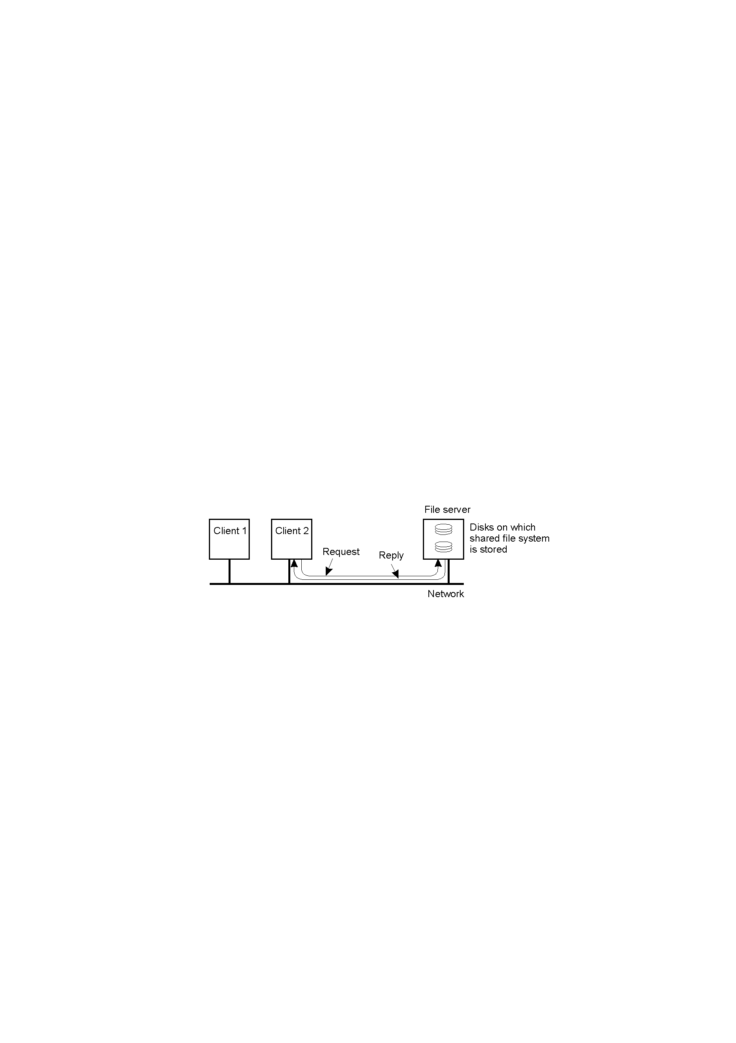
Network Operating System (2)
1-20
Two clients and a server in a network operating system – relatively primitive set of services provided

Slide 12
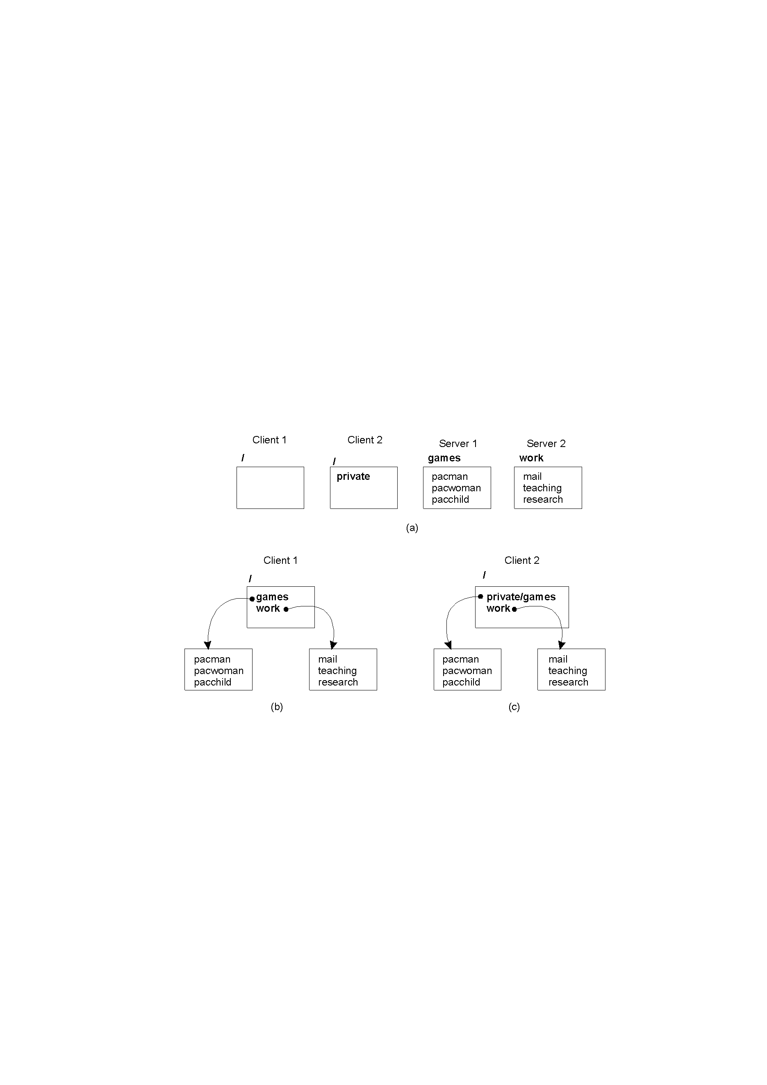
Network Operating System (3)
1.21
Different clients may mount the servers in different places – difficult to maintain a consistent “view”
of the system

Slide 13
The Best of Both Worlds?
DOS: too inflexible (all systems of the
same type).
NOS: too primitive (lowest common denominator – too much diversity).
“Middleware” – best possible compromise?
Middleware = NOS + additional software layer.

Slide 14

Positioning Middleware
1-22
General structure of a distributed system as middleware

Slide 15
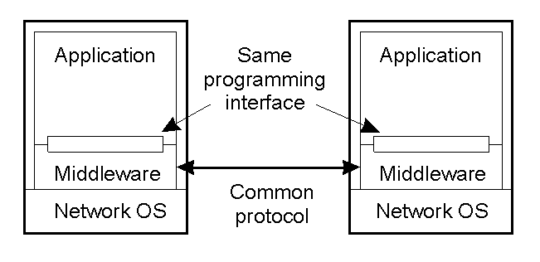
Middleware and Openness
1.23
In an open middleware-based distributed system, the protocols used by each middleware layer should be the same, as well as the interfaces they offer to applications. This is a much higher level of abstraction than (for instance) the NOS Socket API.

Slide 16
Comparison between the systems
Item | Distributed OS |  | Network OS | Middleware-based OS
 | Multiproc. | Multicomp.
Degree of transparency | Very High | High | Low | High
Same OS on all nodes | Yes | Yes | No | No
Number of copies of OS | 1 | N | N | N
Basis for communication | Shared memory | Messages | Files | Model specific
Resource management | Global, central | Global, distributed | Per node | Per node
Scalability | No | Moderately | Yes | Varies
Openness | Closed | Closed | Open | Open

Slide 17
Architectural Styles
Important styles of architecture for distributed systems:
  Layered architectures
  Object-based architectures
  Data-centered architectures
  Event-based architectures

Slide 18
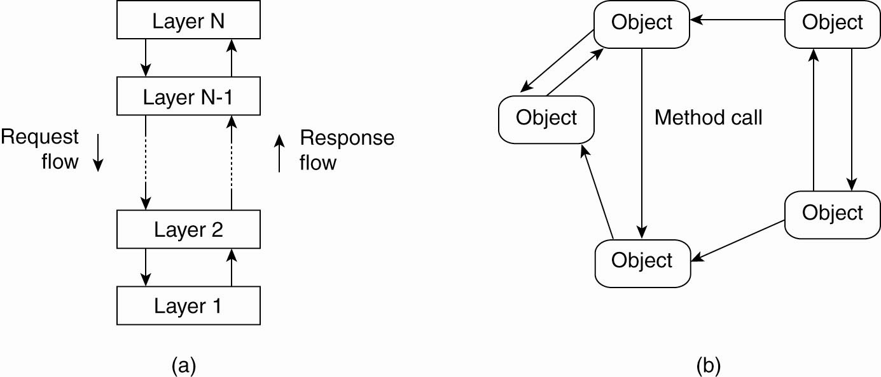
Architectural Styles (2)
The (a) layered architectural style and …

Slide 19
Architectural Styles (3)
(b) The object-based architectural style

Slide 20
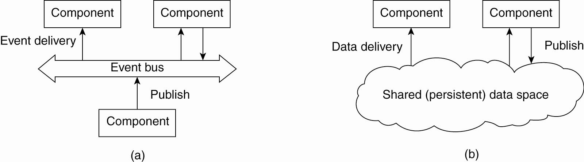
Architectural Styles (4)
(a) The event-based architectural style and …

Slide 21
Architectural Styles (5)
(b) The shared data-space architectural style

Slide 22
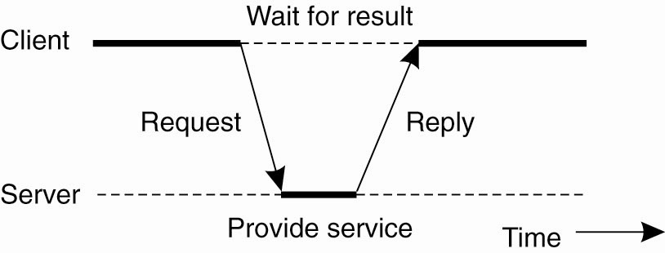
Centralized Architectures
Client/Server Model
General interaction between a client and a server

Slide 23
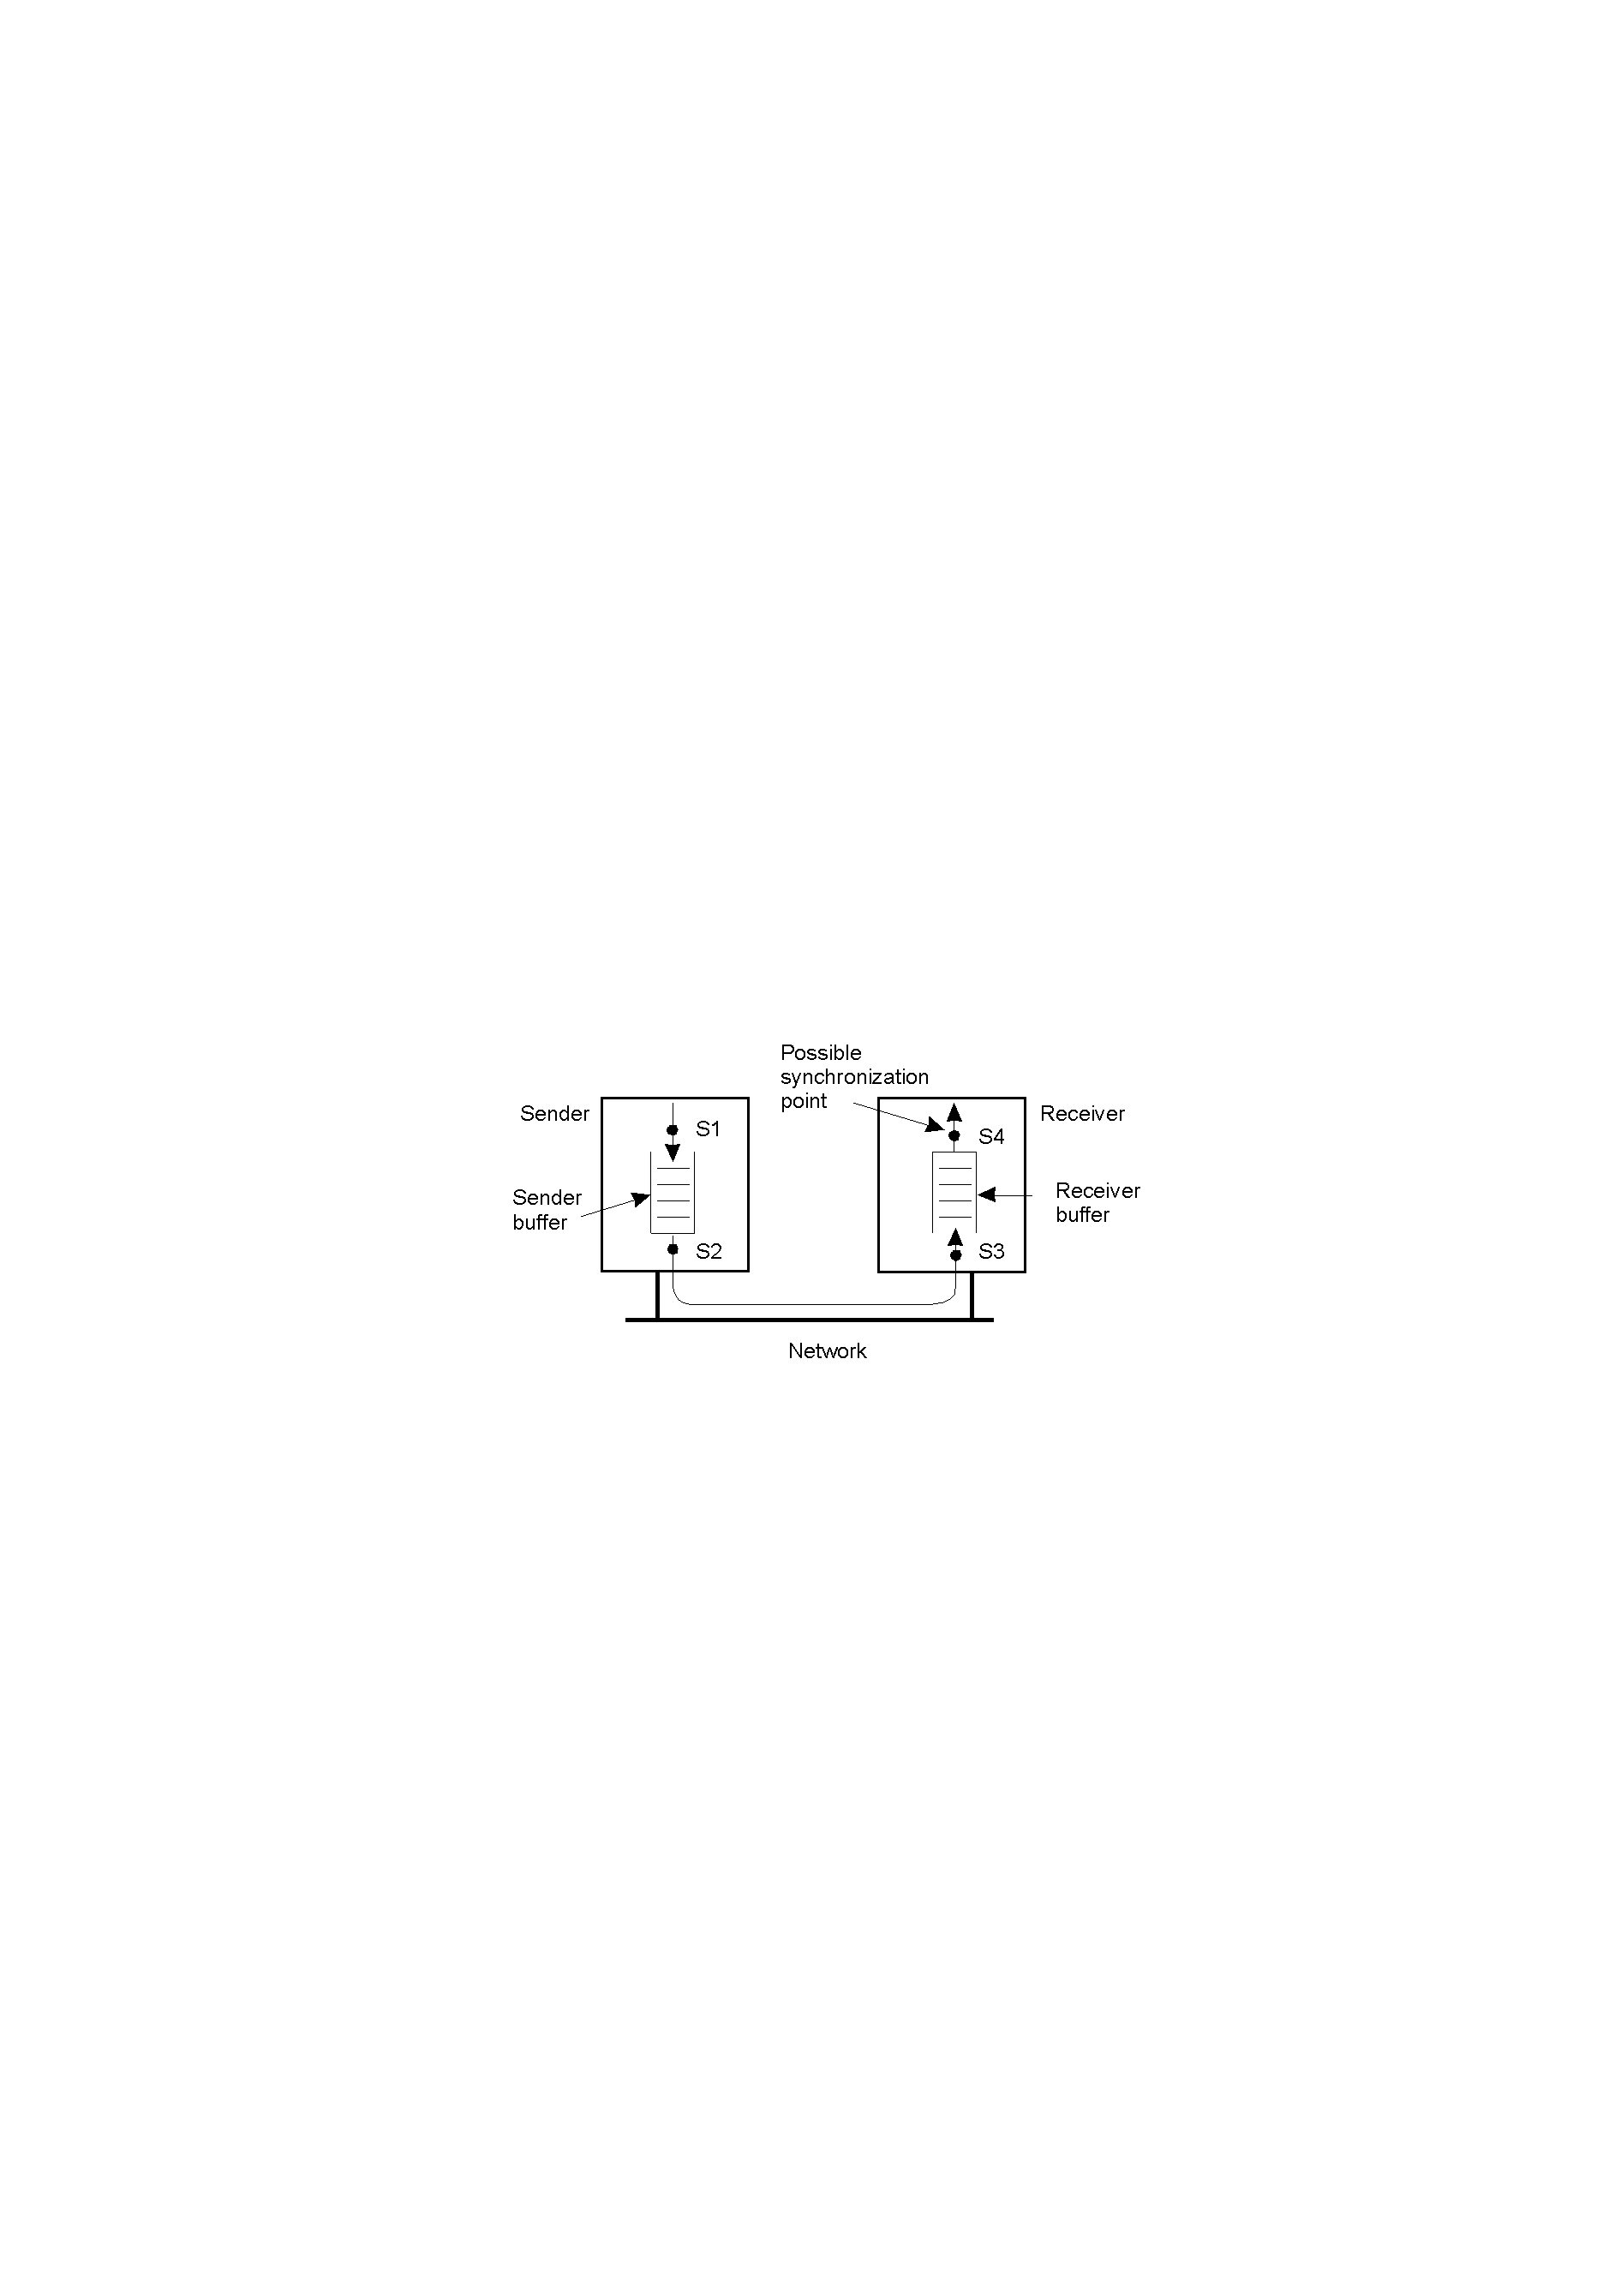
Alternatives for blocking and buffering in message passing
1.15

Slide 24
Relation between blocking, buffering, and reliable communications
Synchronization point | Sender buffer | Reliable communication guaranteed?
Block sender until buffer not full | Yes | Not necessarily
Block sender until message sent | No | Not necessarily
Block sender until message received | No | Necessary
Block sender until message delivered | No | Necessary

Slide 25
Application Leveling (1)
Traditional three levels of architectural style:
  User-interface level
  Processing level
  Data level

Slide 26
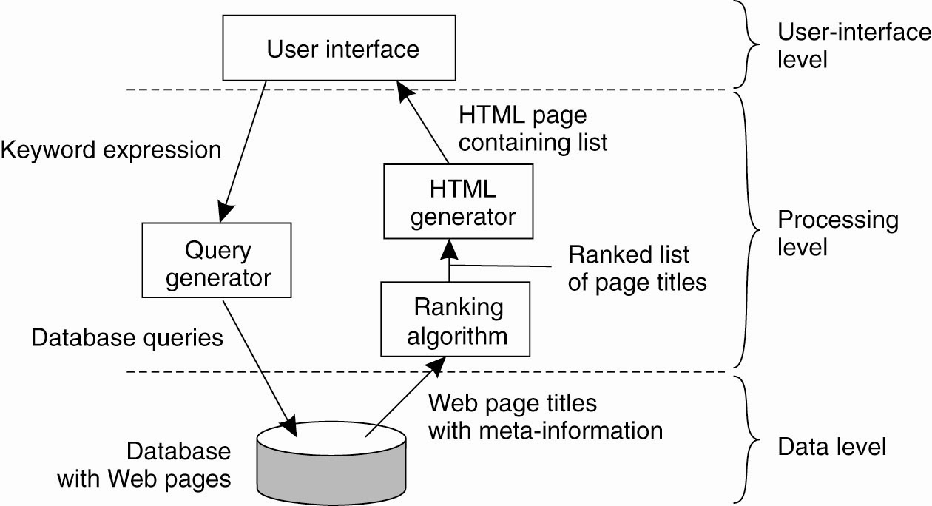
Application Leveling (2)
The simplified organization of an
Internet search engine into three different levels

Slide 27
Multi-tiered Architectures (1)
The simplest organization is to have
only two types of machines:
  A client machine containing only the programs implementing (part of) the
  user-interface level.
  A server machine containing the rest, the programs implementing the processing
  and data levels.

Slide 28
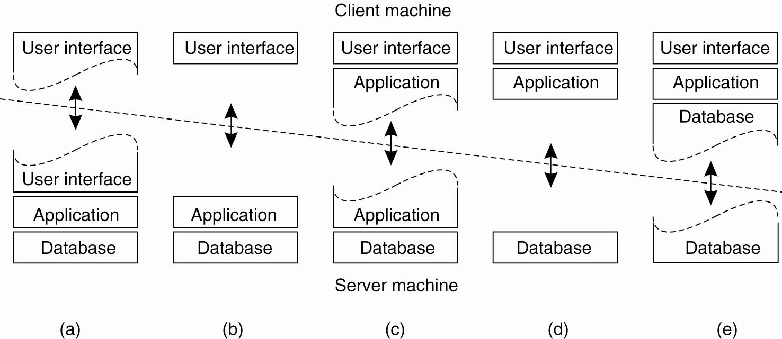
Multi-tiered Architectures (2)
Alternative client-server organizations (a)–(e)

Slide 29
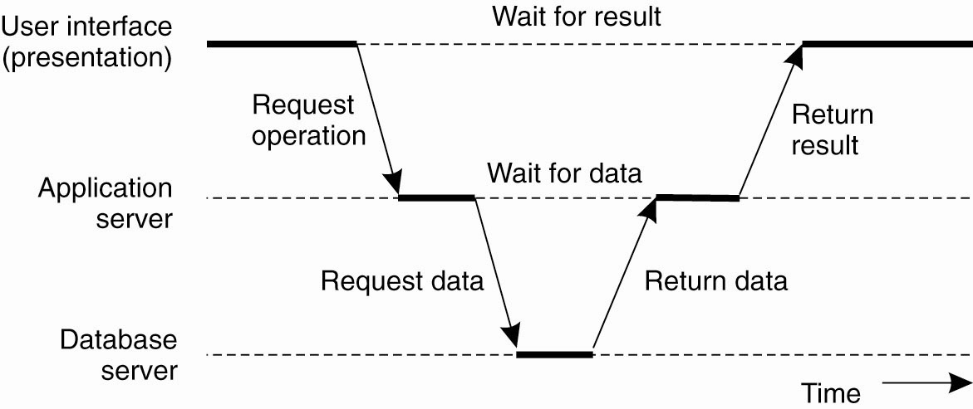
Multi-tiered Architectures (3)
An example of a server acting as a client – this is a very common vertical distribution model for distributed systems

Slide 30
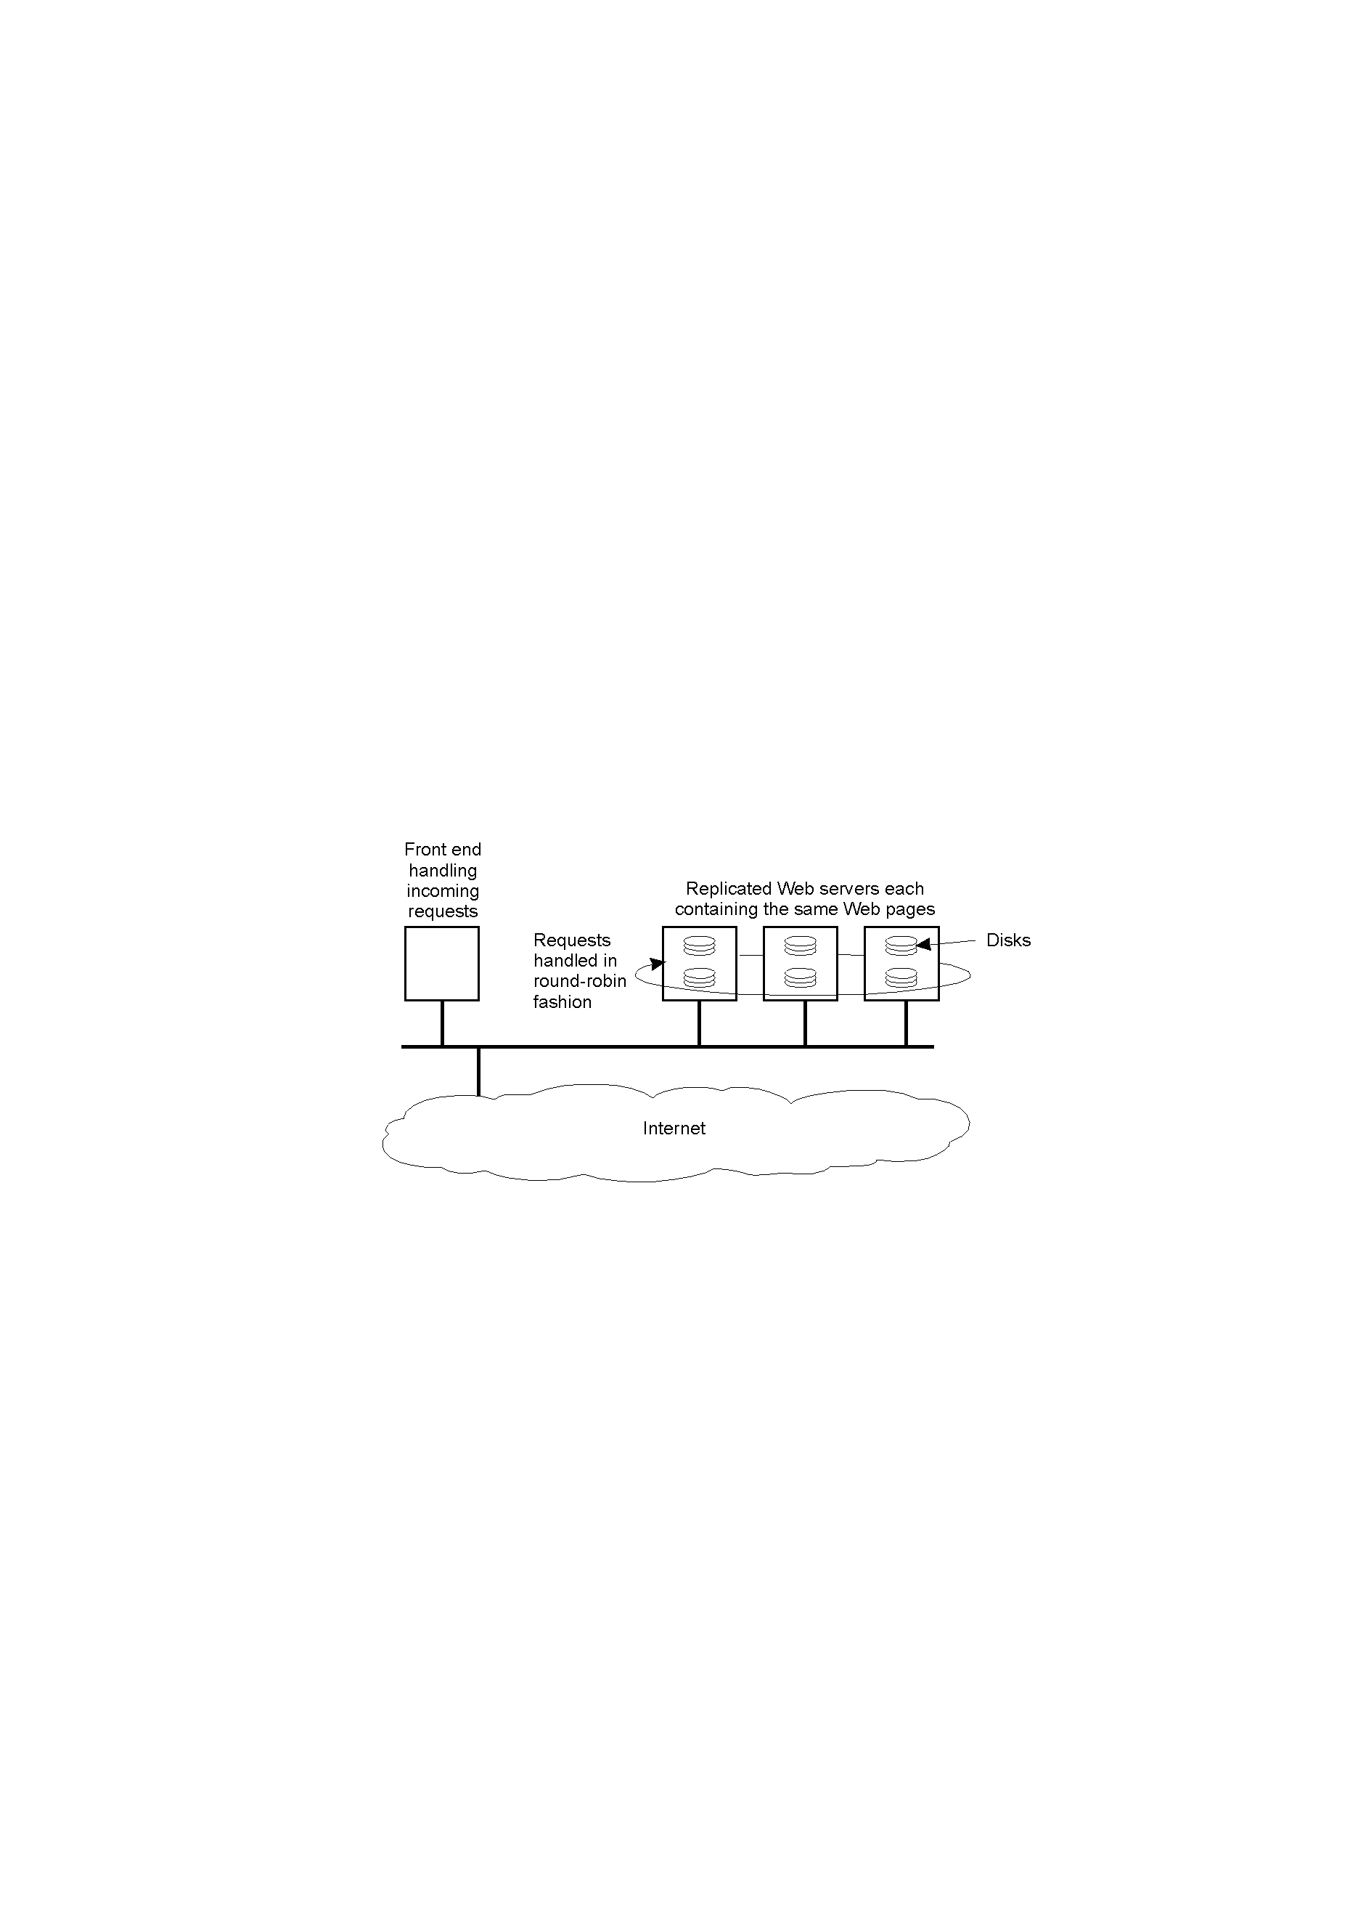
Replicated Web Servers
1-31
An example of horizontal distribution of a Web service (often also referred to as “clustering”)

Slide 31
Decentralized Architectures
Three types of Peer-to-Peer (P2P) systems:
  Structured P2P: nodes are organized following a specific distributed data structure.
  Unstructured P2P: nodes have randomly selected neighbors.
  Hybrid P2P: some nodes are appointed special functions in a well-organized fashion.

Slide 32
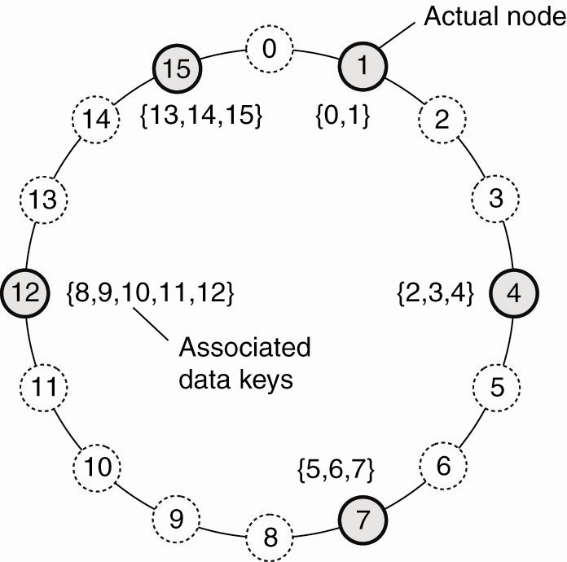
Structured Peer-to-Peer Architectures (1)
The mapping of data items onto nodes in Chord

Slide 33
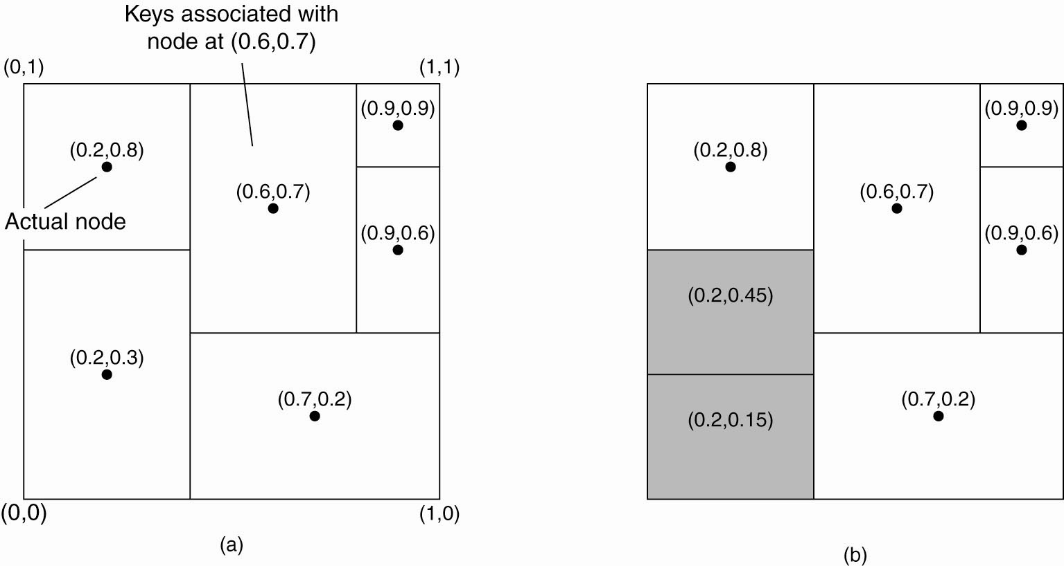
Structured Peer-to-Peer Architectures (2)
(a) The mapping of data items onto nodes in CAN

Slide 34
Structured Peer-to-Peer Architectures (3)
(b) Splitting a region when a node joins

Slide 35
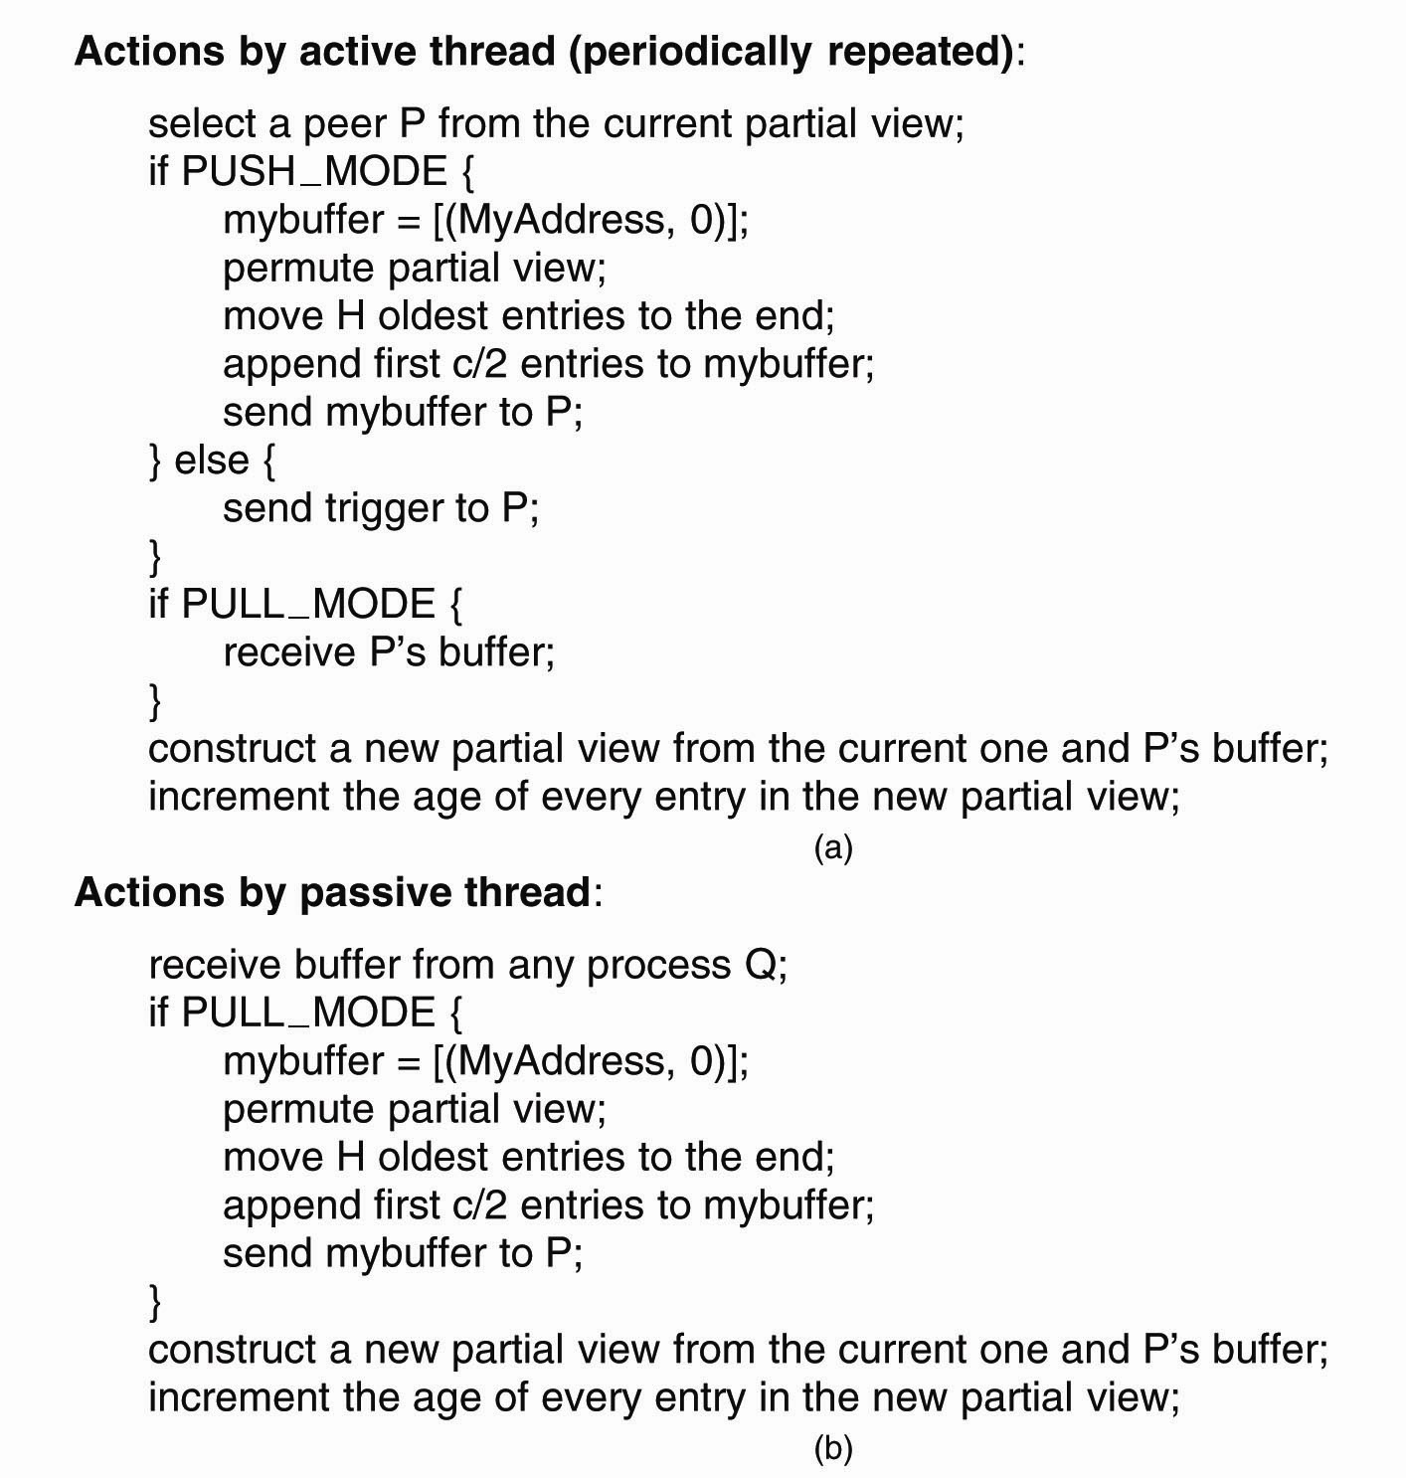
Unstructured Peer-to-Peer Architectures (1)
(a) The steps taken by the active thread

Slide 36
Unstructured Peer-to-Peer Architectures (2)
(b) The steps taken by the passive thread

Slide 37
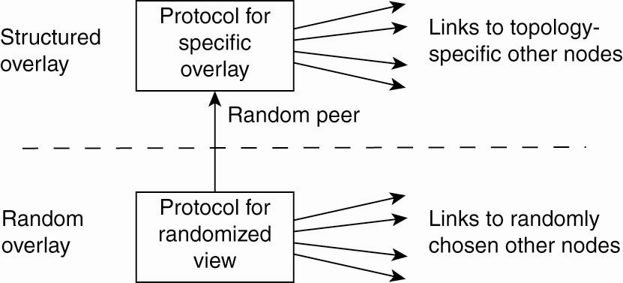
Topology Management of Overlay Networks (1)
A two-layered approach for constructing and maintaining specific overlay topologies using techniques from unstructured peer-to-peer systems

Slide 38
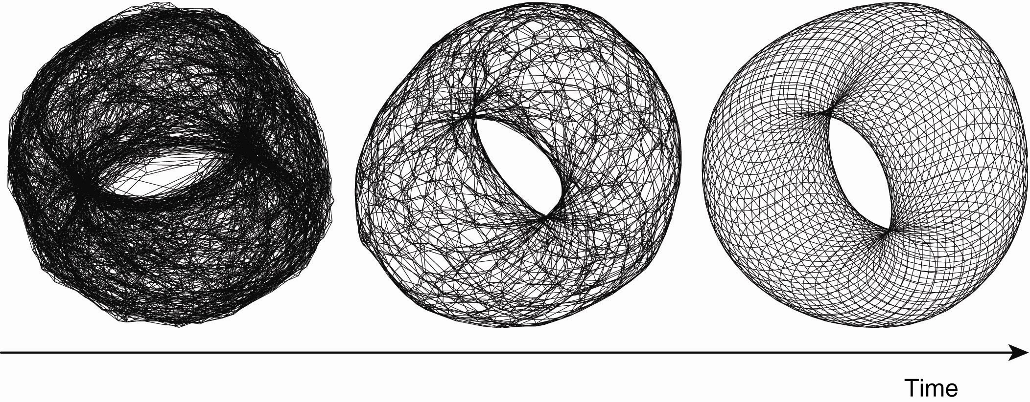
Topology Management of Overlay Networks (2)
Generating a specific overlay network using a two-layered unstructured peer-to-peer system [adapted with permission from Jelasity and Babaoglu (2005)]

Slide 39
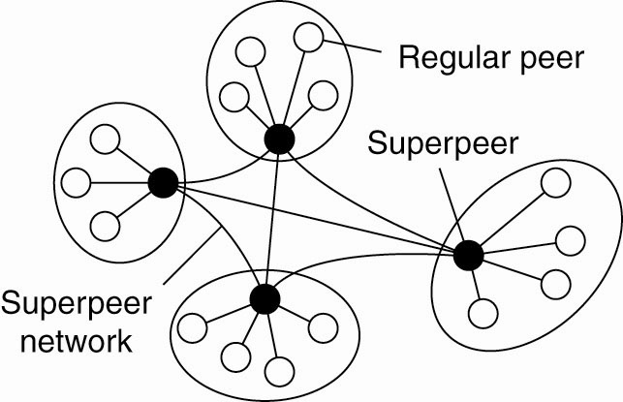
Superpeers
A hierarchical organization of nodes
into a superpeer network

Slide 40
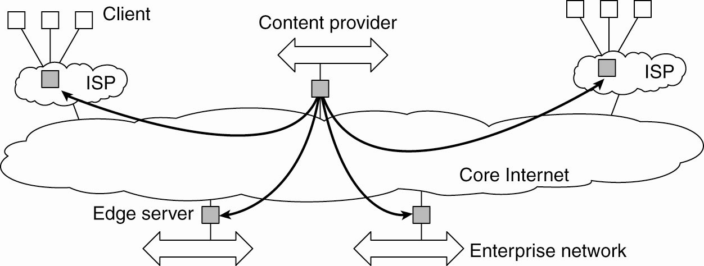
Hybrid Architectures
Edge-Server Systems
Viewing the Internet as consisting
of a collection of edge servers

Slide 41
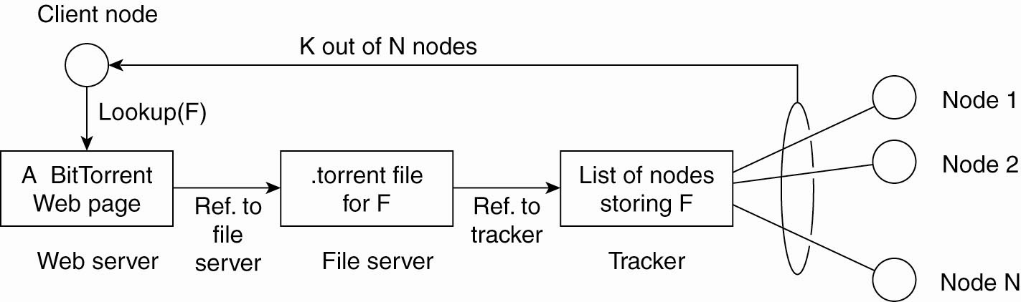
Collaborative Distributed Systems (1)
The principal working of BitTorrent [adapted with permission from Pouwelse et al. (2004)]

Slide 42
Collaborative Distributed Systems (2)
Components of Globule collaborative content distribution network:
  A component that can redirect client requests to other servers.
  A component for analyzing access patterns.
  A component for managing the replication of Web pages.

Slide 43
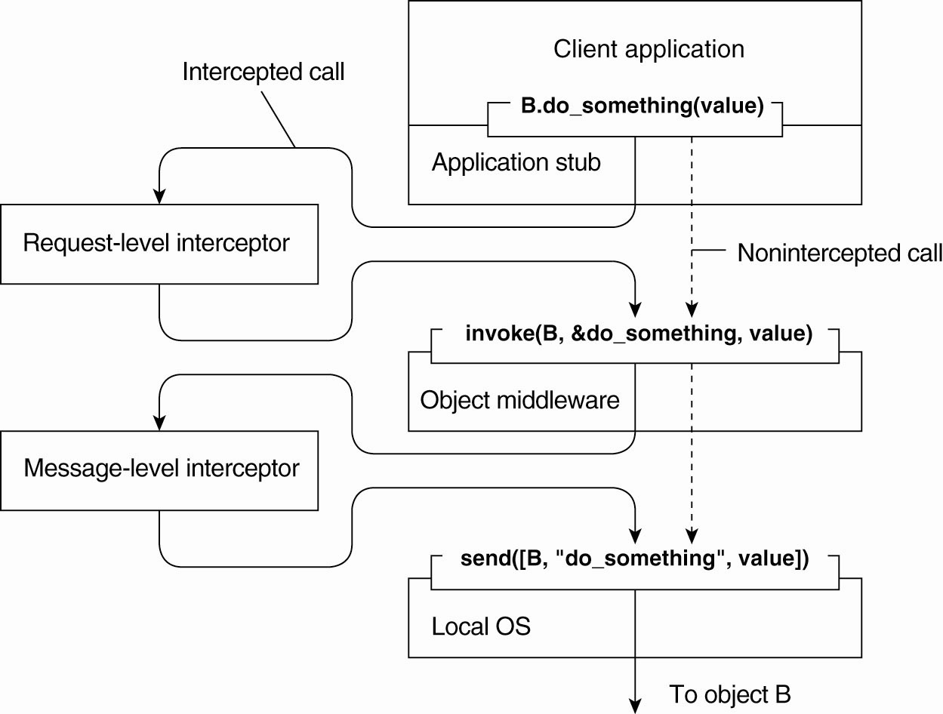
Interceptors
Using interceptors to handle remote-object invocations

Slide 44
General Approaches to Adaptive Software
Three basic approaches to adaptive software:
  Separation of concerns
  Computational reflection
  Component-based design

Slide 45
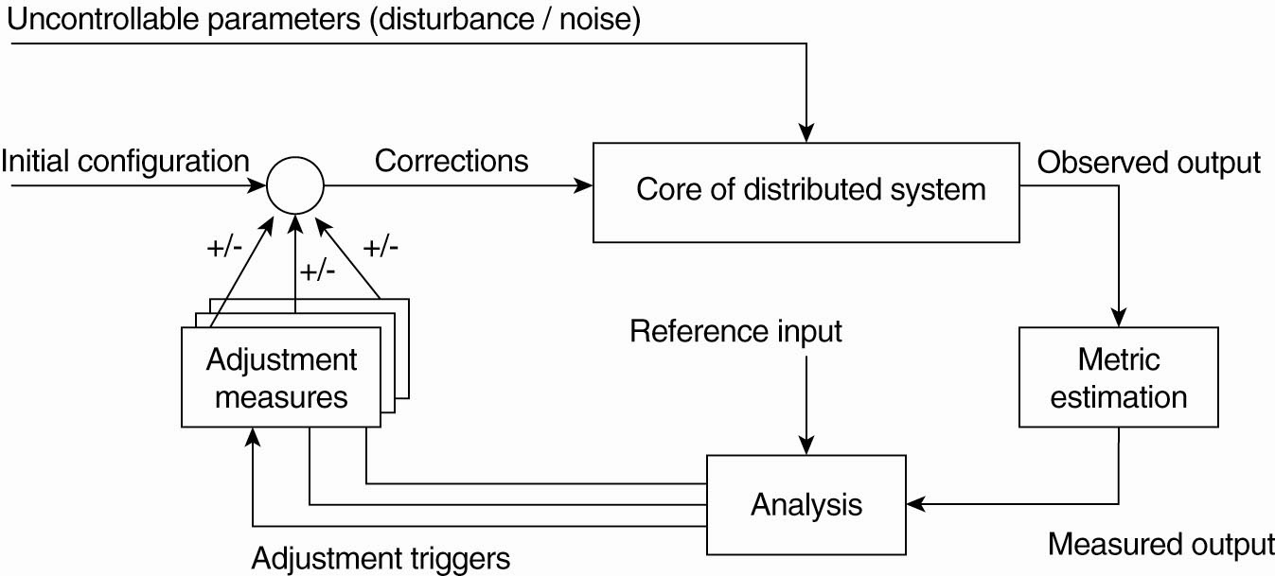
Self-Managing DSs
The Feedback Control Model
The logical organization of a feedback control system

Slide 46
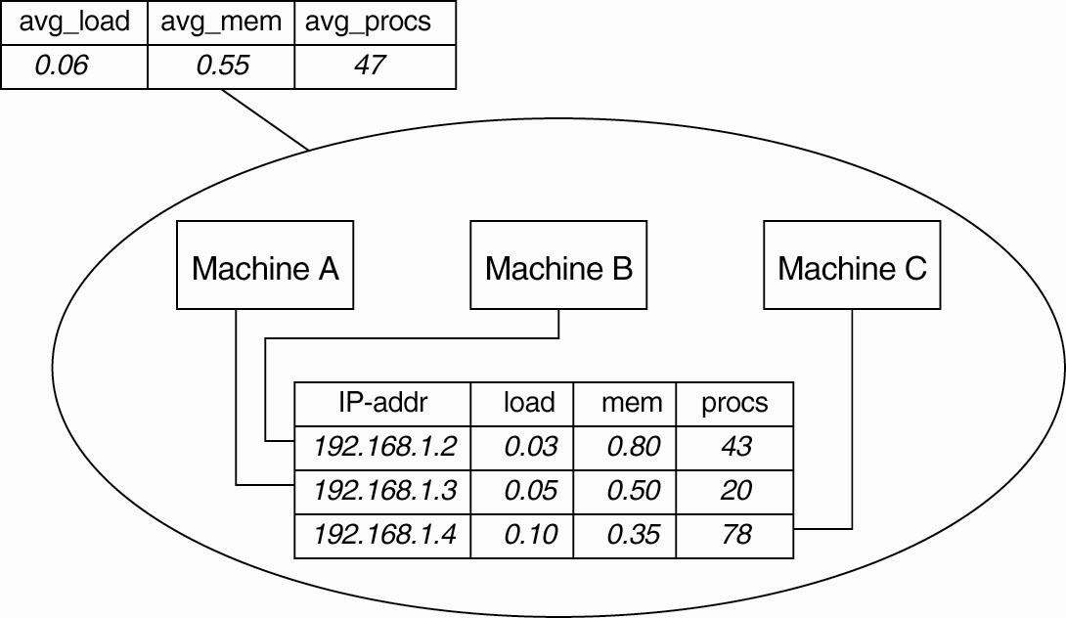
Example: Systems Monitoring with Astrolabe
Data collection and information aggregation in Astrolabe

Slide 47
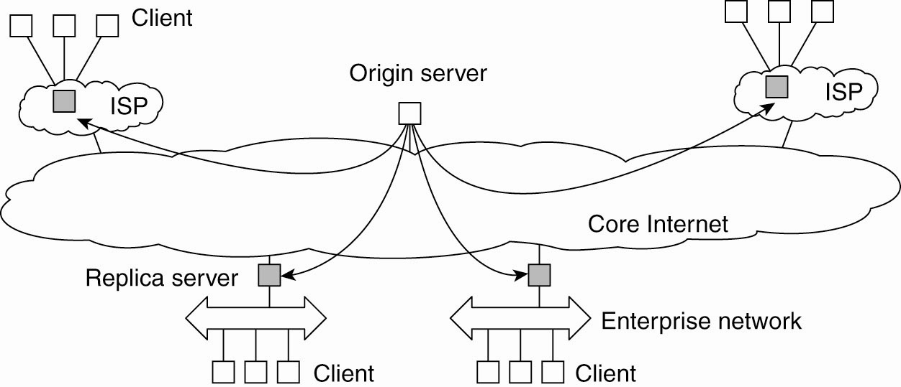
Example: Differentiating Replication Strategies in Globule (1)
The edge-server model assumed by Globule

Slide 48
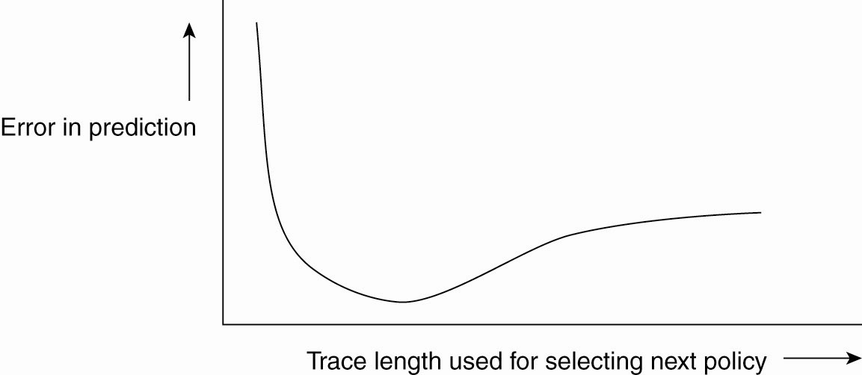
Example: Differentiating Replication Strategies in Globule (2)
The dependency between prediction accuracy and trace length

Slide 49
Example: Automatic Component Repair Management in Jade
Steps required in a repair procedure:
  Terminate every binding between a component on a non-faulty node, and a component on the node that just failed.
  Request the node manager to start and add a new node to the domain.
  Configure the new node with exactly the same components as those on crashed node.
  Re-establish all the bindings that were previously terminated.

