Slide 1
Distributed Systems
Processes
Chapter 3

Slide 2
Course/Slides Credits
Note: all course presentations are based on those developed by Andrew S. Tanenbaum and Maarten van Steen. They accompany their "Distributed Systems: Principles and Paradigms" textbook (1st & 2nd editions).
http://www.prenhall.com/divisions/esm/app/author_tanenbaum/custom/dist_sys_1e/index.html
And additions made by Paul Barry in course CW046-4: Distributed Systems
http://glasnost.itcarlow.ie/~barryp/net4.html

Slide 3
Processes
Communication takes place between processes.
But, what’s a process? “A program in execution”.
Traditional operating systems: concerned with the “local” management and scheduling of processes.
Modern distributed systems: a number of other issues are of equal importance.
There are three main areas of study:
  Threads and virtualization within clients/servers
  Process and code migration
  Software agents

Slide 4
Introduction to Threads
Modern OSs provide “virtual processors” within which programs execute.
A programs execution environment is documented in the process table and assigned
a PID.
To achieve acceptable performance in distributed systems, relying on the OS’s idea
of a process is often not enough –
finer granularity is required.
The solution: Threading.

Slide 5
Problems with Processes
Creating and managing processes is generally
regarded as an expensive task (fork system call).
Making sure all the processes peacefully co-exist on the system is not easy (as concurrency transparency comes at a price).
Threads can be thought of as an “execution of a part of a program (in user-space)”.
Rather than make the OS responsible for concurrency transparency, it is left to the individual application to manage the creation and scheduling of each thread.

Slide 6
Important Implications
Two Important Implications:
  Threaded applications often run faster than non-threaded applications (as context-switches between kernel and user-space are avoided).
  Threaded applications are harder to develop (although simple, clean designs can help here).
Additionally, the assumption is that the development environment provides a
Threads Library for developers to use
(most modern environments do).

Slide 7
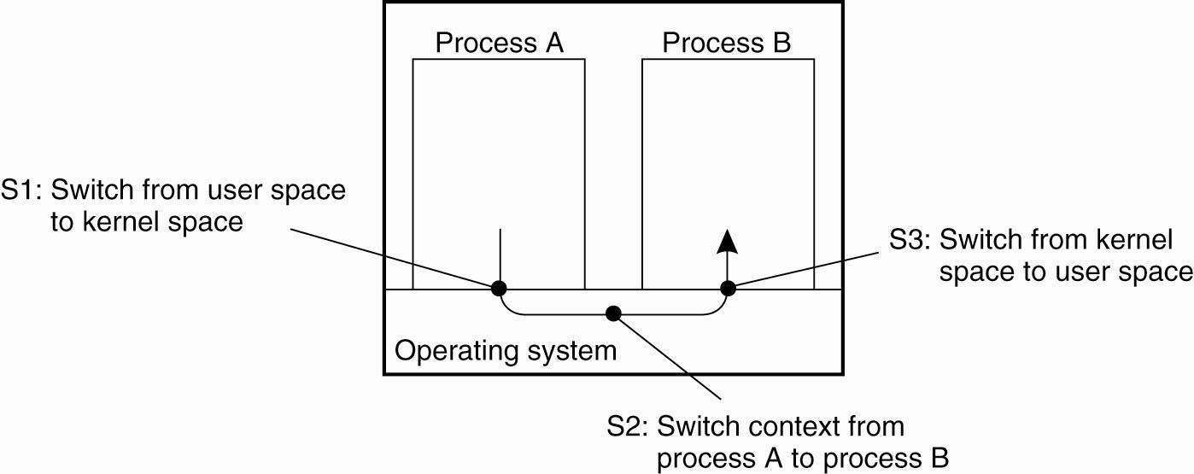
Thread Usage in Non-distributed Systems
Context switching as the result of IPC

Slide 8
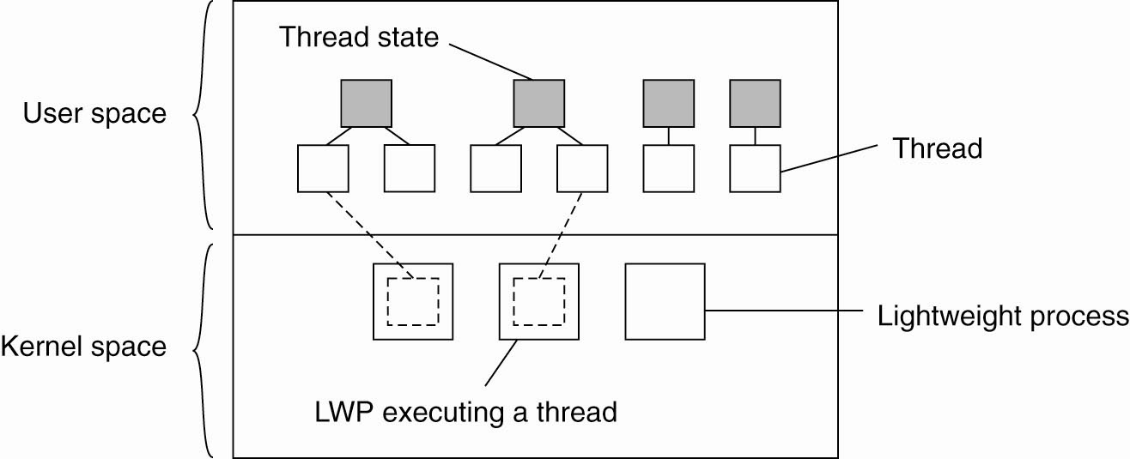
Thread Implementation
Combining kernel-level lightweight processes
and user-level threads

Slide 9
Threads in Non-Distributed Systems
Advantages:
  Blocking can be avoided
  Excellent support for multi-processor systems (each running their own thread).
  Expensive context-switches can be avoided.
  For certain classes of application, the design and implementation is made considerably easier.

Slide 10
Threads in Distributed Systems
Important characteristic: a blocking call in a thread does not result in the entire process
being blocked.
This leads to the key characteristic of threads within distributed systems:
  “We can now express communications in the form of maintaining multiple logical connections at the same time (as opposed to a single, sequential, blocking process).”

Slide 11
Example: MT Clients and Servers
Mutli-Threaded Client: to achieve acceptable levels of perceived performance, it is often necessary to hide communications latencies.
Consequently, a requirement exists to start communications while doing something else.
Example: modern Web browsers.
This leads to the notion of “truly parallel streams of data” arriving at a multi-threaded client application.

Slide 12
Example: MT-Servers
Although threading is useful on clients, it is much more useful in distributed systems servers.
The main idea is to exploit parallelism to attain high performance.
A typical design is to organize the server as a single “dispatcher” with multiple threaded “workers”, as diagrammed overleaf.

Slide 13
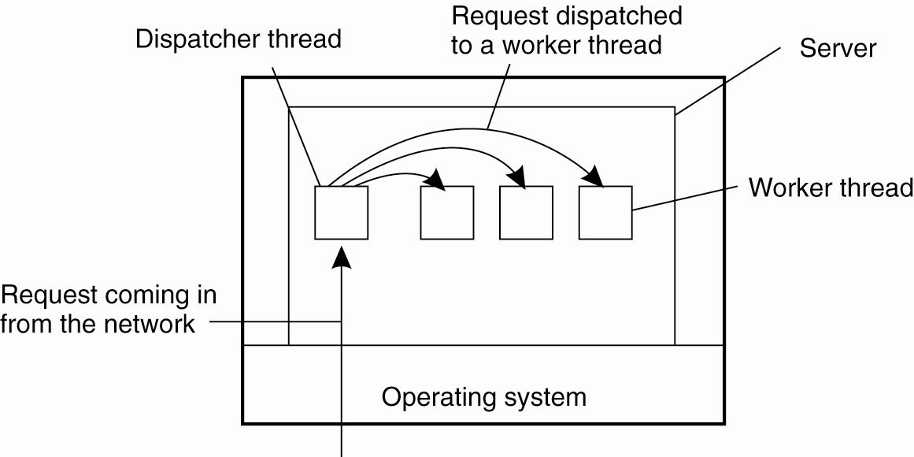
Multithreaded Servers (1)
A multithreaded server organized in a dispatcher/worker model

Slide 14
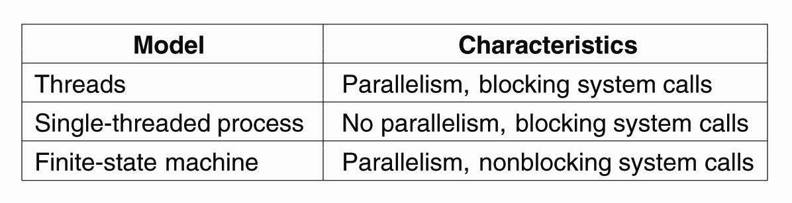
Multithreaded Servers (2)
Three ways to construct a server

Slide 15
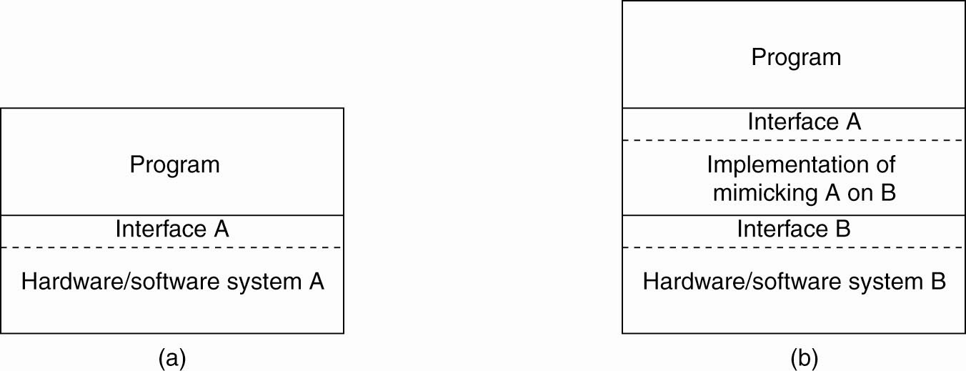
The Role of Virtualization in
Distributed Systems
General organization between a program, interface, and system
General organization of virtualizing system A on top of system B

Slide 16
Architectures of Virtual Machines (1)
There are interfaces at different levels.
An interface between the hardware and software, consisting of machine instructions
  that can be invoked by any program.
An interface between the hardware and software, consisting of machine instructions
  that can be invoked only by privileged programs, such as an operating system.

Slide 17
Architectures of Virtual Machines (2)
An interface consisting of system calls as offered by an operating system.
An interface consisting of library calls
  generally forming what is known as an Application Programming Interface (API).
  In many cases, the aforementioned system calls are hidden by an API.

Slide 18
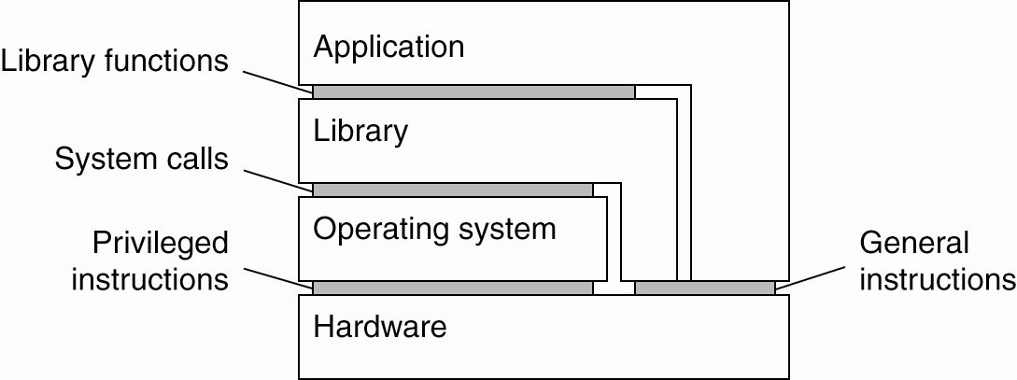
Architectures of Virtual Machines (3)
Various interfaces offered by computer systems

Slide 19
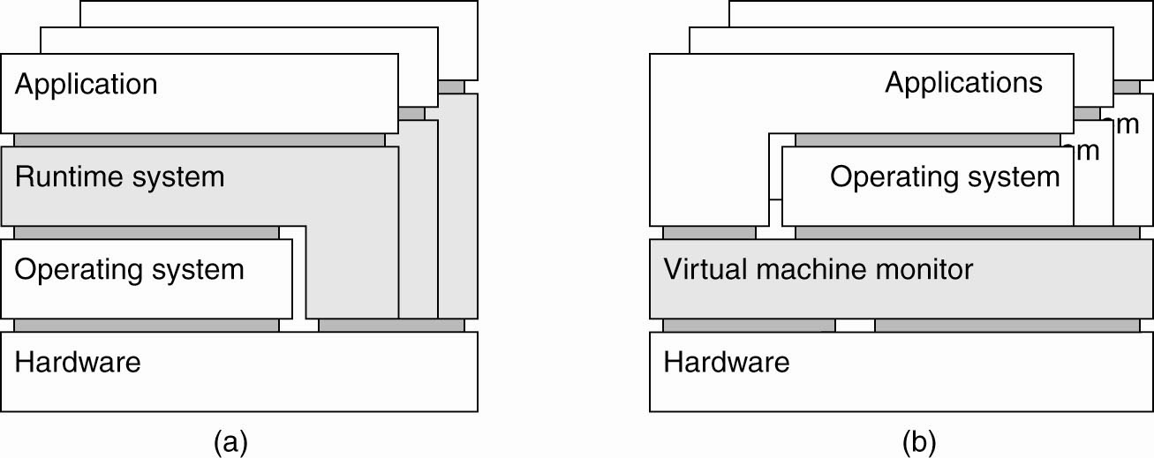
Architectures of Virtual Machines (4)
(a) A process virtual machine, with multiple instances of (application, runtime) combinations

Slide 20
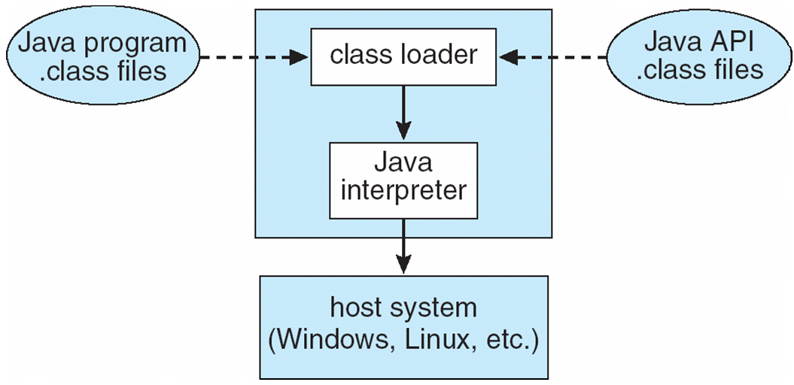
The Java Virtual Machine

Slide 21
Architectures of Virtual Machines (5)
(b) A Virtual Machine Monitor (VMM), with multiple instances of (applications, operating system) combinations.

Slide 22
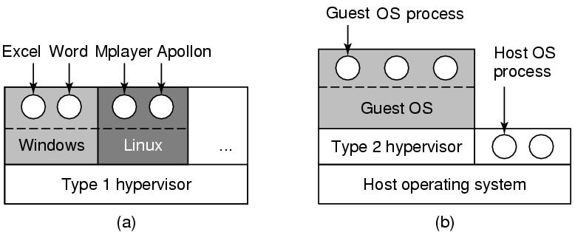
Types of VMM/Hypervisors
(a) A type 1 hypervisor. (b) A type 2 hypervisor

Slide 23
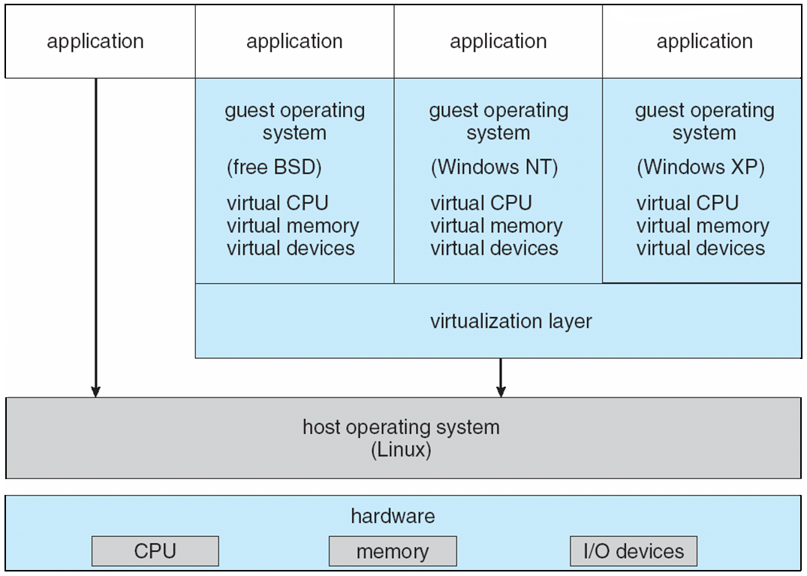
VMware Architecture

Slide 24
More on Clients
What’s a client?
Definition: “A program which interacts with a human user and a remote server.”
Typically, the user interacts with the client
via a GUI.
Of course, there’s more to clients than simply providing a UI. Remember the multi-tiered
levels of the Client/Server architecture from earlier …

Slide 25
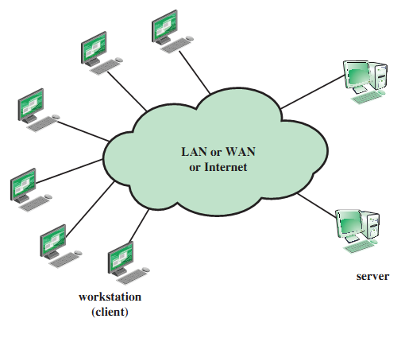
Generic Client/Server Environment

Slide 26
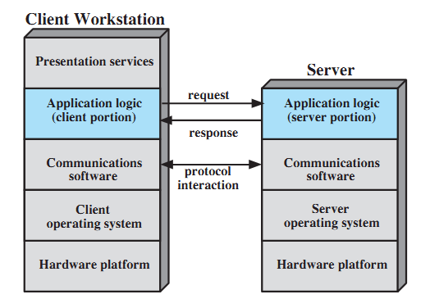
Generic Client/Server Architecture

Slide 27
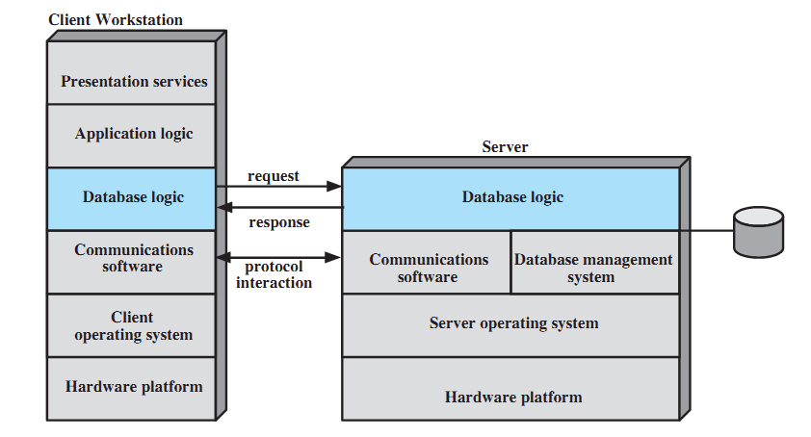
Client/Server Architecture for Database Applications

Slide 28
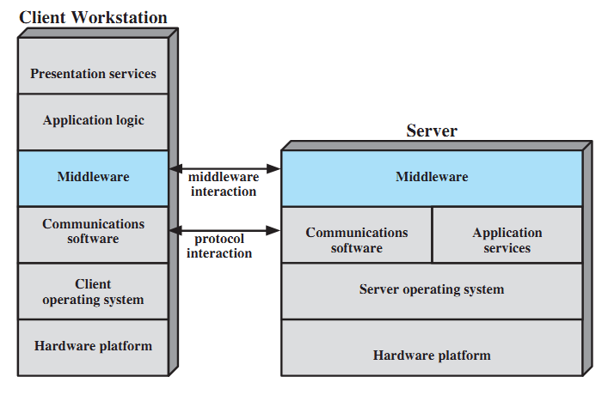
Role of Middleware in Client/Server Architecture

Slide 29
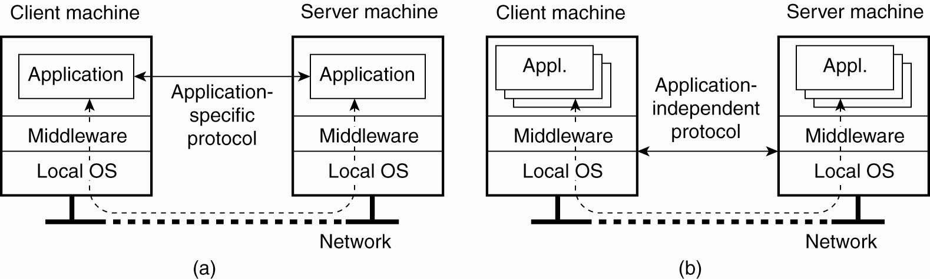
Networked User Interfaces (1)
(a) A networked application with its own protocol

Slide 30
Networked User Interfaces (2)
(b) A general solution to allow access
to remote applications

Slide 31
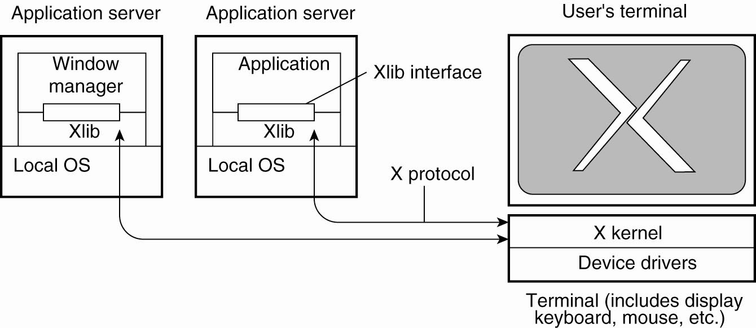
Example: The X Window System
The basic organization of the X Window System

Slide 32
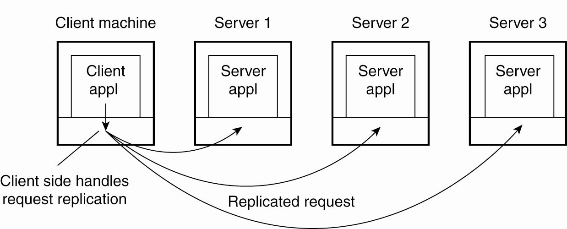
Client-Side Software for Distribution Transparency
Transparent replication of a server
using a client-side solution

Slide 33
More on Servers
What’s a server?
Definition: “A process that implements a specific service on behalf of a collection of clients”.
Typically, servers are organized to do one of two things:
    Wait
    Service
  … wait … service … wait … service … wait …

Slide 34
Servers: Iterative and Concurrent
Iterative: server handles request, then returns results to the client; any new client requests must wait for previous request to complete
(also useful to think of this type of server as sequential).
Concurrent: server does not handle the request itself; a separate thread or sub-process handles the request and returns any results to the client; the server is then free to immediately service the next client (i.e., there’s no waiting, as service requests are processed in parallel).

Slide 35
Server “States”
Stateless servers – no information is maintained on the current “connections” to the server. The Web is the classic example of a stateless service. As can be imagined, this type of server is easy to implement.
Stateful servers – information is maintained on the current “connections” to the server. Advanced file servers, where copies of a file can be updated “locally”, then applied to the main server (as it knows the state of things) - more difficult to implement.
But, what happens if something crashes? (more on this later).

Slide 36
Problem: Identifying “end-points”?
How do clients know which end-point
(or port) to contact a server at?
How do they “bind” to a server?
  Statically assigned end-points (IANA).
  Dynamically assigned end-points (DCE).
  A popular variation:
    the “super-server” (inetd on UNIX).

Slide 37
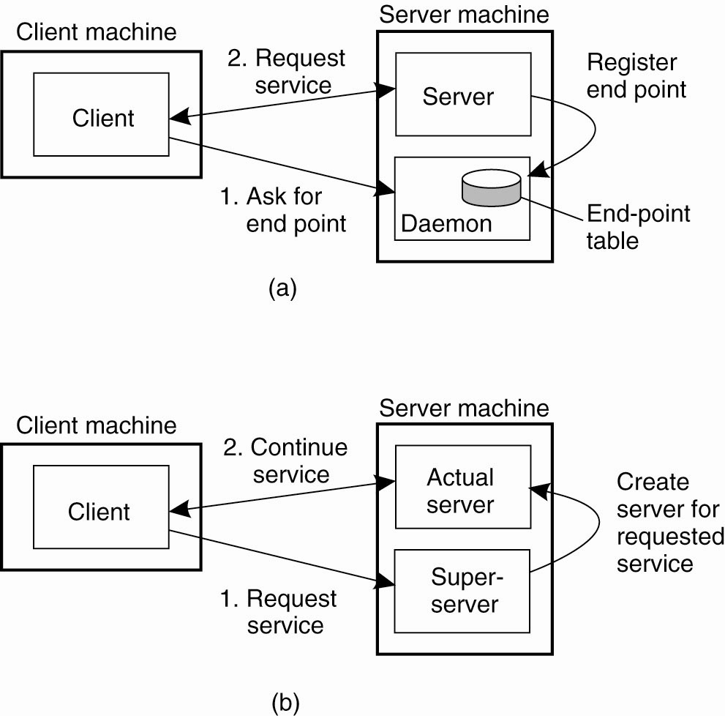
General Design Issues (1)
(a) Client-to-server binding using a daemon

Slide 38
General Design Issues (2)
(b) Client-to-server binding using a superserver

Slide 39
A Special Type: Object Servers
A server tailored to support distributed objects.
Does not provide a specific service.
Provides a facility whereby objects can be remotely invoked by non-local clients.
Consequently, object servers are highly adaptable.
“A place where objects live”.

Slide 40
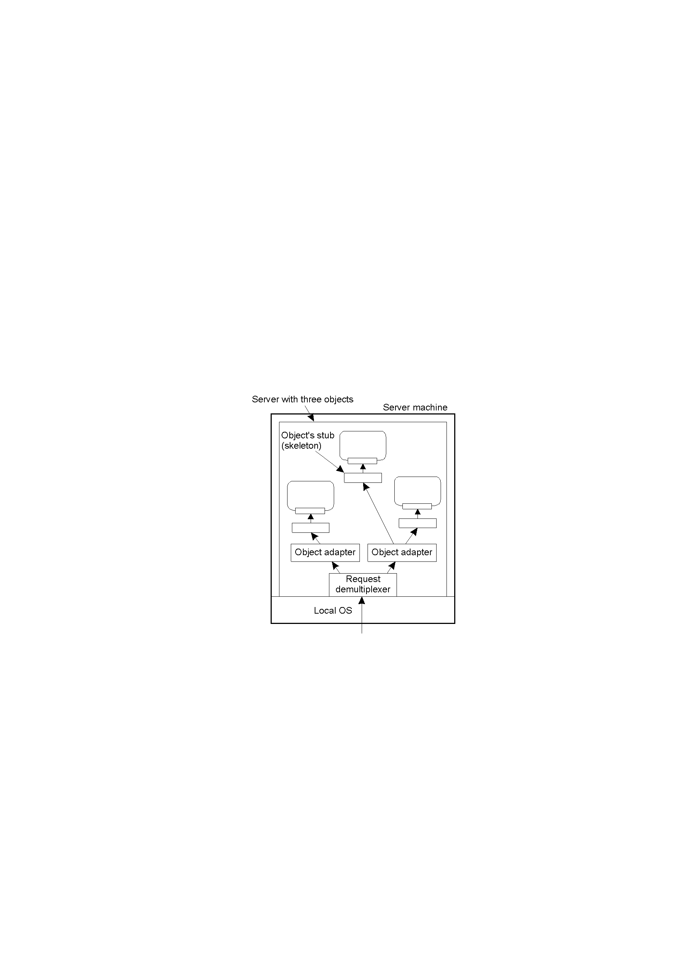
Object Adapter
Organization of an object server supporting different
activation policies.

Slide 41
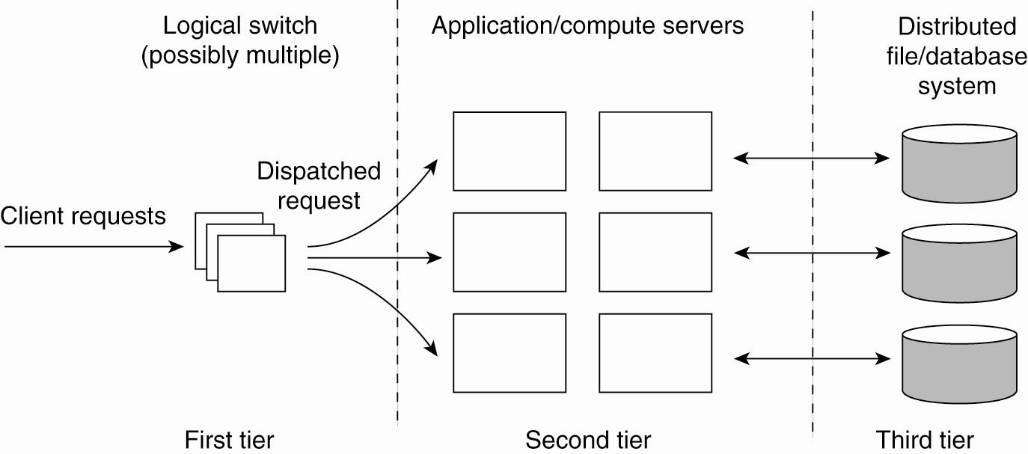
Server Clusters (1)
The general organization of a three-tiered server cluster

Slide 42
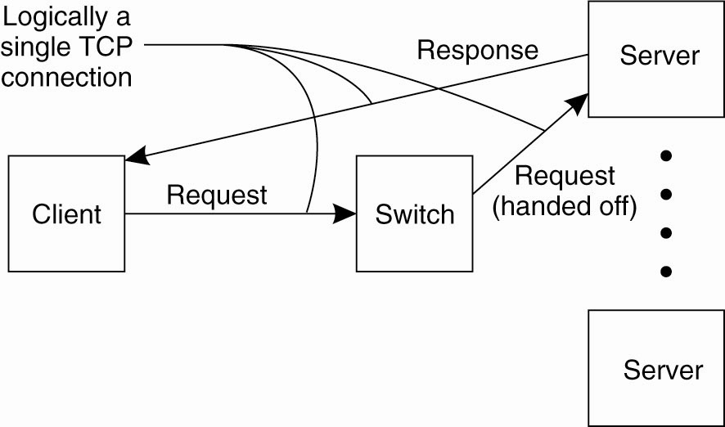
Server Clusters (2)
The principle of TCP handoff

Slide 43
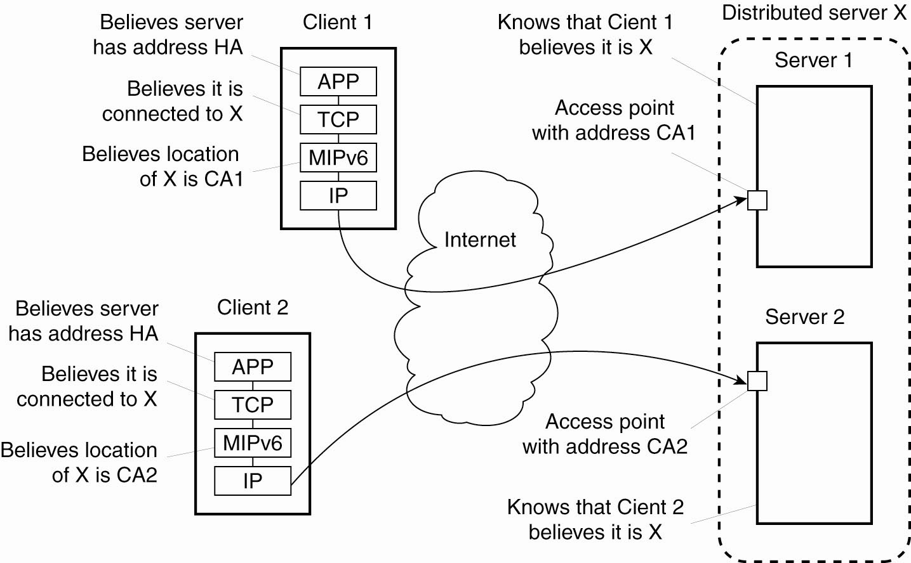
Distributed Servers
Route optimization in a distributed server

Slide 44
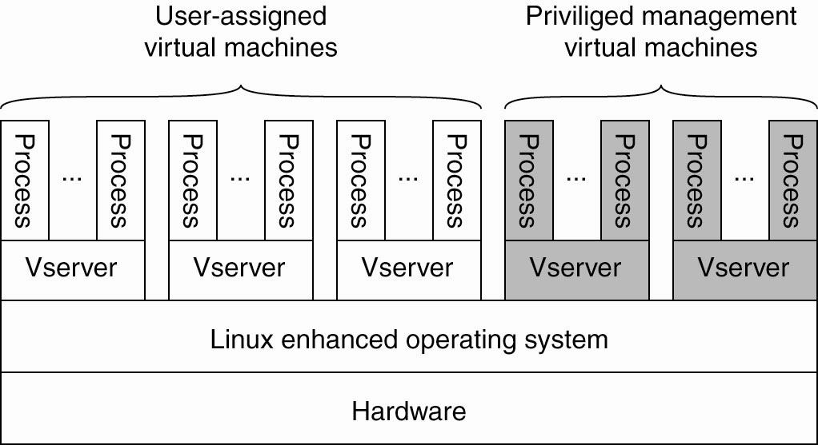
Managing Server Clusters
The basic organization of a PlanetLab node

Slide 45
PlanetLab (1)
PlanetLab management issues:
Nodes belong to different organizations.
  Each organization should be allowed to specify who is allowed to run applications on their nodes,
  And restrict resource usage appropriately.
Monitoring tools available assume a very specific combination of hardware and software.
  All tailored to be used within a single organization.
Programs from different slices but running on the same node should not interfere with each other.

Slide 46
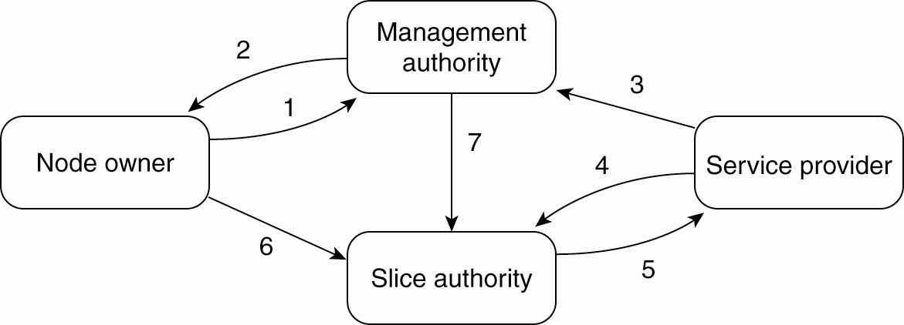
PlanetLab (2)
The management relationships
between various PlanetLab entities

Slide 47
PlanetLab (3)
Relationships between PlanetLab entities:
A node owner puts its node under the regime of a management authority, possibly restricting usage where appropriate.
A management authority provides the necessary software to add a node to PlanetLab.
A service provider registers itself with a management authority, trusting it to provide well-behaving nodes.

Slide 48
PlanetLab (4)
A service provider contacts a slice authority to create a slice on a collection of nodes.
The slice authority needs to authenticate the service provider.
A node owner provides a slice creation service for a slice authority to create slices. It essentially delegates resource management to the slice authority.
A management authority delegates the creation of slices to a slice authority.

Slide 49
Process and Code Migration
Under certain circumstances, in addition to the usual passing of data, passing code (even while it is executing) can greatly simplify the design of a DS.
However, code migration can be inefficient and very costly.
So, why migrate code?

Slide 50
Reasons for Migrating Code
Why? Biggest single reason: better performance.
The big idea is to move a compute-intensive task from a heavily loaded machine to a lightly loaded machine
“on demand” and “as required”.

Slide 51
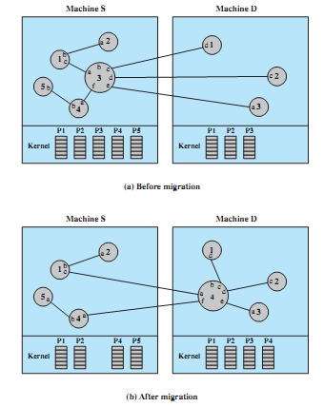
Example of Process Migration

Slide 52
Code Migration Examples
Moving (part of) a client to a server – processing data close to where the data resides. It is often too expensive to transport an entire database to a client for processing, so move the client to the data.
Moving (part of) a server to a client –
checking data prior to submitting it to a server. The use of local error-checking (using JavaScript) on Web forms is a good example of this type of processing. Error-check the data close to the user, not at the server.

Slide 53
“Classic” Code Migration Example
Searching the Web by “roaming”.
Rather than search and index the Web by requesting the transfer of each and every document to the client for processing, the
client relocates to each site and indexes the documents it finds “in situ”. The index is then transported from site to site, in addition to the executing process.

Slide 54
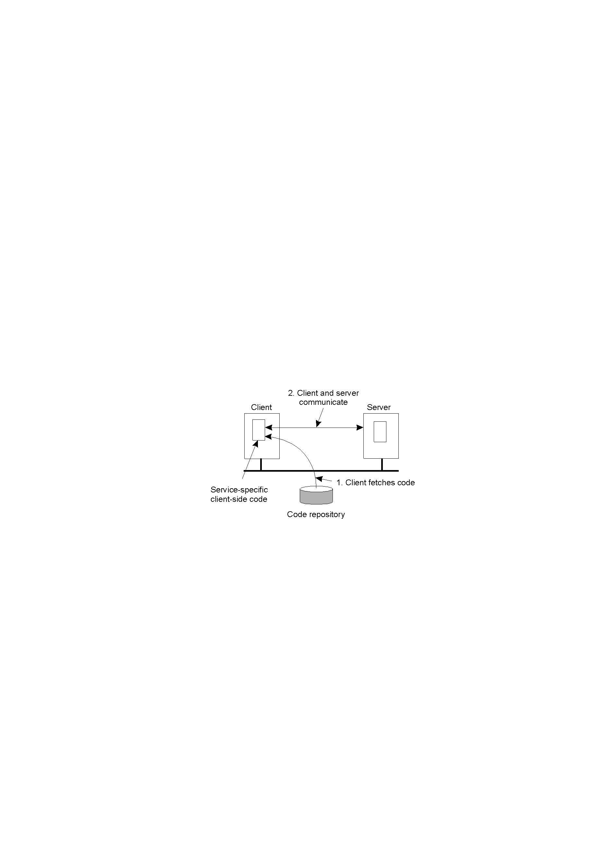
Another Big Advantage: Flexibility
The principle of dynamically configuring a client to communicate to a server. The client first fetches the necessary software, and then invokes the server. This is a very flexible approach.

Slide 55
Major Disadvantage
Security Concerns.
“Blindly trusting that the downloaded code implements only the advertised interface while accessing your unprotected hard-disk and does not send the juiciest parts to heaven-knows-where may not always be such a good idea”.

Slide 56
Code Migration Models
A running process consists of three “segments”:
  Code – instructions.
  Resource – external references.
  Execution – current state.

Slide 57
Migration in Heterogeneous Systems
Three ways to handle migration (which can be combined):
Pushing memory pages to the new machine and resending the ones that are later modified during the migration process.
Stopping the current virtual machine; migrate memory, and start the new virtual machine.
Letting the new virtual machine pull in new pages as needed, that is, let processes start on the new virtual machine immediately and copy memory pages on demand.

Slide 58
Code Migration Characteristics
Weak Mobility: just the code is moved –
and it always restarts from its initial state.
  e.g., Java Applets.
  Comment: simple implementation, but limited applicability.
Strong Mobility: code & state is moved –
and execution restarts from the next statement.
  e.g., D’Agents.
  Comment: very powerful, but hard to implement.

Slide 59
More Characteristics
Sender-Initiated vs. Receiver-Initiated.
Which side of the communication starts the migration?
  The machine currently executing the code (known as sender-initiated)
  The machine that will ultimately execute
  the code (known as receiver-initiated).

Slide 60
How Does the Migrated Code Run?
Another issue surrounds where the migrated code executes:
  Within an existing process (possibly as a thread)
  Within it’s own (new) process space.
Finally, strong mobility also supports the notion of “remote cloning”: an exact copy of the original process, but now running on a different machine.

Slide 61
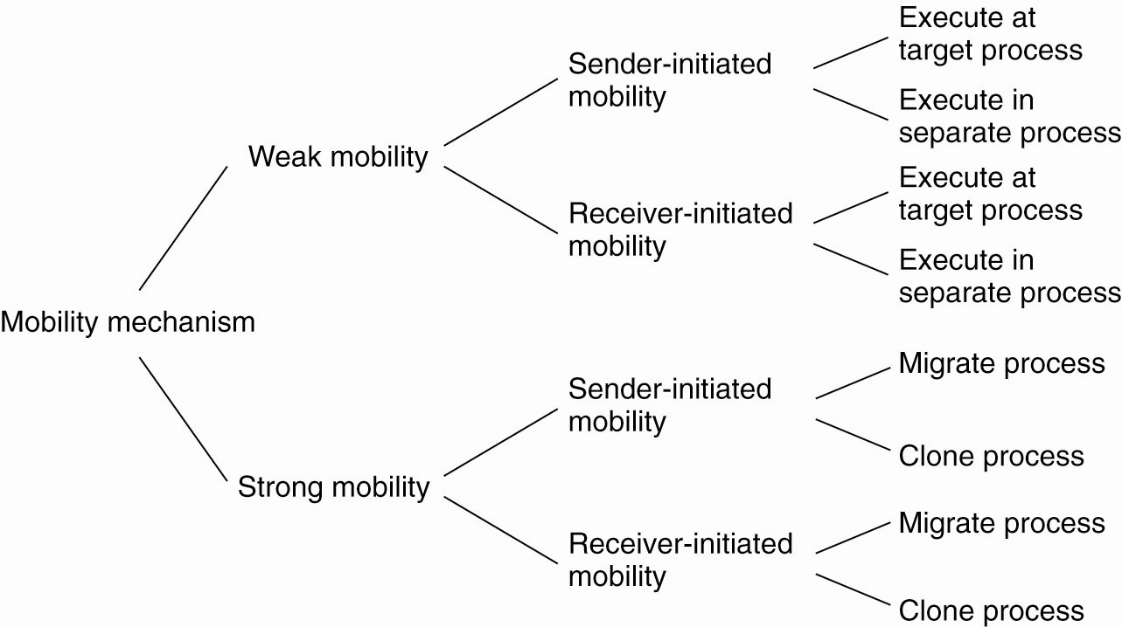
Models for Code Migration
Alternatives for code migration

Slide 62
What About Resources?
This is tricky.
What makes code migration difficult is the requirement to migrate resources.
Resources are the external references that a process is currently using, and includes (but is not limited to):
  Variables, open files, network connections,
  printers, databases, etc...

Slide 63
Types of Process-to-Resource Binding
Strongest: Binding-by-Identifier (BI) – precisely the referenced resource, and nothing else, has to be migrated.
Binding-by-Value (BV) –
weaker than BI, but only the value of the resource need be migrated.
Weakest: Binding-by-Type (BT) –
nothing is migrated, but a resource of a specific type needs to be available after migration
(e.g., a printer).

Slide 64
More Resource Classification
Resources are further distinguished as one of:
  Unattached: a resource that can be moved easily from machine to machine.
  Fastened: migration is possible, but at a high cost.
  Fixed: a resource is bound to a specific machine or environment, and cannot be migrated.
Refer to following diagram for a good summary of resource-to-binding characteristics (to find out what to do with which resource when).

Slide 65
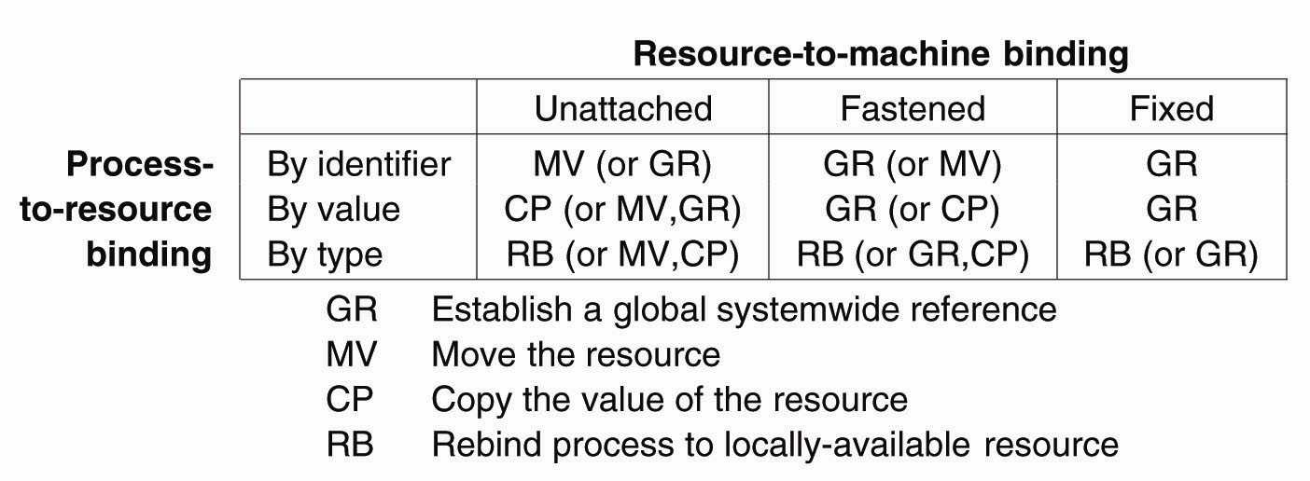
Migration and Local Resources
Actions to be taken with respect to the references to local resources when migrating code to another machine

Slide 66
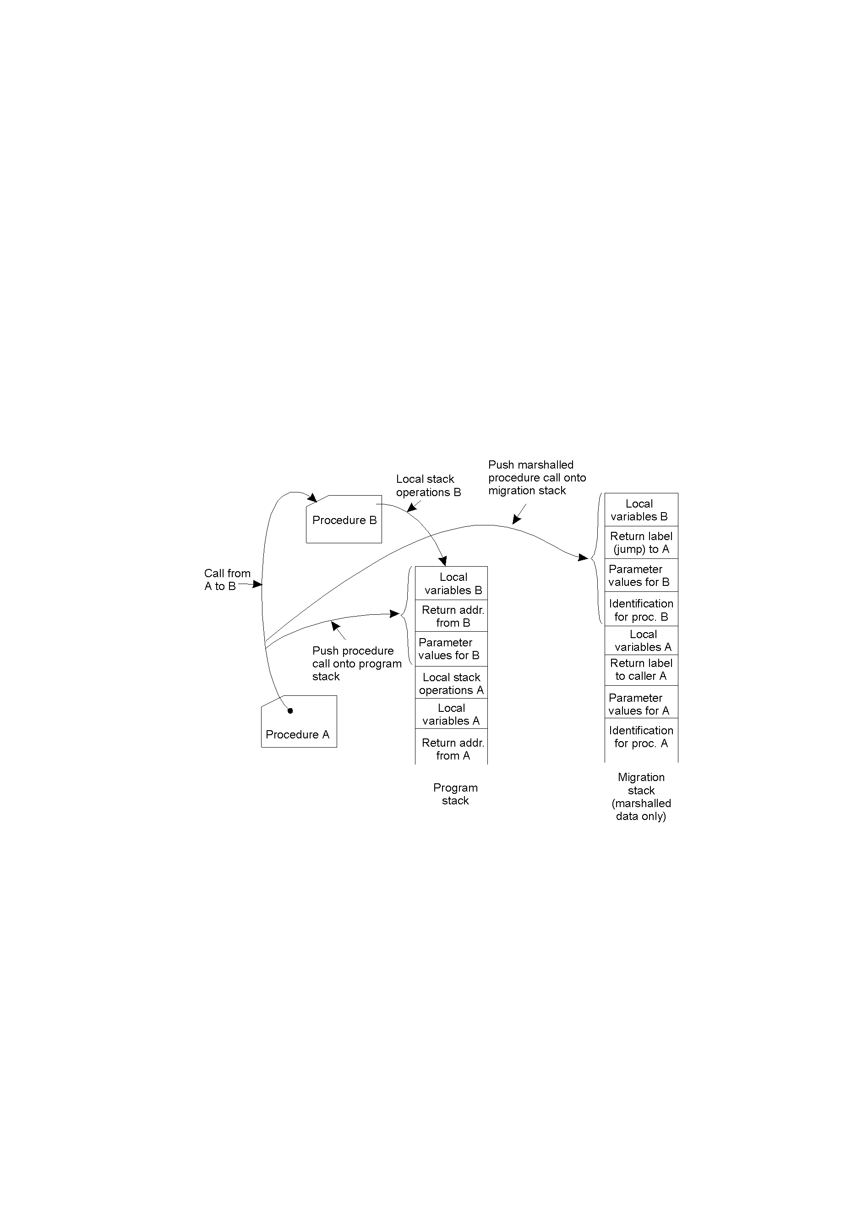
Migration in Heterogeneous DS’s
3-15
Using a migration stack: the principle of maintaining a migration stack to support migration of an execution segment in a heterogeneous environment. Usually requires changes to the programming language and its environment.

Slide 67
Overview of Code Migration in D'Agents (1)
proc factorial n {
if ($n ≤ 1) { return 1; } # fac(1) = 1
expr $n * [ factorial [expr $n – 1] ] # fac(n) = n * fac(n – 1)
}
set number … # tells which factorial to compute
set machine … # identify the target machine
agent_submit $machine –procs factorial –vars number –script {factorial $number }
agent_receive … # receive the results (left unspecified for simplicity)
A simple example of a Tel agent in D'Agents submitting a script to a remote machine (adapted from [Gray 95])

Slide 68
Overview of Code Migration in D'Agents (2)
all_users $machines
proc all_users machines {
set list "" # Create an initially empty list
foreach m $machines { # Consider all hosts in the set of given machines
agent_jump $m # Jump to each host
set users [exec who] # Execute the who command
append list $users # Append the results to the list
}
return $list # Return the complete list when done
}
set machines … # Initialize the set of machines to jump to
set this_machine # Set to the host that starts the agent
# Create a migrating agent by submitting the script to this machine, from where
# it will jump to all the others in $machines.
agent_submit $this_machine –procs all_users
-vars machines
-script { all_users $machines }
agent_receive … #receive the results (left unspecified for simplicity)
An example of a Tel agent in D'Agents migrating to different machines where it executes the UNIX who command.

Slide 69
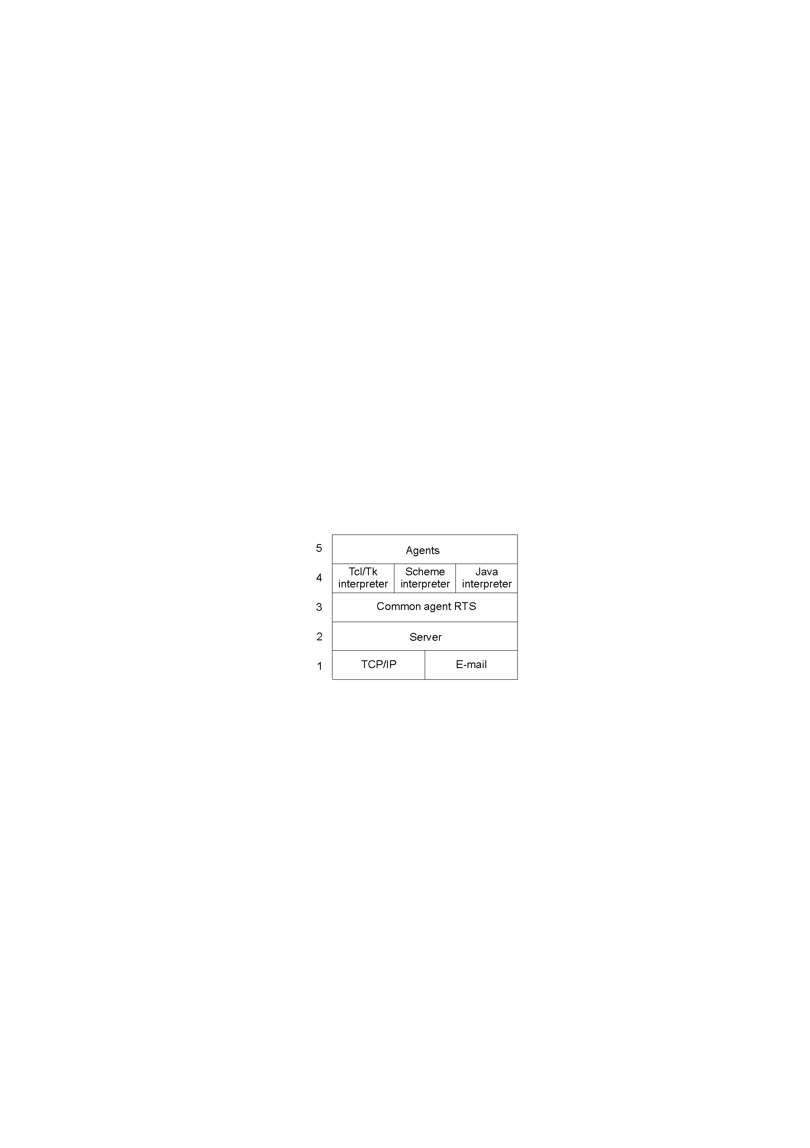
Implementation Issues (1)
The architecture of the D'Agents system.

Slide 70
Implementation Issues (2)
Status | Description
Global interpreter variables | Variables needed by the interpreter of an agent
Global system variables | Return codes, error codes, error strings, etc.
Global program variables | User-defined global variables in a program
Procedure definitions | Definitions of scripts to be executed by an agent
Stack of commands | Stack of commands currently being executed
Stack of call frames | Stack of activation records, one for each running command
The parts comprising the state of an agent in D'Agents.

Slide 71
Software Agents
What is a software agent?
  “An autonomous unit capable of performing a task in collaboration with other, possibly remote, agents”.
The field of Software Agents is still immature, and much disagreement exists as to how to define what we mean by them.
However, a number of types can be identified.

Slide 72
Types of Software Agents
Collaborative Agent – also known as “multi-agent systems”, which can work together to achieve a
common goal (e.g., planning a meeting).
Mobile Agent – code that can relocate and continue executing on a remote machine.
Interface Agent – software with “learning abilities” (that damned MS paperclip, and the ill-fated “bob”).
Information Agent – agents that are designed to collect and process geographically dispersed data
and information.

Slide 73
Software Agents in Distributed Systems
Property | Common to all agents? | Description
Autonomous | Yes | Can act on its own
Reactive | Yes | Responds timely to changes in its environment
Proactive | Yes | Initiates actions that affects its environment
Communicative | Yes | Can exchange information with users and other agents
Continuous | No | Has a relatively long lifespan
Mobile | No | Can migrate from one site to another
Adaptive | No | Capable of learning
Some important properties by which different types of agents can be distinguished.

Slide 74
Agent Technology - Standards
The general model of an agent platform has
been standardized by FIPA (“Foundation
for Intelligent Physical Agents”) located at http://www.fipa.org
Specifications include:
  Agent Management Component.
  Agent Directory Service.
  Agent Communication Channel.
  Agent Communication Language.

Slide 75
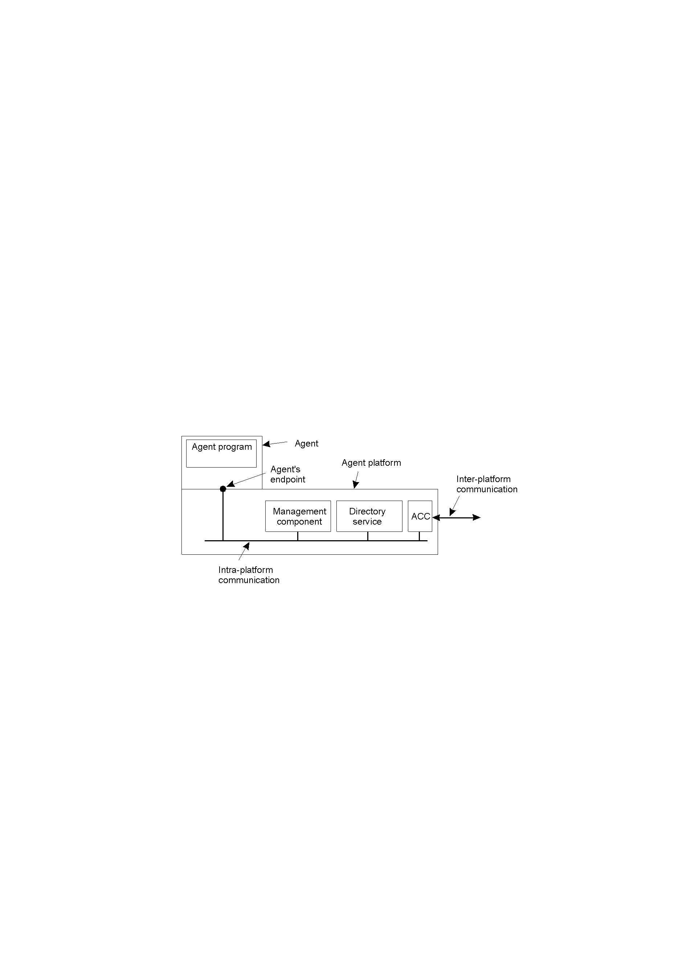
Agent Technology
The general model of an agent platform
(adapted from [FIPA 1998])

Slide 76
Agent Communication Languages (1)
Message purpose | Description | Message Content
INFORM | Inform that a given proposition is true | Proposition
QUERY-IF | Query whether a given proposition is true | Proposition
QUERY-REF | Query for a give object | Expression
CFP | Ask for a proposal | Proposal specifics
PROPOSE | Provide a proposal | Proposal
ACCEPT-PROPOSAL | Tell that a given proposal is accepted | Proposal ID
REJECT-PROPOSAL | Tell that a given proposal is rejected | Proposal ID
REQUEST | Request that an action be performed | Action specification
SUBSCRIBE | Subscribe to an information source | Reference to source
Examples of different message types in the FIPA ACL [FIPA 1998], giving the
purpose of a message, along with the description of the actual message content.

Slide 77
Agent Communication Languages (2)
Field | Value
Purpose | INFORM
Sender | max@http://fanclub-beatrix.royalty-spotters.nl:7239
Receiver | elke@iiop://royalty-watcher.uk:5623
Language | Prolog
Ontology | genealogy
Content | female(beatrix),parent(beatrix,juliana,bernhard)
A simple example of a FIPA ACL message sent between two agents using Prolog to express genealogy information.

