Slide 1
Distributed Systems
Communication
Chapter 4

Slide 2
Course/Slides Credits
Note: all course presentations are based on those developed by Andrew S. Tanenbaum and Maarten van Steen. They accompany their "Distributed Systems: Principles and Paradigms" textbook (1st & 2nd editions).
http://www.prenhall.com/divisions/esm/app/author_tanenbaum/custom/dist_sys_1e/index.html
And additions made by Paul Barry in course CW046-4: Distributed Systems
http://glasnost.itcarlow.ie/~barryp/net4.html

Slide 3
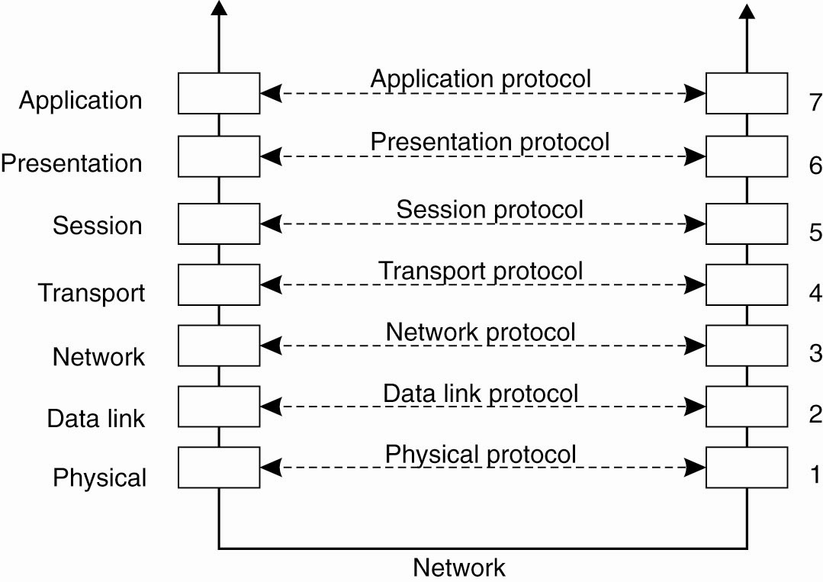
Layers, interfaces, and protocols in the OSI model

Slide 4
ISO Layers (1)
Physical layer – handles the mechanical/electrical details of the physical transmission of a bit stream.
Data-link layer – handles the frames, or fixed-length parts of packets, including any error detection and recovery that occurred in the physical layer.
Network layer – provides connections and routes packets in the communication network, including handling the address of outgoing packets, decoding the address of incoming packets, and maintaining routing information for proper response to changing load levels.

Slide 5
ISO Layers (2)
Transport layer – responsible for low-level network access and for message transfer between clients, including partitioning messages into packets, maintaining packet order, controlling flow, and generating physical addresses.
Session layer – implements sessions, or process-to-process communications protocols.
Presentation layer – resolves the differences in formats among the various sites in the network, including character conversions, and half duplex/full duplex (echoing).
Application layer – interacts directly with the users’ deals with file transfer, remote-login protocols and electronic mail, as well as schemas for distributed databases.

Slide 6
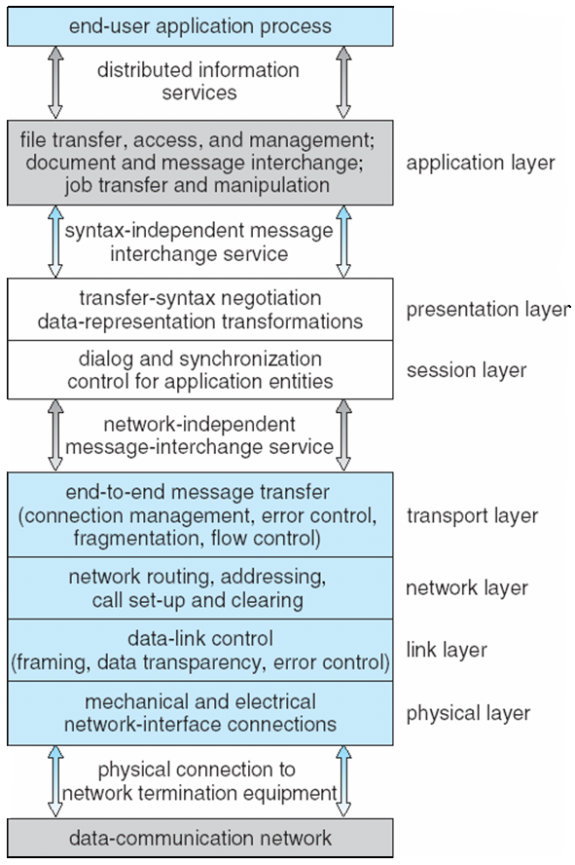
The ISO Protocol Layer

Slide 7
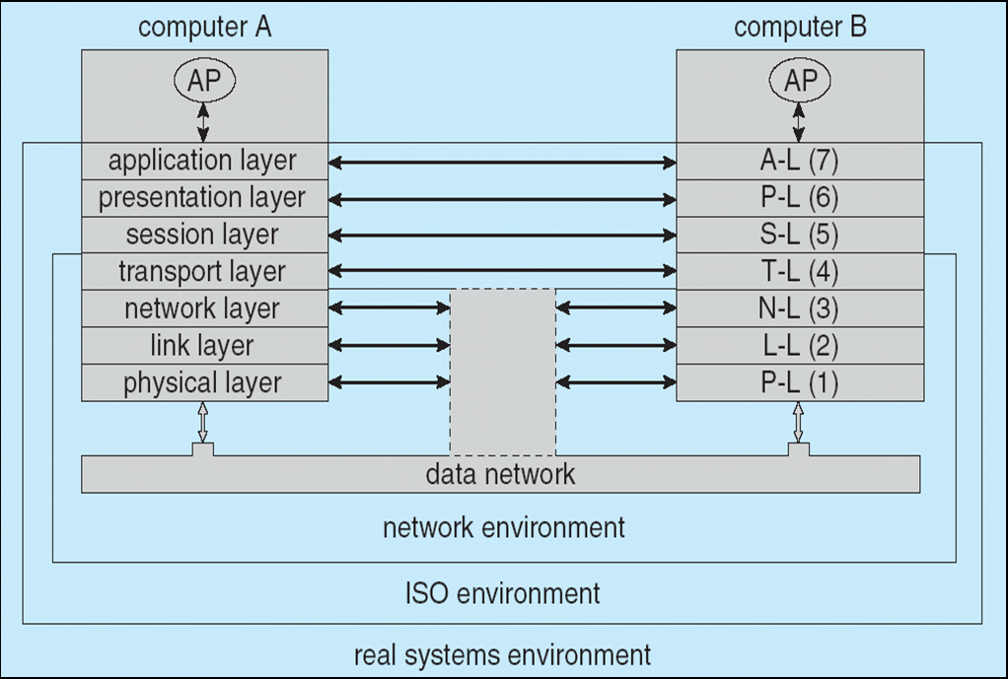
Communication via ISO Network Model

Slide 8
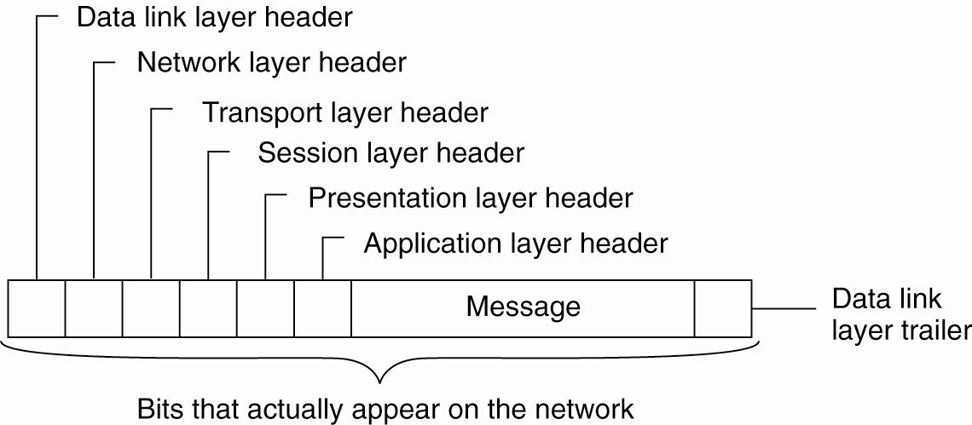
A typical message as it appears on the network

Slide 9
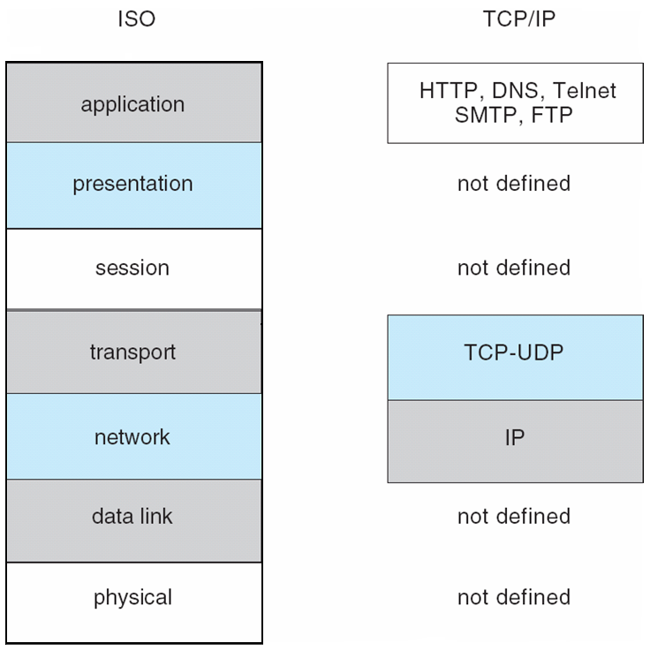
The TCP/IP Protocol Layers

Slide 10
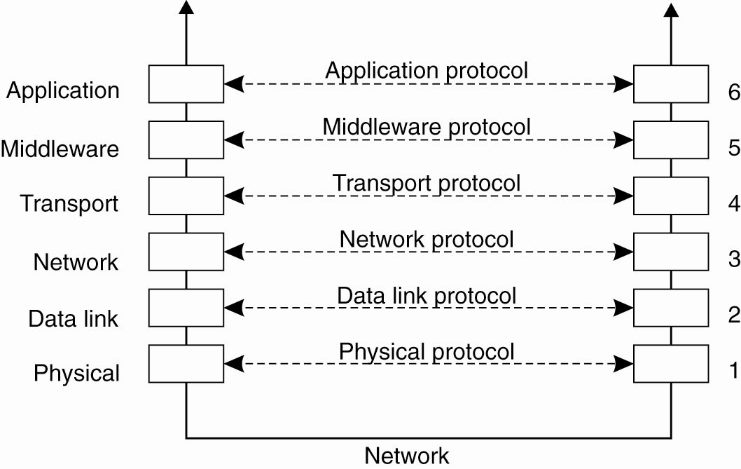
Middleware Protocols
An adapted reference model for networked communication

Slide 11
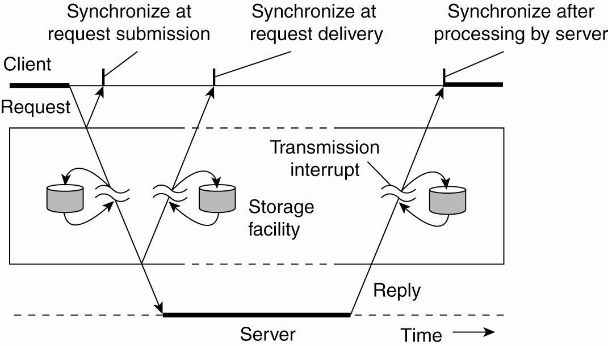
Types of Communication
Viewing middleware as an intermediate (distributed) service in application-level communication

Slide 12
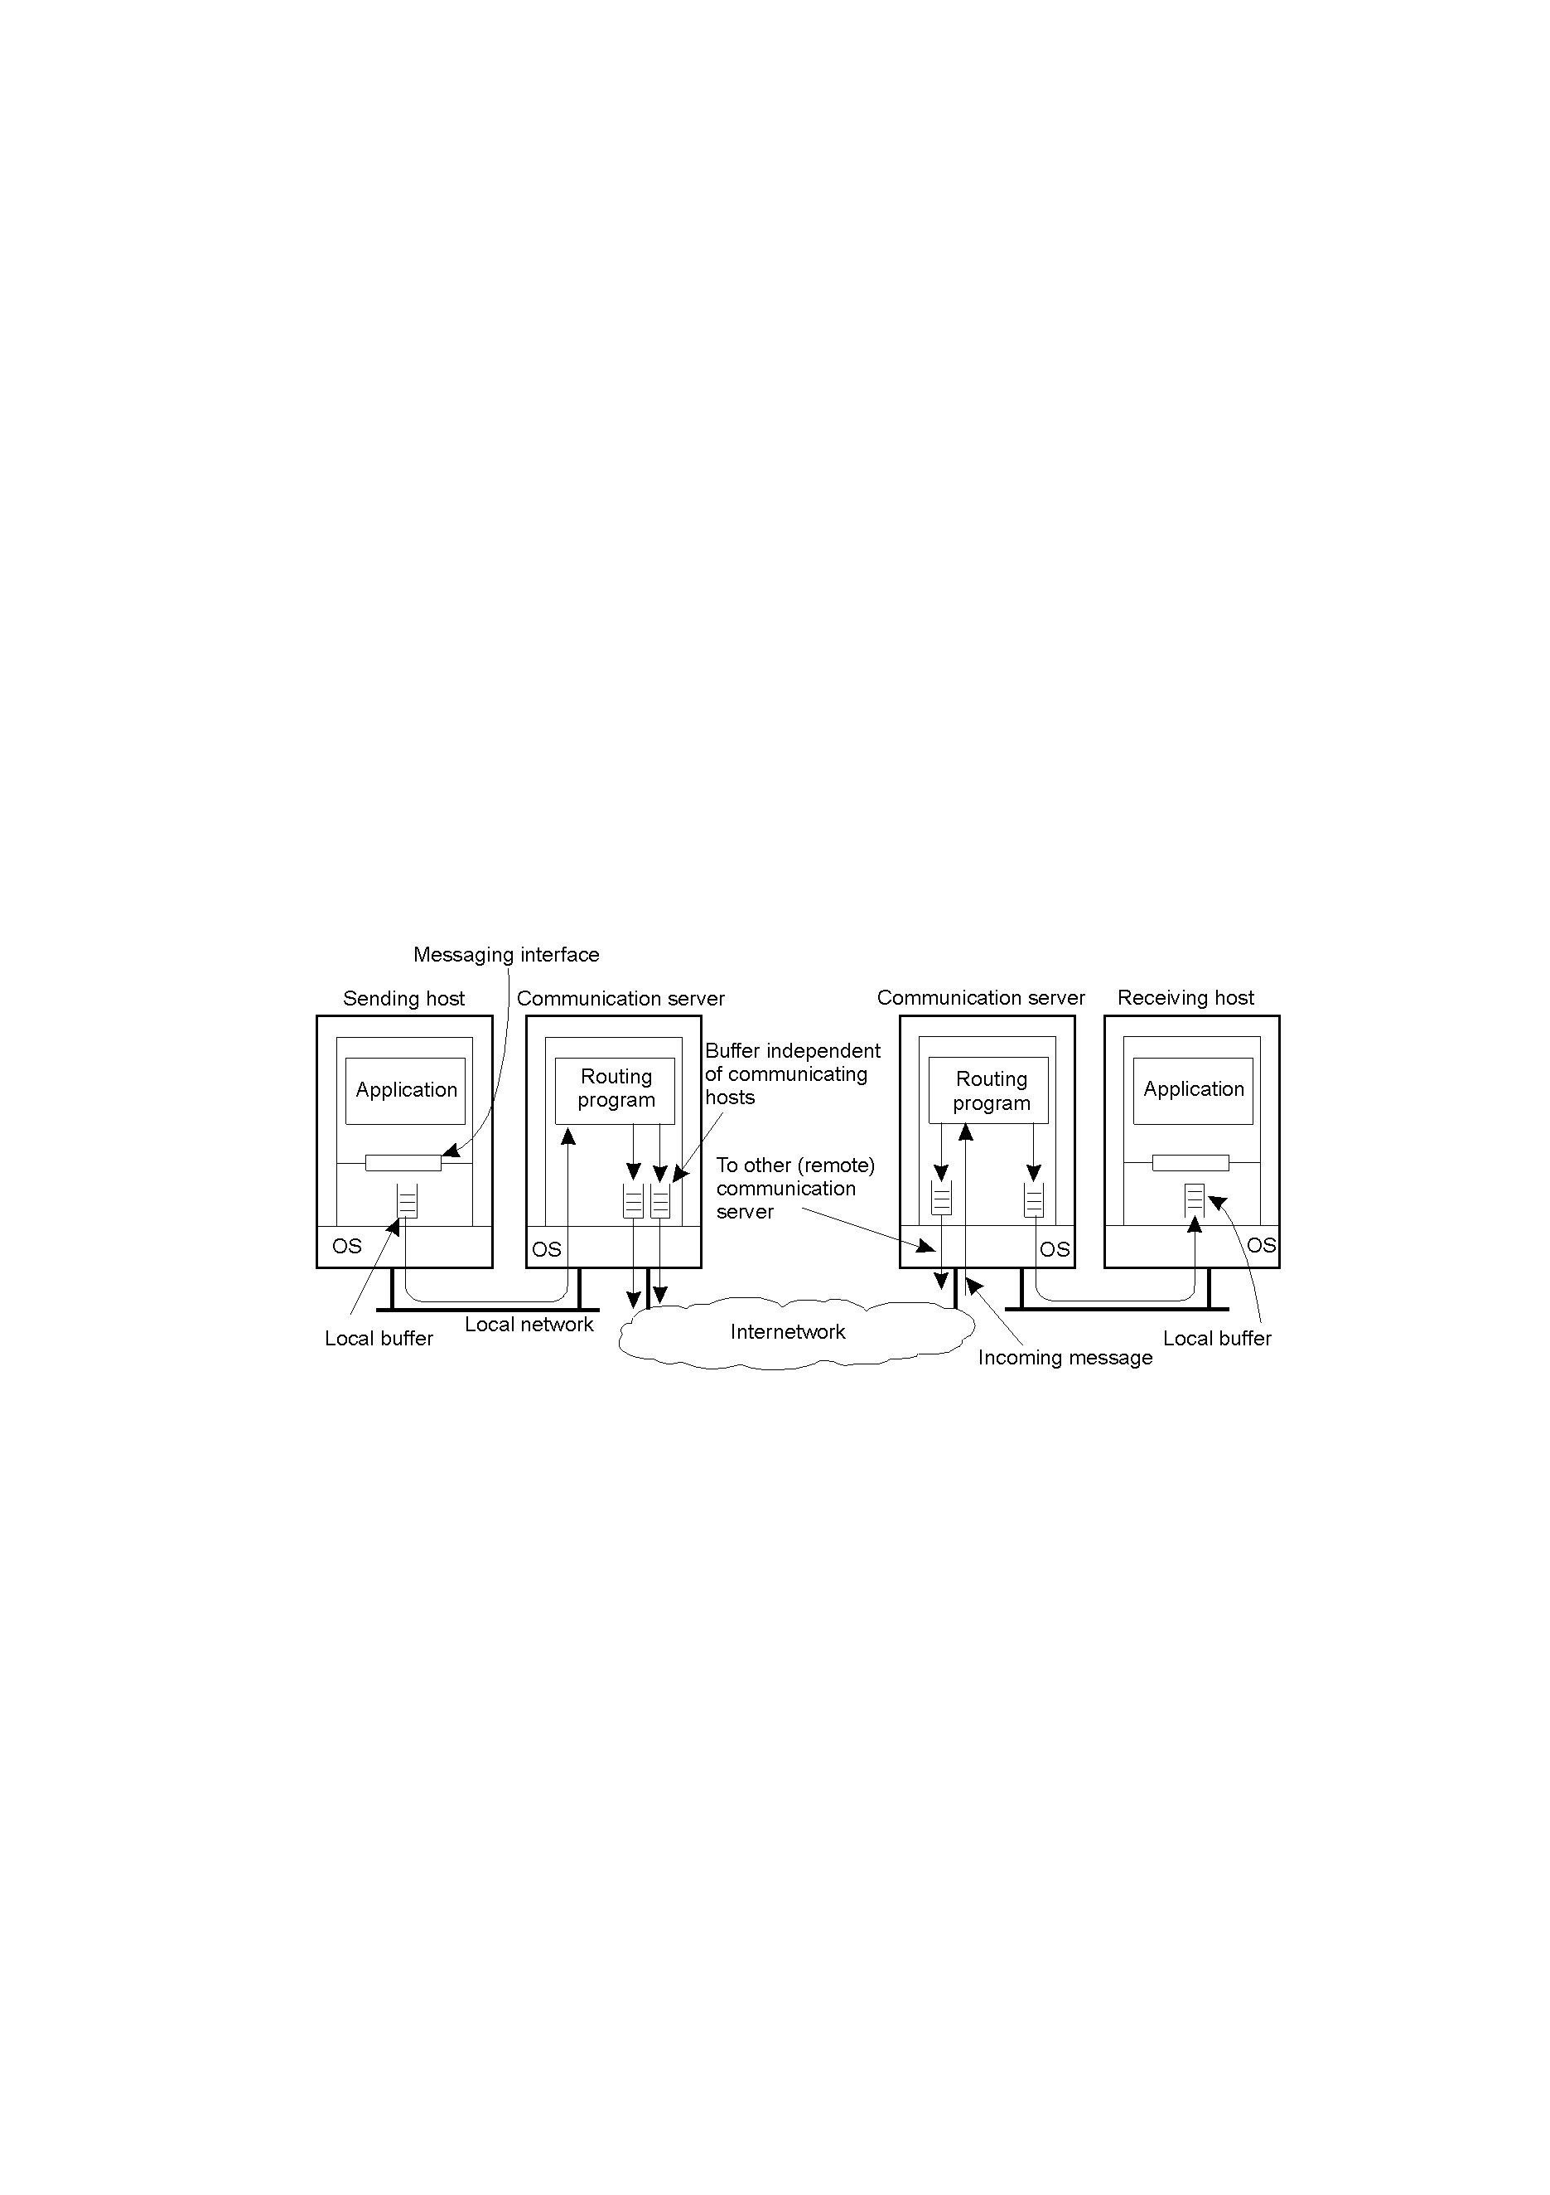
Persistence and Synchronicity in Communication (1)
2-20
General organization of a communication system in which hosts are connected through a network.

Slide 13
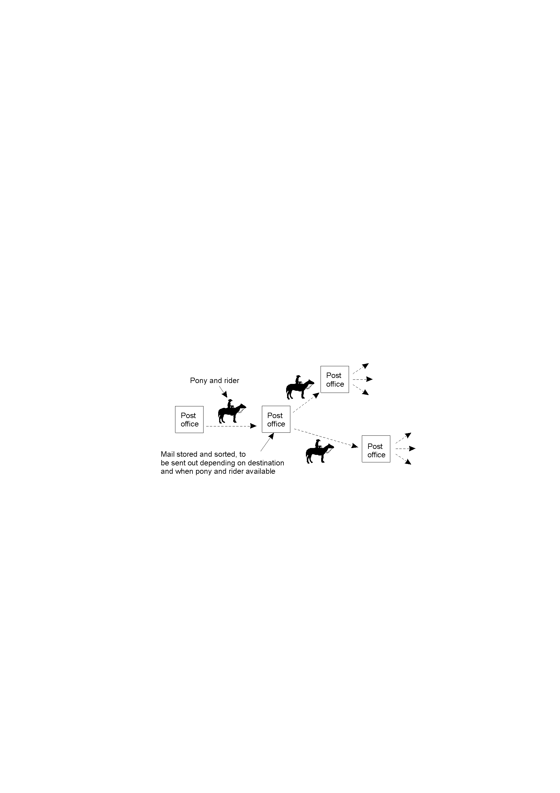
Persistence and Synchronicity in Communication (2)
Persistent communication of letters back in the days of the Pony Express.

Slide 14
DS Communications Terminology (1)
Persistent Communications:
  Once sent, the “sender” can stop executing. The “receiver” need not be operational at this time – the communications system buffers the message as required (until it can be delivered).
Transient Communications:
  The message is only stored as long as the “sender” and “receiver” are executing. If problems occur, the message is simply discarded …

Slide 15
DS Communications Terminology (2)
Asynchronous Communications:
  A sender continues with other work immediately upon sending a message to the receiver.
Synchronous Communications:
  A sender blocks, waiting for a reply from the receiver before doing any other work. (This tends to be the default model for RPC/RMI technologies).

Slide 16
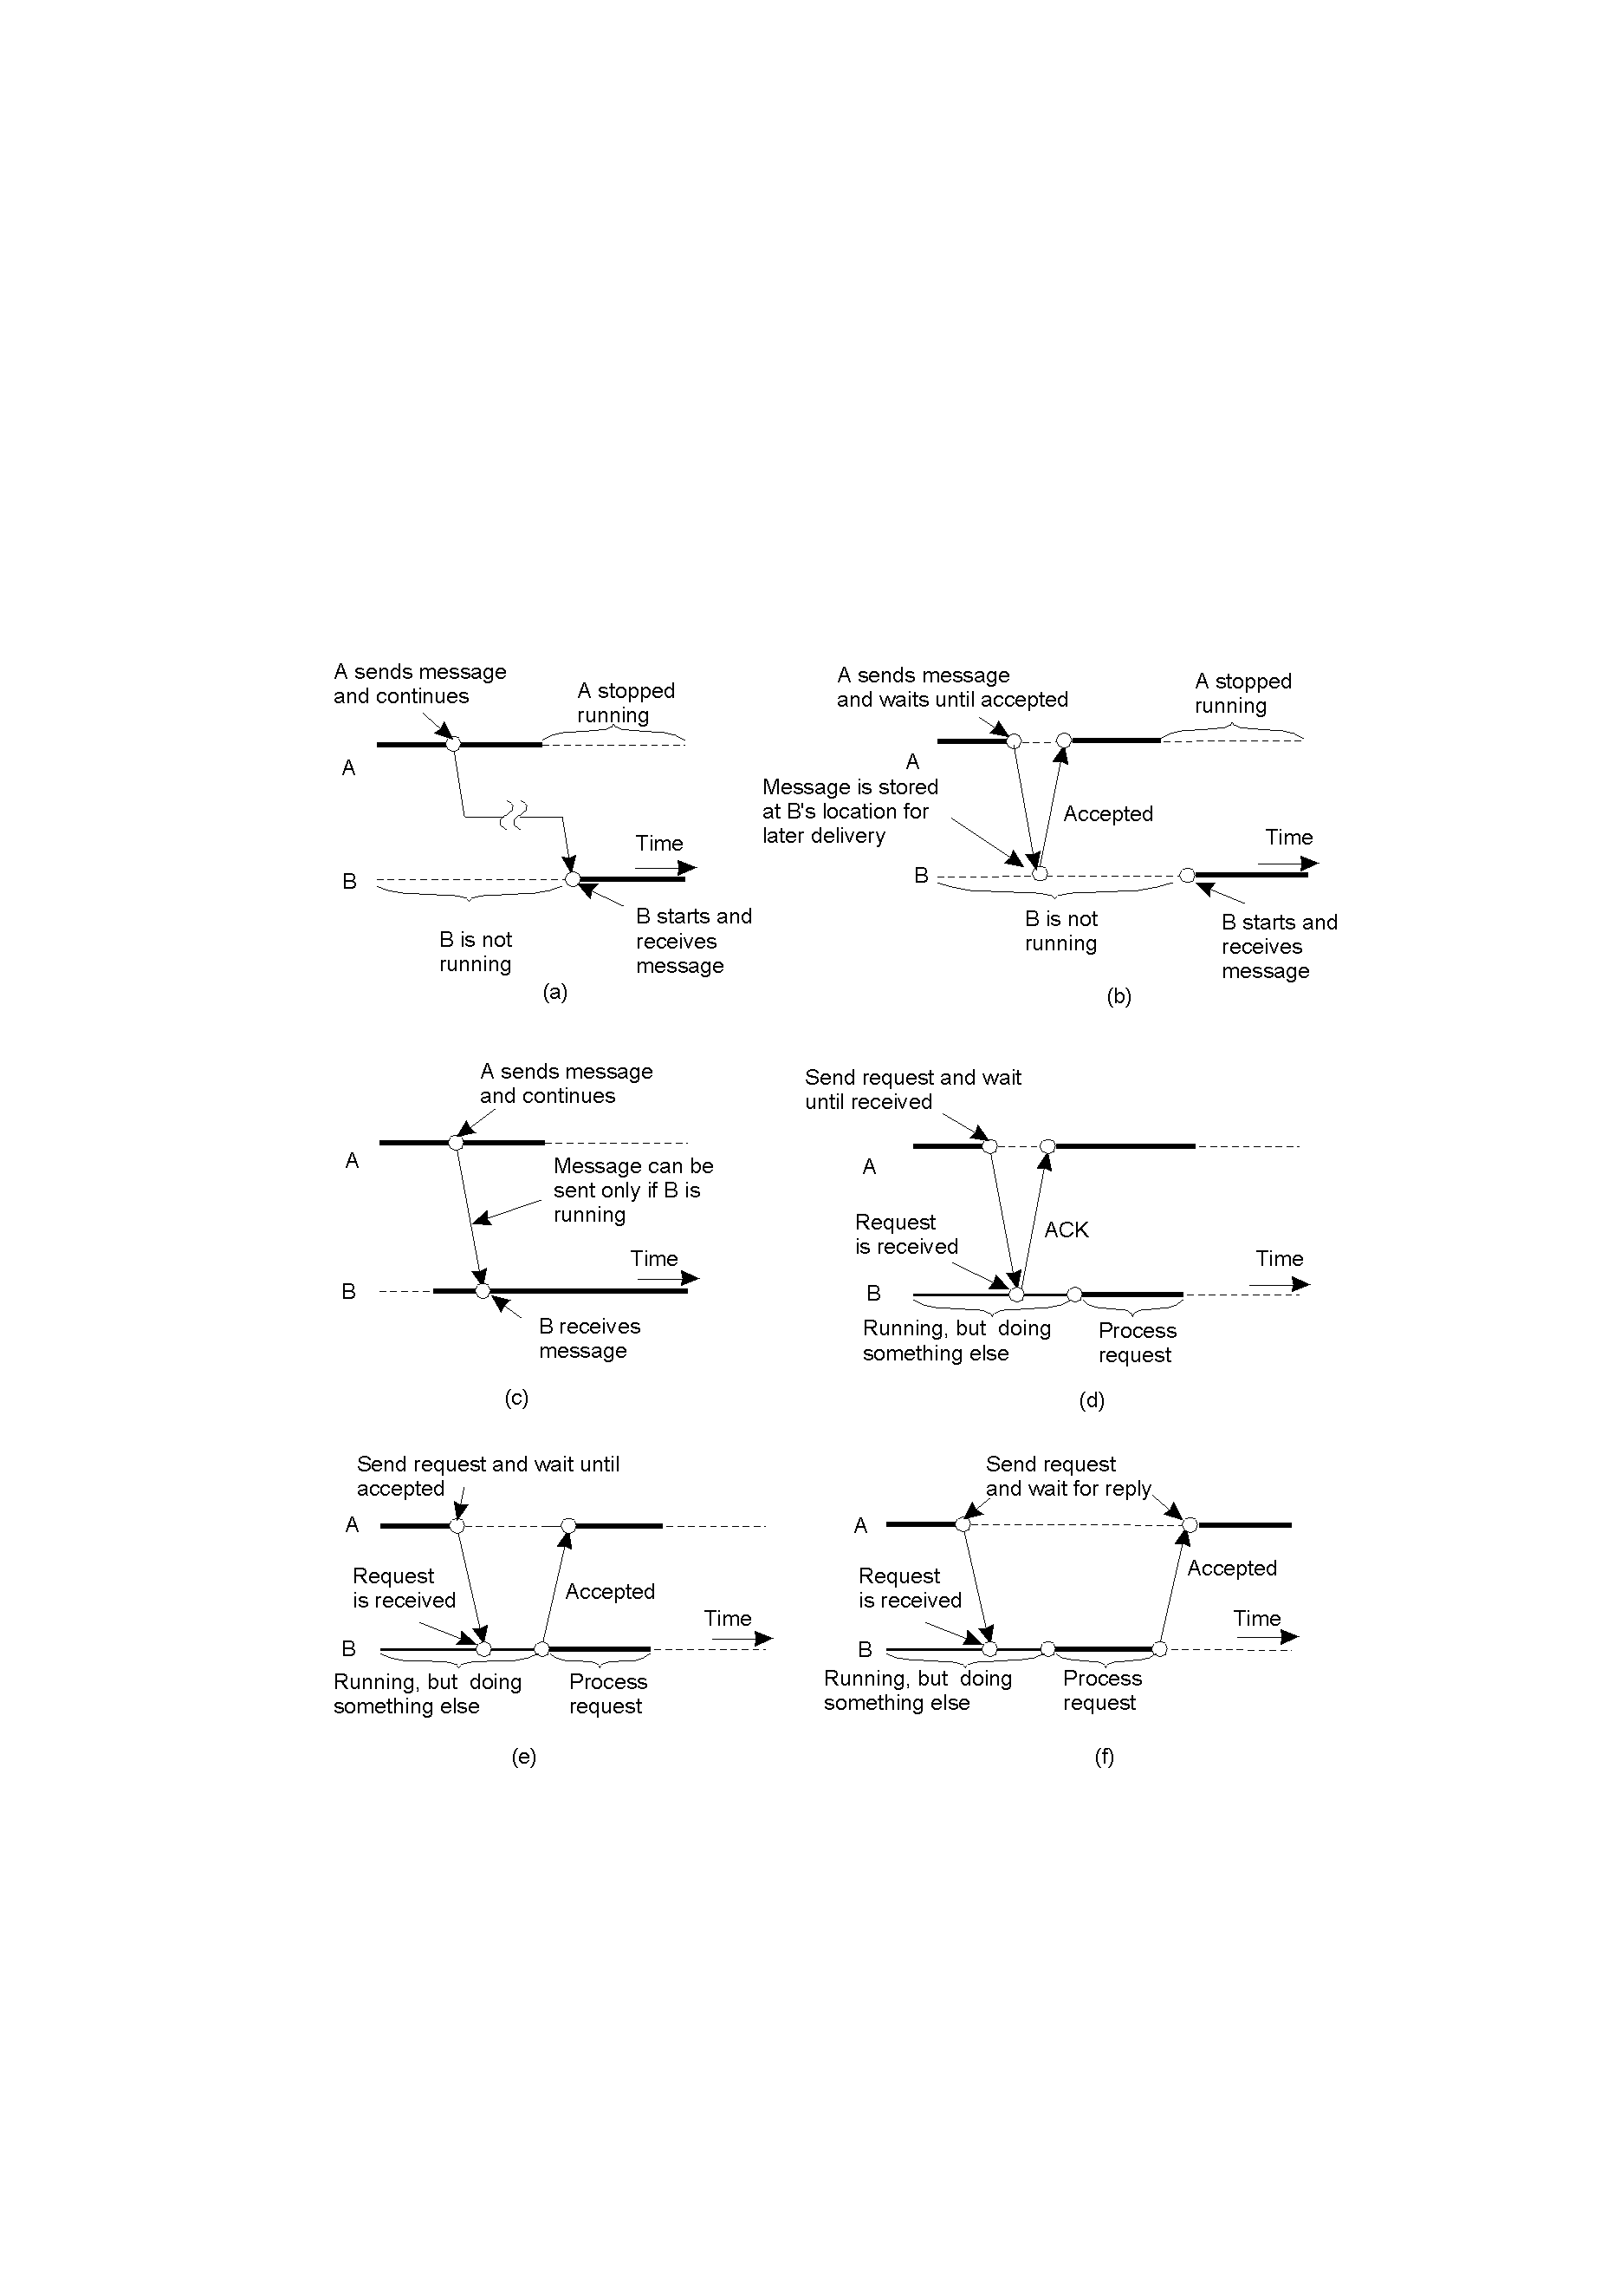
Classifying Distributed Communications (1)
2-22.1
Persistent asynchronous communication.
Persistent synchronous communication.

Slide 17
Classifying Distributed Communications (2)
2-22.2
Transient asynchronous communication.
Receipt-based transient synchronous communication.

Slide 18
Classifying Distributed Communications (3)
Delivery-based transient synchronous communication at message delivery.
Response-based transient synchronous communication.

Slide 19
Interprocess Communication
The “heart” of every distributed system.
Question: how do processes on different machines exchange information?
Answer: with difficulty … ☹
Established computer network facilities are too primitive, resulting in DSs that are too difficult to develop – a new model is required.
Four IPC models are popular:
  RPC; RMI; MOM and Streams

Slide 20
RPC: Remote Procedure Call
Based on Birrell and Nelson (1984).
“To allow programs to call procedures located on other machines.”
Effectively removing the need for the DS programmer to worry about all the details
of network programming (i.e., no more sockets).
Conceptually simple, but …

Slide 21
Complications: More on RPC
Two machine architectures may not (or need not) be identical.
Each machine can have a different address space.
How are parameters (of different, possibly
very complex, types) passed to/from a remote procedure?
What happens if one, the other, or both of the machines crash while the procedure is being called?

Slide 22
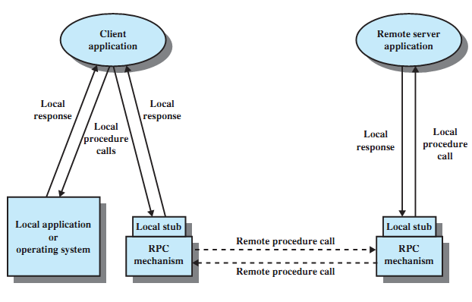
LPC/RPC Mechanisms

Slide 23
How RPC Works: Part 1
As far as the programmer is concerned, a “remote” procedure call looks and works identically to a “local” procedure call.
In this way, transparency is achieved.
Before looking a RPC in action, let’s consider a conventional “local” procedure call (LPC).

Slide 24
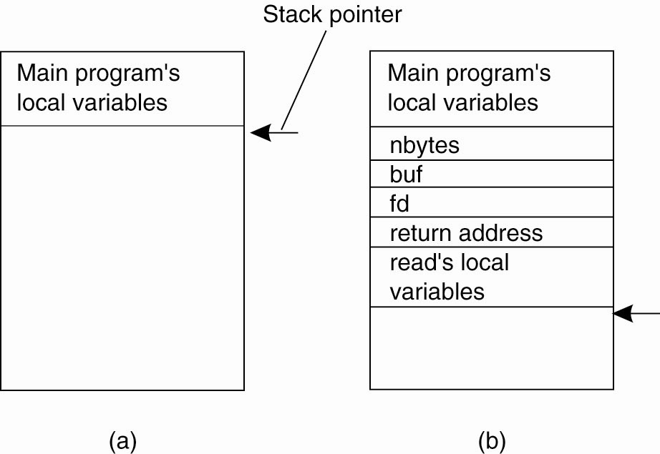
Conventional Procedure Call
(a) Parameter passing in a local procedure call: the stack before the call to read. (b) The stack while the called procedure is active.

Slide 25
How RPC Works: Part 2
The procedure is “split” into two parts:
  The CLIENT “stub” – implements the interface on the local machine through which the remote functionality can be invoked.
  The SERVER “stub” – implements the actual functionality, i.e., does the real work!
Parameters are “marshaled” by the client prior to transmission to the server.

Slide 26
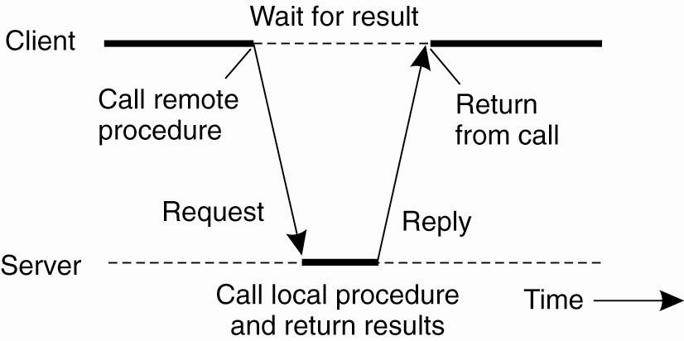
Client and Server Stubs
Principle of RPC between a client and server program

Slide 27
The 10 Steps of a RPC
Client procedure calls client stub in normal way
Client stub builds message, calls local OS
Client's OS sends message to remote OS
Remote OS gives message to server stub
Server stub unpacks parameters, calls server
Server does work, returns result to the stub
Server stub packs it in message, calls local OS
Server's OS sends message to client's OS
Client's OS gives message to client stub
Stub unpacks result, returns to client

Slide 28
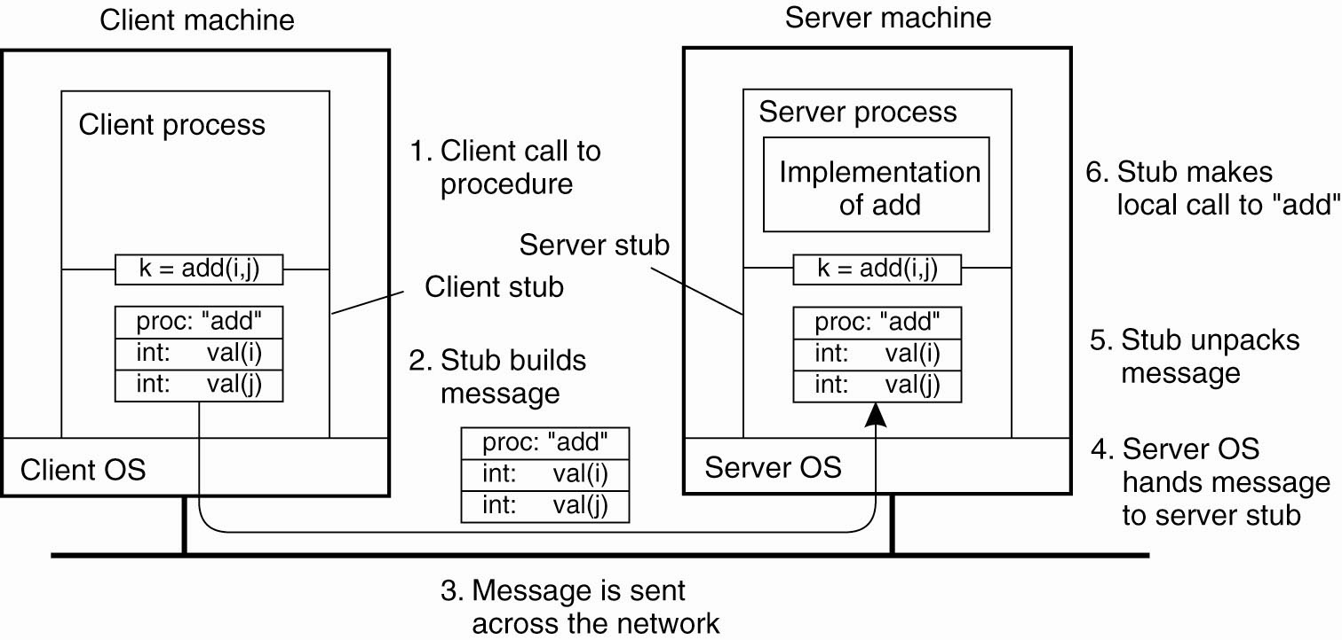
The steps involved in a doing a remote computation through RPC

Slide 29
RPC Problems
RPC works really well if all the machines are homogeneous.
Complications arise when two machines use different character sets, e.g., EBCDIC or ASCII.
Byte-ordering is also a problem:
  Intel machines are “big-endian”.
  Sun Sparc’s are “little-endian”.
Extra mechanisms are required to be built into the RPC mechanism to provide for these types
of situations – this adds complexity.

Slide 30

Passing Value Parameters
Original message on the Pentium.
The message after receipt on the SPARC.
The message after being inverted.
The little numbers in boxes indicate the address of each byte.

Slide 31
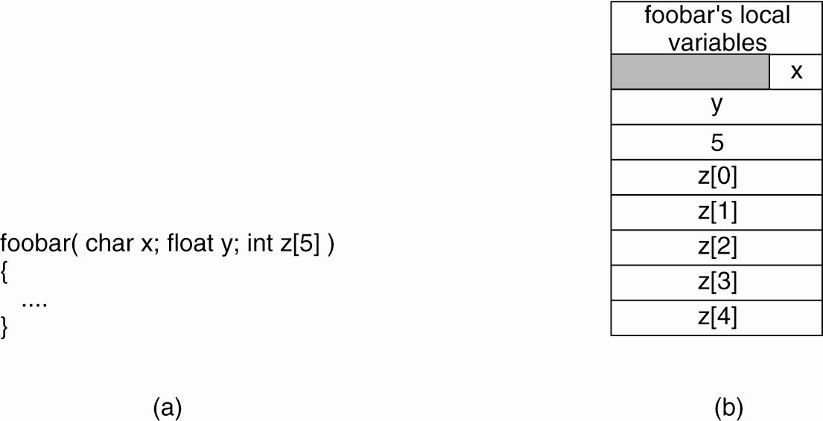
Parameter Specification and Stub Generation
(a) A procedure. (b) The corresponding message.

Slide 32
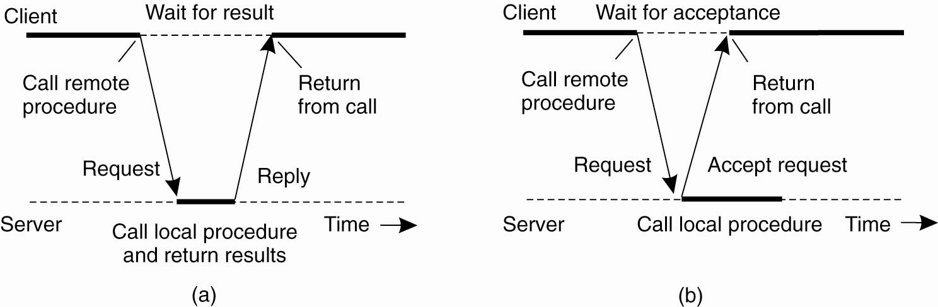
Asynchronous RPC (1)
(a) The interaction between client and
server in a traditional synchronous RPC

Slide 33
Asynchronous RPC (2)
(b) The interaction using asynchronous RPC

Slide 34
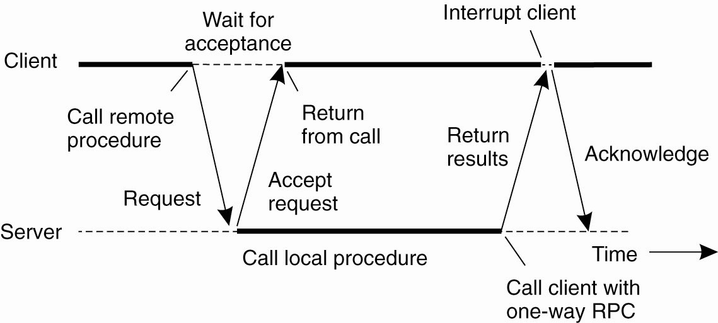
Asynchronous RPC (3)
Deferred Synchronous RPC: A client and server interacting through two asynchronous RPCs

Slide 35
Interface Definition Language (IDL)
RPCs typically require development of custom protocol interfaces to be effective.
Protocol interfaces are described by means of an Interface Definition Language (IDL).
IDLs are “language-neutral” – they do not presuppose the use of any one programming language.
That said, most IDLs look a lot like C …

Slide 36
DCE: An Example RPC
The Open Group’s standard RPC mechanism.
In addition to RPC, DCE provides:
  Distributed File Service.
  Directory Service (name lookups).
  Security Service.
  Distributed Time Service.

Slide 37
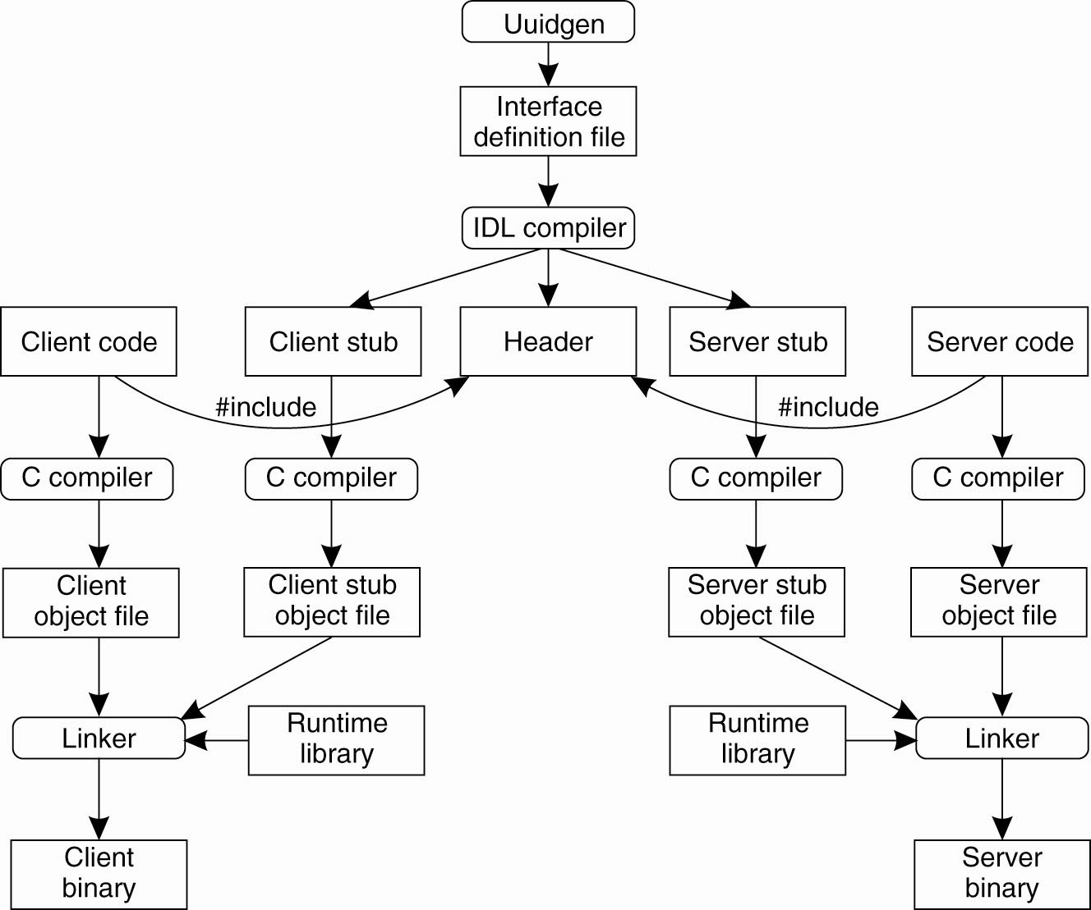
Writing a Client and a Server (1)
The steps in writing a client and a server in DCE RPC

Slide 38
Writing a Client and a Server (2)
Three files are output by the IDL compiler:
A header file (e.g., interface.h, in C terms).
The client stub.
The server stub.

Slide 39
Binding a Client to a Server (1)
Registration of a server makes it possible for a client to locate the server and bind to it.
Server location is done in two steps:
  Locate the server’s machine.
  Locate the server on that machine.

Slide 40
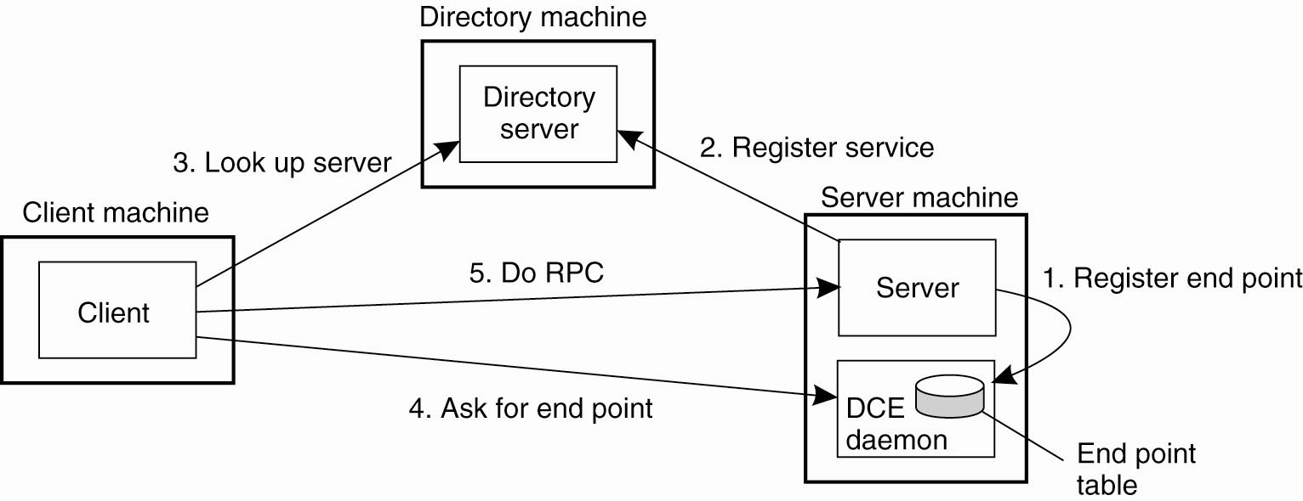
Binding a Client to a Server (2)
Client-to-server binding in DCE

Slide 41
RPC Summary
The distributed systems de-facto standard for communication and application distribution (at the procedure level):
  It is mature.
  It is well understood.
  It works!

Slide 42
RMI: Remote Method Invocation
“Remote objects” can be thought of as an expansion of the RPC mechanism (to support OO systems).
An important aspect of objects is the definition of a well-defined interface to “hidden” functionality.
Method calls support state changes within the object through the defined interface.
An object may offer multiple interfaces.
An interface may be implemented by multiple objects.
Within a DS, the object interface resides on one machine, and the object implementation resides on another.

Slide 43
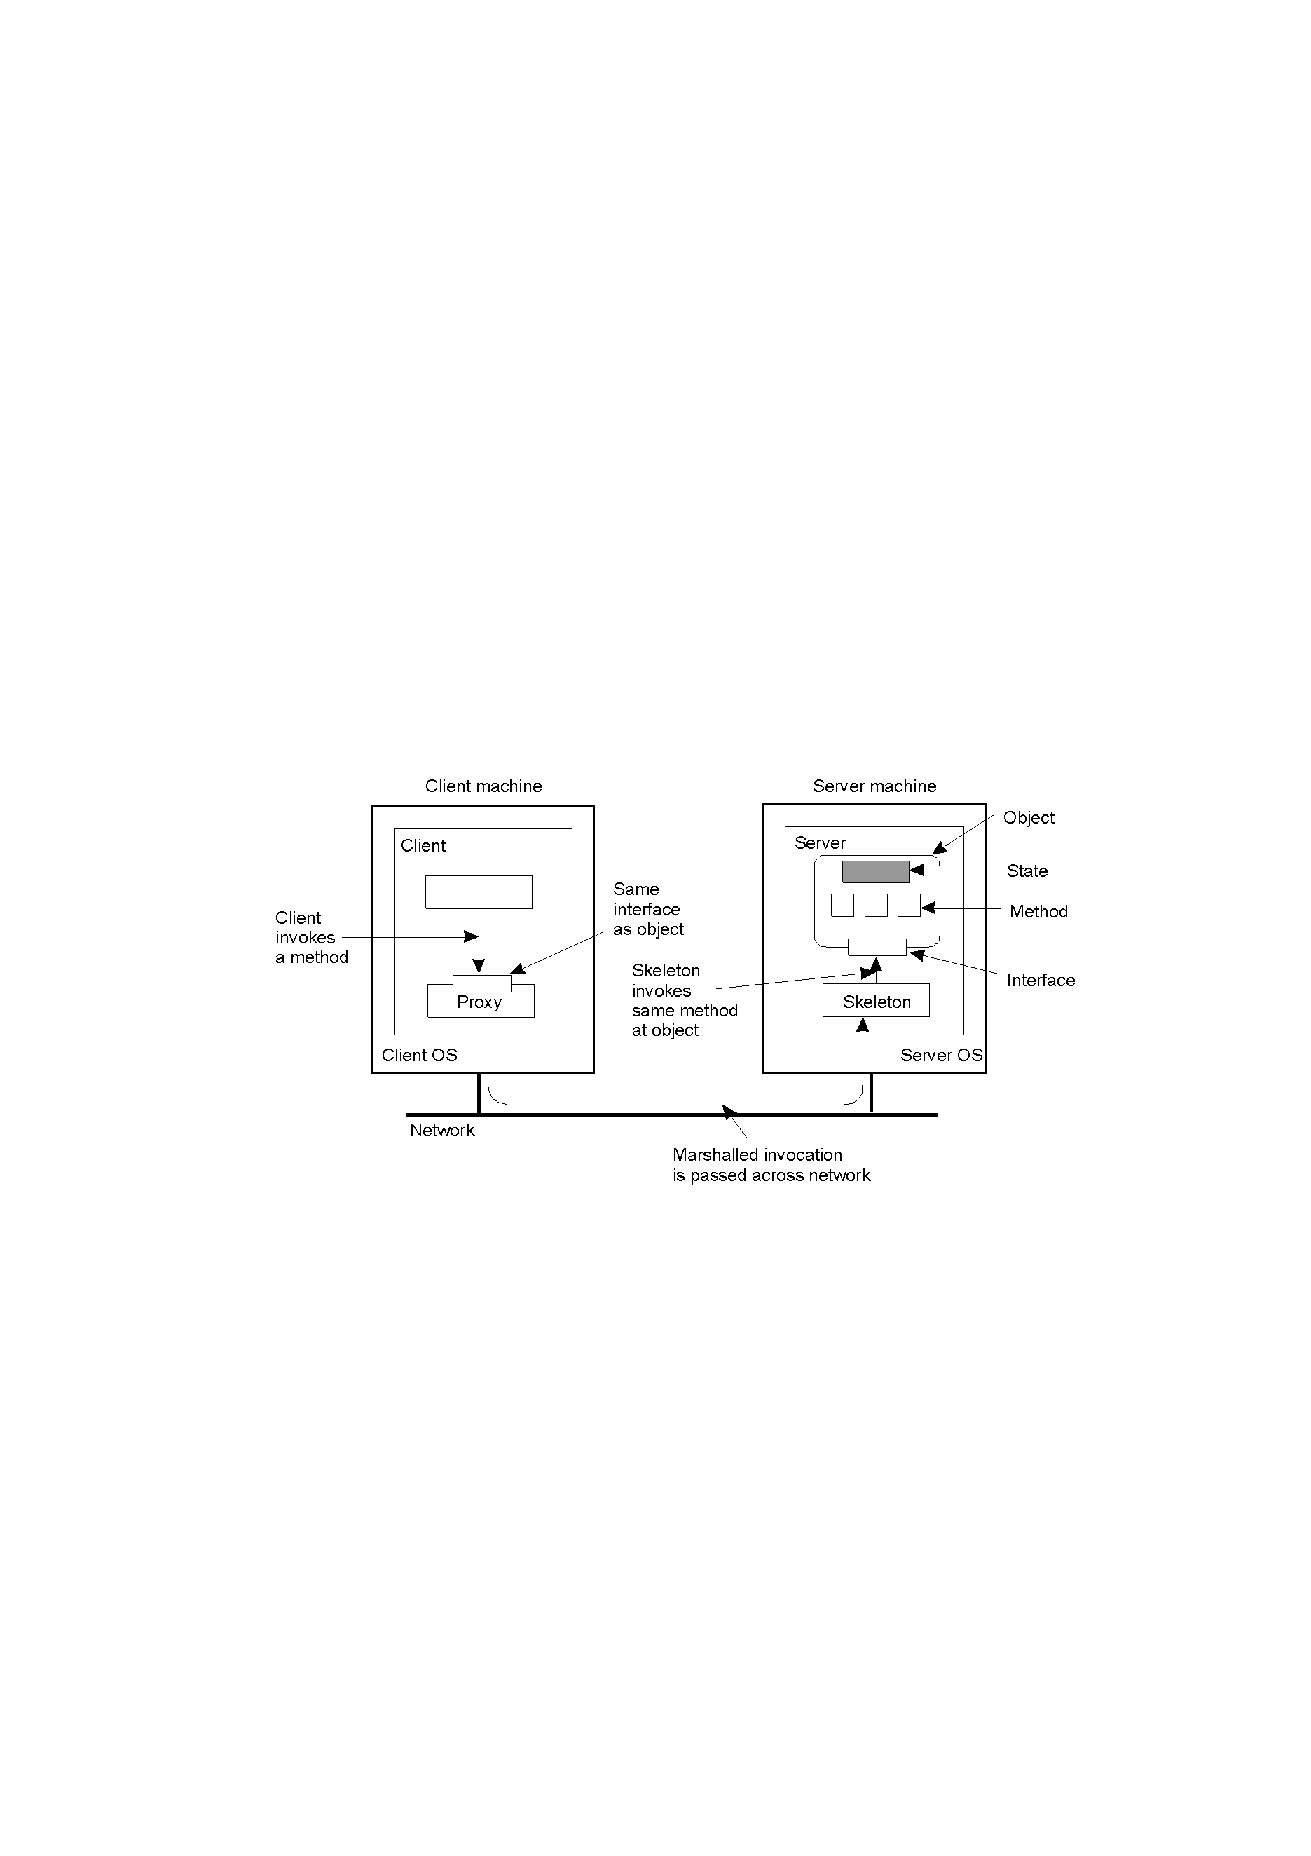
The Distributed Object
2-16
Organization of a remote object with client-side “proxy”.
The “proxy” can be thought of as the “client stub”.
The “skeleton” can be thought of as the “server stub”.

Slide 44
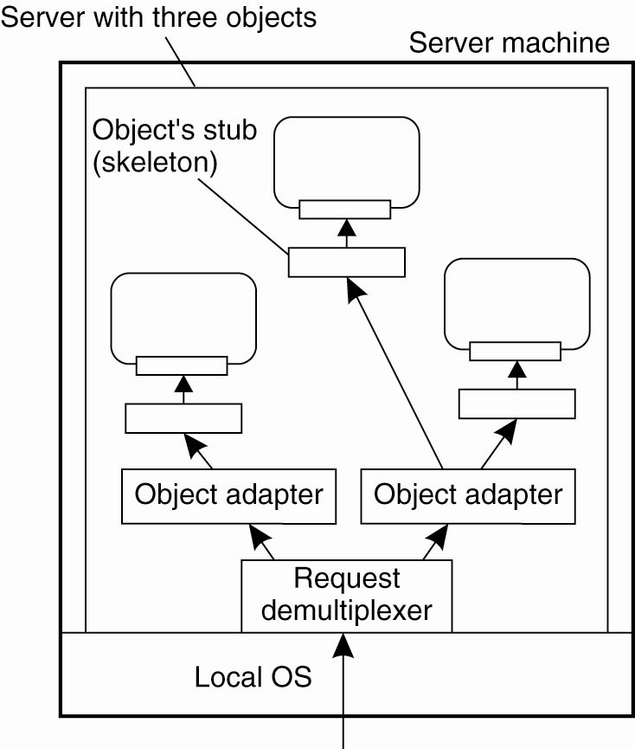
Object Server/Adapter
Organization of an object server
supporting different activation policies

Slide 45
Compile-time vs. Runtime Objects
Compile-time distributed objects generally assume the use of a particular programming language (Java or C++).
This is often seen as a drawback (inflexible).
Runtime distributed objects provide object adaptors to objects, designed to remove the compile-time programming language restriction.
Using object adaptors allows an object implementation to be developed in any way – as long as the resulting implementation “appears” like an object, then things are assumed to be OK.

Slide 46
Persistent vs. Transient Objects
A “persistent” distributed object continues to exist even after it no longer exists in the address space of the server.
It is stored (perhaps on secondary storage) and can be
re-instantiated at a later date by a newer server process (i.e., by a newer object).
A “transient” distributed object does not persist.
As soon as the server exits, the transient object is destroyed.
Which one is better is the subject of much
controversy …

Slide 47
Static vs. Dynamic Invocation
Predefined interface definitions support static invocation:
  all interfaces are known up-front.
  a change to the interface requires all applications
  (i.e., clients) to be recompiled.
Dynamic invocation “composes” a method at
run-time:
  interface can “come and go” as required.
  interfaces can be changed without forcing a
  recompile of client applications.

Slide 48
Example: DCE Remote Objects
DCE’s RPC mechanism has been “enhanced” to directly support remote method invocation.
DCE Objects = xIDL plus C++.
That is, the DCE IDL has been extended to support objects that are implemented in C++.
Two types of DCE objects are supported:
  Distributed Dynamic Objects – a “private” object created by the server for the client.
  Distributed Named Objects – a “shared” object that lives on the server and can be accessed by more
  than one client.

Slide 49
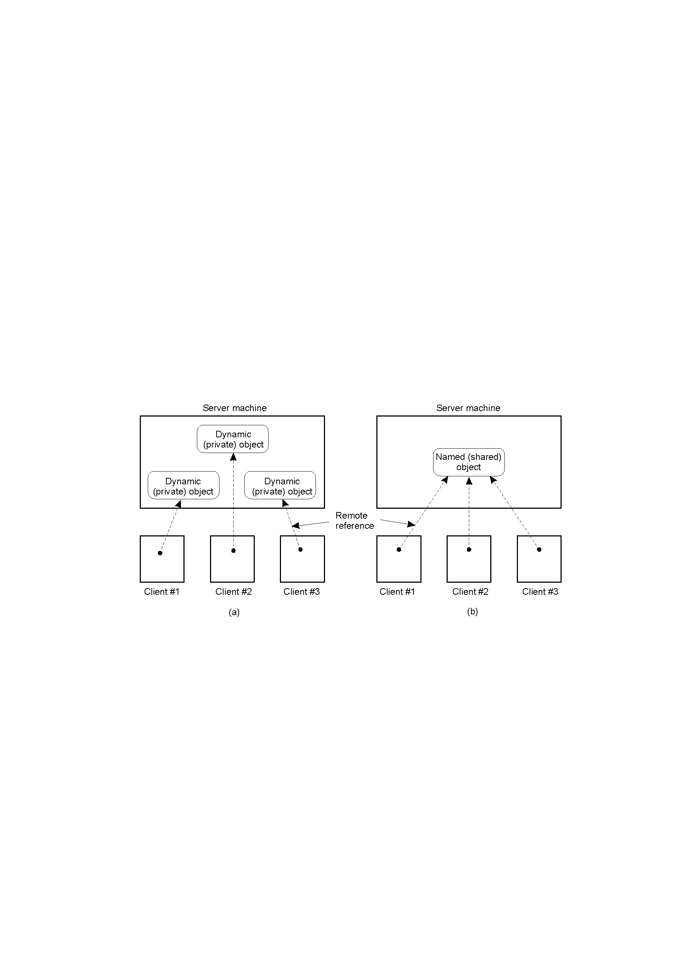
The DCE Distributed-Object Model
2-19
DCE dynamic objects – requests for creation sent via RPC.
DCE named objects – registered with a DS naming service.

Slide 50
Example: Java RMI
In Java, distributed objects are integrated into the language proper.
This affords a very high degree of distribution transparency (with exceptions, where it makes sense, perhaps to improve efficiency).
Java does not support RPC, only distributed objects.
The distributed object’s state is stored on the server, with interfaces made available to remote clients (via distributed object proxies).
To build the DS application, the programmer simply implements the client proxy as a class, and the server skeleton as another class.

Slide 51
Message-Oriented Middleware: MOM
As a communications mechanism, RPC/RMI is often inappropriate.
For example: what happens if we cannot assume that the receiving side is “awake” and waiting to communicate?
Also: the default “synchronous, blocking” nature of RPC/RMI is often too restrictive.
Something else is needed: Messaging.

Slide 52
Message Passing (MP) Systems
Fundamentally different approach.
All communications primitives are defined in terms of passing “messages”.
Initially, MP systems were “transient”, but these did not scale well geographically.
Recent emphasis has been on “persistent” solutions.

Slide 53
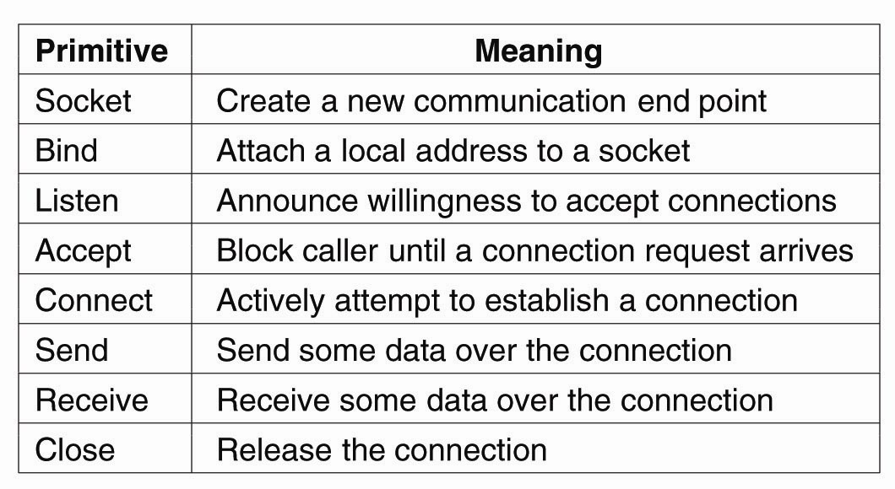
Berkeley Sockets
The socket primitives for TCP/IP

Slide 54
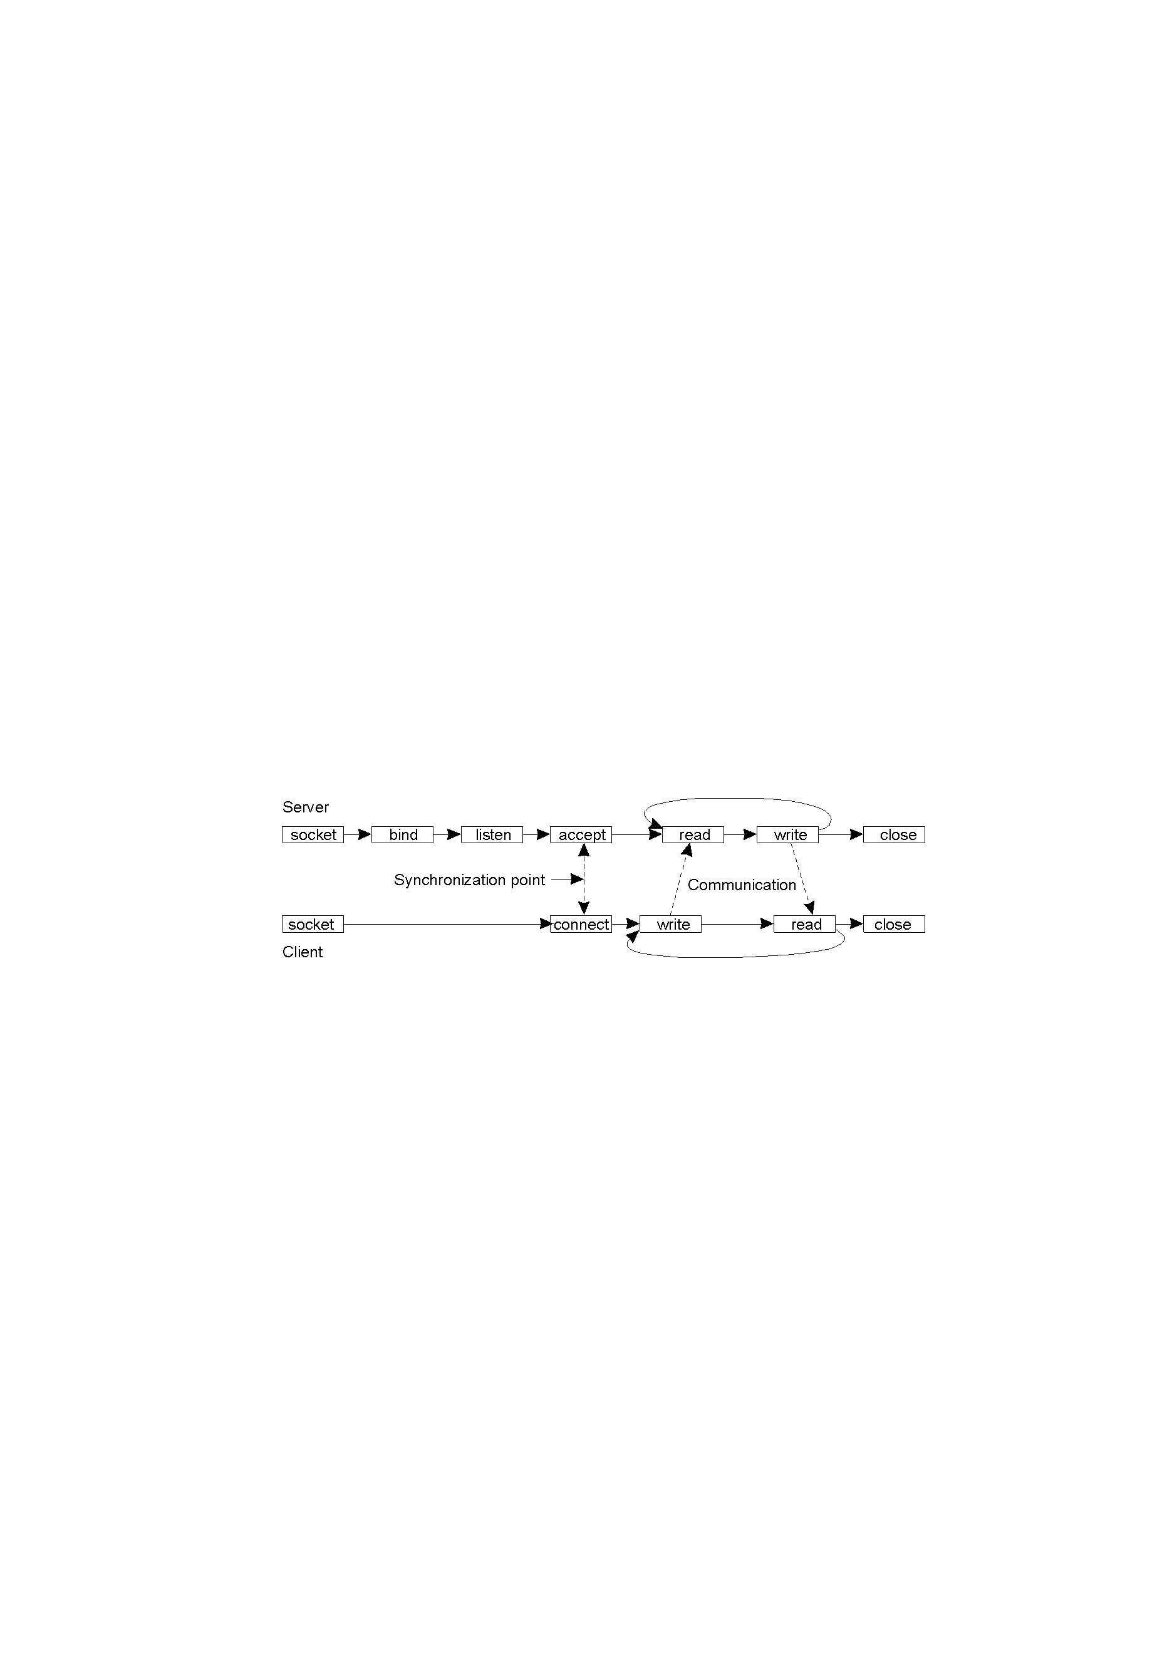
Message-Oriented Transient Communications
Initial efforts relied on connection-oriented communication patterns using Sockets (API).
However, DS developers rejected Sockets:
Wrong level of abstraction (only “send” and “receive”).
Too closely coupled to TCP/IP networks – not diverse enough.

Slide 55
The Message-Passing Interface (1)
Middleware vendors looked to provide a higher-level of abstraction.
Every vendor did their own thing (which is typical).
As can be imagined, this lead to portability problems, as no two vendors product interfaces were the same.
The solution?
  The “Message-Passing Interface” (MPI).

Slide 56
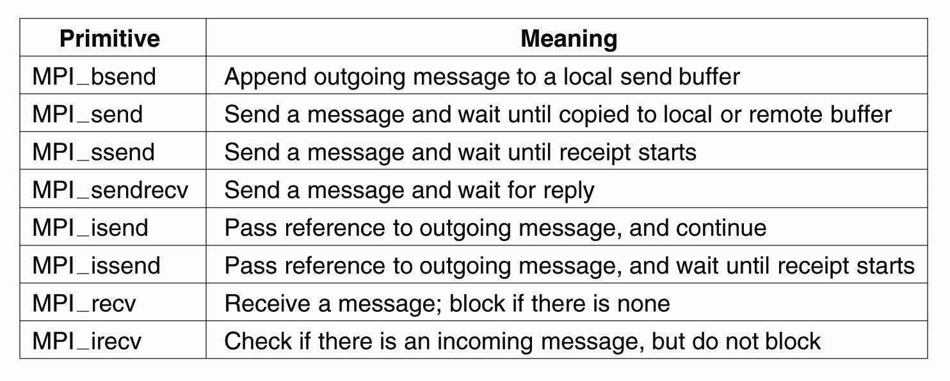
The Message-Passing Interface (2)
Some of the most intuitive
message-passing primitives of MPI

Slide 57
Message-Oriented Persistent Communications
Also known as: “message-queuing systems”.
They support persistent asynchronous communications.
Typically, transport can take minutes (hours?) as opposed to seconds/milliseconds.
The basic idea: applications communicate by putting messages into and taking messages out of “message queues”.
Only guarantee: your message will eventually make it into the receiver’s message queue.
This leads to “loosely-coupled” communications.

Slide 58
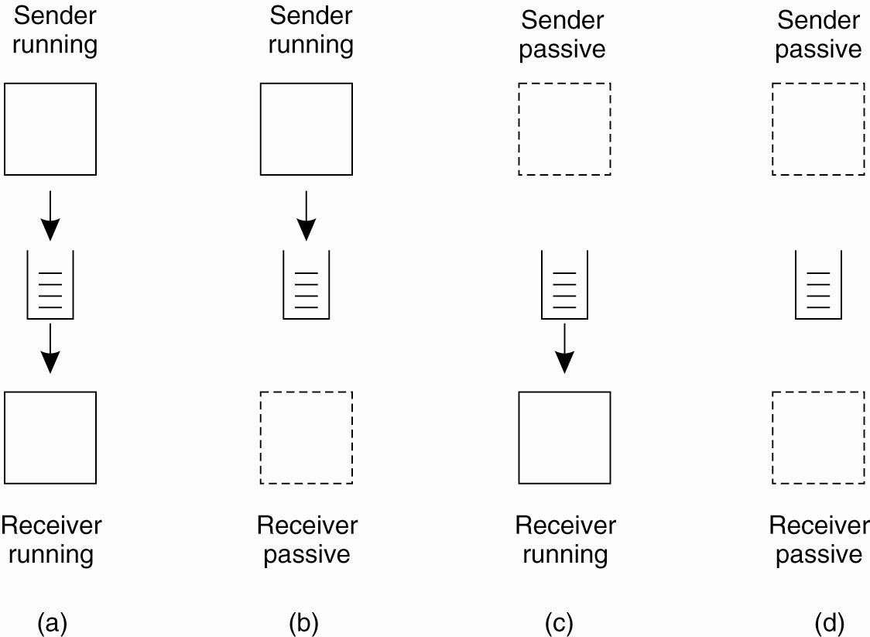
Message-Queuing Model (1)
Four combinations for loosely-coupled
communications using queues

Slide 59
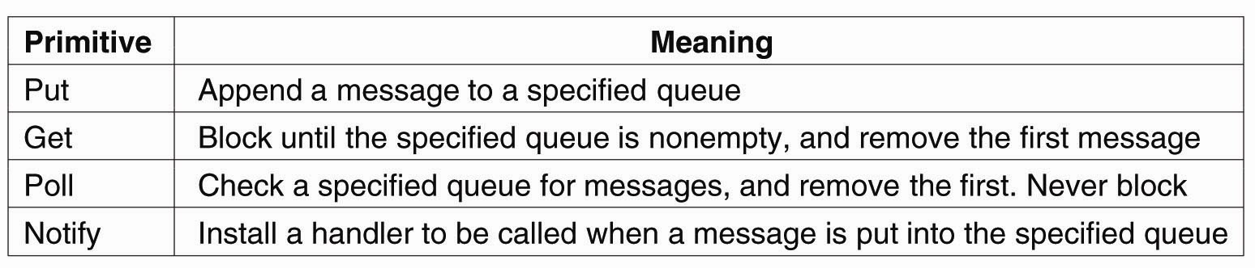
Message-Queuing Model (2)
Basic interface to a queue in a
message-queuing system

Slide 60
Message-Queuing System Architecture
Messages are “put into” a source queue.
They are then “taken from” a destination queue.
Obviously, a mechanism has to exist to move a message from a source queue to a destination queue.
This is the role of the Queue Manager.
These are message-queuing “relays” that interact with the distributed applications and with each other. Not unlike routers, these devices support the notion of a DS “overlay network”.

Slide 61
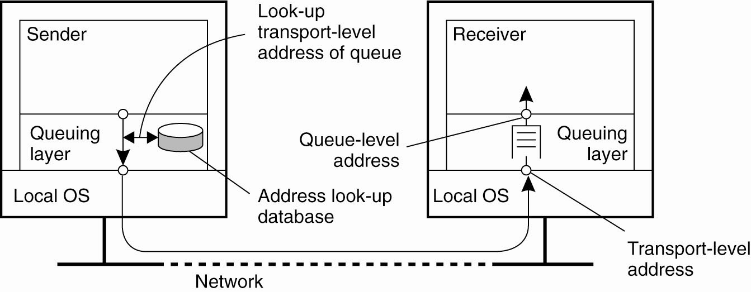
General Architecture of a Message-Queuing System (1)
The relationship between queue-level addressing and network-level addressing

Slide 62
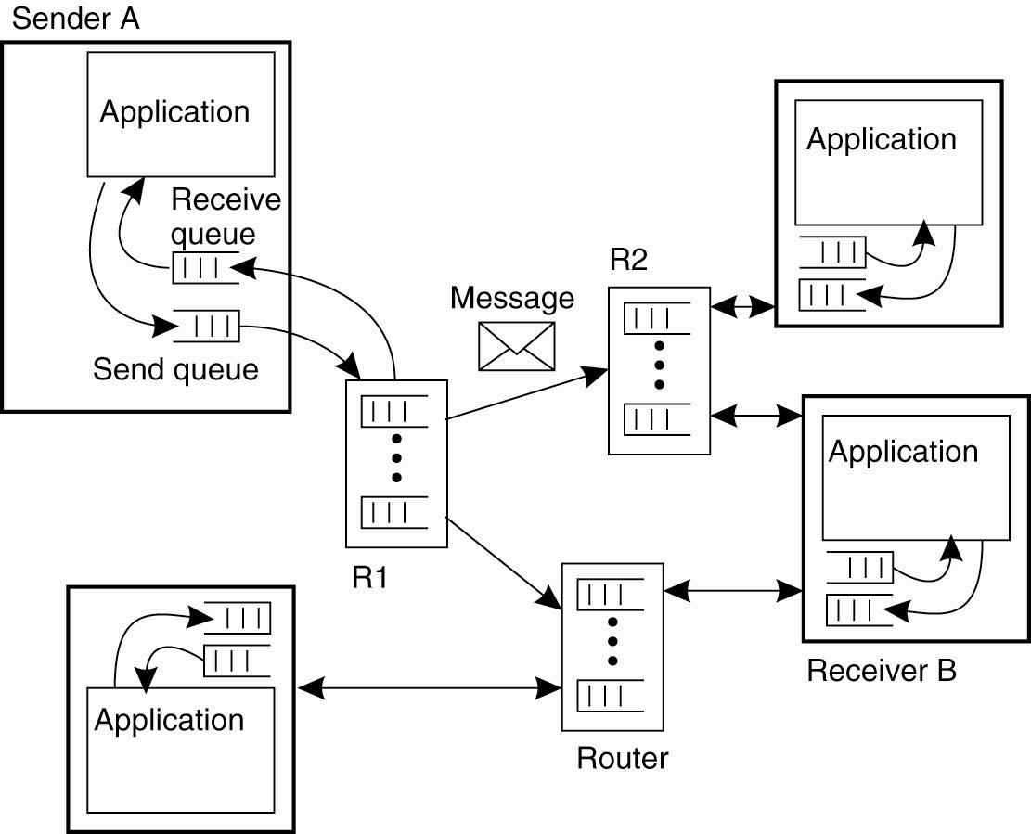
General Architecture of a Message-Queuing System (2)
The general organization of a message-queuing system with routers

Slide 63
The Role of Message Brokers
Often, there’s a need to integrate new/existing apps into a “single, coherent Distributed Information System (DIS)”.
In other words, it is not always possible to start with a blank page – DSs have to live in the real world.
Problem: different message formats exist in legacy systems (cooperation and adherence to open standards was not how things were done in the past).
It may not be convenient to “force” legacy systems to adhere to a single, global message format (cost!?).
It is often necessary to live with diversity (no choice).
How? Meet the “Message Broker”.

Slide 64
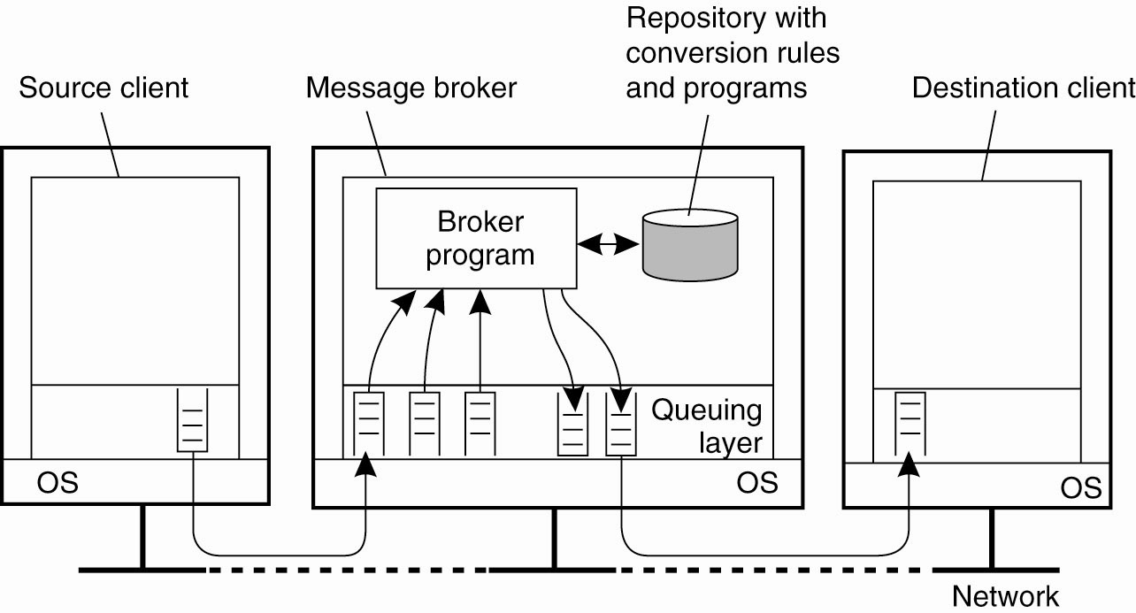
Message Brokers
The general organization of a message broker in a message-queuing system

Slide 65
Message-Queuing (MQ) Applications
General-purpose MQ systems support a wide range of applications, including:
  Electronic mail
  Workflow
  Groupware
  Batch Processing
Most important MQ application area:
  The integration of a widely dispersed collection of database applications (which is all but impossible to do with traditional RPC/RMI techniques).

Slide 66
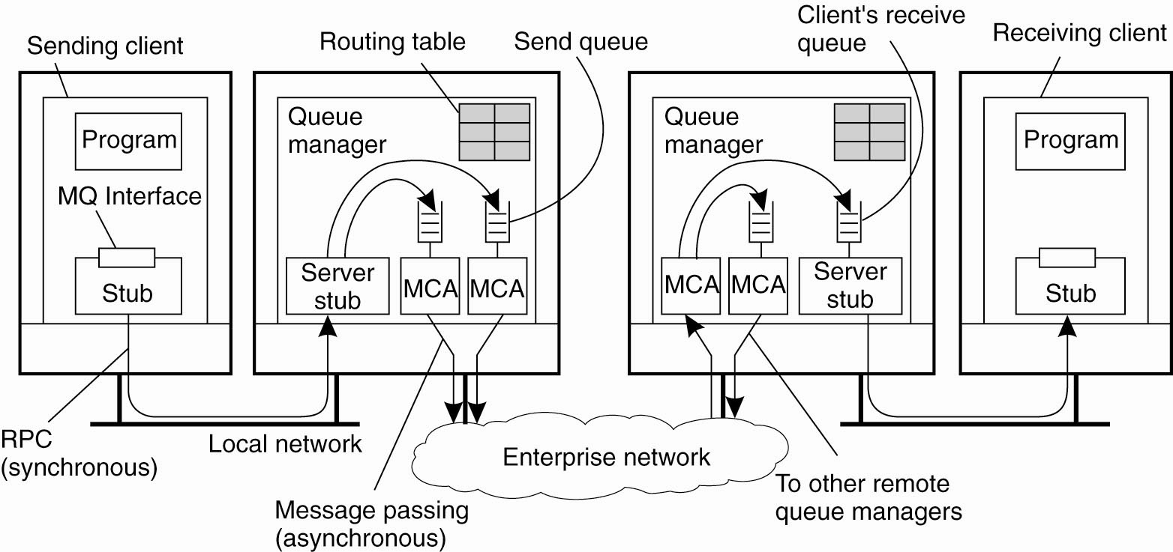
IBM’s WebSphere
Message-Queuing System
General organization of IBM’s message-queuing system

Slide 67
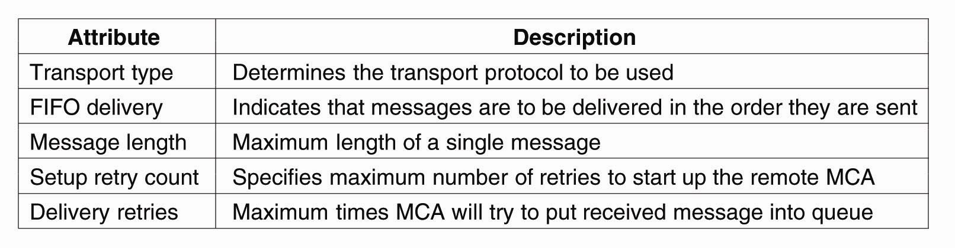
Channels
Some attributes associated with
message channel agents

Slide 68
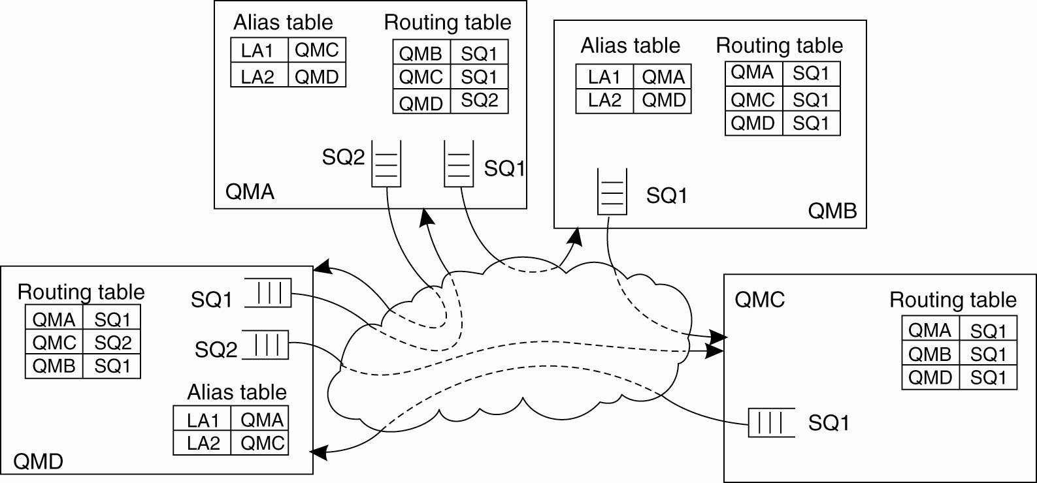
Message Transfer (1)
The general organization of an MQ queuing network using routing tables and aliases

Slide 69
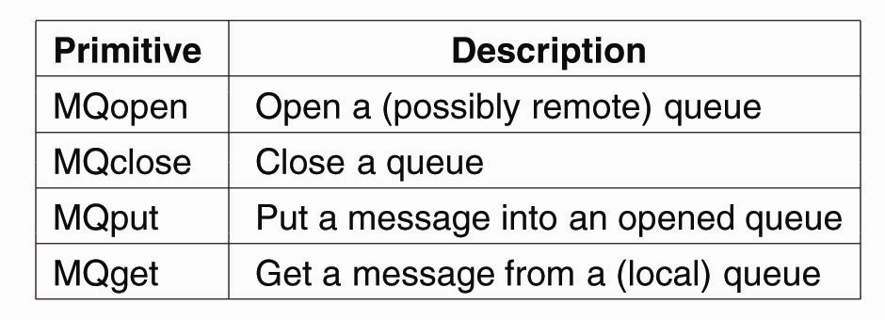
Message Transfer (2)
Primitives available in the message-queuing interface

Slide 70
Stream-Oriented Communications
With RPC, RMI and MOM, the effect that time has on correctness is of little consequence.
However, audio and video are time-dependent data streams – if the timing is off, the resulting “output” from the system will be incorrect.
Time-dependent information – known as “continuous media” communications:
  Example: voice: PCM: 1/44100 sec intervals on playback.
  Example: video: 30 frames per second (30-40ms per image).
KEY MESSAGE: Timing is crucial!

Slide 71
Transmission Modes
Asynchronous transmission mode – the data stream is transmitted in order, but there’s no timing constraints placed on the actual delivery (e.g., File Transfer).
Synchronous transmission mode – the maximum end-to-end delay is defined (but data can travel faster).
Isochronous transmission mode – data transferred “on time” – there’s a maximum and minimum end-to-end delay (known as “bounded jitter”).
Known as “streams” – isochronous transmission mode is very useful for multimedia systems.

Slide 72
Two Types of Streams
Simple Streams – one single sequence of data, for example: voice.
Complex Streams – several sequences of data (sub-streams) that are “related” by time. Think of a lip-synchronized movie, with sound and pictures, together with sub-titles …
This leads to data synchronization problems … not at all easy to deal with.

Slide 73
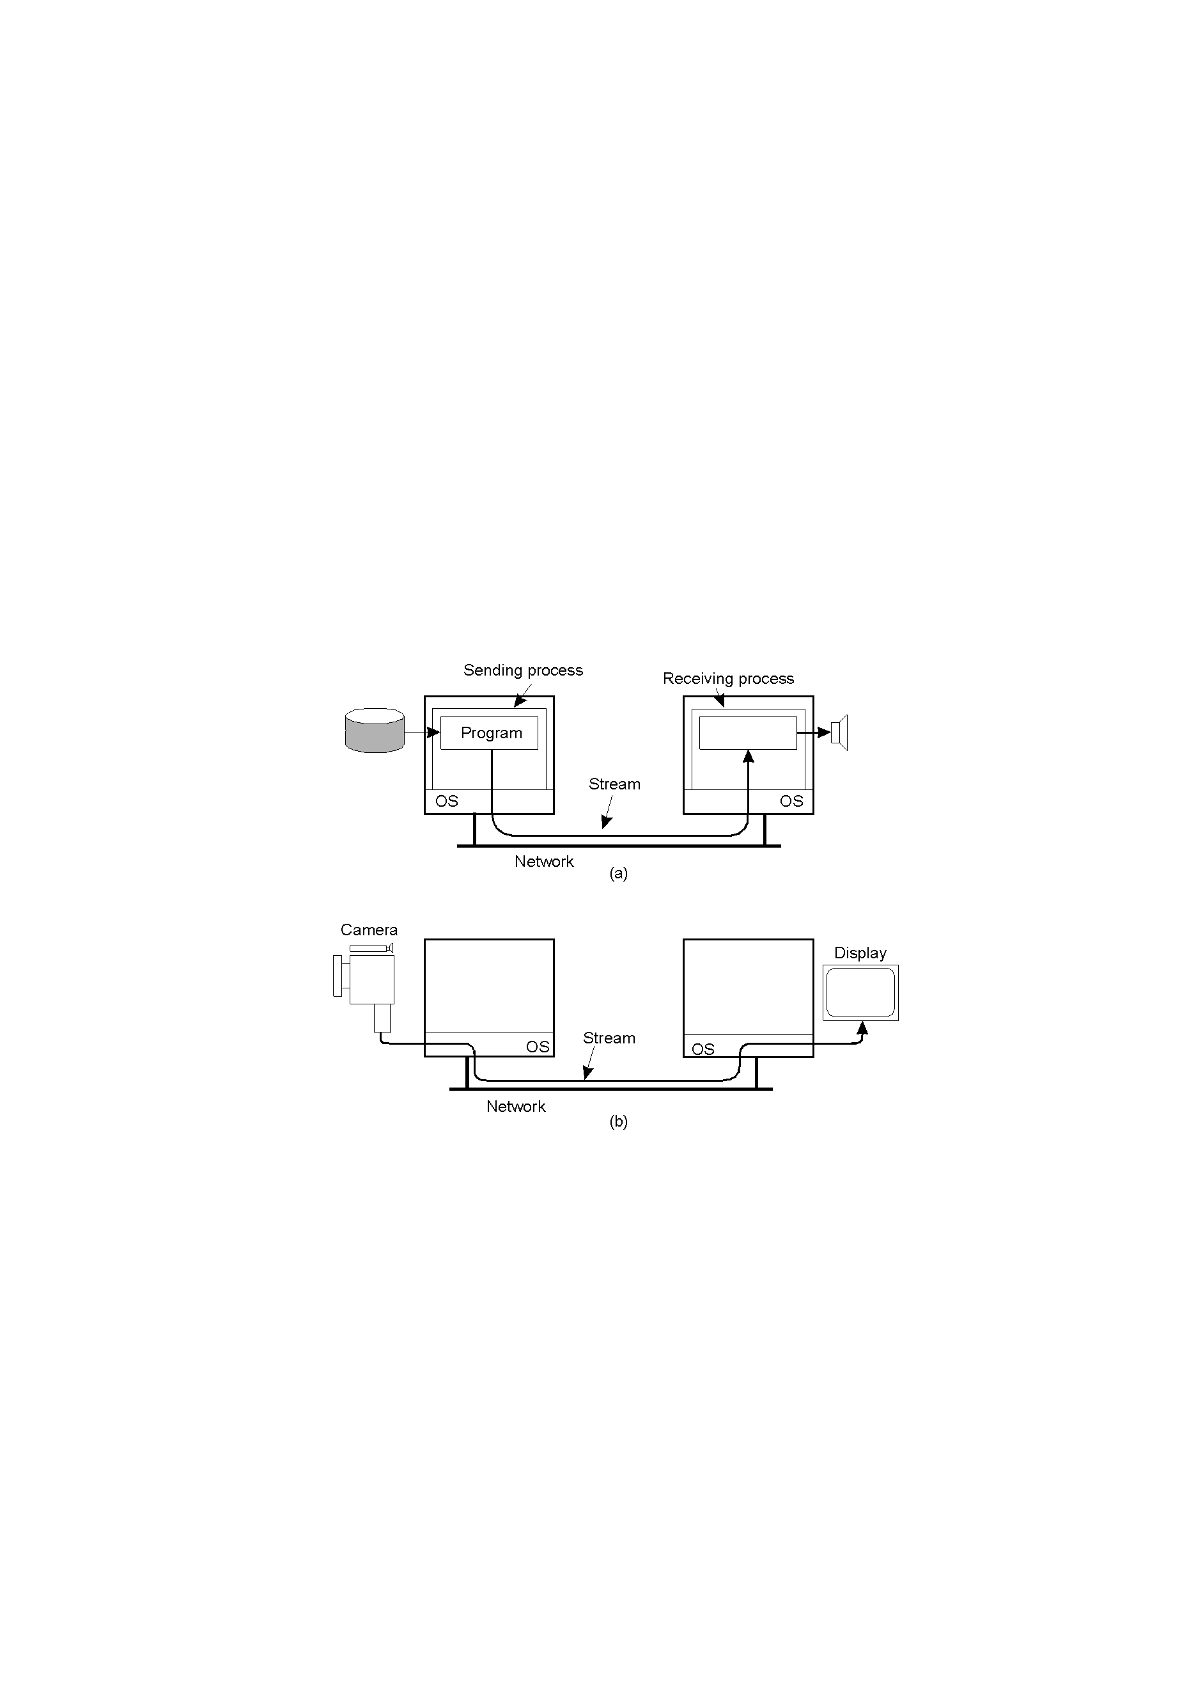
Components of a Stream
Two parts: a “source” and a “sink”.
The source and/or the sink may be a networked
process (a) or an actual end-device (b).

Slide 74
End-device to End-device Streams
2-35.2
Setting up a stream directly between two devices –
i.e., no inter-networked processes.

Slide 75
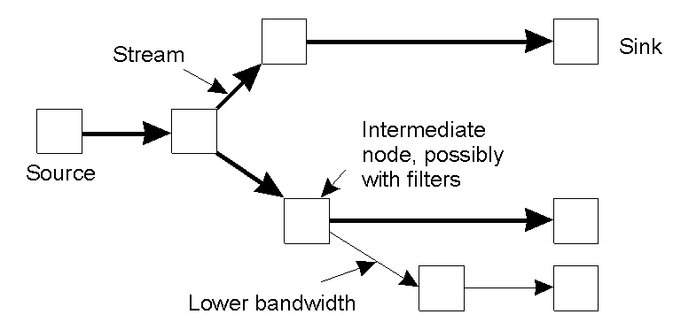
Multi-party Data Streams
An example of multicasting a stream to several receivers.
This is “multiparty communications” – different delivery transfer rates may be required by different end-devices.

Slide 76
Quality of Service (QoS)
Definition: “ensuring that the temporal relationships in the stream can be preserved”.
QoS is all about three things:
  Timeliness
  Volume
  Reliability
But, how is QoS actually specified?
Unfortunately, most technologies do their
own thing.

Slide 77
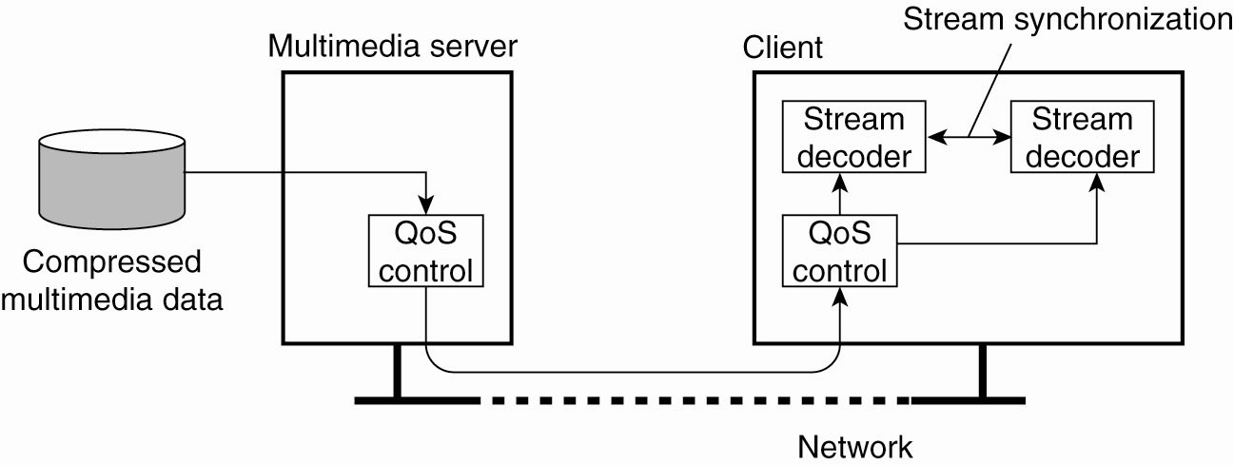
Data Stream
A general architecture for streaming
stored multimedia data over a network

Slide 78
Streams and Quality of Service
Properties for Quality of Service (QoS):
The required bit rate at which data should be transported.
The maximum delay until a session has been set up.
The maximum end-to-end delay.
The maximum delay variance, or jitter.
The maximum round-trip delay.

Slide 79
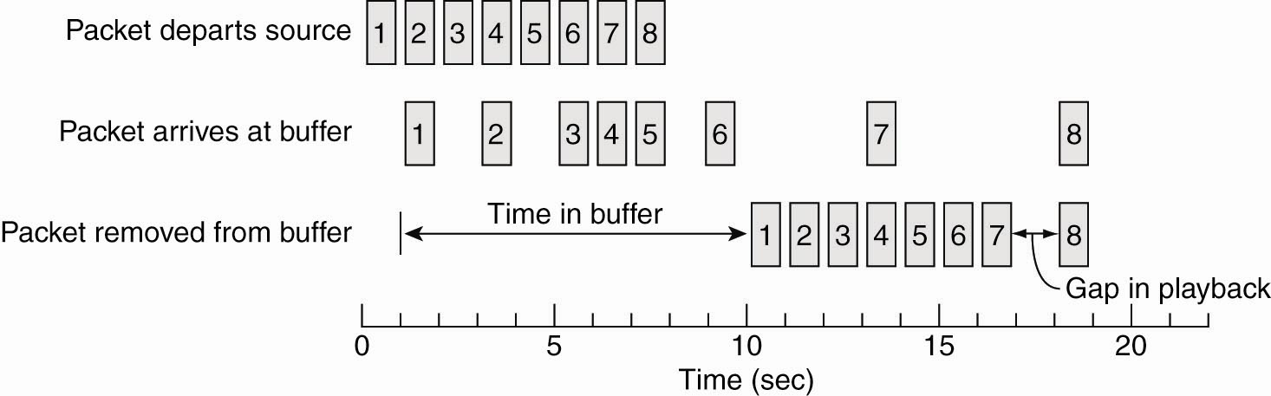
Enforcing QoS (1)
Using a buffer to reduce jitter

Slide 80
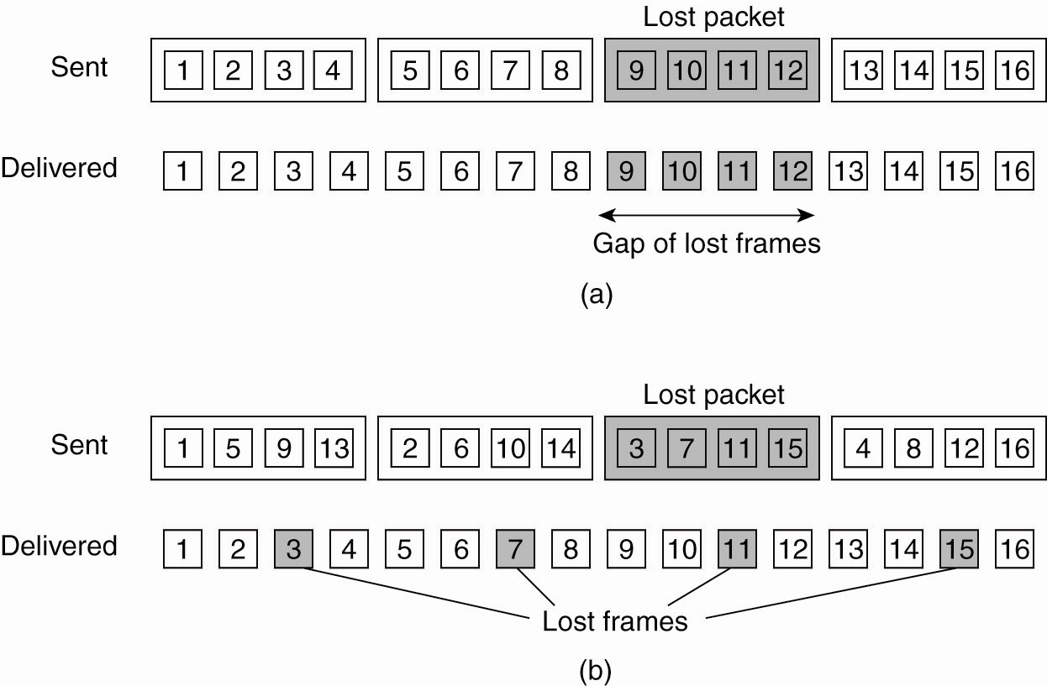
Enforcing QoS (2)
The effect of packet loss in (a) non interleaved transmission and (b) interleaved transmission

Slide 81
Stream Synchronization
A key question is:
  “Where does the synchronization occur?”
    On the sending side?
    On the receiving side?
Think about the advantages/disadvantages of each …

Slide 82
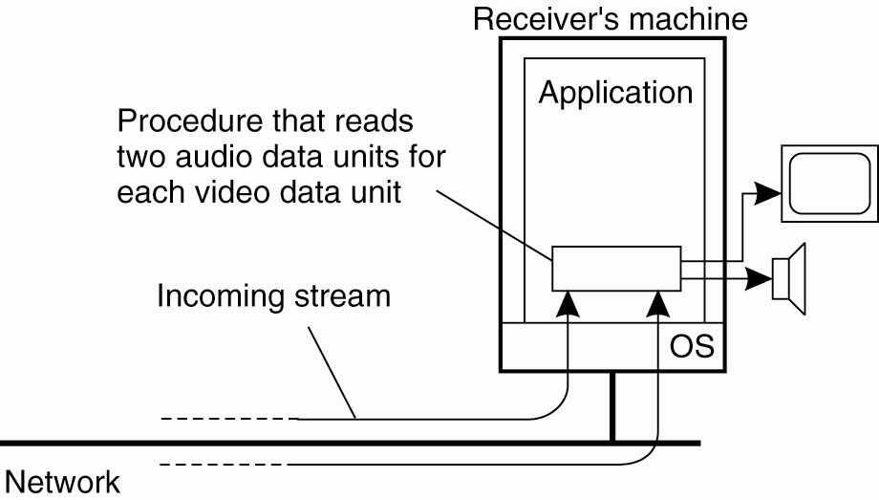
Synchronization Mechanisms (1)
The principle of explicit synchronization
on the level data units

Slide 83
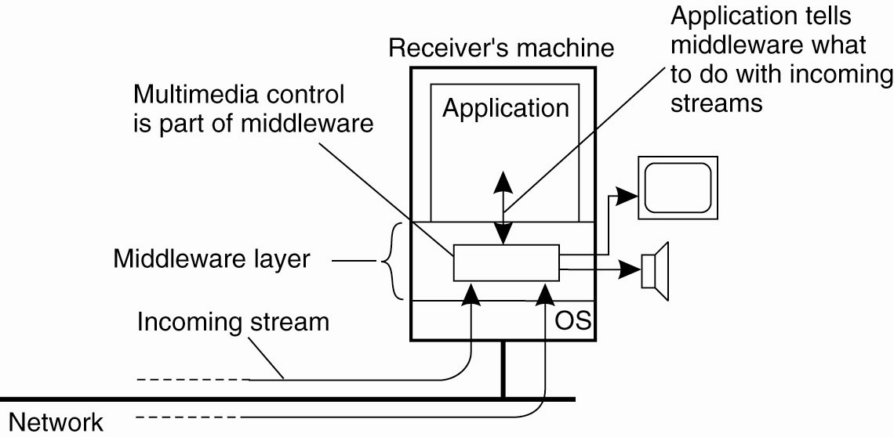
Synchronization Mechanisms (2)
The principle of synchronization as
supported by high-level interfaces

Slide 84
Specifying QoS with Flow Specifications
Characteristics of the Input | Service Required
maximum data unit size (bytes) Token bucket rate (bytes/sec) Toke bucket size (bytes) Maximum transmission rate (bytes/sec) | Loss sensitivity (bytes) Loss interval (μsec) Burst loss sensitivity (data units) Minimum delay noticed (μsec) Maximum delay variation (μsec) Quality of guarantee
A flow specification – one way of specifying QoS –
a little complex, but it does work (but not via a user controlled interface).

Slide 85
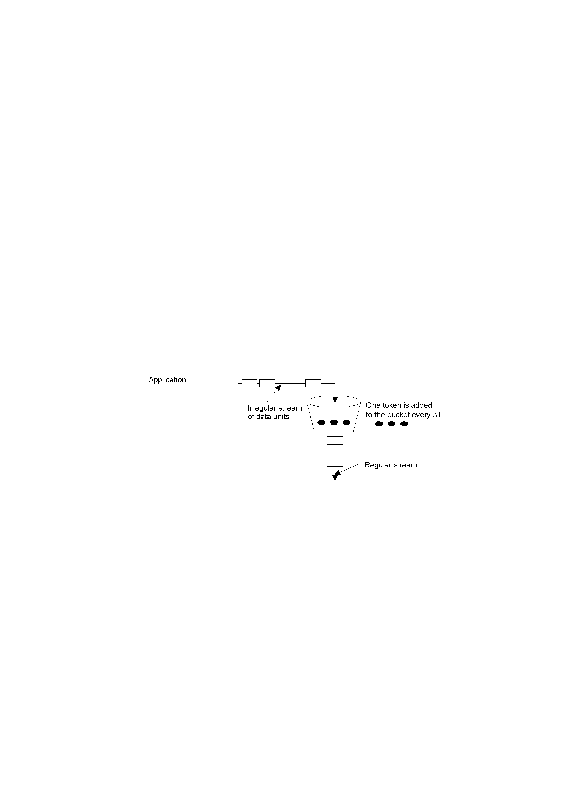
An Approach to Implementing QoS
The principle of a token bucket algorithm – a “classic” technique for controlling the flow of data (and implementing QoS characteristics).

Slide 86
Stream Management
Managing streams is all about managing bandwidth, buffers, processing capacity and scheduling priorities – which are all needed in order to realize QoS guarantees.
This is not as simple as it sounds, and there’s
no general agreement as to “how” it should be done.
For instance: ATM’s QoS (which is very “rich”) has proven to be unworkable (difficult to implement).
Another technique is the Internet’s RSVP.

Slide 87
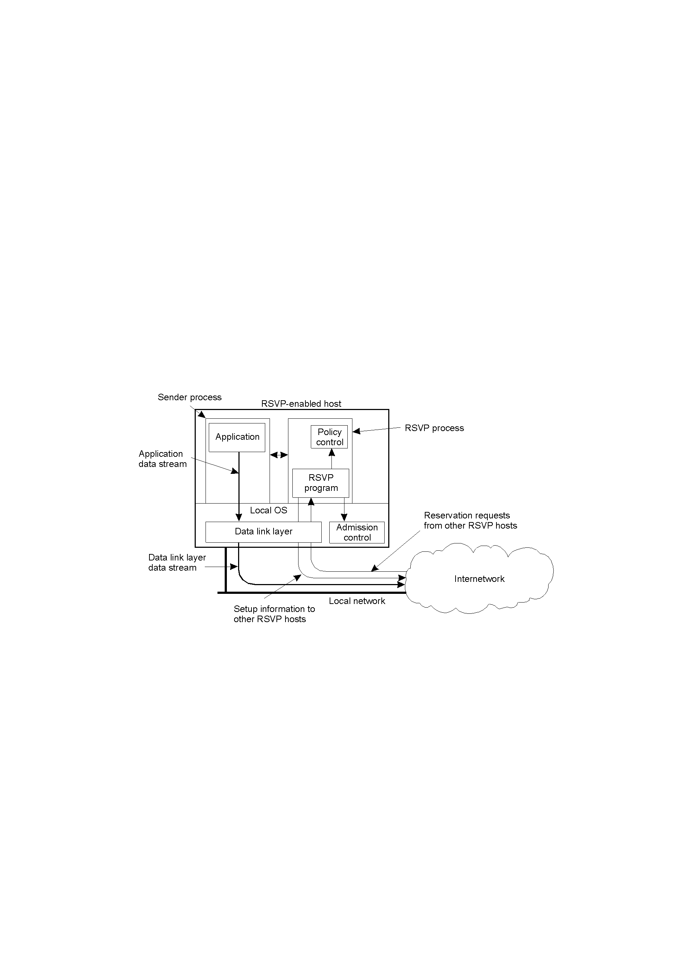
Internet RSVP QoS
The basic organization of RSVP for resource reservation in a distributed system – transport-level control protocol for enabling resource reservations in routers.
Interesting characteristic: receiver initiated.

