Slide 1
DISTRIBUTED SYSTEMS
Principles and Paradigms
Second Edition
ANDREW S. TANENBAUM
MAARTEN VAN STEEN
modified by A. Dobra and R. Newman 2012/2013
Chapter 1
Introduction
Tanenbaum & Van Steen, Distributed Systems: Principles and Paradigms, 2e, (c) 2007 Prentice-Hall, Inc. All rights reserved. 0-13-239227-5

Slide 2
What is an Operating System
An operating system is:
A collection of software components that
Provides useful abstractions and
Manages resources to
Support application programs, and
Provide an interface for users and programs
Tanenbaum & Van Steen, Distributed Systems: Principles and Paradigms, 2e, (c) 2007 Prentice-Hall, Inc. All rights reserved. 0-13-239227-5

Slide 3
Operating System Functions
An operating system’s main functions are to:
Schedule processes & multiplex CPU
Provide mechanisms for IPC and synchronization
Manage main memory
Manage other resources
Provide convenient persistent storage (files)
Maintain system integrity, handle failures
Enforce security policies (e.g., access control)
Give users and processes an interface
Tanenbaum & Van Steen, Distributed Systems: Principles and Paradigms, 2e, (c) 2007 Prentice-Hall, Inc. All rights reserved. 0-13-239227-5

Slide 4
Definition of a Distributed System (1)
A distributed system is (Tannenbaum):
A collection of independent computers that appears to its users as a single coherent system.
A distributed system is (Lamport):
One in which the failure of a computer you didn't even know existed can render your own computer unusable
Tanenbaum & Van Steen, Distributed Systems: Principles and Paradigms, 2e, (c) 2007 Prentice-Hall, Inc. All rights reserved. 0-13-239227-5

Slide 5
Properties of Distributed Systems
Concurrency
  Multicore systems
  Multiple hosts
No global clock
  Theoretical impossibility
  Expense of accurate clocks
Independent view
  Message delay, failure
  Impossible to distinguish slow vs. failed node
Independent failure
  Message delivery (loss, corruption)
  Nodes (fail-stop, Byzantine)
Tanenbaum & Van Steen, Distributed Systems: Principles and Paradigms, 2e, (c) 2007 Prentice-Hall, Inc. All rights reserved. 0-13-239227-5

Slide 6
Software Concepts
System | Description | Main Goal
DOS | Tightly-coupled operating system for multi-processors and homogeneous multicomputers | Hide and manage hardware resources
NOS | Loosely-coupled operating system for heterogeneous multicomputers (LAN and WAN) | Offer local services to remote clients
Middleware | Additional layer atop of NOS implementing general-purpose services | Provide distribution transparency
An overview of
NOS (Network Operating Systems) (80’s)
DOS (Distributed Operating Systems) (90’s)
Middleware (00’s)
Tanenbaum & Van Steen, Distributed Systems: Principles and Paradigms, 2e, (c) 2007 Prentice-Hall, Inc. All rights reserved. 0-13-239227-5

Slide 7
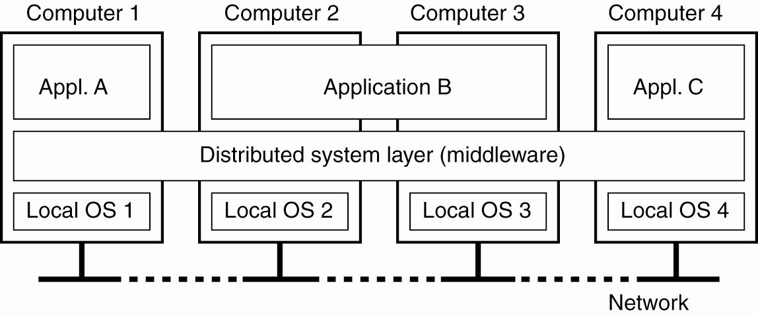
Definition of a Distributed System (2)
Figure 1-1. A distributed system organized as middleware. The middleware layer extends over multiple machines, and offers each application the same interface.
Tanenbaum & Van Steen, Distributed Systems: Principles and Paradigms, 2e, (c) 2007 Prentice-Hall, Inc. All rights reserved. 0-13-239227-5

Slide 8
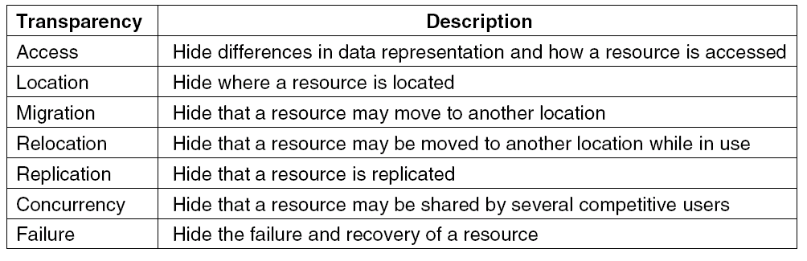
Transparency in a Distributed System
Figure 1-2. Different forms of transparency in a distributed system (ISO, 1995).
Other forms:
Parallelism – Hide the number of nodes working on a task
Size – Hide the number of components in the system
Revision – Hide changes in software/hardware versions
Tanenbaum & Van Steen, Distributed Systems: Principles and Paradigms, 2e, (c) 2007 Prentice-Hall, Inc. All rights reserved. 0-13-239227-5

Slide 9
Challenges
Performance
Concurrency
Failures
Scalability
System updates/growth
Heterogeneity
Openness
Multiplicity of ownership, authority
Security
Quality of service/user experience
Transparency
Debugging
Tanenbaum & Van Steen, Distributed Systems: Principles and Paradigms, 2e, (c) 2007 Prentice-Hall, Inc. All rights reserved. 0-13-239227-5

Slide 10
Approaches
Virtual clocks
Group communication
Heartbeats/failure detection, group membership
Distributed agreement, snapshots
Leader election
Transaction protocols
Redundancy, replication, caching
Indirection - naming
Distributed mutual exclusion
Middleware, modularization, layering
  Decomposition vs. integration
Cryptographic protocols
Tanenbaum & Van Steen, Distributed Systems: Principles and Paradigms, 2e, (c) 2007 Prentice-Hall, Inc. All rights reserved. 0-13-239227-5

Slide 11
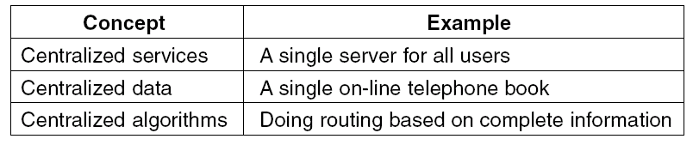
Scalability Problems
Figure 1-3. Examples of scalability limitations.
Engineering = art of compromise (making tradeoffs)
Distributed systems – many theoretical results on lower bounds of tradeoffs that limit practical solutions
Tanenbaum & Van Steen, Distributed Systems: Principles and Paradigms, 2e, (c) 2007 Prentice-Hall, Inc. All rights reserved. 0-13-239227-5

Slide 12
Scalability Examples
Distributed systems are ubiquitous and necessary:
Web search
Financial transactions
Multiplayer games
DNS
Travel reservation systems
Utility infrastructure (e.g., power grid)
Embedded systems (e.g., cars)
Sensor networks
Failure to scale is fatal
Instagram – share cellphone pix
Facebook IPO
Tanenbaum & Van Steen, Distributed Systems: Principles and Paradigms, 2e, (c) 2007 Prentice-Hall, Inc. All rights reserved. 0-13-239227-5

Slide 13
Web Search
Google uses thousands of machines to
  Provide search results
  Run Page-Rank algorithm
Issues
  Connecting large number of machines
  Distributed file system (GFS)
  Indexing
  Programming model
  Scaling up when current system reaches limits
Tanenbaum & Van Steen, Distributed Systems: Principles and Paradigms, 2e, (c) 2007 Prentice-Hall, Inc. All rights reserved. 0-13-239227-5

Slide 14
Financial Transactions
Volume is huge
4 million messages per second
50 million things you can trade
Requirements are stringent
Low latency
24/7 operation (around the world)
Failure “is not an option”
Facebook NASDAQ Freeze
  Transaction system overwhelmed
  Hours to complete transactions in falling market
Tanenbaum & Van Steen, Distributed Systems: Principles and Paradigms, 2e, (c) 2007 Prentice-Hall, Inc. All rights reserved. 0-13-239227-5

Slide 15
Multiplayer Games
Very popular – huge market
Characteristics
May have millions of players
Players operate in same “world”
Players interact with world, each other
Issues
Number of users
Latency, consistency
Coordination of multiple servers
Architecture???
Tanenbaum & Van Steen, Distributed Systems: Principles and Paradigms, 2e, (c) 2007 Prentice-Hall, Inc. All rights reserved. 0-13-239227-5

Slide 16
Scalability Problems
Characteristics of decentralized algorithms:
No machine has complete information about the system state.
Machines make decisions based only on local information.
Failure of one machine does not ruin the algorithm.
There is no implicit assumption that a global clock exists.
Tanenbaum & Van Steen, Distributed Systems: Principles and Paradigms, 2e, (c) 2007 Prentice-Hall, Inc. All rights reserved. 0-13-239227-5

Slide 17
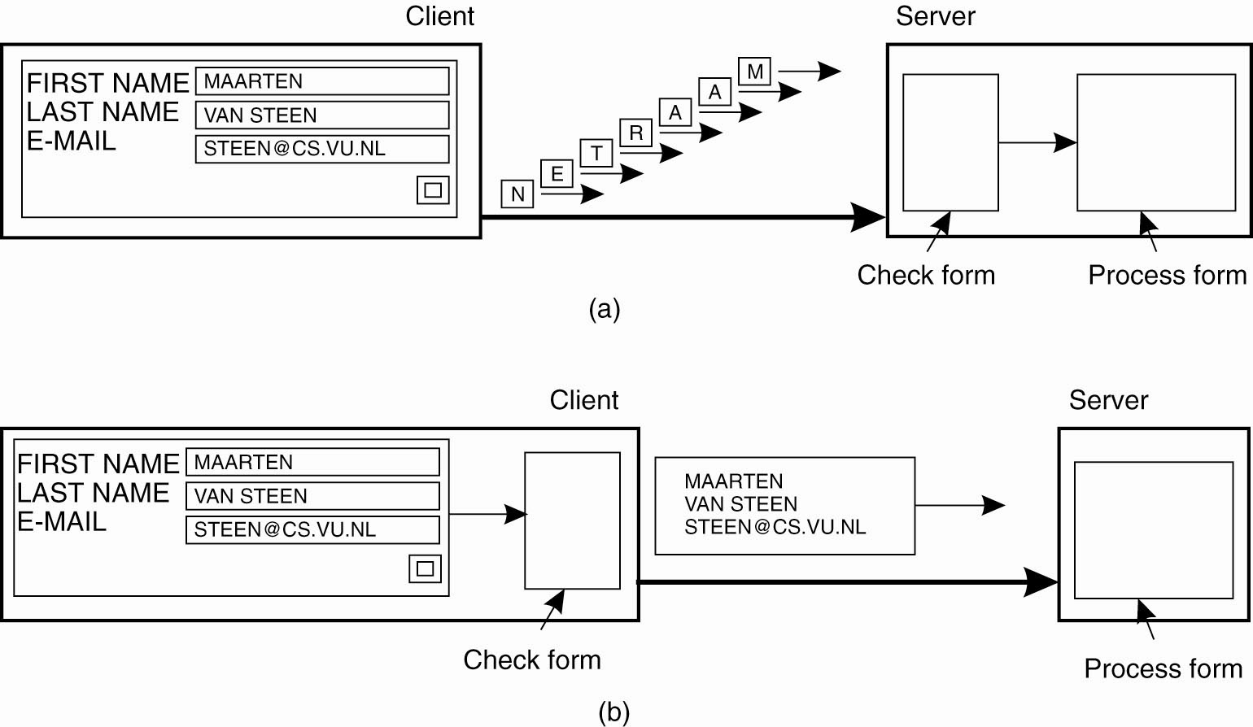
Scaling Techniques (1)
Figure 1-4. The difference between letting (a) a server or (b) a client check forms as they are being filled.
Tanenbaum & Van Steen, Distributed Systems: Principles and Paradigms, 2e, (c) 2007 Prentice-Hall, Inc. All rights reserved. 0-13-239227-5

Slide 18
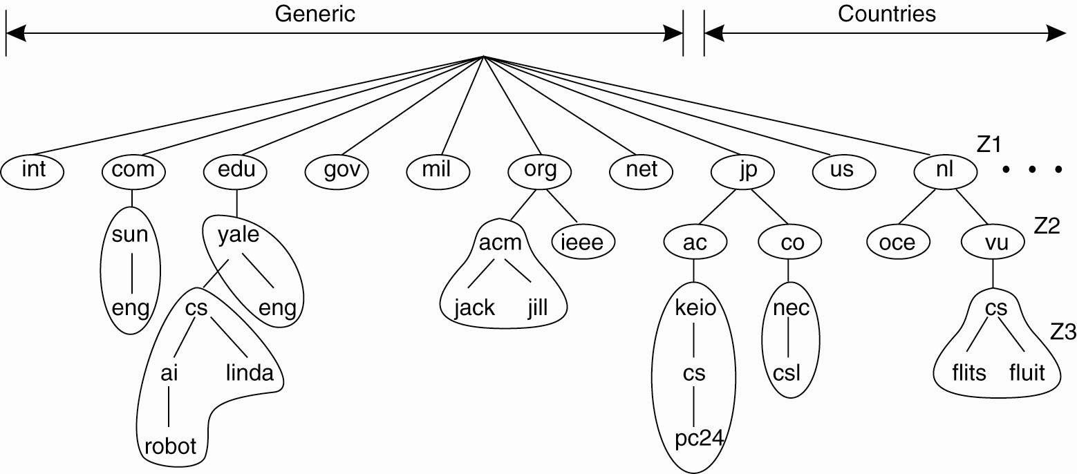
Scaling Techniques (2)
Figure 1-5. An example of dividing the DNS
name space into zones.
Tanenbaum & Van Steen, Distributed Systems: Principles and Paradigms, 2e, (c) 2007 Prentice-Hall, Inc. All rights reserved. 0-13-239227-5

Slide 19
Pitfalls when Developing
Distributed Systems
False assumptions made by first time developer:
The network is reliable.
The network is secure.
The network is homogeneous.
The topology does not change.
Latency is zero.
Bandwidth is infinite.
Transport cost is zero.
There is one administrator.
Tanenbaum & Van Steen, Distributed Systems: Principles and Paradigms, 2e, (c) 2007 Prentice-Hall, Inc. All rights reserved. 0-13-239227-5

Slide 20
Multicore Systems
Knights corner: 64 cores on a chip
Intel “Cloud in a Chip” – 48 cores/256GB @$9K
  http://www.intel.com/content/www/us/en/research/intel-labs-single-chip-cloud-computer.html
Most hosts are 2, 4, or 8 core now
Fine-grained parallelism hard
  Detailed knowledge of algo/programmer involved
  Very fancy compiler
  Scheduling a challenge
Virtualization
  Treat N cores as N hosts (with low latency comm)
  Do sequential programming
  Use DS framework to integrate
Tanenbaum & Van Steen, Distributed Systems: Principles and Paradigms, 2e, (c) 2007 Prentice-Hall, Inc. All rights reserved. 0-13-239227-5

Slide 21
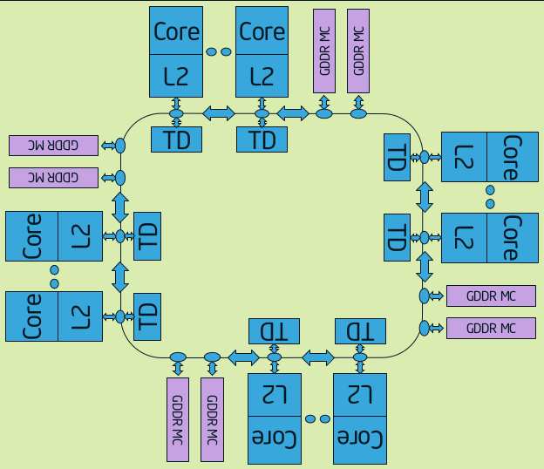
Knights Corner (KC) Chip
10 rings (5 in each direction), Tag Dir, Mem Ctl
Tanenbaum & Van Steen, Distributed Systems: Principles and Paradigms, 2e, (c) 2007 Prentice-Hall, Inc. All rights reserved. 0-13-239227-5

Slide 22
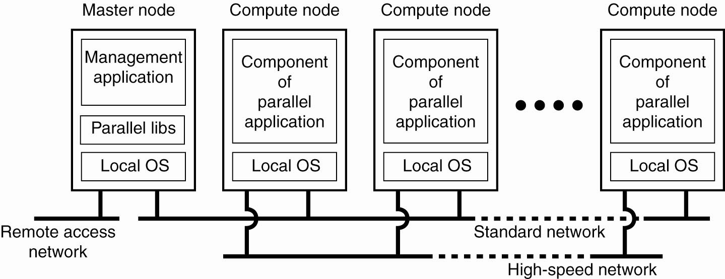
Cluster Computing Systems
Figure 1-6. An example of a cluster computing system.
Tanenbaum & Van Steen, Distributed Systems: Principles and Paradigms, 2e, (c) 2007 Prentice-Hall, Inc. All rights reserved. 0-13-239227-5

Slide 23
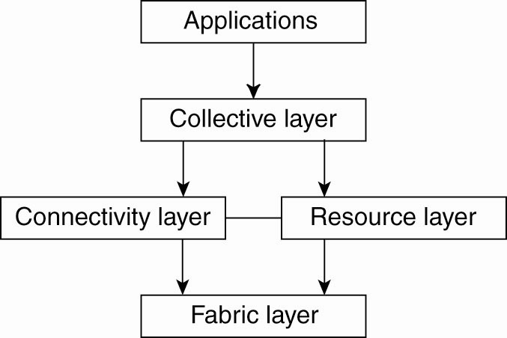
Grid/Cloud Computing Systems
Figure 1-7. A layered architecture for grid computing systems.
Tanenbaum & Van Steen, Distributed Systems: Principles and Paradigms, 2e, (c) 2007 Prentice-Hall, Inc. All rights reserved. 0-13-239227-5

Slide 24
Common Distributed Systems
Query Processing
Transaction Processing
Enterprise Applications
Pervasive Systems
Sensor Networks
Tanenbaum & Van Steen, Distributed Systems: Principles and Paradigms, 2e, (c) 2007 Prentice-Hall, Inc. All rights reserved. 0-13-239227-5

Slide 25
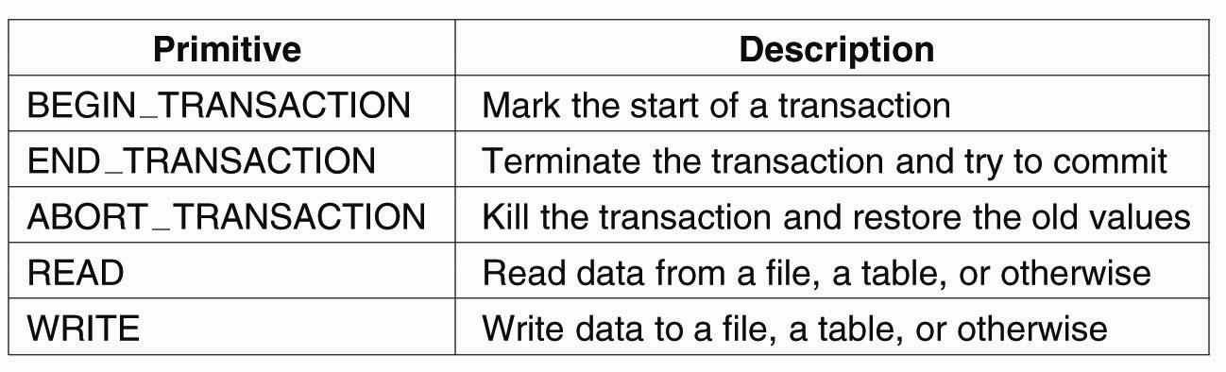
Transaction Processing Systems (1)
Figure 1-8. Example primitives for transactions.
Tanenbaum & Van Steen, Distributed Systems: Principles and Paradigms, 2e, (c) 2007 Prentice-Hall, Inc. All rights reserved. 0-13-239227-5

Slide 26
Transaction Processing Systems (2)
Characteristic properties of transactions:
Atomic: To the outside world, the transaction happens indivisibly.
Consistent: The transaction does not violate system invariants.
Isolated: Concurrent transactions do not interfere with each other.
Durable: Once a transaction commits, the changes are permanent.
Known as ACID properties
Tanenbaum & Van Steen, Distributed Systems: Principles and Paradigms, 2e, (c) 2007 Prentice-Hall, Inc. All rights reserved. 0-13-239227-5

Slide 27
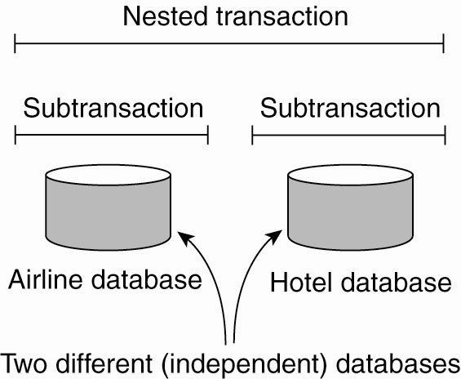
Transaction Processing Systems (3)
Figure 1-9. A nested transaction.
Tanenbaum & Van Steen, Distributed Systems: Principles and Paradigms, 2e, (c) 2007 Prentice-Hall, Inc. All rights reserved. 0-13-239227-5

Slide 28
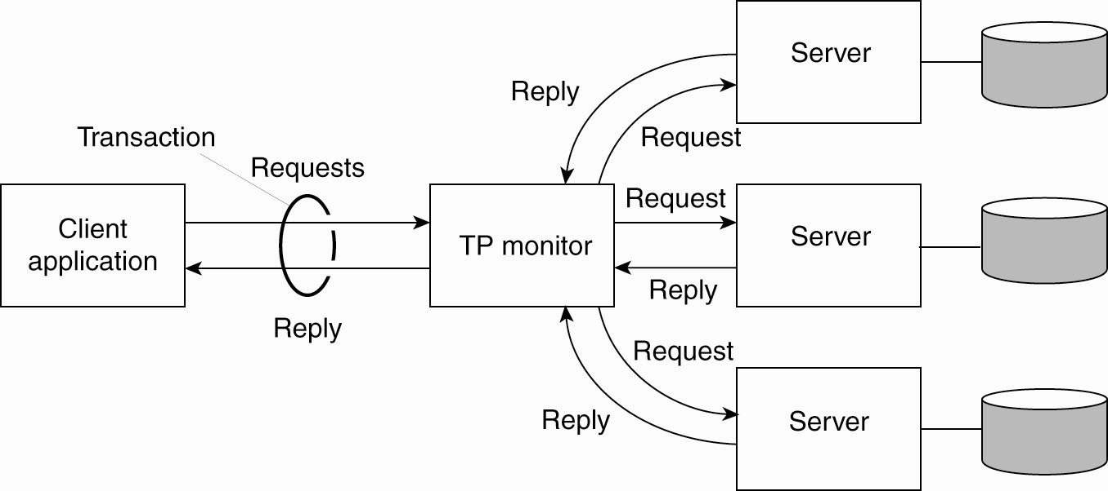
Transaction Processing Systems (4)
Figure 1-10. The role of a TP monitor (a.k.a. Coordinator)
in distributed systems.
Tanenbaum & Van Steen, Distributed Systems: Principles and Paradigms, 2e, (c) 2007 Prentice-Hall, Inc. All rights reserved. 0-13-239227-5

Slide 29
Transaction Processing Systems (4.5)
Coordinator
Object
Client
Transaction
Manager
Scheduler
Object
Manager
...
...
Object
Client
Participants
Object
Client
Transaction
Manager
Scheduler
Object
Manager
...
...
Object
Client
Decomposition of the Transaction Monitor in a TPS
TM – 2PC; SCH – serializability; OM – Atomic Update
Tanenbaum & Van Steen, Distributed Systems: Principles and Paradigms, 2e, (c) 2007 Prentice-Hall, Inc. All rights reserved. 0-13-239227-5

Slide 30
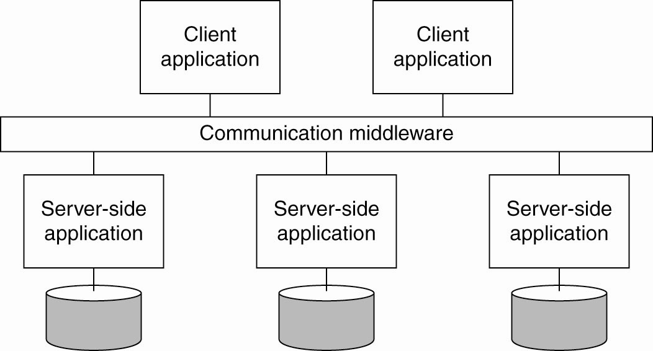
Enterprise Application Integration
Figure 1-11. Middleware as a communication facilitator in enterprise application integration.
Tanenbaum & Van Steen, Distributed Systems: Principles and Paradigms, 2e, (c) 2007 Prentice-Hall, Inc. All rights reserved. 0-13-239227-5

Slide 31
Distributed Pervasive Systems
Requirements for pervasive systems
Embrace contextual changes.
Encourage ad hoc composition.
Recognize sharing as the default.
Tanenbaum & Van Steen, Distributed Systems: Principles and Paradigms, 2e, (c) 2007 Prentice-Hall, Inc. All rights reserved. 0-13-239227-5

Slide 32
Electronic Health Care Systems (1)
Questions to be addressed for health care systems:
Where and how should monitored data be stored?
How can we prevent loss of crucial data?
What infrastructure is needed to generate and propagate alerts?
How can physicians provide online feedback?
How can extreme robustness of the monitoring system be realized?
What are the security issues and how can the proper policies be enforced?
Tanenbaum & Van Steen, Distributed Systems: Principles and Paradigms, 2e, (c) 2007 Prentice-Hall, Inc. All rights reserved. 0-13-239227-5

Slide 33
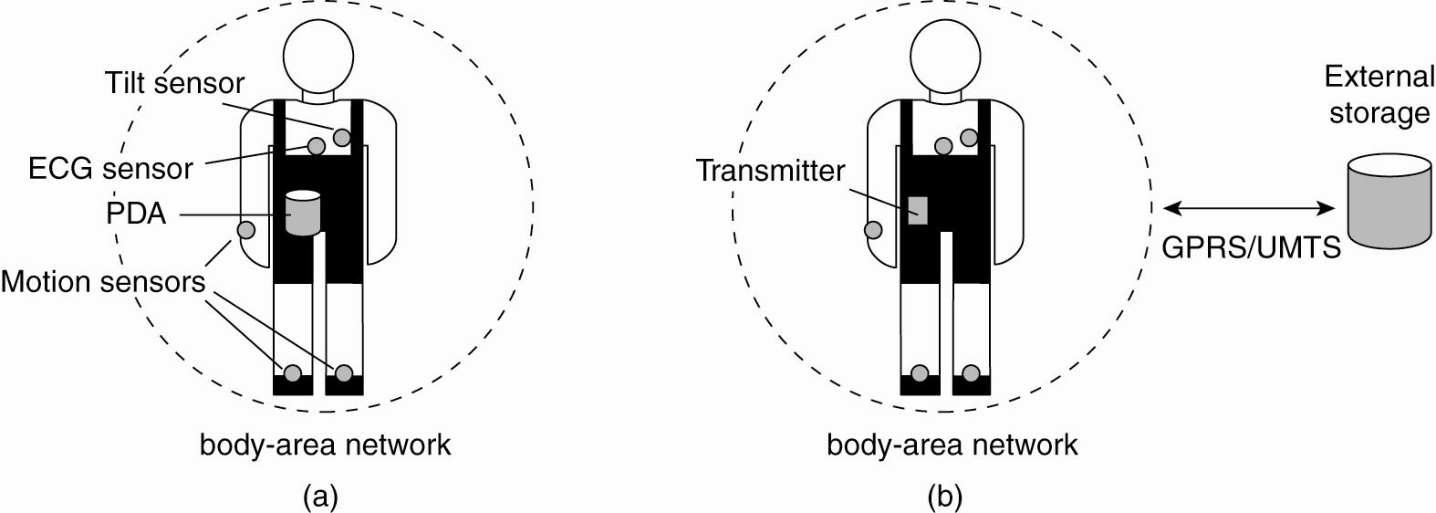
Electronic Health Care Systems (2)
Figure 1-12. Monitoring a person in a pervasive electronic health care system, using (a) a local hub or
(b) a continuous wireless connection.
Tanenbaum & Van Steen, Distributed Systems: Principles and Paradigms, 2e, (c) 2007 Prentice-Hall, Inc. All rights reserved. 0-13-239227-5

Slide 34
Sensor Networks (1)
Questions concerning sensor networks:
How do we (dynamically) set up an efficient tree in a sensor network?
How does aggregation of results take place? Can it be controlled?
What happens when network links fail?
Tanenbaum & Van Steen, Distributed Systems: Principles and Paradigms, 2e, (c) 2007 Prentice-Hall, Inc. All rights reserved. 0-13-239227-5

Slide 35
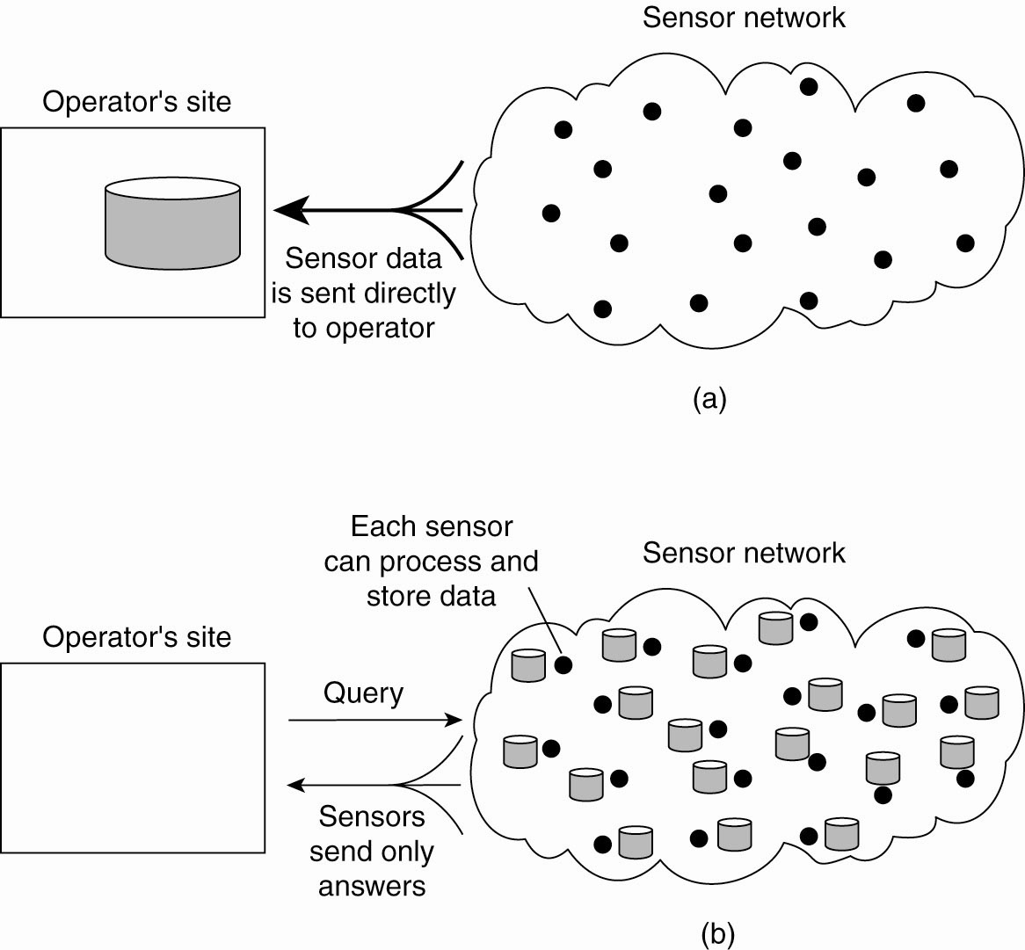
Sensor Networks (2)
Figure 1-13. Organizing a sensor network database, while storing and processing data (a) only at the operator’s site or …
Tanenbaum & Van Steen, Distributed Systems: Principles and Paradigms, 2e, (c) 2007 Prentice-Hall, Inc. All rights reserved. 0-13-239227-5

Slide 36
Sensor Networks (3)
Figure 1-13. Organizing a sensor network database, while storing and processing data … or (b) only at the sensors.
May also do data fusion/aggregation/processing at nodes
along the path to the master node/operator
Tanenbaum & Van Steen, Distributed Systems: Principles and Paradigms, 2e, (c) 2007 Prentice-Hall, Inc. All rights reserved. 0-13-239227-5

Slide 37
Some Fundamental Issues
How do we decompose a complex problem/task into logical/manageable chunks?
What is the physical architecture?
How do we assign roles/responsibilities to physical components?
How do we find components (logical and physical)?
How do we define and maintain consistency?
Tanenbaum & Van Steen, Distributed Systems: Principles and Paradigms, 2e, (c) 2007 Prentice-Hall, Inc. All rights reserved. 0-13-239227-5

