Slide 1
DISTRIBUTED SYSTEMS
Principles and Paradigms
Second Edition
ANDREW S. TANENBAUM
MAARTEN VAN STEEN
Chapter 5
Naming
Tanenbaum & Van Steen, Distributed Systems: Principles and Paradigms, 2e, (c) 2007 Prentice-Hall, Inc. All rights reserved. 0-13-239227-5

Slide 2
Naming
Names denote entities in a distributed system.
To operate on an entity, we access it at an access point.
Access points are entities named by an address.
A location-independent name for an entity E, is independent from the addresses of the access points offered by E.
Tanenbaum & Van Steen, Distributed Systems: Principles and Paradigms, 2e, (c) 2007 Prentice-Hall, Inc. All rights reserved. 0-13-239227-5

Slide 3
True Identifiers
Pure name: One with no meaning; just a random string used for comparison.
Identifier: A name with these properties:
  Each identifier refers to at most one entity
  Each entity referred to by at most one identifier
  An identifier always refers to the same entity (prohibits reusing an identifier)
An identifier need not necessarily be a pure name, i. e., it may have content.
Tanenbaum & Van Steen, Distributed Systems: Principles and Paradigms, 2e, (c) 2007 Prentice-Hall, Inc. All rights reserved. 0-13-239227-5

Slide 4
Naming vs. Locating Entities (1)
Location service: Provides current addresses of entities.
  Entities are mobile - current address may change often.
Naming service: Provide content of nodes in a name space given a name.
  Node contents at higher levels is relatively stable.
Tanenbaum & Van Steen, Distributed Systems: Principles and Paradigms, 2e, (c) 2007 Prentice-Hall, Inc. All rights reserved. 0-13-239227-5

Slide 5
Naming vs. Locating Entities (2)
If traditional naming service used to locate entities, must assume node contents at local level is stable.
Not realistic to assume stable node contents down to the local naming level
Decouple naming and locating entities.
Tanenbaum & Van Steen, Distributed Systems: Principles and Paradigms, 2e, (c) 2007 Prentice-Hall, Inc. All rights reserved. 0-13-239227-5

Slide 6
Broadcasting & Multicasting
Broadcasting works only in LANs
  Too much load on Network
  Too much load on machines that can’t answer
Multicasting
  Possible in LAN hardware
  not well supported at IP layer
  Can use to find a nearest replica
Tanenbaum & Van Steen, Distributed Systems: Principles and Paradigms, 2e, (c) 2007 Prentice-Hall, Inc. All rights reserved. 0-13-239227-5

Slide 7
Forwarding Pointers (1)
When an entity moves, it leaves a pointer to where it went.
Dereferencing can be made transparent to client - follow the pointer chain
Update client's reference when location is found
Geographical scalability problems:
– Long chains not fault tolerant
– High latency when dereferencing
Need chain reduction mechanisms
Tanenbaum & Van Steen, Distributed Systems: Principles and Paradigms, 2e, (c) 2007 Prentice-Hall, Inc. All rights reserved. 0-13-239227-5

Slide 8
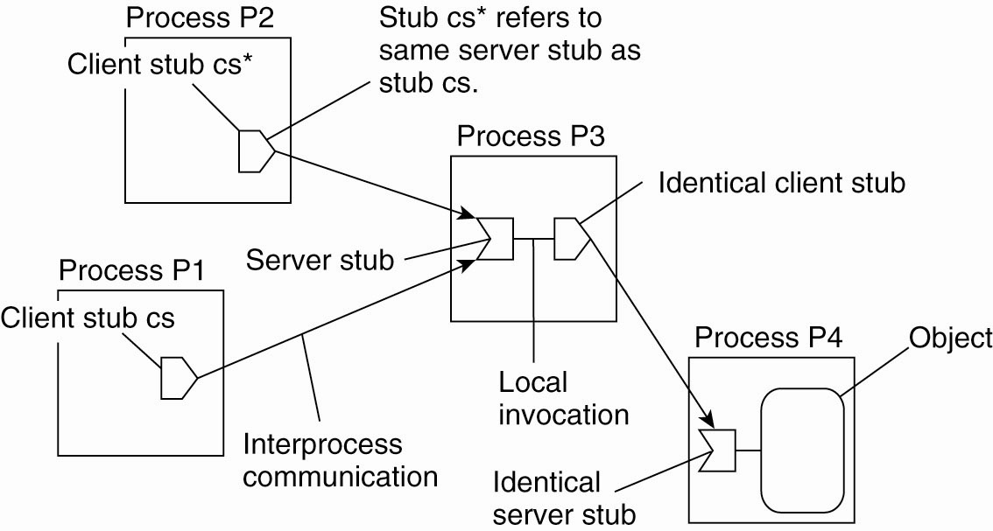
Forwarding Pointers (1)
Figure 5-1. The principle of forwarding pointers
using (client stub, server stub) pairs.
Tanenbaum & Van Steen, Distributed Systems: Principles and Paradigms, 2e, (c) 2007 Prentice-Hall, Inc. All rights reserved. 0-13-239227-5

Slide 9
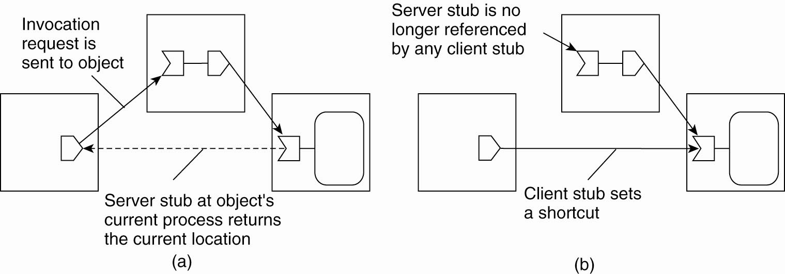
Forwarding Pointers (2)
Figure 5-2. Redirecting a forwarding pointer by
storing a shortcut in a client stub.
Tanenbaum & Van Steen, Distributed Systems: Principles and Paradigms, 2e, (c) 2007 Prentice-Hall, Inc. All rights reserved. 0-13-239227-5

Slide 10
Forwarding Pointers (3)
Figure 5-2. Redirecting a forwarding pointer by
storing a shortcut in a client stub.
Tanenbaum & Van Steen, Distributed Systems: Principles and Paradigms, 2e, (c) 2007 Prentice-Hall, Inc. All rights reserved. 0-13-239227-5

Slide 11
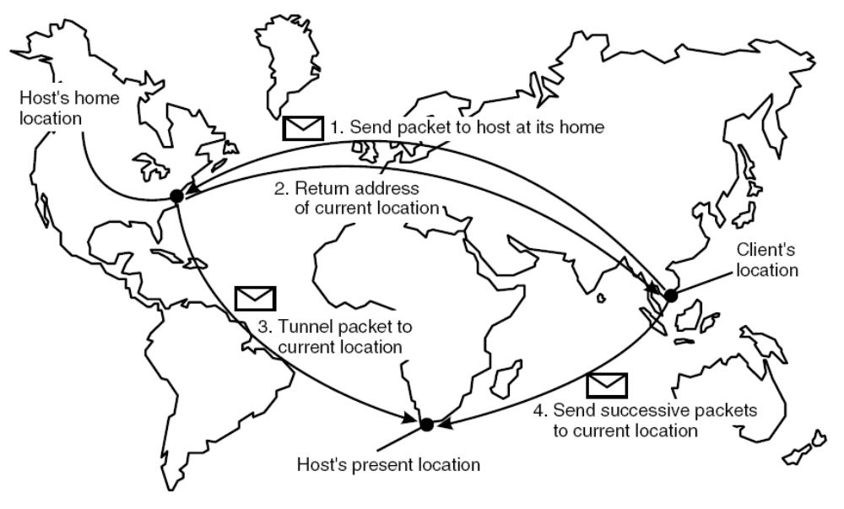
Home-Based Approaches
Figure 5-3. The principle of Mobile IP.
Tanenbaum & Van Steen, Distributed Systems: Principles and Paradigms, 2e, (c) 2007 Prentice-Hall, Inc. All rights reserved. 0-13-239227-5

Slide 12
Home-Based Approaches (2)
Problems with home-based approaches:
Home address has to be supported as long as entity lives
Home address is fixed - unnecessary burden if entity permanently moves
Poor geographical scalability (the entity may be next to the client)
Tanenbaum & Van Steen, Distributed Systems: Principles and Paradigms, 2e, (c) 2007 Prentice-Hall, Inc. All rights reserved. 0-13-239227-5

Slide 13
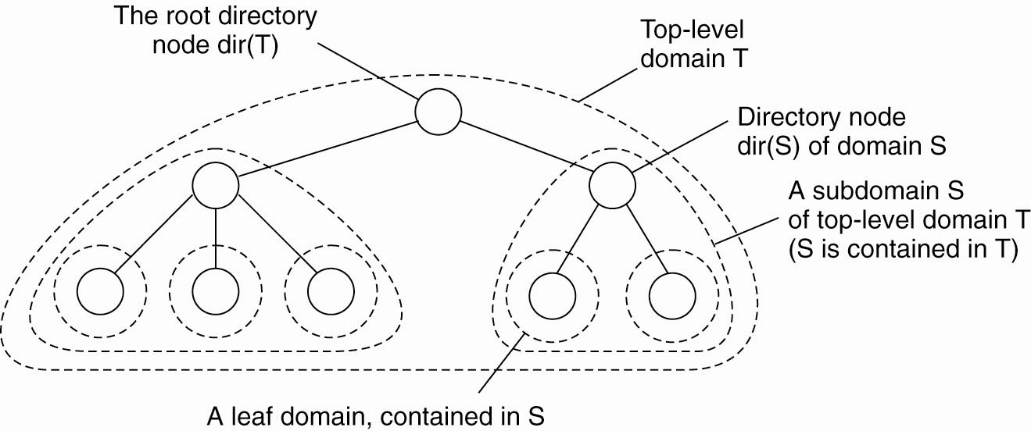
Hierarchical Approaches
Figure 5-5. Hierarchical organization of a location service into domains, each having an associated directory node.
Tanenbaum & Van Steen, Distributed Systems: Principles and Paradigms, 2e, (c) 2007 Prentice-Hall, Inc. All rights reserved. 0-13-239227-5

Slide 14
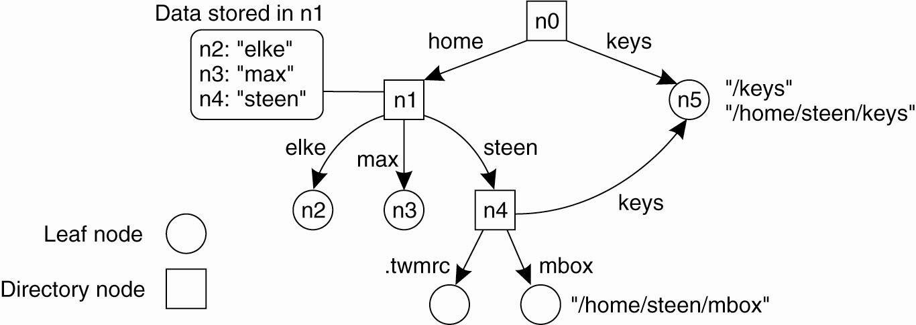
Name Spaces (1)
Figure 5-9. A general naming graph with a single root node.
Tanenbaum & Van Steen, Distributed Systems: Principles and Paradigms, 2e, (c) 2007 Prentice-Hall, Inc. All rights reserved. 0-13-239227-5

Slide 15
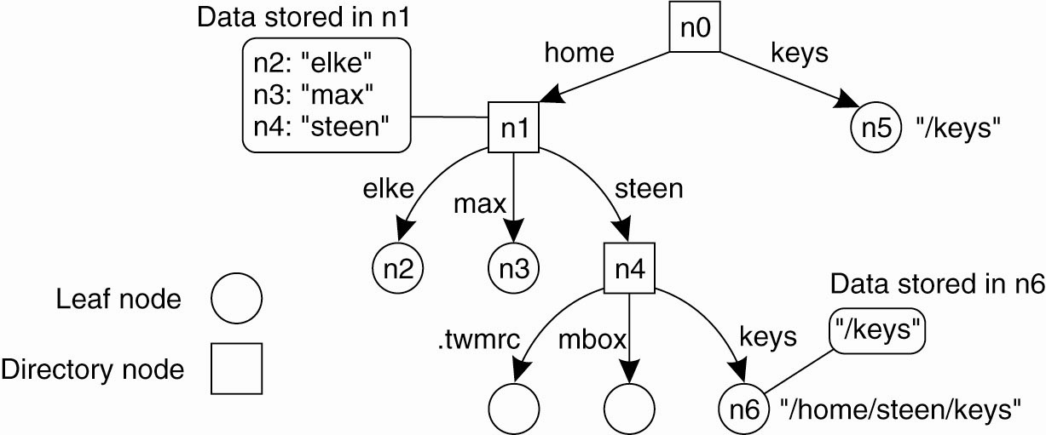
Name Spaces (2)
Figure 5-11. The concept of a symbolic link
explained in a naming graph.
Tanenbaum & Van Steen, Distributed Systems: Principles and Paradigms, 2e, (c) 2007 Prentice-Hall, Inc. All rights reserved. 0-13-239227-5

Slide 16
Linking and Mounting (1)
Merging Name Spaces
Problem: To reach different name spaces from any given name space.
Solution 1: A naming scheme by which pathnames of different name spaces are concatenated (URLs).
ftp://ftp.cs.vu.nl/pub/steen
ftp | Name of protocol used to talk with server
:// | Name space delimiter
ftp.cs.vu.nl | Name of a node representing an FTP server, and containing the IP address of that server
/ | Name space delimiter
pub/steen | Name of a (context) node in the name space rooted at the context node mapped to the FTP server
Tanenbaum & Van Steen, Distributed Systems: Principles and Paradigms, 2e, (c) 2007 Prentice-Hall, Inc. All rights reserved. 0-13-239227-5

Slide 17
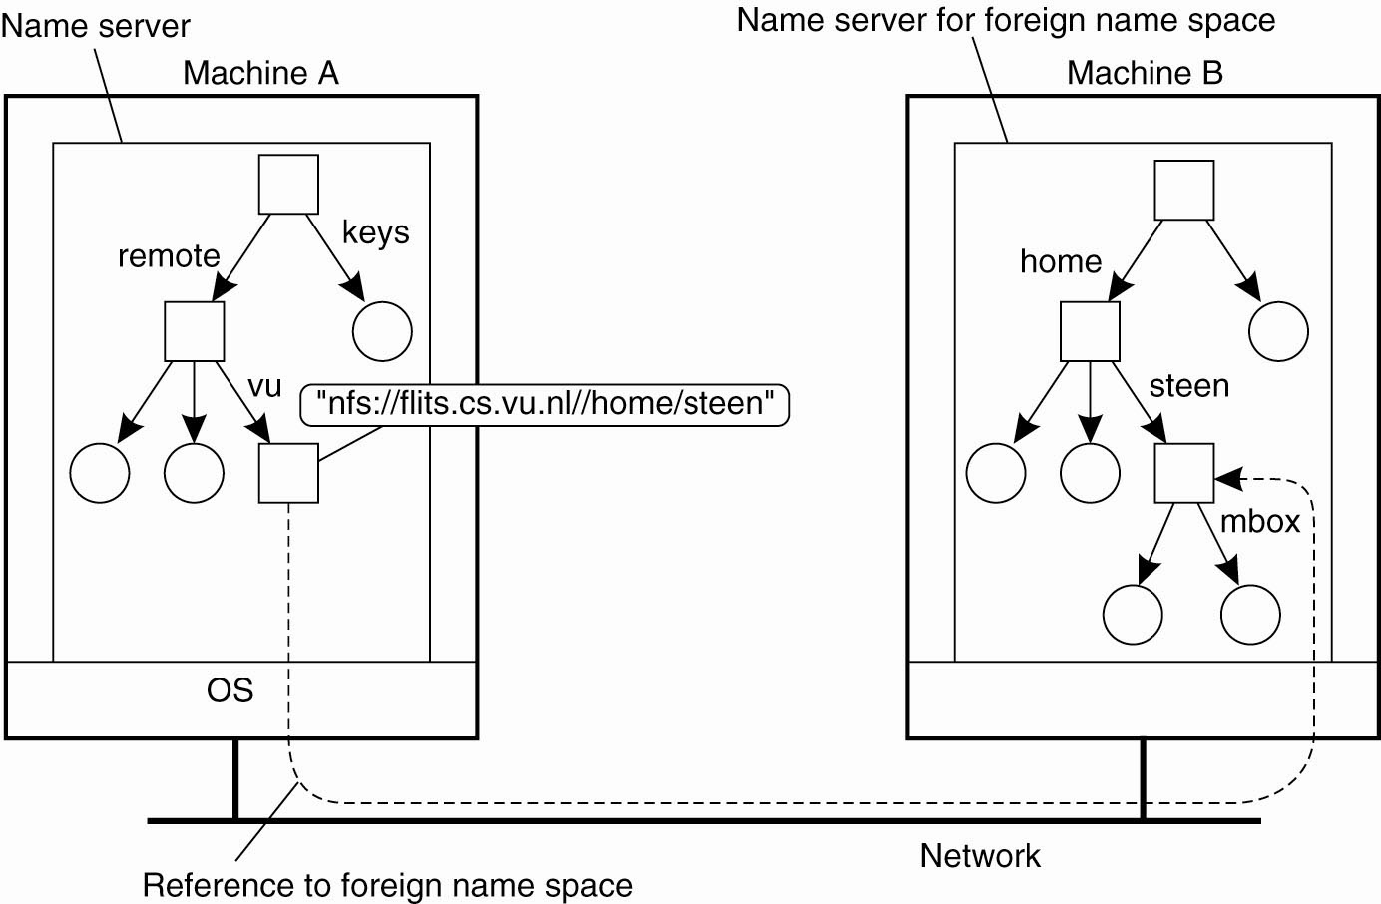
Linking and Mounting (2)
Figure 5-12. Mounting remote name spaces
through a specific access protocol.
Tanenbaum & Van Steen, Distributed Systems: Principles and Paradigms, 2e, (c) 2007 Prentice-Hall, Inc. All rights reserved. 0-13-239227-5

Slide 18
Linking and Mounting (3)
Merging Name Spaces
Mount point: (Directory) node in naming graph that refers to other naming graph
Mounting point: (Directory) node in other naming graph that is referred to.
Tanenbaum & Van Steen, Distributed Systems: Principles and Paradigms, 2e, (c) 2007 Prentice-Hall, Inc. All rights reserved. 0-13-239227-5

Slide 19
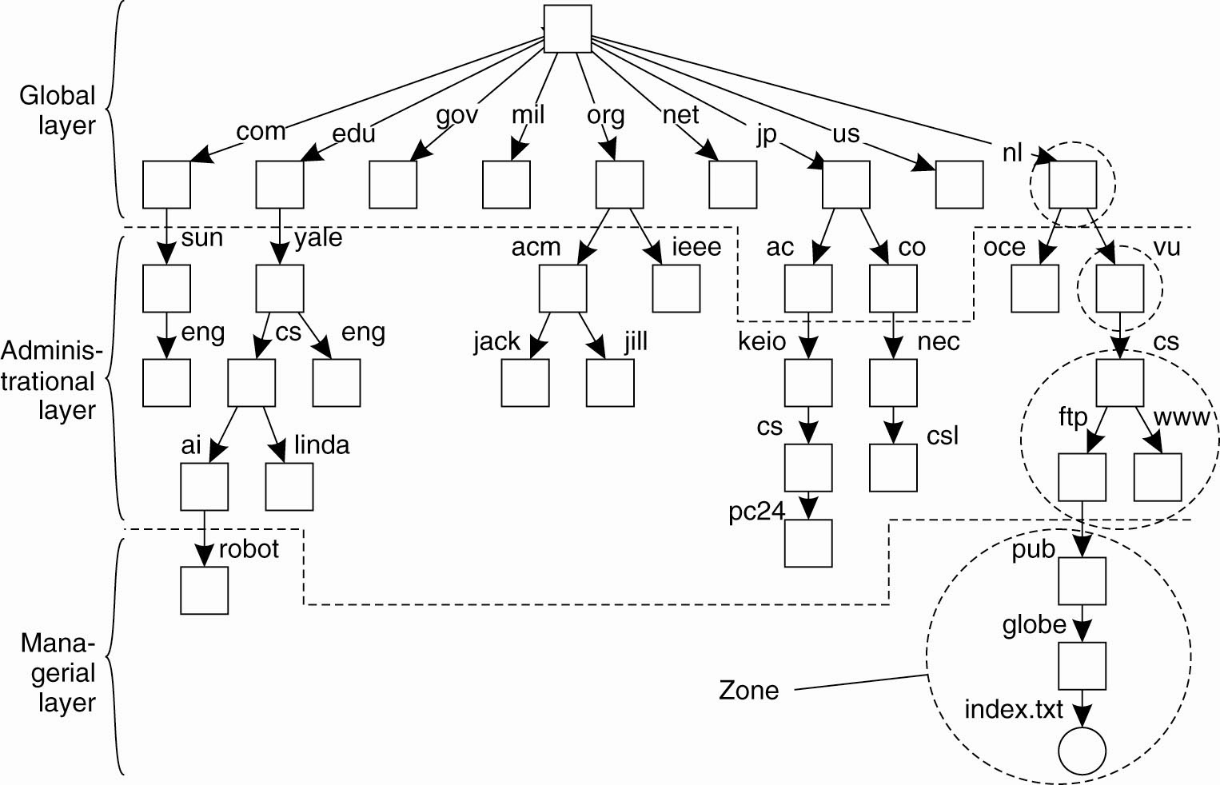
Name Space Distribution (1)
Figure 5-13. An example partitioning of the DNS name space, including Internet-accessible files, into three layers.
Tanenbaum & Van Steen, Distributed Systems: Principles and Paradigms, 2e, (c) 2007 Prentice-Hall, Inc. All rights reserved. 0-13-239227-5

Slide 20
Name Space Distribution (2)
Basic issue: Distribute name process & name space management across multiple machines by distributing nodes of the naming graph.
A hierarchical naming graph with three levels:
  Global level: Consists of the high-level directory nodes. These directory nodes have to be jointly managed by different administrations.
  Administrative level: Contains mid-level directory nodes that can be grouped in such a way that each group can be assigned to a separate administration.
  Managerial level: Consists of low-level directory nodes within a single administration. Main issue is effectively mapping directory nodes to local name servers.
Tanenbaum & Van Steen, Distributed Systems: Principles and Paradigms, 2e, (c) 2007 Prentice-Hall, Inc. All rights reserved. 0-13-239227-5

Slide 21
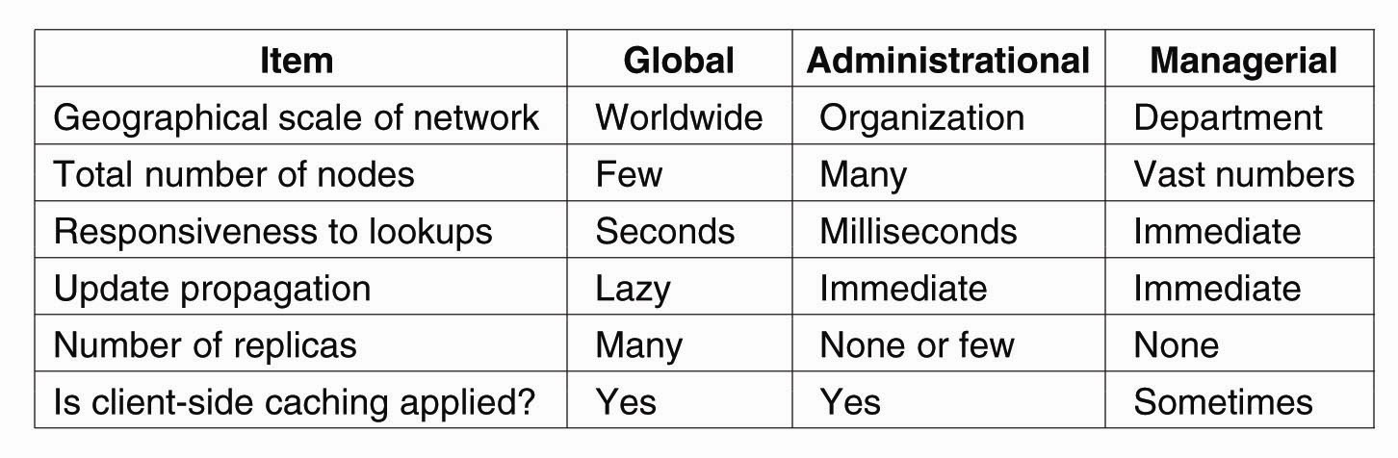
Name Space Distribution (2)
Figure 5-14. A comparison between name servers for implementing nodes from a large-scale name space partitioned into a global layer, an administrational
layer, and a managerial layer.
Tanenbaum & Van Steen, Distributed Systems: Principles and Paradigms, 2e, (c) 2007 Prentice-Hall, Inc. All rights reserved. 0-13-239227-5

Slide 22
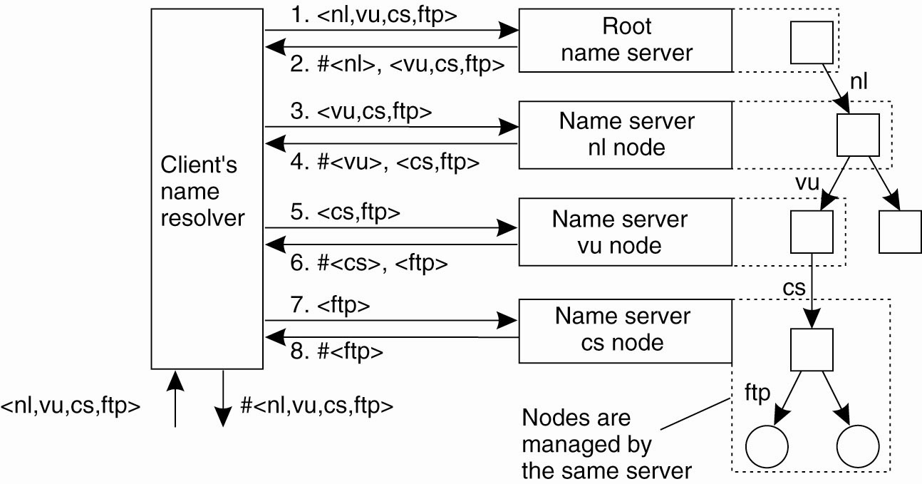
Implementation of Name Resolution (1)
Figure 5-15. The principle of iterative name resolution.
Tanenbaum & Van Steen, Distributed Systems: Principles and Paradigms, 2e, (c) 2007 Prentice-Hall, Inc. All rights reserved. 0-13-239227-5

Slide 23
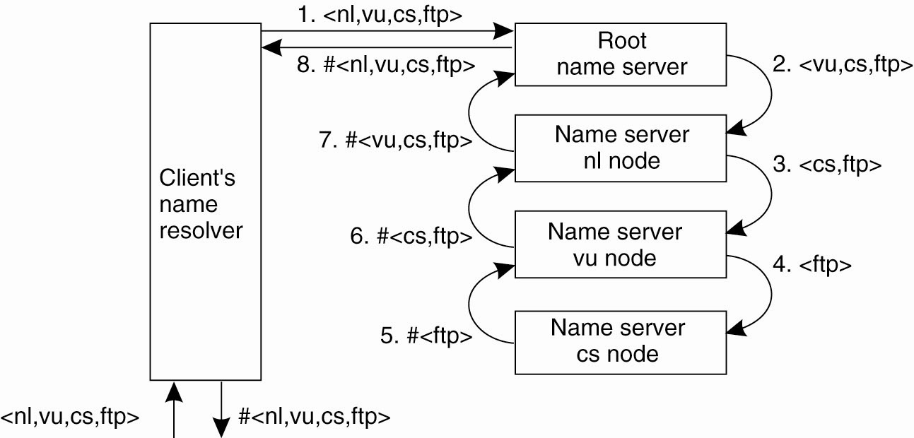
Implementation of Name Resolution (2)
Figure 5-16. The principle of recursive name resolution.
Tanenbaum & Van Steen, Distributed Systems: Principles and Paradigms, 2e, (c) 2007 Prentice-Hall, Inc. All rights reserved. 0-13-239227-5

Slide 24
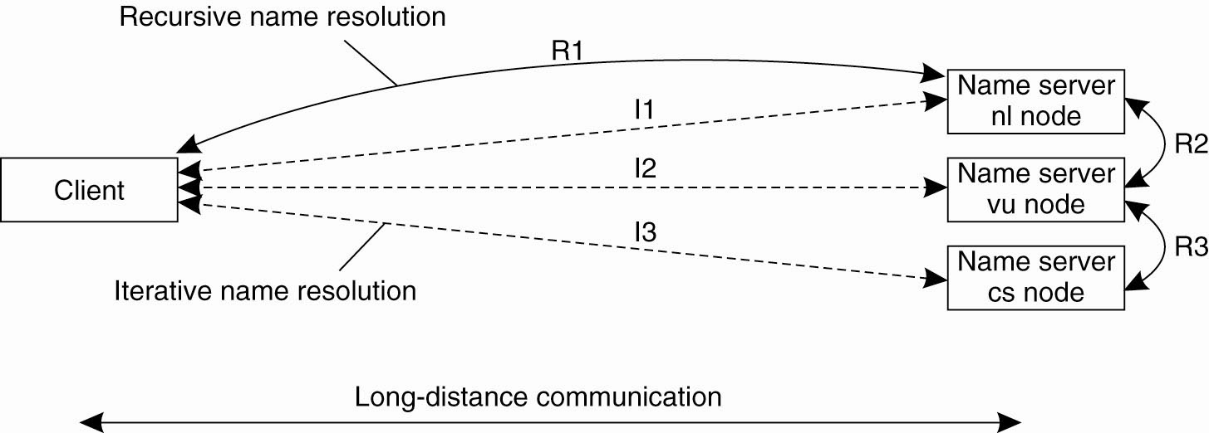
Example: The Domain Name System
Figure 5-18. The comparison between recursive and iterative name resolution with respect to communication costs.
Tanenbaum & Van Steen, Distributed Systems: Principles and Paradigms, 2e, (c) 2007 Prentice-Hall, Inc. All rights reserved. 0-13-239227-5

Slide 25
Scalability Issues (1)
Size scalability: Need to ensure servers can handle large number of requests per time unit
  high-level servers are in big trouble.
Solution: Assume that node content at global and administrative level rarely changes. Apply extensive replication by mapping nodes to multiple servers, and start name resolution at the nearest server.
Observation: An important attribute of many nodes is the address where the represented entity can be contacted. Replicating nodes makes large-scale traditional name servers unsuitable for locating mobile entities.
Tanenbaum & Van Steen, Distributed Systems: Principles and Paradigms, 2e, (c) 2007 Prentice-Hall, Inc. All rights reserved. 0-13-239227-5

Slide 26
Scalability Issues (2)
Geographical scalability: Need to ensure that name resolution process scales across large distances.
Problem: By mapping nodes to servers that may be located anywhere, we introduce implicit location dependency.
Solution: No general one available yet.
Tanenbaum & Van Steen, Distributed Systems: Principles and Paradigms, 2e, (c) 2007 Prentice-Hall, Inc. All rights reserved. 0-13-239227-5

Slide 27
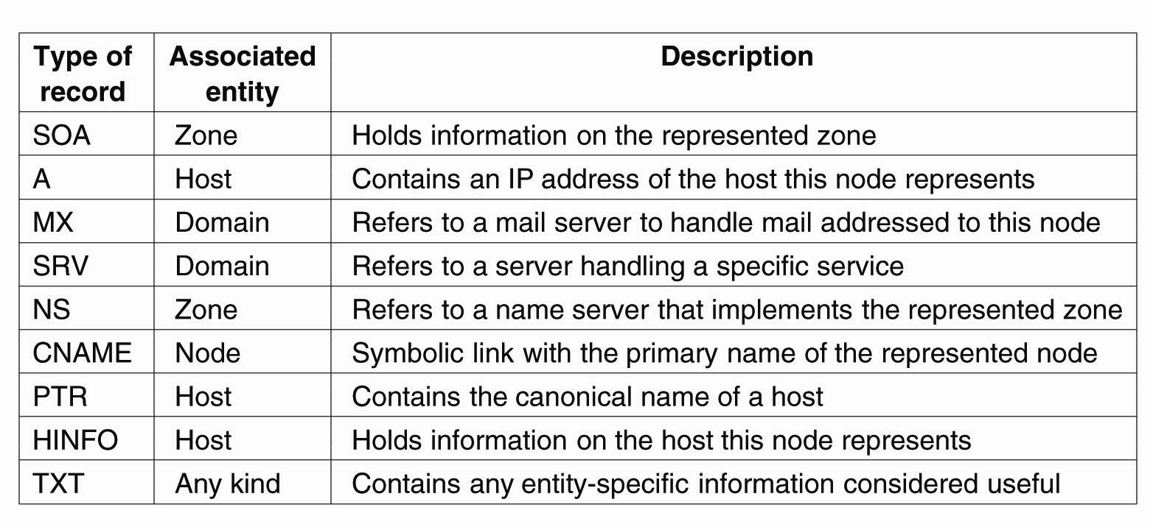
The DNS Name Space
Figure 5-19. The most important types of resource records forming the contents of nodes in the DNS name space.
Tanenbaum & Van Steen, Distributed Systems: Principles and Paradigms, 2e, (c) 2007 Prentice-Hall, Inc. All rights reserved. 0-13-239227-5

Slide 28
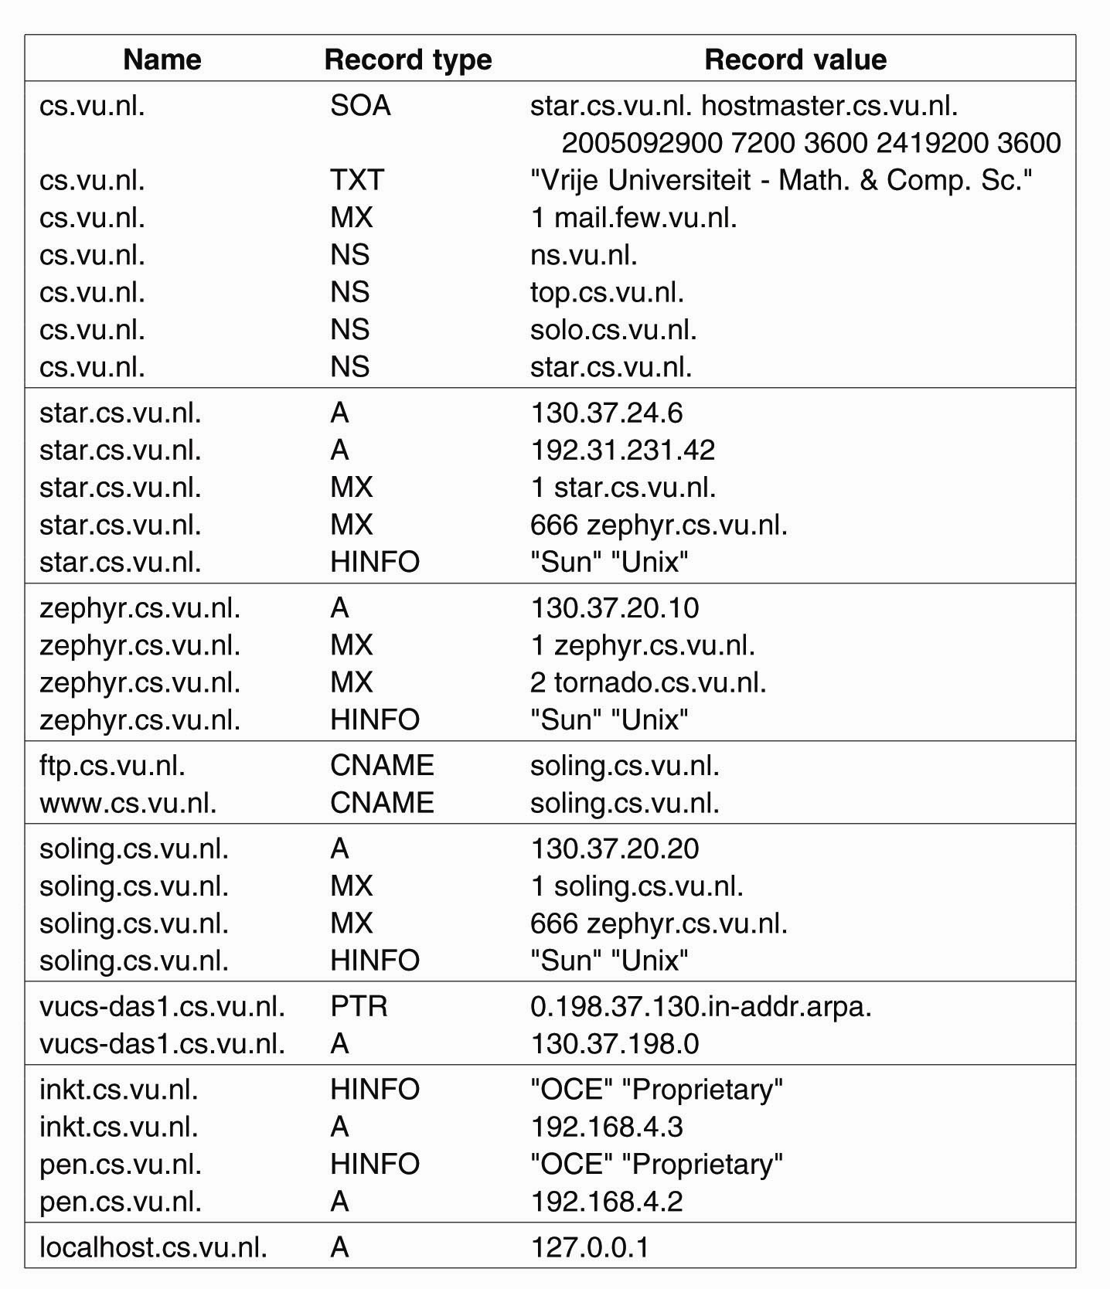
DNS Implementation (1)
Figure 5-20. An excerpt from the DNS
database for the zone cs.vu.nl.
Tanenbaum & Van Steen, Distributed Systems: Principles and Paradigms, 2e, (c) 2007 Prentice-Hall, Inc. All rights reserved. 0-13-239227-5

Slide 29
DNS Implementation (2)
Figure 5-20. An excerpt from the DNS
database for the zone cs.vu.nl.
Tanenbaum & Van Steen, Distributed Systems: Principles and Paradigms, 2e, (c) 2007 Prentice-Hall, Inc. All rights reserved. 0-13-239227-5

Slide 30
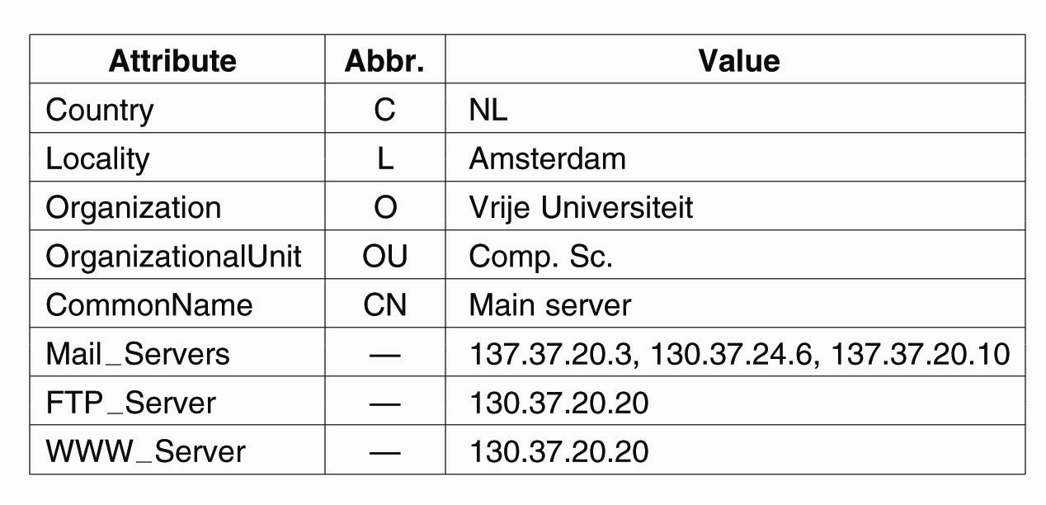
Hierarchical Implementations: LDAP (1)
Figure 5-22. A simple example of an LDAP
directory entry using LDAP naming conventions.
Tanenbaum & Van Steen, Distributed Systems: Principles and Paradigms, 2e, (c) 2007 Prentice-Hall, Inc. All rights reserved. 0-13-239227-5

Slide 31
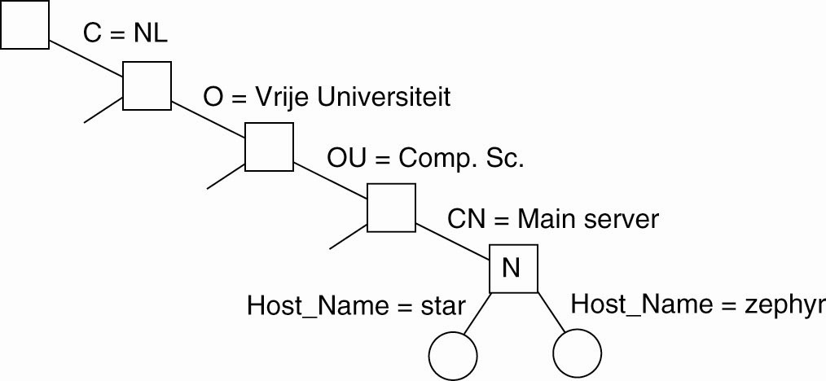
Hierarchical Implementations: LDAP (2)
Figure 5-23. (a) Part of a directory information tree.
Tanenbaum & Van Steen, Distributed Systems: Principles and Paradigms, 2e, (c) 2007 Prentice-Hall, Inc. All rights reserved. 0-13-239227-5

Slide 32
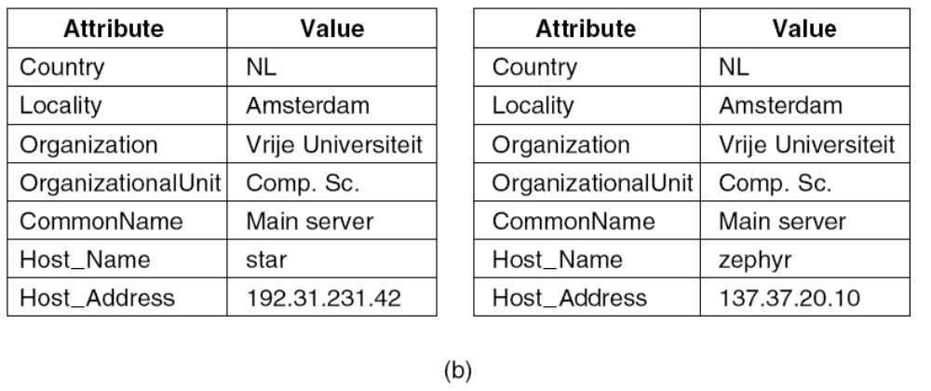
Hierarchical Implementations: LDAP (3)
Figure 5-23. (b) Two directory entries
having Host_Name as RDN.
Tanenbaum & Van Steen, Distributed Systems: Principles and Paradigms, 2e, (c) 2007 Prentice-Hall, Inc. All rights reserved. 0-13-239227-5

Slide 33
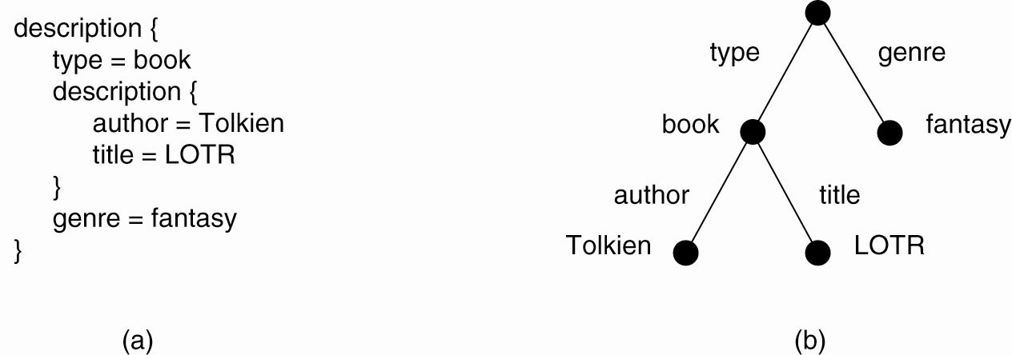
Mapping to Distributed Hash Tables (1)
Figure 5-24. (a) A general description of a resource.
(b) Its representation as an AVTree.
Tanenbaum & Van Steen, Distributed Systems: Principles and Paradigms, 2e, (c) 2007 Prentice-Hall, Inc. All rights reserved. 0-13-239227-5

Slide 34
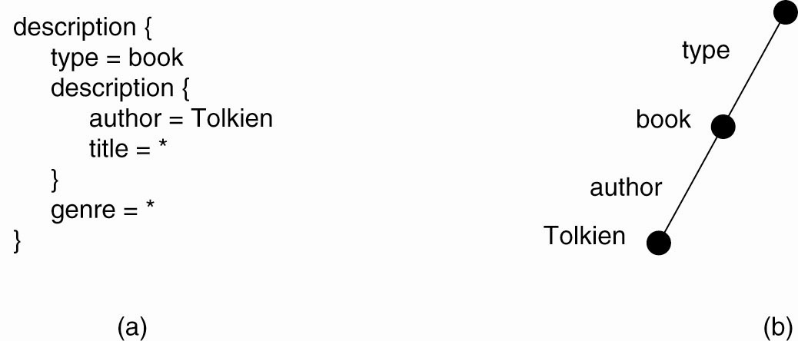
Mapping to Distributed Hash Tables (2)
Figure 5-25. (a) The resource description of a query.
(b) Its representation as an AVTree.
Tanenbaum & Van Steen, Distributed Systems: Principles and Paradigms, 2e, (c) 2007 Prentice-Hall, Inc. All rights reserved. 0-13-239227-5

Slide 35
UDDI
Universal Discovery Description and Integration
Can offer Web service without registering in UDDI
"Yellow Pages" of Web services.
Search for services needed
Tanenbaum & Van Steen, Distributed Systems: Principles and Paradigms, 2e, (c) 2007 Prentice-Hall, Inc. All rights reserved. 0-13-239227-5

Slide 36
UDDI
XML file that describes a business and the services it offers
Three parts to an entry
  “White pages" describe the company
  “Yellow pages" include industrial categories
  “Green pages" describe interface to service
Tanenbaum & Van Steen, Distributed Systems: Principles and Paradigms, 2e, (c) 2007 Prentice-Hall, Inc. All rights reserved. 0-13-239227-5

Slide 37
UDDI
Services defined by a Type Model
  AKA tModel
tModel may contain a WSDL file that describes a SOAP interface to a Web service
flexible enough to describe almost any kind of service
Tanenbaum & Van Steen, Distributed Systems: Principles and Paradigms, 2e, (c) 2007 Prentice-Hall, Inc. All rights reserved. 0-13-239227-5

Slide 38
UDDI
UDDI directory includes several ways to search
  providers of a service in a certain location
  business of a specified type
Directory will supply information, contacts, links, and technical data
Allows us to evaluate which services meet our requirements
Tanenbaum & Van Steen, Distributed Systems: Principles and Paradigms, 2e, (c) 2007 Prentice-Hall, Inc. All rights reserved. 0-13-239227-5

