Slide 1
Optimal Tutoring Service Location Search
Applied Data Science Capstone
IBM Data Science Professional Certificate
Summer 2018

Slide 2
Synopsis
Part 1: Problem Description
The idea is to find areas with the schools with the greatest enrolment as well as the fewest tutoring services offered nearby. The presence of schools signifies existence of clients, the lack of offered tutoring services a lack of competition for our prospective business owner. Additionally we consider schools with a lower percentage of low income families or a higher percentage of parents with university education as more valuable in the sense that it indicates that parents can afford the services.

Slide 3
Synopsis
Part 2: Data We Need
The data we will use is publicly available from the government of Ontario at https://www.ontario.ca/data/schoolinformation-and-student-demographics. It provides info about almost 5,000 schools all over ontario, most importantly their location coordinates and students enrolled. Using the location data along with foursquare, a venue search engine, it is possible to search for tutoring services near each of the schools.

Slide 4
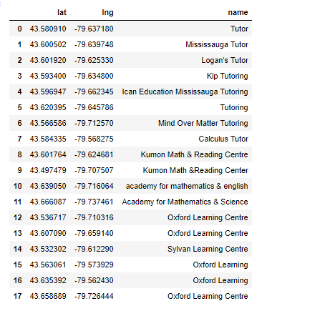
Synopsis
Part 2: Data We Need

Slide 5
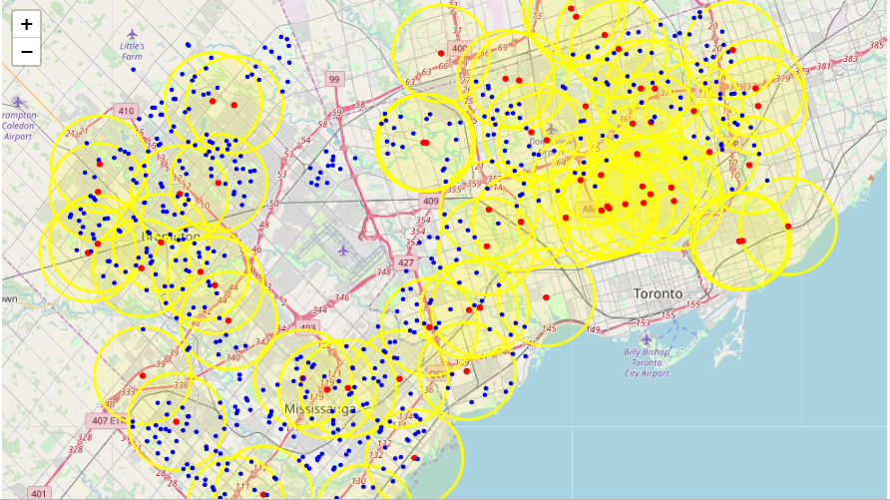
Main Article

Slide 6
Main Article
We define a naive measure of available students per school. This is calculated for each school by the following equation, the 1 in the denominator represents including our projected tutoring service, and the measure gives each nearby tutoring service an equal share of the enrolled students for the school.

Slide 7
Main Article
Part 3: Processing the Retrieved Data and Creating a DataFrome for All the Venues inside the Scarborough
When the data is completely gathered, we will perform processing on that raw data to find our desirable features for each venue. Our main feature is the category of that venue. After this stage, the column "Venue's Category" wil be One-hot encoded and different venues will have different feature-columns. After On-hot encoding we will integrate all restaurant columns to one column "Total Restaurants" and all food joint columns to "Total Joints" column.

Slide 8
Result
The clusters received reveal the schools with the least competition and highest available students. The areas interesting to us are the orange and green markers, orange markers are high enrolment schools:

Slide 9
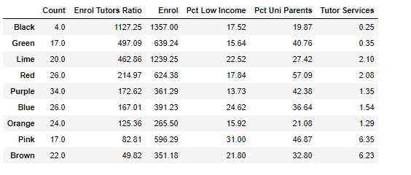

Slide 10
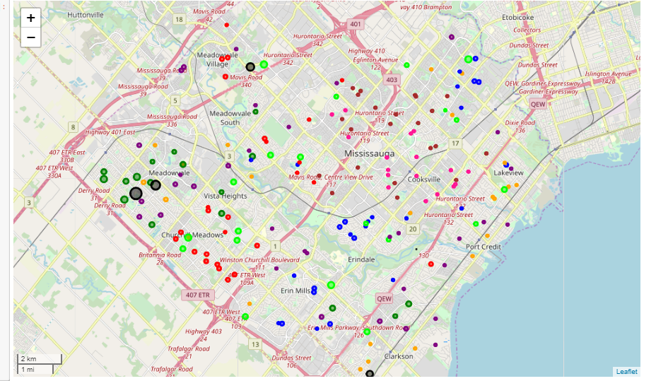
Main Article

Slide 11
Decision
This study was not taken as far as it could have been. There is much more data that can be used, for example the percentage of students who pass standardized tests. Additionally we are only considering three searches, for better success we may add more. We are also filtering said results manually and it could be automated.The biggest limitation in the study is our sole use of foursquare. More search engines could be applied to obtain a complete list of the nearby services.

Slide 12
CONCLUSION
The information the data yielded shows us mainly areas which seem unavailable. However there is one clearly optimal area towards the west side of Mississauga. The resulting adviced course of action is for our prospective business owner to establish their tutoring service west of Meadowvale

Slide 13
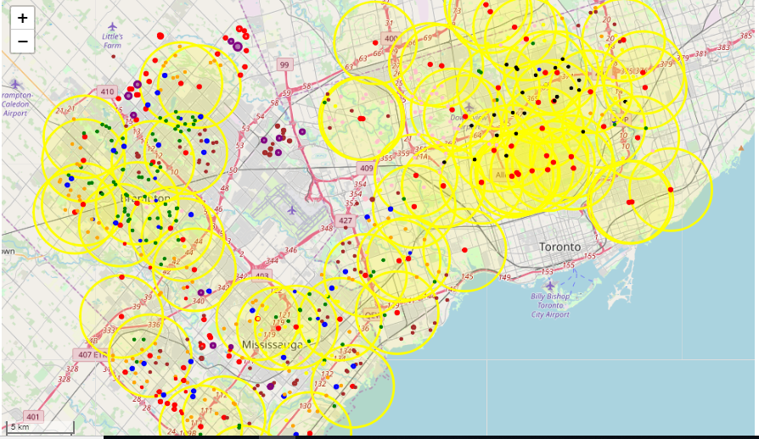

Slide 14


