Slide 1

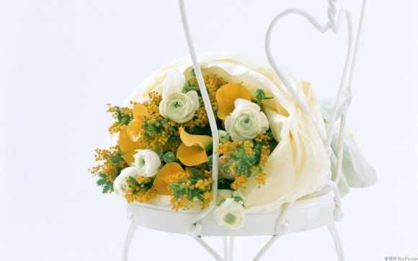

Dithering Project-2013
--Team Members--
Chang Guemsong
Kim Ryongbong
Moon Yoosung
Lee Chulhoon
Chae Yungshik

Slide 2

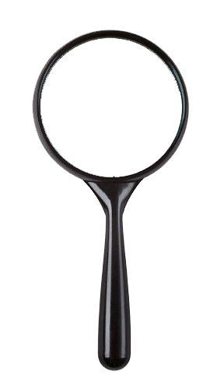



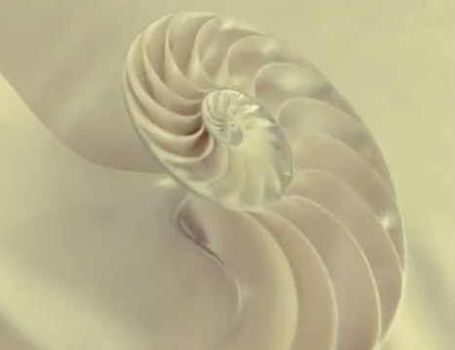
Brief Introduction
What is dithering?
How can we display various colors by using fixed numbers of colors? -> density of dots
Dithering works by approximating unavailable colors with available colors, by mixing and matching available colors in a way that mimics unavailable ones.

Slide 3
Brief Introduction
Simple formula:
Is the color value closer to 0 (black) or 255 (white)?
ex: gray value 96 is closer to 0 than 255,so turn to black.
But have a problem if we have a bunch of 96 gray pixels .
They all get turned to black.
Error diffusion takes a smarter approach to the problem.
Error diffusion works by diffusing or spreading the error of each calculation to neighboring pixels.
There are several error diffusion
algorithms such as Floyd-Steinberg Dithering,
Stucki, Atkinson, Burkes .
val ,if val < 255-val
Error =
val – 255 , otherwise

Slide 4
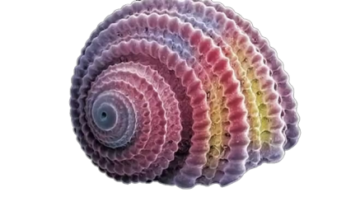
Our Surprising Works
Algorithms
We choose 3 algorithms and make one our own.
1. Floyd-Steinberg Dithering: 2. Burkes Dithering:
16
32
3. Sierra Dithering: 4.Our own:
16
16
x
7
x
8
4
3
5
1
2
4
8
4
2
x
4
1
x
4
3
3
4
3
1
2
3
2
1
1

Slide 5
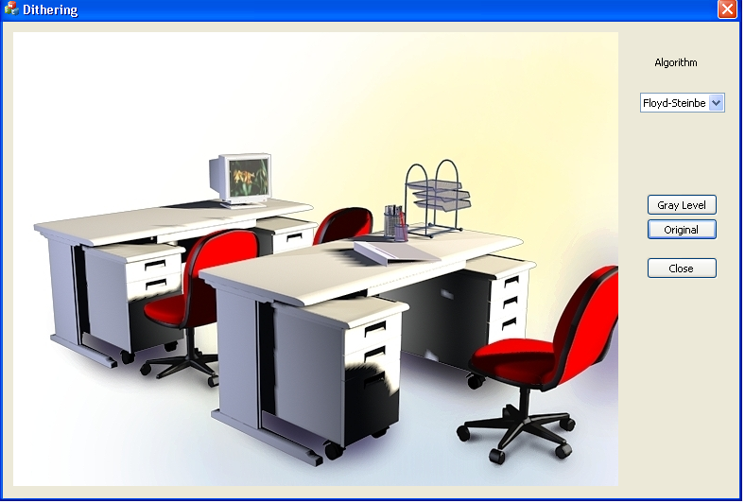
Our Surprising Works
Program tool
We use Visual C++ program because it is common , has good speed and supports various graphics.
Picture area
Choose the algorithms
Change the gray scale picture.
Show the origin RGB
image
Close the program.
Our Program interface

Slide 6
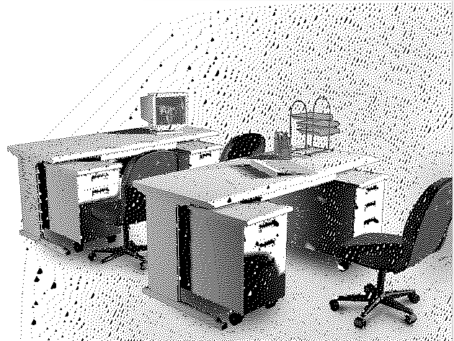
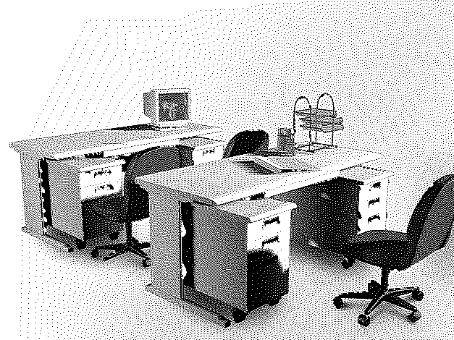
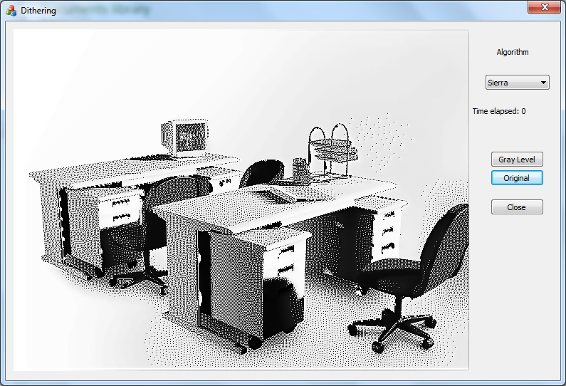

Dithering Project
Floyd-steihberg
Berkes
Sierra
Our Dithering

Slide 7
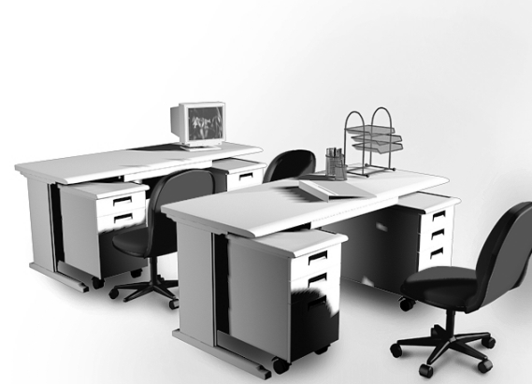
Our Surprising Works
Result images -1
Floyd-steihberg
Berkes
Gray Image
Pro: Fast & simple
Results not bad image
Pro: results good quality image.
Detailed borderlines.
Con: Many noises.
Big black &white lumps instead of small dots.
Con: still has noises.
some Diagonal line shapes.

Slide 8

Our Surprising Works
Result images -2
Sierra Dithering
Our Dithering
Gray Image
Pro: looks nice & not too many detailed dots
Pro: detailed borderlines & areas.
Con: not good for describing detailed color areas and borderlines
Con: has some noise parts.
And some diagonal dot lines.

Slide 9
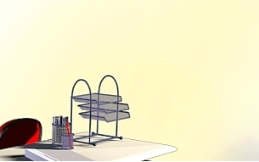
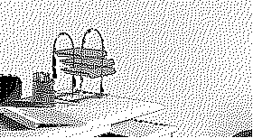
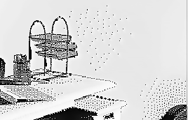


Our Surprising Works
Comparing our algorithm to others :
Our algorithm and Burkes are different , but the result images are similar each other.
Our algorithm describes more details than sierra.
RGB image more dots in yellow area(ours) less dots in yellow area(siera)
Borderline is more exact than Sierra.

Slide 10
void CDitheringDlg::OnCbnSelchangeComboAlgo()
{
CTime start;
int indx = m_algo.GetCurSel();
getGray();
if(indx == 0)
{
floyd_steinberg();
}else if(indx == 1){
sierra();
}else if(indx == 2){
burkes();
}else if(indx == 3){
myOwn();
}
CTime finish;
CString strTime;
strTime.Format(_T("Time elapsed: %ld"),(long)(finish.GetSecond() - start.GetSecond()));
m_time.SetWindowText(strTime);
OnPaint();
}

Slide 11
void CDitheringDlg::getGray()
{
COLORREF pxrgb;
int nI,nJ,avv;
CBitmap bitmap;
bitmap.LoadBitmap(IDB_BITMAP);
mDC->SelectObject(&bitmap);
for (nI = 0; nI < width; nI++)
for (nJ = 0; nJ < height; nJ++)
{
pxrgb = mDC->GetPixel(nI,nJ);
avv = (GetRValue(pxrgb) + GetGValue(pxrgb) + GetBValue(pxrgb)) / 3;
mDC->SetPixel(nI,nJ,RGB(avv,avv,avv));
}
}

Slide 12
void CDitheringDlg::floyd_steinberg(void)
{
for (nI = 1; nI < width - 1; nI++)
for (nJ = 1; nJ < height - 1; nJ++)
{
// for the current point
pxrgb = mDC->GetPixel(nI,nJ);
avv = GetRValue(pxrgb);
if(avv > 128){
err = avv - 255;
avv = 255;
}else{
err = avv;
avv = 0;
}
mDC->SetPixel(nI,nJ,RGB(avv,avv,avv));
ev = err << 1;
dv = err;
neighbour = mDC->GetPixel(nI + 1,nJ + 1);
pv = GetRValue(neighbour) + (dv >> 4);
mDC->SetPixel(nI + 1,nJ + 1,RGB(pv,pv,pv));

Slide 13
neighbour = mDC->GetPixel(nI + 1,nJ - 1);
pv = GetRValue(neighbour) + (dv >> 4);
mDC->SetPixel(nI + 1,nJ - 1,RGB(pv,pv,pv));
dv += ev;
neighbour = mDC->GetPixel(nI + 1,nJ);
pv = GetRValue(neighbour) + (dv >> 4);
mDC->SetPixel(nI + 1,nJ,RGB(pv,pv,pv));
dv += ev;
neighbour = mDC->GetPixel(nI,nJ + 1);
pv = GetRValue(neighbour) + (dv >> 4);
mDC->SetPixel(nI,nJ + 1,RGB(pv,pv,pv));
}
}

Slide 14
Other functions
void CDitheringDlg::burkes(void)
void CDitheringDlg::sierra(void)
void CDitheringDlg::myOwn(void)

Slide 15
for (nI = 1; nI < width - 1; nI++)
for (nJ = 2; nJ < height - 2; nJ++)
{
// for the current point
pxrgb = mDC->GetPixel(nI,nJ);
avv = GetRValue(pxrgb); // all channels are same
if(avv > 128){
err = avv - 255;
avv = 255;
}else{
err = avv;
avv = 0;
}
mDC->SetPixel(nI,nJ,RGB(avv,avv,avv));
ev = err;
dv = err; // err X 1
neighbour = mDC->GetPixel(nI,nJ + 2);
pv = GetRValue(neighbour) + (dv >> 4);
mDC->SetPixel(nI,nJ + 2,RGB(pv,pv,pv));
neighbour = mDC->GetPixel(nI + 2,nJ);
pv = GetRValue(neighbour) + (dv >> 4);
mDC->SetPixel(nI + 2,nJ,RGB(pv,pv,pv));
neighbour = mDC->GetPixel(nI + 1,nJ + 2);
pv = GetRValue(neighbour) + (dv >> 4);
mDC->SetPixel(nI + 1,nJ + 2,RGB(pv,pv,pv));

Slide 16
dv += ev << 1; // err X 3
neighbour = mDC->GetPixel(nI + 1,nJ - 1);
pv = GetRValue(neighbour) + (dv >> 4);
mDC->SetPixel(nI + 1,nJ - 1,RGB(pv,pv,pv));
neighbour = mDC->GetPixel(nI + 1,nJ);
pv = GetRValue(neighbour) + (dv >> 4);
mDC->SetPixel(nI + 1,nJ,RGB(pv,pv,pv));
neighbour = mDC->GetPixel(nI,nJ + 1);
pv = GetRValue(neighbour) + (dv >> 4);
mDC->SetPixel(nI,nJ + 1,RGB(pv,pv,pv));
dv = ev << 2; // err X 4
neighbour = mDC->GetPixel(nI + 1,nJ + 1);
pv = GetRValue(neighbour) + (dv >> 4);
mDC->SetPixel(nI + 1,nJ + 1,RGB(pv,pv,pv));

Slide 17
Dithering Project
Thank you!!!

