Slide 1

Build a Basic LED Circuit
Program an LED Light Show

Slide 2
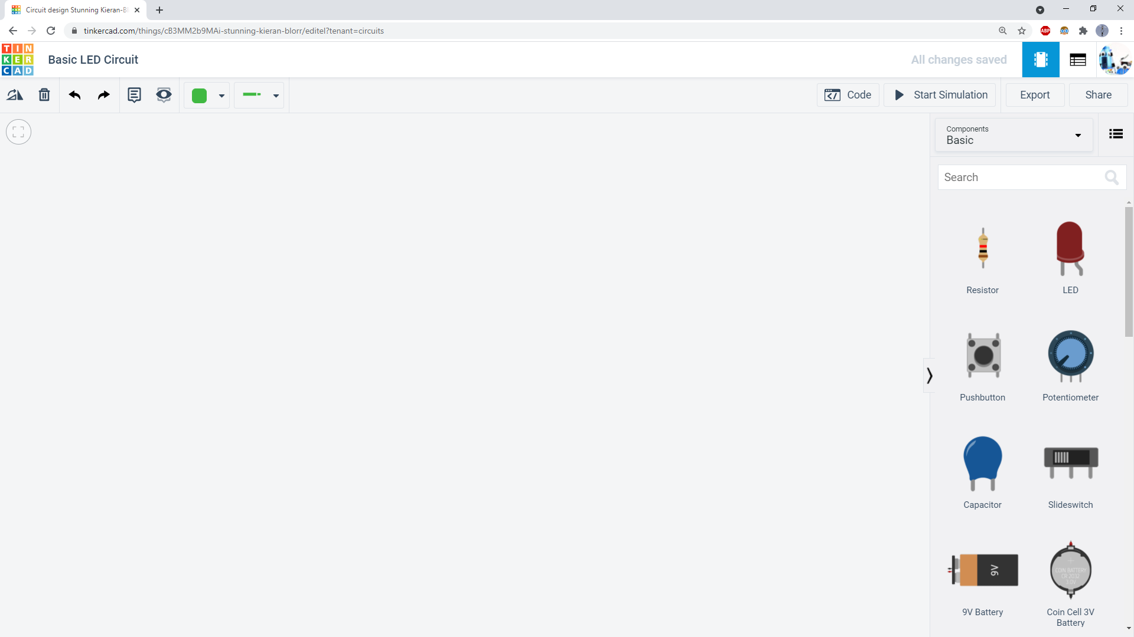
Click and drag parts from the components list into the circuit area.

Slide 3
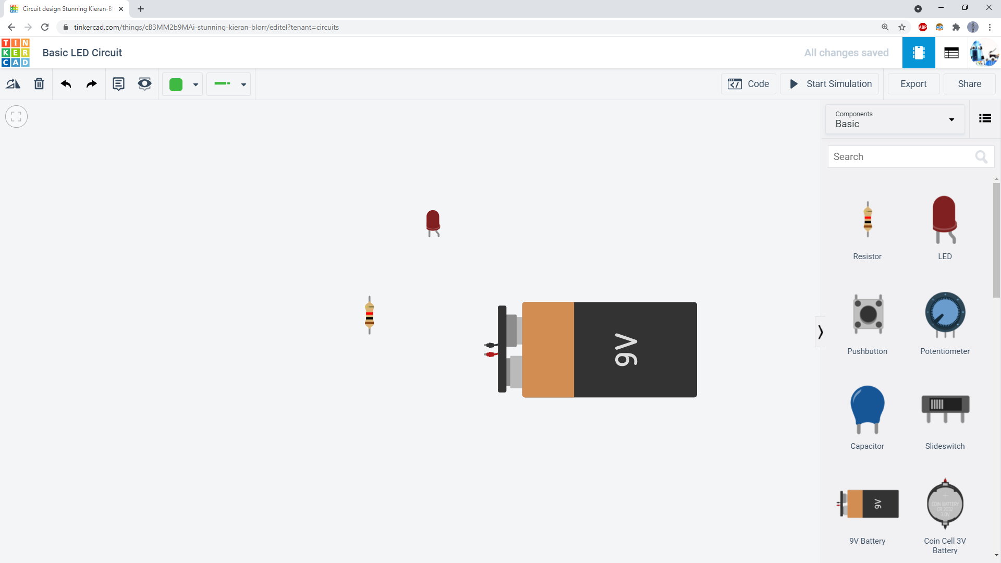
Add a 9V battery, a resistor, and an LED.

Slide 4
Add a 9V battery, a resistor, and an LED. The resistor is an important part that prevents too much electrical current from flowing through the LED and burning it out.

Slide 5
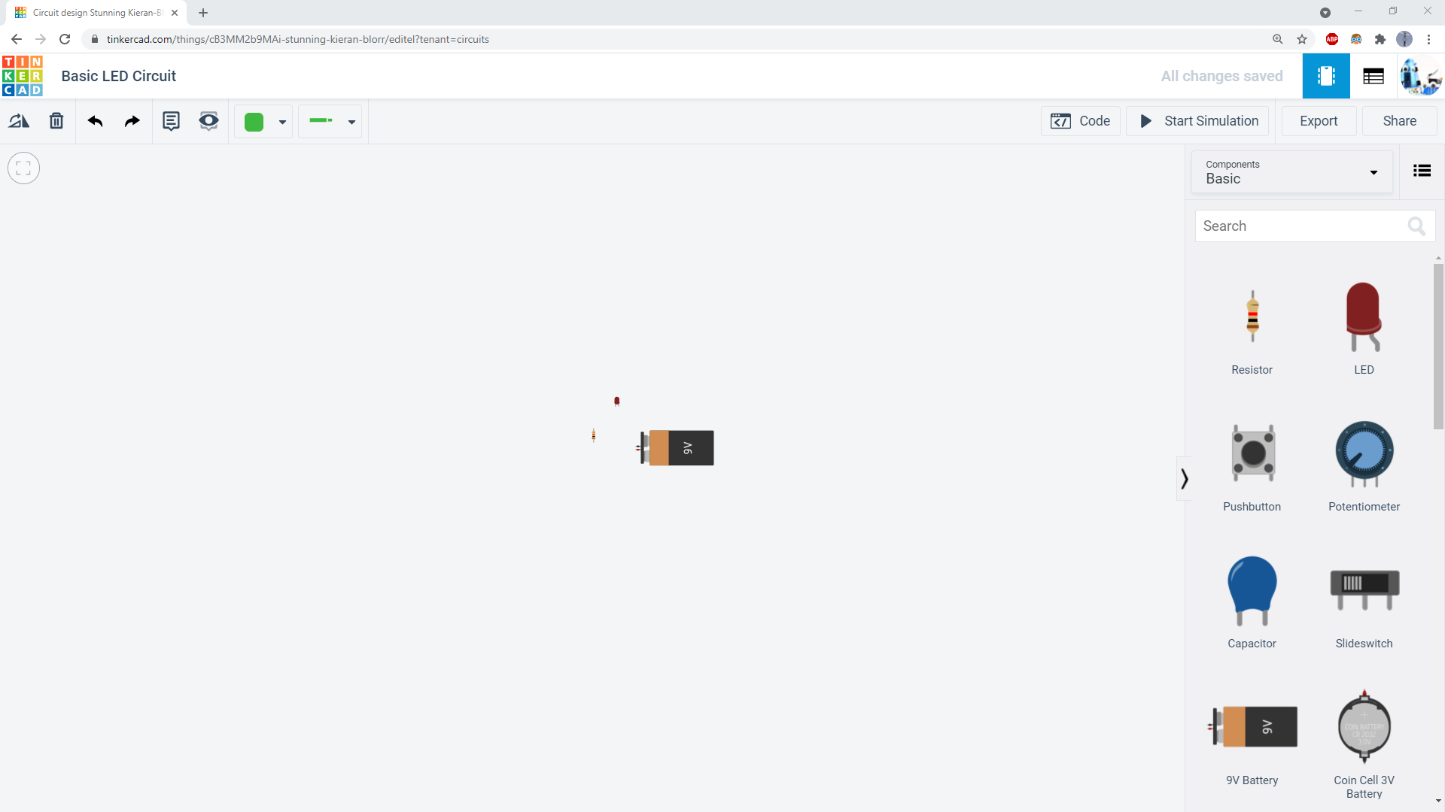
Use your mouse wheel to zoom in and out. Click and drag on a blank area to pan your view. If you get lost and can’t find your circuit, click the “Zoom to fit” button.

Slide 6
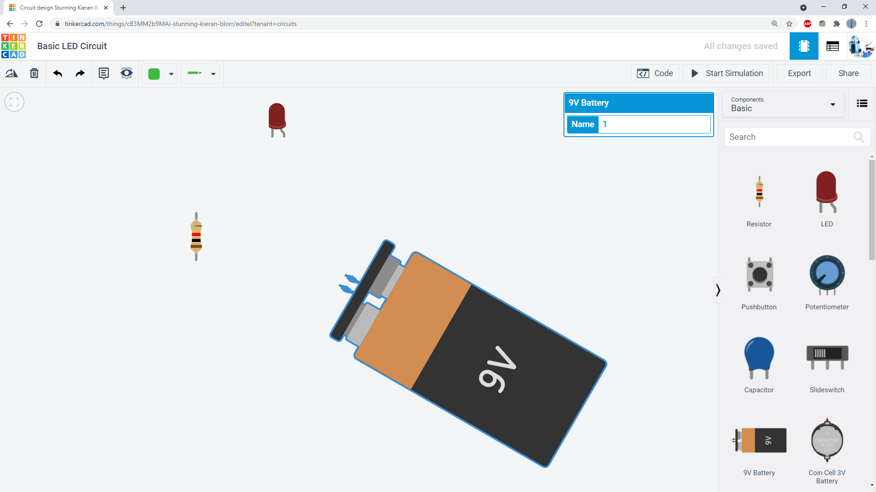
Select a part, then click the “rotate” button to rotate it. Click and drag on parts to move them.

Slide 7
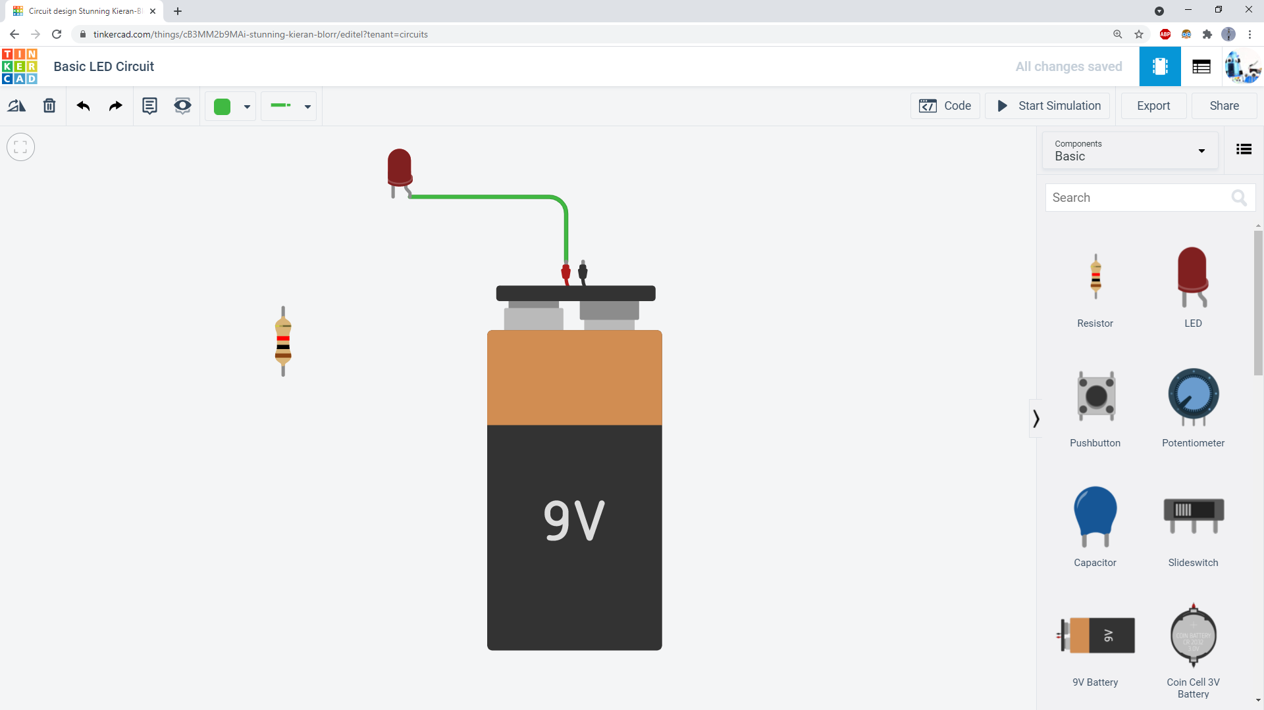
2. Click again to create a bend point in the wire
3. Click on another component’s terminal to end the wire.
1. Click on a component’s terminal to start a wire.

Slide 8
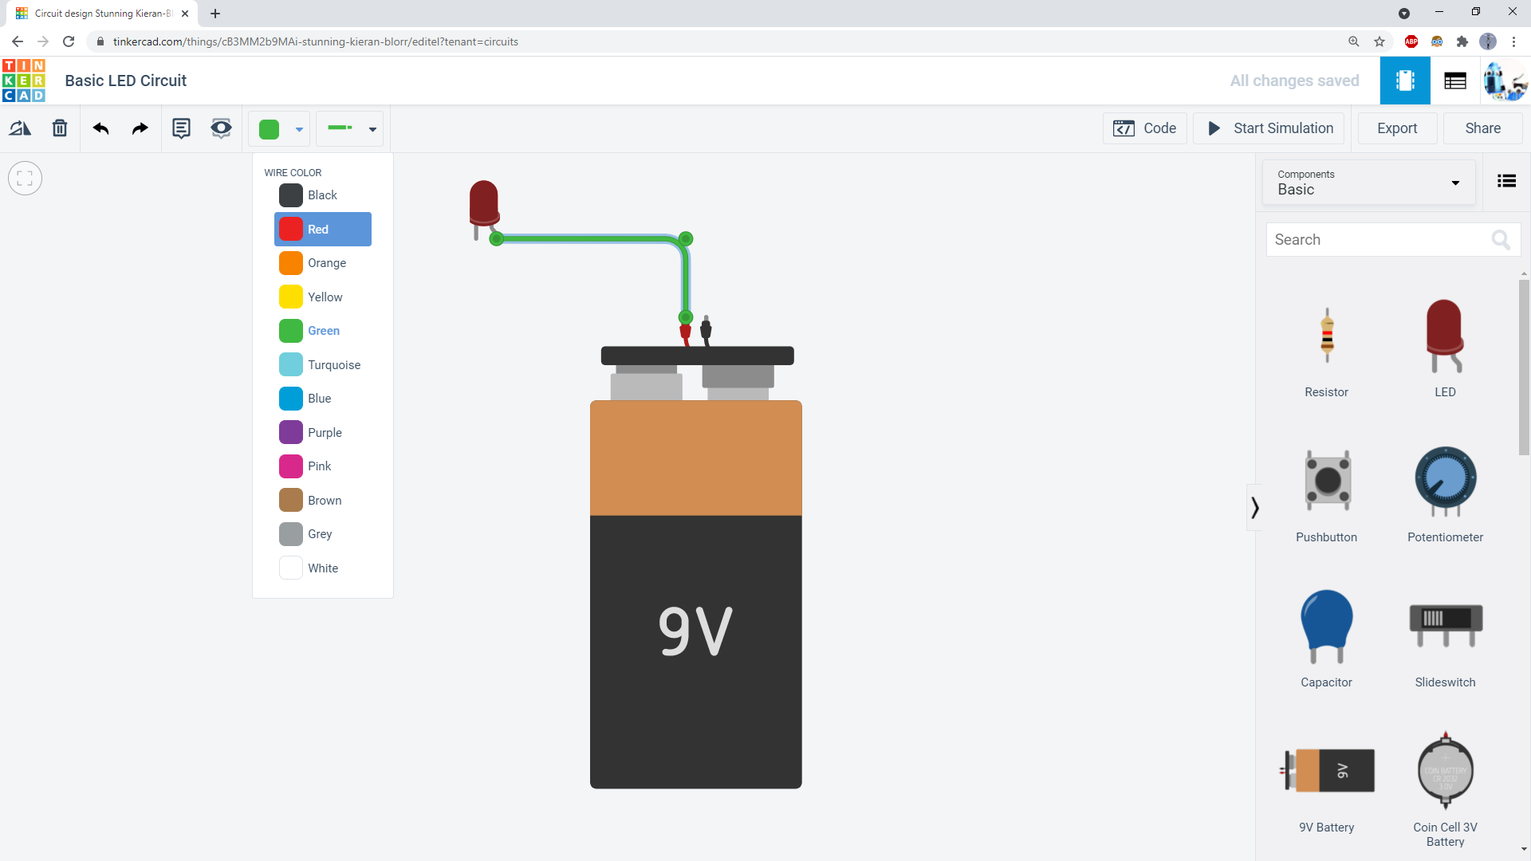
Select the wire, then use this drop-down menu to change the wire’s color.

Slide 9
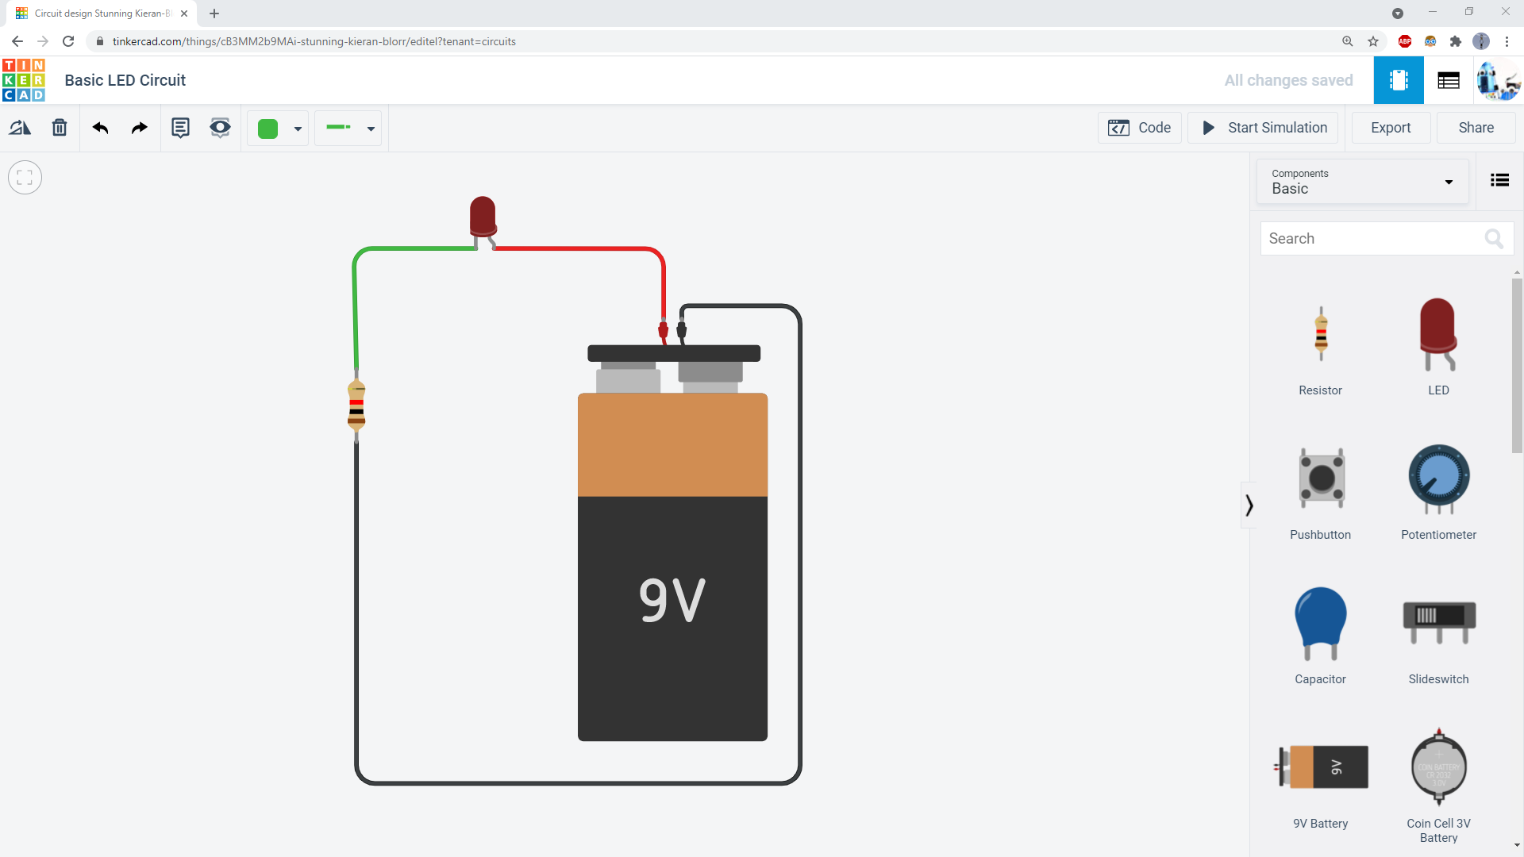
Connect wires so your circuit looks like this. This is called a series circuit.
In electronics, we usually use red wires for positive and black wires for negative.
It is important to use neat, color-coded wiring so your circuit is not messy.

Slide 10
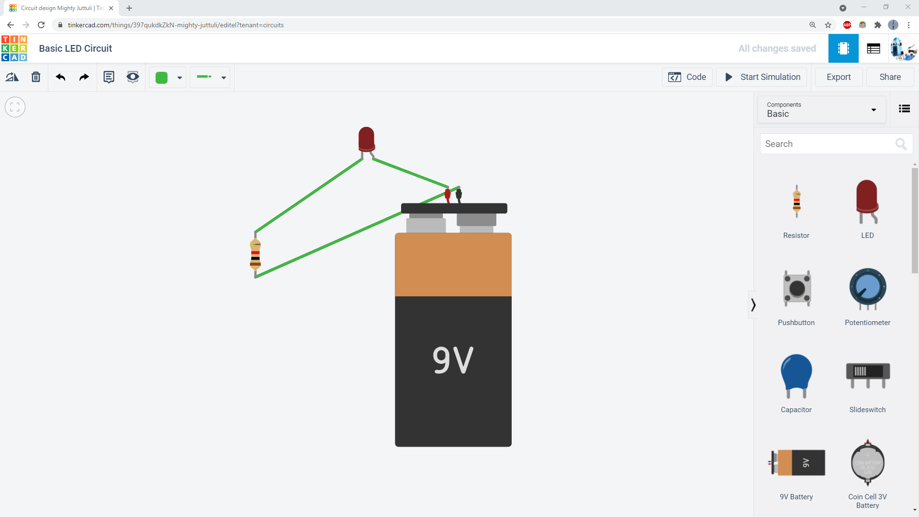
This is an example of bad wiring. Technically, this circuit will work. But all the wires are the same color and they criss-cross each other. Wiring like this makes it harder to “debug,” or find problems when you build more complex circuits.

Slide 11
Click the “Start Simulation” button…

Slide 12
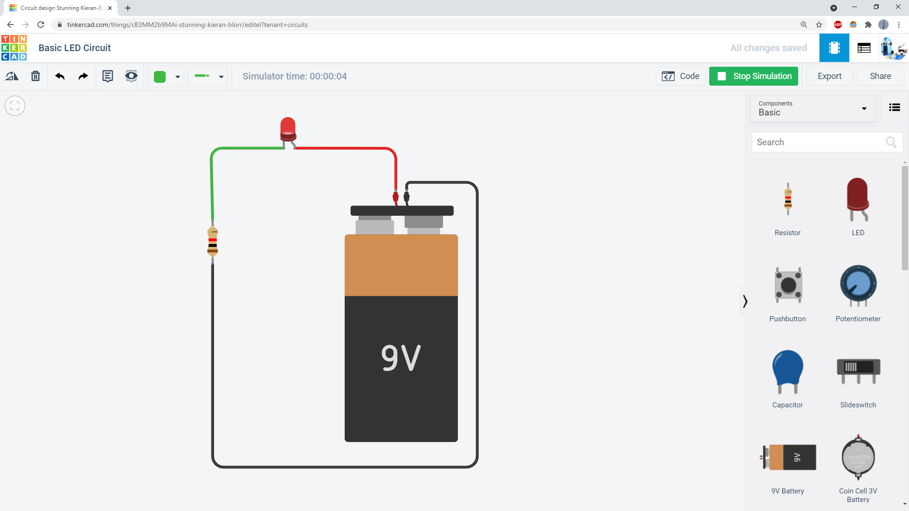
…and your LED should light up!

Slide 13
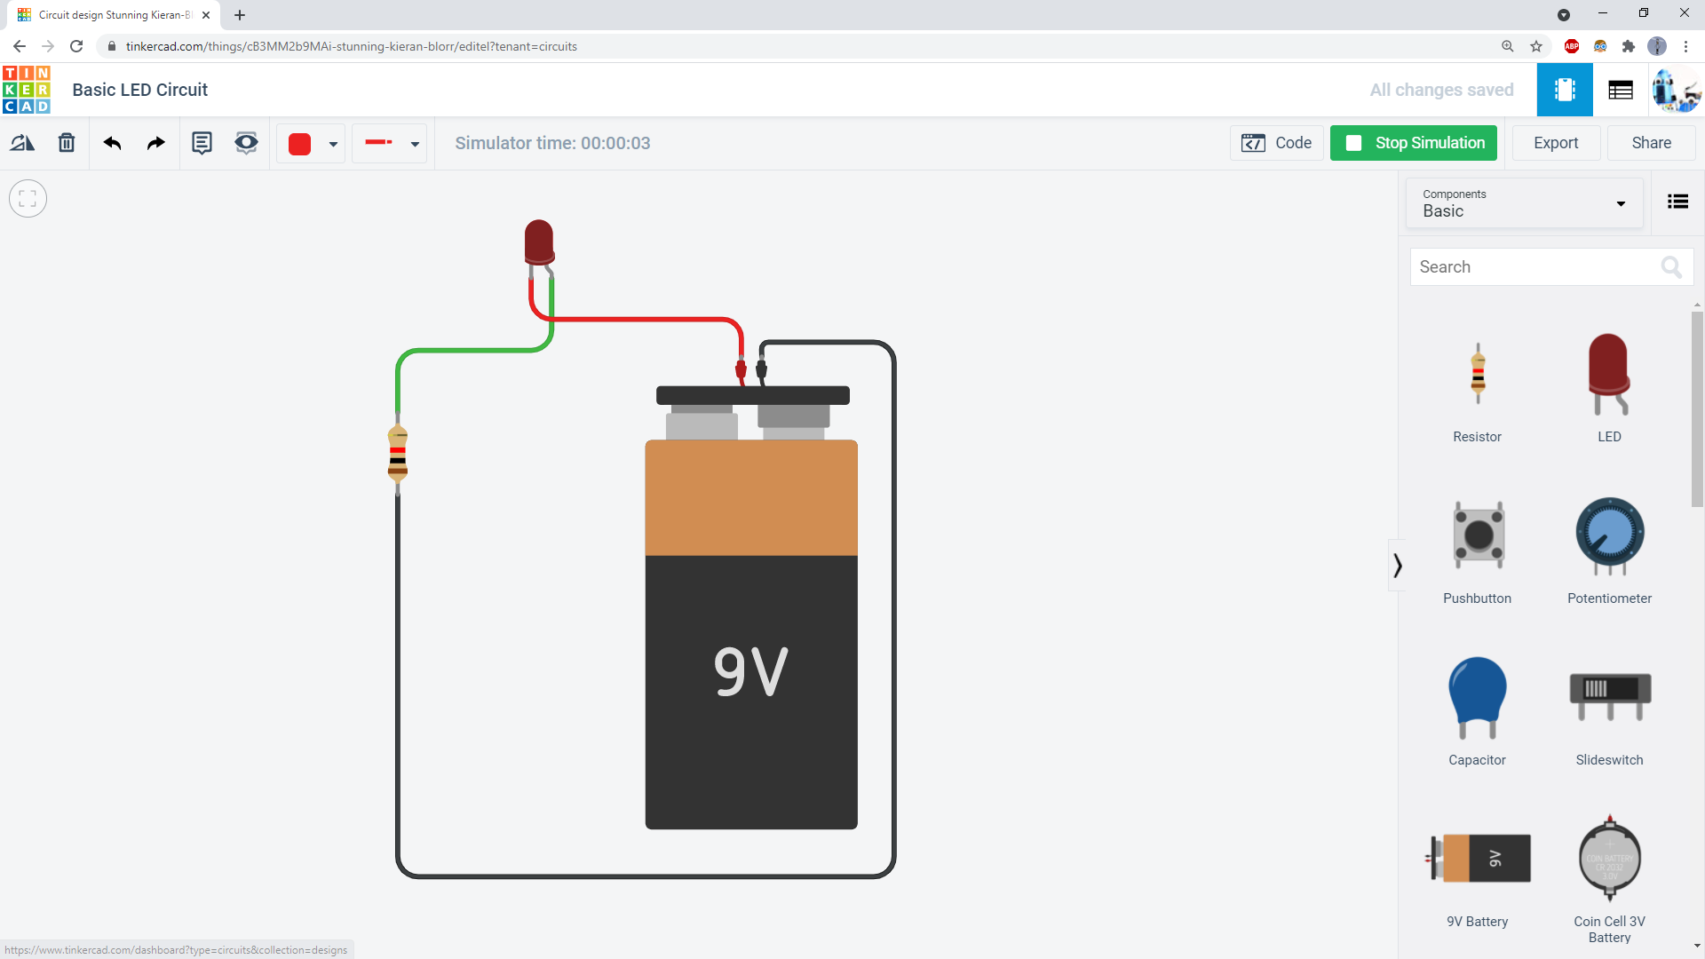
If your LED does not light up, make sure you have the longer (bent) leg of the LED connected to the red terminal of the battery.
LEDs have polarity, meaning they only work in one direction. The LED will not light up if it is wired backwards.
A single misplaced or missing wire can prevent your whole circuit from working! Always double-check your wiring if your circuit does not work.
Incorrect wiring

Slide 14
Attribution und Quellen
Diese Folien basieren auf Material, was von der Firma Autodesk auf folgender Webseite für Lehrende zur Verfügung gestellt wird:
https://www.tinkercad.com/teach
Für diese Folien gilt deshalb nicht die Attribution-ShareAlike 3.0 Unported
Lizenz, sondern die jeweiligen Regelungen der Firma Autodesk auf der oben genannten Seite.

