Slide 1

Registers
Program an LED Light Show

Slide 2
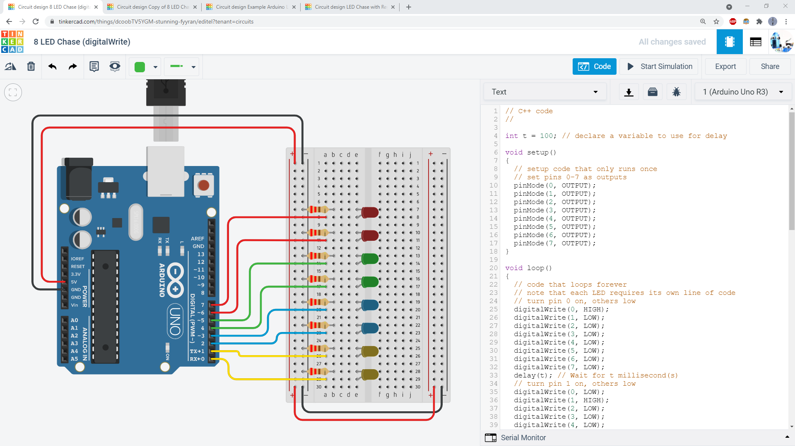
Using pinMode() and digitalWrite() to control LEDs requires one line of code per pin. This means a LOT of code for complicated animations and circuits with lots of LEDs.

Slide 3
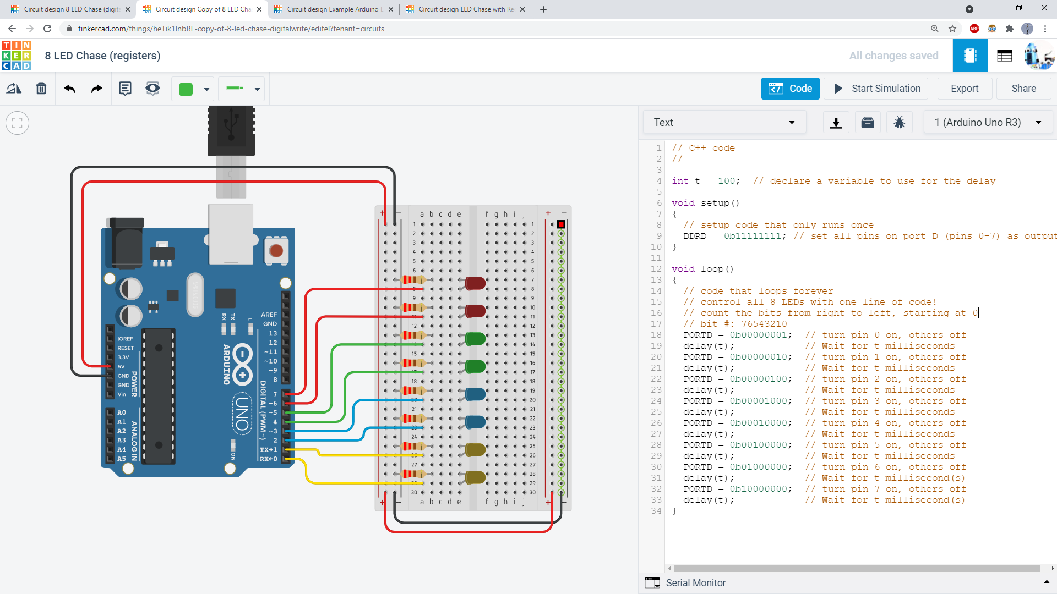
You can use registers to control 8 LEDs with a single line of code! This makes programming LED patterns much easier.

Slide 4
Each register has 8 bits:
Each bit can be 0 or 1.
7
6
5
4
3
2
1
0
Bit 7
Bit 0
Count the bits from right to left, starting at 0.

Slide 5
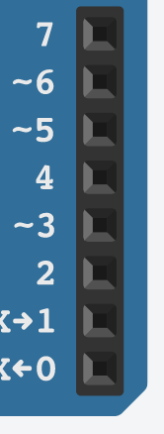
The bits in the register correspond to physical pins on the Arduino:
Bit 7
Bit 6
Bit 5
Bit 4
Bit 3
Bit 2
Bit 1
Bit 0
(We will talk about pins 8-13 a little later.)

Slide 6
The DDRD register replaces the pinMode() command.
Setting a bit to 1 sets the pin as an output.
Setting a bit to 0 sets the pin as an input.
For example:
DDRD = 0b11111111;
This line of code sets pins 0-7 as outputs.
Note: the “0b” tells the Arduino that this number is in binary.

Slide 7
The PORTD register replaces the digitalWrite() command.
Setting a bit to 1 sets the pin HIGH.
Setting a bit to 0 sets the pin LOW.
For example:
PORTD = 0b10000000;
This line of code sets pin 7 high and all the other pins low.

Slide 8
You can now shrink eight lines of code into a single line!
pinMode(0, OUTPUT);
pinMode(1, OUTPUT);
pinMode(2, OUTPUT);
pinMode(3, OUTPUT);
pinMode(4, OUTPUT);
pinMode(5, OUTPUT);
pinMode(6, OUTPUT);
pinMode(7, OUTPUT);
DDRD = 0b11111111;
digitalWrite(0, HIGH);
digitalWrite(1, LOW);
digitalWrite(2, LOW);
digitalWrite(3, LOW);
digitalWrite(4, LOW);
digitalWrite(5, LOW);
digitalWrite(6, LOW);
digitalWrite(7, LOW);
PORTD = 0b10000000;

Slide 9
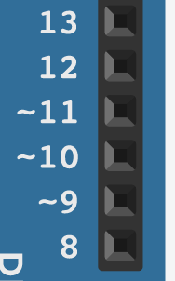
But what about Arduino pins 8-13?
?

Slide 10
They are controlled by the DDRB and PORTB registers.
DDRB: set pin mode (input or output)
PORTB: set pin high or low if it’s an output

Slide 11
But be careful – the bit numbers in the registers do not match up to the Arduino pin numbers! This can be confusing, so it’s easier to work with pins 0-7 when you are first learning to use registers.
Bit 5
Bit 4
Bit 3
Bit 2
Bit 1
Bit 0
For example, these two lines of code would set all the pins as outputs, then set pin 13 (bit 5) high:
DDRB = 0b00111111;
PORTB = 0b00100000;

