Slide 1
Tetris
By-
Kanwarpal singh
Simarjit kaur
Nitisha kalra
Gaurav kumar

Slide 2
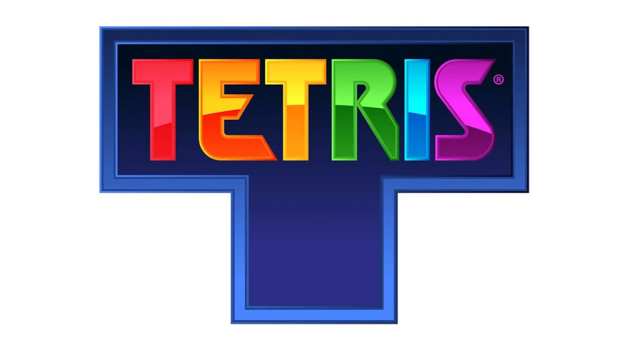

Slide 3
Online Gaming
An online game is a video game that is either partially or primarily played through the Internet or any other computer network available. Online games are ubiquitous on modern gaming platforms.

Slide 4
The design of online games can range from simple text-based environments to the incorporation of complex graphics and virtual worlds. Many online games create their own online communities, while other games, especially social games, integrate the players' existing real-life communities

Slide 5
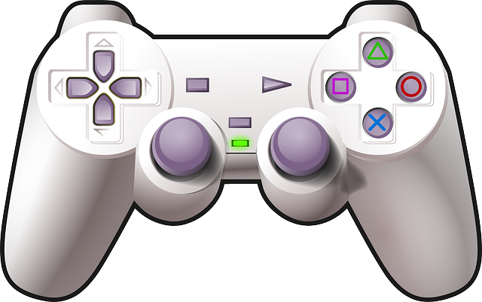

Slide 6
Description
The game has a simple goal of destroying lines of block before it reaches the top. The line is made up of a square block.
The player will have to use the Tetrominoes to create lines that fill the box horizontally.
The game has levels of difficulties which rises as the game is being played.

Slide 7
When the goal number reaches zero, the player moves to the next level. As the levels go up, the tetrominoes fall faster.

Slide 8
Features
THE USER :
Start:- When the user starts the game, a block appears, now he has the control over the block.
Move Block:- The user can move the block towards left or right in order to create the best structure possible.
Flip Block:- The user can flip the block
Pause:- The user can pause the game and has the feature of Resume to continue with the game again.
Quit:- The user can quit the game whenever he wants to.

Slide 9
The System
Calculate Score:- The System can calculate the score when the row is filled up using the incrementor when the above stated condition is satisfied.
Delete Row :- The system can Delete the row when it gets filled up .7
Finish Game :- The system will finish the game when the row gets filled up vertically .
Generate High Score :- As there is no winner , the system will generate high score.

Slide 10
Challenges
As we were new to javascript, it was difficult for us to begin and gain the concepts .
Eventually , by watching the videos and taking help from the fellow colleagues we were able to get through it.
Also , getting together for creating the project by 4 of us was also a challenge because of the different availabilities of our team members.

Slide 11

Why Tetris

Slide 12
The process of learning something new should always start with easy and something we already know.
Tetris is a game that we have grown up playing. We all like it and that’s what was common among us.
So we chose this game to bring in a little fun while learning a new technology, so that we continue learning and don’t get bored of it.

Slide 13
Technologies used
In this game, the technologies used are:
JAVASCRIPT
HTML
CSS

Slide 14
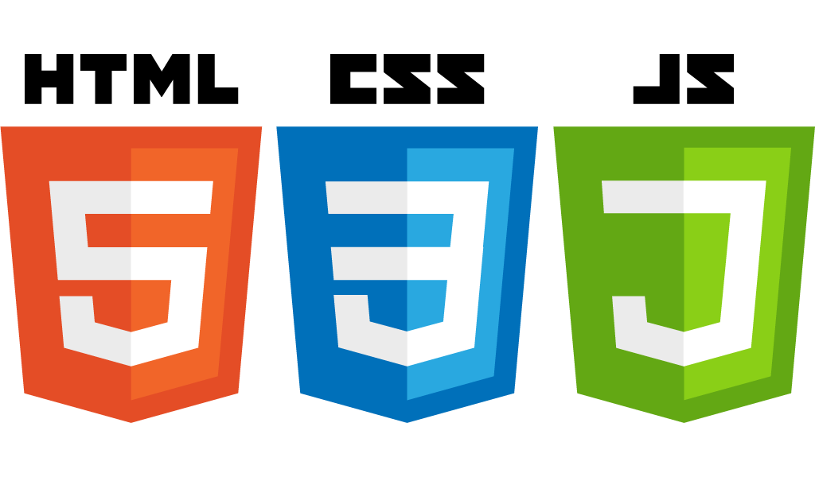

Slide 15
Other Technologies options
For tetris game, we can also use some other technologies:
GO
C#
Python

Slide 16
History of Tetris
Tetris is a tile-matching puzzle video game originally designed and programmed by Soviet Russian software engineer Alexey Pajitnov. The first playable version was completed on June 6, 1984.
Tetris was the first game to be exported from the Soviet Union to the United States. The game is a popular use of tetrominos, the four-element case of polyominoes, which have been used in popular puzzles since at least 1907.
The game, or one of its many variants, is available for nearly every video game console and computer operating system, as well as on devices such as graphing calculators, mobile phones, portable media players etc.

Slide 17
Use case diagram

Slide 18
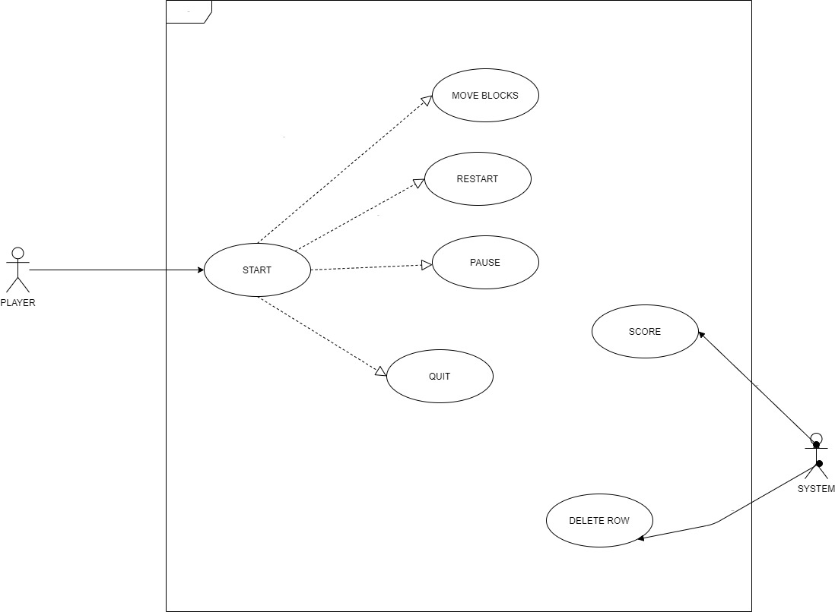

Slide 19
Activity diagram

Slide 20
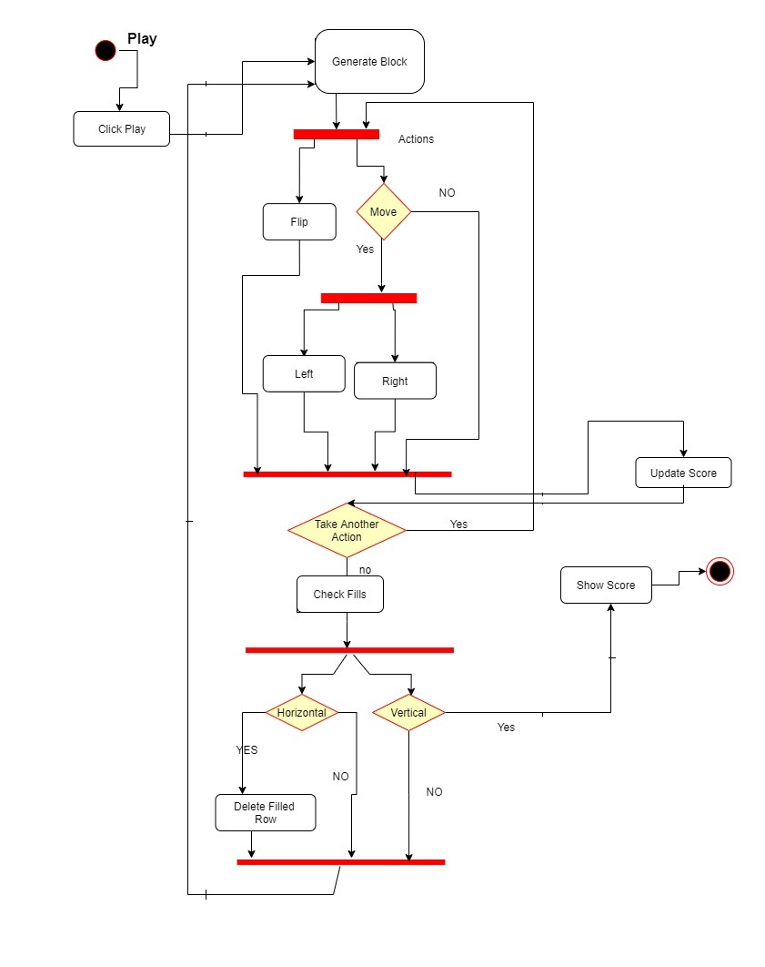

Slide 21
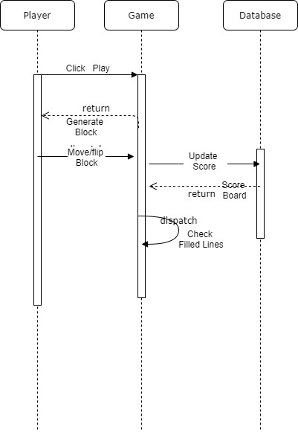
Sequence diagram

Slide 22
Thank you

Slide 23
Any question

