Slide 1


TMP-23-081
Improving Cognitive Independence of Dementia Patients Using Machine Learning Enabled Mobile Application
PRESENTED BY | TMP-23-081
PRESENTED ON | 27/03/2023

Slide 2





Introduction

Slide 3
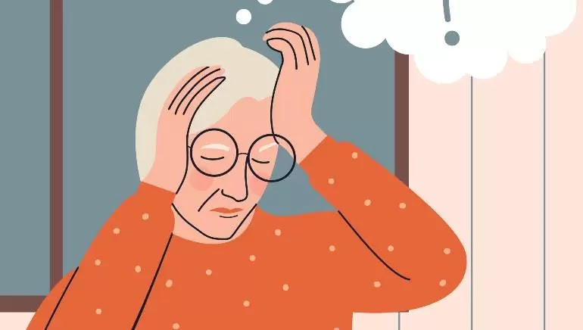
What Is Dementia?
Dementia patients are individuals who have a decline in their cognitive and memory abilities that interferes with their daily life and activities. It is a progressive condition that affects thinking, memory, behavior, and the ability to perform everyday activities.

Slide 4

35.6 Million
Worldwide Population with dementia with an increase of
7.7 Million
New cases every year
By 2030
It is projected to be doubled

Slide 5
Research Problem

Slide 6

Lack of accessibility options in available tools
Affects the quality of life
Affording a caregiver is costly
Lack of resources in available mediums
Caregivers lack the expertise to handle the patient
Caregivers cannot always be available, whenever needed

Slide 7
Research Objectives
To explore and identify the feasible solutions to develop a smart solution to improve the quality of life and independence of Dementia patients
IoT device to analyze wandering and predict future movement.
Maintain a digital diary via voice recognition for mental stability.
Feelings detection mechanism to provide musical therapy sessions.
Face recognition system to detect loved ones and relatives.

Slide 8
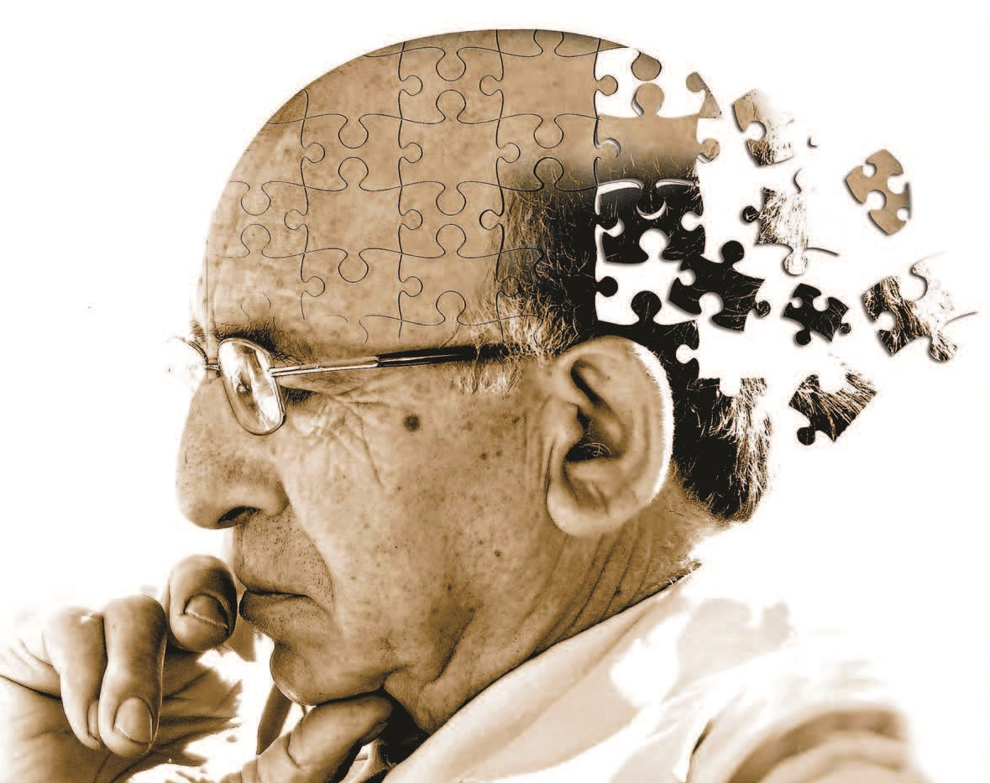
Overall System Diagram

Slide 9
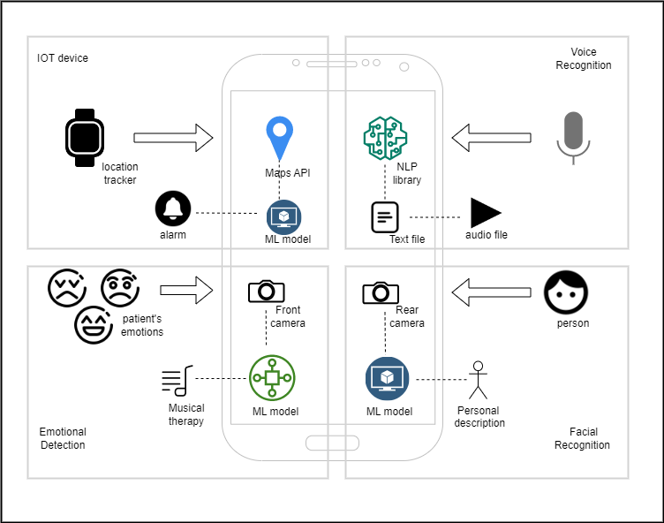

Slide 10
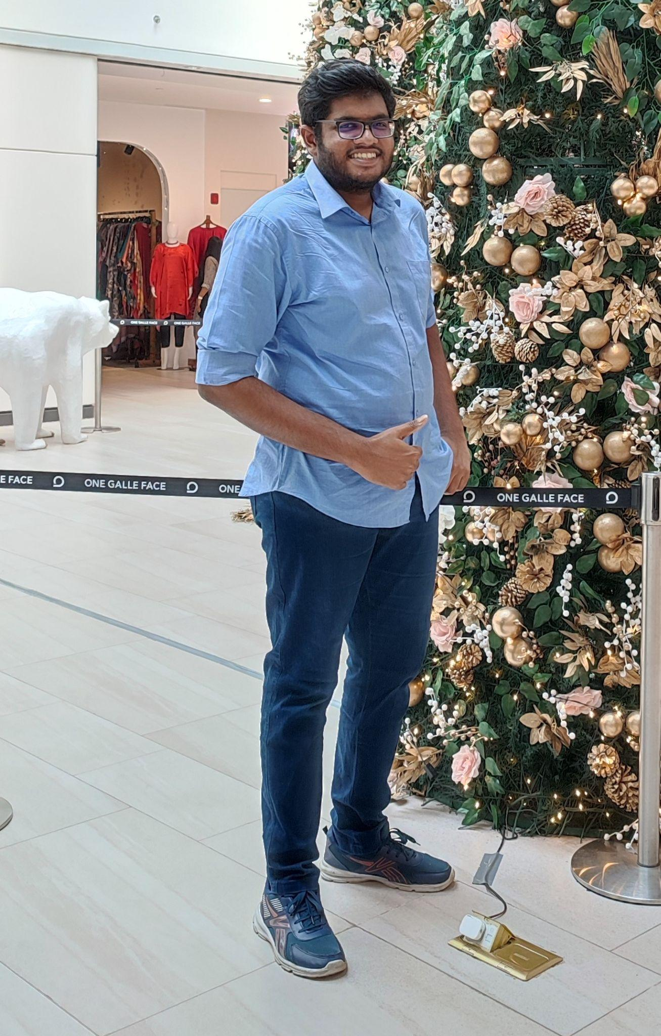
Kachchakaduwa E.U
IT20230388
BSc (Hons) in Information Technology (Specialization in Data Science)
Providing a smart solution for wandering behaviour of dementia patients by inventing an IoT device to track locations while establishing safe zones and analyzing their movement patterns for future predictions.
IT20230388 | Kachchakaduwa E.U. |TMP-23-081

Slide 11
Introduction
IT20230388 | Kachchakaduwa E.U. |TMP-23-081

Slide 12
Background
● Research area?
● Impact of Wandering on Dementia Patients and Their Caregivers.
● Why it’s needed for this research?
IT20230388 | Kachchakaduwa E.U. |TMP-23-081

Slide 13
Research Gap
Research A
Research B
Research C
IoT-Based Wearable Devices for Patients Suffering from Alzheimer Disease [1]
iWander: An Android Application for Dementia Patients [2]
Real-time Location Tracker for Critical Health Patient using Arduino, GPS Neo6m and GSM Sim800L in Health Care [3]
IT20230388 | Kachchakaduwa E.U. |TMP-23-081

Slide 14


 | A | B | C | Solution
Track the current location of the patient and monitor movement and speed constantly
Establish safe zones and change them according to the whereabouts at the time by caregivers
Analyze patient’s historical records and predict future movements
Bidirectional communication
Alerting and alarming system for emergencies
Show the current date, time and weather whenever the patient needs
IT20230388 | Kachchakaduwa E.U. |TMP-23-081

Slide 15
Research Problem
Caregivers cannot prioritize their supervision on patinet all the time
50% of the Dementia patients dies and get immobilized due to wandering
Inability to memorize all the activities and places that visit
Patients need their independence while not being lock in.
Existing tools lacks accuracy, efficiency and simplicity
No ways to analyze patients history and predict future movements
IT20230388 | Kachchakaduwa E.U. |TMP-23-081

Slide 16
Create a device to constantly track locations of patients real-time and maintain communication with caregiver.
Research Objectives
Create a system to establishing safe zones with customizable options while giving alerts to the caregivers in emergencies.
Providing a smart solution for wandering behaviour of dementia patients by inventing an IoT device to track locations while establishing safe zones and analyzing their movement patterns for future predictions
Build a predictive model to analyze patient’s historic records and predict future movements.
IT20230388 | Kachchakaduwa E.U. |TMP-23-081

Slide 17
Methodology
IT20230388 | Kachchakaduwa E.U. |TMP-23-081

Slide 18
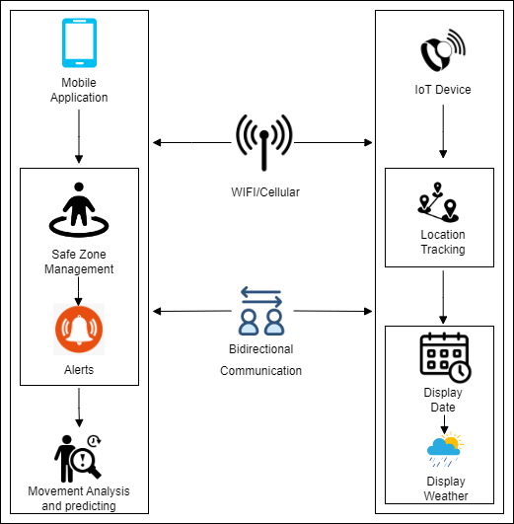
System Diagram
IT20230388 | Kachchakaduwa E.U. |TMP-23-081

Slide 19
Tools
Microcontrollers
Display
Sensors
Actuators
Enclosures
Battery
IT20230388 | Kachchakaduwa E.U. |TMP-23-081

Slide 20





Technologies
Github
Reactnative
Python
Firebase
Power BI
IT20230388 | Kachchakaduwa E.U. |TMP-23-081

Slide 21
Techniques and Algorithms
Geofencing
A method of defining virtual barriers on a real geographical location [4]. Can use to define safe zones and trigger alerts when patients enter or exit the defined areas.
A neural network used in location tracking [5]
Provides predictions with high accuracies using several techniques such as K-Nearest Neighbours[6]
Artificial Neural Network (ANN)
Artificial Neural Network (ANN)
IT20230388 | Kachchakaduwa E.U. |TMP-23-081

Slide 22
Requirements
Functional Requirements
Identify and monitor patient’s location constantly
Identify and establish correct safe zones upon caregiver’s input
Maintain historical records separately
Predict patient’s future movements
Display current date, time and weather
Non- functional Requirements
Accuracy
Usability
Accessibility
Reliability
Well optimized for cloud/mobile use
IT20230388 | Kachchakaduwa E.U. |TMP-23-081

Slide 23
Work Breakdown Structure
Providing a smart solution for wandering behaviour of dementia patients by inventing an IoT device to track locations while establishing safe zones and analyzing their movement patterns for future predictions
Feasibility Study
Requirement Analysis
Design
Implementation
Testing
Documentation
Identifying the problem
Gather Requirements
System Design
Implement a real-time location tracking system
Unit Testing
Project Charter
Design a Solution
Analize Requirements
Interface Design
Implement a safe zones monitoring system
Integration Testing
Project Proposal
Literature Review
Well Optimized
Implement a future movements predictive model
User Acceptance Testing
Research Paper
System Testing
Final Report
IT20230388 | Kachchakaduwa E.U. |TMP-23-081

Slide 24
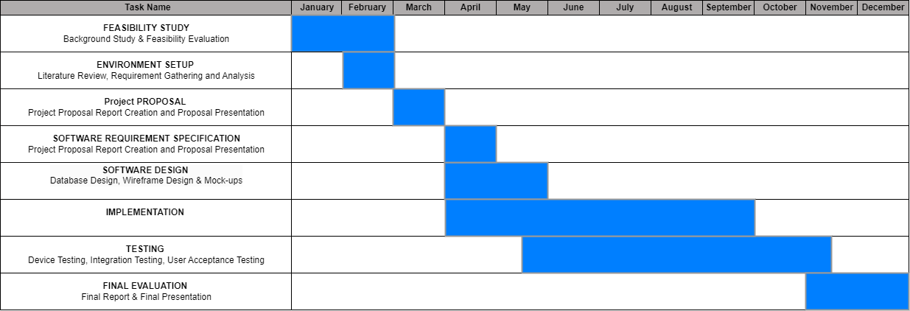
Gantt Chart
IT20230388 | Kachchakaduwa E.U. |TMP-23-081

Slide 25
References
[1] Waleed Salehi, Gaurav Gupta, Surbhi Bhatia, Deepika Koundal, Arwa Mashat, Assaye Belay, "IoT-Based Wearable Devices for Patients Suffering from," 2022.
[2] Frank Sposaro, Justin Danielson, Gary Tyson, "iWander: An Android Application," 2010.
[3] Pratik Kanani, Dr. Mamta Padole, "Real-time Location Tracker for Critical Health," 2020.
[4] Aagy Paulose, Aswathy K S, Nurjahan V A, "Smart Geofencing: An Inventive Mobile Marketing Strategy," p. 2019.
[5][Online]. Available: https://www.ncbi.nlm.nih.gov/pmc/articles/PMC6181345/.
[6] Alirezha Hamoudzadeh, Saeed Behzadi, "Predicting user’s next location using machine learning algorithms," 2021.
IT20230388 | Kachchakaduwa E.U. |TMP-23-081

Slide 26
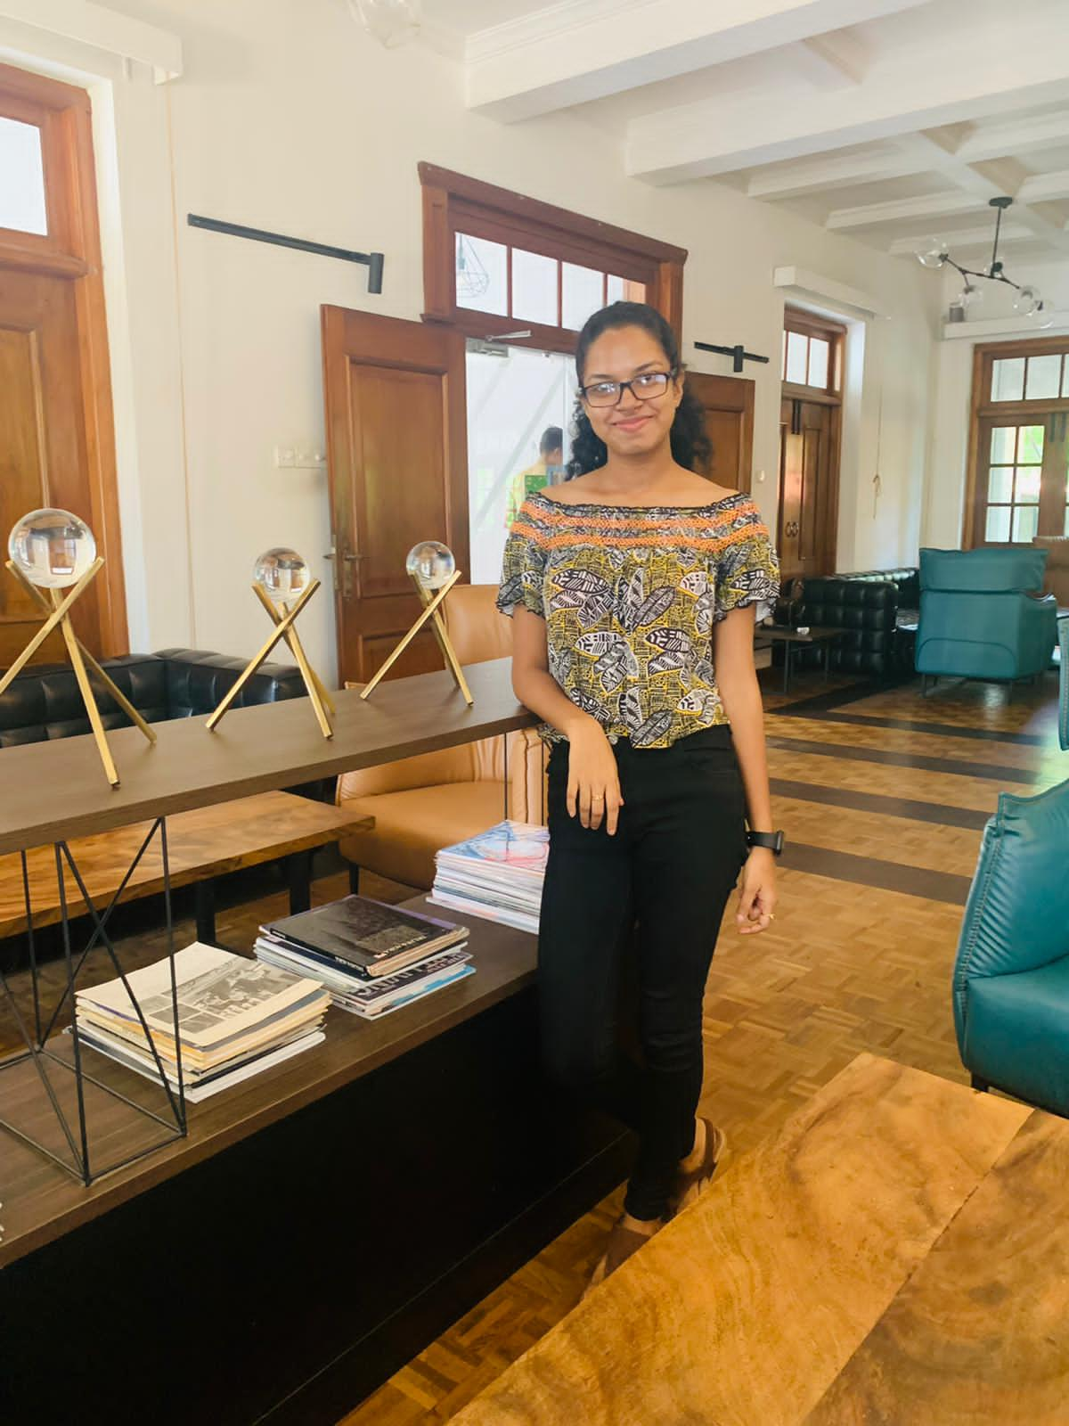
Madhubhashini A.D.P
IT20174576
BSc (Hons) in Information Technology (Specialization in Information Technology)
Design a smart solution that have capability to detect patients loved ones and relatives via face recognition in a way that patient is fully independent.
IT20174576 | Madhubhashini A.D.P. |TMP-23-081

Slide 27
Introduction And Background
● Research area?
● Importance of identifying family members.
● Why it’s needed for this research?
IT20174576 | Madhubhashini A.D.P. |TMP -23-081

Slide 28
Research Gap
A
B
C
Recognition of familiar people with a mobile cloud architecture for Alzheimer patients [1]
Smart Phone Based Facial and Text Recognition Application (RICO) [2]
Alzheimer assistant: a mobile application using Machine Learning [3]
IT20174576 | Madhubhashini A.D.P. |TMP -23-081

Slide 29


Research Gap
Features | A | B | C | Solution
Real time image capturing option using smartphone camera
Screening the person information
Use a text-to-speech module to hear the information.
Special User Interface creation for dementia patients
Use object recognition mechanism to filter a memory, related to captured person.
IT20174576 | Madhubhashini A.D.P. |TMP - 23-081

Slide 30
Research Problem
Emotional impact on both the patient and the family members.
Lead to feeling of frustration, fear and anxiety.
Every time can’t get a 3rd party assistant for identify people
Patient may become withdrawn and socially isolated.
Burden on Caregivers.
Not having a proper assistive tool for make their life more independant
IT20174576 | Madhubhashini A.D.P. |TMP - 23-081

Slide 31
Create a model to detect the faces of individuals
Research Objectives
Train a object recognition that can filter Image or video clip of relevant person
Improving the independence by designing a smart and effective solution for the Dementia patients to identify their loved ones by increasing their confidence to remember each member of their family.
Create a text-to speech module to hear the information

Slide 32
Methodology

Slide 33
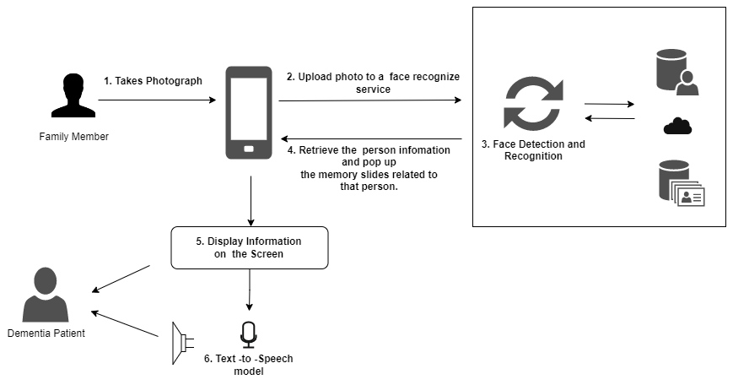
System Overview Diagram

Slide 34
Tools and technologies
Reactnative
Github
Firebase
Python

Slide 35
Tools and technologies
Convolutional Neural Network (CNN)
principal component analysis (PCA)
CNN used to detect and match the faces of individuals [4]
CNN cascade operates at multiple resolutions, quickly rejects the background regions in the fast low resolution stages[4]
Statistical technique used to identify patterns in data.[5]

Slide 36
Requirements
Functional Requirements
Extract data from the image
Identify the person who is captured
Display the memory related to the person
Generate a audio clip of the information that display in the screen
Non Functional Requirements
Accuracy
Availability
Compatibility

Slide 37
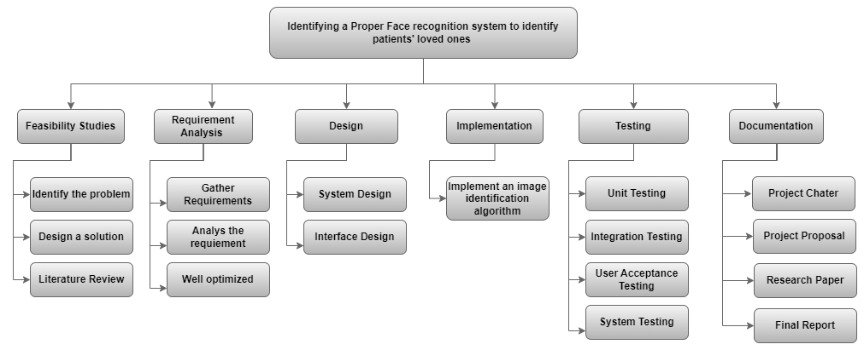
Work Breakdown Chart

Slide 38
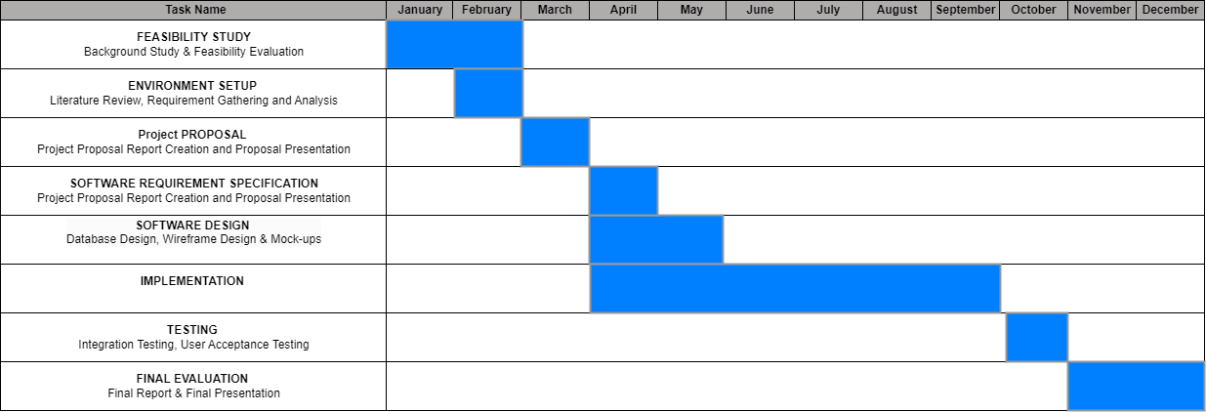
Gantt Chart
IT20174576 | Madhubhashini A.D.P. |TMP23-081

Slide 39
References
[15] [1] H. M. Fardoun, A. A. Mashat, and J. Ramirez Castillo, “Recognition of familiar people with a mobile cloud architecture for Alzheimer patients,” Disabil Rehabil, vol. 39, no. 4, pp. 398–402, Feb. 2017, doi: 10.3109/09638288.2015.1025992.
[4 [2] Sadjad University of Technology, Institute of Electrical and Electronics Engineers. Iran Section., and Institute of Electrical and Electronics Engineers, ICEE 2018 : 2018 26th Iranian Conference on Electrical Engineering : Sadjad University of Technology, 8-10 May 2018.
[3] N. Aljojo et al., “Alzheimer assistant: a mobile application using Machine Learning,” Revista Română de Informatică și Automatică, vol. 30, no. 4, pp. 7–26, Dec. 2020, doi: 10.33436/v30i4y202001tant: a mobile application using Machine Learning,” Revista Română de Informatică și Automatică, vol. 30, no. 4, pp. 7–26, Dec. 2020, doi: 10.33436/v30i4y202001
[4] M. M. Kasar, D. Bhattacharyya, and T. H. Kim, “Face recognition using neural network: A review,” International Journal of Security and its Applications, vol. 10, no. 3, pp. 81–100, 2016, doi: 10.14257/ijsia.2016.10.3.08.
[5] Institute of Electrical and Electronics Engineers and PPG Institute of Technology, Proceedings of the 5th International Conference on Communication and Electronics Systems (ICCES 2020) : 10-12, June 2020.

Slide 40
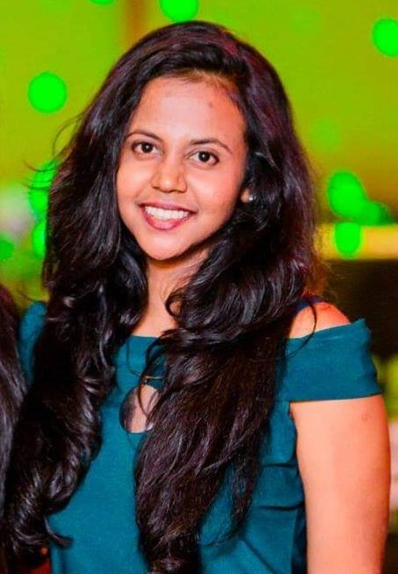
Jayasinghe J.M.S.U.
IT20034740
BSc (Hons) in Information Technology (Specialization in Software Engineering)
Providing a smart solution by using voice recognition and NLP to maintain a digital audio diary by a patient as journalism helps to keep stability of memory
IT20034740 | Jayasinghe J.M.S.U. |TMP-23-081

Slide 41
Introduction & Background
● Research area?
● Impact of Journalism and diary writing for mild and moderate dementia patients
● Why it’s needed for this research?
IT20034740 | Jayasinghe J.M.S.U. |TMP-23-081

Slide 42
Research Gap
Personal Journal Keeping and Linguistic Complexity Predict Late-Life Dementia Risk [1]
Modifying the Diary Interview Method to Research the Lives of People With Dementia [2]
AN INDEPENDENT EVALUATION OF ‘DEMENTIA DIARIES’ [3]
IT20034740 | Jayasinghe J.M.S.U. |TMP-23-081

Slide 43
 | A | B | C | Solution
Including audio recordings of patients
Usage of voice recognition
Speech to text conversion and storage of text files
Sentimental analysis of the generated text file and part of speech tagging
Named entity recognition
Speech summarization
A - [1]
B - [2]
C - [3]
IT20034740 | Jayasinghe J.M.S.U. |TMP-23-081

Slide 44
Research Problem
Social isolation
Difficulties in communication
Forgetting daily tasks
Frustrations and stressful behavioral patterns
Lack of literacy and poor vocabulary
Depression and anxiety
IT20034740 | Jayasinghe J.M.S.U. |TMP-23-081

Slide 45
Speech recognition and voice detection
Research Objectives
Converting speech to text using NLP algorithms to ease maintaining diaries
Improving the cognitive independence and wellbeing of dementia patients by motivating them to maintain a digital audio diary.
Prediction of summarized speeches
IT20034740 | Jayasinghe J.M.S.U. |TMP-23-081

Slide 46
Methodology
IT20034740 | Jayasinghe J.M.S.U. |TMP-23-081

Slide 47
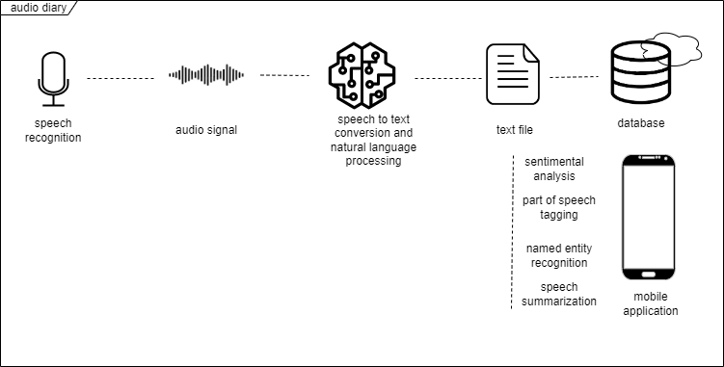
System Overview Diagram
IT20034740 | Jayasinghe J.M.S.U. |TMP-23-081

Slide 48
Tools and technologies
Reactnative
Github
Firebase
Python
IT20034740 | Jayasinghe J.M.S.U. |TMP-23-081

Slide 49
Techniques and Algorithms
Linear Predictive Coding (LPC)
Pre processing in feature extraction of voice
Neural network based approach
Pattern classification [4]
Hidden Markov Model (HMM)
a statistical model used in speech recognition
Artificial Neural Network (ANN) [5]
IT20034740 | Jayasinghe J.M.S.U. |TMP-23-081

Slide 50
Requirements
Functional Requirements
Language support
Speed - ability to convert speech to text in real time
Context awareness
Vocabulary support
Intrgration compatibility
Non- functional Requirements
Scalabilty
Performance
Security
Reliability
Maintainability
IT20034740 | Jayasinghe J.M.S.U. |TMP-23-081

Slide 51
Work Breakdown Structure
Improving the cognitive independence and wellbeing of dementia patients by motivating them to maintain a digital audio diary.
Feasibility Study
Requirement Analysis
Design
Implementation
Testing
Documentation
Identifying the problem
Gather Requirements
System Design
Implementation of voice recognition and speech to text conversion
Unit Testing
Project Charter
Design s Solution
Analize Requirements
Interface Design
Implementation of generated text based mechanisms
Integration Testing
Project Proposal
Literature Review
Well Optimized
User Acceptance Testing
Research Paper
System Testing
Final Report
IT20034740 | Jayasinghe J.M.S.U. |TMP-23-081

Slide 52
Gantt Chart
IT20034740 | Jayasinghe J.M.S.U. |TMP-23-081

Slide 53
References
[1] Personal Journal Keeping and Linguistic Complexity Predict Late-Life Dementia Risk: The Cache County Journal Pilot Study, Jessica J. Weyerman, Cassidy Rose, and Maria C. Norton
[2] Modifying the Diary Interview Method to Research the Lives of People With Dementia, Ruth Bartlett, originally published online 3 October 2012
[3] An independent evaluation of ‘Dementia Diaries’. Woodall, J and Surr, C and Kinsella, K and Bunyan, A (2016)
[4] Speech to text and text to speech recognition systems-Areview
Ayushi Trivedi,Navya Pant, Pinal Shah,Simran Sonik and Supriya Agrawal
DepartmentofComputerScience, NMIMS University,Mumbai,India.
[5] Speech to text conversion and summarization for effective
understanding and documentation Vinnarasu A., Deepa V. Jose
Department of Computer Science, CHRIST (Deemed to be University), India
IT20034740 | Jayasinghe J.M.S.U. |TMP-23-081

Slide 54
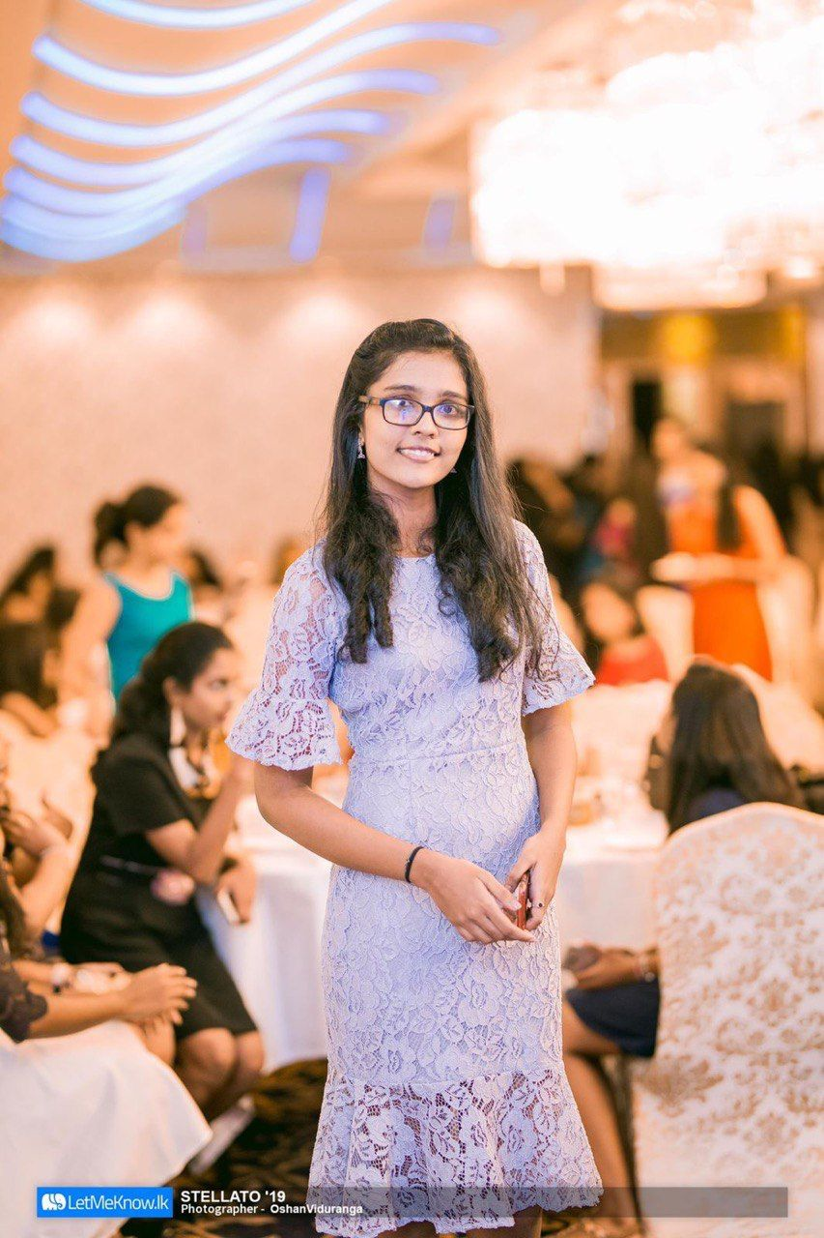
Hiththatiyage D.K
IT20162696
BSc (Hons) in Information Technology (Specialization in Software Engineering)
Improving cognitive independence of dementia patients by directing them to the appropriate music therapy sessions while analyzing their emotional state
IT20162696 | Hiththatiyage D.K |TMP-23-081

Slide 55
Introduction And Background
● Research area?
● Impact of Music on Dementia Patients
● And Why it’s needed for this research
IT20162696 | Hiththatiyage D.K |TMP-23-081

Slide 56
Research Gap
Real-time EEG-based emotion recognition for music therapy [2]
Alive Inside: Developing mobile apps for the cognitively impaired[3]
Emotion Based Music Player[1]
IT20162696 | Hiththatiyage D.K |TMP-23-081

Slide 57
 | A | B | C | Solution
Assist emotion feature extraction
Detect age and classify music separately
Visual Presentations accordance with the classified music
Build a music library based on real time patient reaction
optimized for mobile/ cloud use
A -Music Player
B - EEG
C - Alive Inside
IT20162696 | Hiththatiyage D.K |TMP-23-081

Slide 58
Research Problem
Inability to control emotional changes
Emotional responses frequently vary
Caregivers lack the expertise to assist patients
Third prty not being available all thetime
Existing tools lacks the accessibility for dementia patients
Music recommendations are ineffective in elevating mood
IT20162696 | Hiththatiyage D.K |TMP-23-081

Slide 59
Detecting the Face using a face Detection Model
Research Objectives
Collecting facial expression data with the help of an emotion extraction module
Improving cognitive independence of dementia patients by directing them to the appropriate music therapy sessions while analyzing their emotional state
Choosing the appropriate therapeutic music session using an emotion-audio integration module
IT20162696 | Hiththatiyage D.K. |TMP-23-081

Slide 60
Methodology
IT20162696 | Hiththatiyage D.K |TMP-23-081

Slide 61
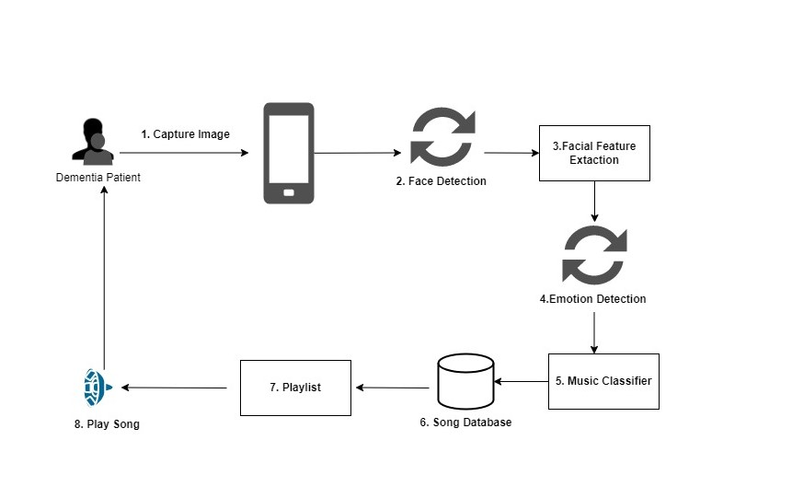
System Diagram
IT20162696 | Hiththatiyage D.K. |TMP-23-081

Slide 62
Tools and technologies
Reactnative
Github
Firebase
Python
IT20162696 | Hiththatiyage D.K |TMP-23-081

Slide 63
Techniques and Algorithms
Haar Cascade
A Haar classifier is used for face detection where the classifier is trained with pre-defined varying face data which enables it to detect different faces accurately [4]
A neural network used in image recognition and extraction [5]
Automatically detects the important features without any human supervision [5]
Convolution Neural Network (CNN)
IT20162696 | Hiththatiyage D.K |TMP-23-081

Slide 64
Requirements
Functional Requirements
Identify Face from the image
Extract Features from the image
Generate meaningful music
Generate Meaningful Visuals
Non- functional Requirements
Accuracy
Availability
Well optimized for cloud/mobile use
IT20162696 | Hiththatiyage D.K |TMP-23-081

Slide 65
Work Breakdown Structure
Improving cognitive independence of dementia patients by directing them to the appropriate music therapy sessions while analyzing their emotional state
Feasibility Study
Requirement Analysis
Design
Implementation
Testing
Documentation
Identifying the problem
Gather Requirements
System Design
Implement a Face detection Model
Unit Testing
Project Charter
Design s Solution
Analize Requirements
Interface Design
Implement a Emotion Extraction Model
Integration Testing
Project Proposal
Literature Review
Well Optimized
User Acceptance Testing
Research Paper
System Testing
Final Report
IT20162696 | Hiththatiyage D.K |TMP-23-081

Slide 66
Gantt Chart
IT20162696 | Hiththatiyage D.K |TMP-23-081

Slide 67
References
[1] Emotion Based Music Player,
Hafeez Kabani1, Sharik Khan2, Omar Khan3, Shabana Tadvi4
[2] Sourina, Olga & Liu, Yisi & Nguyen, Minh Khoa. (2011). Real-time EEG-based emotion recognition for music therapy. Journal on Multimodal User Interfaces. 5. 10.1007/s12193-011-0080-6.
[3] Alive Inside: Developing Mobile Apps for the Cognitively Impaired Martine Nezerwa, Robert Wright, Stefan Howansky, Jake Terranova
[4] Music Recommendation Based on Face Emotion Recognition Madhuri Athavle1 , Deepali Mudale2 , Upasana Shrivastav3 , Megha Gupta4
[5] A. Dertat, “Applied Deep Learning - Part 4: Convolutional neural networks,” Towards Data Science, 08-Nov-2017. [Online]. Available: https://towardsdatascience.com/applied-deep-learning-part-4-convolutional-neural-networks-584bc134c1e2. [Accessed: 31-Jan-2022].
IT20162696 | Hiththatiyage D.K |TMP-23-081

Slide 68
Spread the word around Dementia Individuals
Obtain regulatory approval
COMMERCIALIZATION
Sponsor content creators with the same disability
Provide ongoing support

Slide 69
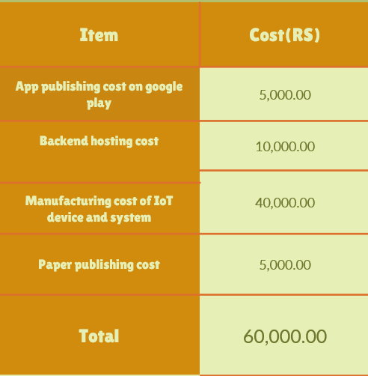
Budget for overall system

Slide 70
THANK YOU!

