Slide 1

TIMETABLE MANAGEMENT SYSTEM

Slide 2
INTRODUCTION
1.1 Background of the Company
Established in 2015 London Bridge Sri Lanka is reputable higher education institution and frontier of academic and intellectual discovery. Those who venture here—to learn, research, teach, work, and grow—join nearly four centuries of students and scholars in the pursuit of truth, knowledge, and a better world.
As a research university and nonprofit institution, London Bridge is focused on creating educational opportunities for people from many lived experiences. They have countless non-degree opportunities for professional and lifelong learners, including executive education, continuing education, and online courses.
Their aim is to revolutionize the education landscape by igniting a passion for the intrinsic value of learning to nurture leaders who uplift lives, and they aspire to ‘inspire love for learning’ in all our students and through them within society

Slide 3
1.2 Problem Statement and Difficulties they face
One of the most important components of an institute is its timetable. That is why all institutes whether small or big, follow a timetable. It is a timetable that divides the duration of institute into various periods and designates different modules. A timetable specifies activities that are supposed to be carried out in an institute on a particular day.
A proper timetable is pivotal as it leads to effective learning, Ensures that all subjects are studies equally, It makes lesson planning and delivery easy and Optimization of time.
What happens if a timetable isn’t being followed or properly implemented ?
Data redundancy
hard to make updates of the timetables perfectly because they do not always allocate some course units, lecturers’ names on the timetables and even when some are allocated, there is always collision in different lecture, tests or examinations
slowness and misallocation of course units, lecture time, lecture rooms, practical sessions

Slide 4
1.3 Solution to the above problem
As a solution to the problems defined in the problem statement a timetable management system is proposed to develop that allocates lectures, sessions ,rooms to specific courses as this will be the main objective of this project too
Specific Objectives
To identify the requirements for the timetable generation system by analyzing the existing systems
To design the system
To develop the system
To test and validate the system

Slide 5
1.3 Benefits of the proposed solution
Display the generated timetable for a specific semester.
Printable timetables
This proposed system provides an attractive graphical front-end and it is the main interaction point with user
It will be able to generate printouts on timetabling
The system should save the time
To increase the optimization, generated timetables can be fine-tuned

Slide 6
Functions of the Project
Name with Initials | Brief Description of the Function
Muhassan Faizal | Session Management : Add session, List the Sessions in details, add filers to search the sessions based on a particular Lecturer and Tag. Add consecutive sessions and list the consecutive sessions. Lecturer Management : Add , Update and Manage lecturer details along with the faculty, department, center and building that is related to him/her

Slide 7
Name with Initials | Brief Description of the Function
M.I.M Uzman | Location Management : This will add location of not available times in location. User can select the day room and time to adding locations details to the system and they have clear and add sessions options Tag Management : This will be used to add tags to the system. When adding tag to the system, the operator should fill each field given in the interface, the operator would not be able to add any tag to the system without completing fields Session Room Management : - This clarifies to schedule a format for the particular sessions and for the room as well .

Slide 8
Name with Initials | Brief Description of the Function
M.R.M Rifakathullah | Subject Management : This will be used to add subjects the system. : When adding subjects to the system, the operator should fill each field for given interface and also to update and delete subjects the subject details from the system Working Days Management : This will be used to add working days and hours to the system. user can manage the details related to workings by updating or deleting them Session Management : - Parallel and non overlapping sessions will be managed here. Users are able view the sessions availability with the help oh this management

Slide 9
Name with Initials | Brief Description of the Function
S.Keerthana | Student Management : Here Student academic details are to be added and managed. The details are what academic he/she belongs to, the programme he/she is on ,Group and subgroup that he belongs along with group id

Slide 10
Tools and Technologies
The DBMS we decided to use is the MySQL Workbench. It is a visual database design tool where it allows the user to design visual models. It is designed as an advanced database administrator tool where all the necessary database functions are available
The implementation language we planned to use is JAVA and we will be using JAVA SWING as the graphical user interface widget toolkit
Testing phase is to be done manually by testing each and every input with their combination

Slide 11
Work Distribution
Registration Number | Name | Work Distribution
IT19212050 | Muhassan Faizal | Product Backlog ,Sprint Backlog ,Session Management, Student Management ,Lecturer Management, ER Diagram
IT18403602 | M I M Uzman | Product Backlog, Sprint Backlog, Tag Management, Location Management, Session Room Management, System Overview Diagram
IT19033310 | M R M Rifakathullah | Product Backlog , Sprint Backlog , Subject Management , Session Management ,Working Days Management, Gantt Chart
IT20040130 | S Keerthana | Product Backlog ,Sprint Backlog, Student Management

Slide 12
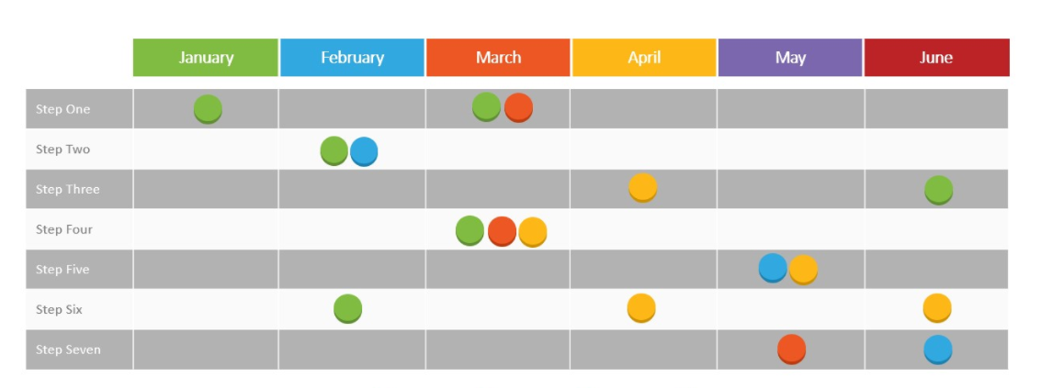
Project Management plan
Timetable management system is a unanimous requirement for planning class timings in school or universities. The system can be deployed to schedule a new class, cancel an existing class, and making other changes to a timetable. The process of building up and serving this to final user is depicted below
Step 1 Planning
Step 2 Topic Selection & Requirement Gathering
Step 3 Start the project code
Step 4 Implement and test the project
Step 5 Correct the errors
Step 6 Final Testing
Step 7 Presentation

Slide 13
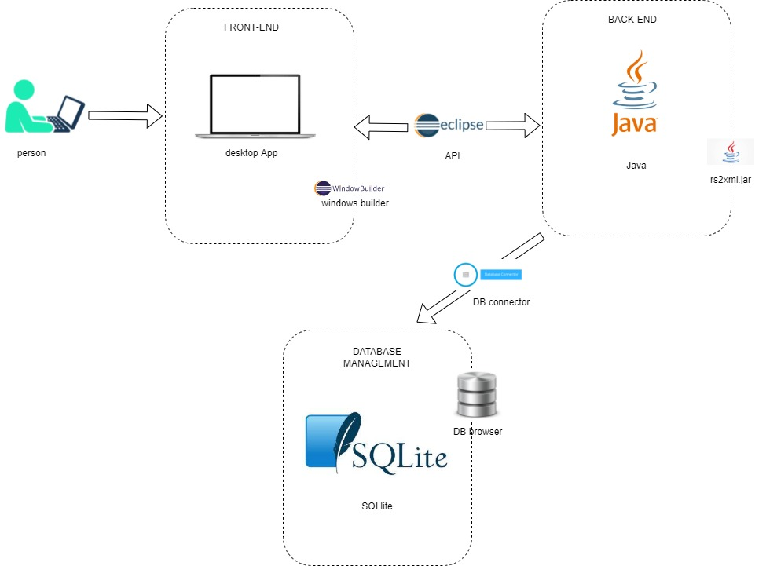
System Overview Diagam

Slide 14
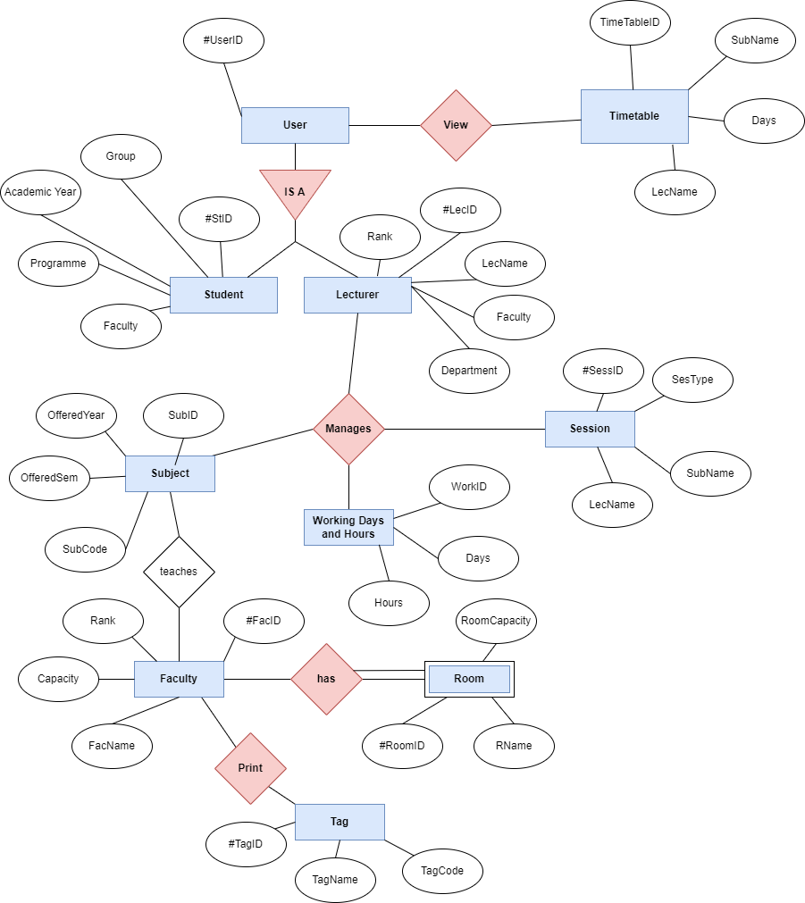
ER Diagram

Slide 15
THANK YOU
Any Questions ?

