Slide 1



Churn_Analysis_Dashboard
View in Power BI
Last data refresh:
12/15/2023 3:58:23 AM UTC
Downloaded at:
12/15/2023 4:08:52 AM UTC

Slide 2
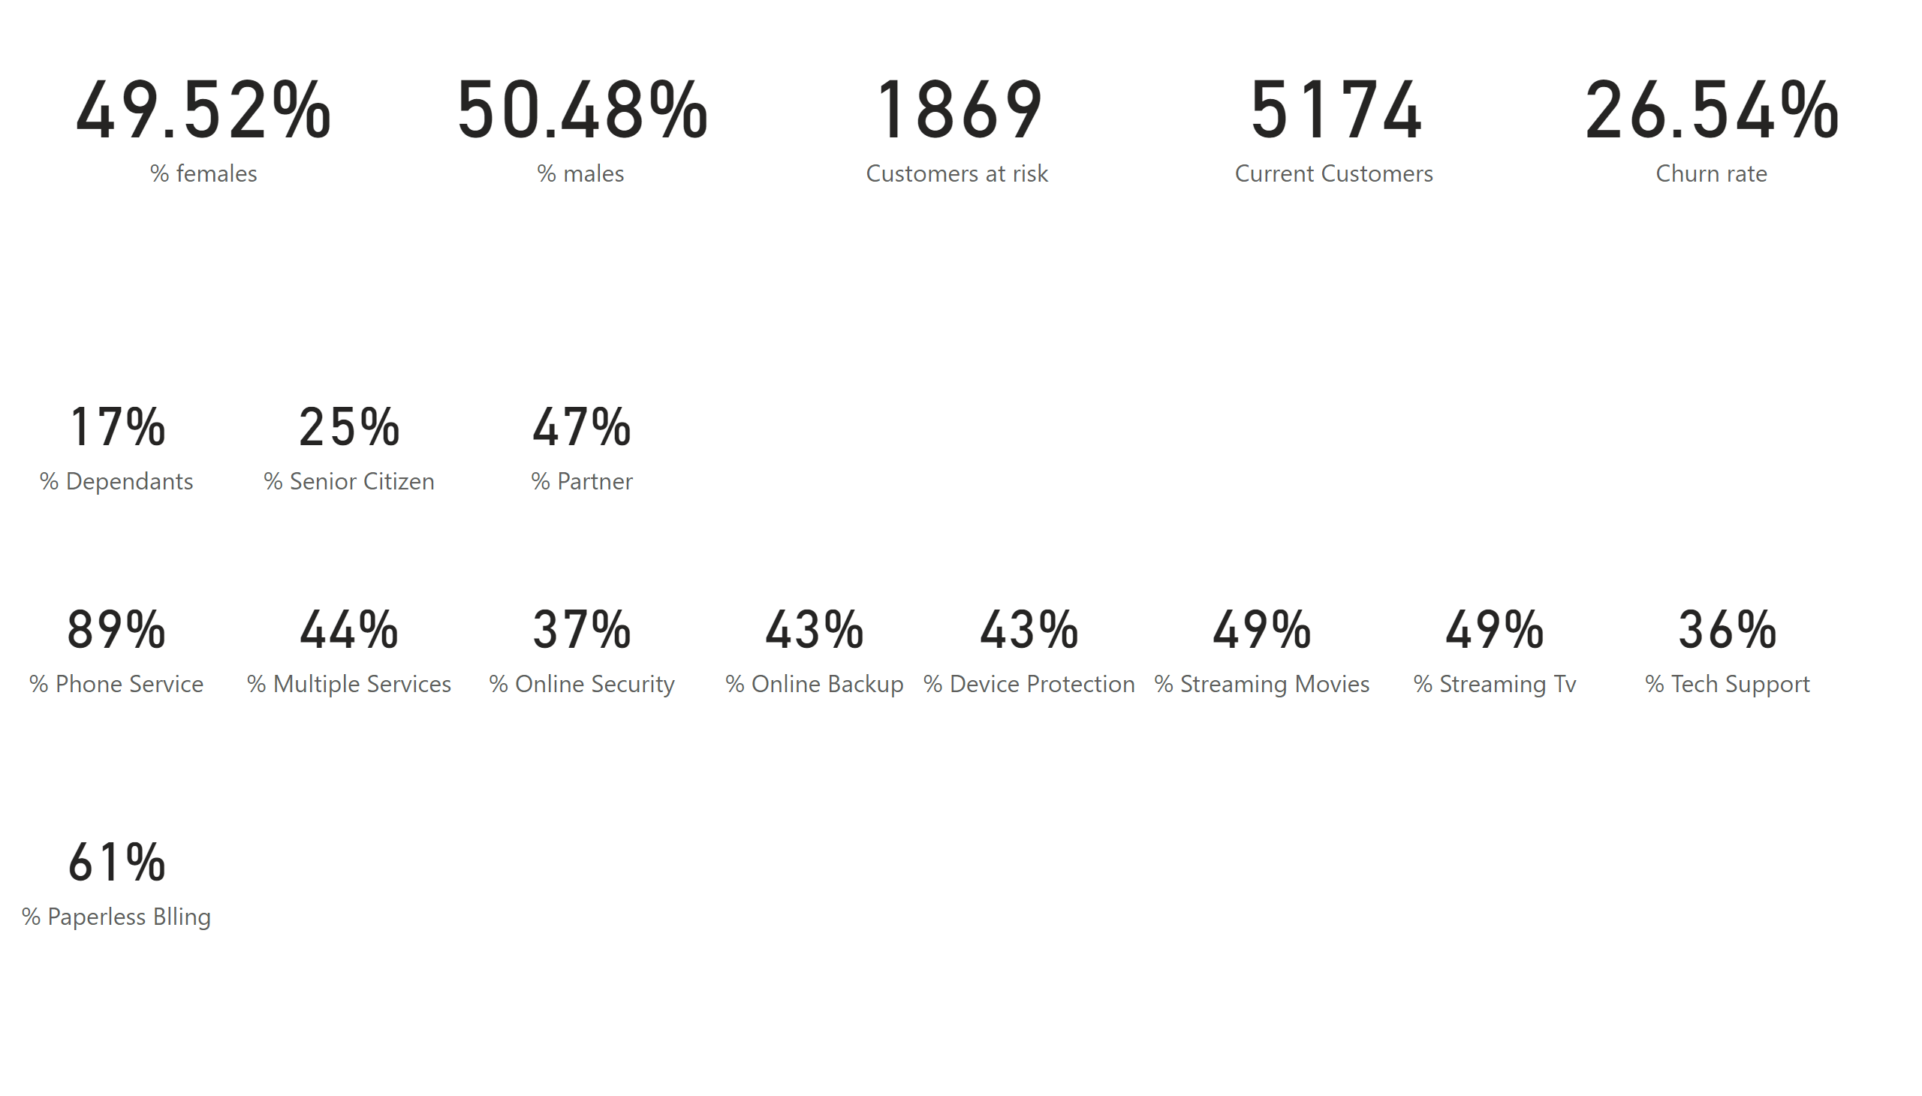
Metrics
Notes:
card
No alt text provided
card
No alt text provided
card
No alt text provided
card
No alt text provided
card
No alt text provided
card
No alt text provided
card
No alt text provided
card
No alt text provided
card
No alt text provided
card
No alt text provided
card
No alt text provided
card
No alt text provided
card
No alt text provided
card
No alt text provided
card
No alt text provided
card
No alt text provided
card
No alt text provided

Slide 3
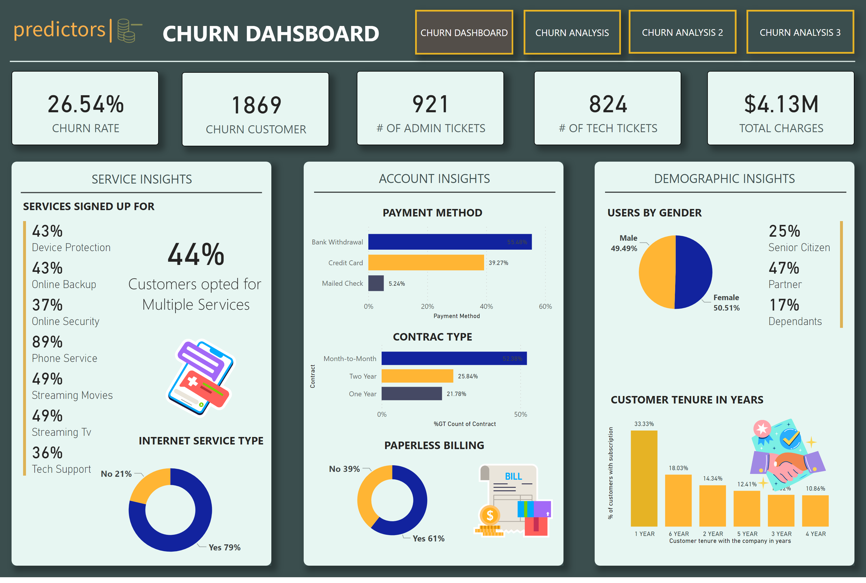
CHURN DASHBOARD
Notes:
SERVICE
No alt text provided
shape
No alt text provided
shape
No alt text provided
shape
No alt text provided
shape
No alt text provided
HEADING
No alt text provided
actionButton
No alt text provided
actionButton
No alt text provided
Multi-row card
No alt text provided
LINE
No alt text provided
LINE
No alt text provided
lINE
No alt text provided
ACCT
No alt text provided
DEMO
No alt text provided
card
No alt text provided
textbox
No alt text provided
donutChart
No alt text provided
image
No alt text provided
barChart
No alt text provided
textbox
No alt text provided
textbox
No alt text provided
textbox
No alt text provided
barChart
No alt text provided
donutChart
No alt text provided
image
No alt text provided
textbox
No alt text provided
textbox
No alt text provided
Multi-row card
No alt text provided
pieChart
No alt text provided
textbox
No alt text provided
clusteredColumnChart
No alt text provided
card
No alt text provided
card
No alt text provided
card
No alt text provided
card
No alt text provided
card
No alt text provided
textbox
No alt text provided
image
No alt text provided
actionButton
No alt text provided
actionButton
No alt text provided
image
No alt text provided

Slide 4
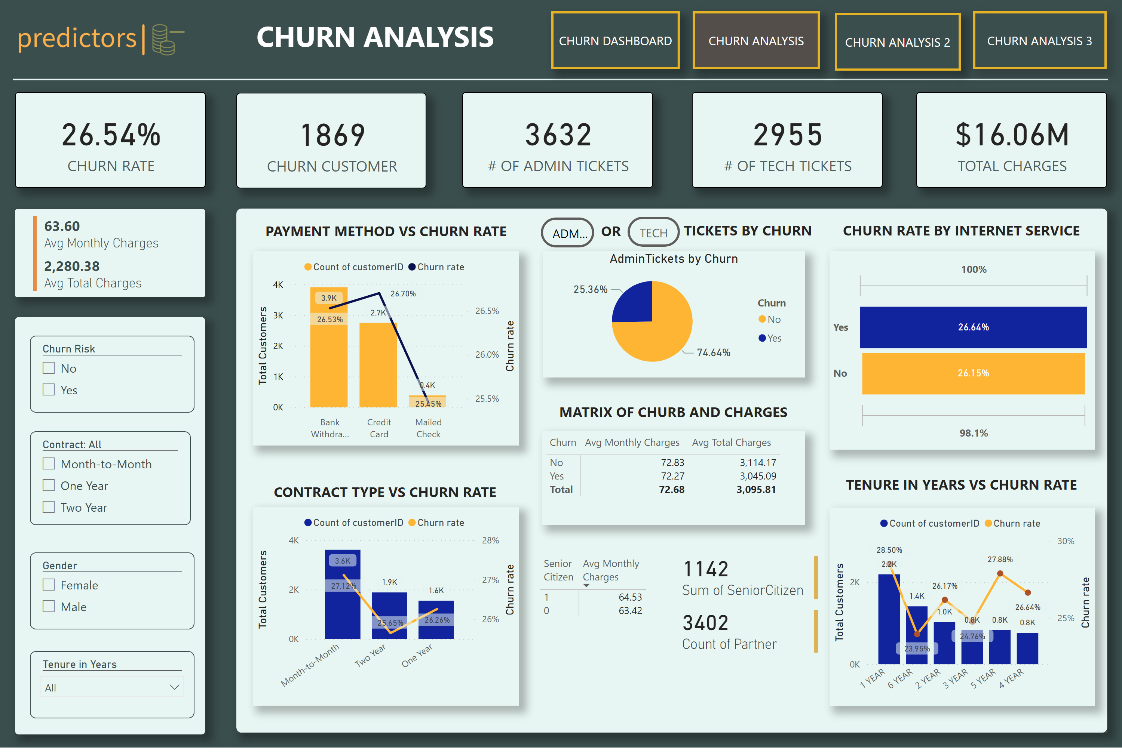
CHURN ANALYSIS
Notes:
shape
No alt text provided
HEADING
No alt text provided
actionButton
No alt text provided
actionButton
No alt text provided
card
No alt text provided
card
No alt text provided
card
No alt text provided
card
No alt text provided
card
No alt text provided
lineStackedColumnComboChart
No alt text provided
shape
No alt text provided
shape
No alt text provided
slicer
No alt text provided
slicer
No alt text provided
slicer
No alt text provided
slicer
No alt text provided
lineStackedColumnComboChart
No alt text provided
pieChart
No alt text provided
AdminTickets by Churn
No alt text provided
textbox
No alt text provided
textbox
No alt text provided
lineStackedColumnComboChart
No alt text provided
multiRowCard
No alt text provided
shape
No alt text provided
Multi-row card
No alt text provided
pivotTable
No alt text provided
actionButton
No alt text provided
actionButton
No alt text provided
textbox
No alt text provided
textbox
No alt text provided
pivotTable
No alt text provided
funnel
No alt text provided
Multi-row card
No alt text provided
actionButton
No alt text provided
textbox
No alt text provided
textbox
No alt text provided
textbox
No alt text provided
actionButton
No alt text provided
image
No alt text provided

Slide 5
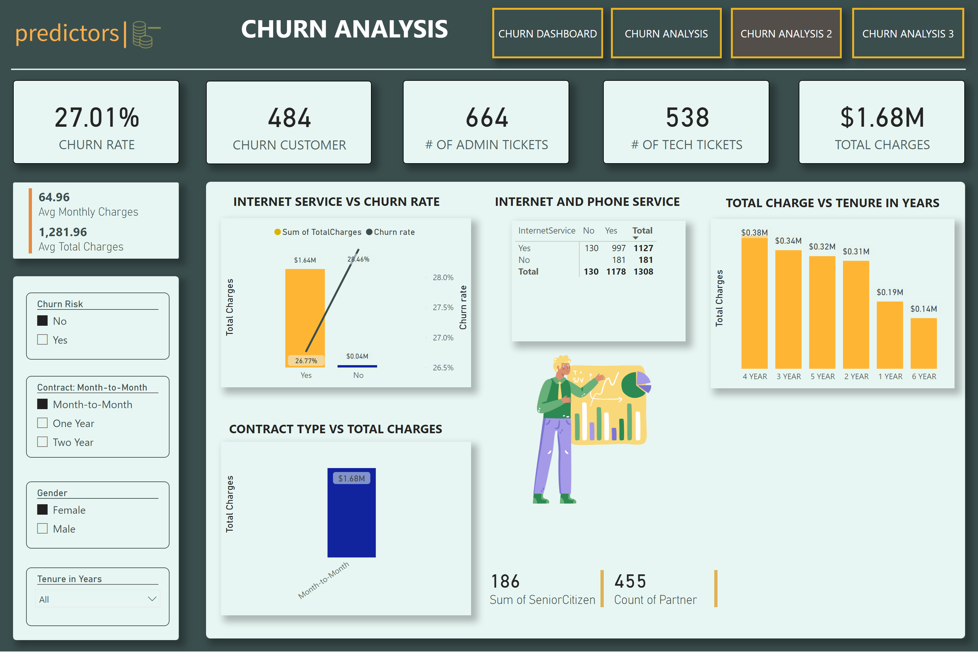
CHURN ANALYSIS 2
Notes:
shape
No alt text provided
HEADING
No alt text provided
actionButton
No alt text provided
actionButton
No alt text provided
card
No alt text provided
card
No alt text provided
card
No alt text provided
card
No alt text provided
card
No alt text provided
lineStackedColumnComboChart
No alt text provided
shape
No alt text provided
shape
No alt text provided
slicer
No alt text provided
slicer
No alt text provided
slicer
No alt text provided
slicer
No alt text provided
lineStackedColumnComboChart
No alt text provided
pieChart
No alt text provided
textbox
No alt text provided
textbox
No alt text provided
lineStackedColumnComboChart
No alt text provided
multiRowCard
No alt text provided
shape
No alt text provided
Multi-row card
No alt text provided
Multi-row card
No alt text provided
pivotTable
No alt text provided
image
No alt text provided
textbox
No alt text provided
actionButton
No alt text provided
textbox
No alt text provided
actionButton
No alt text provided
image
No alt text provided

Slide 6
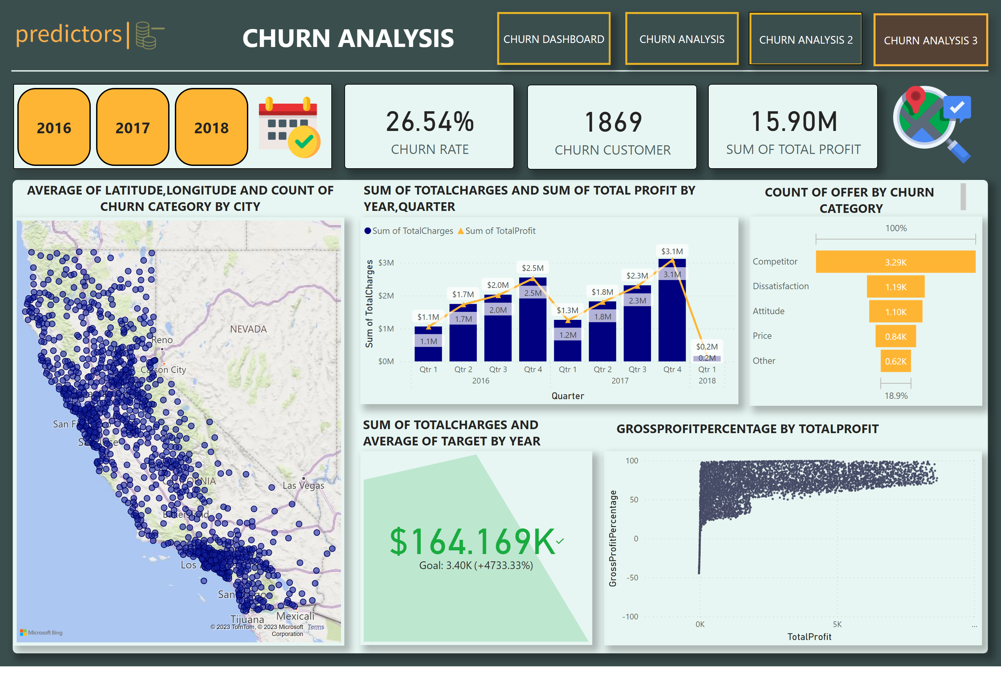
CHURN ANALYSIS 3
Notes:
shape
No alt text provided
HEADING
No alt text provided
actionButton
No alt text provided
actionButton
No alt text provided
card
No alt text provided
card
No alt text provided
shape
No alt text provided
pieChart
No alt text provided
textbox
No alt text provided
textbox
No alt text provided
actionButton
No alt text provided
textbox
No alt text provided
funnel
No alt text provided
scatterChart
No alt text provided
map
No alt text provided
lineStackedColumnComboChart
No alt text provided
kpi
No alt text provided
textbox
No alt text provided
textbox
No alt text provided
advancedSlicerVisual
No alt text provided
actionButton
No alt text provided
card
No alt text provided
image
No alt text provided
image
No alt text provided
image
No alt text provided

