Slide 1

Machine Learning Based Automated Construction
24-25J-201

Slide 2
This is our Team
Supervisor - Mr. Supunya Swarnakantha
Co- Supervisor - Dr. Dharshana Kasthurirathna
STUDENT NAME | REGISTRATION NUMBER
Sathurjan . K | IT21188718
Linganathan. J | IT21223808
Silva A A I | IT21188718
R A AHAMED | IT21223808

Slide 3


Introduction
Automated construction is a user-friendly website for users . It uses machine learning to analyze neck circumference cost estimation, material recommends, solar panel specifications Interior Design ,
Simple interface for accessibility to all users
The system aims to automate key planning tasks, enhance decision-making accuracy, and improve project efficiency

Slide 4

Research Question
Accurate, real-time cost and material estimates, considering local market variations and project specifics?
Recommend suitable materials using building plans and weather data, and what are the impacts on durability
What techniques can recommend optimal solar panel specifications and pricing based on energy consumption, location, and technology?
Learning tools improve communication between clients and architects, ensuring requirements are effectively incorporated into designs?

Slide 5




Objectives
Main Objective :
Specific Objectives
To develop architectural design process “Automated architectural plans”, developing a machine learning (ML) based system for automatic architecture planning
To integrate data processing techniques to accurately interpret complex architectural and climatic information
To ensure a user-friendly interface for widespread accessibility.
To Maintain high performance and quick response times

Slide 6
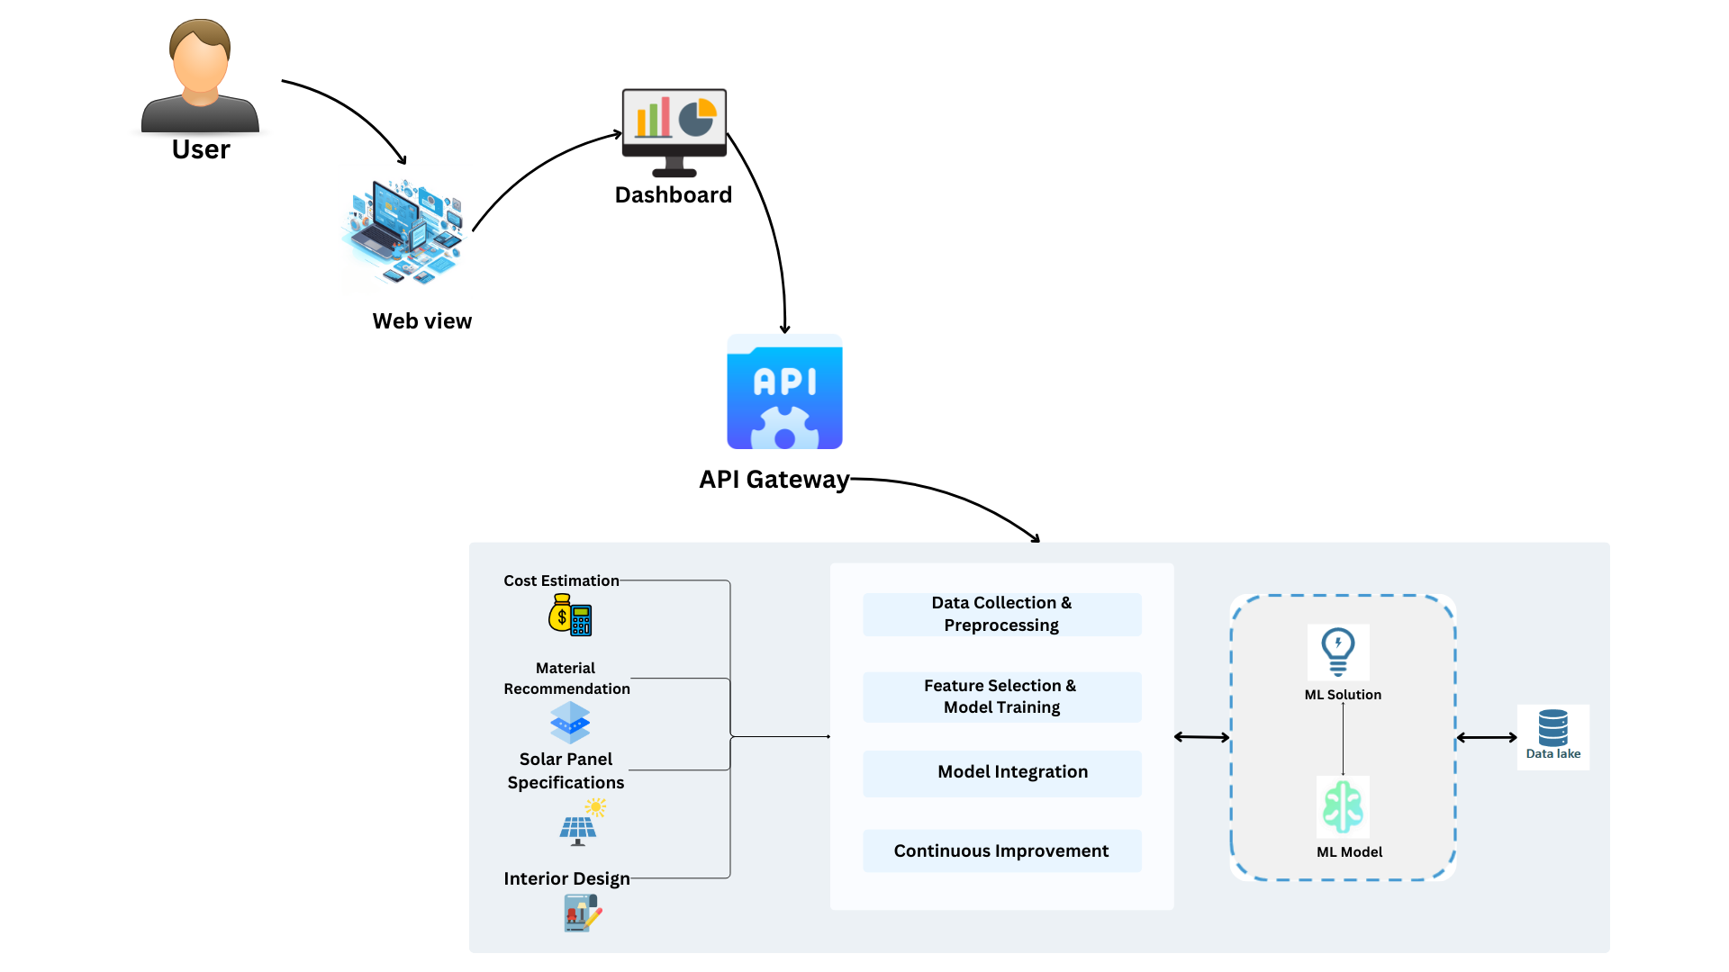
Overall System Diagram

Slide 7

IT21188718 | Sathurjan.K
BSc (Hons) in Information Technology Specializing in IT
IT21188718 | SATHURJAN.K| 24-25J-201

Slide 8
Introduction
Overview:
The construction industry faces significant challenges in selecting the right materials for varying climates and building designs.
Project Aim:
Develop a machine learning-based system to recommend the most suitable building materials for specific construction projects by analysing building plans and local weather conditions.

Slide 9

Research problem
The efficient selection of building materials is critical in architecture, particularly given the diverse climatic conditions and the unique requirements of each building design. However, challenges such as analysing vast datasets from building plans and weather conditions, selecting materials that balance cost, and adapting to local building codes make this task complex.
IT21223808 | LINGANATHAN . J | 24-25J-201

Slide 10

Objectives
Main Objective
Specific Objectives
Implement evaluation methods that material performance, cost, and sustainability for optimal recommendations.
To integrate data processing techniques to accurately interpret complex architectural and climatic information
Maintain high performance and quick response times, even with complex calculations and large datasets
To facilitate efficient project planning and cost management
Introduce recommend the most suitable building materials by analysing building plans and local weather data.

Slide 11
Research Gap
Aspect | Details
Lack of Recommendations | Current research does not provide precise recommendations tailored to specific building plans and local weather conditions.
Integration Challenges | Existing methods fail to effectively merge architectural and climatic data, compromising material selection accuracy.
Development of a New System | Proposes using advanced machine learning algorithms to extensively analyse building plans and weather data.
Optimized Material Selection | Recommends materials best suited to the specific conditions and requirements of construction projects.

Slide 12
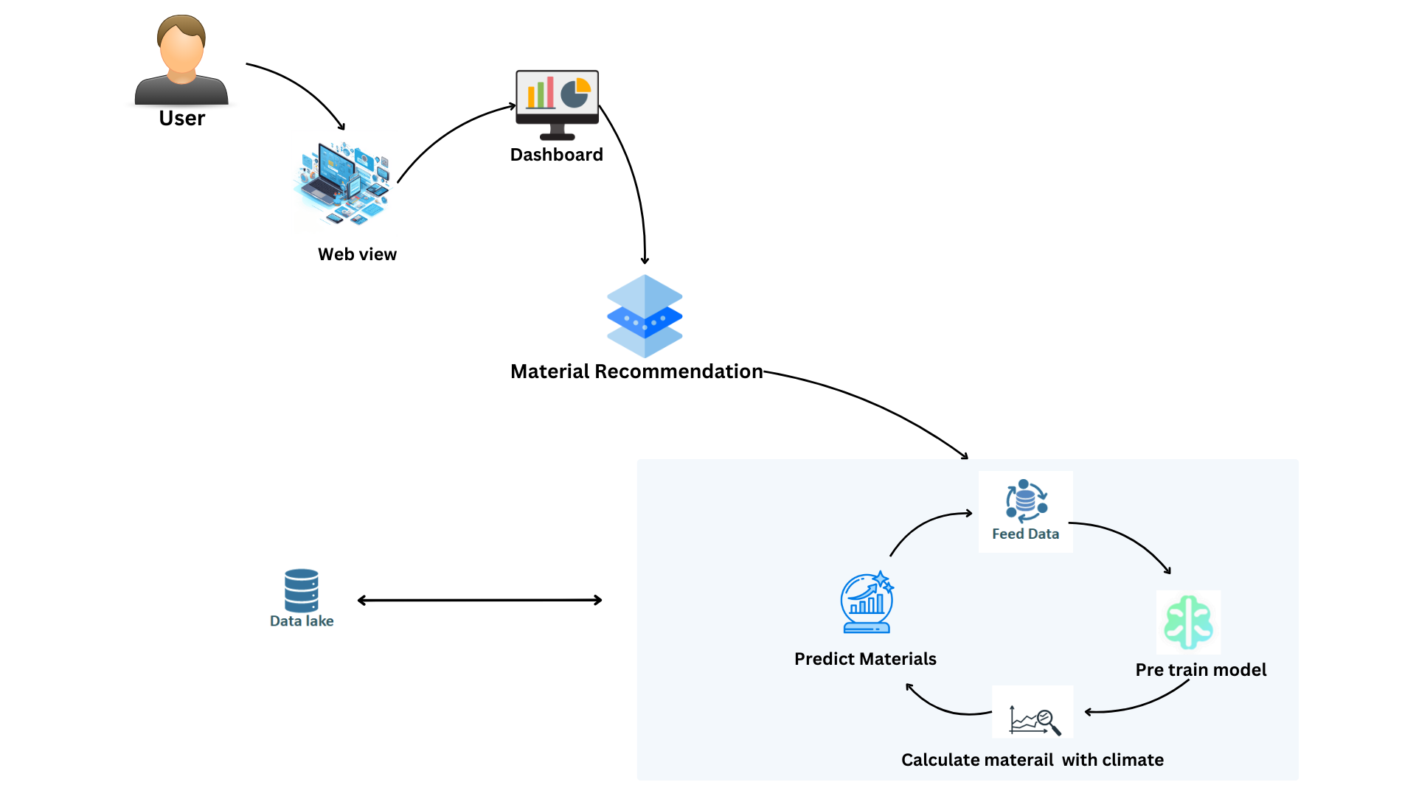
Component Diagram

Slide 13


Technologies
Machine Learning
Python, React, MongoDB (pymongo)
Technologies
and
Algorithms
Algorithms
Feature Extraction Techniques
Decision Trees
Random Forests

Slide 14

The system, Personnel and Software specification requirements
Software Specification Requirement
Non-Functional Requirements
Scalability: Capable of handling large datasets and increasing numbers of user queries without performance degradation.
Functional Requirements
User-friendly data input interface: Allows easy input of building plans and weather details.
Material recommendation dashboard: Displays suitable materials based on analyses, including durability and cost-effectiveness
Building plan and weather data processing: Incorporates algorithms to interpret complex datasets from climatic conditions
Required Data Set
Online Dataset
IT21223808 | LINGANATHAN . J| 24-25J-201

Slide 15
Commercialization
Market Potential : The system offers precise and environmentally friendly material recommendations, aligning with industry trends towards green building.
Business Model : Subscription-based model for individual users such as architects, engineers, and consultants.
Commercialization Strategy : Market analysis to identify target clients, such as green construction firms and regulatory bodies.
Scaling : Introduction of new features like integration with BIM tools and localized material recommendations.

Slide 16
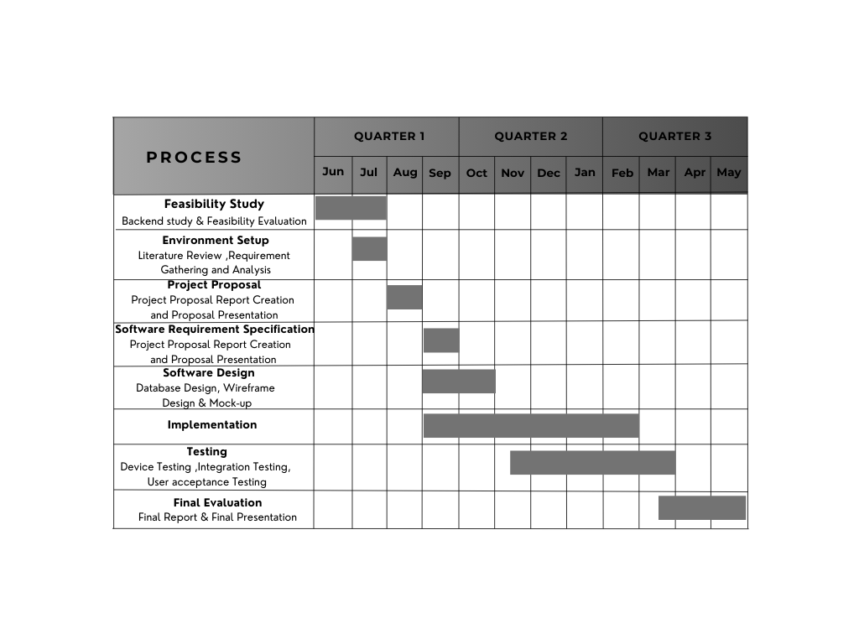
Gantt Chart

Slide 17
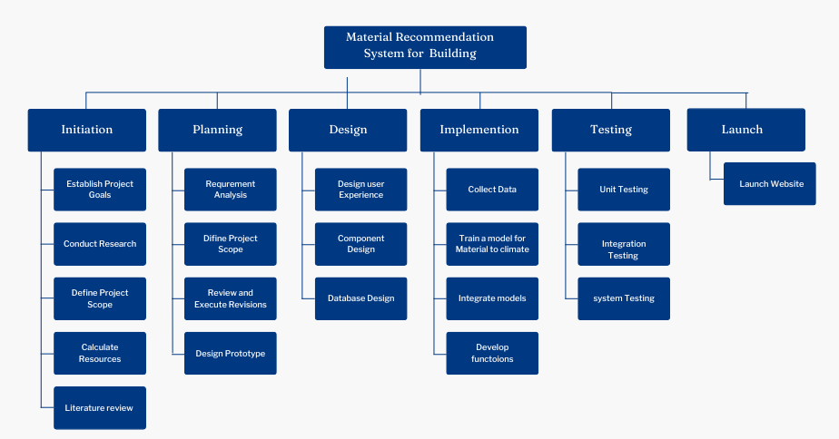
Work Breakdown Structure

Slide 18
References
[1] “The easiest way to find the and compare building materials”, Available: https://2050-materials.com/.
[2]“Building Materials”, Available: https://www.bimobject.com/en/categories/building-materials.
[3] “Building Materials and Components statistics” : https://www.data.gov.uk/dataset/75ee36ed-21f7-4d7b-9e7c-f5bf4546145d/building-materials-and-components-statistics.
[3] “Climate change ” : https://www.data.gov.uk/dataset/75ee36ed-21f7-4d7b-9e7c-f5bf4546145d/building-materials-and-components-statistics.
[4]Kaggle : “Climate change Earth Surface Temperature Data” : https://www.kaggle.com/datasets/berkeleyearth/climate-change-earth-surface-temperature-data?select=GlobalLandTemperaturesByMajorCity.csv

Slide 19

IT21188718 |R A Ahamed
BSc (Hons) in Information Technology Specializing in IT
IT21158018 | R A AHAMED | 24-25J-201

Slide 20
Introduction
Overview:
Construction projects often face challenges in cost estimation due to fluctuating material prices and varying project demands.
Accurate and dynamic estimation methods can significantly improve budgeting and project planning.
Project Aim:
Develop a system that uses machine learning to provide real-time construction cost and material estimations.
Base estimations on current market data and historical trends to ensure accuracy and adaptability.

Slide 21
Research Problem
The construction industry still relies heavily on static and outdated methods for cost estimation, leading to inaccuracies and budget overruns. This project aims to integrate machine learning to dynamically adjust cost predictions based on real-time data, addressing these critical shortcomings.[1]

Slide 22
Objectives
Objectives
Specific Objectives
To create a robust machine learning model that can predict construction costs and material needs accurately and adaptively.
Enhance the model's ability to adapt to new data and improve estimation accuracy over time.
Develop a user-friendly interface for inputting project parameters and retrieving estimates.
Utilize historical data to refine the model's predictive accuracy and responsiveness.

Slide 23
Research Gap
Lack of Dynamic Methods: Existing research lacks dynamic and adaptable methods for construction cost and material estimations.[
Reliance on Static Data: Current methods often rely on static data, which does not account for real-time fluctuations in material prices and labor costs.[2]
Need for Adaptive Approach: There is a clear need for a more adaptive and data-driven approach to address these limitations.[3]
Proposed Solution: The proposed research aims to develop a system that uses machine learning algorithms to dynamically adjust cost estimations.

Slide 24
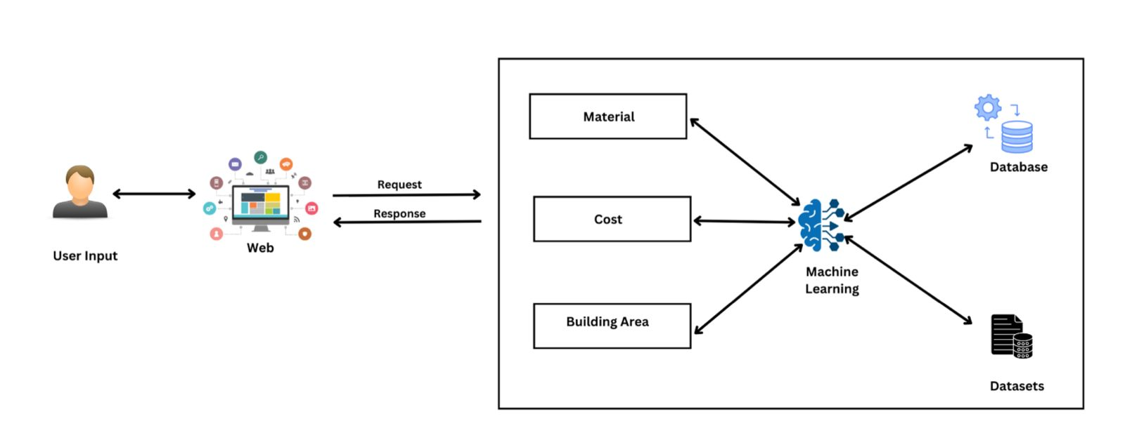
Component Diagram

Slide 25
Technologies
Machine Learning: Enhance predictive accuracy and adaptability.
Python: For backend development and model implementation.
MongoDB: To store and manage dynamic data inputs and outputs.
Technologies
and
Algorithms
Algorithms
Linear Regression: To predict costs based on various inputs.
Clustering Algorithms: To categorize materials and associated costs for better estimation.

Slide 26
The system, Personnel and Software specification requirements
Software Specification Requirement
Functional Requirements
User-Friendly Interface for Data Input: Include forms to enter built-up area and estimated cost per square foot along with other project-specific details.
Dashboard to Display Cost Breakdowns: Show detailed breakdowns of construction costs, material estimations, and potential savings.
Real-Time Data Processing: Ability to handle real-time data for accurate and dynamic cost estimation.
Machine Learning Model Implementation: Utilize regression models and other algorithms to predict and adjust construction costs based on historical data and ongoing market trends.
Non-Functional Requirements
Scalability: The system must efficiently handle large datasets and multiple user queries without performance degradation.
Security: Ensure high levels of security to protect sensitive construction cost data and user inputs.
Required Data Set
Historical Construction Cost Data: Gathered from past projects and standard construction cost databases.
Real-Time Market Data: Use APIs to fetch current material costs and labor rates.
User-Entered Project Details: Forms that capture detailed information about the construction project’s scope and specifications.
IT21223808 | LINGANATHAN . J| 24-25J-201

Slide 27

To commercialize the machine learning-powered construction cost estimation system, focus on key areas: identify market demand for digital tools in construction industry; market the system to construction companies, project management firms and government; adopt a tiered pricing structure for different levels of service; emphasize the systems ability to give live, accurate cost estimates; and look at different revenue models such as subscription fees, professional services and value added via data analysis. It will also have a better marketing and distribution strategy that will cover extensive market and sustainable long-term.

Slide 28
Gantt Chart

Slide 29

Work Breakdown Structure
Work Breakdown Structure

Slide 30
References
[1] Sphurti S. Arage and Nagaraj V. Dharwadkar, "Cost Estimation of Civil Construction Projects Using Machine Learning Paradigm," IEEE. Available: [https://ieeexplore.ieee.org/document/8058249](https://ieeexplore.ieee.org/document/8058249).
[2] Sanaz Tayefeh Hashemi, Omid Mahdi Ebadati, and Harleen Kaur, "Cost Estimation and Prediction in Construction Projects: A Systematic Review on Machine Learning Techniques," SN Applied Sciences, vol. 2, article 1703, September 2020. Available: [https://link.springer.com/article/10.1007/s42452-020-03497-1](https://link.springer.com/article/10.1007/s42452-020-03497-1).
[3] Salman Saeidlou and Nikdokht Ghadiminia, "A Construction Cost Estimation Framework Using DNN and Validation Unit," Available: [https://www.tandfonline.com/doi/full/10.1080/09613218.2023.2196388](https://www.tandfonline.com/doi/full/10.1080/09613218.2023.2196388).
[4] Suchitha, N. V., Adithya, S., Ashik, S., Dhanush, S., & Thrinsh Reddy S. G. (Year). Home construction cost estimation using ML. Sri Dharmasthala Manjunatheshwara Institute of Technology. Retrieved from https://www.irejournals.com/formatedpaper/1704488.pdf

Slide 31

IT21223808 |Linganathan.J
BSc (Hons) in Information Technology Specializing in IT
IT21223808 | LINGANATHAN . J| 24-25J-201

Slide 32
Introduction
Overview:
- Solar energy is a key solution to the growing energy needs and environmental concerns
- Harnessing solar power efficiently can significantly reduce carbon footprint and energy costs.
Project Aim:
- Develop a system to recommend optimal solar panel specifications and pricing.
- Base recommendations on estimated energy consumption and available land area.
IT21223808 | LINGANATHAN . J| 24-25J-201

Slide 33
Research problem
The growing demand for renewable energy necessitates cost-effective solar panel installations. However, challenges like predicting energy consumption, selecting suitable configurations, and balancing cost, efficiency, and space constraints remain.
The research aims to recommend solar panel specifications and pricing based on estimated energy consumption and available land area. It explores models, algorithms, selection methods, and cost estimation methods to develop a tailored system for reliable solar panel recommendations.
IT21223808 | LINGANATHAN . J | 24-25J-201

Slide 34
Objectives
Main Objective :
Specific Objectives
Ensure scalability and accuracy of the system.
Provide secure and private data handling.
Maintain high performance and quick response times.
Create algorithms to calculate land area and estimate power demand.
Develop a user-friendly interface for data collection.
Integrate cost consumption estimation using Linear Regression and Clustering Algorithms.

Slide 35
Research Gap
The existing research literature lacks accurate and personalized solar panel installation recommendations.
Current methods often fail to integrate energy consumption predictions with customized configurations and cost estimations.
This gap highlights the need for a more comprehensive approach.
The proposed research aims to fill this gap by developing a system using advanced algorithms to predict energy consumption, optimize solar panel configurations, and integrate cost estimation methods.
This will provide precise, efficient, and cost-effective solar panel recommendations, enhancing the adoption and effectiveness of solar energy solutions.
IT21223808 | LINGANATHAN . J| 24-25J-201

Slide 36
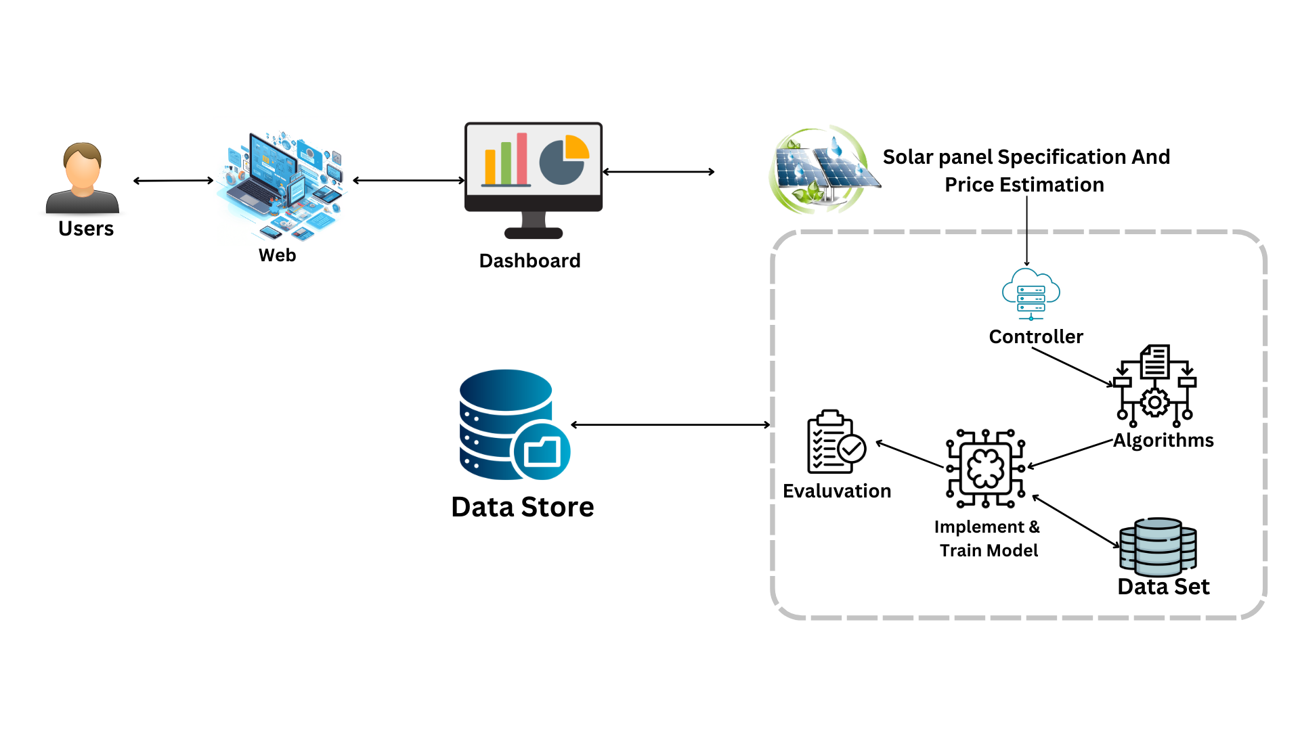
Component Diagram
IT21223808 | LINGANATHAN . J| 24-25J-201

Slide 37
Technologies
Machine learning
Python, React, MongoDB (pymongo)
Technologies
and
Algorithms
Algorithms
Linear Regression
Clustering Algorithms
IT21223808 | LINGANATHAN . J| 24-25J-201

Slide 38
The system, Personnel and Software specification requirements
Software Specification Requirement
Non-Functional Requirements
Scalability - Handle large datasets and numerous user requests.
Security - Protect user data and ensure privacy.
Functional Requirements
User-friendly data input interface.
Dashboard for solar panel recommendations, energy consumption, and cost analysis.
Historical energy consumption data processing.
Machine learning models for predicting future energy consumption.
Algorithms for handling various data types and formats.
Linear Regression and Clustering Algorithms for cost and savings estimation.
Required Data Set
Online Dataset
IT21223808 | LINGANATHAN . J| 24-25J-201

Slide 39
Commercialization
Market Potential : High demand for renewable energy creates a strong opportunity. The system offers precise, affordable solar recommendations
Business Model : A subscription-based model for end-users and a licensing model for businesses, with tiered plans based on service levels
Commercialization Strategy : Market analysis to identify target clients, pricing, and partners and product refinement on improve based on pilot feedback
Scaling : Scale the system with new features and expand to international markets as the user base grows.

Slide 40
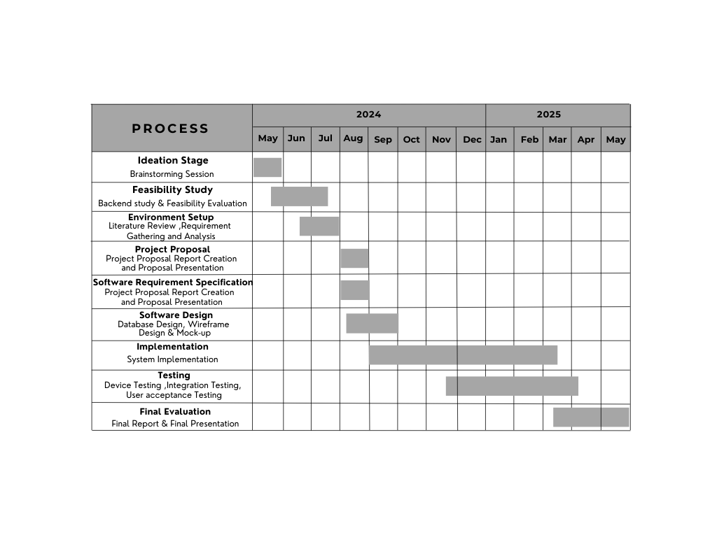
Gantt Chart
IT21223808 | LINGANATHAN . J| 24-25J-201

Slide 41
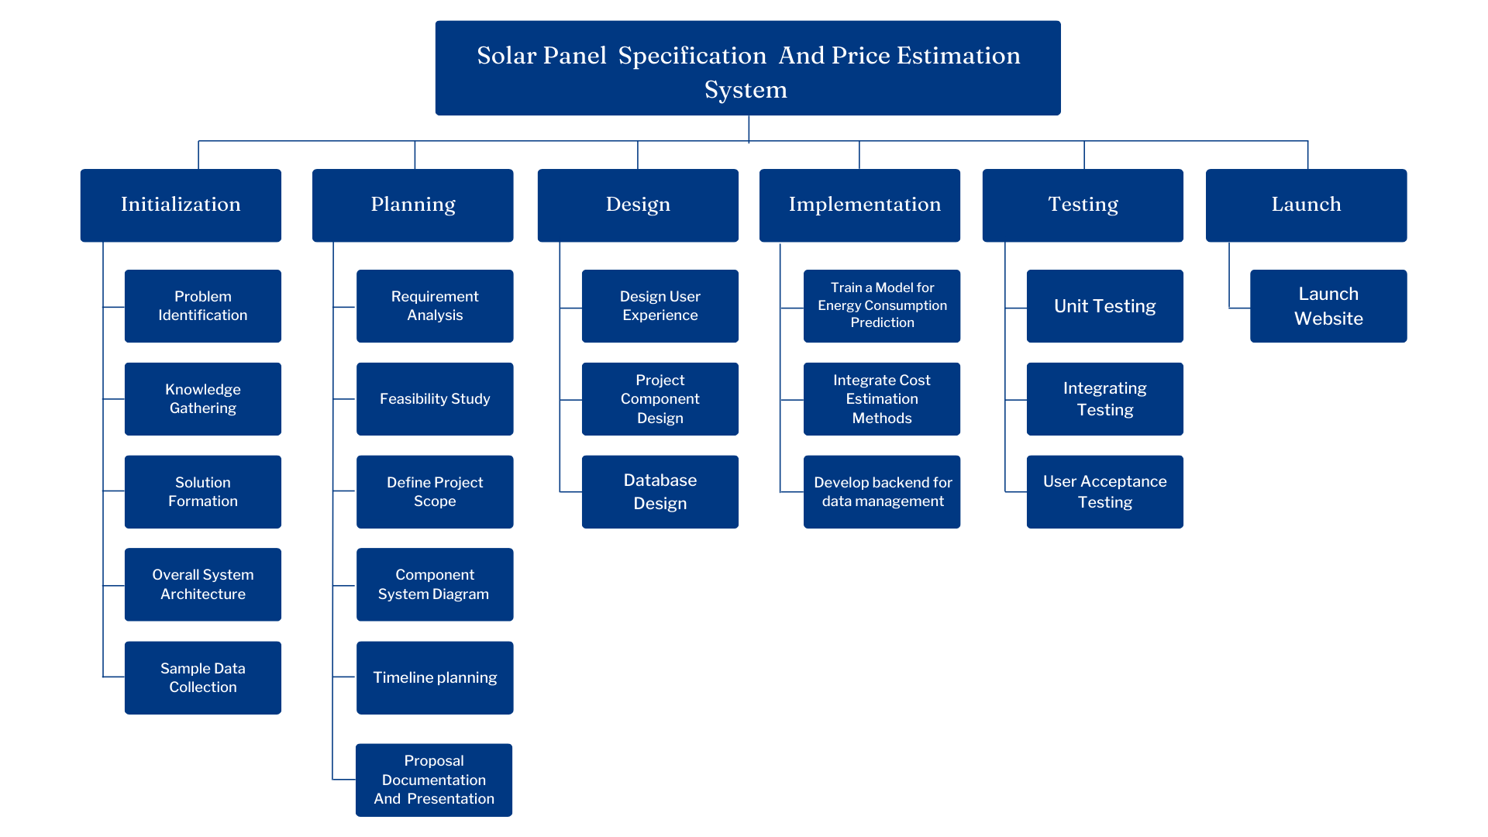
Work Breakdown Structure

Slide 42
References
[1] Ani Kannal, “Solar Power Generation Data: Solar power generation and sensor data for two power plants”, Feb,2020, Available: https://www.kaggle.com/datasets/anikannal/solar-power-generation-data/data.
[2] Meshva , “Solar energy power generation dataset: Solar power generated from a solar plant”, May,2021, Available: https://www.kaggle.com/datasets/stucom/solar-energy-power-generation-dataset .
[3] UK Power Networks , “Photovoltaic (PV) Solar Panel Energy Generation data: UK Power Networks”, April,2022, Available: https://data.london.gov.uk/dataset/photovoltaic--pv--solar-panel-energy-generation-data .
[4] Yingchen Zhang (Manager, Sensing, Measurement, and Forecasting Group), “Solar Power Data for Integration Studies(NREL's Solar Power Data for Integration Studies are synthetic solar photovoltaic (PV) power plant data points for the United States representing the year 2006,” Jun. 2023, Available: https://www.nrel.gov/grid/solar-power-data.html .
[5] Sheffield Solar , “PV_Live:Live PV generation,” 03 August. 2024, Available: https://www.solar.sheffield.ac.uk/pvlive/ .
[6] Nate Blair, Nicholas DiOrio, Janine Freeman,Paul Gilman, Steven Janzou, Ty Neises, and Michael Wagne, “System Advisor Model (SAM)
General Description,” national laboratory of the U.S. Department of Energy Office of Energy Efficiency & Renewable Energy Operated by the Alliance for Sustainable Energy, LLC, vol. 2017.9.5, TP-6A20-70414, May. 2020, doi: http://www.osti.gov/scitech .
IT21223808 | LINGANATHAN . J| 24-25J-201

Slide 43

IT21301254 | Silva A.A.I
BSc (Hons) in Information Technology Specializing in IT
IT21301254 | Silva A.A.I | 24-25J-201

Slide 44
Introduction
Overview:
My component , "AI-Driven Interior Design Collaboration Platform," focuses on improving the way clients and interior architecture designers interact during the design process. Clients often struggle to clearly convey their design ideas due to a lack of technical knowledge, which leads to misunderstandings and inefficiencies
Project Aim:
The aim of my component is to develop an interactive design dashboard that integrates text, and image inputs. This tool will bridge the communication gap by enabling clear, real-time interaction between clients and interior architecture designers, facilitating better understanding and quicker decision-making.
IT21301254 | Silva A.A.I | 24-25J-201

Slide 45
Research problem
Communication Gap- Clients often have a clear vision for their interior spaces but lack the technical language and expertise to communicate their ideas effectively to interior architecture designers. This communication gap leads to misunderstandings, design iterations, and project delays.[3]
Inefficiency and Rework- Due to the inability to accurately express their design preferences, clients frequently face multiple revisions and rework, resulting in inefficiencies and increased project costs. This problem hinders productivity and client satisfaction.
IT21301254 | Silva A.A.I | 24-25J-201

Slide 46
Objectives
Main Objective :
Specific Objectives
Utilize AI LLM-powered image generation to visualize client design ideas accurately.
Implement a reinforcement learning-based recommendation system that adapts to client preferences according to reward feedback.
Develop an AI-driven platform to enhance client-designer communication and improve design efficiency.
IT21301254 | Silva A.A.I | 24-25J-201

Slide 47

Research Gap
Existing platforms lack integration of text and image inputs for complete design communication.[2]
Current tools do not use advanced AI LLM-driven image generation for accurate visualizations.
Traditional systems miss out on reinforcement learning algorithms like Q-learning for adapting recommendations.
Current platforms do not use policy-gradient methods for optimizing design suggestions in real-time.[4]
Platforms lack adaptive learning to improve recommendation relevance based on client feedback.
IT21301254 | Silva A.A.I | 24-25J-201

Slide 48
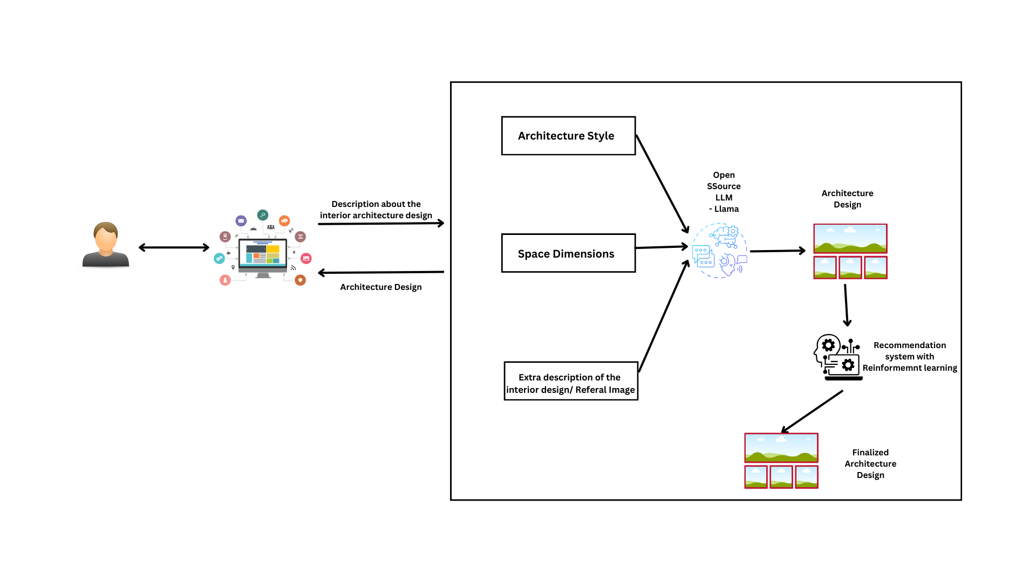
Component Diagram
IT21301254 | Silva A.A.I | 24-25J-201

Slide 49
Technologies Used
Backend: Python, Django
Frontend: React
AI and Machine Learning: Open Source LLM, Reinforcement Learning (Q-learning, Policy Gradient)
Recommendation System: Collaborative Filtering, Matrix Factorization
Database: PostgreSQL
API: RESTful API
Cloud Hosting: Azure
Technologies
and
Algorithms
IT21301254 | Silva A.A.I | 24-25J-201

Slide 50
The system, Personnel and Software specification requirements
Software Specification Requirement
Non-Functional Requirements
Performance: Handle high loads with minimal latency.
Usability: Intuitive interface for seamless interaction.
Reliability: Consistent availability and minimal downtime.
Accuracy: Ensure precise design visualizations and recommendations.
Functional Requirements
Image generation for design visualization.
Personalized design recommendations using reinforcement learning.
Integrated text and image input for design feedback.
Real-time updates on design adjustments and feedback.
Required Data Set
Kaggle Datasets: Publicly available design data and trends.[1]
Sri Lankan Interior Architecture: Region-specific data from local designers.
IT21301254 | Silva A.A.I | 24-25J-201

Slide 52
Gantt Chart
IT21301254 | Silva A.A.I | 24-25J-201

Slide 54
References
[1] DUMITRUX, "Architectural Styles," Available: [https://www.kaggle.com/datasets/dumitrux/architectural-styles-dataset]
[2] Zhe Xu, Ya Zhang, Dacheng Tao, and Junjie Wu, "Architectural Style Classification Using Multinomial Latent Logistic Regression," Shanghai Jiao Tong University, Sun Yat-Sen University, 2014. Available: [https://www.researchgate.net/publication/275604099_Architectural_Style_Classification_Using_Multinomial_Latent_Logistic_Regression]
[3] Nima Norouzi, Maryam Shabak, Mohamed Rashid Embi, and Tareef Hayat Khan, "The Architect, the Client and Effective Communication in Architectural Design Practice," Universiti Teknologi Malaysia, Islamic Azad University, January 2015. Available: [https://www.researchgate.net/publication/273501174_The_Architect_the_Client_and_Effective_Communication_in_Architectural_Design_Practice]
[4] Feiyang Pan, Qingpeng Cai, Pingzhong Tang, Fuzhen Zhuang, and Qing He, "Policy Gradients for Contextual Recommendations." Available: [https://arxiv.org/abs/1802.04162](https://arxiv.org/abs/1802.04162).
IT21301254 | Silva A.A.I | 24-25J-201

