Slide 1

FreshKeep Spatial
Your whole kitchen, at a glance — so nothing goes to waste
Abisheak S · IT21244384 · SE4041 Assignment 02 — Part B (visionOS)
Notes:
Hi, I am Abisheak. FreshKeep Spatial is a visionOS app that lets people see everything in their kitchen in 3D and rescue food before it expires.

Slide 2
Households throw away food they forgot they had
🙈
Out of sight, out of mind
79 kg
Food at the back of the fridge is forgotten until it smells.
⌨️
Tracking apps are tedious
of food wasted per person, per year, at home (UNEP Food Waste Index 2024)
Typing every item and date by hand — people give up in days.
Households are the single largest source of food waste.
🤷
No idea what to use first
Nothing tells you which food is about to expire today.
Notes:
The problem is forgetting. UNEP estimates 79 kg per person per year is wasted at home. Existing apps fail because data entry is boring.

Slide 3
Why spatial computing?
🧊
Kitchens are physical spaces
👀
Glanceable urgency
A 3D fridge you can look into beats a scrolling list.
Colour and distance show what expires first — no reading needed.
🙌
Hands-free while cooking
🏠
Made for the home
Look and pinch with messy hands; no phone to unlock.
Vision Pro is used at home, where the food decisions happen.
Notes:
Spatial computing turns an invisible problem into something you can see.

Slide 4
Three spatial experiences
🪟
🧊
🕰️
Glass window
3D virtual fridge (volume)
Expiry timeline (immersive)
Pantry grouped by urgency, item details and recipe ideas. Ornament launches the spatial modes.
Shelves for fridge, counter, pantry and freezer. Items are tokens coloured by freshness. Pinch to inspect; drag into the pot to cook.
Food floats on an arc around you in your real kitchen — the closer it is, the sooner it expires.
Notes:
The prototype has three scenes. All share the same data as the iPhone app.

Slide 5
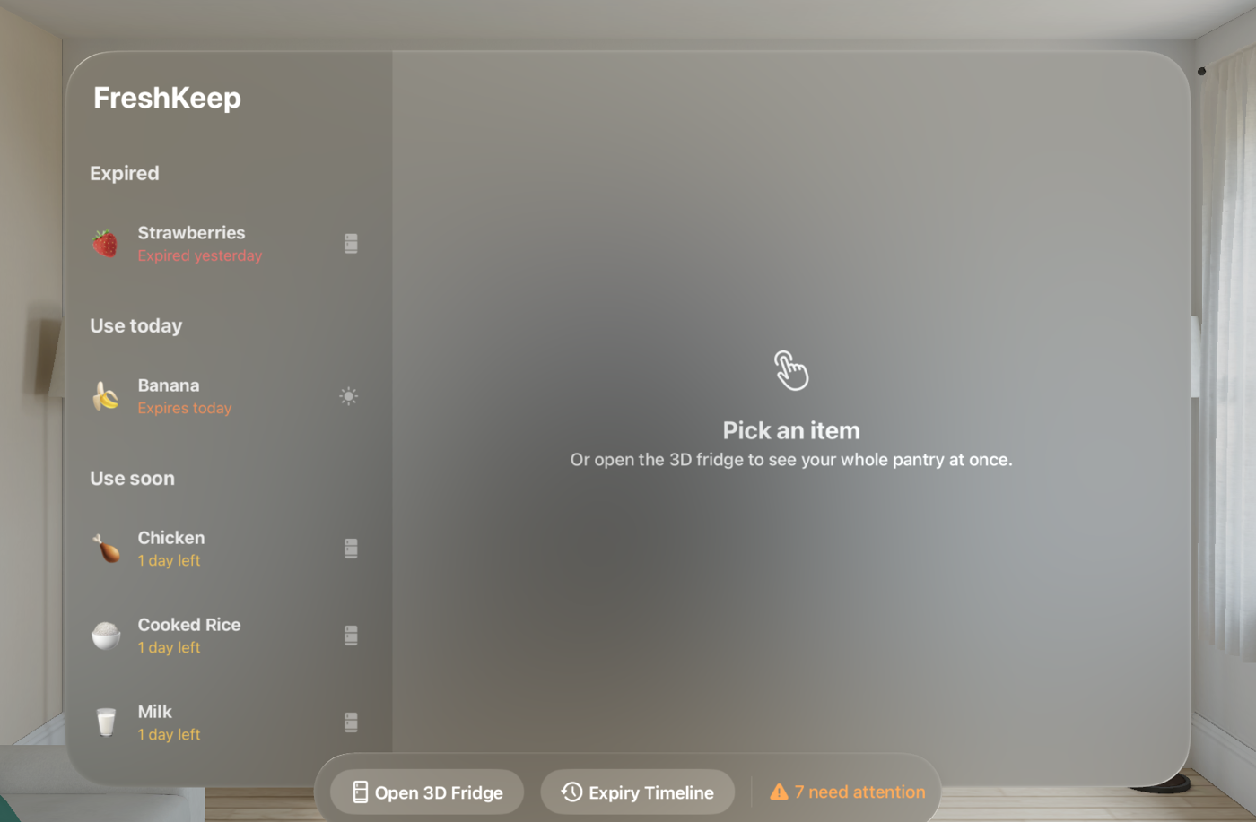
Working prototype on visionOS
RealityKit volume
generated 3D shelves, tokens and pot — no asset files
Spatial gestures
SpatialTapGesture + DragGesture targeted to entities
Attachments
SwiftUI glass cards floating above 3D items
Shared data
same SwiftData model + FreshKeepCore package as iOS
Verified in CI
built and launched in the Vision Pro simulator on every push
Notes:
Demo: open the fridge volume, pinch a banana to see its card, drag it into the pot. Then open the expiry timeline.

Slide 6
Designed for eyes and hands
👁️
Look + pinch
Select an item; hover highlight shows what you are looking at
🤏
Pinch + drag
Pick food up and drop it into the Cook-now pot to log it as eaten
🧭
Ornaments
Primary actions float below the window, following Apple HIG
🔮
Glass & depth
System glass materials keep the room visible and comfortable
🧘
Comfort
Content at 0.8 – 2.2 m, mixed immersion, no forced motion
Notes:
Every interaction maps to the native visionOS input model: look, pinch, drag.

Slide 7
Existing apps solve only part of it
Product | Platform | What it does | Gap
Crouton | iOS, visionOS | Recipe manager and cooking mode | No pantry or expiry awareness
Lowe's Style Studio | visionOS | Design a kitchen spatially | Kitchen layout, not food
Smart fridges with cameras | Appliance | Look inside the fridge remotely | Expensive hardware; fridge only
NoWaste / Fridgely | iOS | Manual inventory and expiry lists | Typing; not spatial
FreshKeep Spatial | iOS + visionOS | AI capture on iPhone, 3D pantry & timeline on Vision Pro | Whole kitchen, urgency-first
Notes:
Competitors either do recipes, kitchen design or need special hardware. Nobody makes the food itself visible and urgent.

Slide 8
Who it is for
Beachhead
Long term
FreshKeep iPhone users who own an Apple Vision Pro — early adopters, home cooks
Expansion
Expansion
All Vision Pro households; families who share a kitchen
Beachhead
Long term
Lighter, cheaper headsets and smart-home partners
Notes:
We start with people who already use FreshKeep on iPhone and own a Vision Pro, then grow as headsets get cheaper.

Slide 9
Revenue model: freemium + partnerships
Free
FreshKeep Plus
Partners
iPhone app
USD 2.99 / month · USD 24.99 / year (proposed)
B2B (future)
Scan food & labels
Reminders
Insights
Spatial fridge & timeline
Household sharing & iCloud sync
Premium recipe packs
Grocery partners: “use it up” offers
Appliance makers: licensed spatial view
Anonymised waste insights for NGOs
Notes:
The iPhone app stays free to build habit. Spatial features are part of a Plus subscription. Later, partnerships with grocers and appliance makers.

Slide 10
Go-to-market plan
1
2
3
4
Launch iOS
Add Spatial
Build proof
Partner
Free on the App Store; campus and sustainability communities in Sri Lanka
Release FreshKeep Plus with the visionOS app; App Store feature pitch
Publish rescue stats; partner with food-waste NGOs and cooking creators
Pilot "use it up" offers with grocers; explore appliance licensing
Notes:
iOS first to grow users cheaply, then the spatial app as the premium differentiator.

Slide 11
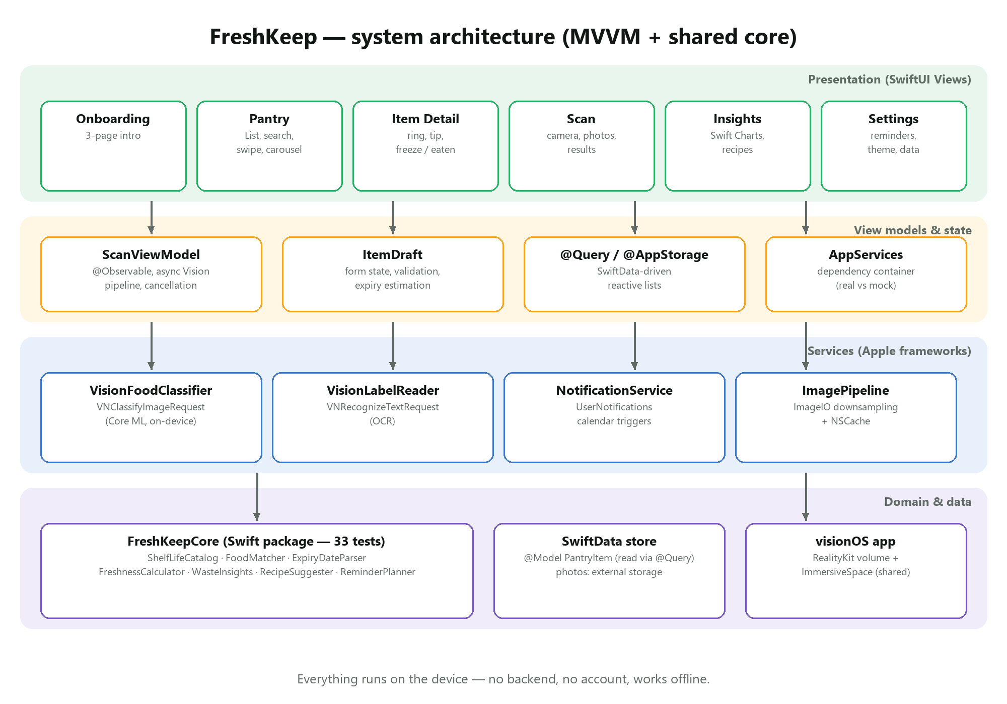
Built to scale across Apple platforms
One Swift package shared by iPhone and Vision Pro
SwiftData model shared by both apps
On-device Vision AI — private and offline
RealityKit entities generated in code (small app size)
50+ automated tests run on every push
Notes:
The same core code powers both apps, so features ship to both platforms at once.

Slide 12
Impact and roadmap
Next
Less waste
Urgency-first view and reminders target the main cause: forgetting
Anchor labels to the real fridge with object tracking
SharePlay household mode: plan meals together
Custom Core ML model for local produce (jackfruit, gotukola)
Apple TV / iPad kitchen dashboards
Money saved
Every rescued item is tracked in LKR so users see the benefit
Lower emissions
Rescued food avoids its CO₂e footprint
Notes:
Next steps make the experience even more physical: labels attached to the real fridge.

Slide 13
See it. Save it.
Thank you — questions?
github.com/IT21244384/SE4041-FreshKeep
Notes:
Thank you. Happy to take questions or show the prototype again.

