Slide 1
SE4041 / MADD / PART B
The decision
before the film.
TONIGHT?
Pick together.
A better way for a group to agree on movie night.
GATHERTV
Ama Hitiarachchi
IT22079640
ONE ROOM • ONE REMOTE

Slide 2
01 / THE IDEA
What is GatherTV?
A simple group decision flow on one Apple TV.
01
02
03
04
Create movie night
→
Set the vibe
→
Vote
→
See the ranking
Name the night + people
Mood • genres • time
For or Against each film
Vote score + mood match
NATIVE tvOS PROTOTYPE
PROTOTYPE LIMITS
One Apple TV • one shared remote
14 fictional films • No accounts • No playback
02 / 08

Slide 3
02 / THE AUDIENCE
Who is it for?
Designed around a shared screen and a shared decision.
FRIENDS / FAMILY
THE JOB
Agree what to watch tonight.
2–8 named
participants
Together in one room.
Passing one Apple TV remote.
NOT THE CURRENT USE CASE
Solo viewing or people in different cities
A limit enforced by the Create screen
03 / 08

Slide 4
03 / EXISTING ALTERNATIVES
What already exists?
Useful products - but each solves a different part of the experience.
Apple TV app
Letterboxd
Recommends from household profile history; supports SharePlay.
Film diary: ratings, reviews, lists and watchlist.
GatherTV adds named For / Against votes for tonight.
GatherTV is a group decision, not a diary.
JustWatch
Teleparty
Finds where a title is available to stream.
Synchronised playback and chat across supported services.
GatherTV decides before the service search.
GatherTV votes on one TV; it does not play video.
GatherTV’s difference: same-room voting + a readable explanation of the ranking.
04 / 08

Slide 5
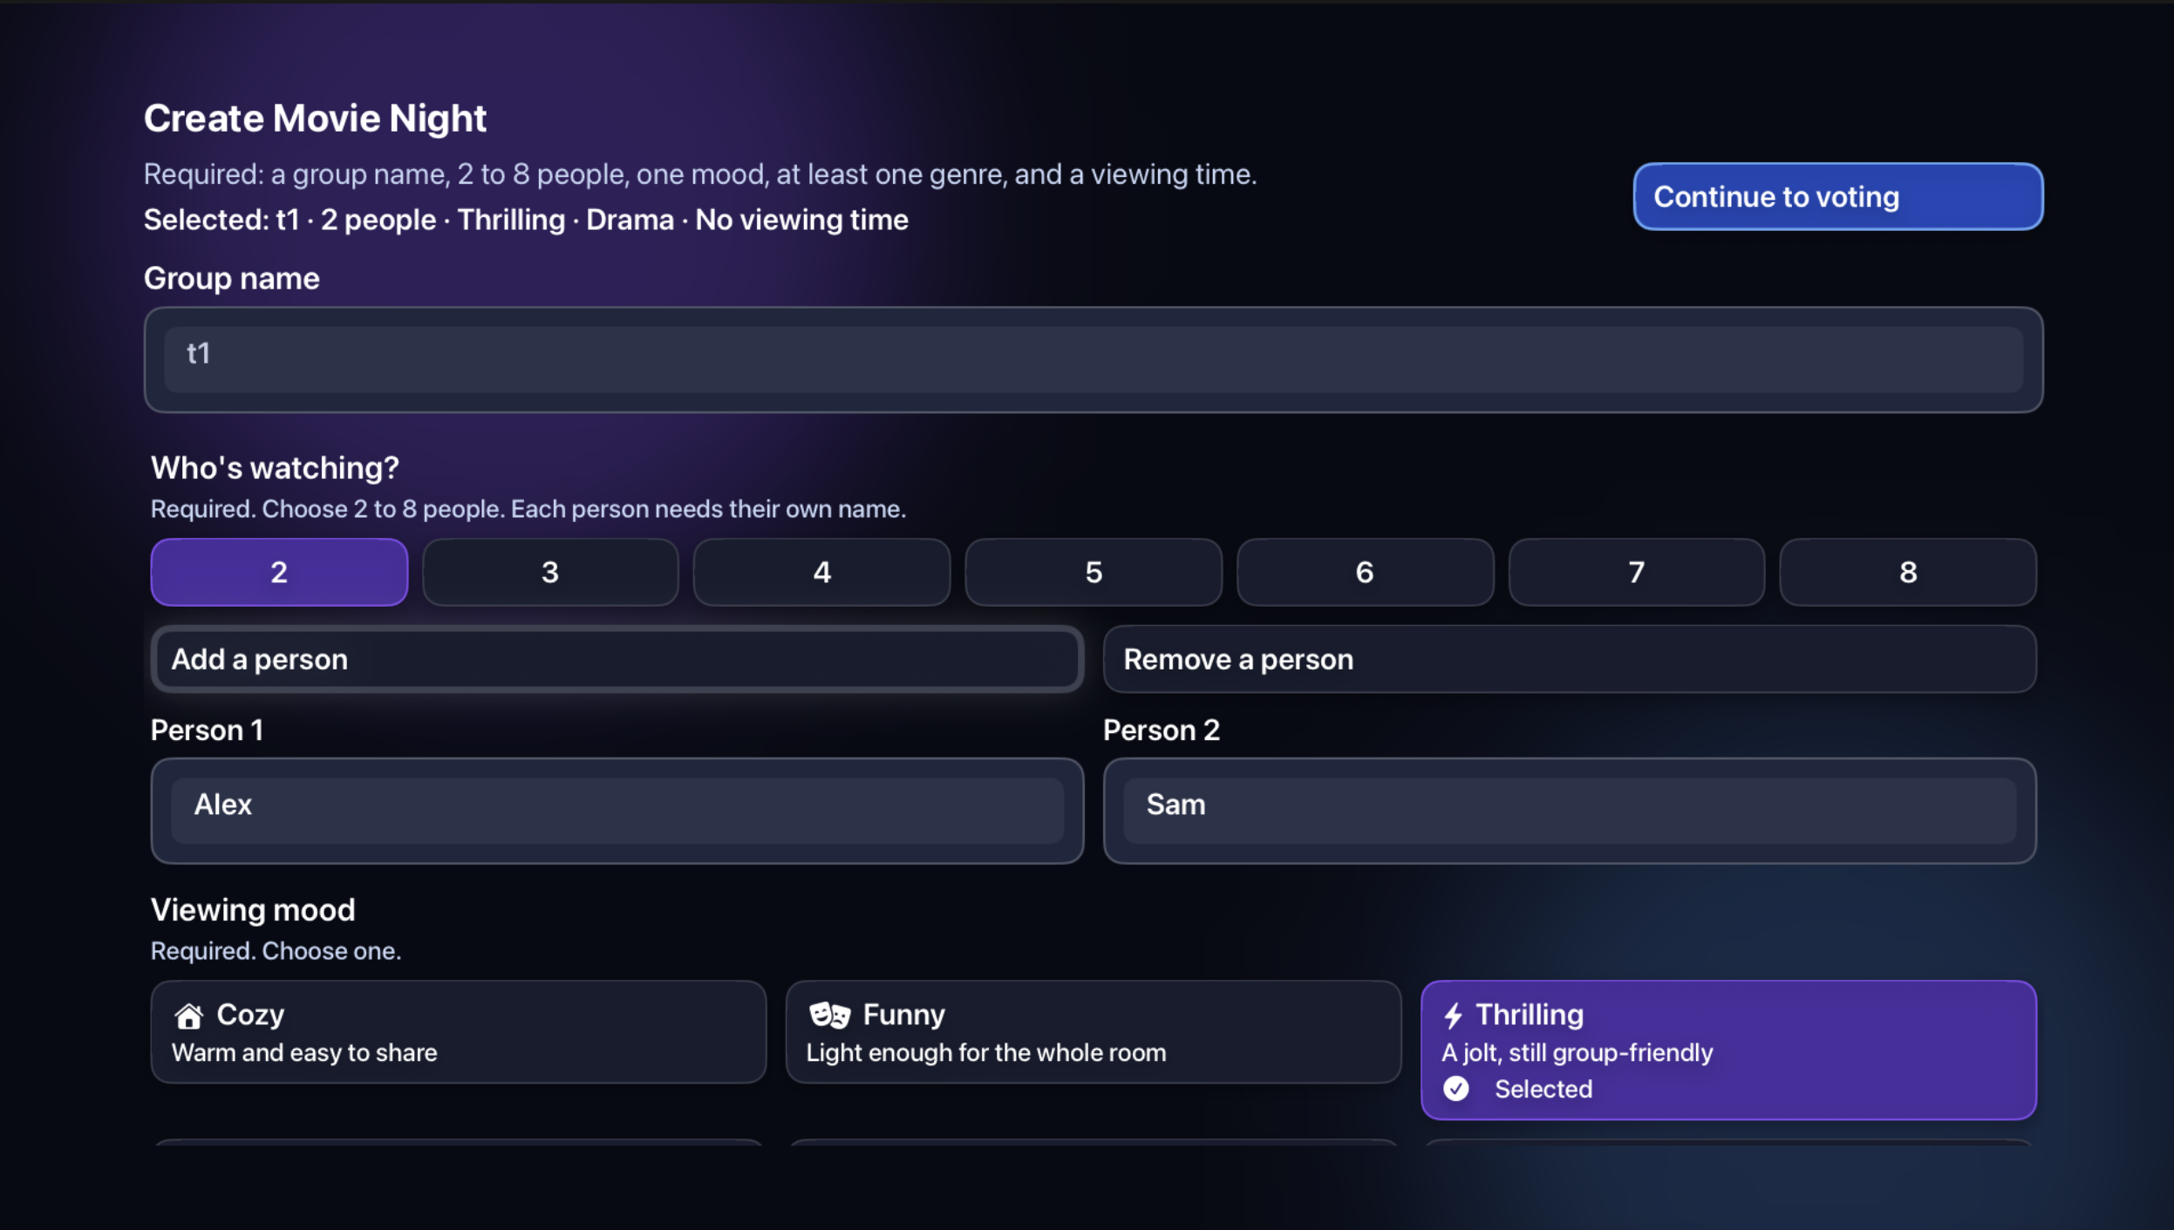
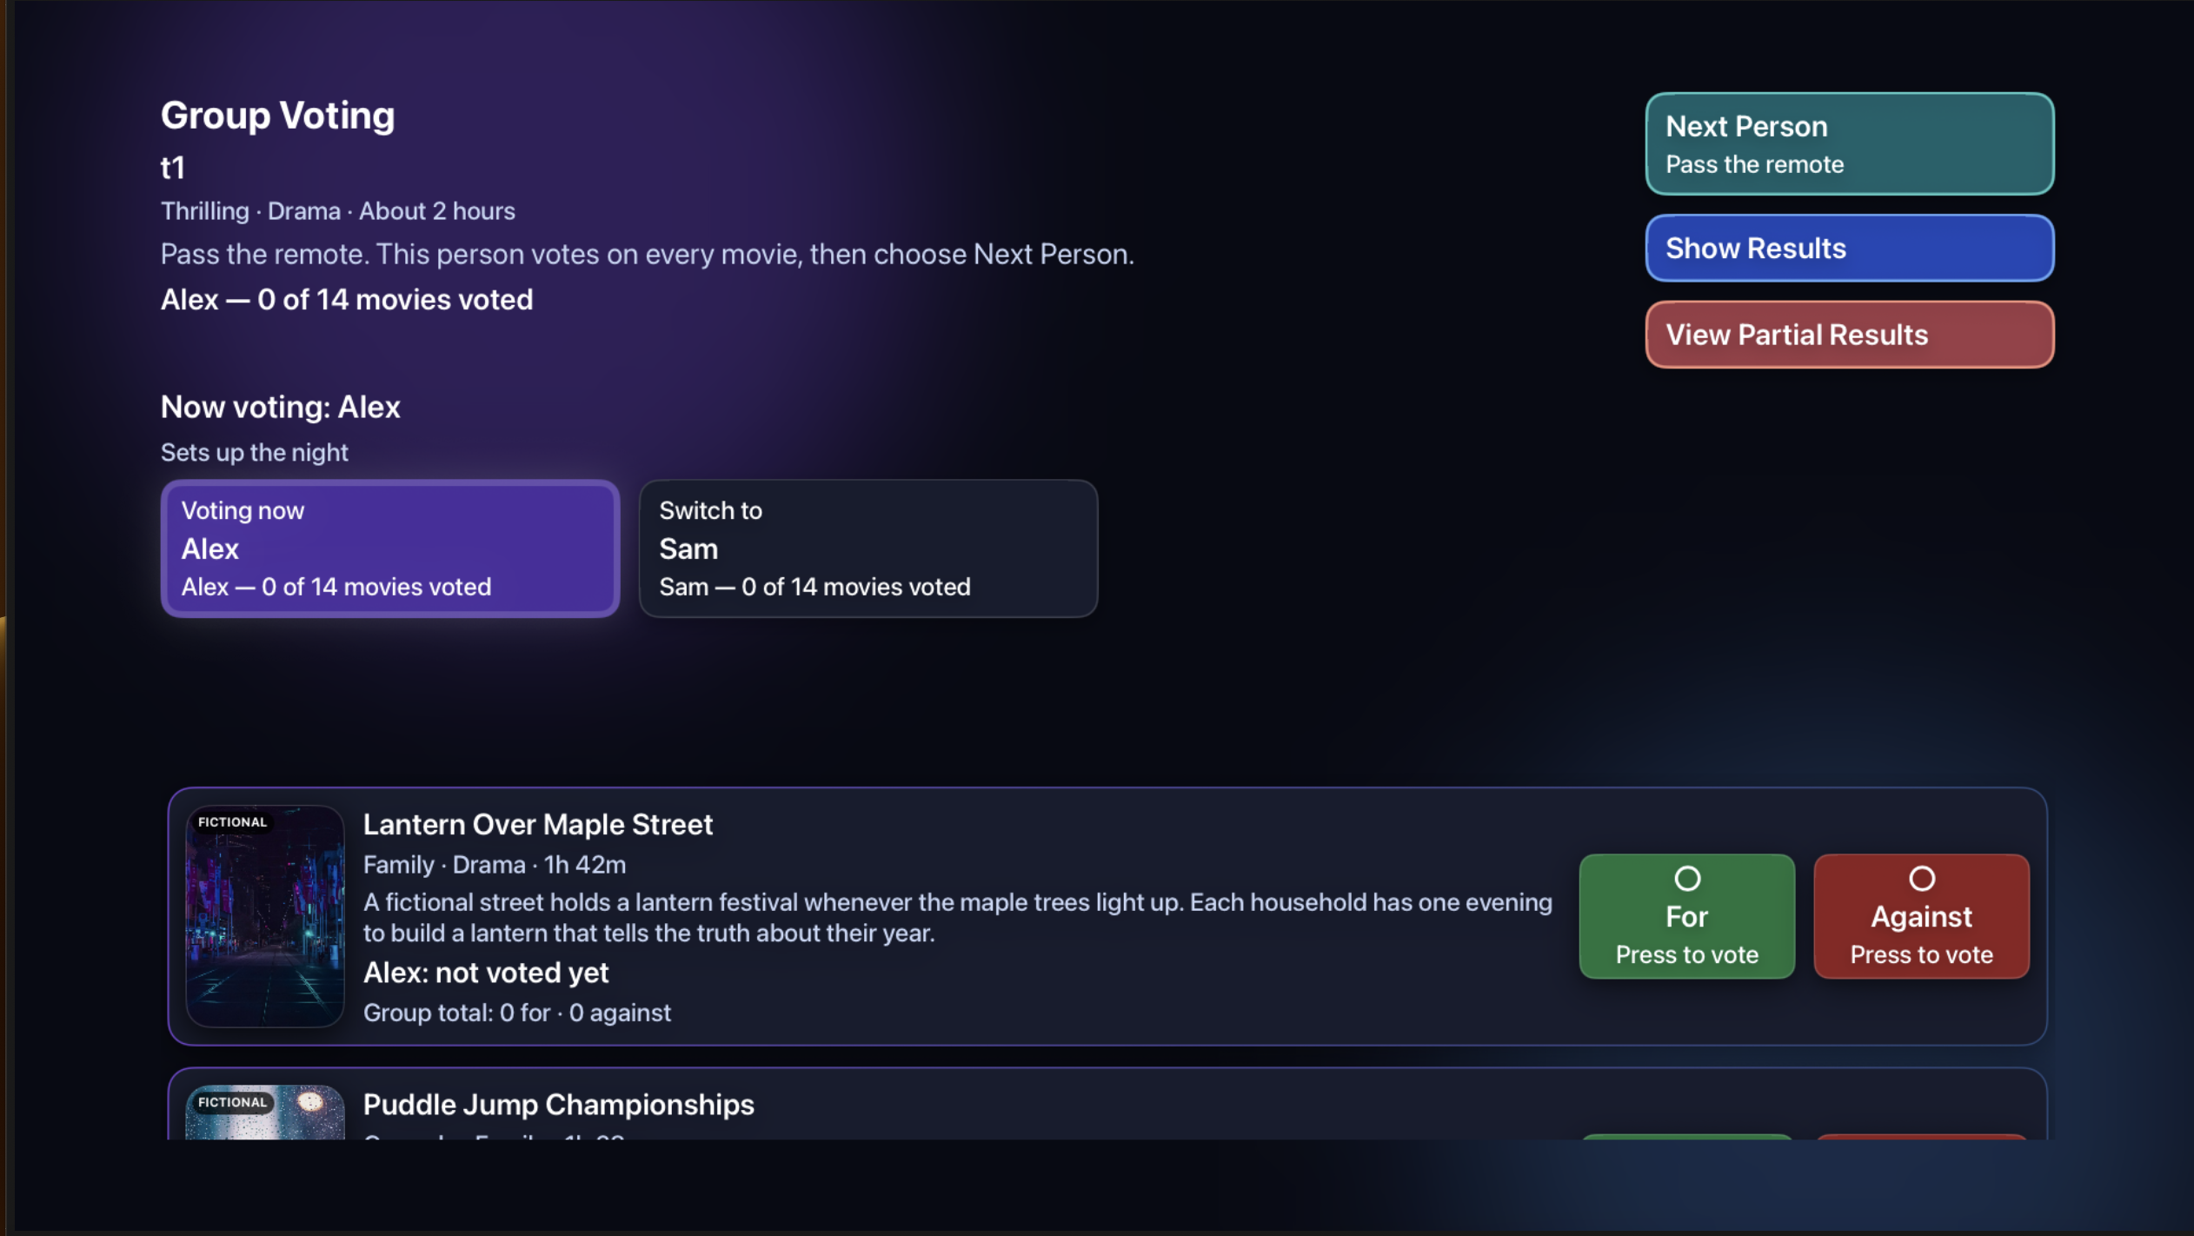
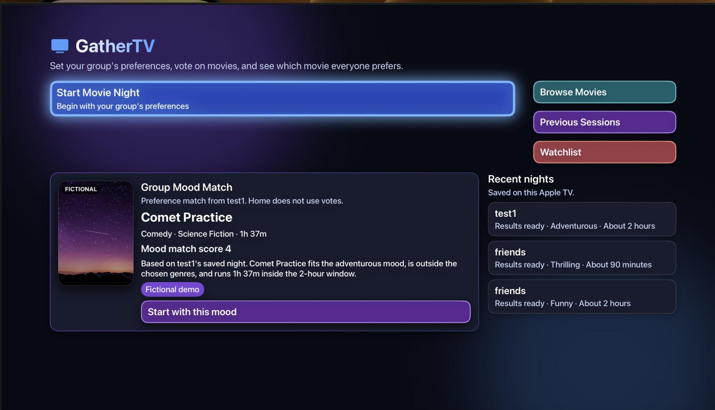
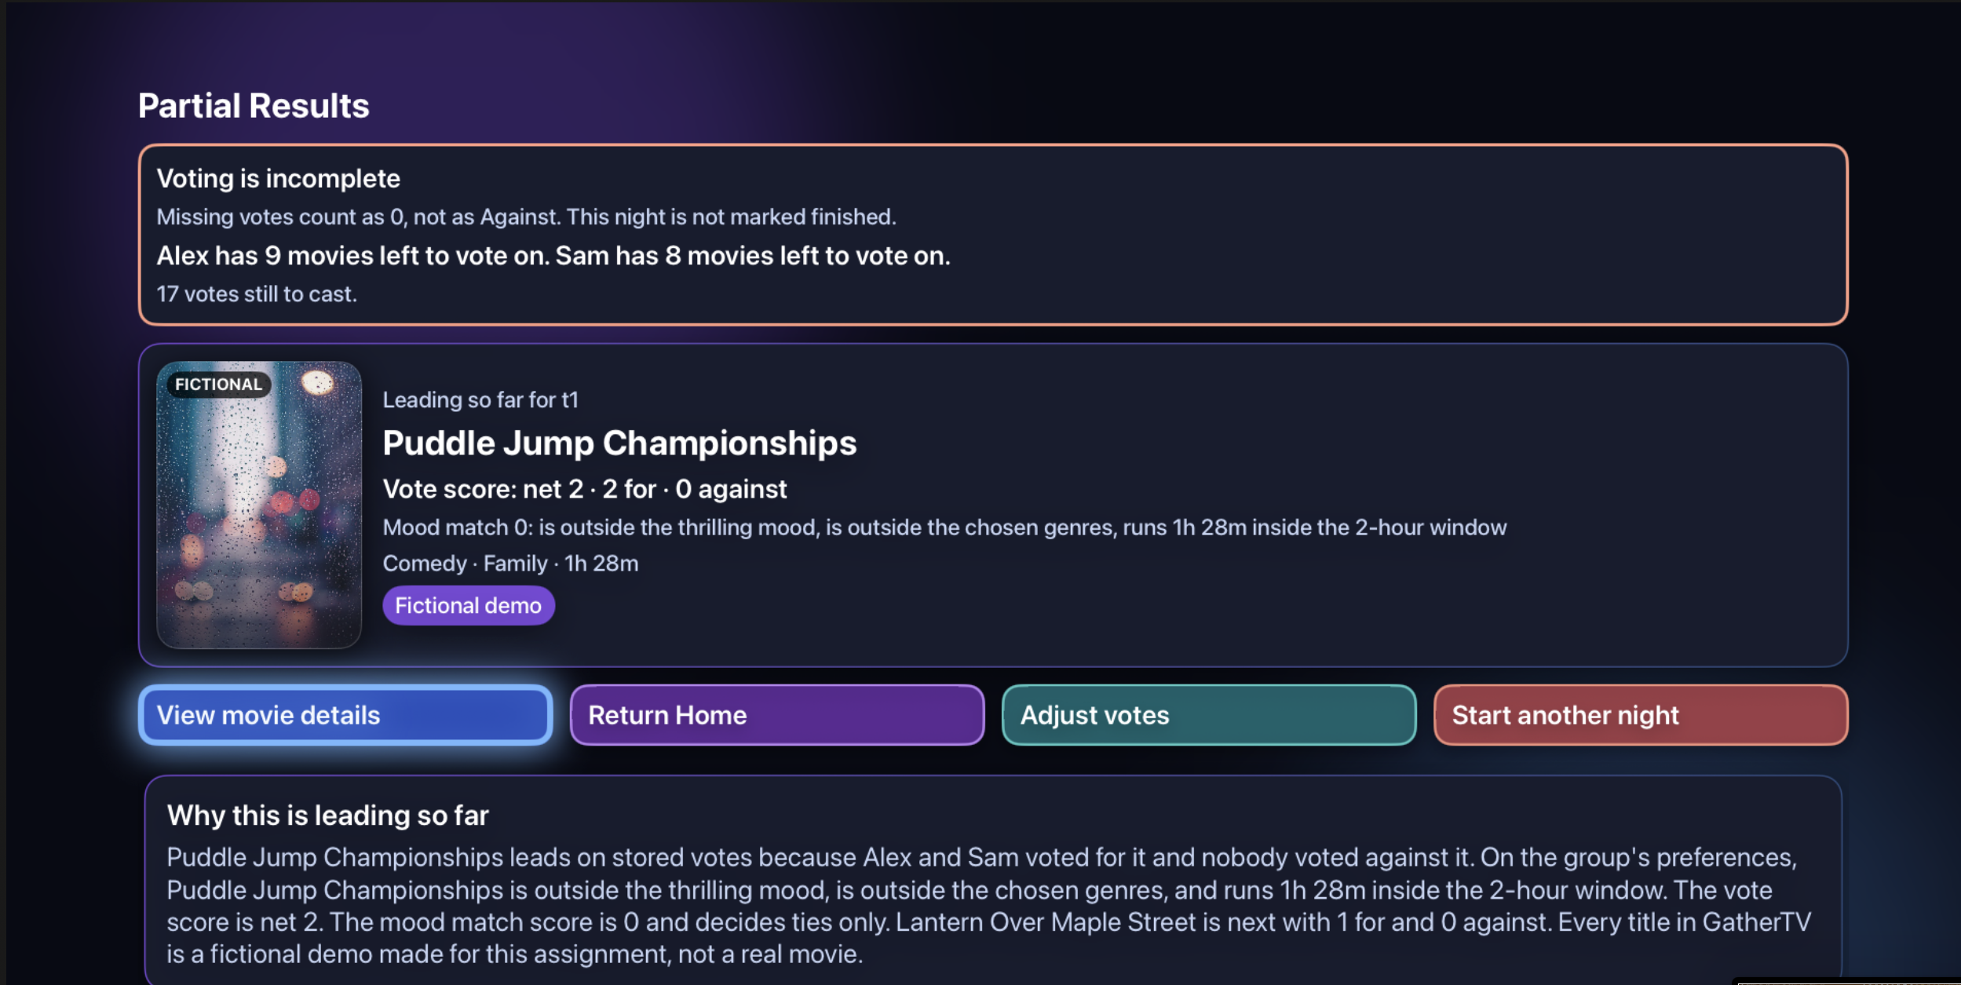
04 / LIVE PROTOTYPE
The prototype & Group Mood Match
Replace these four labelled placeholders with your real simulator screenshots.
02 • CREATE NIGHT
03 • VOTING
01 • HOME / GROUP MOOD MATCH
04 • RESULTS
VOTE SCORE = THE ORDER
MOOD MATCH = THE FIT
For +1 • Against −1 • Mood Match breaks ties only
05 / 08

Slide 6
05 / BUSINESS POSSIBILITY
How could it make money?
Two future options to explore — neither exists in the prototype.
OPTION A
OPTION B
Free decision app
Paid sync feature
A future hand-off to a service to rent, buy or stream a real film.
A possible paid extra if multi-device support is built later.
Possible referral model • no agreement exists
Requires features that do not exist yet
TODAY: no revenue • no pricing • no ads • no accounts • no payments
06 / 08

Slide 7
06 / PROPOSED ROADMAP
How could it reach people?
A future plan — these steps have not started.
01
02
03
Polish the TV identity
→
Test in real homes
→
Assess release readiness
Finish app icon + Top Shelf artwork
Try the remote flow with a few Apple TV households
Consider App Store only if catalogue rights are solved
No waitlist • no advertising campaign • no partners in place
07 / 08

Slide 8
07 / CLOSE
What is real - and what comes next?
A prototype to evaluate, not a company asking for funding.
REAL IN THIS PROTOTYPE
NOT BUILT / NOT CLAIMED
Movie-night flow + two separate scores
14 fictional films; no playback
Local saving on one Apple TV
No accounts, revenue or partnerships
Ranking logic covered by unit tests
Catalogue rights and demand unvalidated
I’d love your feedback: what would make this movie-night flow clearer or more useful?
Next: replace the fictional catalogue with rights-cleared films before considering a release.
08 / 08

