Slide 1



ArmiGo
Gamified VR-Based Therapy System for Upper Limb Rehabilitation for Children with Hemiplegia.
PRODUCT RESEARCH PROPOSAL
30 Aug, 2025
25-26j-472
1

Slide 2



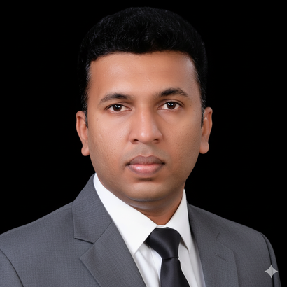




Our Team
Supervisor
Co - Supervisor
External Supervisor
Mr. Didula Chamara Thanaweera Arachchi
Mr. Eishan Dinuka Weerasinghe
Mr. Buuddhika Senevirathene
Project Manager
Project Member
Project Member
Project Member
Asanka Wickramasurendra
Sanjana Nimesh
Dinithi Weerasinghe
Anushka Siyambalapitiya
25-26j-472
2

Slide 3

Agenda
01
Introduction to the Problem
02
Social / Research impact of the solution
03
Previous research and shortcoming and our approach
04
Constraints and limitations
05
System Diagram
06
Individual components and responsibilities
25-26j-472
3

Slide 4

Introduction
Wearable system with multi-sensor modules (fingers, wrist, elbow, shoulder)
Collects real-time motion data using IMU & flex sensors
Machine learning models (SVM & LSTM) for movement recognition & quality classification
Exercise through interesting games.
Real-time feedback and AI voice Assistance through VR and therapist dashboard
Doctor / Parent monitoring
Progress Tracking according to the performance
25-26j-472
4

Slide 5

Social and research impact
Social Impact
Increased Access to Quality Rehabilitation.
Improved Rehabilitation Outcomes
Empowerment of Families and Therapists
Cultural Relevance and Scalability
Research Impact
Advances the Field of Automated Movement Analysis
Introduces a Novel Feedback Paradigm
Bridges a Critical Technological Gap
Introduces a Novel Feedback Paradigm
25-26j-472
5

Slide 6
Previous reseach and shortcomings
Previous Research
Sensor Tracking: Prior studies used IMU and sEMG for offline rehab assessment in adults.
Robotic/Haptic Feedback: Exoskeletons give precise assistance but are costly and complex.
Adult Focus: Most systems target adults (post-stroke), not children with hemiplegia.
VR Engagement: Studies show VR games boost motivation and rehab adherence with task-based activities.
Shortcomings in Previous Research
Real-Time Feedback Gap - Most systems give task-based feedback but can’t assess movement quality in real-time.
Proximal Joint Neglect -VR systems often track only the hand, ignoring shoulder and elbow compensations.
Adult/Clinic Focus -Systems suit adult stroke patients in clinics, not children at home in low-resource settings.
Cost & Complexity -Advanced tracking systems (robotic/FES) are costly and hard to use, limiting access in Sri Lanka.
25-26j-472
6

Slide 7
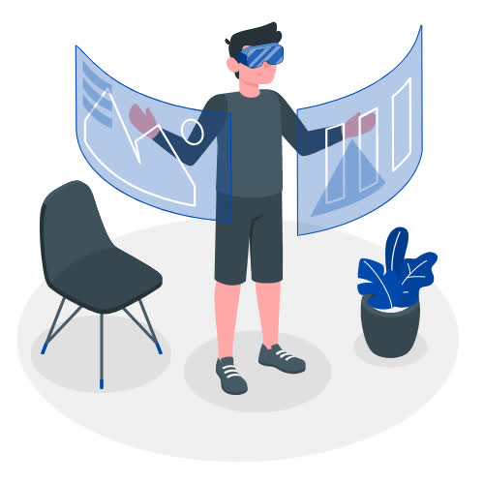
Constraints and Limitations
Integration Complexity - Combining sensors, ML, VR, and emotional AI into one low-latency system is difficult; delays or instability reduce therapy effectiveness.
Hardware Dependence - Reliance on low-cost sensors may cause noise, drift, or low sampling rates, reducing tracking and accuracy.
Algorithm Performanc - Limited training data may reduce model accuracy
Resource Needs - Requires PC and VR headset, which may limit access for low-income families.
Clinical Validation - Small sample size (n<30) limits statistical power and generalizability.
25-26j-472
7

Slide 8
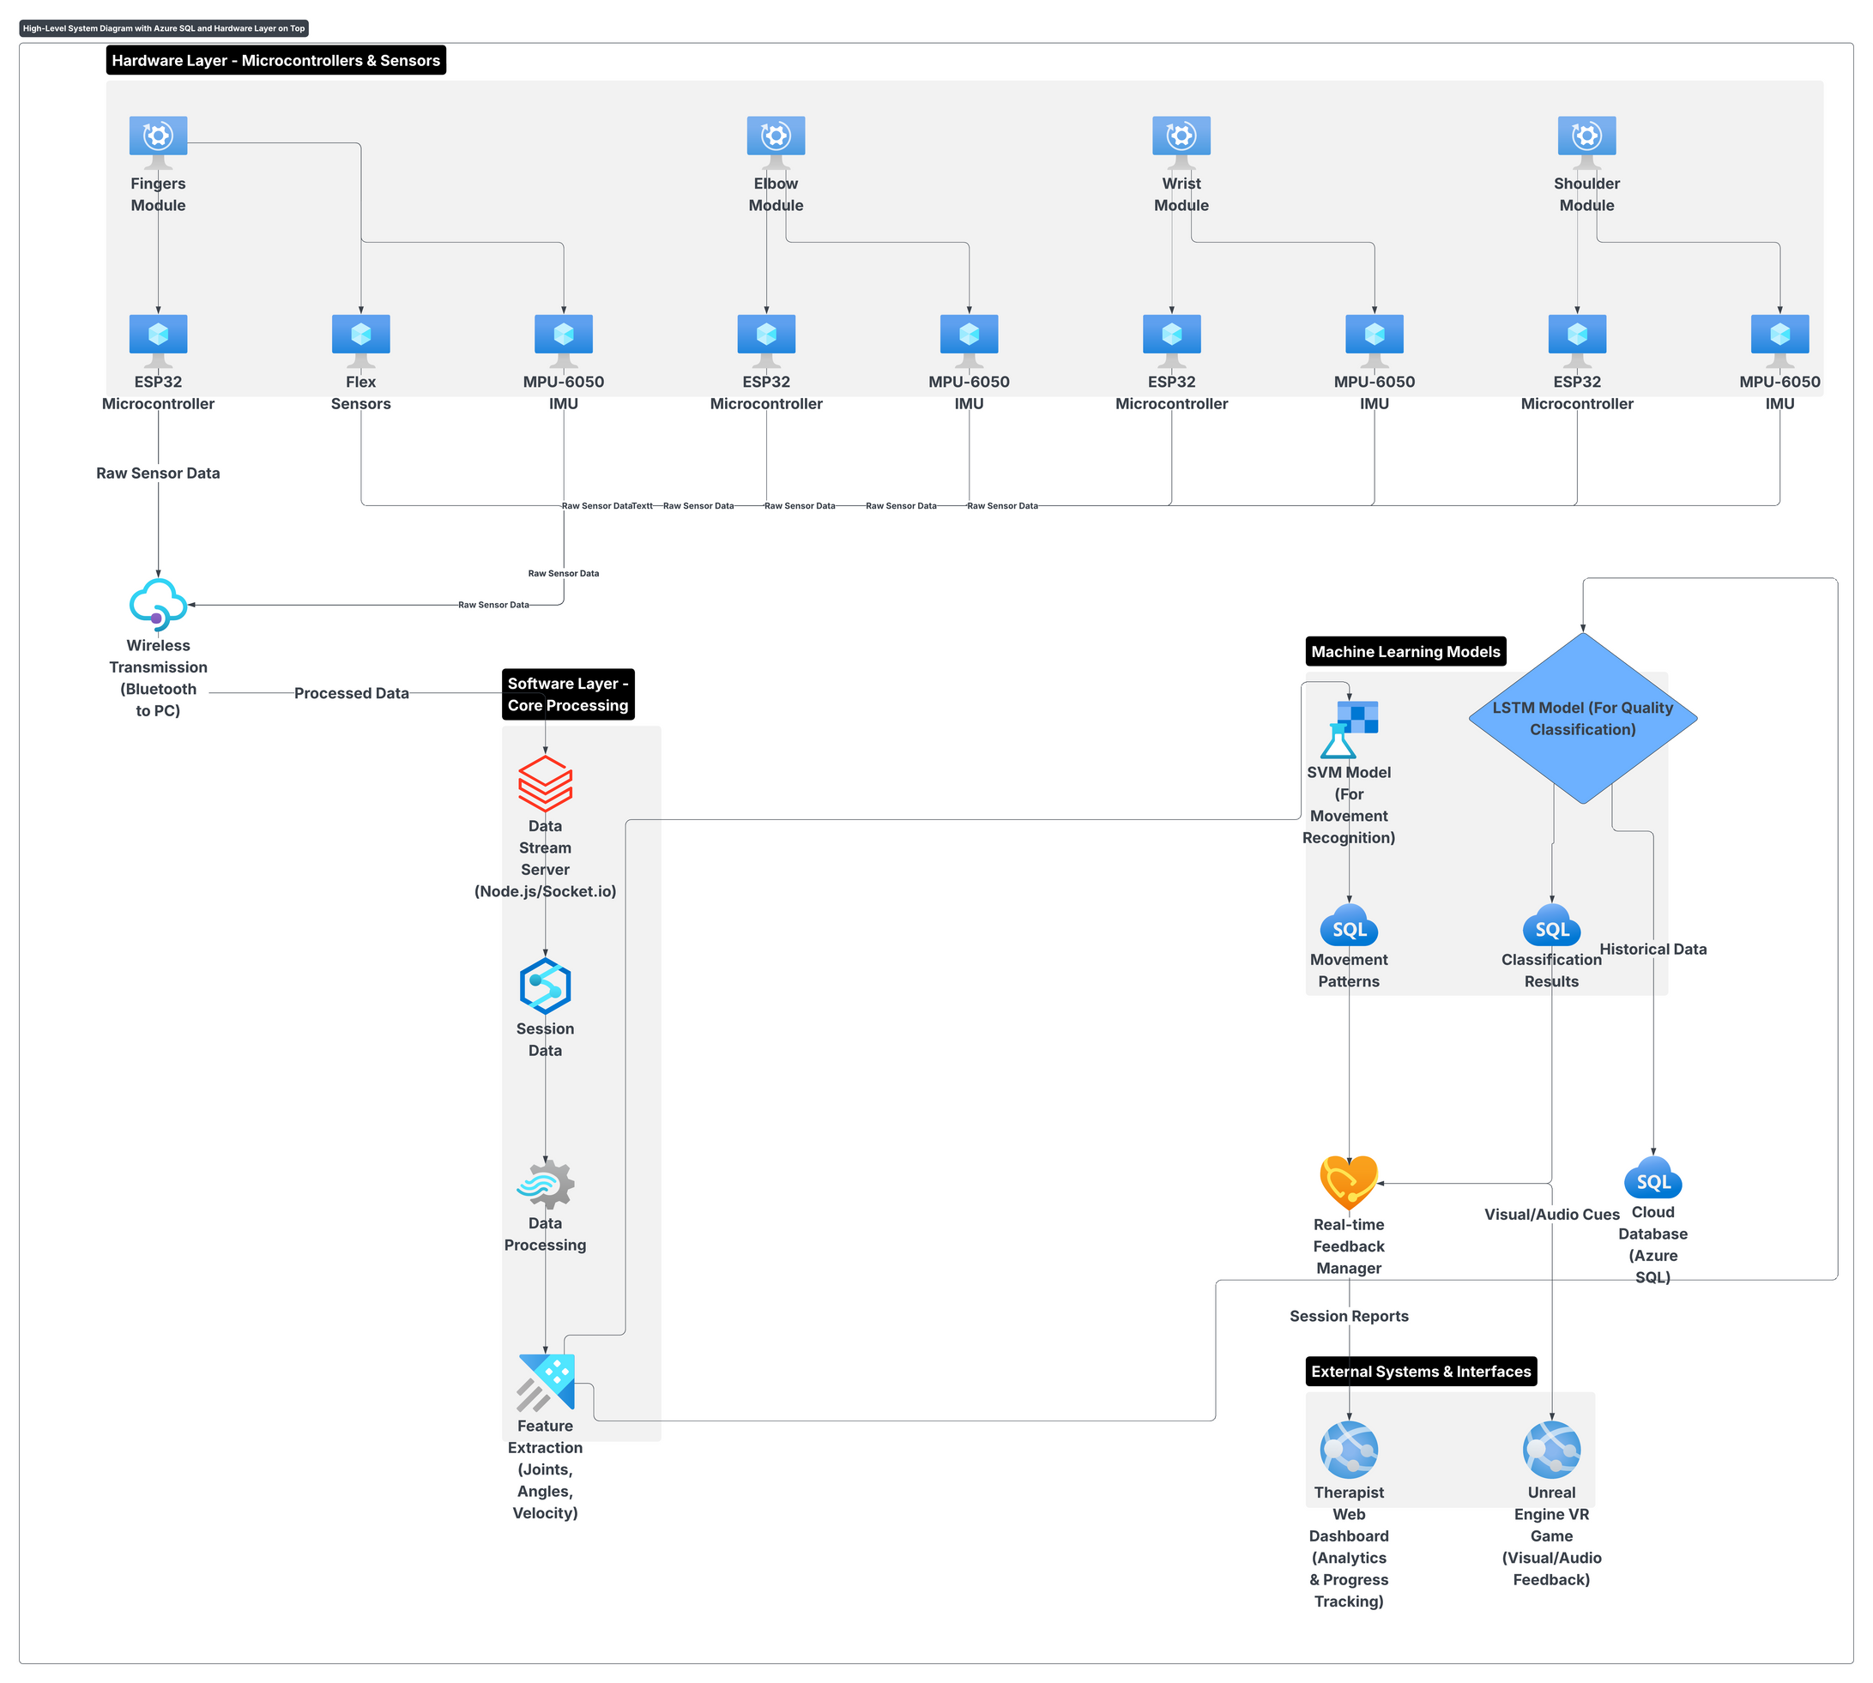
Overall System Diagram
25-26j-472
8

Slide 9
IT22102546
Nimesh S D S
Specialization : Software Engineering
FINGER MOVEMENT TRACKING AND FINGERS BASED THERAPY FOR CHILDREN WITH HEMIPLEGIA
IT22102546
Nimesh S.D.S
25-26j-472
03/09/2025
9

Slide 10
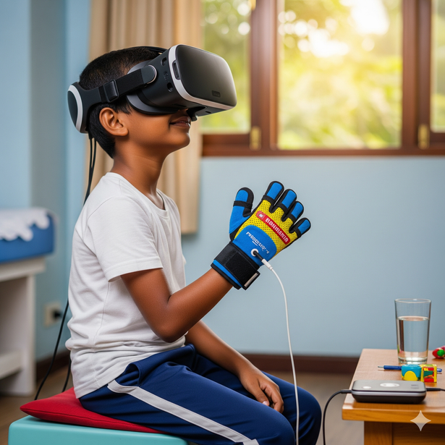
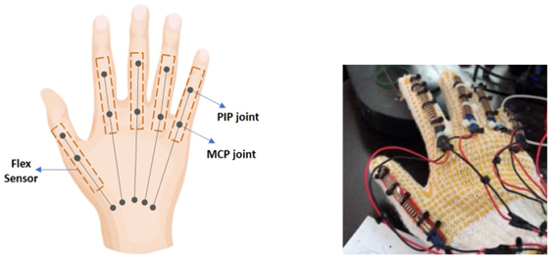
Finger Movement Tracking And Fingers Based Gamified Therapy For Children with Hemiplegia
Proven Gap
Existing gloves track only finger Flexion and Extension
No system Developed for children
No Real Time Monitoring and Progress Tracking
Lack of gamification
Knowledge Gap
Lack of Pediatric Physiotherapist in Sri Lanka.
Limited knowledge and engagement in rehab game systems.
Creative Solution
Low cost glove with 5 bend flex sensors + MPU 6050 with ML support
Remote Clinical Dashboard with real time update According to Gameplay.
AI voice assistance to encourage the child
Real Time doctor monitoring.
IT22102546
Nimesh S.D.S
25-26j-472
03/09/2025
10

Slide 11

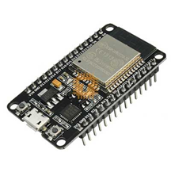
Finger Movement Tracking And Fingers Based Gamified Therapy For Children with Hemiplegia
Key Domains of Knowledge
IoT & Embedded Systems - ESP32 + 5 Flex sensors +1 MPU 6050.
Machine Learning - motion recognition (SVM, LSTM).
Noise Filtering - Kalman Filter method
Message Passing - socket.io
VR & Game Design - Unreal engine.
Cloud & Mobile Apps - Remote doctor & parent tracking.
Key Domains of Knowledge
Hardware: ESP32, Bend Flex sensors ,MPU6050IMU.
Software: TensorFlow Lite / ONNX.
Platforms: Unreal Engine.
Services: Firebase / MS Azure.
IT22102546
Nimesh S.D.S
25-26j-472
03/09/2025
11

Slide 12
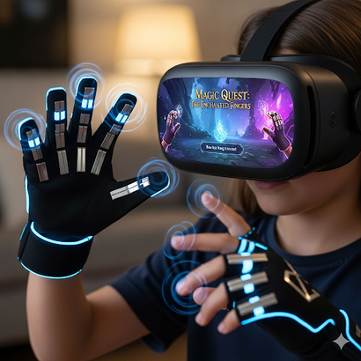
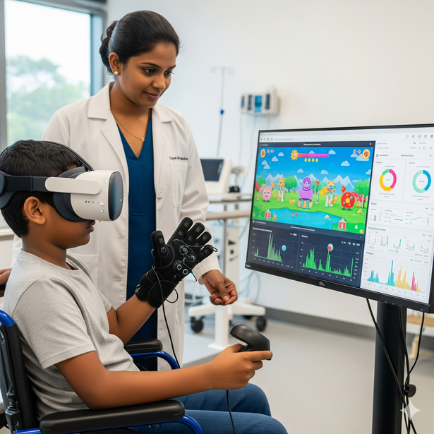
Finger Movement Tracking And Fingers Based Gamified Therapy For Children with Hemiplegia
Evaluation / Success Metrics
.ML model accuracy >90%
End-to-end latency <300 ms
High System Usability Scale (SUS) n >80%.
Focus on glove comfort , Dashboard + Game usability
Data Availability & Ethical Clearance
Data from healthy + affected children (consent taken).
Pilot testing at Sirimavo Bandaranaike Children’s Hospital.
Requires ethical clearance for pediatric involvement.
IT22102546
Nimesh S.D.S
25-26j-472
03/09/2025
12

Slide 13
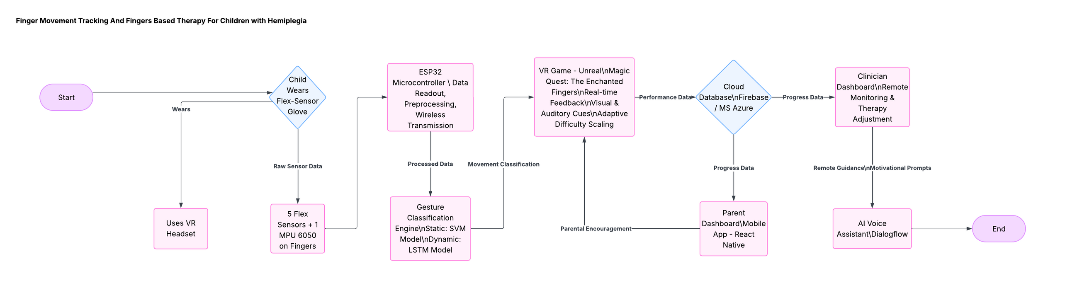
Finger Movement Tracking And Fingers Based Gamified Therapy For Children with Hemiplegia
System Overview
Real-World Usage
Child wears glove & plays 'Magic Quest’.
pinch, grasp, tap, extend, pronation/supination exercises through a game .
Clinician dashboard & caregiver monitoring for adherence with AI voice assistance.
IT22102546
Nimesh S.D.S
25-26j-472
03/09/2025
13

Slide 14
IT22115720
Wickramasurendra K.D.A.D
Specialization : Software Engineering
SHOULDER MOVEMENT TRACKING AND SHOULDER-BASE THERAPY GAME FOR CHILDREN WITH HEMIPLEGIA
IT22115720
Wickramasurendra K.D.A.D
25-26j-472
02/09/2025
14

Slide 15
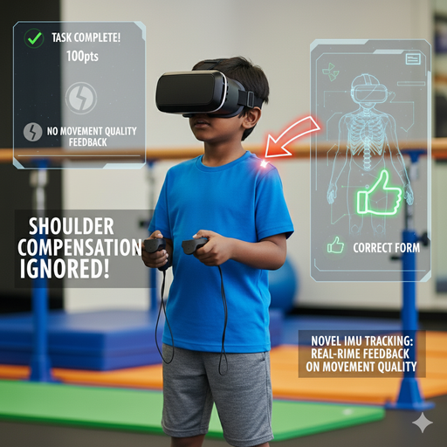
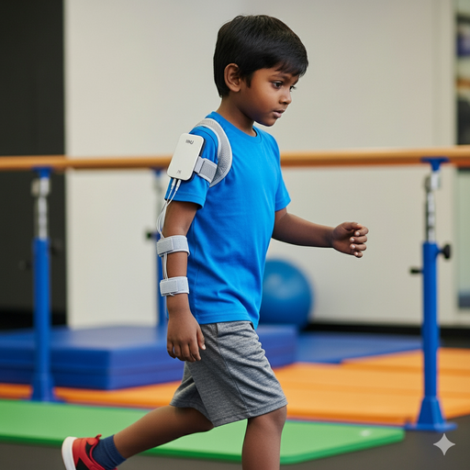
Intelligent & Affordable Shoulder Rehabilitation for Pediatric Hemiplegia
Knowledge gap
Shortage of physiotherapy professionals in rural areas.
High-tech solutions are too costly for widespread use in Sri Lanka
Patients practice incorrect and reinforce compensatory patterns at home.
Proven gap
VR rehab games track hands only, ignoring shoulder compensation.
No real-time monitoring or progress tracking systems exist yet.
Solution
Uses low-cost MPU-6050 sensor to capture shoulder kinematics.
A real-time LSTM model classifies movements as "correct" or "compensatory."
The VR game provides immediate visual, auditory, and gamified feedback to guide correct patterns.
IT22115720
Wickramasurendra K.D.A.D
25-26j-472
02/09/2025
15

Slide 16
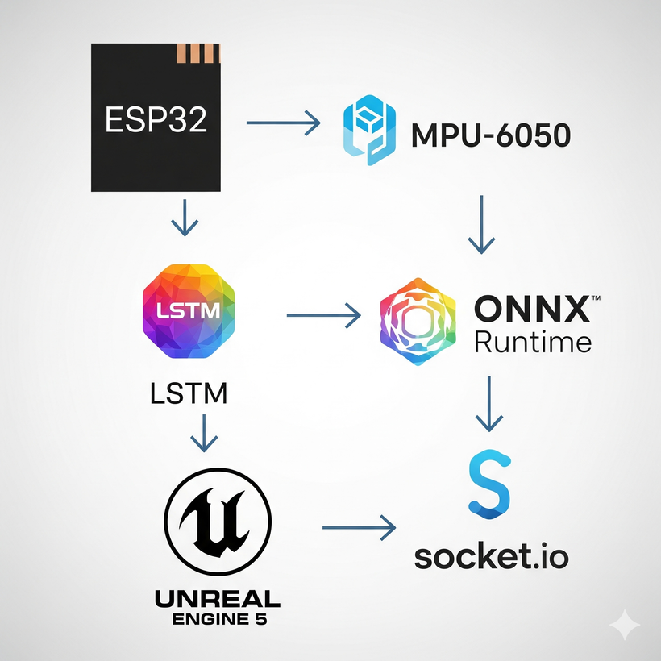
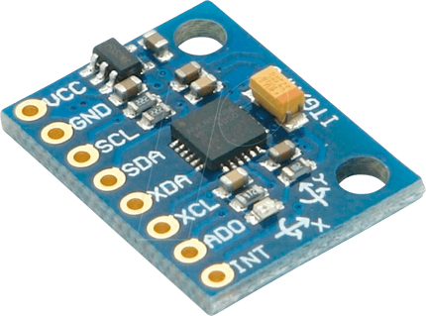
Intelligent & Affordable Shoulder Rehabilitation for Pediatric Hemiplegia
Key Domains of Knowledge
Embedded systems and IoT for ESP32 and MPU6050 sensor integration.
Machine Learning & AI for LSTM-based movement classification.
Game development and VR knowledge.
Cloud and mobile technologies for monitoring system.
Specific Latest Technologies
Hardware – ESP32 microcontroller, MPU-6050 IMU sensor.
AI/ML - LSTM networks, ONNX Runtime for deployment
Software - Unreal Engine 5 (C++) for VR, Socket.io for real-time data communication
16
IT22115720
Wickramasurendra K.D.A.D
25-26j-472
02/09/2025

Slide 17
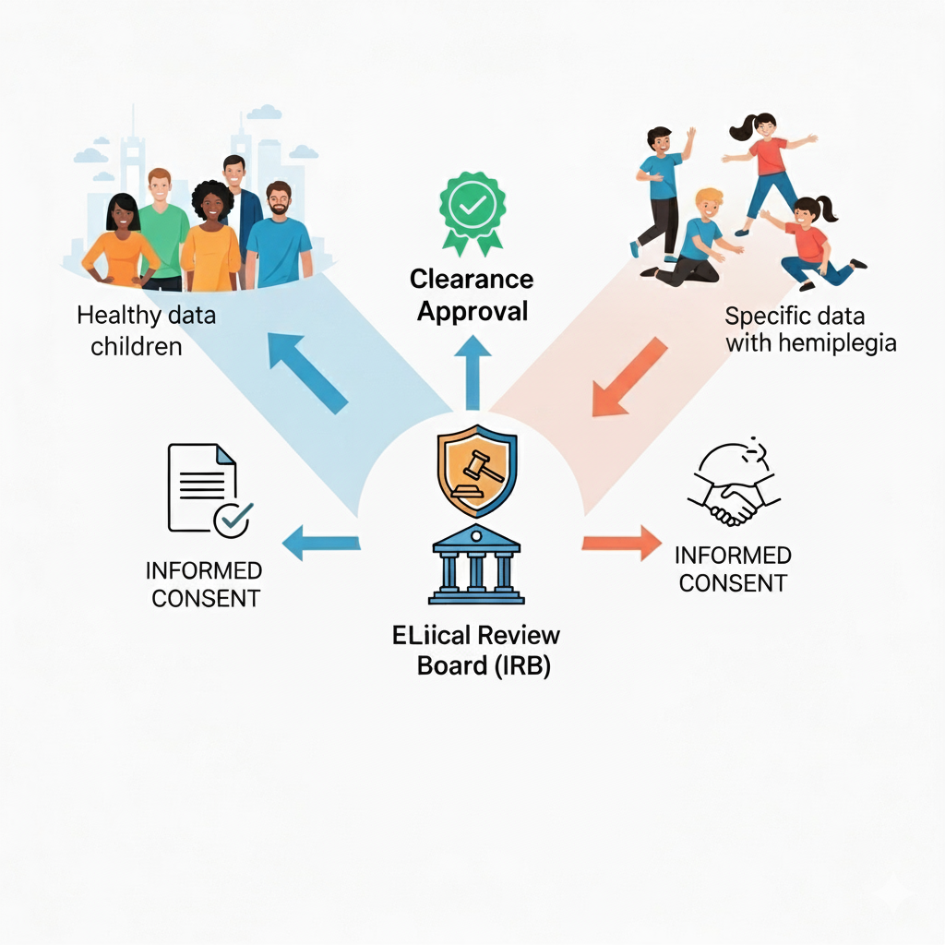
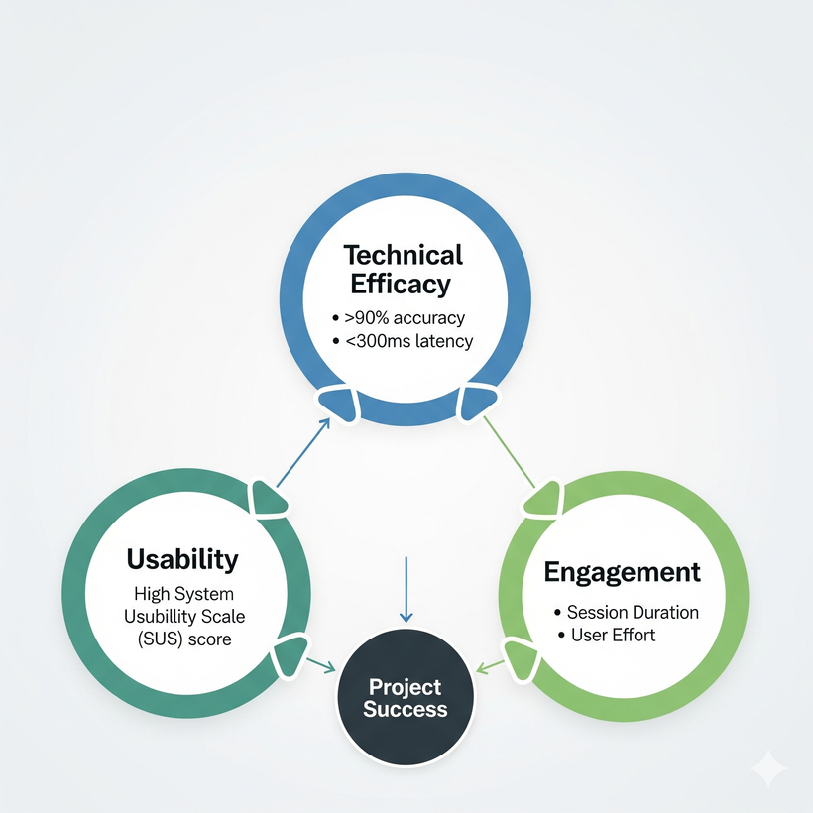
Intelligent & Affordable Shoulder Rehabilitation for Pediatric Hemiplegia
Data & Ethics
Initial dataset from healthy participants and children with hemiplegia via rehab center collaboration.
Ethical clearance from university and partner boards; informed consent and child assent required.
How to Evaluate and Validate
Technical Efficacy – ML accuracy >90% (vs. therapist labels) and system latency <300 ms.
Usability – High SUS scores from therapists and parents
Engagement – Measured by session duration and user effort in pilot studies with children.
17
IT22115720
Wickramasurendra K.D.A.D
25-26j-472
02/09/2025

Slide 18
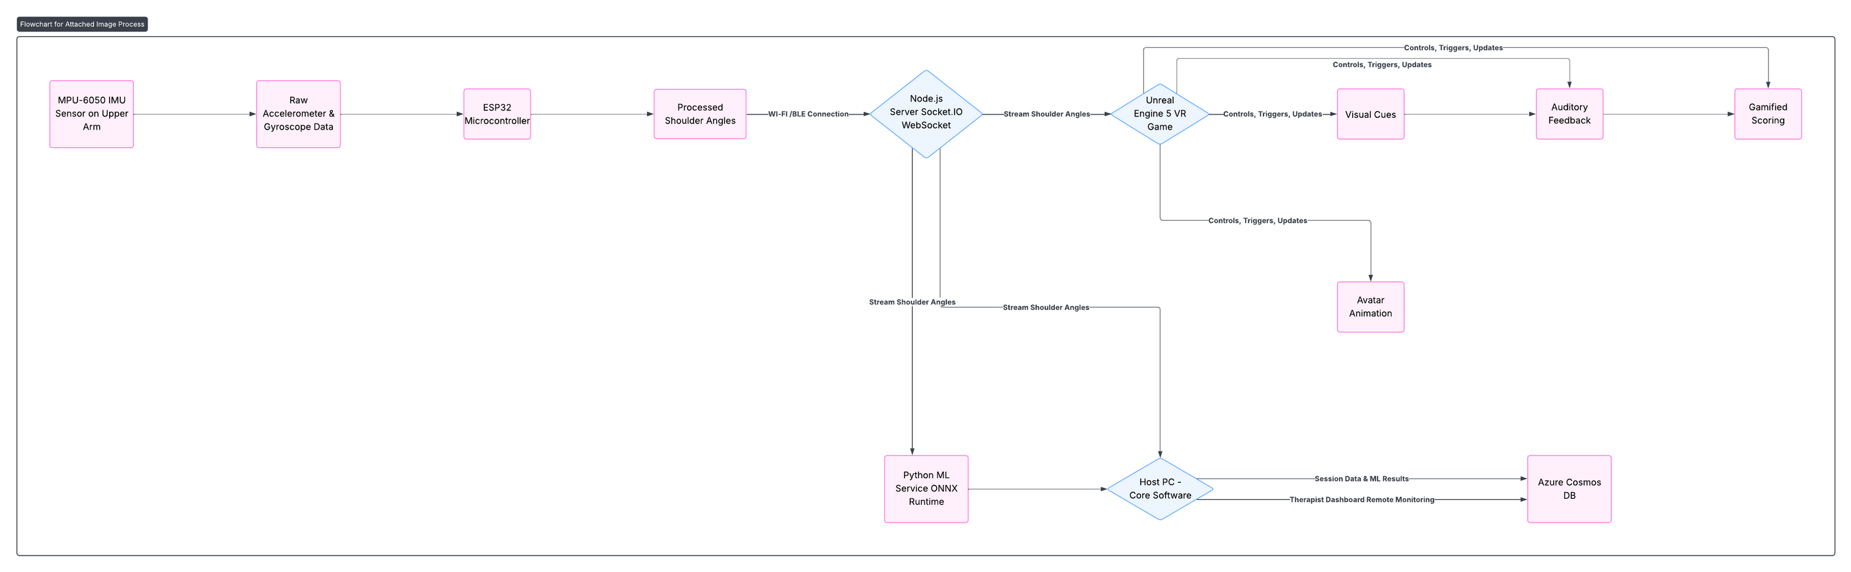
Intelligent & Affordable Shoulder Rehabilitation for Pediatric Hemiplegia
Primary Use Case
Action - A child uses correct shoulder movement to reach foods in the game.
Feedback - System rewards with positive sounds, visual celebration (happy animal), and high points.
Corrective Use Case
Action - Child hikes shoulder to compensate while reaching.
Fedback - Avatar's trunk glows red, a corrective sound plays, and points are reduced.
18
IT22115720
Wickramasurendra K.D.A.D
25-26j-472
02/09/2025

Slide 19
IT22557292
Siyambalapitiya S V A P B
Specialization : Software Engineering
WRIST MOVEMENT TRACKING AND THERAPY FOR CHILDREN WITH HEMIPLEGIA
IT22557292 Siyambalapitiya S.V.A.P.B 25-26J-472
02/09/2025
19

Slide 20
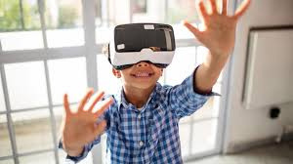
Wrist Movement Tracking & Therapy for Children with Hemiplegia
Proven Gap
Hemiplegia causes severe wrist movement impairments, limiting children’s ability to perform daily activities.
Traditional wrist rehabilitation is repetitive, lacks objective wrist movement tracking, and provides no real-time feedback for progress.
Access to specialized wrist therapy is limited in Sri Lanka due to cost, therapist shortages, and geographical barriers.
IT22557292 Siyambalapitiya S.V.A.P.B 25-26J-472
02/09/2025
20

Slide 21
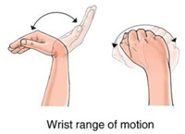
Wrist Movement Tracking & Therapy for Children with Hemiplegia
Creative Solution
Integrate wearable sensors for wrist movement tracking.
Implement VR-based therapy game focused on wrist-based exercises
Train ML model on wrist motion classification.
Develop clinical dashboard providing detailed analytics on patient
Progress, movement quality assessments, and therapy compliance rates
IT22557292 Siyambalapitiya S.V.A.P.B 25-26J-472
02/09/2025
21

Slide 22
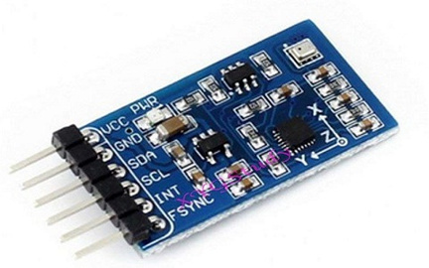

Wrist Movement Tracking & Therapy for Children with Hemiplegia
Shortcomings of Existing Systems
Latest Technologies
Repetitive therapy, no real-time feedback.
Few pediatric wrist-specific rehab systems.
High cost, limited access in Sri Lanka.
High Precision IMU Sensors(MPU 6050)
ESP 32 Micro Controller
Long Short-Term Memory(LSTM)
Support Vector Machines
Unreal Engine 5.3+
Key Specialized Domain
IMU Sensors – MPU6050 for wrist tracking.
Embedded Systems – ESP32 firmware, sensor fusion, Bluetooth.
Machine Learning & AI – LSTM & SVM for classification.
VR Game Development – Unreal Engine VR with feedback.
IT22557292 Siyambalapitiya S.V.A.P.B 25-26J-472
02/09/2025
22

Slide 23
Wrist Movement Tracking & Therapy for Children with Hemiplegia
Train AI with normative wrist movement data.
Validate using child’s unaffected hand or normative dataset.
Target ≥90% accuracy, ≤100ms latency, and improved wrist ROM in clinical tests.
Expected Accuracy & Validation Criteria
Initial dataset from healthy children; primary data via rehab center collaboration.
Ethical clearance from university & partner boards; informed consent & child assent required.
Clinical data from Sirimavo Bandaranaike Hospital under Dr. Senavirathne’s supervision.
Data Availability & Ethical Clearance
IT22557292 Siyambalapitiya S.V.A.P.B 25-26J-472
02/09/2025
23

Slide 24
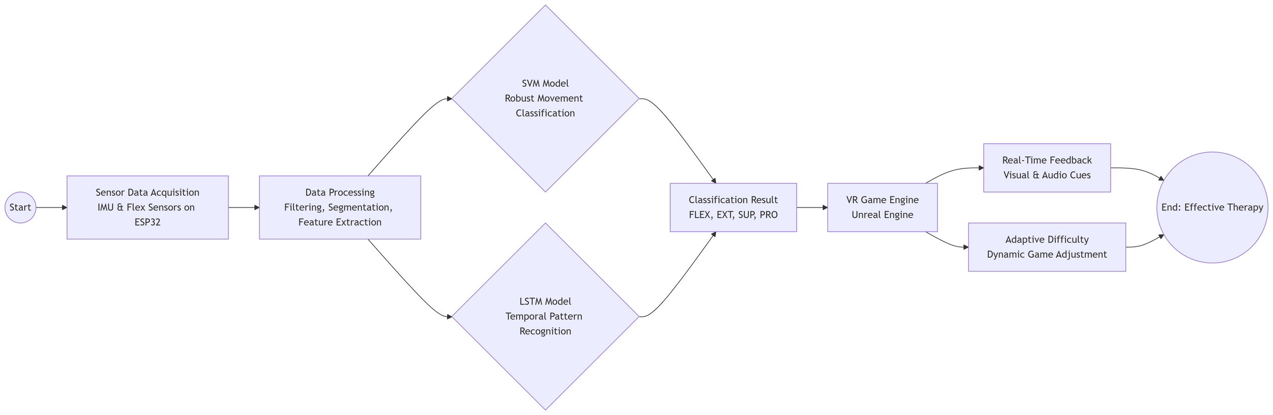
Wrist Movement Tracking & Therapy for Children with Hemiplegia
System Overview
Child wears wrist band with IMU sensor.
Plays VR therapy game (‘Catch the Fish’) using wrist motions.
Exercises: flexion, extension, pronation, supination.
Engaging gameplay encourages regular therapy and tracks progress for clinicians.
Real World Usage
IT22557292 Siyambalapitiya S.V.A.P.B 25-26J-472
02/09/2025
24

Slide 25
IT22119230
Weerasinghe D.N.T
Specialization : Software Engineering
ELBOW MOVEMENT TRACKING AND ELBOW-BASED THERAPY FOR CHILDREN WITH HEMIPLEGIA
IT22119230
Weerasinghe D.N.T
25-26j-472
03/09/2025
25

Slide 26
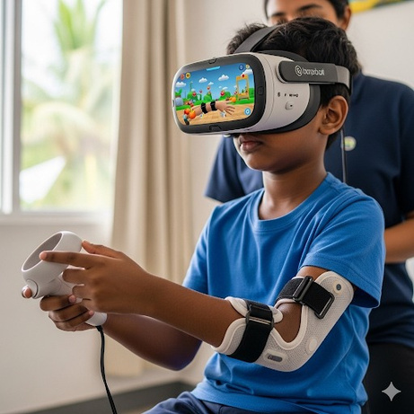
Gamified VR-Based Therapy for Pediatric Elbow Rehabilitation
Knowledge Gap
Existing VR rehab is designed for adults, not for kids with hemiplegia.
High cost setup not practical in sri lanka.
Lack of adaptive motivation and continuous monitoring.
Shortcomings of existing systems.
Low engagement in Generic, repetitive rehab games.
No real-time doctor-parent tracking.
No AI-based encouragement
Our Creative Solutions.
A wearable IMU sleeve with an ML tracking system.
A specially developed therapeutic VR game for elbow movements.
Adaptive AI voice assistant with gamification to reduce the difficulty.
IT22119230
Weerasinghe D.N.T
25-26j-472
03/09/2025
26

Slide 27
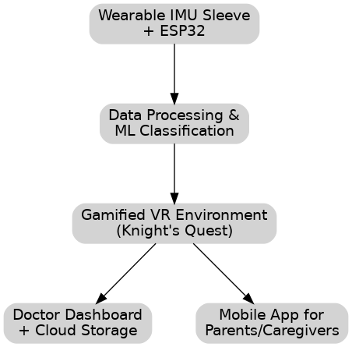




Gamified VR-Based Therapy for Pediatric Elbow Rehabilitation
Domains Applied
Machine Learning - motion recognition (SVM, LSTM).
VR & Game Design - Unity/Unreal immersive rehab.
IoT & Embedded Systems - ESP32 + IMUs.
Cloud & Mobile Apps - Remote doctor & parent tracking.
Technologies
Hardware: ESP32, MPU6050/9250 IMU.
Software: TensorFlow Lite / ONNX.
Platforms: Unreal Engine.
Services: Firebase / MS Azure.
IT22119230
Weerasinghe D.N.T
25-26j-472
03/09/2025
27

Slide 28
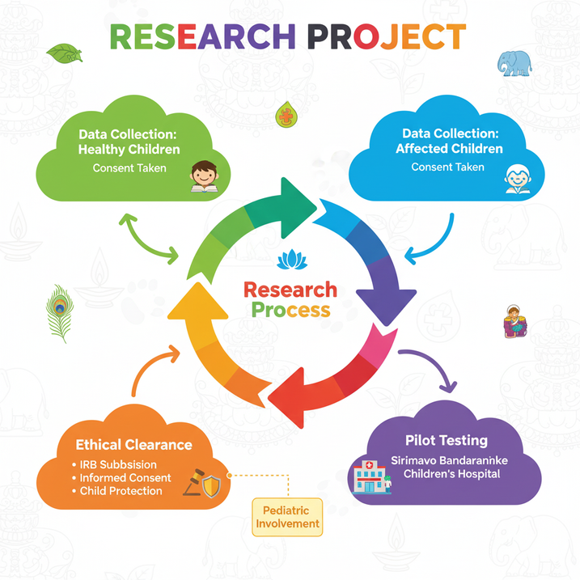
Gamified VR-Based Therapy for Pediatric Elbow Rehabilitation
Validation & Evaluation
≥ 85% accuracy in motion recognition.
Usability → System Usability Scale (SUS).
Engagement → Session duration, adherence rates.
Clinical → Range of motion, task completion time.
Data & Ethics
Data from healthy + affected children (consent taken).
Pilot testing at Sirimavo Bandaranaike Children’s Hospital.
Requires ethical clearance for pediatric involvement.
IT22119230
Weerasinghe D.N.T
25-26j-472
03/09/2025
28

Slide 29
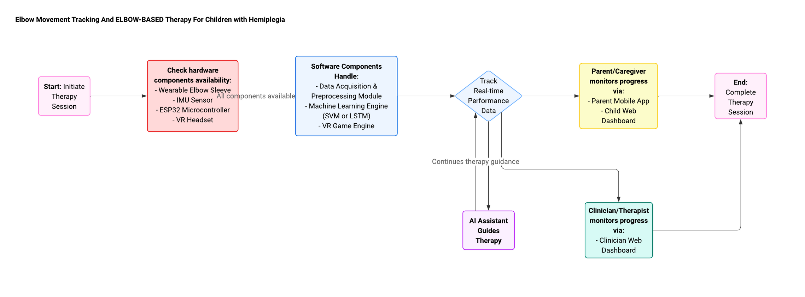
Gamified VR-Based Therapy for Pediatric Elbow Rehabilitation
System Overview and Real-World Use
Child wears sleeve → plays Knight’s Quest VR.
Doctors adjust therapy remotely.
Parents monitor progress via mobile app.
Affordable, engaging home-based rehab.
IT22119230
Weerasinghe D.N.T
25-26j-472
03/09/2025
29

