Slide 1
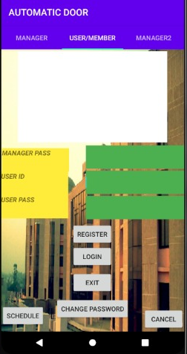
TEST CASE-1
USER REGISTER
In this page, the user can register himself into the database by entering his college id and password and then clicking on register button

Slide 2
TEST CASE-2
USER LOGIN
After the user gets registered successfully into the database then, the user can login by entering his ID and password and then clicking login button

Slide 3
TEST CASE-3
STUDENT EXIT
In this page,the user can exit by entering his correct id and password and then clicking on exit button

Slide 4
TEST CASE-4
USER CHANGE PASSWORD
In this page, the user can change his/her password with the help of manager.First the manager will enter his correct password and then the user will enter his Id and new password and then click on change password button

Slide 5
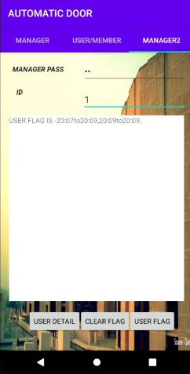
TEST CASE-5
MANAGER LOGIN
In this page,the manager can login by entering his correct password

Slide 6
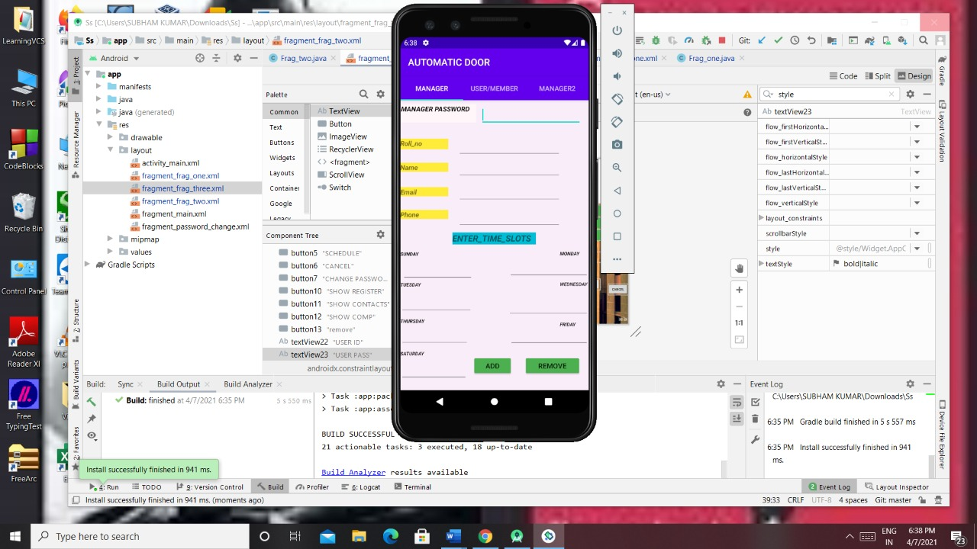
TEST CASE-6
UPDATING DETAILS OF USERS
In this page, the manager will enter his password and then he’ll enter the details of that student (like user’s roll no,name,email id etc) whose details needs to be updated and then he’ll click on add button

Slide 7
TEST CASE-7
REMOVING USERS
In this page, the manager will enter his/her password then he’ll enter the enter the details of that user whom he want to remove and then he’ll click on remove button

Slide 8
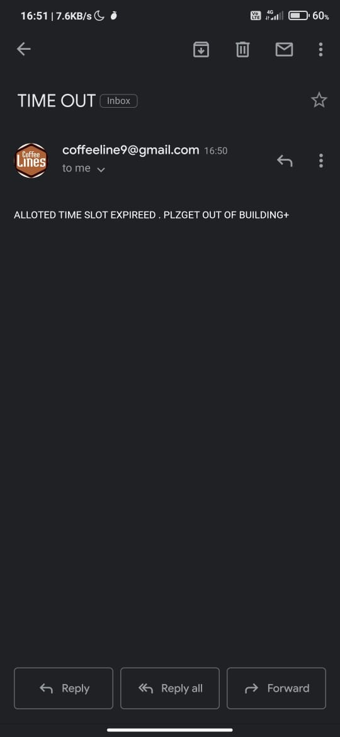
TEST CASE-10
MAIL FOR TIMEOUT
Here, a system generated mail will be sent automatically when the time allotted to the student will expire and it’ll tell the student to come out of the building

Slide 9
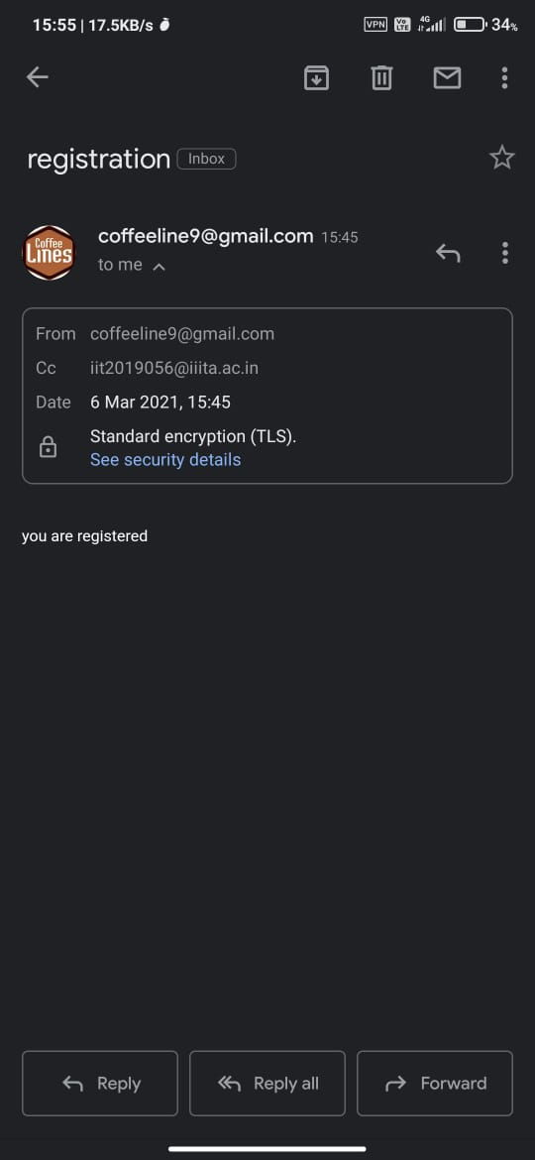
TEST CASE-11
MAIL REGISTRATION NOTIFICATION
Here, a system generated mail will be sent to the user who will register themselves into the system and that mail will say that “you are registered”

Slide 10

TEST CASE-13
MANAGER SEES THE ENTRY/EXIT TIME
In this page, the manager will enter his/her password and then he’ll enter the ID of that student whose entry/exit details he wants to see and then he’ll click on user detail button

Slide 11
TEST CASE-14
MANAGER SEES THE DETAILS OF USER
In this page, the manager will enter his/her password and then he’ll enter the ID of that student whose details he wants to see and then click on the user detail button

Slide 12
TEST CASE-15
MANAGER INSERTS DETAILS OF PERSON
In this page the manager will enter his password and then he’ll enter the details of the person (like user’s name,roll no,id etc.) which he wants to enter and then he’ll click on add to enter the details in the database

