Slide 1
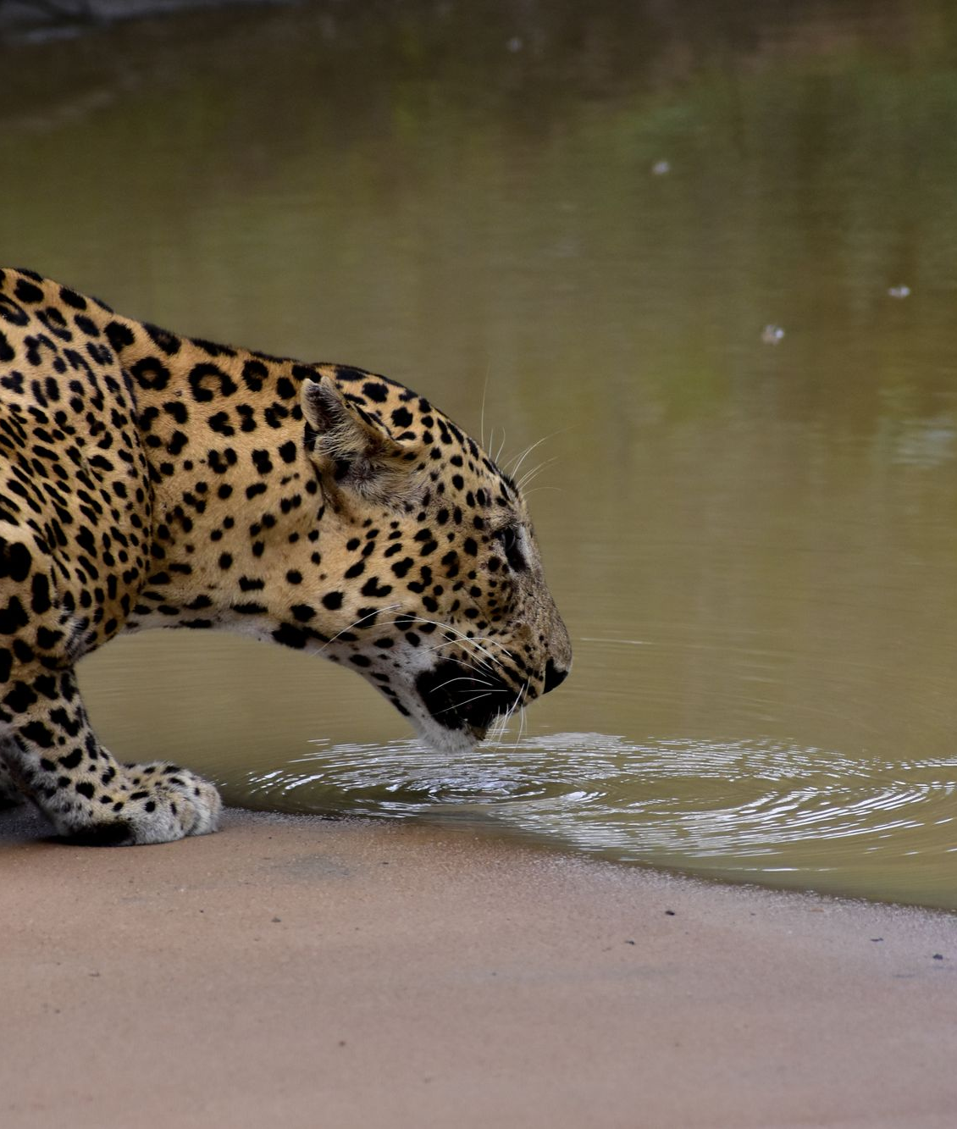
WILDTRAIL
Safari Booking
System
ONE WEB APPLICATION · SIX CONNECTED MODULES
SE1020 • Object Oriented Programming
Group 26-MTR-Y1S2-WD-009
Notes:
Explain the whole system first: browser → Next.js → Java API → H2/file data. This is a campus demonstration. Photo used by the project website: https://images.pexels.com/photos/10607669/pexels-photo-10607669.jpeg

Slide 2
WILDTRAIL / TEAM AND OWNERSHIP
Six contributors, one project
# | Student | Member | Component | Main demonstration
01 | IT26100894 | Mekhala B.G.R.S | Users and customers | Register, profile, staff access
02 | IT26100895 | Mihiran S.P.D | Safaris and packages | Catalogue, price, package CRUD
03 | IT26100896 | Nayanajith W.R.S.C | Bookings | Availability, change, cancel
04 | IT26100899 | Senevirathna M.K.K.T | Guides and vehicles | Schedules, guide file CRUD
05 | IT26100900 | Lakshani W.G.C | Payments | Pending, cash, receipt, refund
06 | IT26100901 | Gamage C.I.P | Reviews | Submit, moderate, edit, delete
Each row leads to its classes, pages and tests in README → Complete project map.
SE1020 • Group 26-MTR-Y1S2-WD-009 02 / 09
Notes:
Each member owns a business flow. Cross-module files are shared. Do not claim all lines of the integrated baseline as a member-specific commit. The Git history is evidence for specific changes.

Slide 3
WILDTRAIL / UNIFIED APPLICATION FLOW
One customer journey crosses all six modules
01
Customer signs in
→
02
Chooses a safari
→
03
Books a date
→
04
Gets vehicle/guide
→
05
Pays on arrival
→
06
Leaves a review
✓
Controller → service/model → repository. Business rules live in Java, not only in the browser.
SE1020 • Group 26-MTR-Y1S2-WD-009 03 / 09
Notes:
Follow one sample booking. 01 creates identity. 02 offers the package. 03 checks availability and reserves. 04 supplies the vehicle and guide. 05 records pending payment, then cash if actually collected. 06 receives a review after the experience.

Slide 4
WILDTRAIL / ONE INTEGRATED CLASS MAP
Java classes connected across the application
01 User
02 SafariPackage
04 Vehicle / Guide
User → Customer / Admin
AuthService
Seven safari subtypes
PackageService
Jeep subtypes · NaturalistGuide
VehicleService
↘
↓
↙
03 Booking
BookingService · Booking
JdbcBookingRepository
↙
↘
05 Payment
06 Review
PaymentProcessor → Payment
CashPayment / CardPayment
Review → VerifiedReview
ReviewService
SE1020 • Group 26-MTR-Y1S2-WD-009 04 / 09
Notes:
One class map replaces six unrelated UML slides. Models use inheritance within their modules. BookingService coordinates package, vehicle, booking and payment repositories. ReviewService works with customer identity. Guide records are stored in resources.txt. The complete source-linked inventory is in docs/SYSTEM_MAP.md.

Slide 5
WILDTRAIL / CRUD AND PERSISTENCE
Every component has a clear data path
Component | Create / Read / Update / Delete example | Primary store
Users | Register · profile · remove eligible account | H2 SQL
Safaris | Add · filter · edit · remove unused package | H2 SQL
Bookings | Reserve · history · change · cancel | H2 SQL
Guides / vehicles | Add · schedule · edit · remove unused | Guide file + H2 SQL
Payments | Pending · receipt · status · failed removal | H2 SQL
Reviews | Submit · view · edit · moderate/delete | H2 SQL
Guide file: resources.txt • Payment card option: simulation only; no card data or charge.
SE1020 • Group 26-MTR-Y1S2-WD-009 05 / 09
Notes:
The SE1020 brief permits a proper SQL connection or file read/write. H2 SQL is the verified local store for most records. FileGuideRepository implements actual UTF-8 file CRUD in resources.txt. Staff text reports are snapshots, not the authoritative database.

Slide 6
WILDTRAIL / OBJECT ORIENTED DESIGN
Four concepts visible in the Java code
Encapsulation
Inheritance
Booking guards status, dates and price.
SafariPackage → concrete safari types.
Polymorphism
Abstraction
calculatePrice() varies by subtype.
PaymentProcessor defines processing.
A viva answer should name a class, a method and the behavior it changes.
SE1020 • Group 26-MTR-Y1S2-WD-009 06 / 09
Notes:
Encapsulation: Booking protects dates, price and status. Inheritance: SafariPackage is extended by concrete safari types. Polymorphism: calculatePrice uses the actual subtype. Abstraction: PaymentProcessor defines a contract and Payment is abstract. Ask each presenter to open the named class and one real method.

Slide 7
WILDTRAIL / LIVE DEMONSTRATION
A single demo through the whole application
01
Browse packages and destinations
02
Register and create a booking
03
Show an eligible change or cancellation
04
Inspect guide / vehicle schedule
05
Record cash collection and receipt
06
Submit and moderate a review
24-hour notice and availability checks are enforced by the Java API.
SE1020 • Group 26-MTR-Y1S2-WD-009 07 / 09
Notes:
Use sample records. Register or sign in, browse packages, create a booking, show the 24-hour rule, assign a guide/vehicle, record actual cash and view receipt, submit and moderate a review. Do not show administrator password files to the audience.

Slide 8
WILDTRAIL / EVIDENCE
Tests, Git history and project documents
57
11
4
12
Java tests
Browser flows
Access checks
Viewport widths
Individual review trail
#14 Mekhala #12 Mihiran #7/#9 Nayanajith
#16 Senevirathna #10 Lakshani #11 Gamage
SE1020 • Group 26-MTR-Y1S2-WD-009 08 / 09
Notes:
Local QA report: Java 17 Maven 57 tests; browser flows 11; access/navigation 4; responsive widths 12. TypeScript, ESLint and production build passed. PRs show recorded individual changes, not authorship of every baseline line. See docs/FINAL_REPORT.md and docs/QA_REPORT.md for scope and limits.

Slide 9
WILDTRAIL / VIVA QUICK ANSWERS
Six short answers to remember
Where are rules?
Where is data?
Java service and model.
H2 SQL; guides in resources.txt.
How is staff access checked?
How are booking conflicts stopped?
Server-side session and role.
Transactions, locks and validation.
Does card payment charge?
Why 24 hours?
No. Demo only, pending.
Notice protects planned resources.
SE1020 • Group 26-MTR-Y1S2-WD-009 09 / 09
Notes:
Be ready to expand each answer by opening the relevant Java class. 1 A controller receives; service validates; repository stores. 2 SQL is primary; guides use resources.txt. 3 Server-side session and role checks protect staff routes. 4 A transaction and row lock prevent partial/double booking. 5 The card option is demo-only, pending, with no card details. 6 User changes/cancellations need at least 24 hours notice.

