Slide 1
Where to open an Ukrainian Restaraunt in the United States of America
The Battle of the Neighborhoods Project

Slide 2
Introduction/Business Backgound
When I think about opening my own business, one of the options I am considering is the opening of Ukrainian restaurant in U.S.
My goal is to figure out, what city is the best place for opening such venue.
My main target are immigrants from Ukraine and tourists who would like to taste traditional Ukrainian cuisine.

Slide 3
Data
Based on definition of our problem, factors that will influence my decision are:
Main cities where Ukrainian Americans live.
Security level based on crime statistics
I will use the FourSquare API to collect data about locations of Ukrainian restaurants in cities chosen choose for this analysis.
To determine the safest neighborhood for opening our restaurant, I will use data sets from police departments, like from Police Department Incident Reports from DataSF.org site for San Francisco.

Slide 4
Methodology
My first goal is to determine main cities where Ukrainian Americans live.
According to Wikipedia (https://en.wikipedia.org/wiki/Ukrainian_Americans) New York, Philadelphia and Chicago are TOP3 cities:
New York: 160, 000;
Philadelphia: 60,000;
Chicago: 46,000.
As San Francisco Bay Area Resident, I also added San Francisco to my analysis.
Therefore, I am going to work with below city list.
New York;
Philadelphia;
Chicago;
San Francisco.
Working with FourSquare API, I used venues channel, near queries to get venues in the cities we selected before.
CategoryID was used to show only Ukrainian Restaurants (CategoryID of Ukrainian Restaurant is 52e928d0bcbc57f1066b7e96)

Slide 5
Using Foursquare API
I used FourSquare API to get an information about quantity of Ukrainian restaurants, already available in cities included in analysis.
Here is a result:
Total number of Ukrainian Restaurant in New York, NY = 18
Total number of Ukrainian Restaurant in Philadelphia, PA = 3
Total number of Ukrainian Restaurant in Chicago, IL = 9
Total number of Ukrainian Restaurant in San Francisco, CA = 1
As we see, there is only one Ukrainian restaurant in San Francisco!
Therefore, there is my first conclusion: if I planned the opening of a Ukrainian restaurant, I would do it in San Francisco!

Slide 6
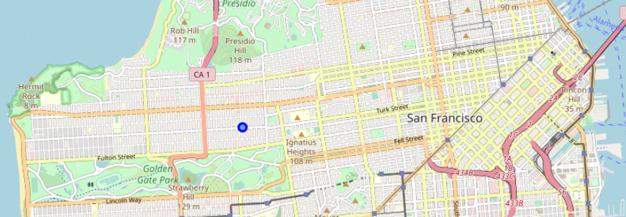
Cinderella Bakery & Café: The only Ukrainian restaurant in San Francisco

Slide 7
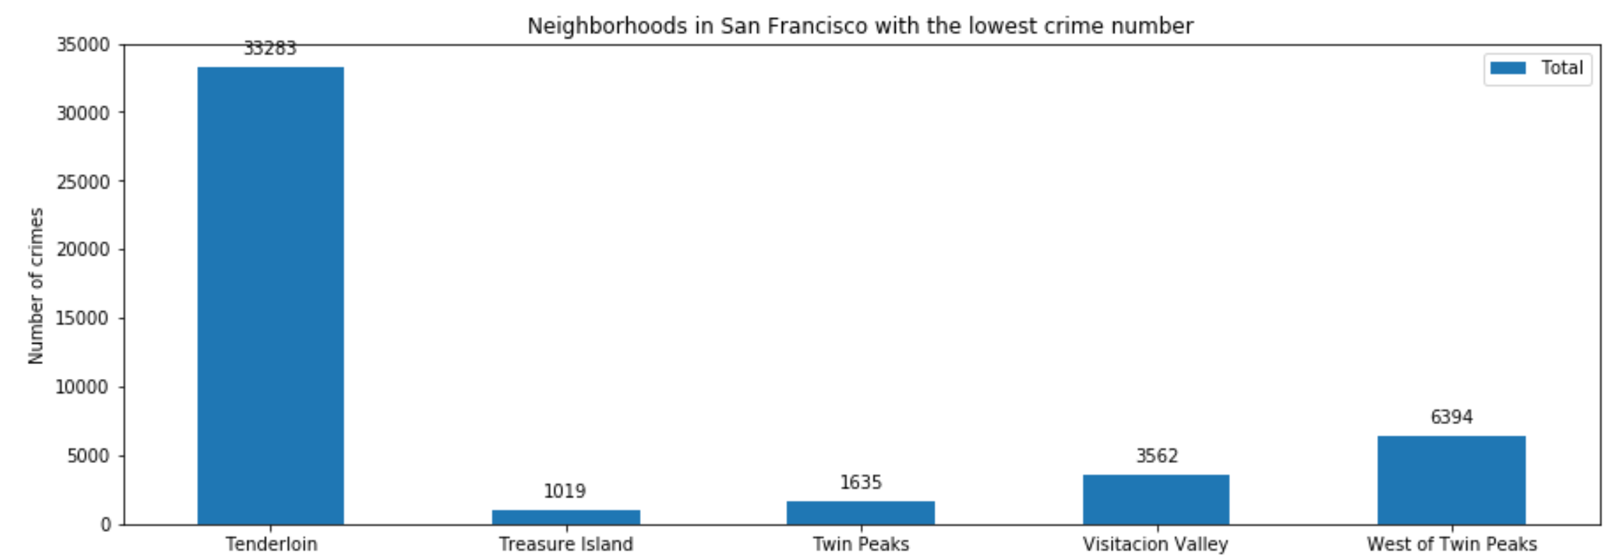
Deterring the safest neighborhood in San Francisco It is Twin PEAKS!

Slide 8
Discussion/Conclusion
Based on my analysis, at first sight San Francisco is the best city for opening Ukrainian restaurant.
However, for further analysis I need to take into considerations more factors like the cities that are most popular among Ukrainian tourists, availability of Eastern European restaurants (Polish, Russian, etc.), etc.
I have no doubt that Twin Peaks neighborhood of San Francisco is the best place to open my first restaurant in US.
Laskavo prosymo!! (Welcome in Ukrainian)

