Slide 1

O2O
Group 1 Take-out
Elvis
Ace
Joey
CD
Nick
Suky

Slide 2
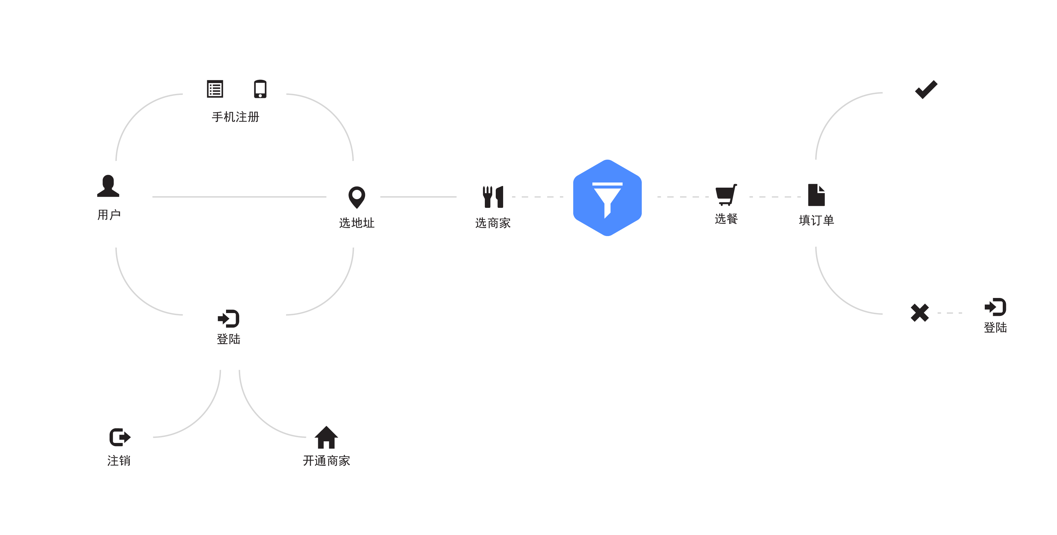
用户

Slide 3
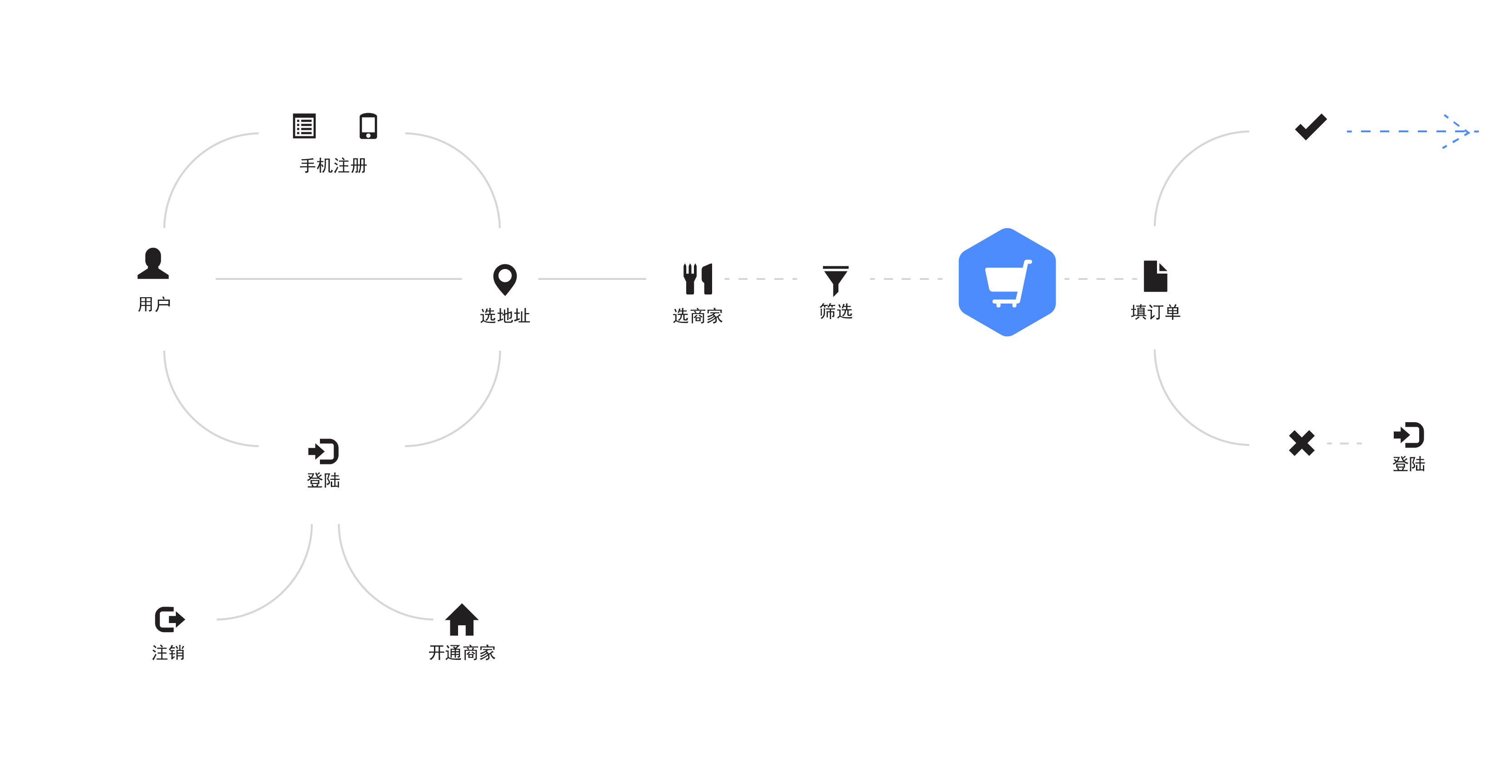
下单

Slide 4
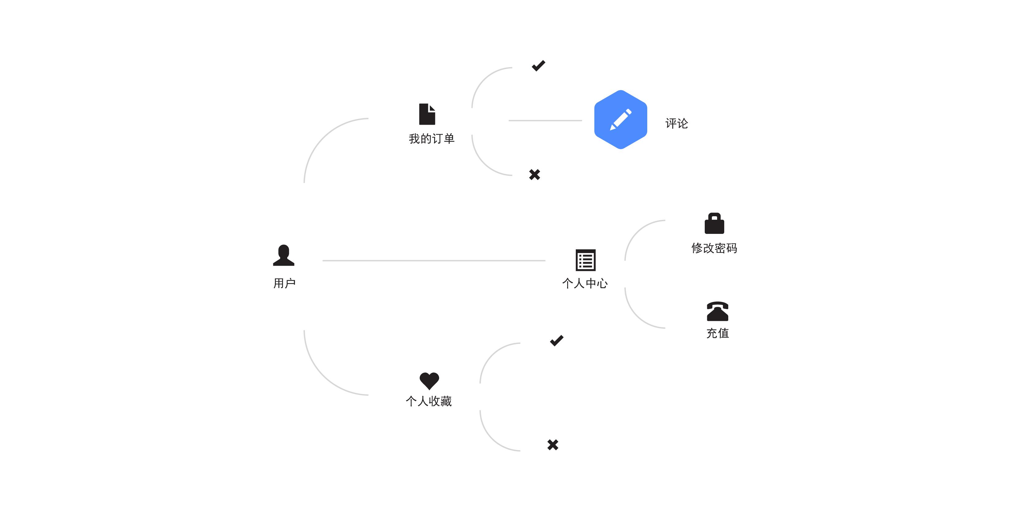
用户中心

Slide 5
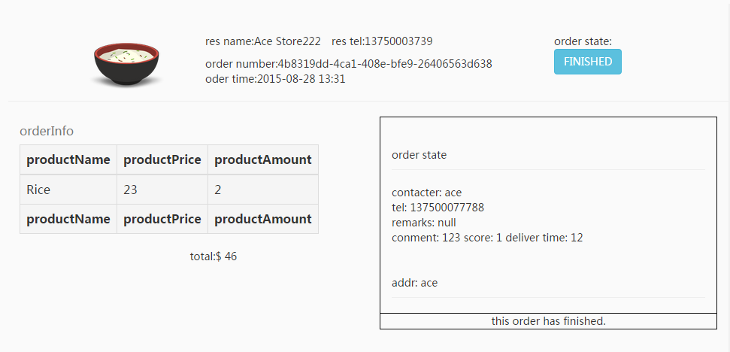

Slide 6
new
accept
sending
finished
cancel

