Slide 1
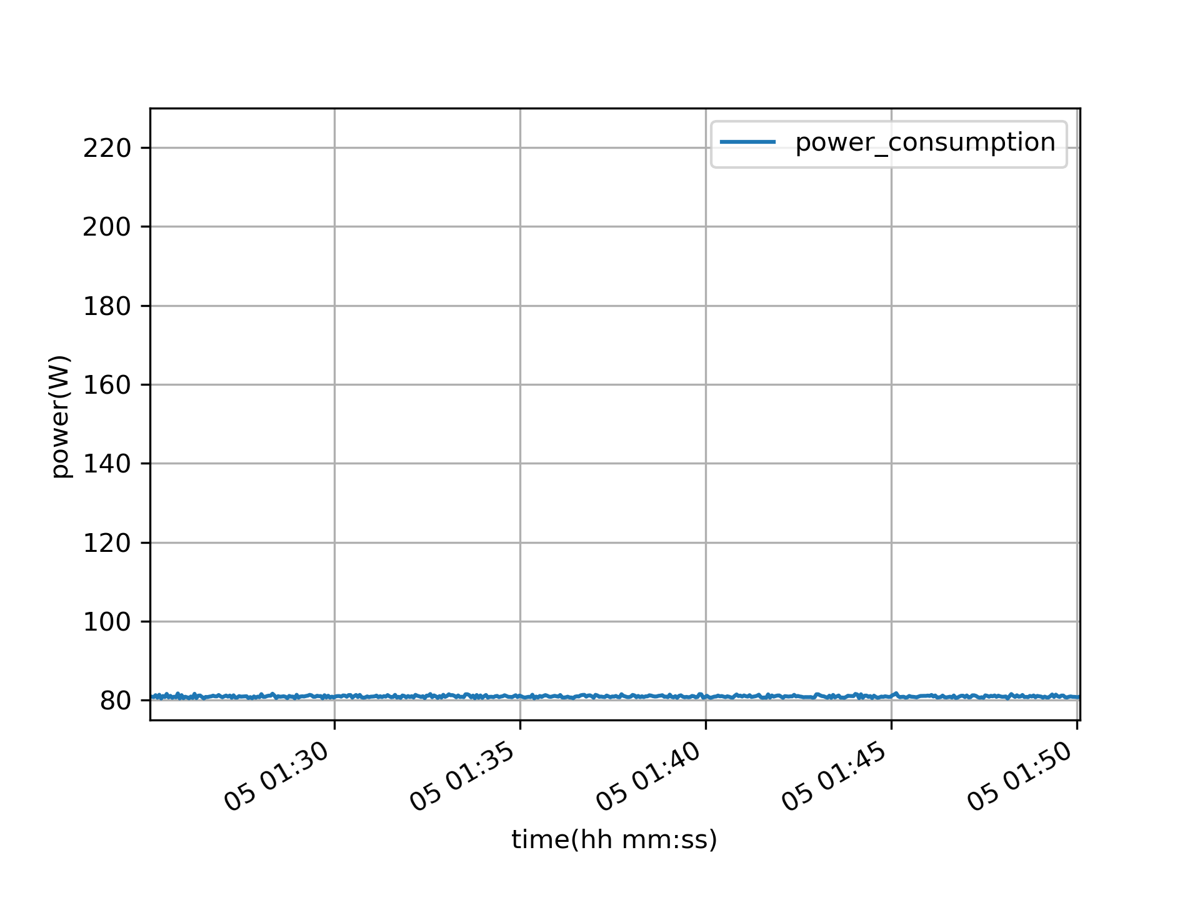
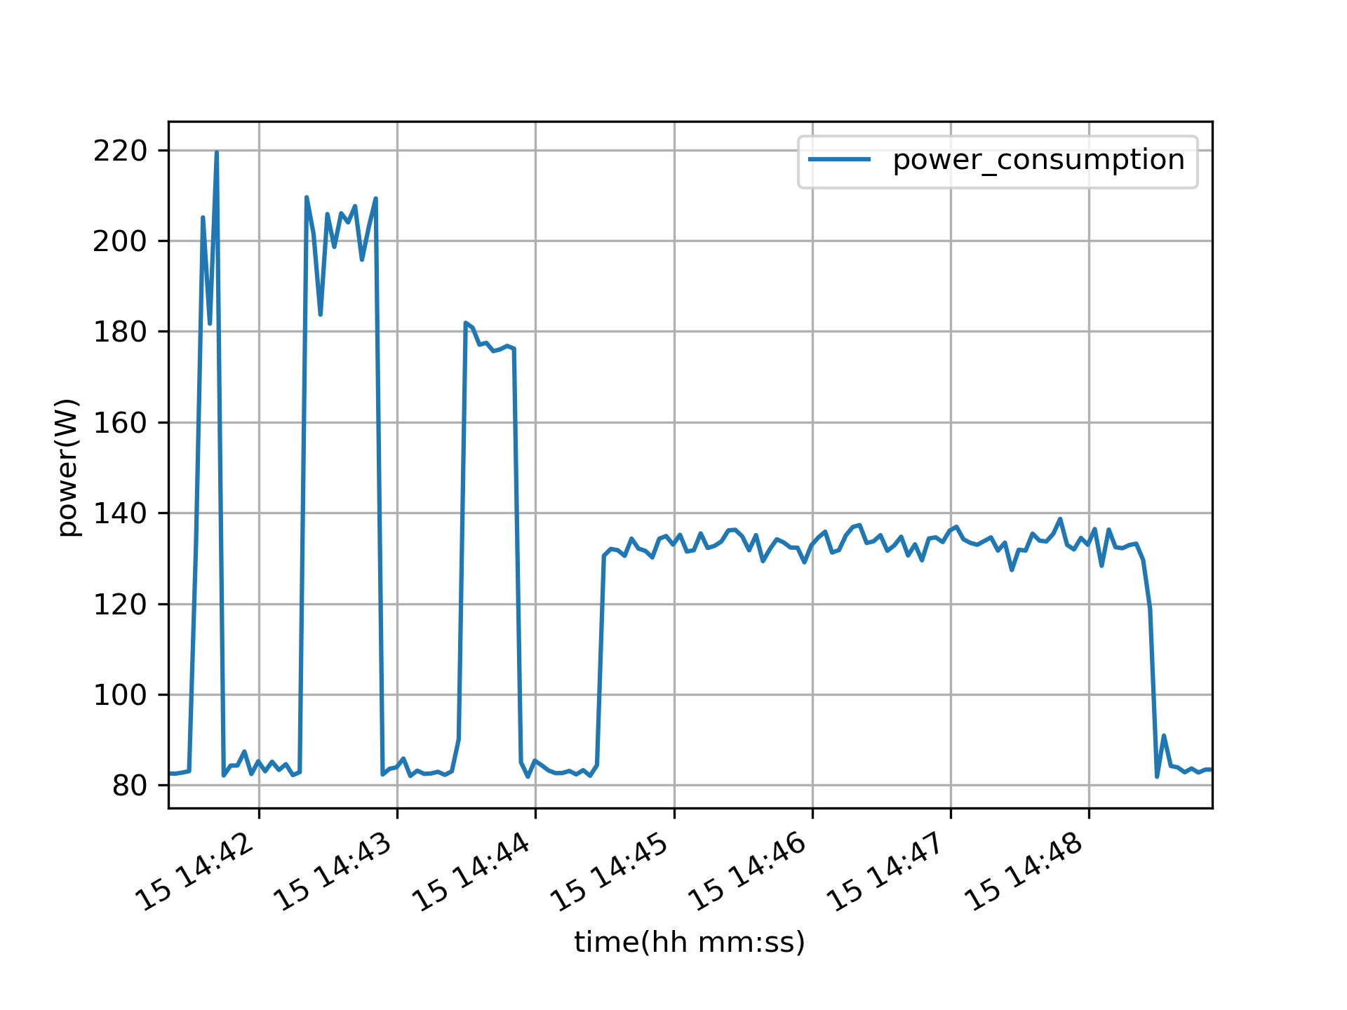
1
2
3
4
5
6
7
8
Encode with h264
Decode & play with h264
Encode with h265
Decode & play with h265
Encode with vp8
Decode & play with vp8
Encode with vp9
Decode & play with vp9

