Slide 1

FACTS4WORKER-Survey Taker
DD.MM.YYYY
This project has received funding from the European Union's Horizon 2020 research and innovation programme under Grant Agreement n˚ 636778
FACTS4WORKERS – Survey Taker

Slide 2
Index
ODK Introduction
Creating a Basic Survey
  Introduction; General Considerations; Question Types; Survey Worksheet; Choices Worksheet; Metadata; Settings Workseet
Advanced Creation Options
  Multilingual Support; Hints; Field’s Constraints; Calculations; Default values and Read Only Questions;Including Media Files;
  Modify Form Appearance; Setting
  https://opendatakit.github.io/odk-xform-spec/
  http://xlsform.org/ref-table/
FACTS4WORKERS - IP Deployment

Slide 3
Index
ODK Introduction
FACTS4WORKERS - IP Deployment

Slide 4
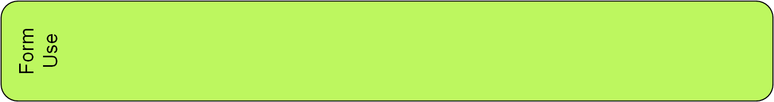



ODK Introduction
F4W Survey Taker is based on Open Data Kit (opendatakit.org/about)
ODK helps to create and manage mobile data collection.
  Forms are created on JavaRosa and Java implementation of OpenRosa
  OSS: Apache 2 license
Architecture:
Forms can be created based on an Excel Template an Xform
Android Mobile
Client
ODK Aggregate
Server
XLSForm
Based on Template
FACTS4WORKERS - IP Deployment

Slide 5
ODK Introduction
Support for presenting/gathering binary data (audio, video)
  Need to test other formats
Applications:
  Gather data from forms created by a final user
    The bad new is when it is needed to be “cooked”.
  Surveying
  Gather Quality information
  Creating mock ups of forms
  Creating forms to be embedded in applications
Not (well) covered
  JSON interface
  User permissions for accessing a form
The actual client app does not support forms navigation.
FACTS4WORKERS - IP Deployment

Slide 6
Creating a Basic Survey
FACTS4WORKERS - IP Deployment

Slide 7
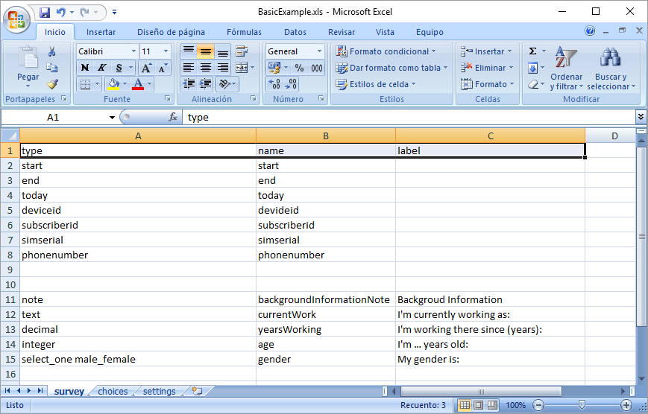
Creating a Basic Survey: Introduction
Documentation available at
  http://xlsform.org/
  https://docs.google.com/spreadsheets/d/1u9d2O-ikpzINIJ2q6dAq0Ubualn3suyGN5NcEJgpxnw/edit#gid=0
Form creation can be based on an Excell file (*.xls)
Basic Format
Survey Worksheet
List of questions and information about how they should appear in the form
Choice Worksheet
Answer Choices for Multiple choices questions
Settings Worksheet
It is optional and support customizations of the form.
FACTS4WORKERS - IP Deployment
Notes:
The Survey Worksheet
It gives the form its overall structure and contains most of the content of the form: the full list of questions and information about how they should appear in the form. Each row usually represents one question; however, there are certain other features described below that you can add to the form to improve the user experience.
The Choices Worksheet
IT is used to specify the answer choices for multiple choice questions. Each row represents an answer choice. Answer choices with the same list name are considered part of a related set of choices and will appear together for a question. This also allows a set of choices to be reused for multiple questions (for example, yes/no questions).
The Settings WorkSheet
An optional worksheet supporting the customizations of forms. These optimizations include: encrypting your form or setting an overall style theme for your form.

Slide 8
Creating A Basic Survey: General Considerations
General Considerations:
The name of the Excel file should be compliant with the xml labels syntax rules
The syntax of the names of columns and worksheet must be preserved.
survey and choices worksheet have mandatory columns
The order of creation of the columns is not mandatory (an optional column can be used for presenting they ordering).
The empty rows in the worksheet are just ignored
FACTS4WORKERS - IP Deployment

Slide 9
Creating A Basic Survey: Question Types
Type | Comment | Type | Comment
integer | Whole number | decimal | Decimal input
text | Free text | note | Display a note (no input).
date |  | time
dateTime |  | image | Take a picture
audio | Take an audio recording | video | Take a video recording
barcode | Scan a barcode (an external scanner app must be installed) | calculate | perform a calculation based on previous gathered data
select_one | Select one of multiple answers | select_multiple | Select any of several answers
geopoint | collect GPS coordinates | geotrace | Record a line of two or more GPS coordinates
geoshape | Record a polygon of multiple GPS coordinates | acknowledge | Acknowledge prompt that sets value to “OK” if selected.
FACTS4WORKERS - IP Deployment

Slide 10
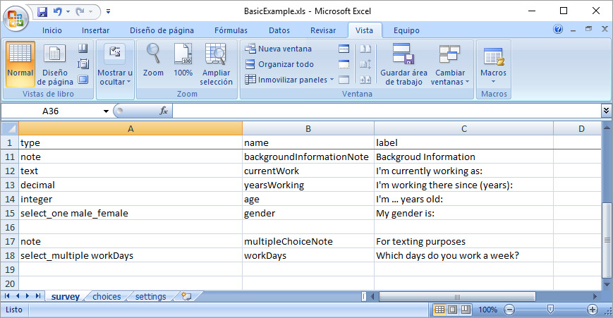
Creating A Basic Survey: Survey Worksheet
Mandatory columns:
  type: type of entry
  name: a unique variable name for the entry
  label: the text you see in the form
    Several translation labels can be provided
FACTS4WORKERS - IP Deployment

Slide 11
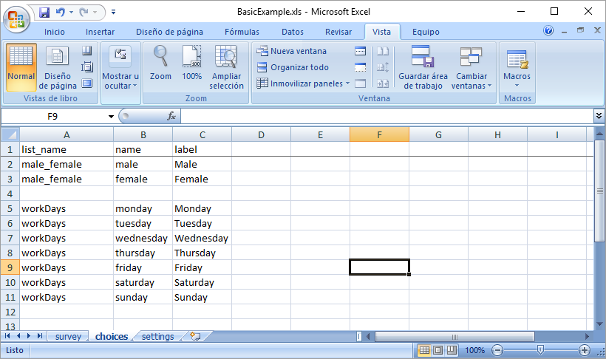
Creating A Survey: Choices Worksheet
Mandatory columns:
  list_name: lets group together a set of related answer choices
  name: a unique variable name for the choice entry
  label: the text you see in the form
    Several translation labels can be provided
FACTS4WORKERS - IP Deployment

Slide 12
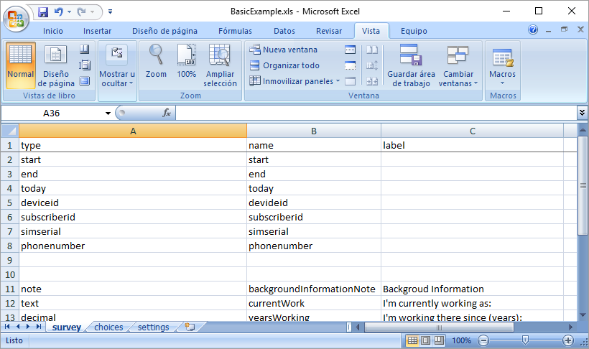
Creating A Basic Survey: Metadata
When used with the ODK client some metadata can be requested to the client (phone).
The metadata requests are included in the survey worksheet without including a label
FACTS4WORKERS - IP Deployment

Slide 13
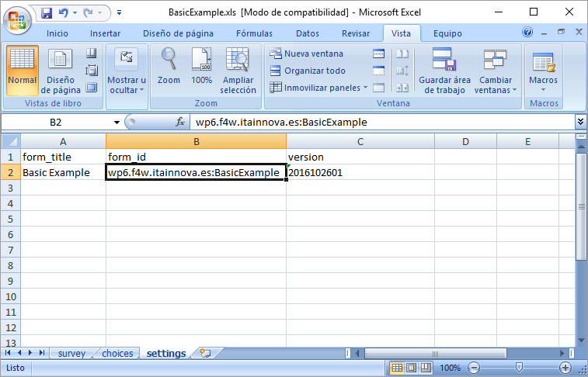
Creating A Survey: Settings Worksheet
It’s optional
It provides information about the form itself
    form_title is the label show to interact with the form
    form_id is an unique id
      It is recommened to have following format: your.domain:form
    version must be an integer number (<= 2147483648)
      New versions must be always bigger than existing one.
      The (Excel) file name is considered as part of the version.
FACTS4WORKERS - IP Deployment

Slide 14
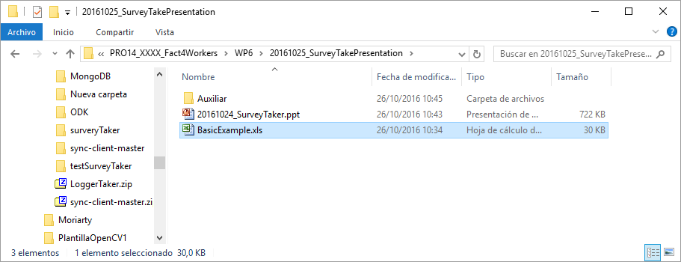
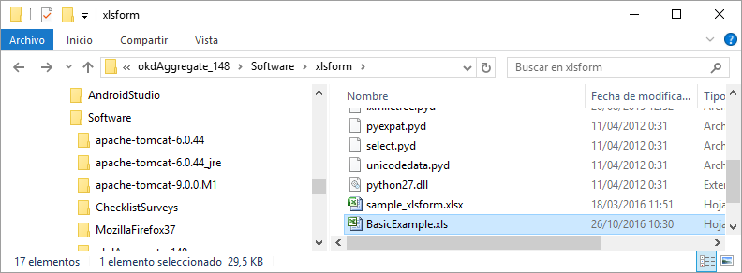
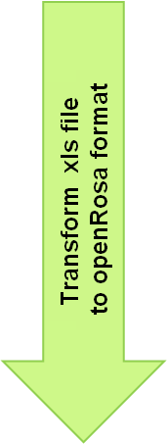
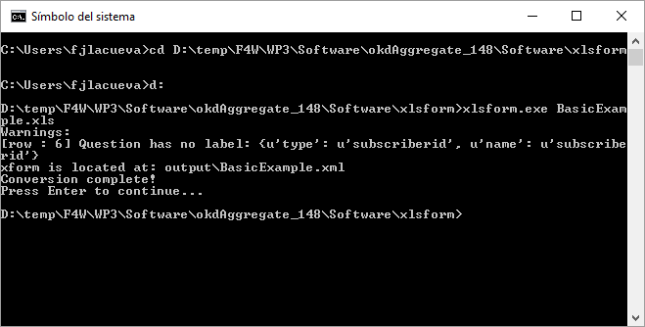
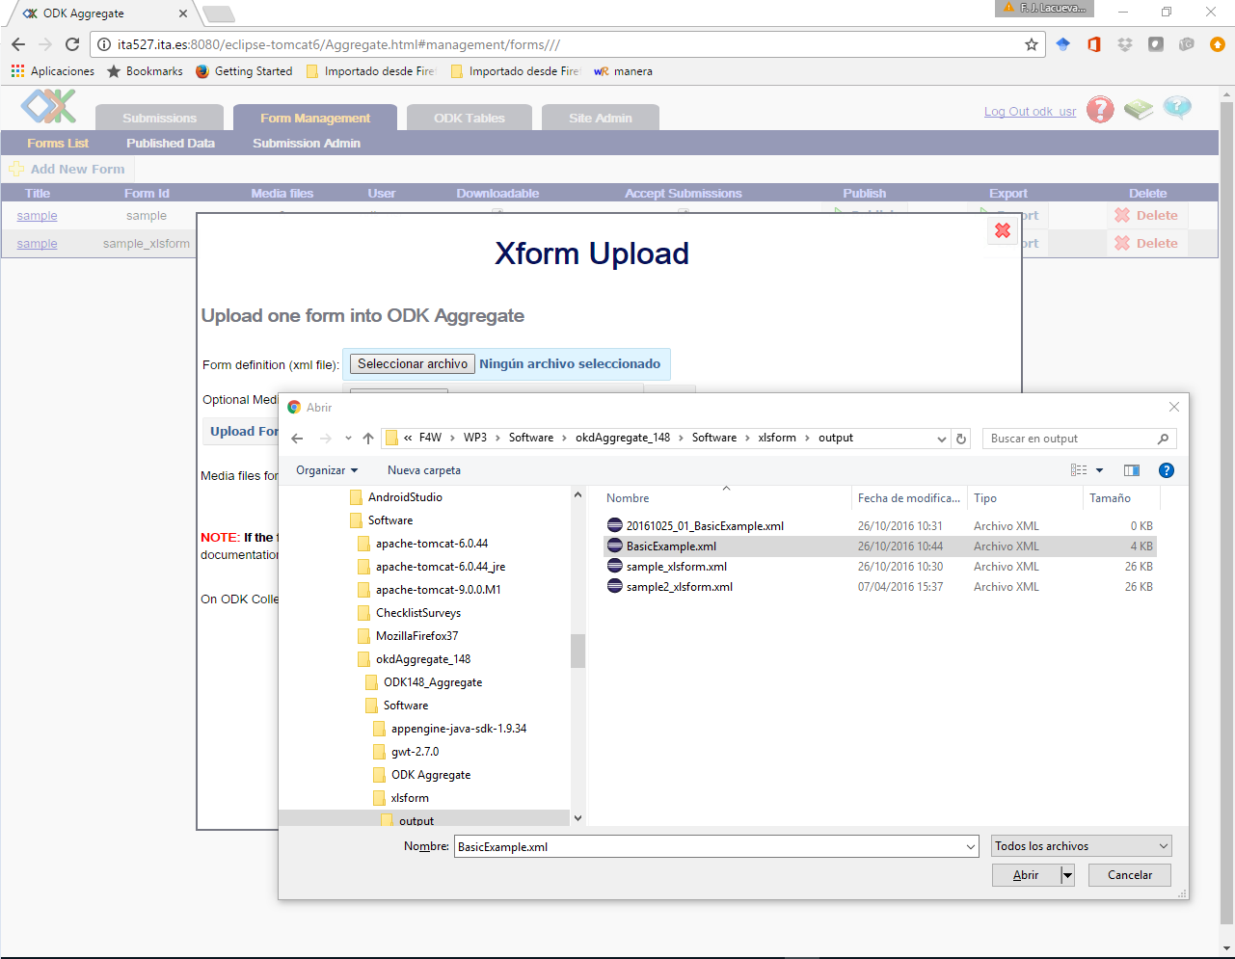
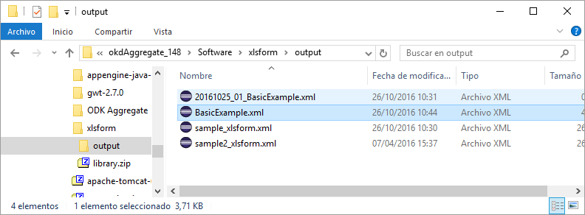
Creating A Basic Survey: Transforming the Form
Copy xls file
to xlsform folder
Upload openRosa file to the ODK aggregate server
FACTS4WORKERS - IP Deployment

Slide 15
Advanced Creation Options
FACTS4WORKERS - IP Deployment

Slide 16
Advanced Creation Options: Templates Description
Excel File Name | Description
BasicExample_1.0.xls | Most basic template: survey metadata, main data types examples, basic choices and form metadata. See slides: 10-13.
BasicExample_2.0.xls | Multilingual Labelling, hints. See slides: 17-18.
BasicExample_3.0.xls | Form field constraints and multilingual constraints labelling; Radio button choices. See slide 19.
BasicExample_4.0.xls | Form calculated fields; form required field and associated messages when the user does not provide a value. See slides 20-21.
BasicExample_5.0.xls | Form media fields. See slides 22-23. Media files: image.jpg; video.mp4
BasicExample_6.0.xls | Creating Groups of fields. Selective show of fields and group of fields. Group formatting. See slides 24-25-26.
BasicExample_7.0.xls | Creating repeat groups (answer the same group of questions several (defined/undefined) times.
FACTS4WORKERS - IP Deployment

Slide 17
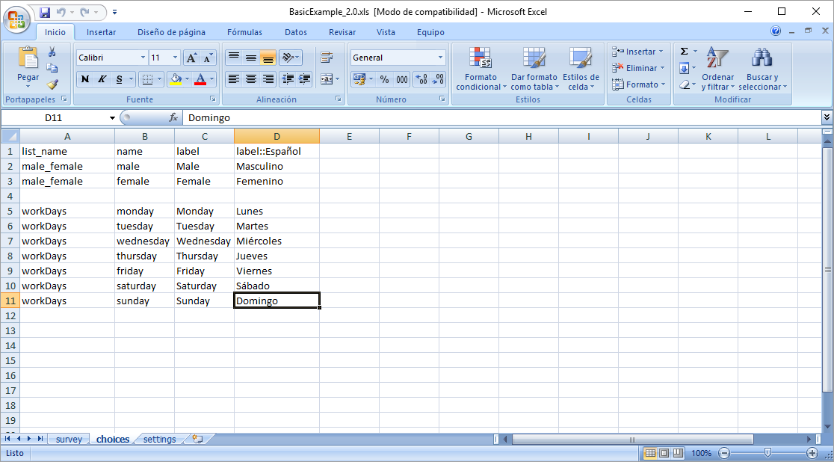
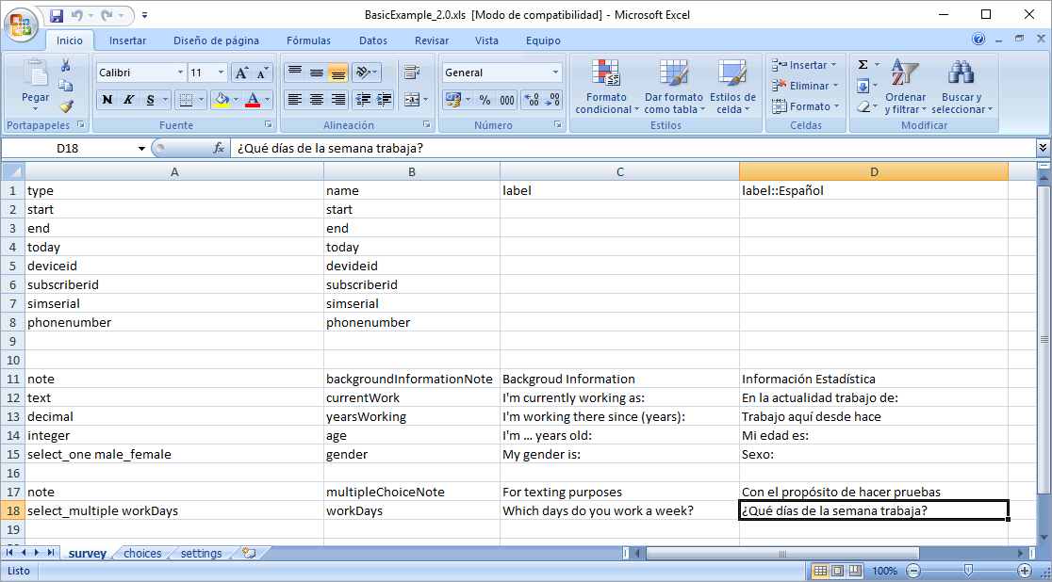
Advanced Creation Options: Multilingual Support
It is as simple as adding the language to the label column and as many languages as it is needed.
The default language is the one under the label column
The “language label” is just another label.
The language of the form (in the ODK client) is not associated to the mobile local setting (can be modified when presenting the form).
FACTS4WORKERS - IP Deployment

Slide 18
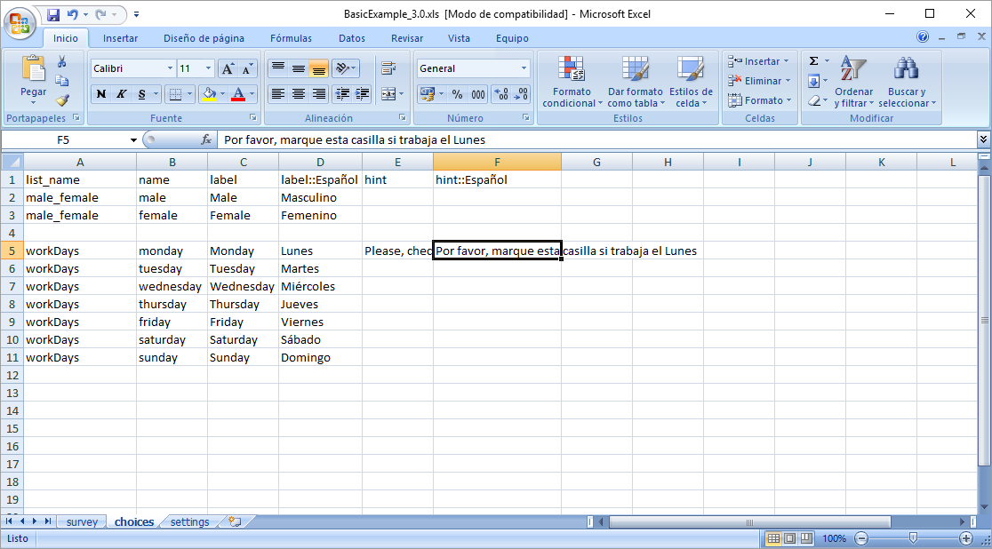
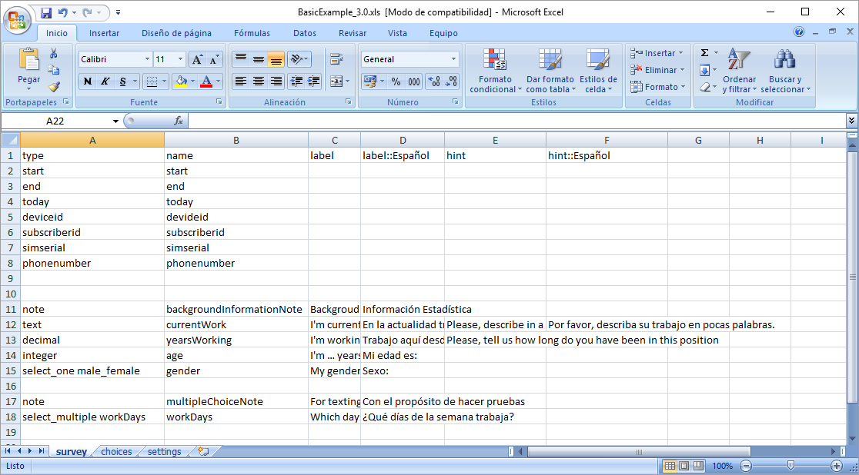
Advanced Creation Options: Hints
They can be used to provided contextual help
The rules for supporting multi-language are the same as the label’s ones.
FACTS4WORKERS - IP Deployment

Slide 19
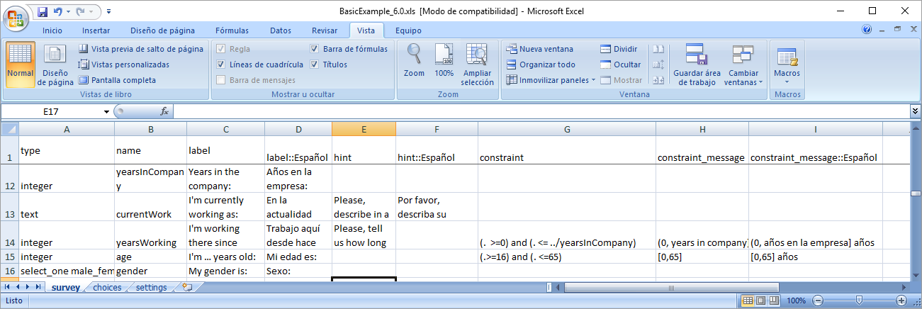
Advanced Creation Options: Field’s Constraints
Constraints can be defined for each form field.
An error message can be associated to the constraint
  The message can also be customized to the selected language.
Constraints can be complex Boolean expressions
  Form variables can referenced using Xpath expressions

Slide 20
Añadir una transparencia con lo del ${tip} calculo de valores intermedios en función de otros creados
FACTS4WORKERS - IP Deployment

Slide 21
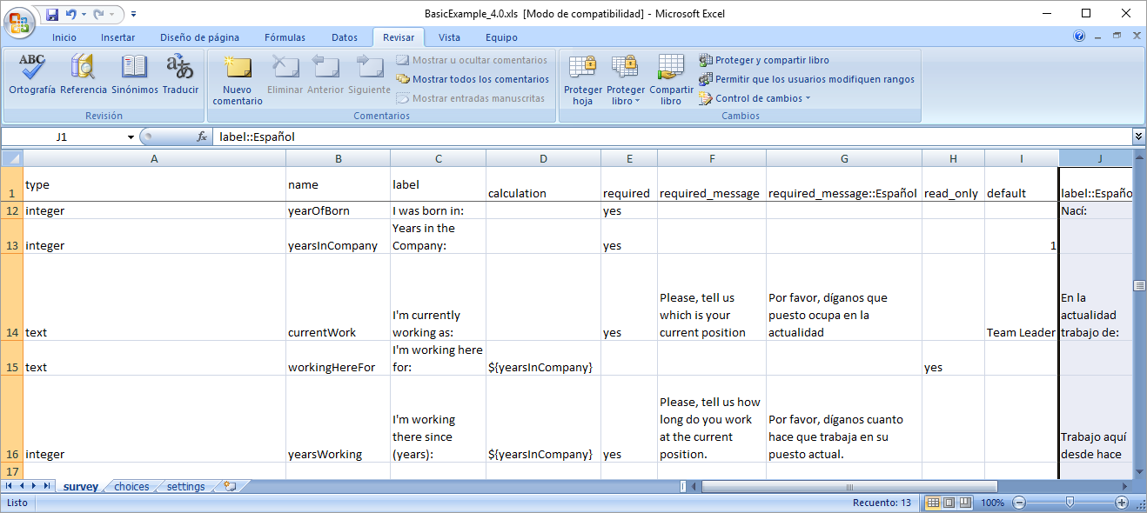
Advanced Creation Options: Calculations
It is possible to create calculation based on previous introduced values
  ${<field_name>}
Some questions can be marked as required
  A message can also be associated when a value is not specified

Slide 22
Advanced Creation Options: Default values and Read Only Questions
For a given field it can be provided a default value
A question can be shown as read only (in example for providing feedback to user).

Slide 23
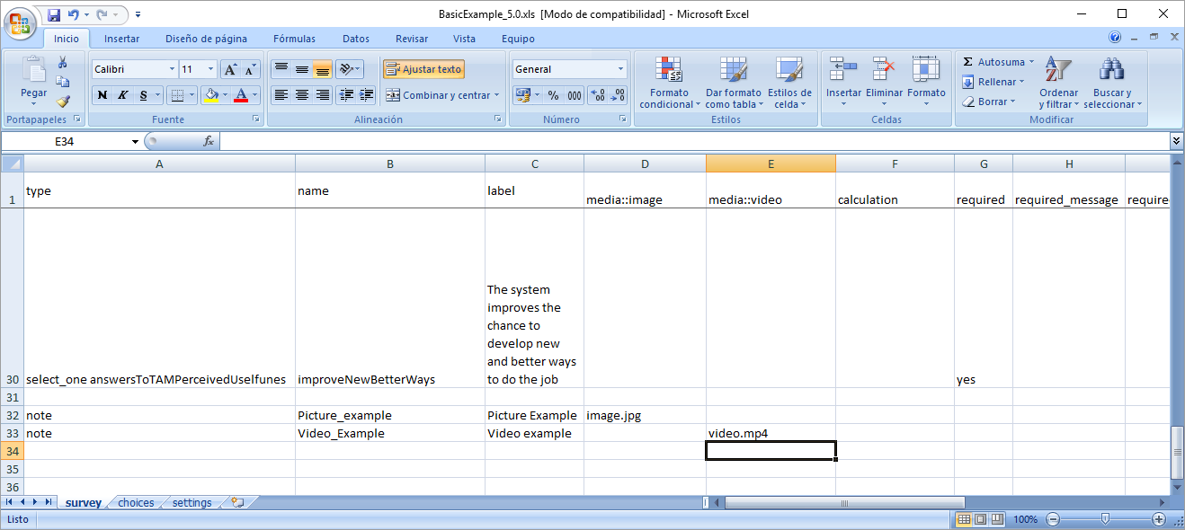
Advanced Creation Options: Including Media Files
 | Supported Format
Image | jpg, jpeg, gif, png
Audio | mp3, wav
Video | 3gp, mp4

Slide 24
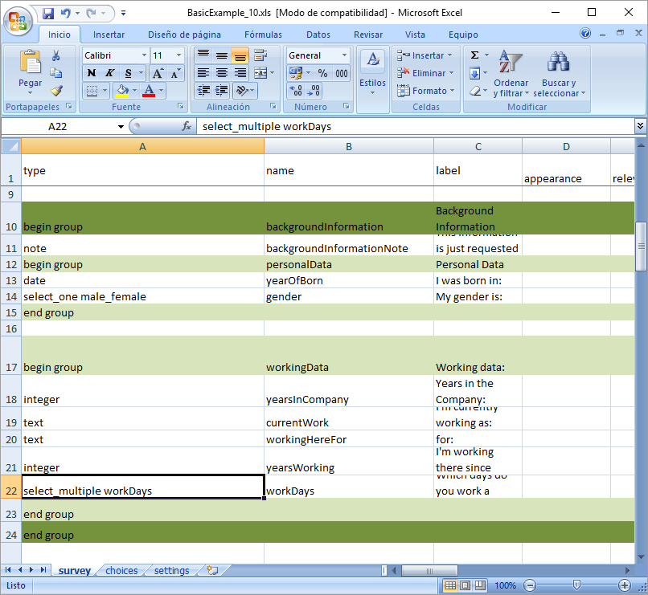
Advanced Creation Options: Grouping and Appearance
For fields can be grouped
  all fields between two rows of type “begin group” and “end group”
  groups can be nested
  groups can be assigned a given appearance
  showing or not a group of questions can depend on the value of a previous question answer.
FACTS4WORKERS - IP Deployment

Slide 25
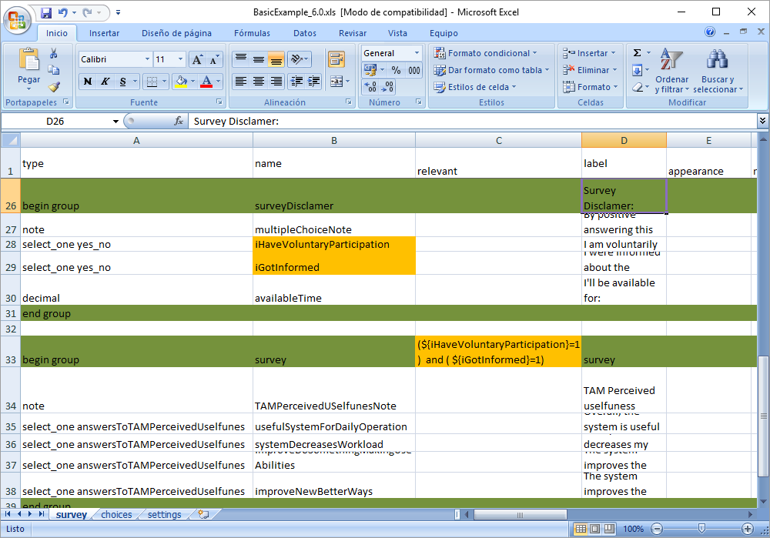
Advanced Creation Options: Grouping and Appearance
For fields can be grouped
  showing or not a group of questions can depend on the value of a previous question answer.
  Note: formulas use the XPATH standard
  http://www.w3schools.com/xml/xpath_operators.asp
FACTS4WORKERS - IP Deployment

Slide 26
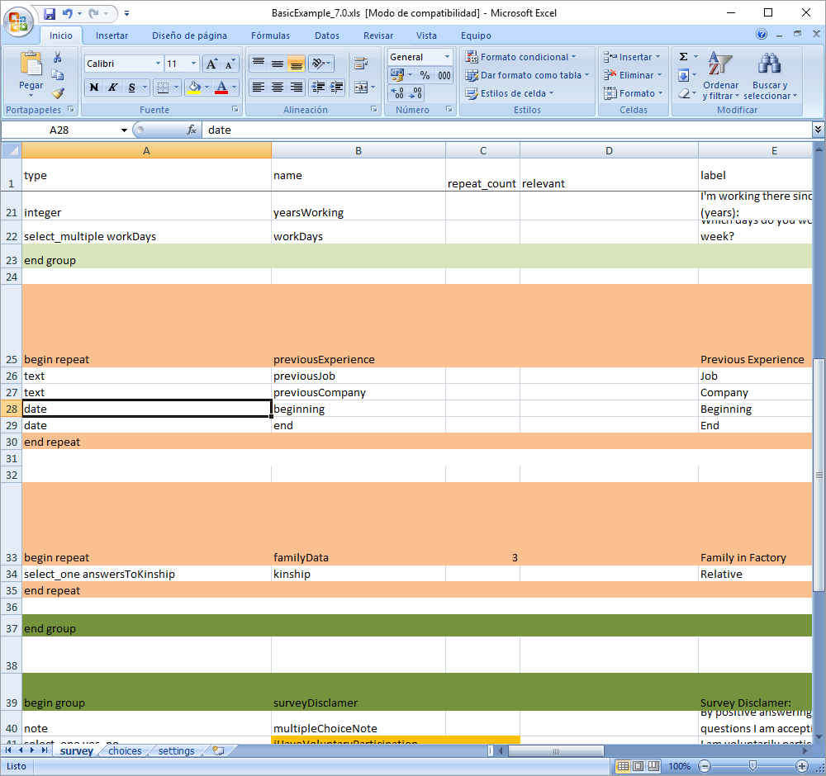
Advanced Creation Options: Repeating Questions
Repeats are a special kind of groups
  Tags are begin repeat/end repeat
  Questions are presented a: repeat_count column name of times
  Undefined number of times if no values is specified for repeat_count
FACTS4WORKERS - IP Deployment
Notes:
En el cliente actual no funciona más que en la última tabla de las anidadas.

Slide 27
FACTS4WORKERS - IP Deployment

Slide 28
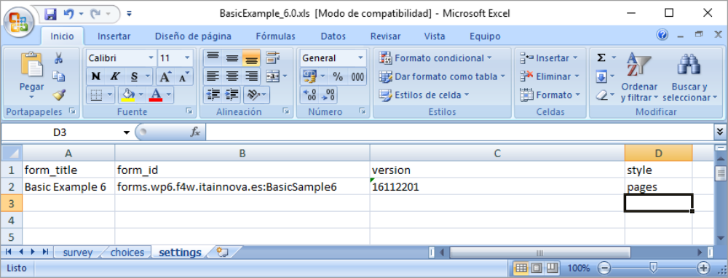
Advanced Creation Options: Modify Form Appearance
The appearance of the forms and fields can be modified.
Appearance can be modified at the form level including a style column in the setting sheet.
Possible Values
pages
theme-grid
FACTS4WORKERS - IP Deployment

Slide 29
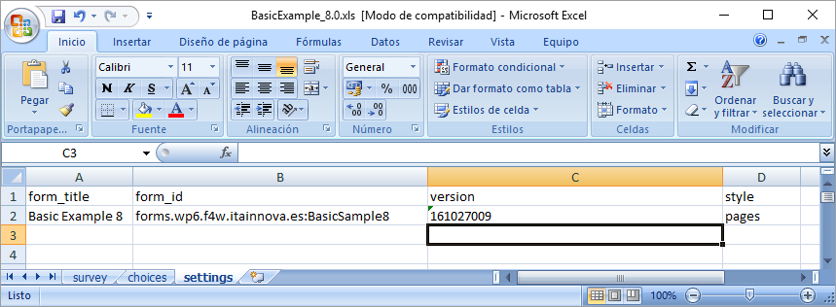
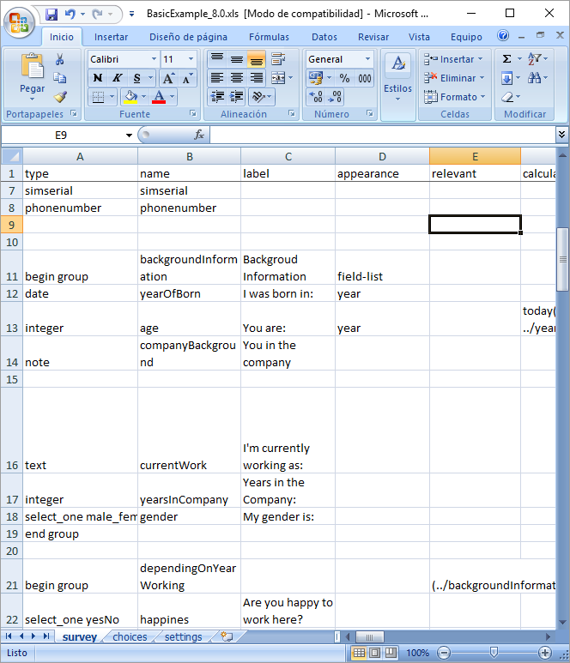
Advanced Creation Options: Modify Form Appearance
Questions can be grouped and groups can be nested
Groups can be presented in different “pages”
The appearance of the fields can be modified

Slide 30
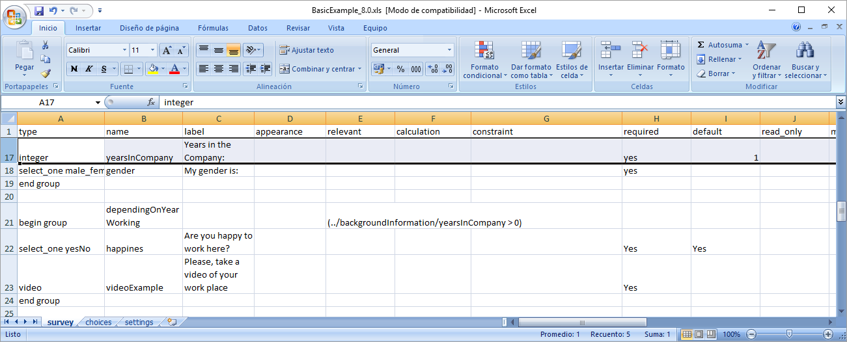
Advanced Creation Options: Modify Form Appearance
Groups can be used to skip a set of questions depending on the value of a variable.

Slide 31
Advanced Creation Options: Modify Form Appearance
Different styles can be provided to the complete form depending on the settings and on the created groups .
style | group appearance
page | field-list
theme-grid | w1, w2, …, w10 (relative width of a group or cell)

Slide 32
Advanced Creation Options: Settings
Setting tags
Tag | Comment
form_title: | The title of the form that is shown to users. The form title is pulled from form_id if form_title is blank or missing.
form_id: | The name used to identify the form submission. The form id is pulled from the XLS file name if form_id is blank or missing.
public_key: | For encrypted forms, this is where the public key is copied and pasted.
submission_url: | For encrypted forms, this url specifies the server where finalized forms are submitted to.
default_language: | In localized forms, this sets which language should be used as the default

