Slide 1

F4W-WP6 Logger
Documentation
{BFranco, FJLacueva}@itainnova.es
This project has received funding from the European Union's Horizon 2020 research and innovation programme under Grant Agreement n˚ 636778
May 2018
FACTS4WORKERS –

Slide 2
Agenda
Logger Architecture
Logger Results
Logger Information Management
Demo: Add data in real time
Data interpretation
BB requirements
May 2018
FACTS4WORKERS –

Slide 3

Logger Architecture
Traditional Architecture for Big Data
Data Sources
Data collection
Data processing
raw data
channels
information
May 2018
FACTS4WORKERS –
Notes:
Allows to follow the traditional steps in Data Science process.
Commonly used in Big Data projects, where lots of information are gathered from different sources and collected using a channel. After that, this raw data is processed using batch computing to transform it in information.

Slide 4
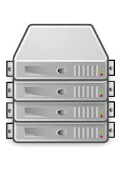

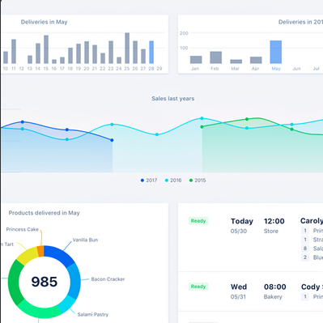


Logger Architecture
Technologies used in each layer
ANALYSER
BB1
syslog
DOCKER
syslog
BB2
KAFKA
.
.
.
syslog
BB3
F4W
Logger
May 2018
FACTS4WORKERS –
Notes:
Actualmente solo loggeamos informacion procedente del BB de Moodle (THO). Llega a syslog a traves de mensajes tcp y este se encarga de redirigirla a Kafka (y a un fichero de log). El Logger se plantea como un script que se encarga de leer la informacion que va llegando a Kafka y almacenarla en campos en una base de datos de Mongo. Esta informacion de Mongo se consulta a traves del analizador que es el encargado de ir realizando analisis y mostrarlos a traves de un interfaz web.

Slide 5
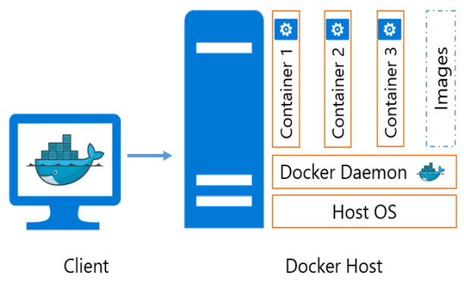


Logger Architecture
How to send information to Syslog?
  Daemon configuration (docker level)
      Requirements:
      - Containers must be created after change docker daemon.
      Problems:
      - All containers send information to syslog.
  Docker-compose file (container level)
      Requirements:
      - In docker-compose specify logger as syslog and syslog container address.
      Problems:
      - Not allowed with docker stop/start. Need up containers again.
      - Syslog in the same docker network.
      Advantages:
      - Only those containers send information to syslog.
  Redirecting log with –follow and netcat
      Requirements:
      - Local process countinuosly sending information arrives to log file docker.
      - Tool allow redirect messages (netcat).
      Problems:
      - Duplicated messages
      Advantages:
      - Only those containers send information to syslog.
Info log
follow
Info log
May 2018
FACTS4WORKERS –

Slide 6
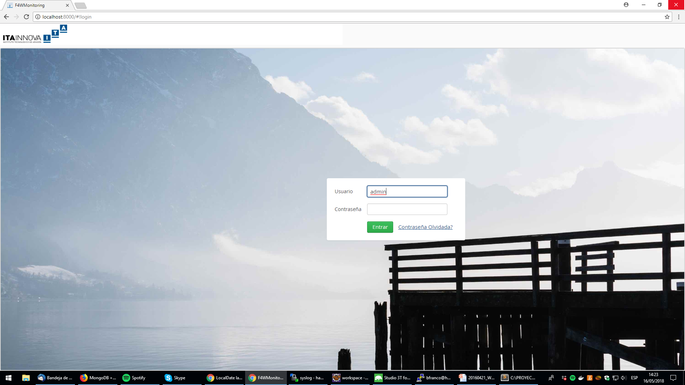
Logger Results
http://localhost:8000/
May 2018
FACTS4WORKERS –

Slide 7
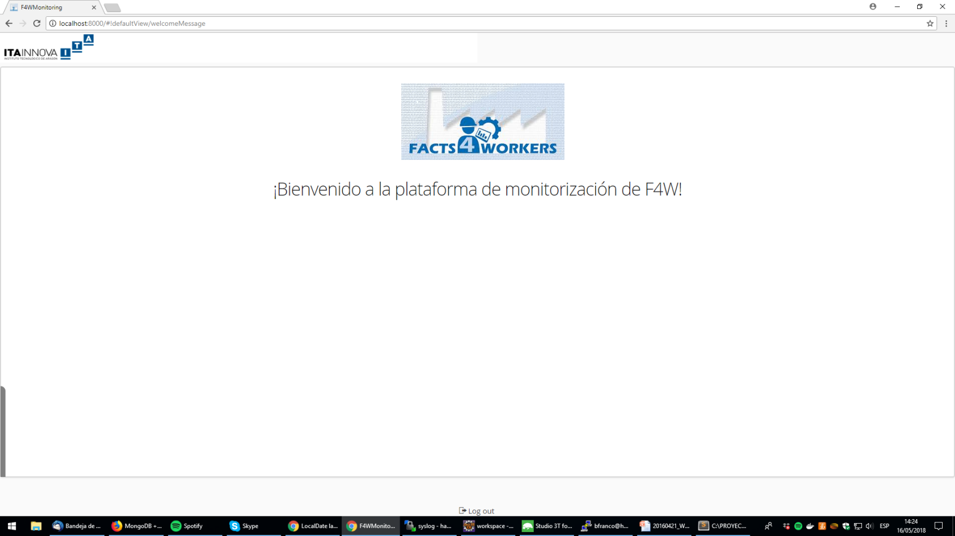
Logger Results
http://localhost:8000/
May 2018
FACTS4WORKERS –

Slide 8
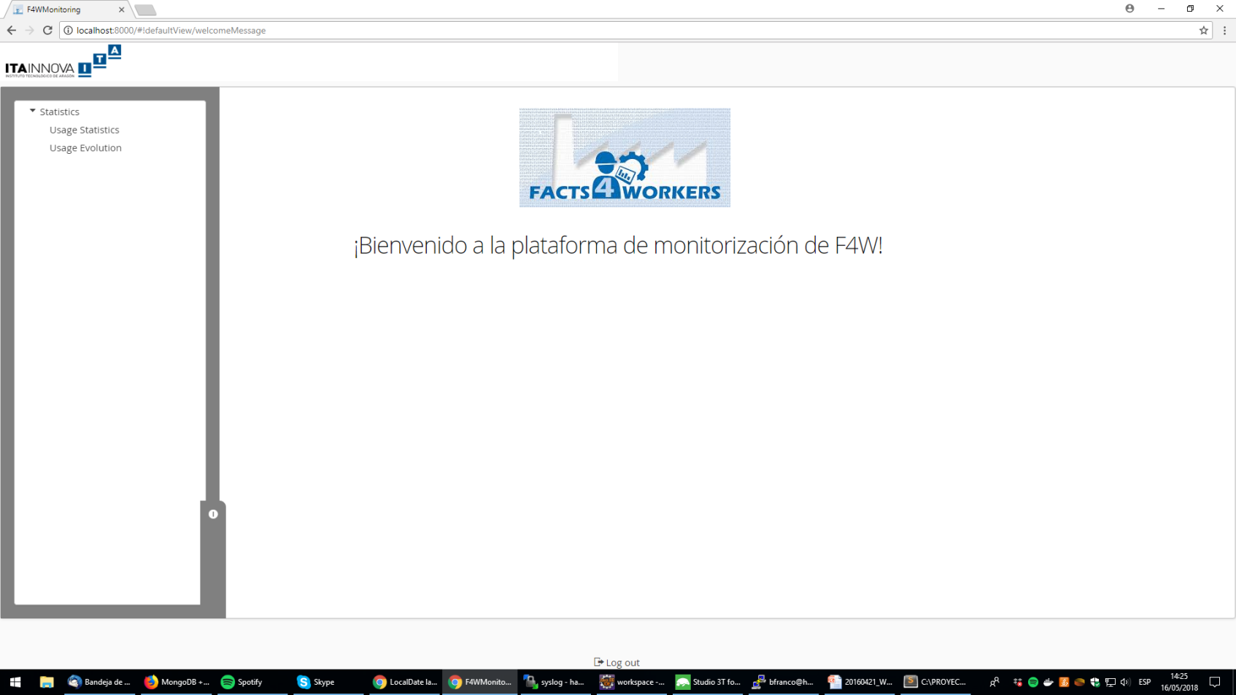
Logger Results
http://localhost:8000/
May 2018
FACTS4WORKERS –

Slide 9
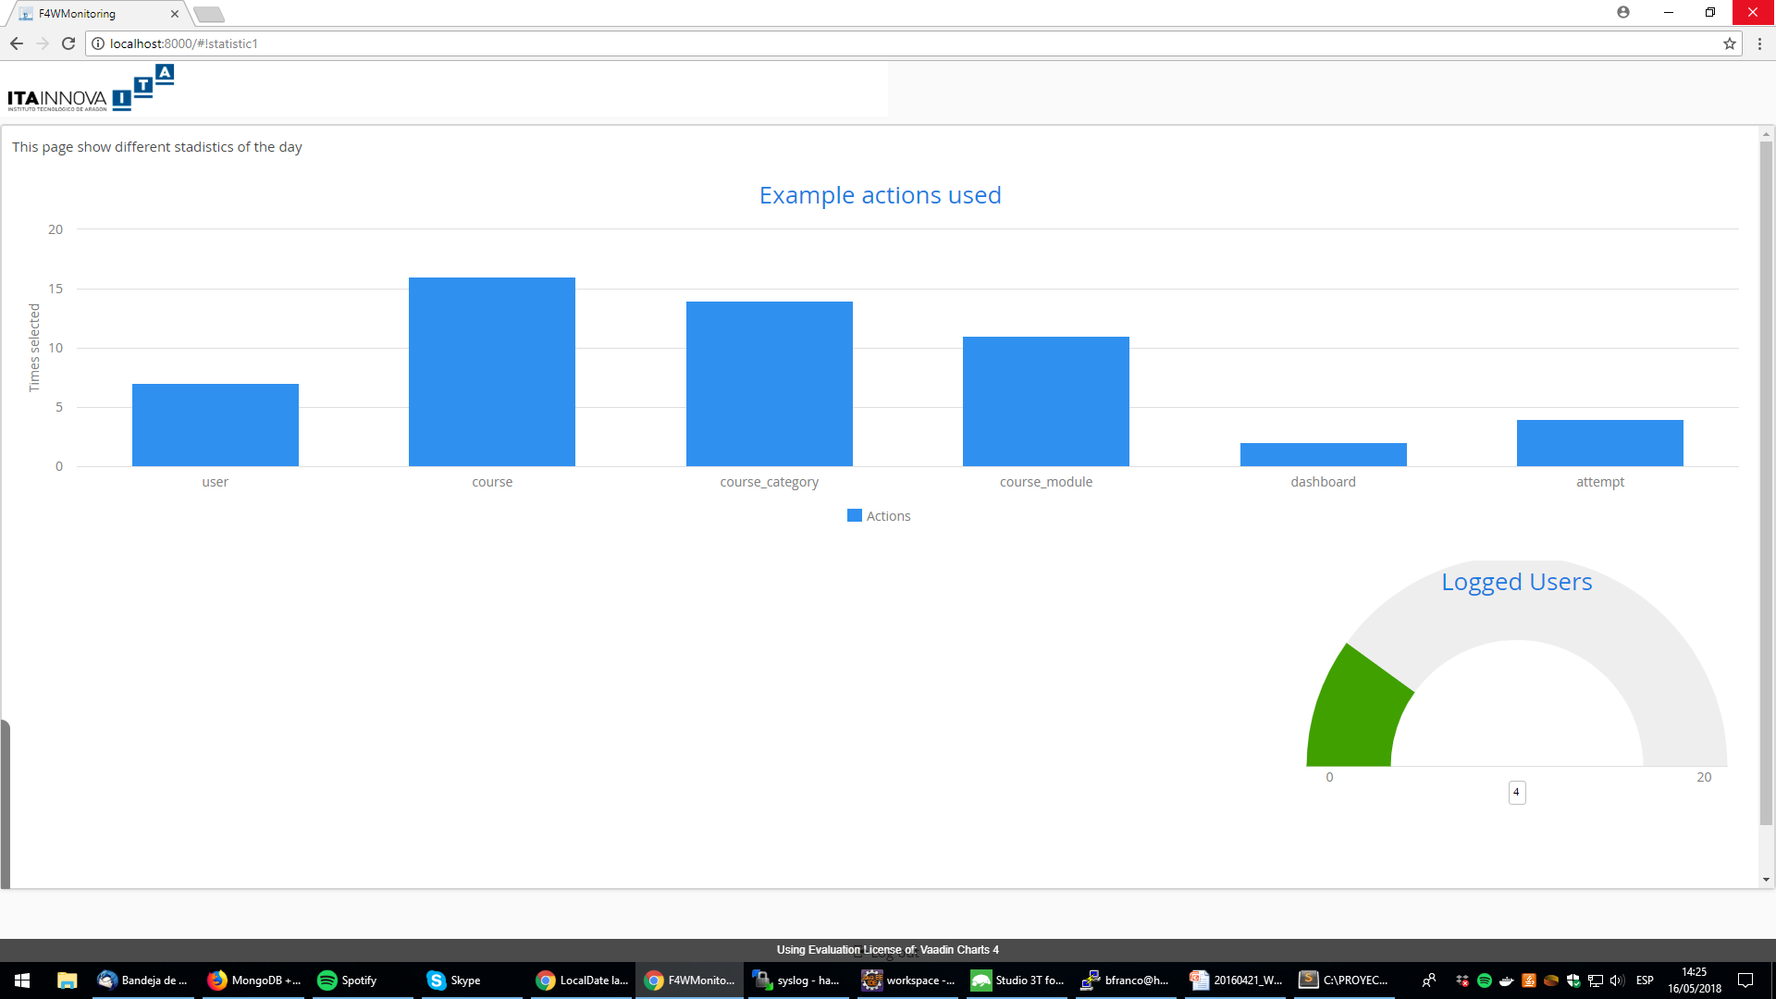
Logger Results
http://localhost:8000/
May 2018
FACTS4WORKERS –

Slide 10
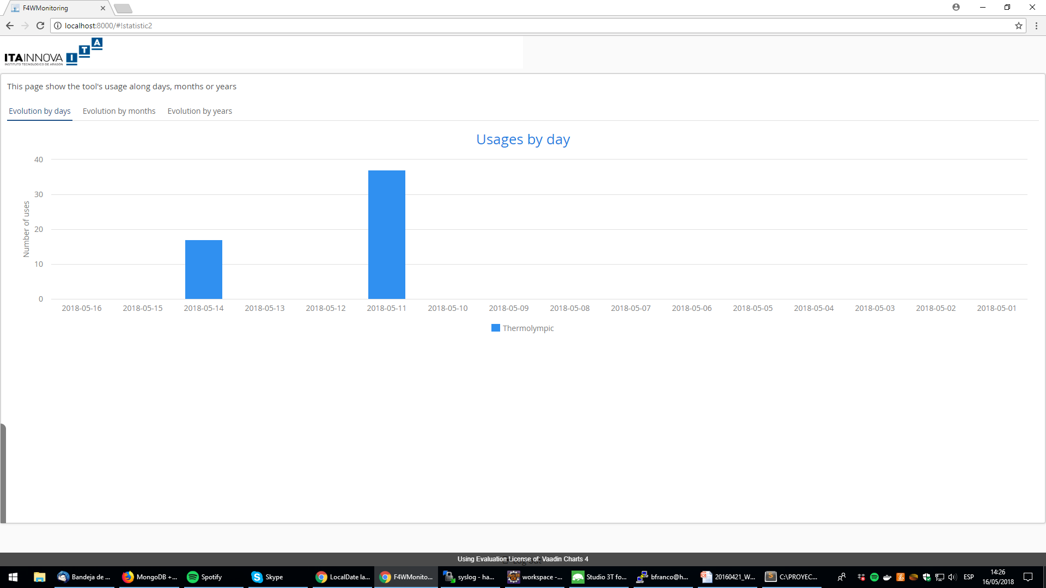
Logger Results
http://localhost:8000/
May 2018
FACTS4WORKERS –

Slide 11
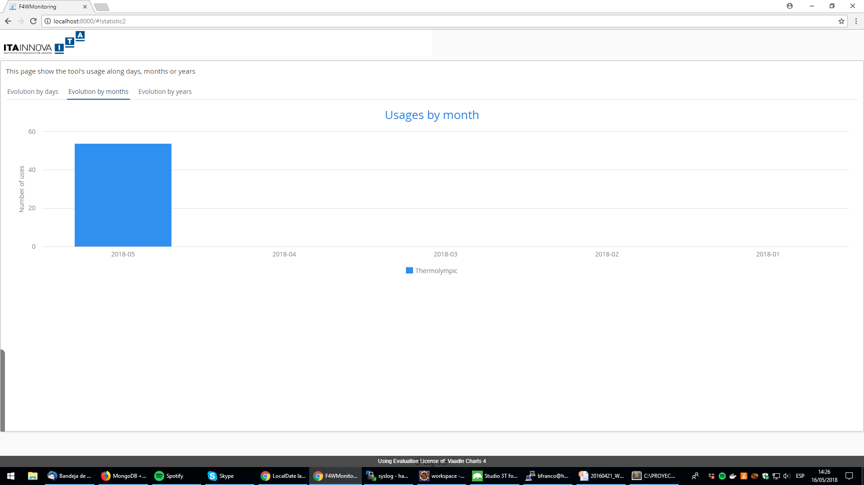
Logger Results
http://localhost:8000/
May 2018
FACTS4WORKERS –

Slide 12
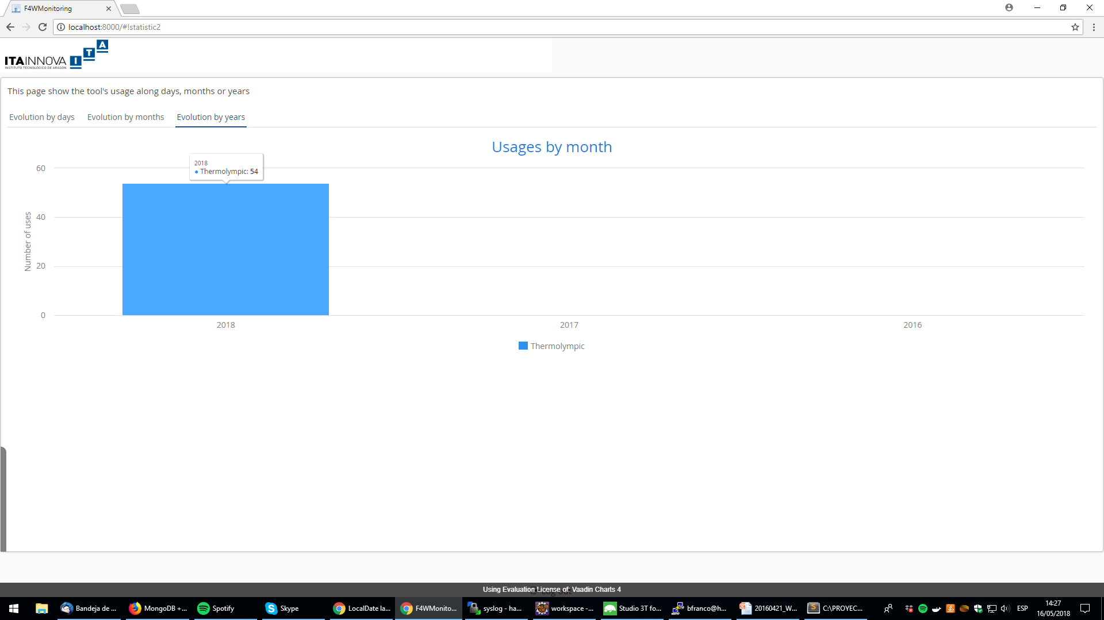
Logger Results
http://localhost:8000/
May 2018
FACTS4WORKERS –

Slide 13
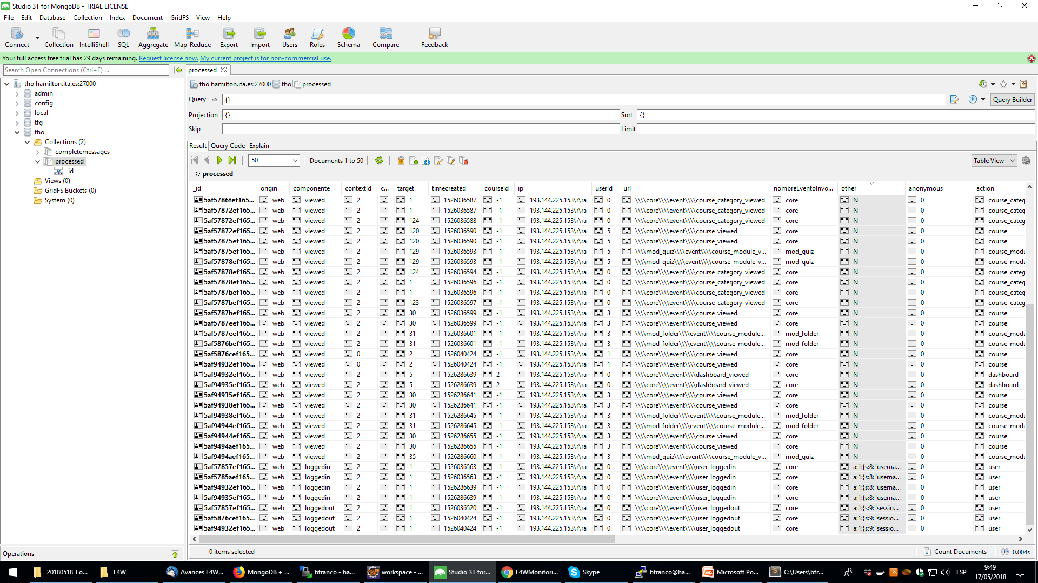
Logger Information Management
May 2018
FACTS4WORKERS –

Slide 14
Logger Information Management
"_id " : ObjectId("5aec24d8cd8e1800514a08d8"),
"message" : "2018-05-04T09:16:08+00:00 172.23.0.1 hamilton.ita.es/moodle;1276; \\\\core\\\\event\\\\course_viewed;core;viewed;course;30;2;3;-1;0;N;;1525425359;web;193.144.225.153\r\ra\n"
"_id " : ObjectId("5aec250bcd8e1800514a08e2"),
"message" : "2018-05-04T09:16:59+00:00 172.23.0.1 hamilton.ita.es/moodle;1282;
\\\\mod_quiz\\\\event\\\\attempt_viewed;mod_quiz;viewed;attempt;32;2;3;2;0;a:1:{s:6:\"quizid\";s:1:\"2\";};
1525425414;web;193.144.225.153\r\ra\n"
"(.*) 172.23.0.1 .*: (.*);(.*);(.*);(.*);(.*);(.*);(.*);(.*);(.*);(.*);(.*);(.*);;(.*);(.*);(.*)"
"(.*) 172.23.0.1 .*: (.*);(.*);(.*);(.*);(.*);(.*);(.*);(.*);(.*);(.*);(.*);(a:.*:{.*});(.*);(.*);(.*)”
["message","dockerTimestamp","container","idLog","url","nombreEventoInvocado","componente","action","target”,
"contextId","userId","courseId","anonymous","other","timecreated","origin","ip"]
GDPR compliant. In any case we will inform workers about the data gathering and the purpose of it.
Hash
May 2018
FACTS4WORKERS –

Slide 15
Propossed Fields
Field | Comment
Datatime | When: the log message is generate
userID | Who: it could be the token (so not directly linked to the worker)
sessionID | Optional. Who A finest tracking support.
bbID.entrypoint | Which functionality is required
typeOfLogMessage | An integer representing the type of call to the Logger. Supported values are: -1 -> Error record. This value is used to log as much information as possible to be used to debug/trace an error. 0 -> Invocation to a REST service. Depending on the error level additional application data can be provided. 1 -> Return from a REST service. Depending on the error level additional application data can be provided.
deviceInfo | Optional, only for “front End” services: deviceManufacturer deviceOS deviceOSVersion browserVersion
errorInfo | Optional. Error information.
appInfo | Optional. Not confidential information. I.e.: the Control Chart could log id of the machine or the Training BB the Course id.
12.12.2014
FACTS4WORKERS –

Slide 16
Demo: Add data in real time
http://hamilton.ita.es:8781/moodle/login/index.php
http://localhost:8000/
May 2018
FACTS4WORKERS –
Notes:
Generar datos a traves del interfaz de moodle de thermolympic y ver que los datos de las graficas se modifican en base a la nueva informacion que se ha incorporado

Slide 17

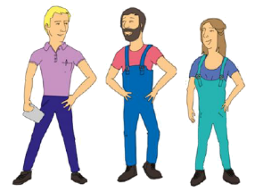



Data Interpretation
As-Is Situation
Case studies
Personas
Problem scenarios
…
Focus groups with management
Industry practices & objectives
Alignment within project
Appropriation
To-Be (smart factory) solutions
Activtiy
Scenarios
Prototype
development
(Building Blocks)
Pilot
Demo
Validator
Maturity
Mock-up
Legend
Interactions with the workers consisting of:
Observations Interviews, Think Aloud, …
Iterations
12.12.2014
FACTS4WORKERS –

Slide 18
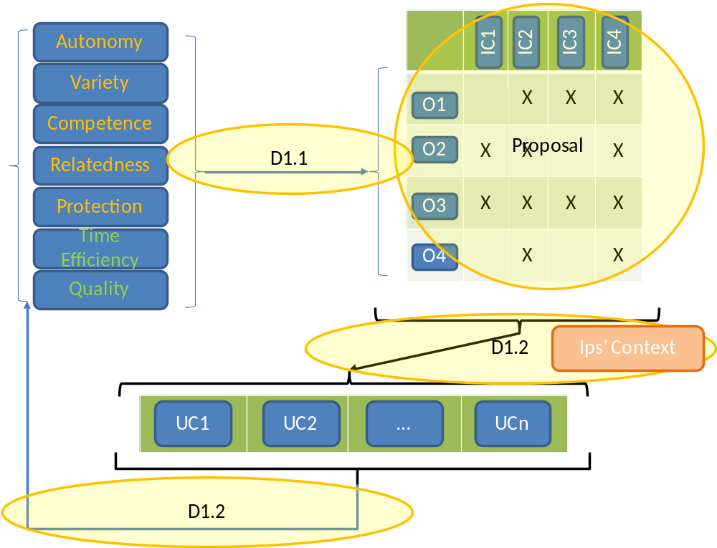
Data Interpretation
12.12.2014
FACTS4WORKERS –

Slide 19
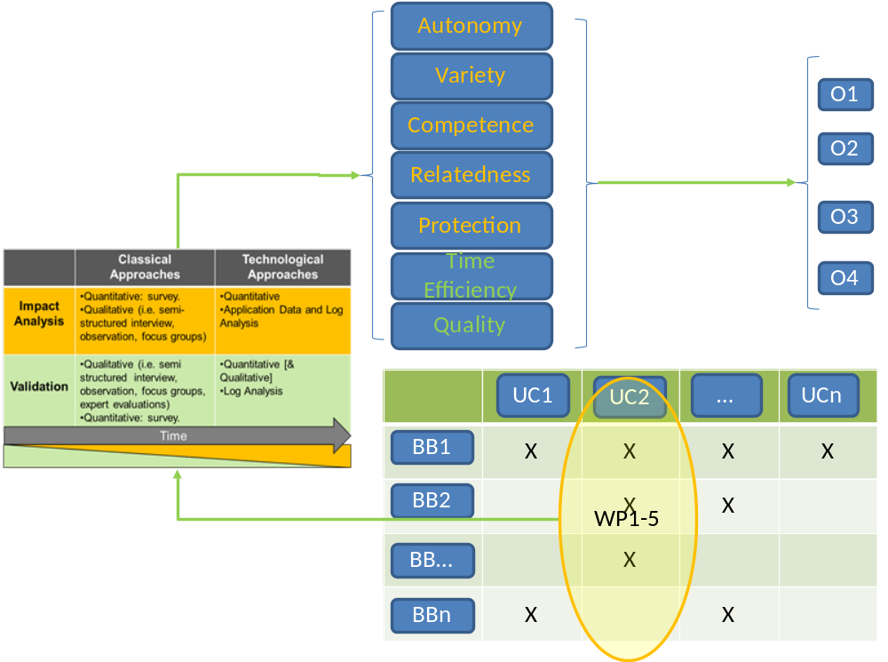
Data Interpretation
12.12.2014
FACTS4WORKERS –

Slide 20
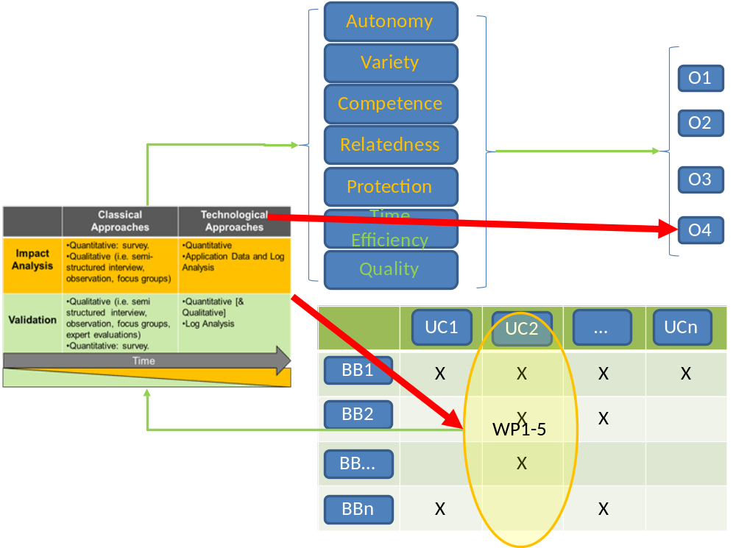
Data Interpretation
12.12.2014
FACTS4WORKERS –

Slide 21
Data Interpretation
Validation CA seems to work right as new requirements and developments
Impact Analysis does not work as right as expected:
  Few quantity of samples
  General questions helping to determine biases where CG is available
  Really dependant on the workers honesty
  Do not (completely) show impact (change in practices) is due to deployed artefacts
Use of Technological Approach (Data Driven):
  D6.1 define “TA”measurements for “kind of system”
    Select a subset which can be used for measuring impact of deployed BBs
12.12.2014
FACTS4WORKERS –

Slide 22
Data Interpretation
Example Digital Shift Book
  “Knowledge” management system
  Use of the “writeShiftBook”
    Probe use of the system
    But does not show change in practice (other than move the support from paper to digital ;-) ).
  Use of the “findAShiftBookLog” which match some issue
    Probe use of the system
    But “it also probe change in practice” (as explained during the review there are no evidences of reading paper book)
  Use of the “addComment” functionality
    Probe use of the system
    But it better probes change in practice: if someone comment something, we assume this one read the log record and provide feedback to this
12.12.2014
FACTS4WORKERS –

Slide 23
Data Interpretation
Example Digital Shift Book
  Possible problems
    Some measurements are going to be “limited” in growth
      Number of user x Shifts limited “use writeShiftBook”-> possible condition for not considering a given measure
      This could be understand as “consider to improve other practices”
    Measurements must change with requirements and solution maturity
      New functionalities could require different measurements
      It would be interesting to try to fix what to measure (not how) together with the requirements
12.12.2014
FACTS4WORKERS –

Slide 24
BB requeriments
Log to stderr/stdout
  If not the case, they log to file/database/… it can be set up in the docker-entrypoint.sh
Log message formart examples
  We will try to provide the script for transforming and hashing data
Deploy the logger BBs and setup them
  Working on the guide
12.12.2014
FACTS4WORKERS –

