Slide 1
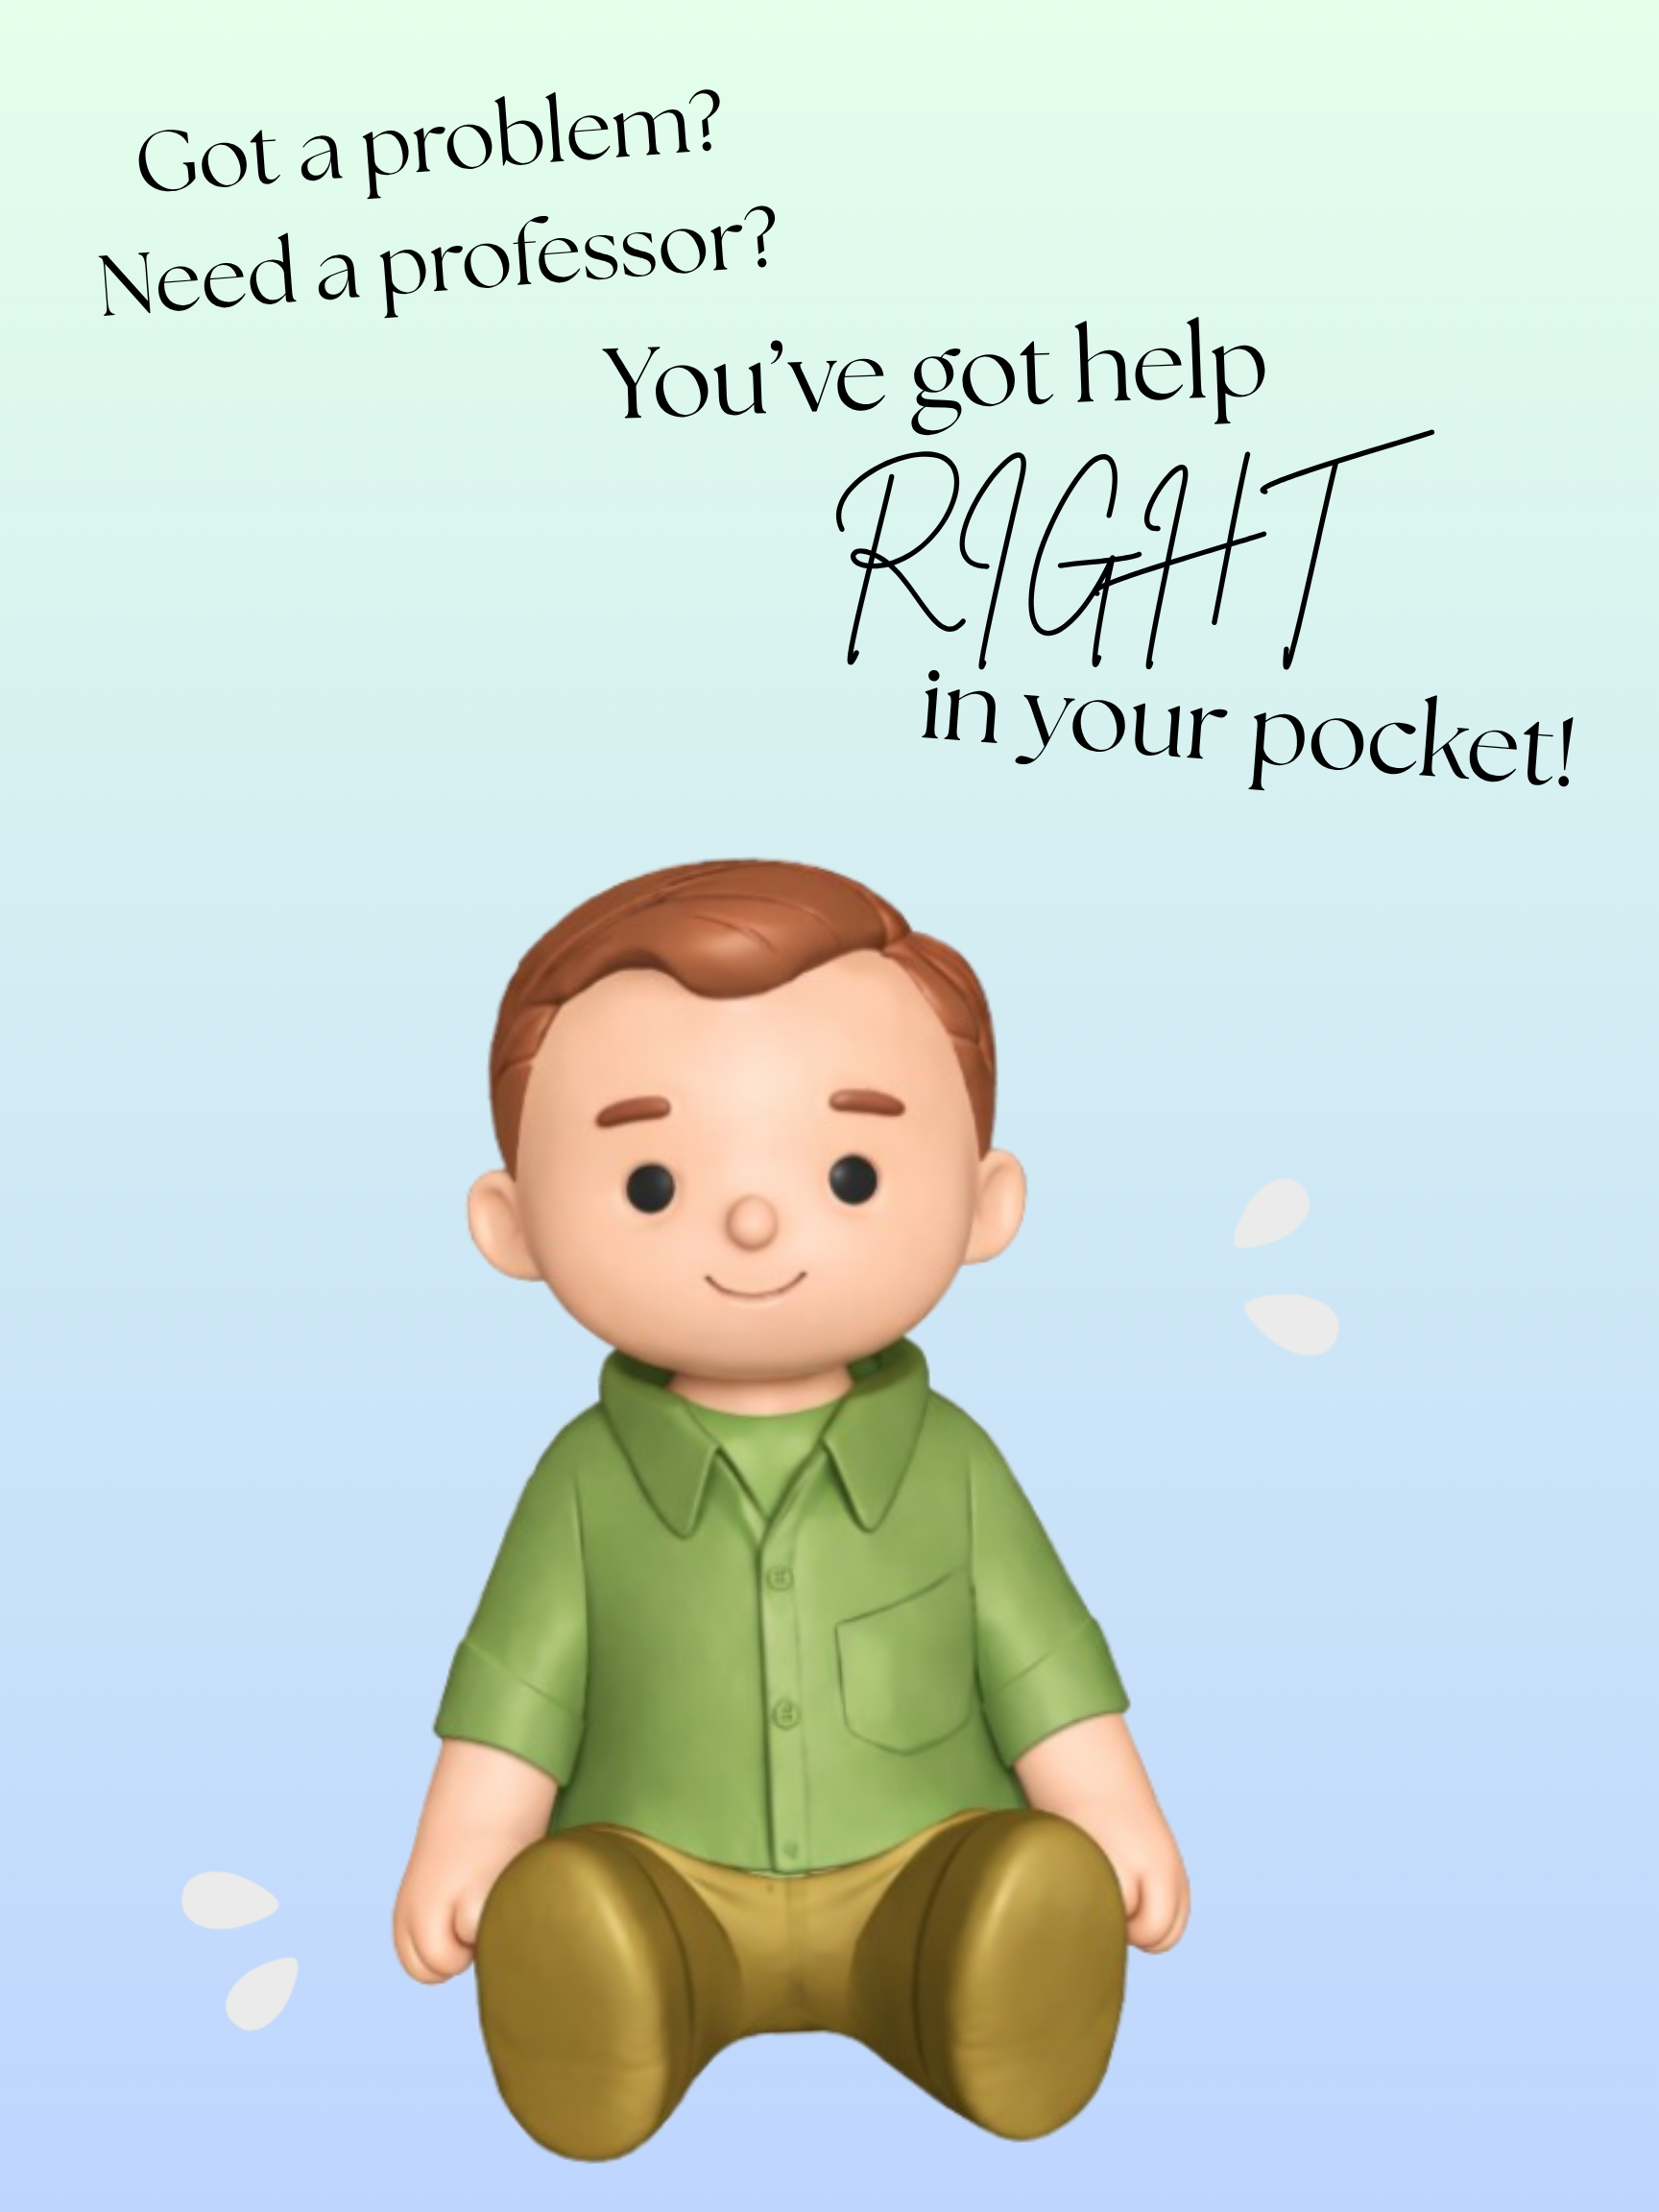
The Pocket Professor
Saige Gee ,
Lukas Gairdner,
Bekah Vanderzee
Notes:
Person 1: Welcome everyone. We're Team Pocket Professor.
My name is ___ and with me today are ___ and ____
Together we designed, built, and programmed a physical AI assistant named the Pocket Professor; and today we are here to walk you through how it came to life. Lets get into it.

Slide 2
Agenda
Team Introduction
Project Overview
Original vs Final Scope
Technology Used
Demo
Challenges
Lessons Learned
Conclusion
Notes:
Person 1: We will start with Who we are, then briefly walk through the project, what it is, how the scope changed, and what we built it with.
We will do a live demo, then wrap it up with what went well, what didn’t, and what we learned.

Slide 3
Team Introduction
Saige Gee
3D-Printing the Pocket Professor and Code Help
Lukas Gairdner
Coding and Hardware Setup
Bekah Vanderzee
Code Help, Documentation and Source Research
Notes:
Person 1: Introduce each team member and their role.

Slide 4
Project Overview
Physical AI assistant that helps users troubleshoot IT problems hands-free
Powered by Raspberry Pi with open-source AI, camera, microphone, and speaker
Gives hints, not answers, keeps users focused and off their phones
Notes:
Person 2: The Pocket Professor is a small physical device that sits on your desk
and helps you troubleshoot IT problems without breaking your focus.
Instead of Googling or reaching for your phone, you ask it a question
and it gives you a hint to point you in the right direction.
It uses a Raspberry Pi, a camera, a microphone, and a speaker.
All local, no internet required.

Slide 5
Original Scope
Physical 8 inch tall model
Voice Interaction
Hint-Based AI Responses
Camera-Based Workspace Viewing
Face-Down Detection
Notes:
Person 2: Describe the original plan.
8-inch model, voice interaction, hint-based AI, camera, face-down detection.
This was our starting point before things evolved.

Slide 6
Final Scope
Physical 11 inch tall model
Voice Interaction
Hint-Based AI responses
Camera-Based Workplace Viewing
Face-Down Detection removed for hardware safety and time constraints
Notes:
Person 2: Explain what changed and why.
We grew the model to 11 inches to fit the hardware.
Face-down detection was removed due to hardware safety and time constraints.
Core features stayed the same.

Slide 7
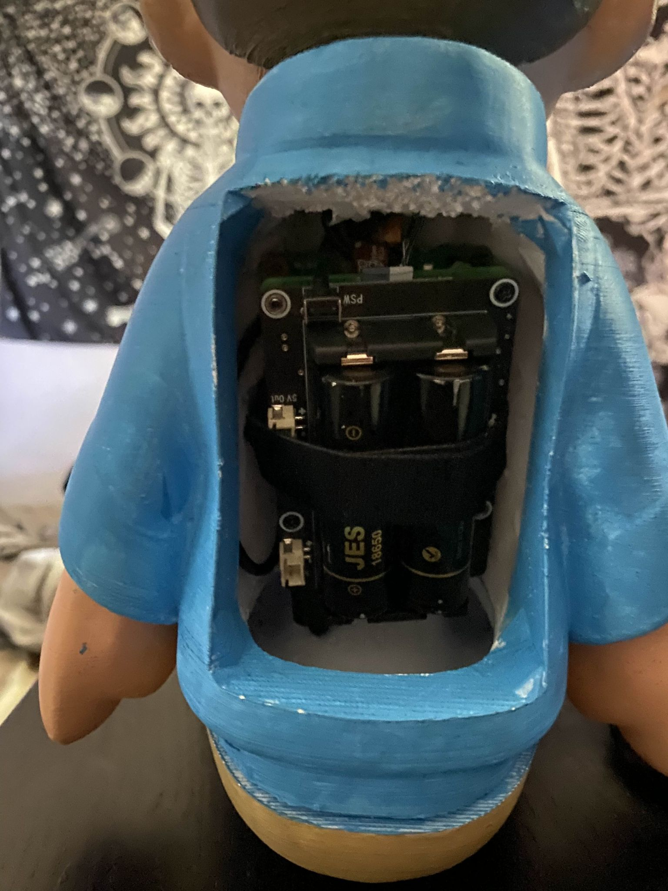
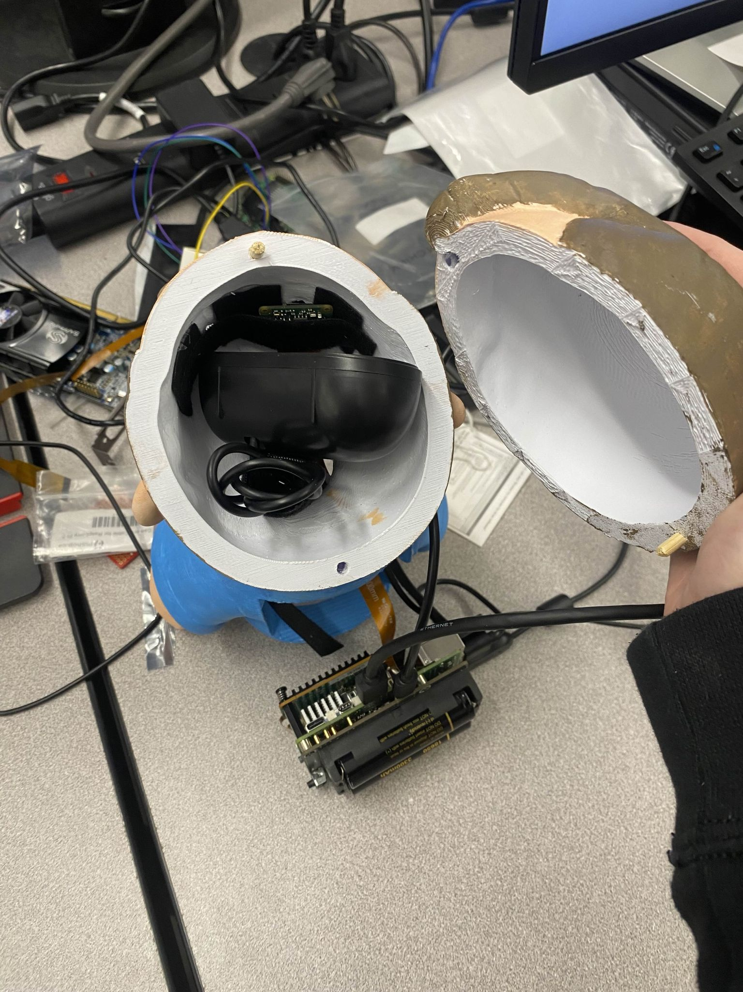
Technology Stack
Raspberry Pi 5
Camera, Microphone and Speaker
Python
Speech-to-Text + Text-to-Speech
Open-Source AI model
Why These Technologies?
Low cost
Runs locally
Flexible with Python
Supports hardware integration
Easily portable
Notes:
Person 3: Walk through the tech stack.
For hardware: Raspberry Pi 5, a camera module, microphone, and speaker.
For software: Python, speech-to-text, text-to-speech,
and an open-source AI model running fully locally.
We chose these because they're low cost, don't need internet,
and Python makes it easy to tie everything together.

Slide 8

Notes:
Person 3: This is the live demo section we are going to do a live demo of the Pocker Professor.
Show the device working end-to-end: ask it a question something like: Why is my computer crashing on boot?, it replies with a hint.
After the Pocket Professor responds say: Notice it didn't just give me the answer, it pointed me in the right direction. That's the whole idea. You stay in problem-solving mode without pulling out your phone or getting distracted.
Keep it under 5 minutes.

Slide 9
Good Parts (Strengths)
Functional Working Prototype
Successful Hardware Integration (Camera, Audio, AI)
Hands-Free Interaction Achieved
Team Adaptability to Setbacks
Improved Workflow Over Time
Notes:
Person 3: Talk about what went well.
We built a working prototype,
Successfully integrated camera, audio, and AI.
The team adapted well when the 3D print had to be redone.

Slide 10
Challenges
Communication Gaps within Team
Limited use of GitHub and Git
Time Management Challenges
3D Printing Redesign Caused Significant Delays
Notes:
Person 1: Be honest about the challenges.
Communication gaps, we didn't always share progress.
Didn't use GitHub enough for version control which made tracking changes messy.
3D printing had to be completely redone..over 50 hours lost.

Slide 11
Lessons Learned
Importance of Consistent Communication
Use of Collaboration Tools (Github) Effectively
Plan and Verify Before Printing
Strong Time Management is Crucial
Notes:
Person 1: Share what we'd do differently.
Communicate consistently, even a quick update helps.
Use GitHub from day one.
Verify designs before committing to long print jobs, print the most important parts first and go from there.

Slide 12
Conclusion
Successfully Built Functional Prototype
Achieved Core Goals
Valuable Technical + Teamwork Experience
Future Improvements Possible
Key Lessons in Communication and Project Planning
Notes:
Person 2: We set out to build a hands-free AI assistant and we built it.
We hit real challenges but figured it out.
The biggest lesson: plan well and communicate early.

Slide 13

Notes:
End of Presenatation, Thank audience and ask if anyone has questions.

