Slide 1
TestNG(Data provider, factories)
www.instigate-training-center.am

Slide 2
Topics
Parameters
DataProviders
Factories

Slide 3
Parameters
You can use an arbitrary number of parameters on each of your test method, and you instruct TestNG to pass you the correct parameters with the @Parameters annotation.
There are two ways to set these parameters: with testng.xml or programmatically.

Slide 4


Parameters from testng.xml
If you are using simple values for your parameters, you can specify them in your testng.xml:
This XML parameter is defined in testng.xml:

Slide 5
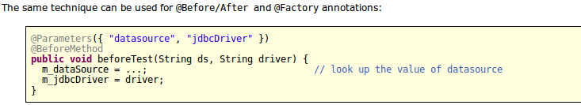
Parameters from testng.xml(cont.)
Notes:
The XML parameters are mapped to the Java parameters in the same order as they are found in the annotation, and TestNG will issue an error if the numbers don't match.
Parameters are scoped. In testng.xml, you can declare them either under a <suite> tag or under <test>. If two parameters have the same name, it's the one defined in <test> that has priority. This is convenient if you need to specify a parameter applicable to all your tests and override its value only for certain tests.

Slide 6
Data Providers
In order to specify complex parameters that need to be created from Java (complex objects, objects read from a property file or a database, etc.) Data Provider can be used.
A Data Provider is a method on your class that returns an array of array of objects.
This method is annotated with @DataProvider

Slide 7
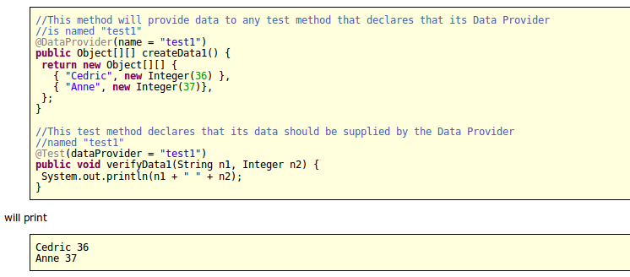
Data Providers(cont.)

Slide 8
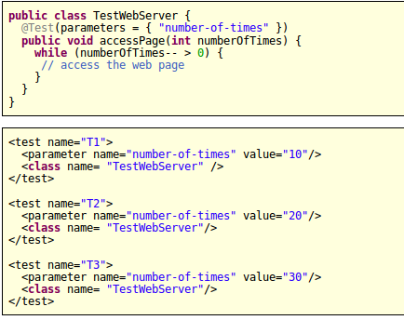
Factories
Factories allow you to create tests dynamically. For example, imagine you want to create a test method that will access a page on a Web site several times, and you want to invoke it with different values.

Slide 9
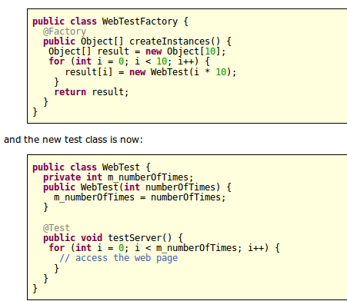
Factories(cont.)
Instead of the previous example you should use a factory:

Slide 10

Factories(cont.)
Your testng.xml only needs to reference the class that contains the factory method, since the test instances themselves will be created at runtime:

