Slide 1
Instigate Design
Java Packages
 2016 Instigate Design. All rights reserved

Slide 2
Agenda
What is a Java package
Why to use packages
Organization of source and class files
Naming conventions
Defining packages
Importing packages
Package scope
Access protection

Slide 3
What is a Java Package
A package is a namespace for organizing classes and interfaces in a logical manner
Typically it is similar to folders on HDD
Packaging is both naming and visibility control mechanism
Package names are dot-separated sequences of identifiers
Each component of a package name corresponds to a subdirectory

Slide 4
Why to use packages
Java uses packages to group related classes and to ensure unique class names to avoid conflicts in integration of independently developed code
Placing the code into packages makes large software projects easier to manage.

Slide 5
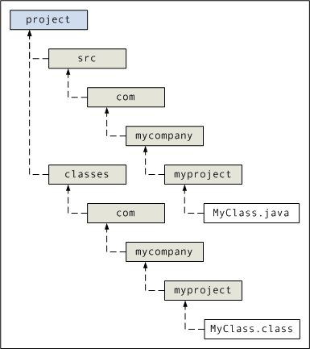
Organization of source and class files
Some useful javac options
-d option specifies output directory for class files. The directory must already exist. This allows to keep the source and class files separately. javac puts the class files in a subdirectory reflecting the package name, creating subdirectories as needed
-classpath overrides CLASSPATH environment variable, which specifies directories of external libs, classes
javac -d classes -classspath C:\java\MyClasses src\com\mycompany\myproject\*.java

Slide 6
Naming conventions
To guarantee the uniqueness of package names, it is recommended to start a package name with a domain name of the company in reverse (e.g. com.<company>) as domain names are unique
Next comes a project name and then the hierarchy of project organization
The full name of the class consists of the package name followed by the class name
An example from Java library: java.util.Vector

Slide 7
Defining packages
The Java compiler will understand the packages if the following line is written at the beginning of the class:
package <package_name>;
If no package name is defined, the class is placed into the default package and the source code will go into ”src” directory.

Slide 8
Importing packages
The classes are imported by fully qualified names, that is with package names
e.g. import java.util.Date;
All classes within the package can be imported using “*” after the package name:
e.g. import java.util.*;
If a class with the same name is contained in more than one imported package, hen the class name should be used specifying the package.

Slide 9
Package scope
Class members that do not have access specifier are accessible by all methods within the same package
Below is an example:
public class MyClass
{
String packageString;
}

Slide 10
Access protection
Public – visible from everywhere
Private – cannot be seen outside of the class
Protected – visible to all subclasses (also in other packages) and classes in the same package
No specifier – visible to subclasses and classes within the package
Example:
package p1;
public class BaseClass {
private int privateInt = 2;
protected int getIntProtected() { return privateInt; }
public int getIntPublic() { return privateInt; }
int getInt() { return privateInt; }
}

Slide 11
Homework
Write a program which has classes Rectangle (with getter and setter methods) and RectangleUtil (which computes the rectangle's area and perimeter)
Place Rectangle class in package ”entities”
Place RectangleUtil class in package ”utils”
Create a RectangleTester class in the default package for testing

