Slide 1
Maven
www.instigate-training-center.am

Slide 2
Topics
Overview
Build Lifecycle
POM
Super POM
Plugins
Dependencies
Useful links

Slide 3
Overview
Maven is open source Java tool that can be primarily used for building and managing any Java-based projects
Developed by Apache group.
Based on the concept of a project object model (POM)
Provides developers a complete build lifecycle framework
Can build multiple projects together, publish projects information, deploy projects, share JARs across several projects and help in collaboration of teams.

Slide 4
Build Lifecycle
There are three built-in build lifecycles:
  Default - handles your project deployment
  Clean - handles project cleaning
  Site - handles the creation of your project's site documentation.
Each of these build lifecycles is defined by a different list of build phases.

Slide 5
Build Lifecycle: Phases
Default lifecycle comprises of the following phases:
  validate - validate the project is correct and all necessary information is available
  compile - compile the source code of the project
  test - test the compiled source code using a suitable unit testing framework. These tests should not require the code be packaged or deployed
  package - take the compiled code and package it in its distributable format, such as a JAR.
  integration-test - process and deploy the package if necessary into an environment where integration tests can be run
  verify - run any checks to verify the package is valid and meets quality criteria
  install - install the package into the local repository, for use as a dependency in other projects locally
  deploy - done in an integration or release environment, copies the final package to the remote repository for sharing with other developers and projects.

Slide 6
Build Lifecycle: Usage
mvn deploy // will execute not only “deploy” build phase, but also every build phase prior to the called build phase
mvn integration-test // will do every life cycle phase before it (validate, compile, package, etc.), before executing integration-test.
mvn clean install // will run clean, then install

Slide 7
Build Lifecycle: Goals
A build phase is made up of plugin goals
A plugin goal represents a specific task (finer than a build phase) which contributes to the building and managing of a project
Example:
  mvn clean dependency:copy-dependencies package , where
  The clean and package arguments are build phases, while the dependency:copy-dependencies is a goal (of a plugin)
  Here the clean phase will be executed first, and then the dependency:copy-dependencies goal will be executed, and finally package phase will be executed

Slide 8
Build Lifecycle: Plugins
The common way to add goals to phases is to configure plugins in your project
Plugins are artifacts that provide goals to Maven
  Plugin can be executed using following syntax:
  mvn [plugin-name]:[goal-name]
Example:
  mvn compiler:compile

Slide 9
Build Lifecycle: Plugins cont.
Following is the list of few common plugins:
Plugin | Description
clean | Clean up target after the build. Deletes the target directory.
compiler | Compiles Java source files.
surefire | Run the JUnit unit tests. Creates test reports.
jar | Builds a JAR file from the current project.
javadoc | Generates Javadoc for the project.

Slide 10
POM
POM stands for Project Object Model
It is an XML file and always resides in the base directory of the project as pom.xml
The POM contains information about the project and various configuration detail used by Maven to build the project(s).
Some of the configuration that can be specified in the POM are following: project dependencies, plugins, goals, project version, developers, mailing list.

Slide 11
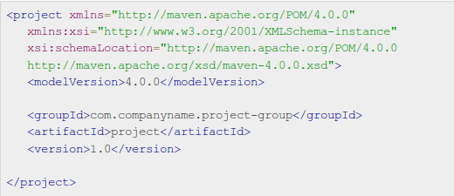
POM
POM example:

Slide 12
Super POM
All POMs inherit from a parent POM, which is called Super POM
Maven use the effective pom (configuration from super pom plus project configuration) to execute relevant goal.
To view default configurations of the super POM run the following command:
  mvn help:effective-pom

Slide 13
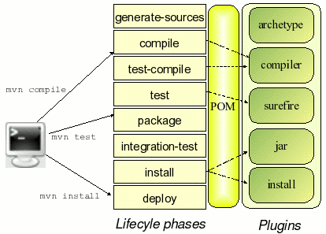
Project lifecycles

Slide 14
Maven Repositories
Repository is a place i.e. directory where all the project jars, library jar, plugins or any other project specific artifacts are stored and can be used by Maven.
Maven repository are of three types:
  Local – located on local machine, default path is ~/.m2
  Central - a repository provided by Maven community, URL path is http://repo1.maven.org/maven2/. All available libraries can be found at http://search.maven.org/#browse
  Remote - is developer's own custom repository containing required libraries or other project jars. Example in POM:
  <repository>
  <id>companyname.lib1</id>
  <url>http://download.companyname.org/maven2/lib1</url>
  </repository>

Slide 15
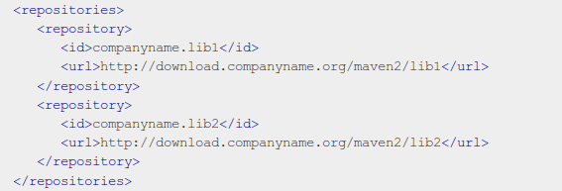
Maven Repositories
Remote Repositories(example):

Slide 16
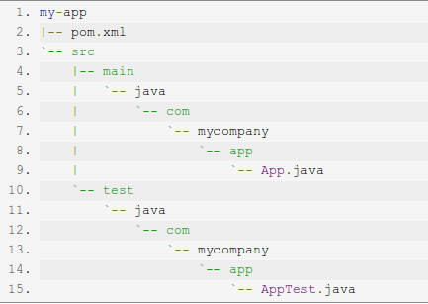
Creating Project
Maven uses archetype plugins to create projects
The following command creates maven project:
  mvn archetype:generate -DgroupId=com.mycompany.app -DartifactId=my-app -DarchetypeArtifactId=maven-archetype-quickstart -DinteractiveMode=false

Slide 17
Creating Project (cont.)
Build the Project:
  mvn package
Test the project:
  java -cp target/my-app-1.0-SNAPSHOT.jar com.mycompany.app.App

Slide 18
POM: Dependencies
Every project depends upon others to build and run correctly
Maven manages the list of dependencies. It downloads and links the dependencies for you on compilation and other goals that require them.
Maven brings in the dependencies of those dependencies (transitive dependencies), allowing your list to focus solely on the dependencies your project requires.

Slide 19
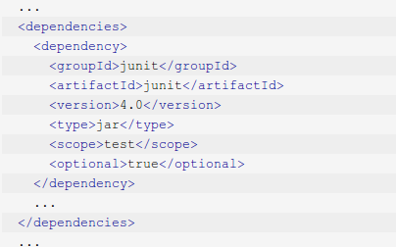
POM: Dependencies: Example

Slide 20
POM: Dependencies: Scope
Scope element refers to the classpath of the task at hand (compiling and runtime, testing, etc.) as well as how to limit the transitivity of a dependency. There are five scopes available:
compile - this is the default scope. Compile dependencies are available in all classpaths.
provided - this is much like compile, but indicates you expect the JDK to provide it at runtime. It is only available on the compilation and test classpath, and is not transitive.
runtime - indicates that the dependency is not required for compilation, but is for execution. It is in the runtime and test classpaths, but not the compile classpath.
test - is only available for the test compilation and execution phases.
system - this scope is similar to provided except that you have to provide the JAR which contains it explicitly. The artifact is always available and is not looked up in a repository.

Slide 21
Useful links
https://maven.apache.org
https://en.wikipedia.org/wiki/Apache_Maven
http://www.tutorialspoint.com/maven/index.htm
https://maven.apache.org/guides/getting-started/

