Slide 1
SMTP
Simple Mail Transfer Protocol (SMTP) is an Internet standard for electronic mail (e-mail) transmission
Mail servers use SMTP to send and receive mail messages.
User-level client mail applications typically use SMTP only for sending messages to a mail server for relaying. For receiving messages, client applications usually use either POP3(Post Office Protocol) or IMAP (Internet Message Access Protocol).

Slide 2
Mail processing model
Email is submitted by a mail client (MUA, mail user agent) to a mail server (MSA, mail submission agent) using SMTP on TCP port 587.
the MSA delivers the mail to its mail transfer agent (MTA, mail transfer agent).Mail transfer agent (MTA) or mail relay is software that transfers electronic mail messages from one computer to another using a client–server application architecture. It implements both the client and server portions.

Slide 3
Mail processing model
A mail delivery agent or message delivery agent (MDA) is a computer software component that is responsible for the delivery of e-mail messages to a local recipient's mailbox.
The target host is being found using MX records(mail exchange).

Slide 4
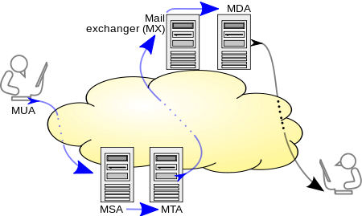
Mail processing model
Mail processing model

Slide 5
SMTP
SMTP defines message transport, not the message content.
It defines the mail envelope and its parameters, such as the envelope sender, but not the header nor the body of the message itself.

Slide 6
Protocol overview
Protocol overview
SMTP transaction consists of three command/reply sequences :
1. MAIL command, to establish the return address, reverse-path, bounce address, mfrom, or envelope sender. This is the address to which bounce messages should be sent.
2. RCPT command, to establish a recipient of this message. This command can be issued multiple times, one for each recipient. These addresses are also part of the envelope.
3. DATA to signal the beginning of the message text; the content of the message, as opposed to its envelope. It consists of a message header and a message body separated by an empty line.

