Slide 1

Jasmine – JS Testing Framework
www.instigate-training-center.am

Slide 2
Topics
Overview
TDD
BDD
Syntax
Pre-defined Matchers
Pre-defined Matchers (cont.)
Setup and Teardown

Slide 3
Overview
Jasmine is an open source testing framework for JavaScript.[2]
Has easy-to-read syntax
Jasmine is a behavior-driven development (BDD) JavaScript testing framework
Download Jasmine from https://github.com/jasmine/jasmine
Official documentation - http://jasmine.github.io/

Slide 4
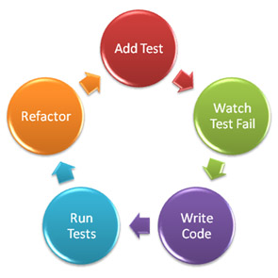
TDD
TDD stands for Test-Driven Development
The concept is we write these tests to check if the code we wrote works fine.
TDD that focuses on the implementation aspect of the system

Slide 5
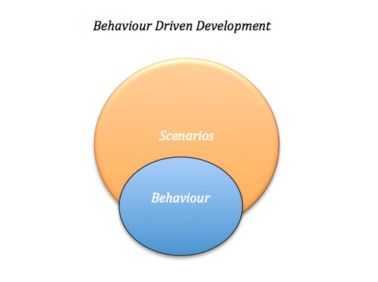
BDD
BDD stands for Behavior-driven develo
pment
BDD is usually done in very English-like
language
BDD uses a more verbose style so that
it can be read almost like a sentence
BDD gives a clearer understanding as
to what the system should do from the
perspective of the developer and the
customer.
BDD is a way to ensure consistency
between requirements and the developer
tests.

Slide 6
Syntax
Jasmine tests have primarily two parts: describe blocks and it blocks.
Example:
A Suite is defined by calling the describe() function
Inside that it block, you can write all the setup code you need for your test.
expect() function defines the test case expected values
describe('JavaScript addition operator', function () {
it('adds two numbers together', function () {
expect(1 + 2).toEqual(3);
});
});

Slide 7
Pre-defined Matchers
toBe: represents the exact equality (===) operator.
toEqual: represents the regular equality (==) operator.
toMatch: calls the RegExp match() method behind the scenes to compare string data.
toBeDefined: opposite of the JS "undefined" constant.
toBeUndefined: tests the actual against "undefined".
toBeNull: tests the actual against a null value - useful for certain functions that may return null, like those of regular expressions (same as toBe(null))

Slide 8
Pre-defined Matchers (cont.)
toBeTruthy: simulates JavaScript boolean casting.
toBeFalsy: like toBeTruthy, but tests against anything that evaluates to false, such as empty strings, zero, undefined, etc…
toContain: performs a search on an array for the actual value.
toBeLessThan/toBeGreaterThan: for numerical comparisons.
toBeCloseTo: for floating point comparisons.
toThrow: for catching expected exceptions.

Slide 9
Setup and Teardown
The beforeEach() method is called before each spec (it() method) in the describe and afterEach() is called after each spec.
Example:
describe("MyObject", function () {
var obj = new MyObject();
beforeEach(function () {
obj.setState("clean");
});
it("changes state", function () {
obj.setState("dirty");
expect(obj.getState()).toEqual("dirty");
})
afterEach(function () {
obj.setState("clean");
});
});

Slide 10
Thank You

