Slide 1
Currency Exchange System
Release 1 – Fundamentals of C++
Team: Magnus Jaaska (@magna413)

Slide 2
Problem Statement & Scope
Problem: Small exchange offices rely on manual conversions → error-prone, slow, not auditable.
Scope (In): Manual rates, Exchange validation, Receipts, Reports, Low-reserve warnings.
Scope (Out): Live rate feeds, Multi-branch sync, External tax/banking integration.
Constraints: C++17, CLI, CSV logs, Win10+/Ubuntu22.04, ≤2s per tx.

Slide 3
User Stories
• US-1: As a Cashier, I want to enter the exchange details so that the system calculates the converted amount and validates reserves.
• US-2: As a Client, I want to receive a printed receipt so that I have proof of the transaction.
• US-3: As a Manager, I want a daily report so that I can review totals and profit.
• US-4: As a Manager, I want to set/update rates so that profitability stays controlled.
• US-5: As a Cashier, I want low-reserve warnings so that I don’t confirm impossible operations.

Slide 4
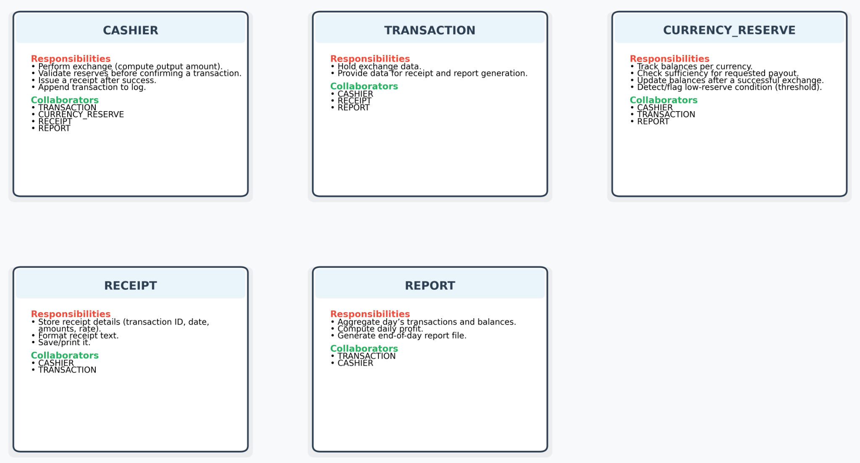
CRC Cards Overview

Slide 5
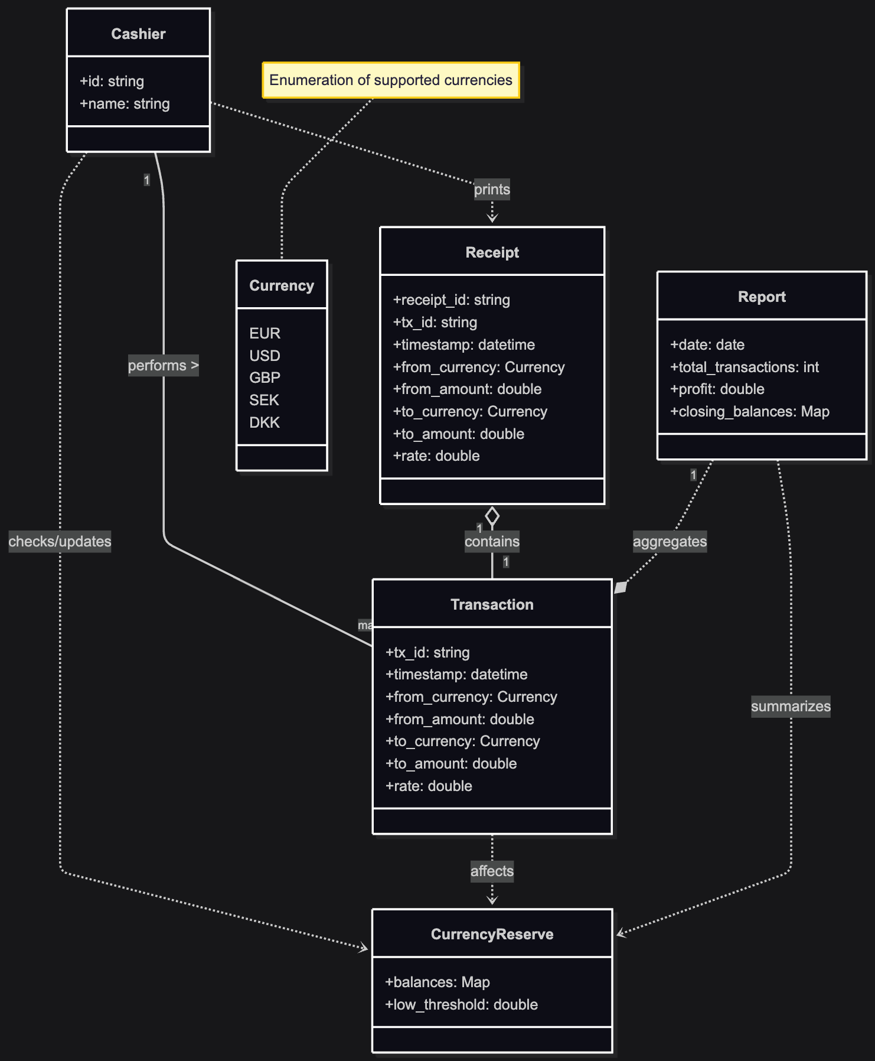
Conceptual Simple Class Diagram

Slide 6
Prototype (C++17, CLI)
Implemented:
- enum Currency
- struct Transaction::make()
- Cashier::exchange(), print_receipt()
- CurrencyReserve::can_fulfill(), apply(), is_low()
- Receipt::print(), csv()
- Report::add(), print_summary()

Slide 7
Team Roles
Requirements specification (SRS)
CRC cards & UML diagram
C++ prototype implementation
Repository setup (README, Makefile, structure)
Traceability table
Release 1 presentation & documentation

Slide 8
Lessons Learned
Easy
Writing user stories and mapping them to CRC cards and UML
Designing a small but clear system in C++17
Challenging
Keeping traceability consistent across requirements, design, and code
Modeling reserve validation and error handling in a simple prototype

Slide 9
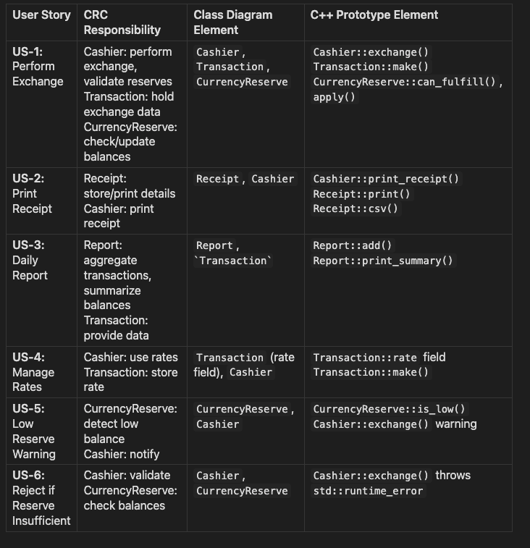
Traceability Table (User Story → Design → Code)

