Slide 1
Railway Ticket Sales
Requirements & Conceptual Design
Diana Anastassija Turks

Slide 2
Identifying Problems
Double-bookings – customer unsatisfied
Slow ticket availability updates – customer unsatisfied
Manual daily reporting – inefficient process, prone to errors
Manual penalty calculation on refunds – inefficient process, prone to errors
“Get what you get” tickets – customer unsatisfied

Slide 3
Scope
Host-based, single-user C++ application with CLI interface
Ticket search by date, destination and optionally coach type
Ticket reservation during purchase (released if cancelled)
Refund processing with penalty calculation
Daily report generation (ticket sales, ticket refunds, profit)
Persistent ticket history storage
Excluded: Online payments, real database or ticketing API, multi-user concurrency

Slide 4
User Stories
As a Client…
As a Client…
As a Client…
I want to purchase a ticket so that I can travel on my chosen date and destination.
Acceptance Criteria: Search uses date and destination, during the purchase process the ticket is reserved by the purchasing client so the sale is guaranteed
I want to be able to choose the type of coach I get so I can travel at the level of comfort I need.
Acceptance Criteria: Tickets include the coach type, search can optionally include coach type filtering
I want to be able to get a refund for a ticket if I cannot travel for any reason.
Acceptance Criteria: System allows for a return of a ticket be performed by the cashier and the money will be returned to client balance

Slide 5
User Stories
As a Cashier…
As a Cashier…
As a Central Office Manager…
I want to search for available tickets so that I can provide the client with valid options.
Acceptance Criteria: System only shows tickets that are not sold or currently reserved with date, destination or coach type filtering
I want to make as little mistakes as possible.
Acceptance Criteria: System eliminates double-booking, automatically calculates and applies penalties on refunds and stores the daily ticket operations history
I want daily reports generated automatically so that I can control profit and efficiency without delays.
Acceptance Criteria: Report includes daily ticket transactions (sold, returned) and profit

Slide 6
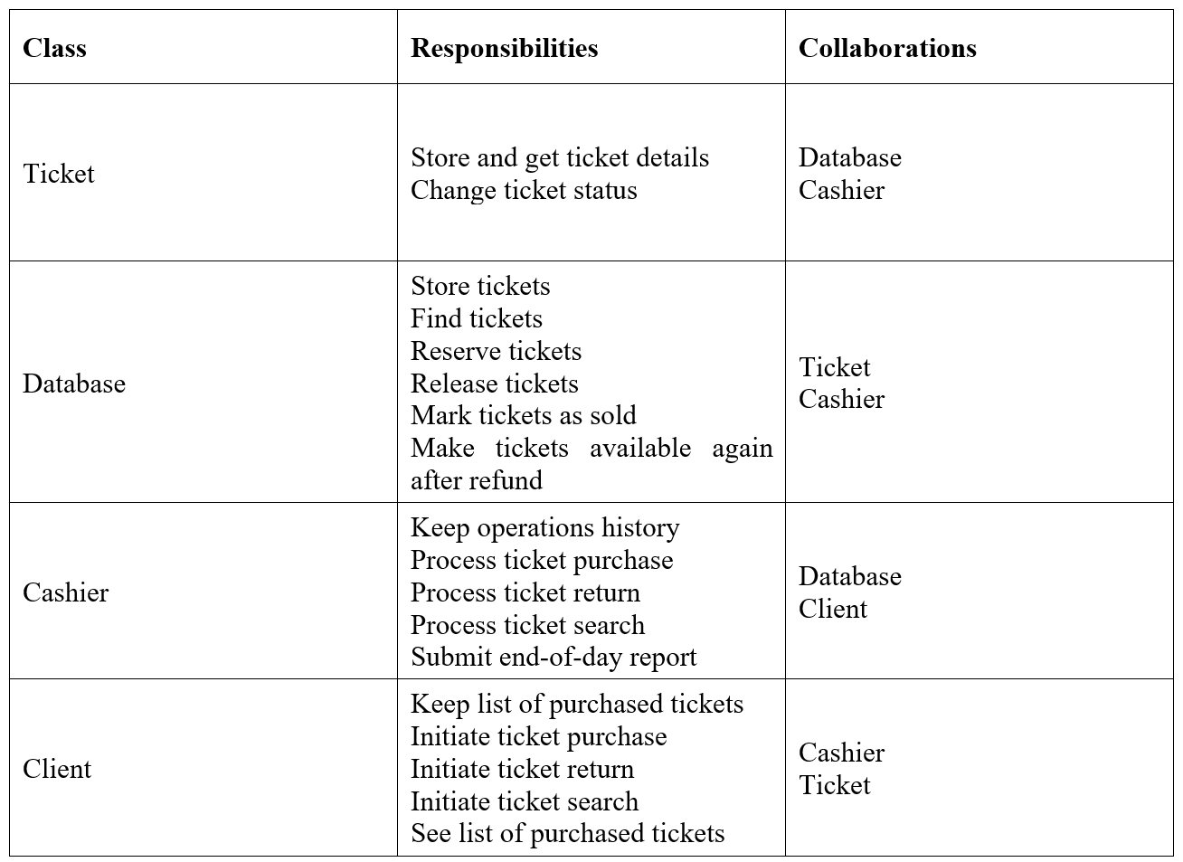
CRC Cards

Slide 7
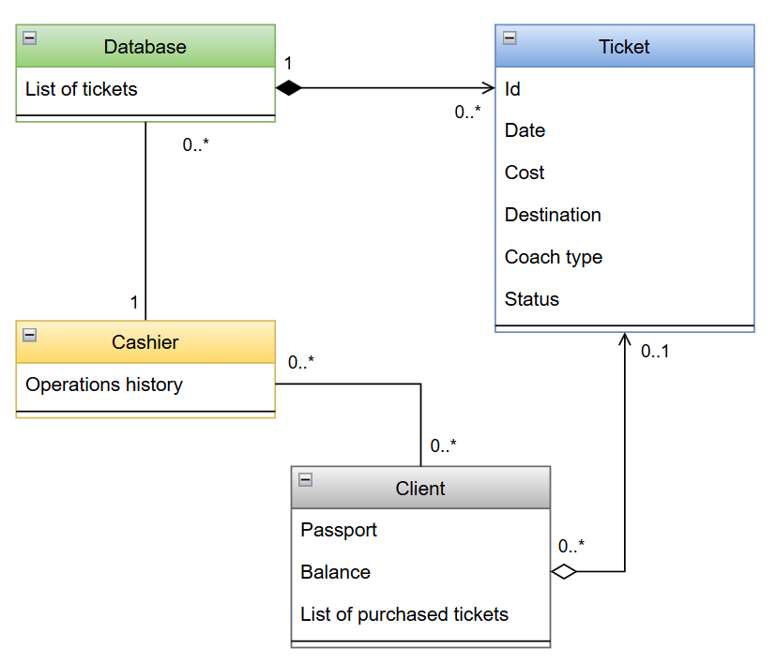
Conceptual Simple Class Diagram

Slide 8
Team Roles
Diana Anastassija Turks – Everything

Slide 9
Lessons Learned
What was easy
User stories really help with outlining functions
Scope is relatively small – not much to think about
What was challenging
Non-functional requirements are still not tackled

Slide 10
User Story | CRC Responsibility | Simple Class Diagram Element | C++ Element
Client purchases a ticket | Cashier: process ticket purchase | Cashier → Database → Ticket | Cashier::processPurchase(const Ticket&, Client&)
Client looks for specific coach type | Cashier: process ticket search | Cashier → Database | Cashier::processSearch(const QueryDate&, QueryDestination&, QueryCoach&)
Client requests a refund | Cashier: process ticket return | Cashier → Database, Cashier → Client | Cashier::processRefund(const Ticket&, Client&, RefundDate&, RefundRules&)
Cashier searches for available tickets | Cashier: process ticket search | Cashier → Database | Cashier::processSearch(const QueryDate&, const QueryDestination&)
Cashier avoids mistakes | Cashier: process ticket return, Cashier: keep operations history | Cashier → Database, Cashier → Client, Cashier | Cashier::processRefund(const Ticket&, Client&, RefundDate&, RefundRules&), Cashier::generateDailyReport()
Manager receives daily reports | Cashier: submit end-of-day report | Cashier | Cashier::generateDailyReport()

