Slide 1

Group 5
Topic
BOOK STORE
Lê Trần Minh Hoàng ITDSIU18042
Cao Ngọc Bảo Long ITDSIU18031
Mai Đặng Nhật Anh ITDSIU19031

Slide 2
Contents
General
Database
Diagram
Relational model
Graphical user interface (GUI)

Slide 3

I. General: Book Store
A system to store Books information in the store
A system to store Customers information come to store
A system to store Bill

Slide 4
II. Database
table
Book
Customer
Author
Discount
Publisher
Bill
Account

Slide 5

1) Schema
Book has attribute: (ISBN, title, genre, price, amount, year) to store information of the book)
Author has attribute: (fullname, nation, age)
Discount has attribute: (id, percentage)
Publisher has attribute:(name,address, phone)
Customer has attribute:(id, name, email, address)
Account has attribute: (id, userName, password, role)

Slide 6
2) Security
Database is the one of the most essential part of any organization or company, database deal with large amount of importance or even secret information of organization. Many people try to access to those database illegally for devastating purpose. One of the most common but still dangerous is sql injection.
Sql injection is the database penetrating technique through input form with unusual symbols to mislead the database engine.
Consequence:
+ Extract sensitive information: user account, credit card…
+ Destroy data.
+ Inject code to be executed when user login.

Slide 7
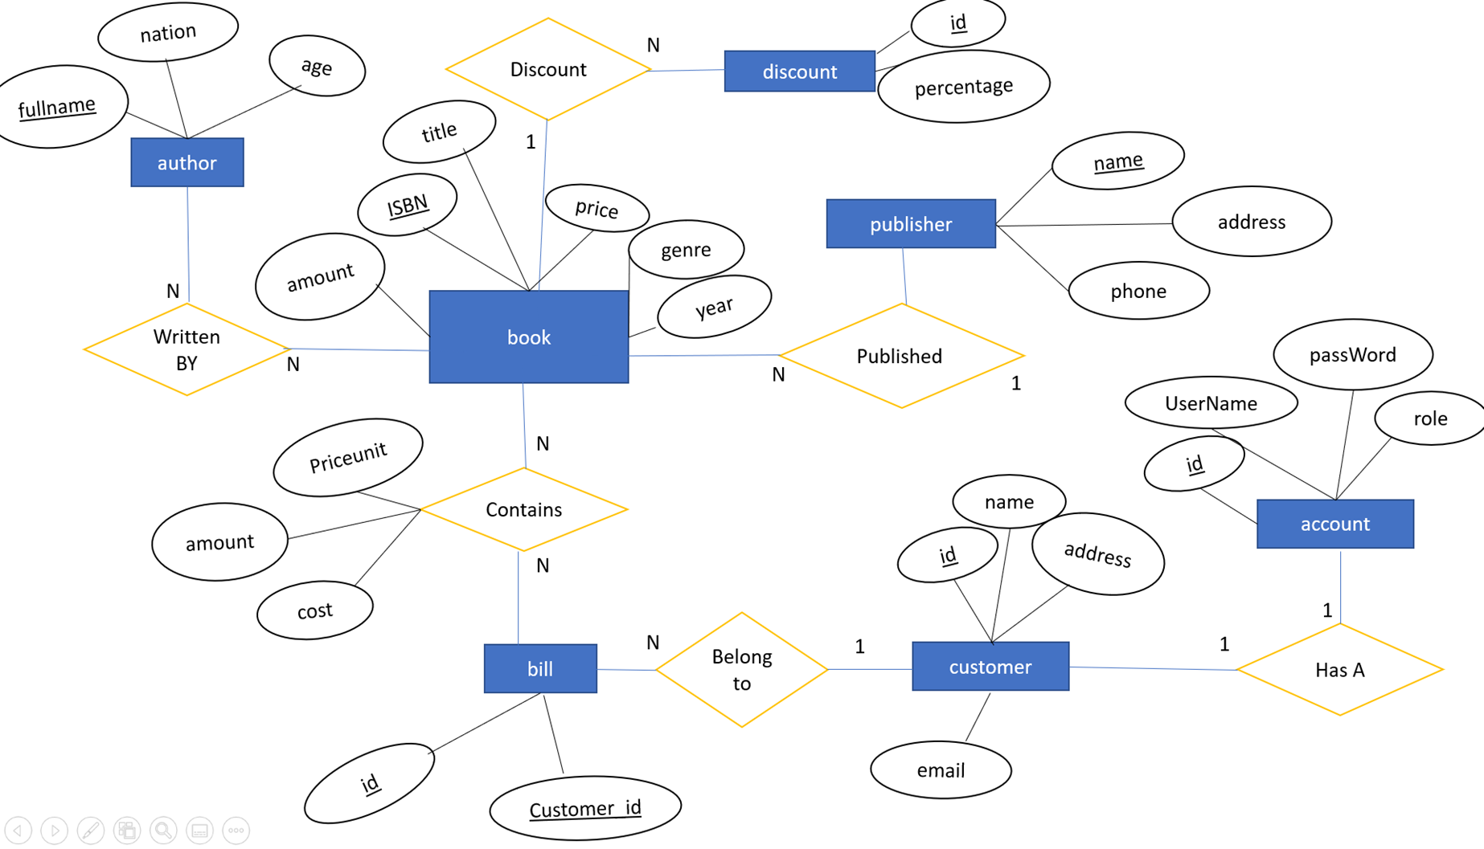
III. Diagram

Slide 8
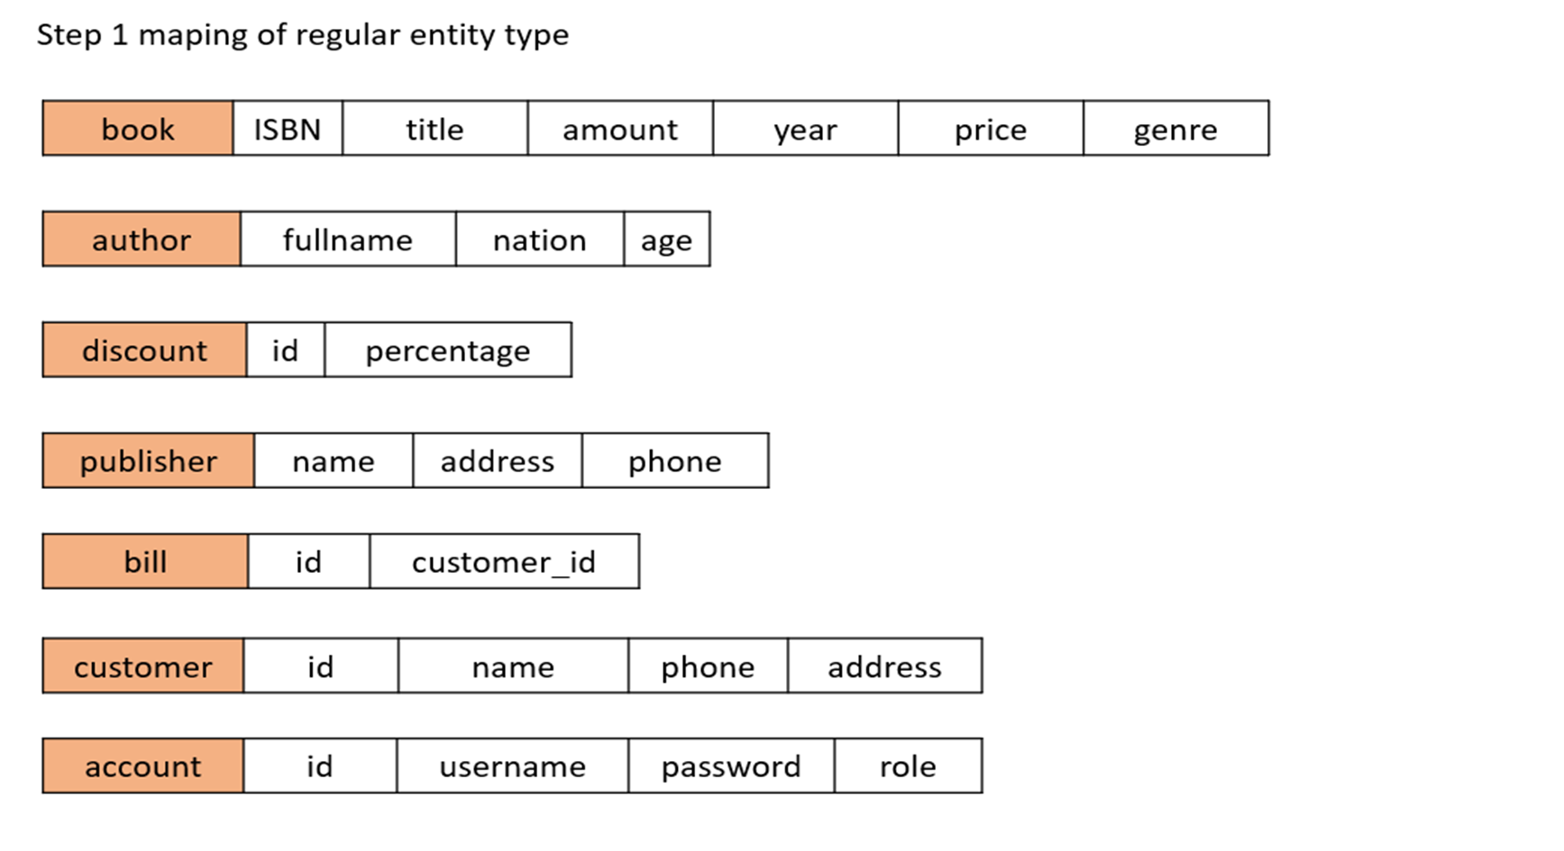
IV. Relational model

Slide 9
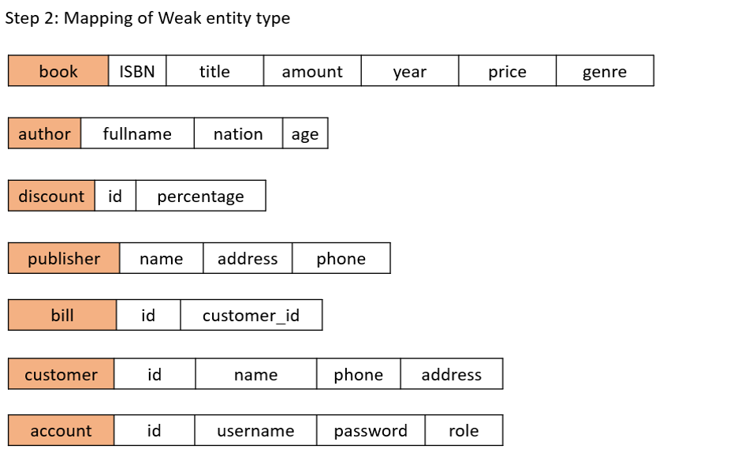

Slide 10
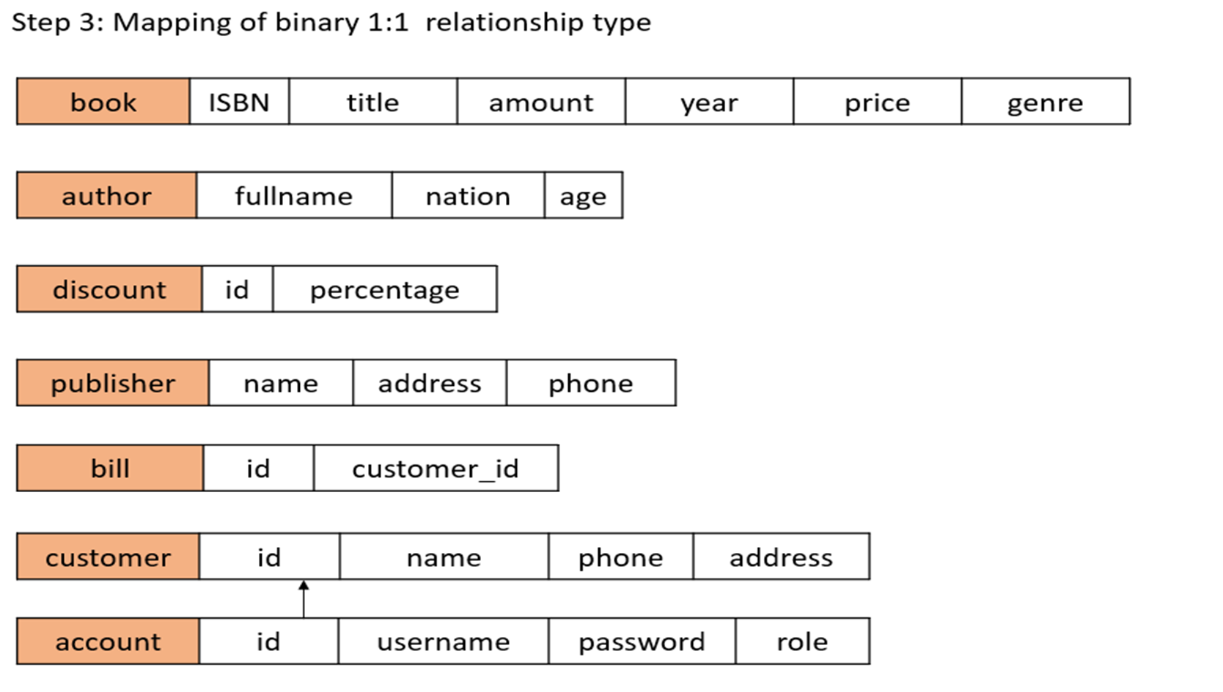

Slide 11
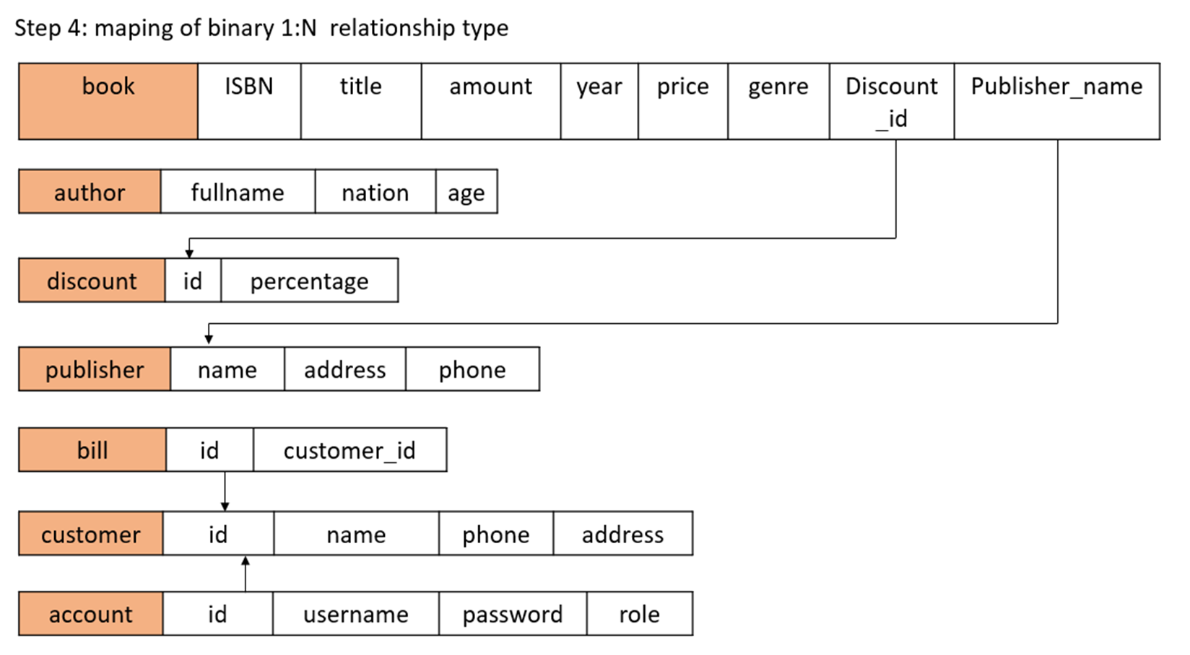

Slide 12
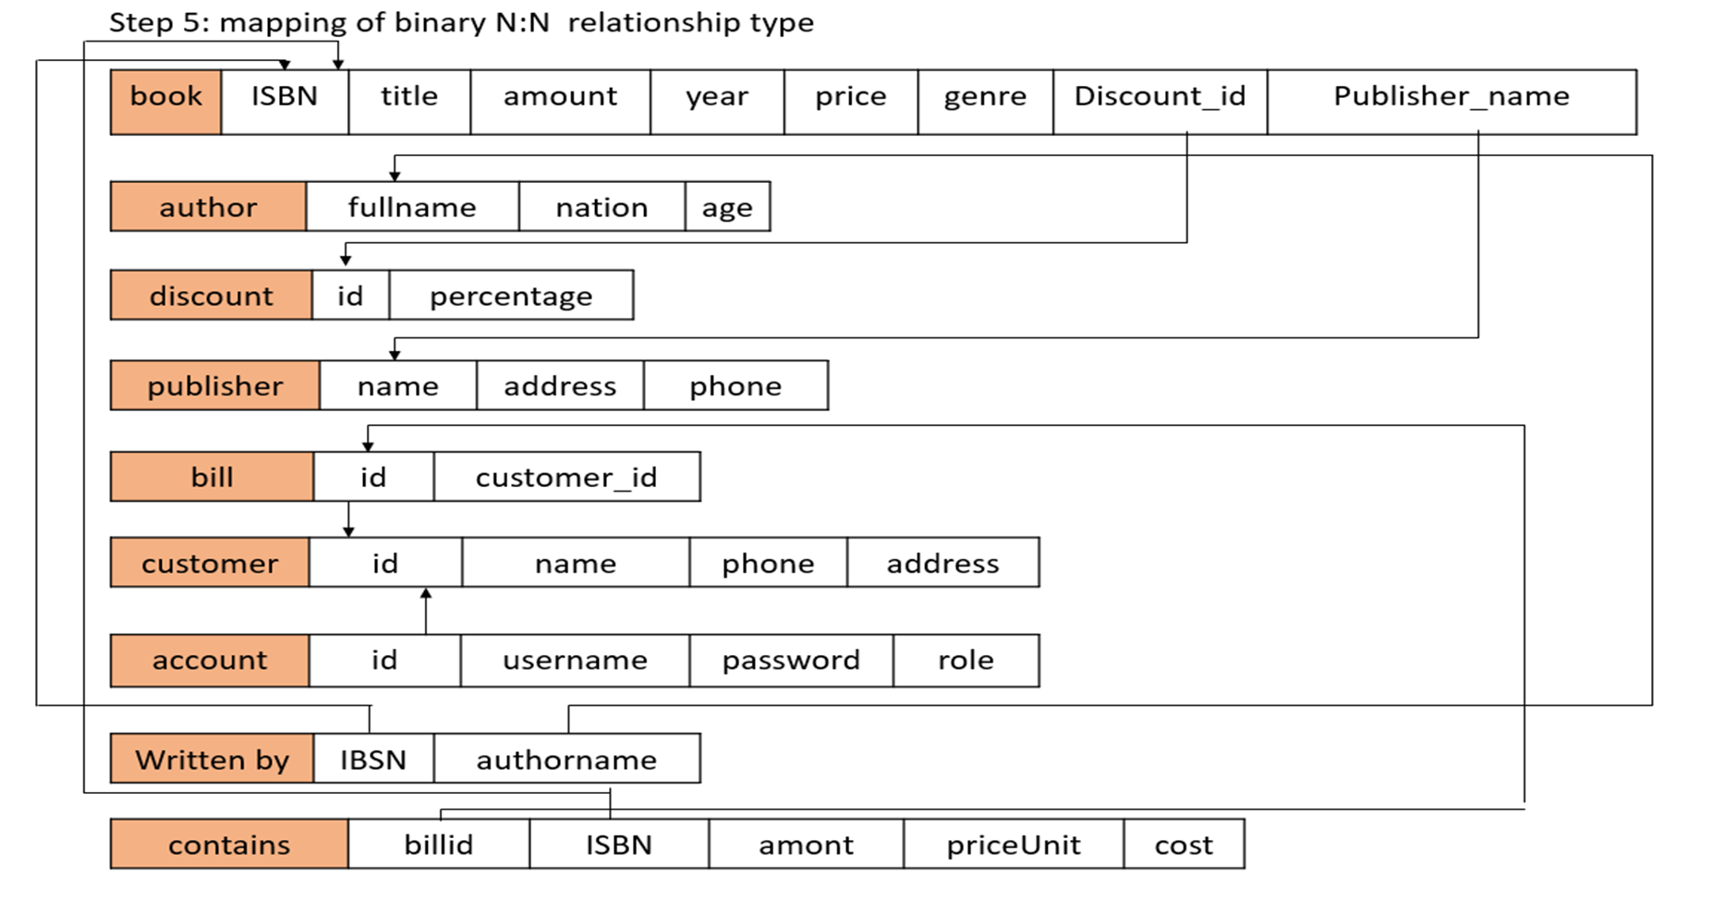

Slide 13
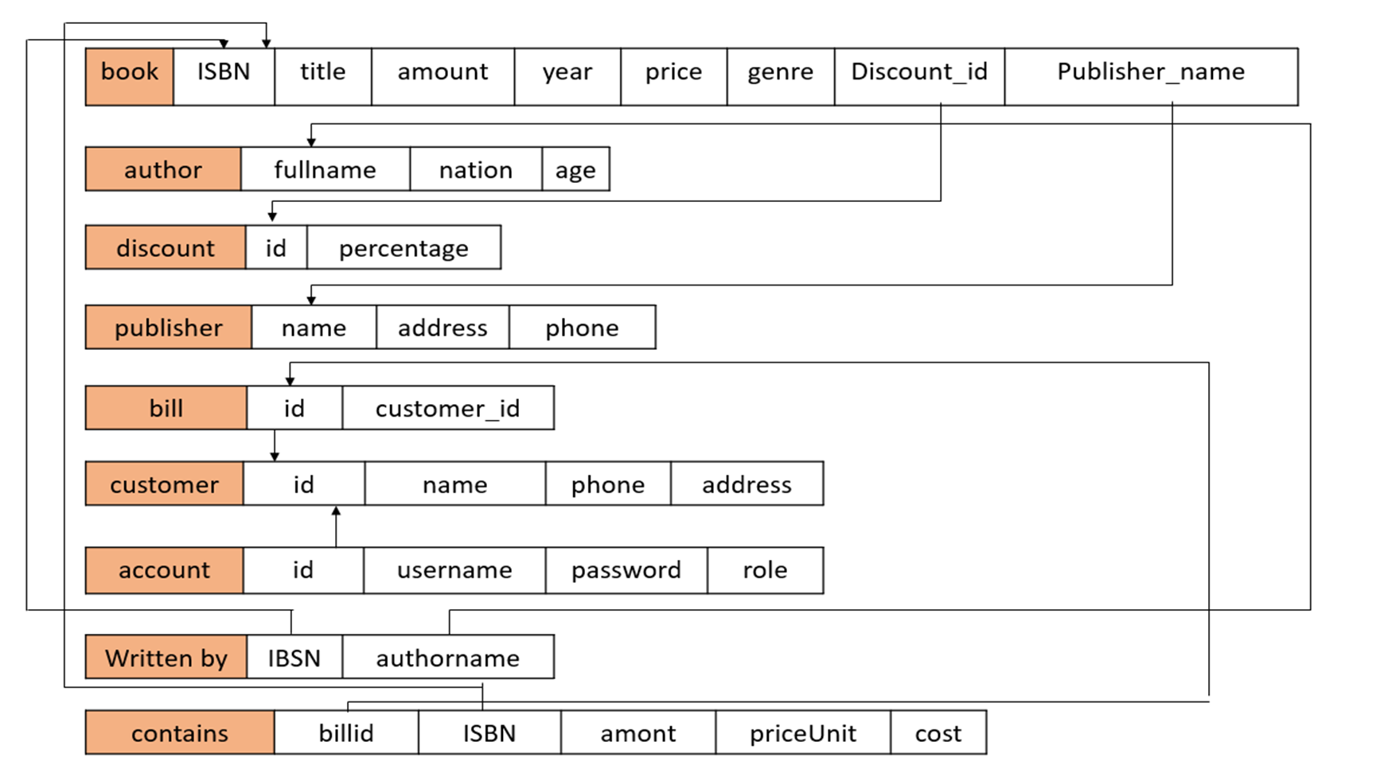

Slide 14

V. GUI
Tool
Conection from GUI to MySQL
Summary

Slide 15
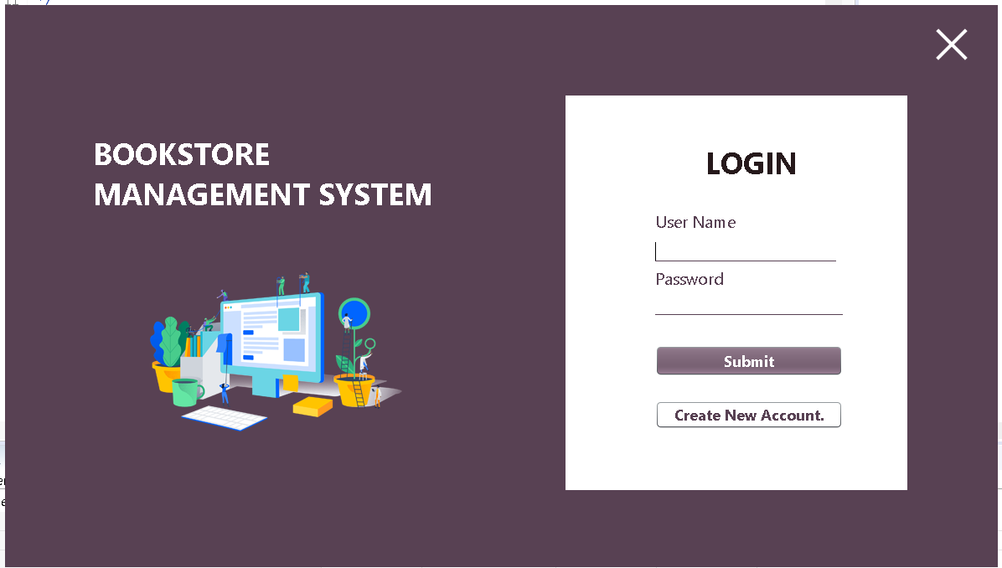
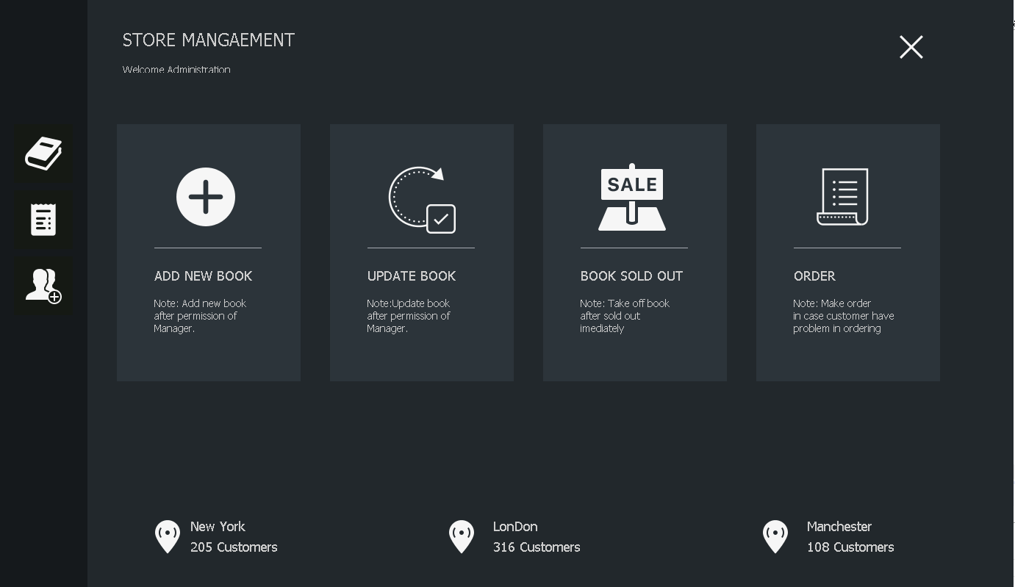
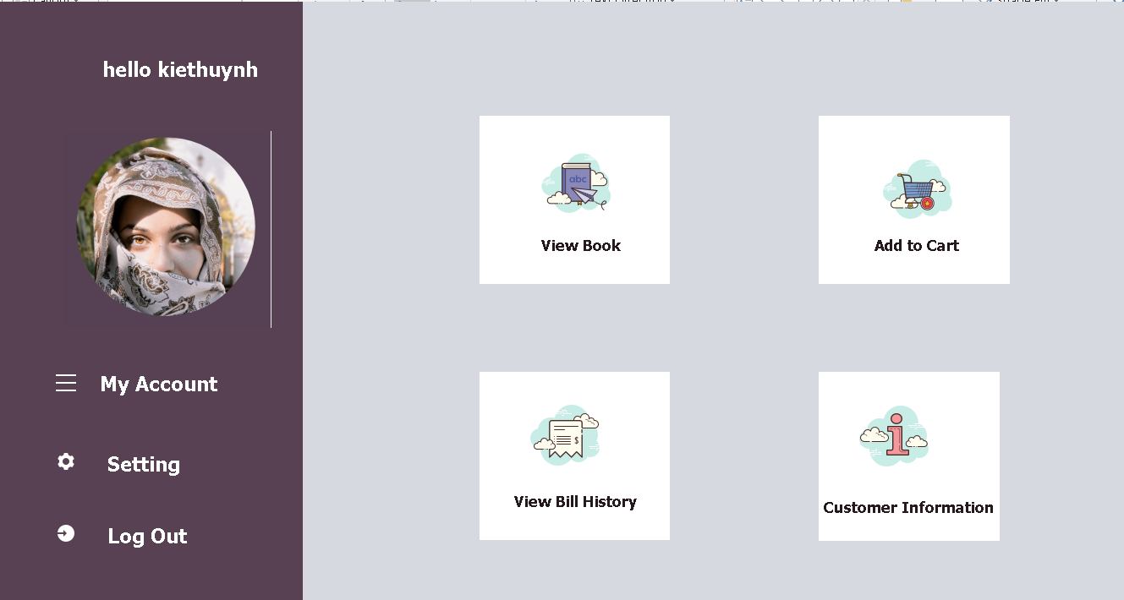
1) Tool
Our team use Java Swing to creat the appearance of the system
. Interface: Login
. Interface: Staff role
. Interface: Customer role

Slide 16
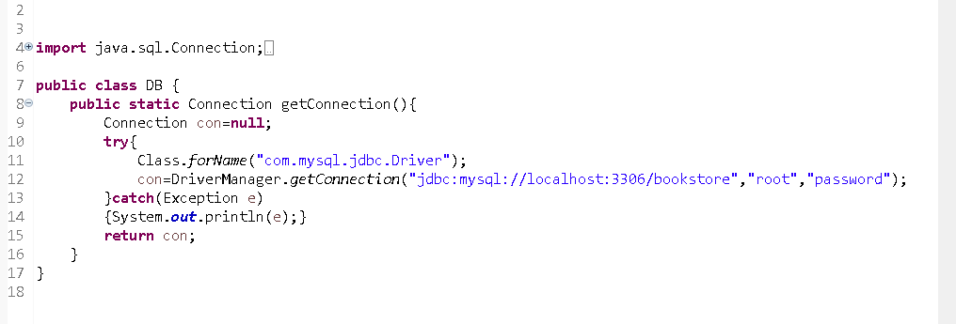
2) Conection from GUI to MySQL

Slide 17

3) Summary
Brief
About the database
Diagram of the BookStore database
Relational model
Interface of the system

Slide 18

THANK YOU

